Slide 1
Basic Time Series patterns
Juan Garbayo
Time Series Analysis

Slide 2
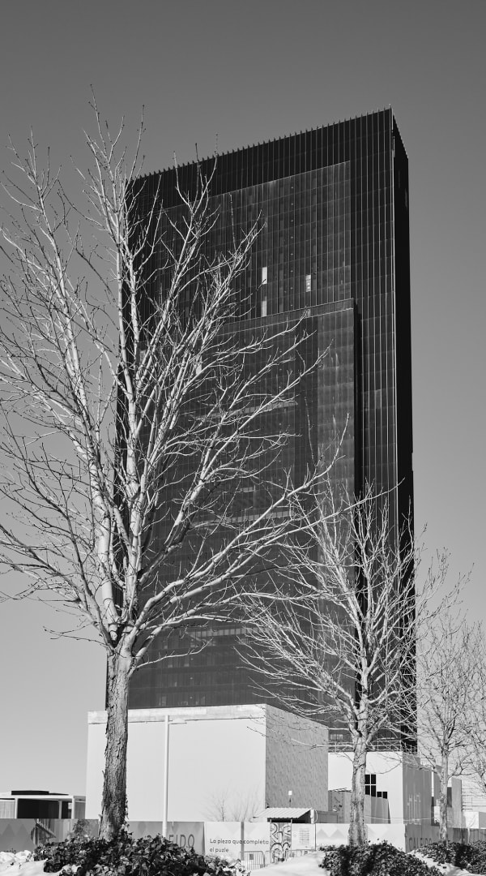


01
Description of patterns
02
Examples
02

Slide 3
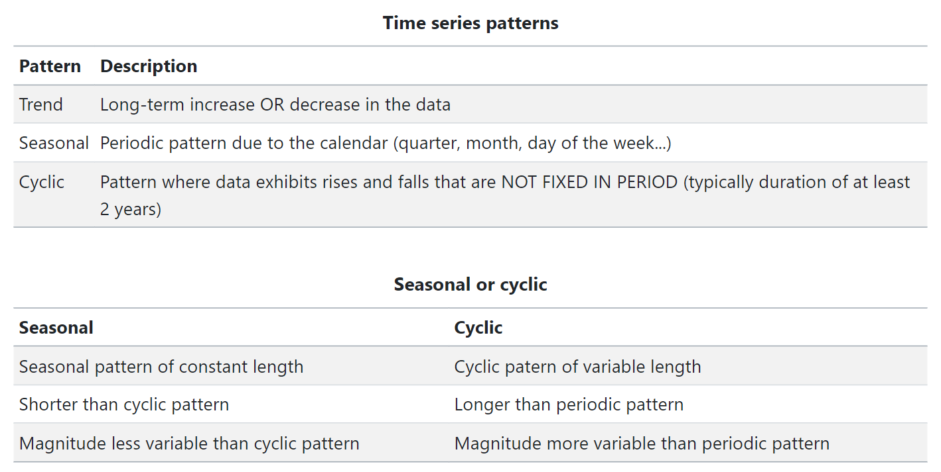
Description of basic time series patterns

Slide 4
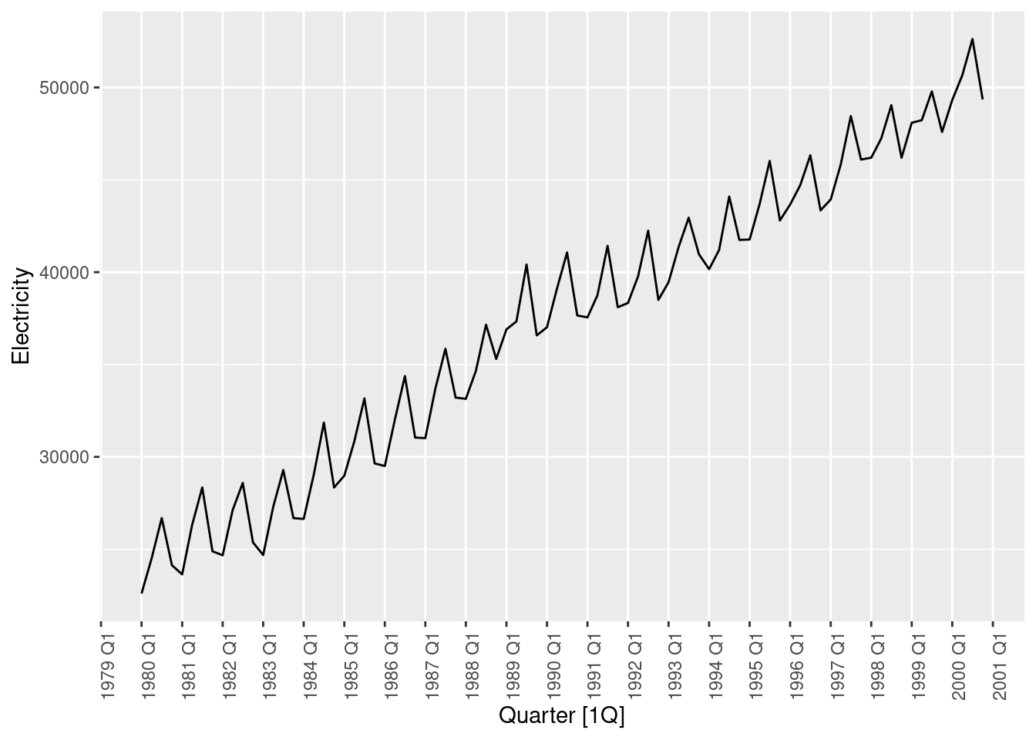
Quarterly electricity production in Australia

Slide 5
Quarterly electricity production in Australia
Trended data with change of slope around 1990 (blue)
Seasonal pattern of length 1 year (red)

Slide 6
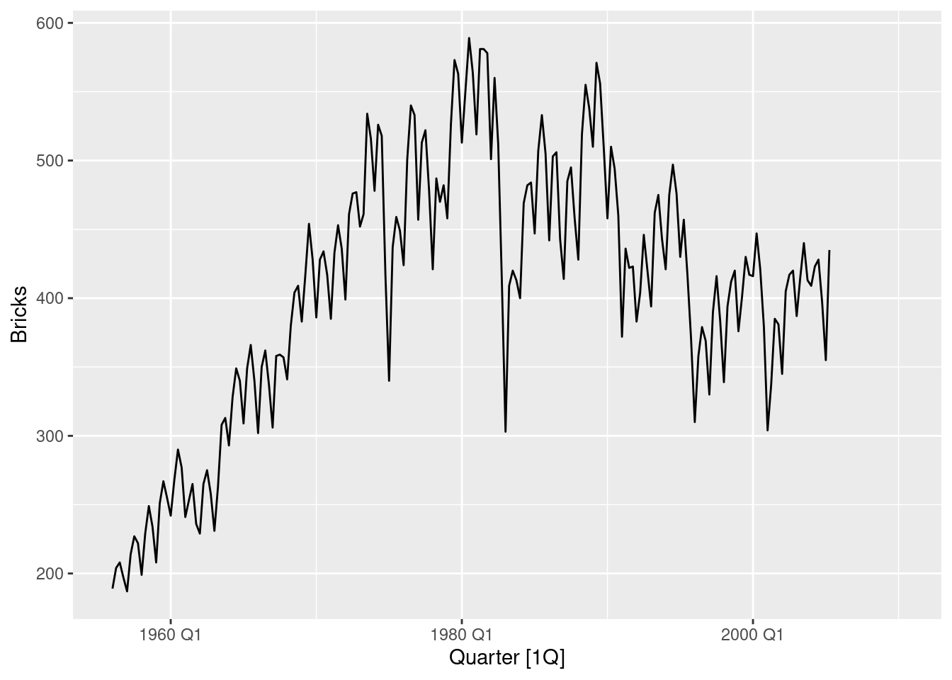
Quarterly bricks production in Australia

Slide 7
Quarterly bricks production in Australia
Trended data with recessions (blue arrows)
Seasonal pattern of length 1 year (red). Repeats every year.
Cicles of variable length and variance (green). Not all cycles have been signalled.

Slide 8
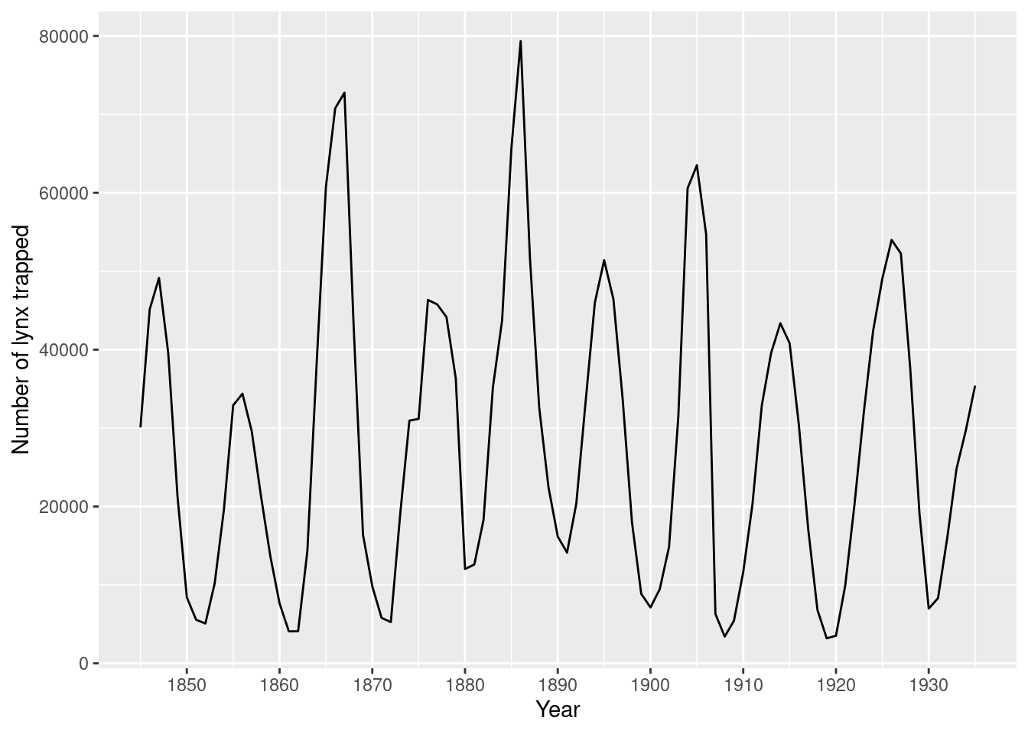
Number of lynxes trapped in a particular region

Slide 9
Number of lynxes trapped in a particular region
Untrended data.
No seasonality since this is yearly data and seasonality is caused by calendar variations
Cycles of variable length in time and of different strength.
In this particular case the cycles are explained by the decrease in population when too many lynxes are trapped. This leads to a ban that results in their population growth, after which the the number of trapped lynxes increases.

Slide 10
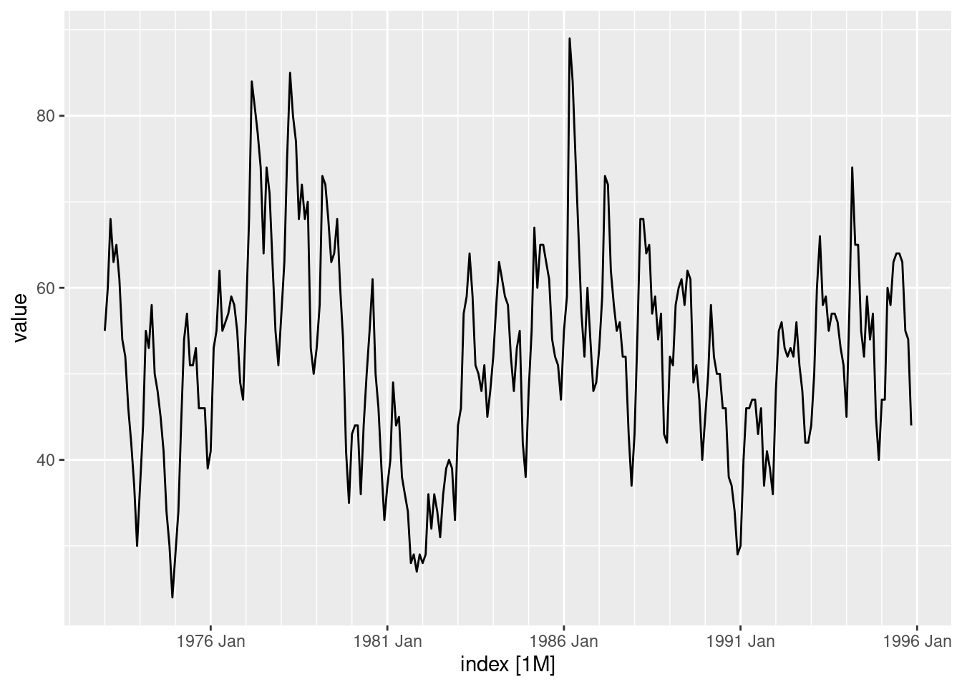
Monthly sales of new one-family houses sold in US since 1973.

Slide 11
Monthly sales of new one-family houses sold in US since 1973.
Untrended data.
Seasonal pattern of length one year (red)
Cycles of different strength and duration (green). The last one is not fully developed in the graph.

Slide 12
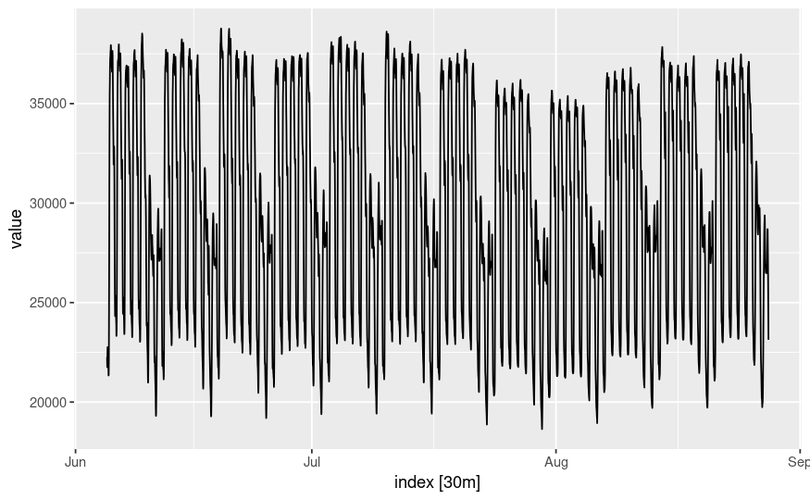
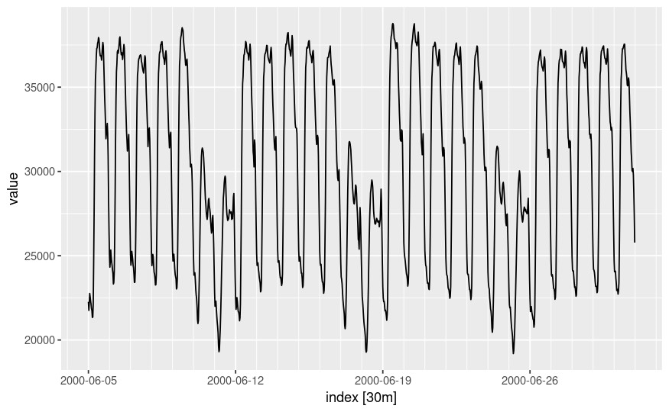
Half-hourly electricity demand in England and Wales
Filter first four weeks to make patterns more clear

Slide 13
Half-hourly electricity demand in England and Wales
Data with multiple seasonal patterns.
Daily seasonal pattern (red)
Weekly seasonal pattern (green)
Note that electricity demand is lower during the weekends in these regions, probably due to the shutdown of the industry.

Slide 14
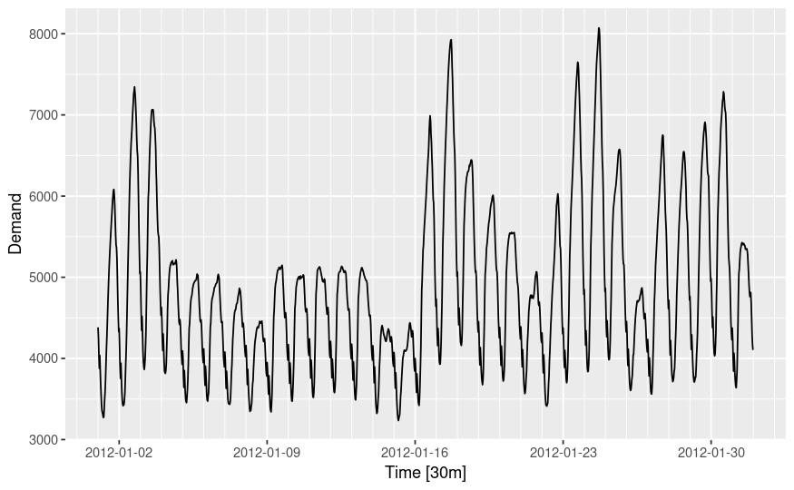
Half-hourly electricity demand in Victoria (Australia)
Daily seasonal pattern (red)
No clear weekly seasonal pattern
A time series will not always exhibit seasonal patterns at every possible seasonal period.

Slide 15


