Slide 1
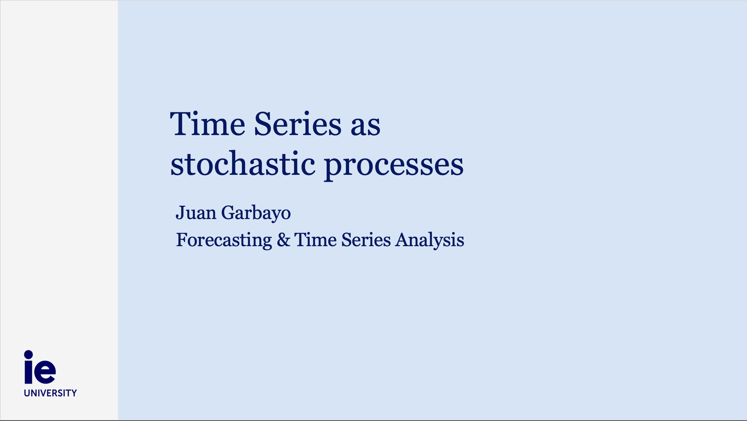

Slide 2
Contents
Modelling time series as stochastic processes
Times series and time correlation
Key takeways

Slide 3
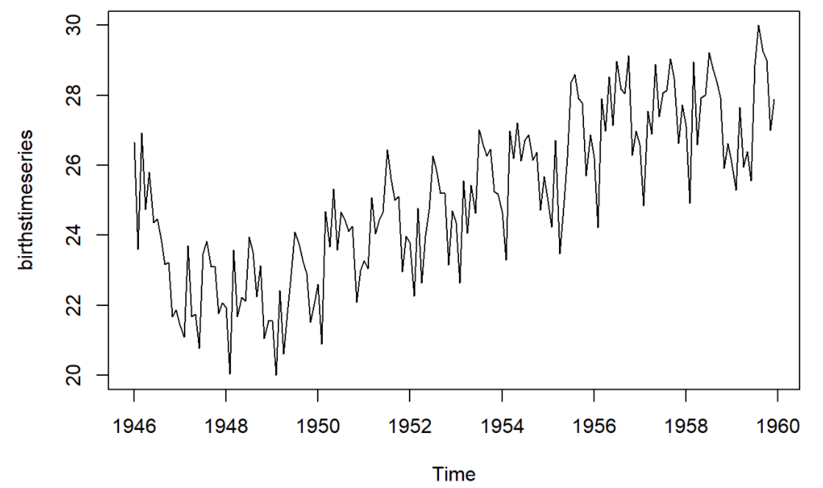
Modelling Time Series as a Stochastic Process
Time Series Data: sequential observations of one or several variables over time
From a mathematical modeling standpoint, we consider the following:
Future values of the time series: a random variable that has not yet been realized.
Past values of the time series: realizations of a random variable

Slide 4
From a mathematical modeling standpoint, we consider the following:
Future values of the time series: a random variable that has not yet been realized.
Past values of the time series: realizations of a random variable
Time Series as a mathematical entity: a collection of random variables {Y_{t}} indexed over time
{ Y₁, Y_{2,} Y_{3,} Y_{4, …,} Y_{t} } : uppercase letters refer to random variabes. Description of the PROCESS
{ y₁, y_{2,} y_{3,} y_{4, …,} y_{t} } : lowercase letters refer to a SPECIFIC OUTCOME of the process.

Slide 5
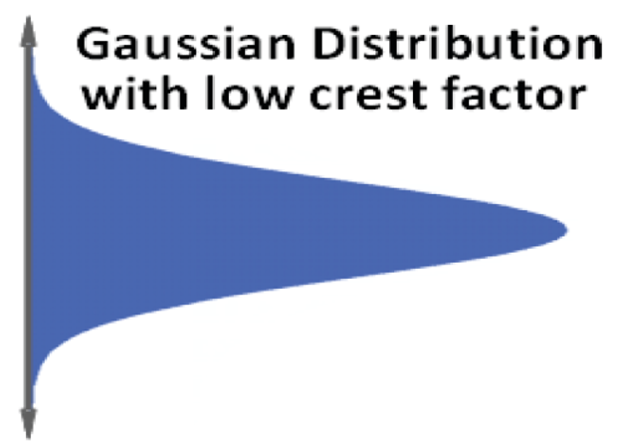
Example:
{ Y₁, Y_{2,} Y_{3,} Y_{4,} …, Y_{t} } are Independent and Identically Distributed (IID). Specifically, they follow the same normal distribution
{ y1, y2, y3, y4, …, yt } : a specific outcome
y
y
y₁
y₃
t = 1
t = 2
t = 3
t = 4
t
y₂
y₄
Future values of the time series: random variables that have not yet been realized.
Past values of the time series: random variables that have been realized
In this particular time series all the random variables are identically distributed (follow the same distribution).

Slide 6
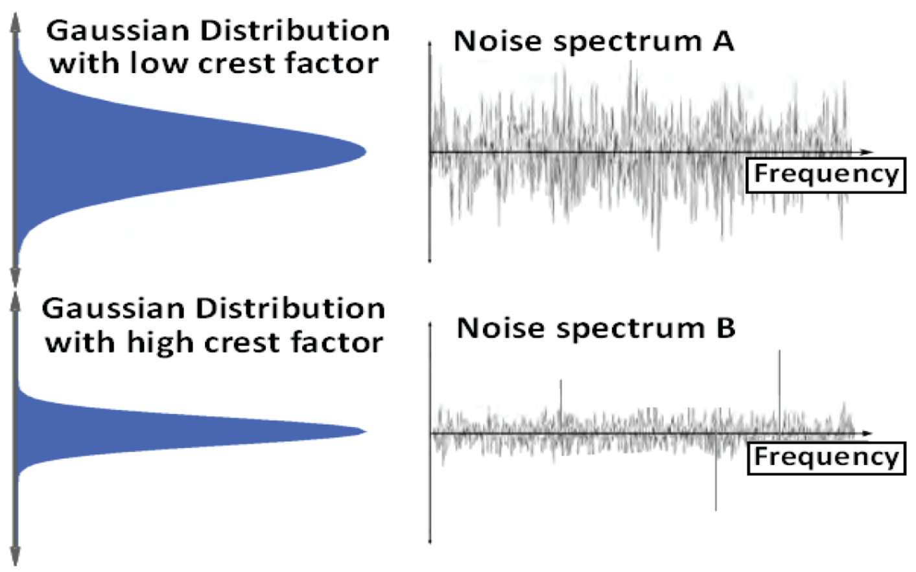
Time
Time

Slide 7
Modelling Time Series as a Stochastic Process
Stochastic vs Random: these two words are many times used interchangeably. However, it is normally the case that:
Random is reserved to refer to random variables.
Stochastic is reserved to refer to processes involving a family of random variables indexed by a set. In the case of time series, indexed over time.
In our previous example:
For each value of time t₁, t₂, t₃… we had a random variable Y₁, Y₂, Y₃…
This collection of random variables {Y_{t}} indexed by time is a stochastic process
The specific outcome of the process is denoted by the collection of outcomes of {Y_{t}} → {y_{t}} (lowercase notation).
NOTE
There are different kinds of stochastic processes. Time series are just one of the infinitely many stochastic processes we can think of.

Slide 8
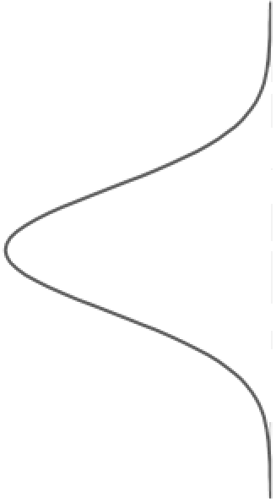
Time series, correlation and independence
y
y₃
y₄
y₁
μ₄
σ
μ₂
σ
y₂
μ₃
σ
μ₁
σ
t = 1
t = 2
t = 3
t = 4
t
Since past events tend to influence future events, there is a correlation between the values of the time series at different points in time.
The random variables of the time series process are in general correlated (and therefore NOT independent).

Slide 9
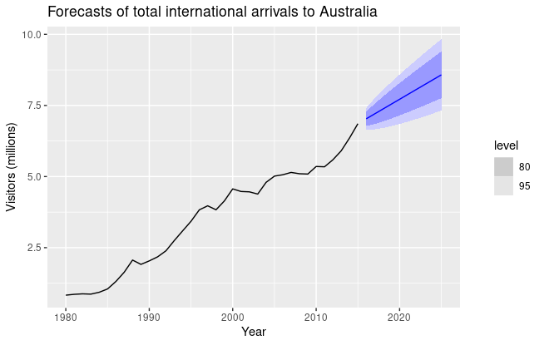
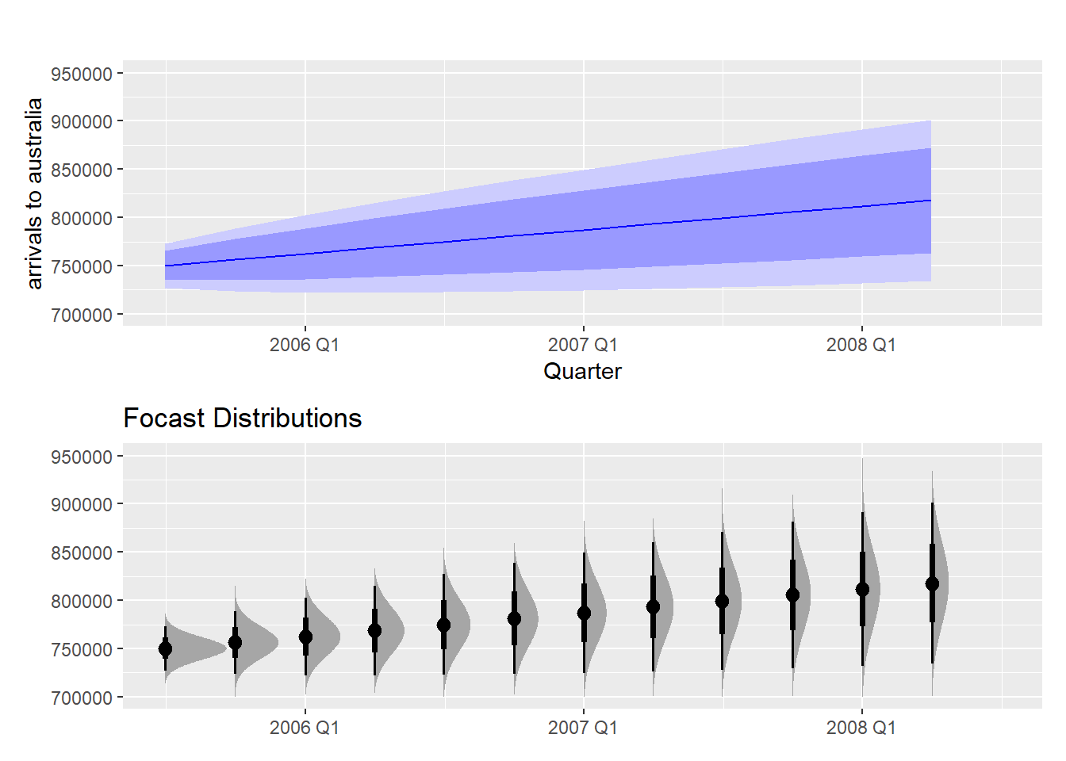
Key takeway 1
Time series as stochastic processes (a collection of random variables indexed over time):
Process (R.Variables) { Y₁, Y_{2,} Y_{3,} Y_{4, …} Y_{t} } vs Specific outcome: { y₁, y_{2,} y_{3,} y_{4, …} y_{t} }
Past values: realizations of random variables.
They are no longer random, they are a specific number, an outcome of the random variable.
Forecast or future values: forecasting a random variable that has not yet realized.
The concept of confidence Intervals therefore applies to time series forecasting.
You should think of the values to forecast as a random variable.

Slide 10
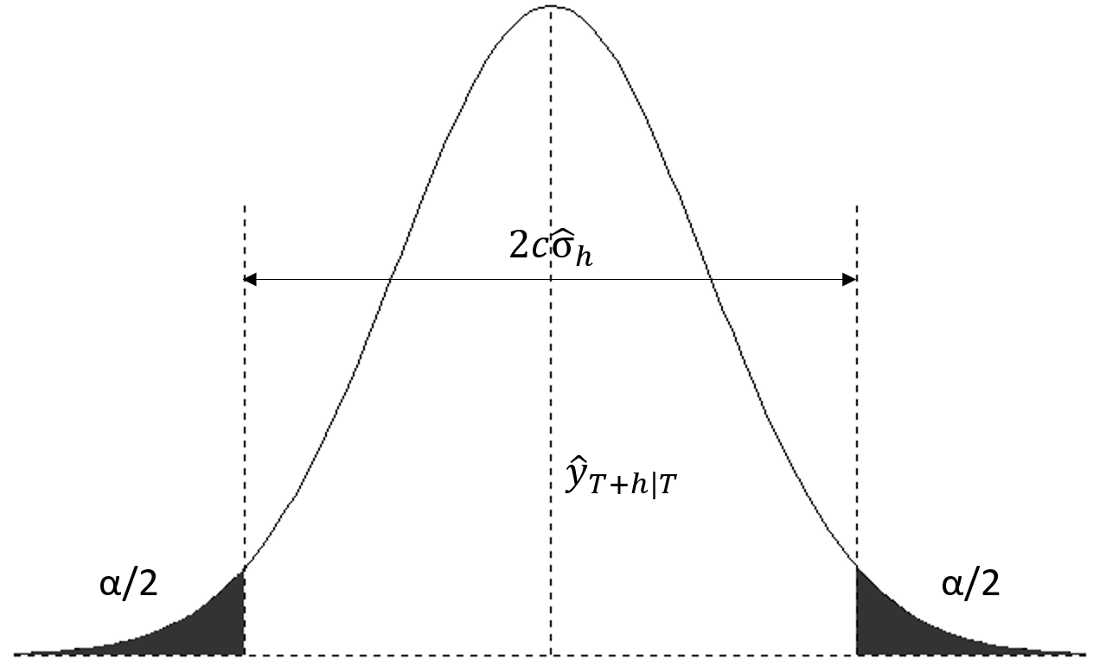

Slide 11
Key takeway 2
The random variables of a time series process are in general:
Correlated (and therefore not independent).
In most phenomena studied in time series, past values tend to affect future values.
Not identically distributed.
The independent and identically distributed hypothesis used in most convential statistical methods (e.g. Central Limit Theorem) does not apply.
Time Series can be referred to as the systematic approach to answer the mathematical and statistical questions posed by these time correlations.

