Slide 1
Summary of concepts
1 – Lagged variables, lag plots and ACF
2 – Correlograms and lag plots
3 – Trend and seasonality and their reflection on correlograms
4 – White noise
5 – Some examples of feature identification on correlograms

Slide 2
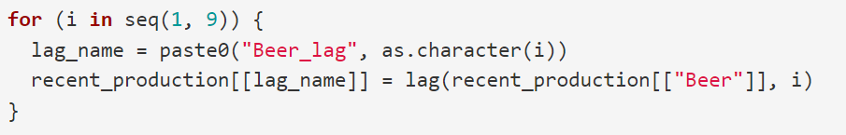
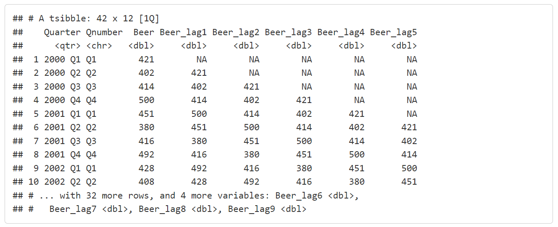
Lagged variables
lag()

Slide 3
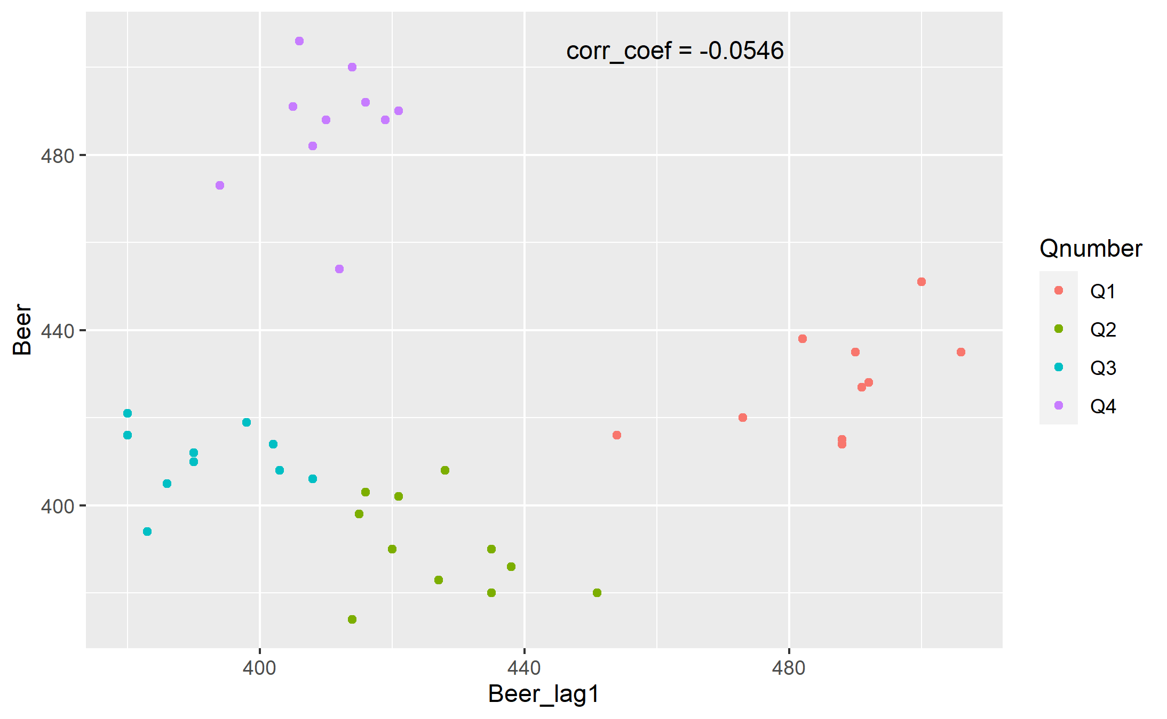
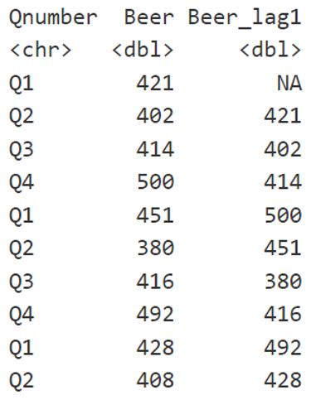
Variable vs lagged variable – lag 1

Slide 4
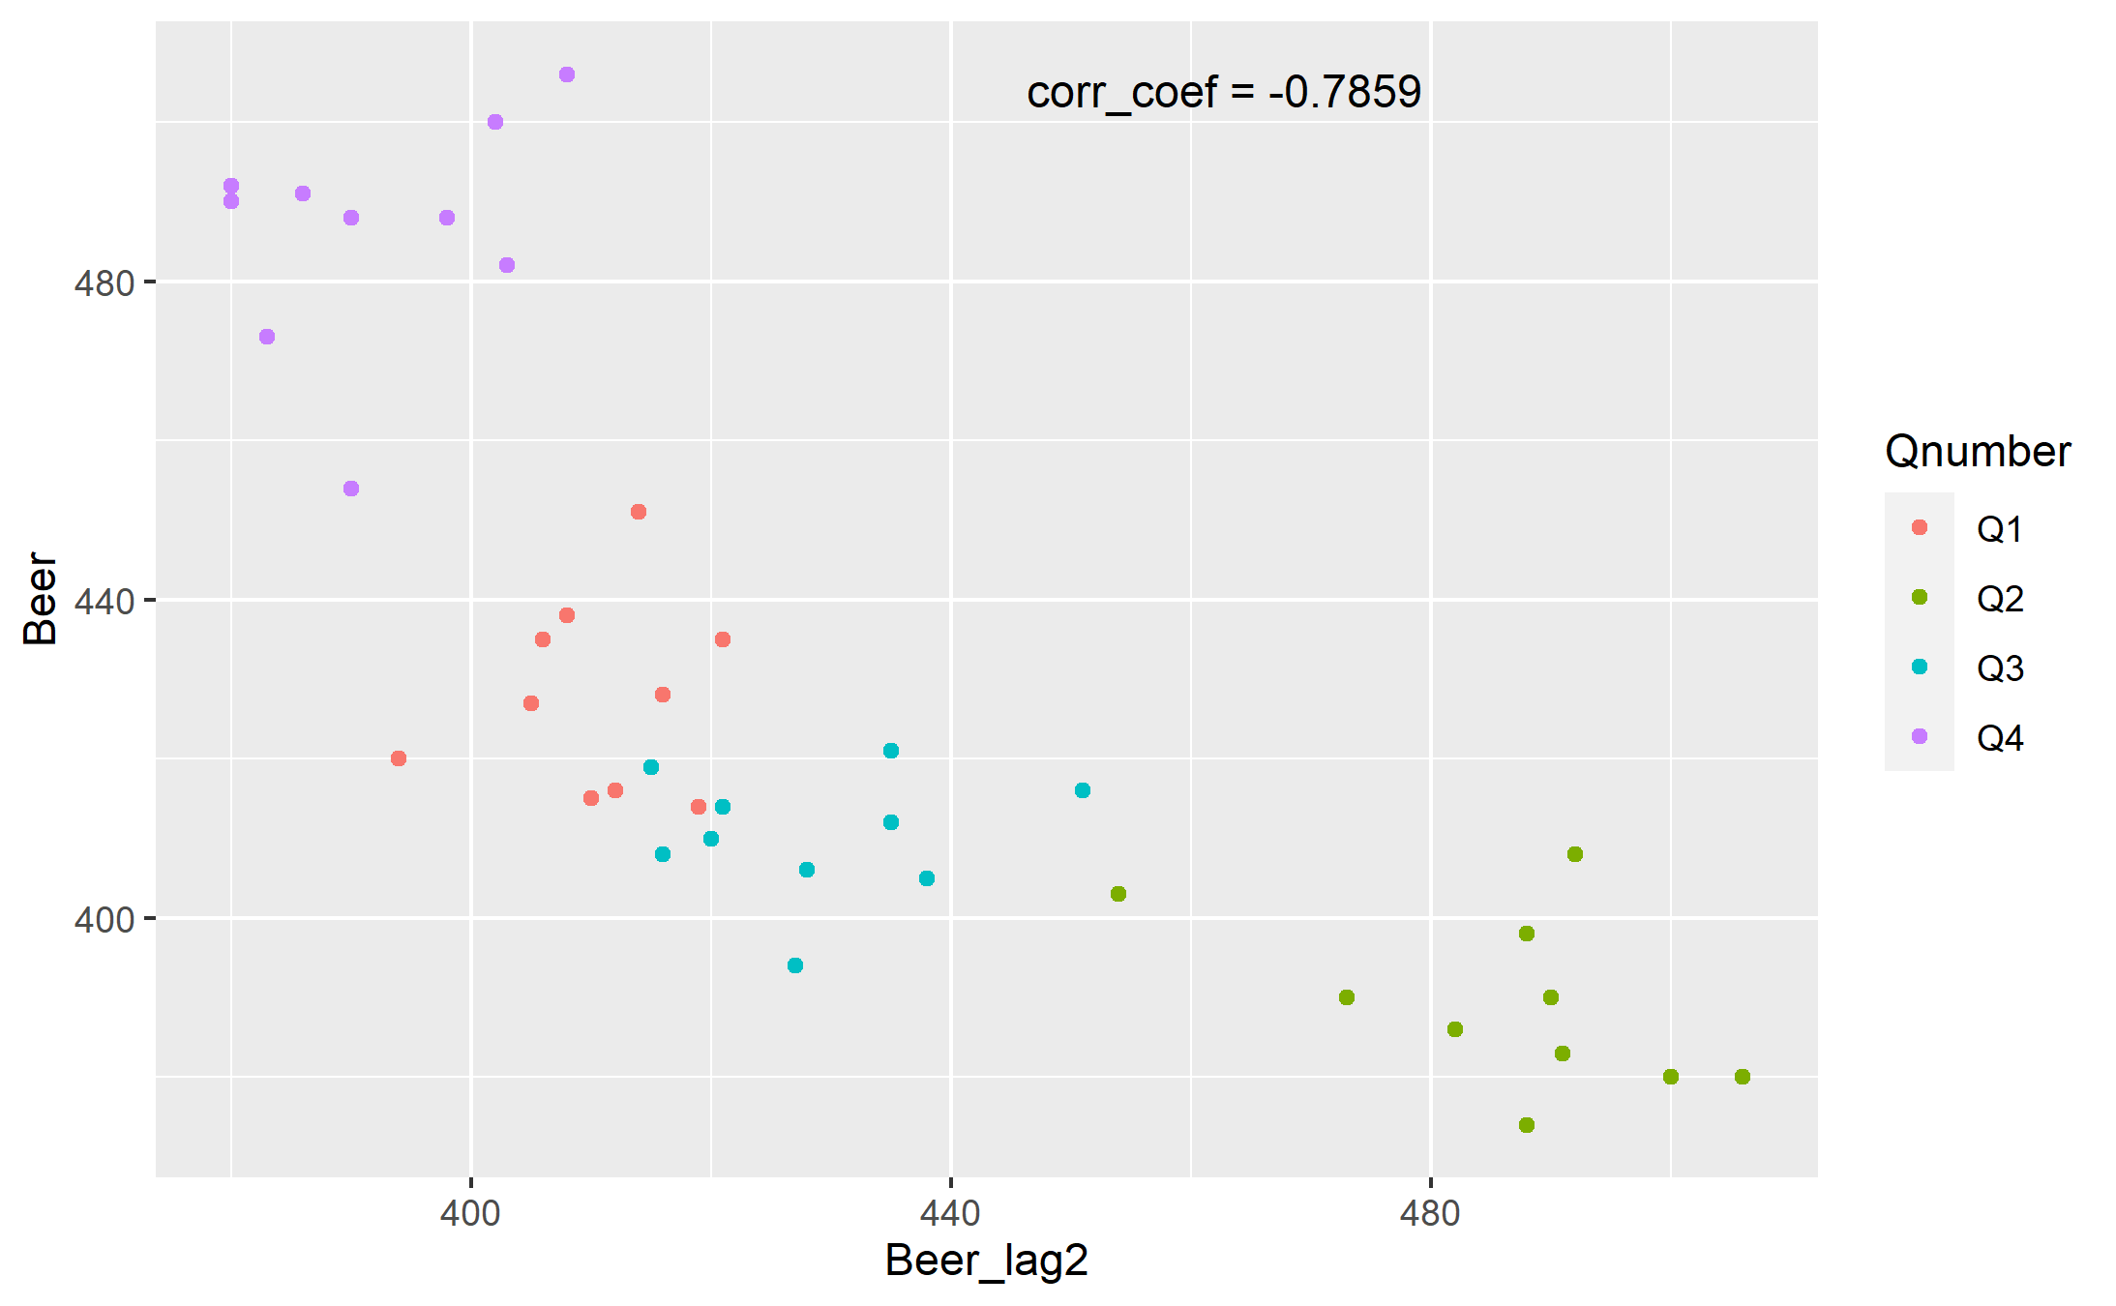
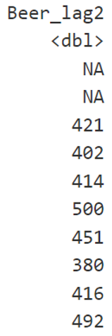
Variable vs lagged variable – lag 2

Slide 5
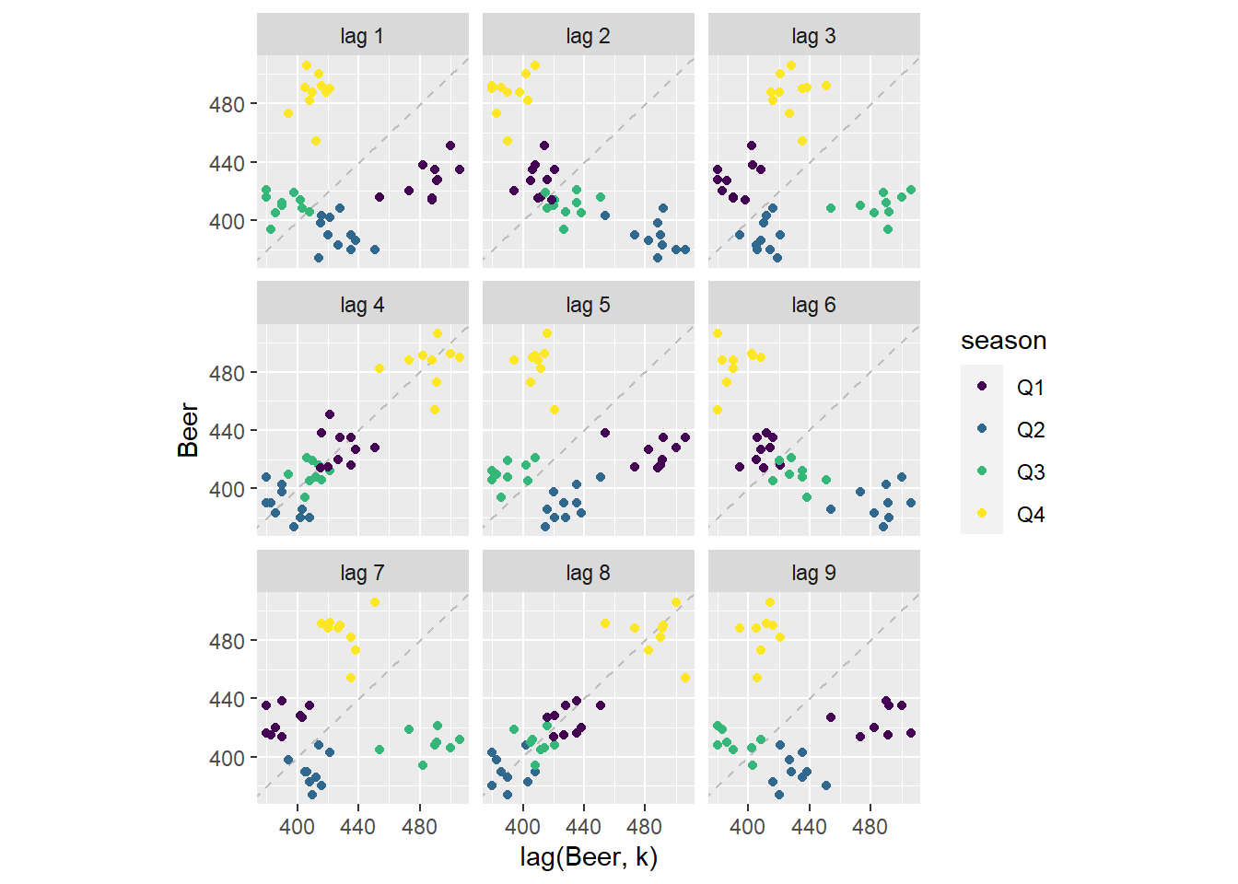
lagplot

Slide 6

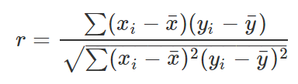

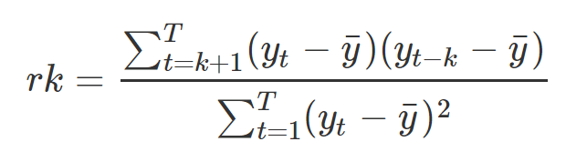
Autocorrelation coefficient

Slide 7
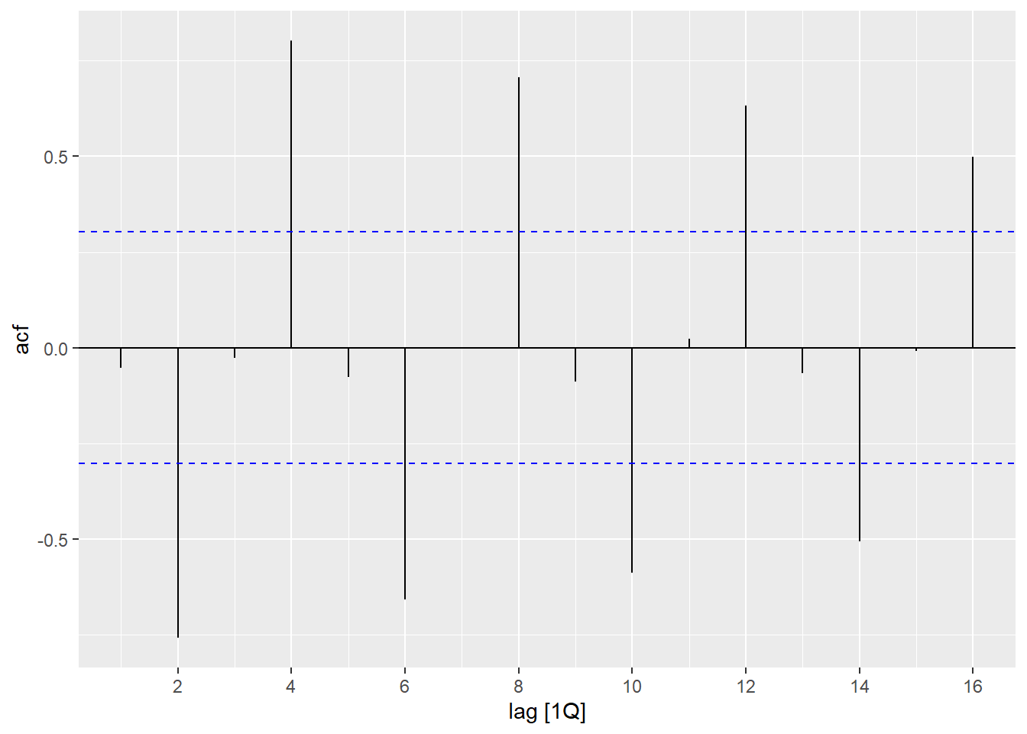
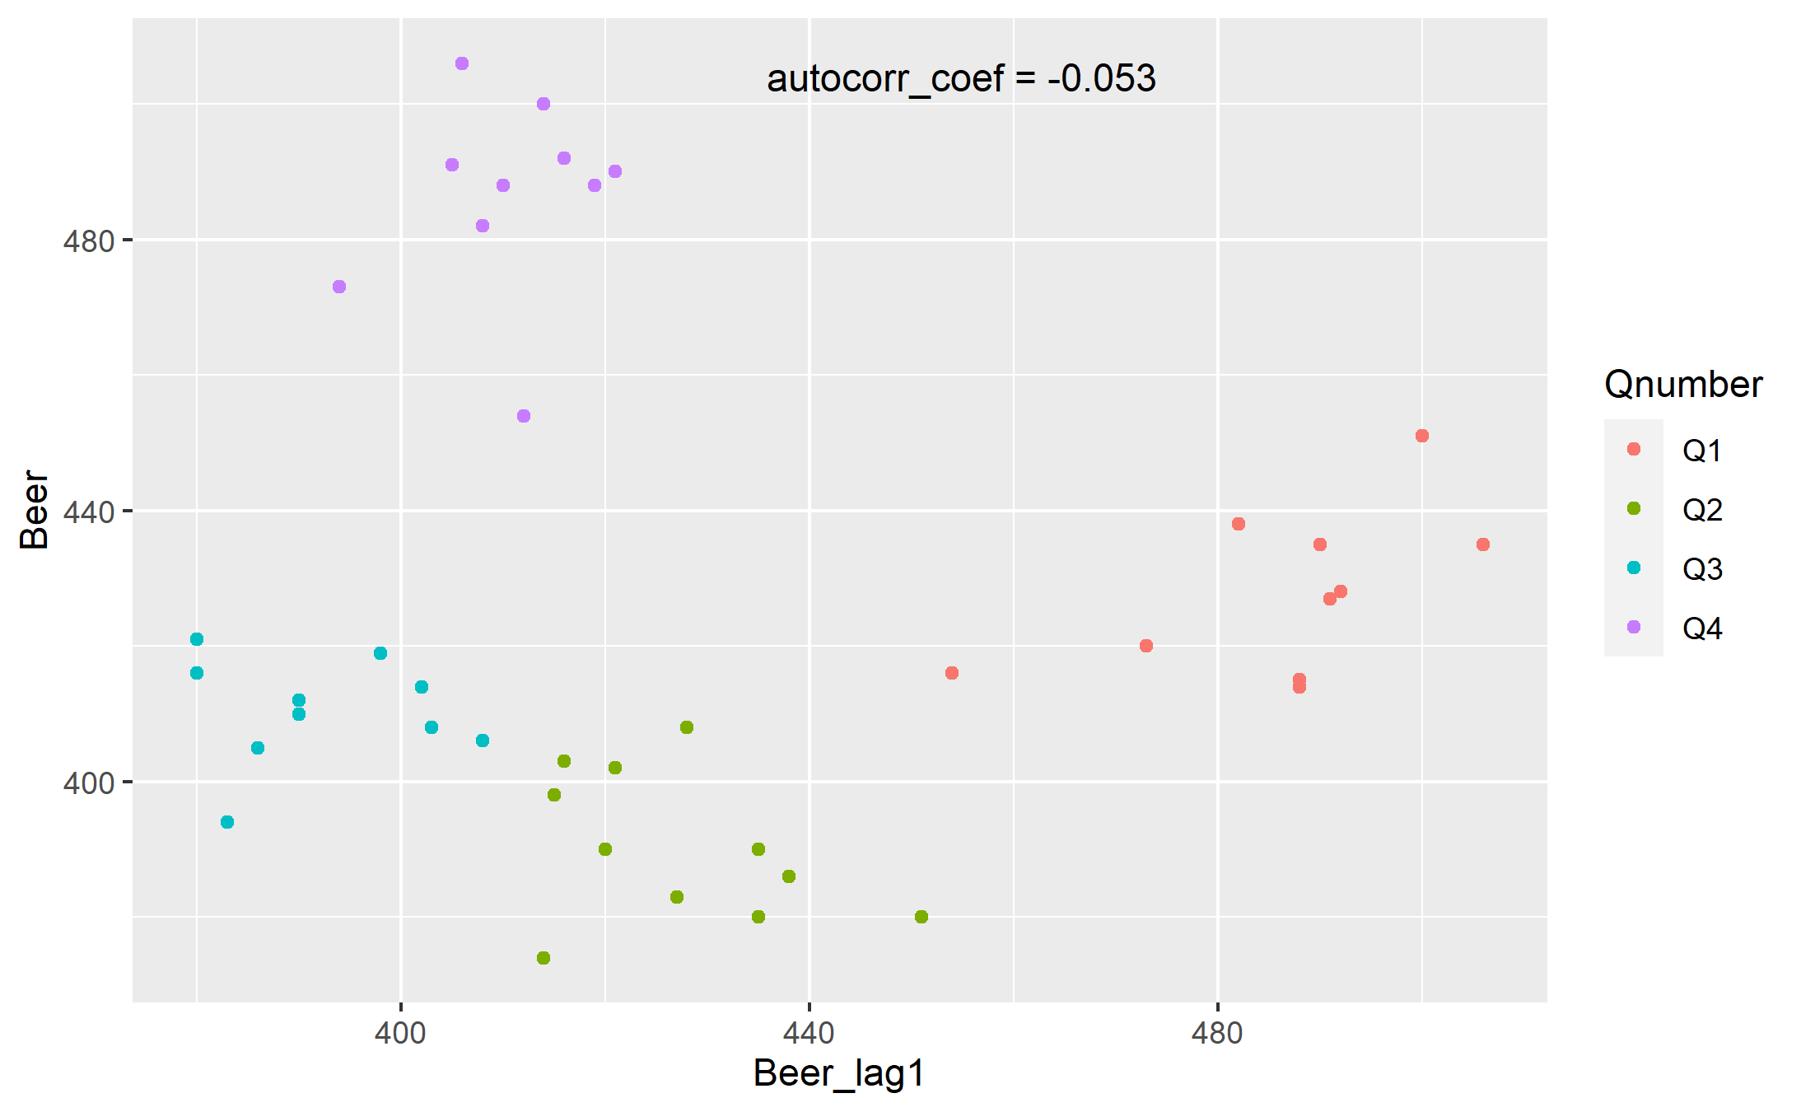
Correlogram

Slide 8
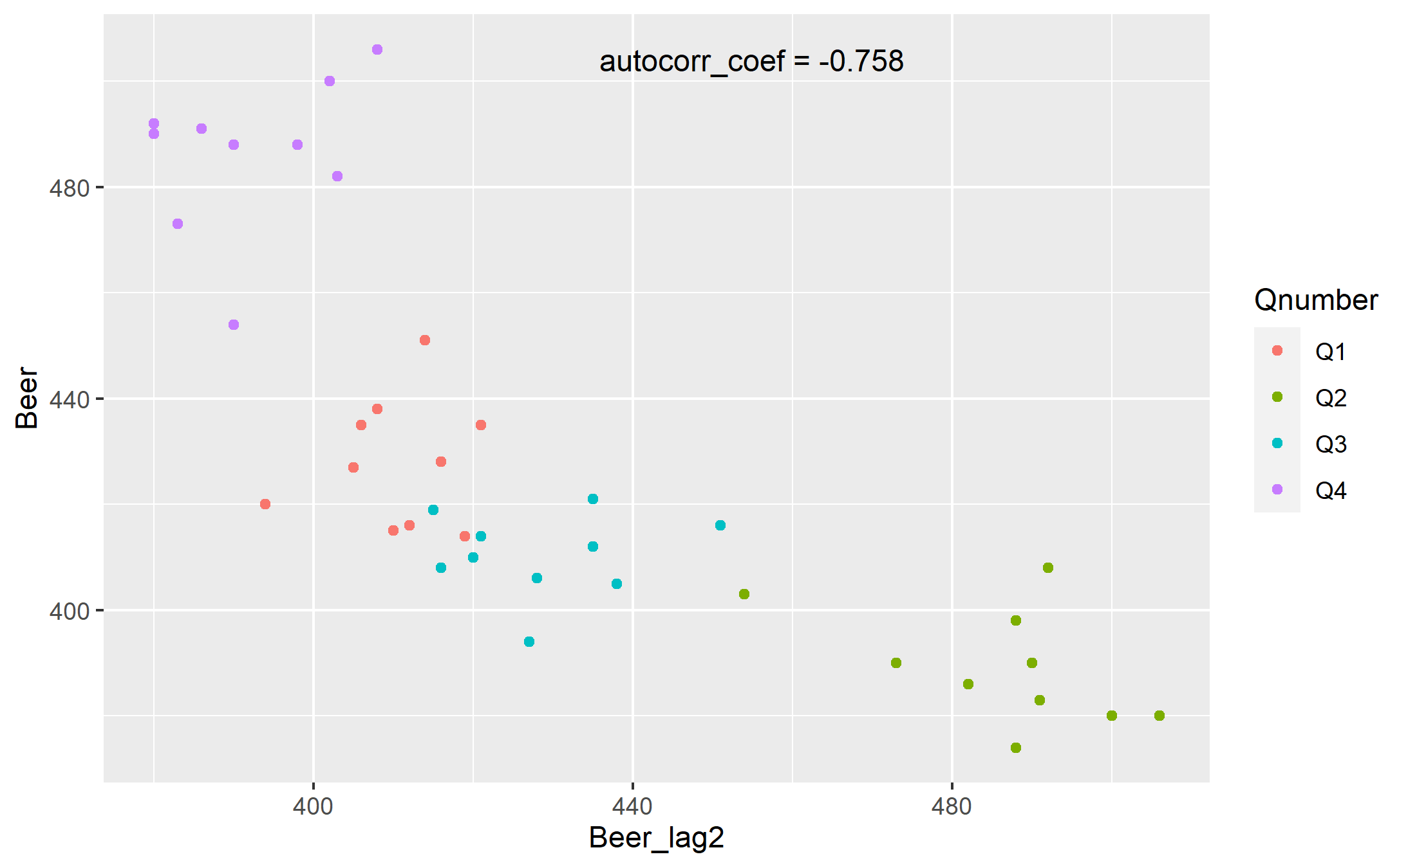
Correlogram

Slide 9
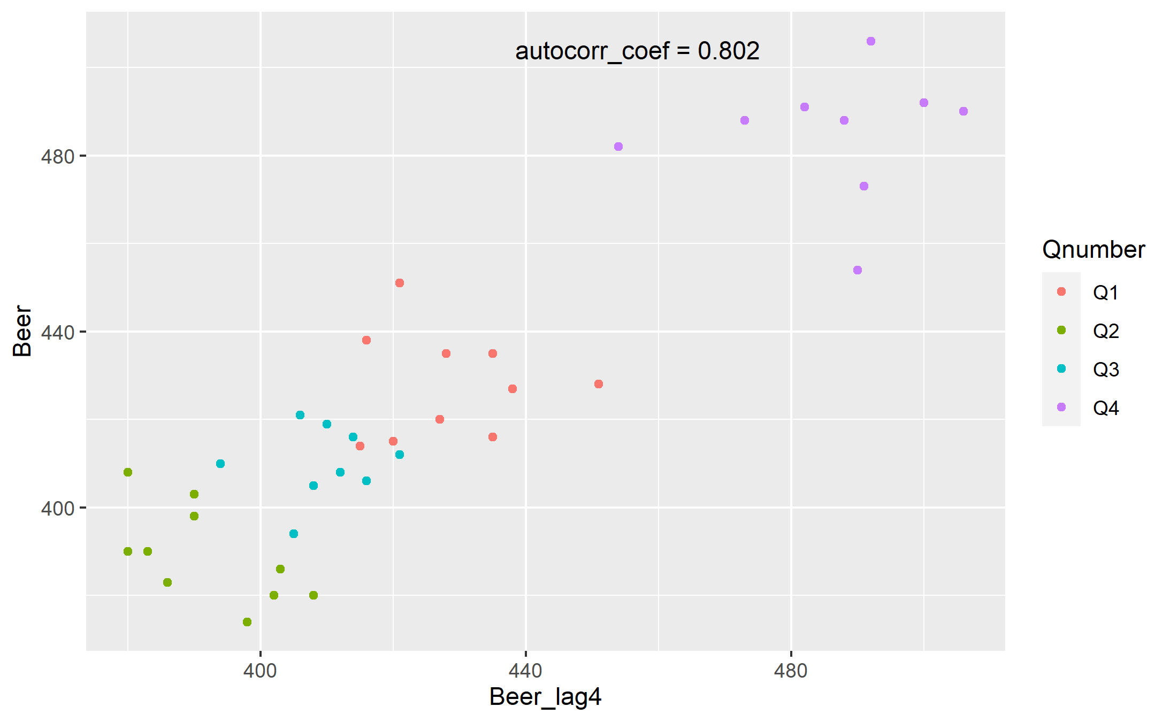
Correlogram

Slide 10
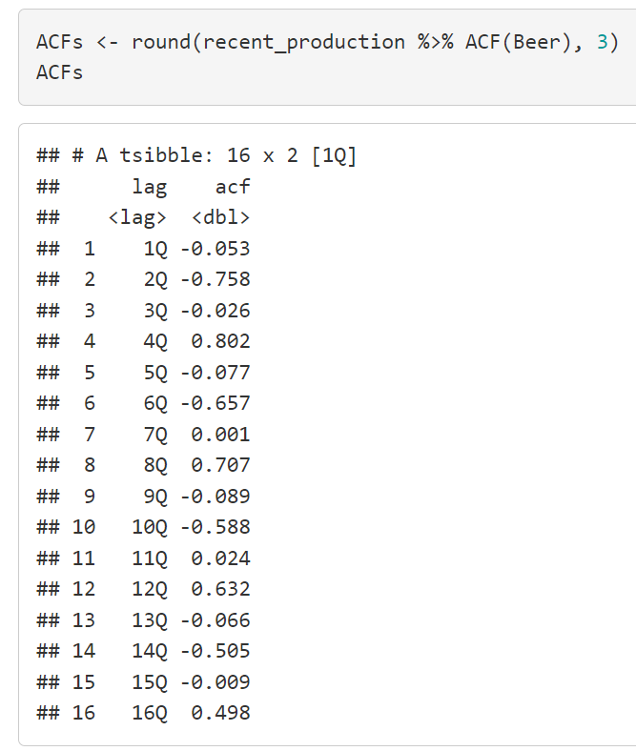

Correlogram
$$±2√T$$

Slide 11
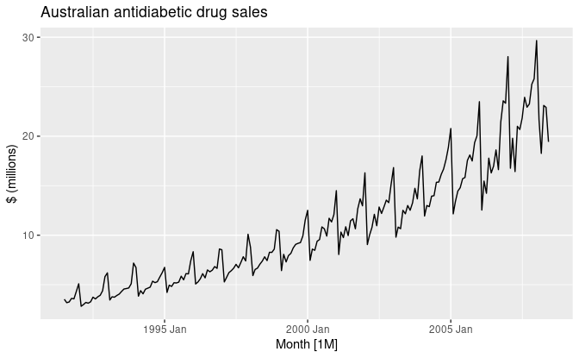
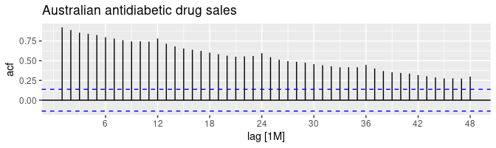
Trends and Seasonality in a correlogram

Slide 12
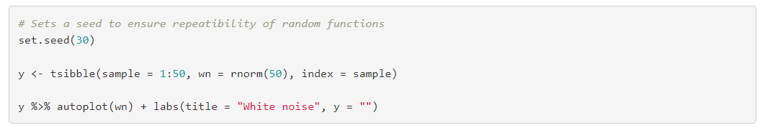
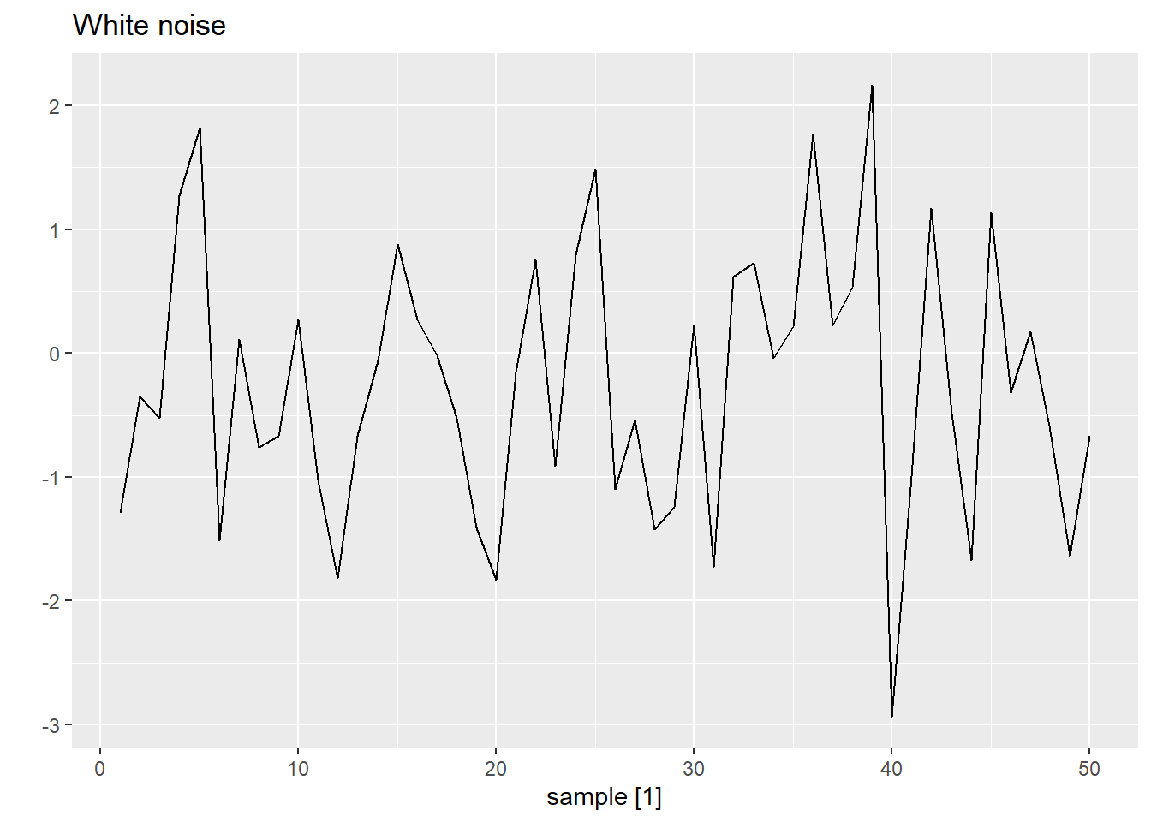
White noise

Slide 13
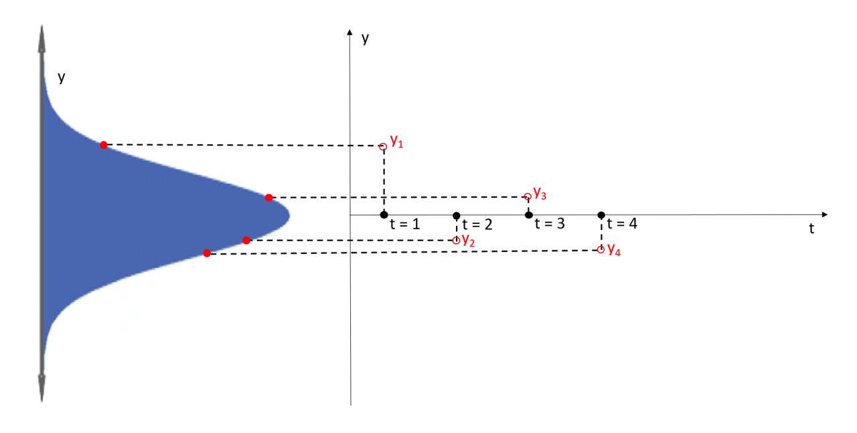
White noise (Gaussian)

Slide 14
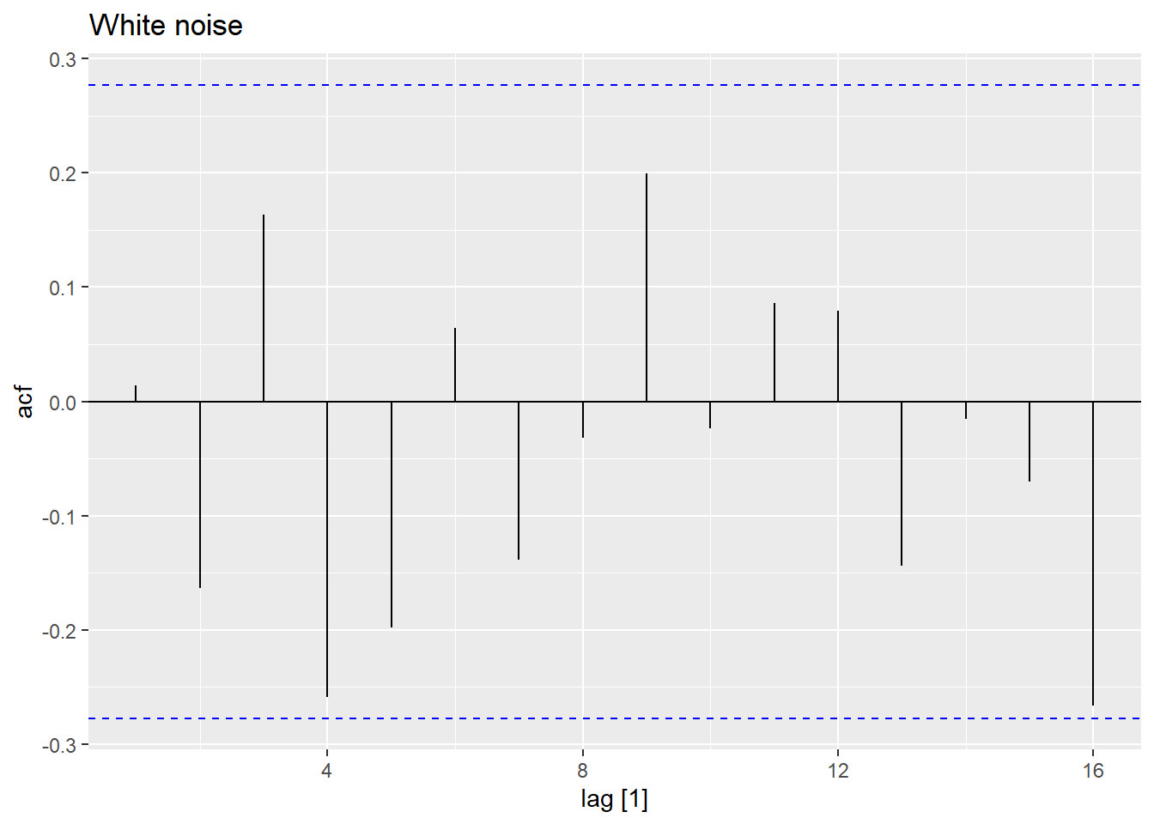

White noise
$$±2√T$$

Slide 15
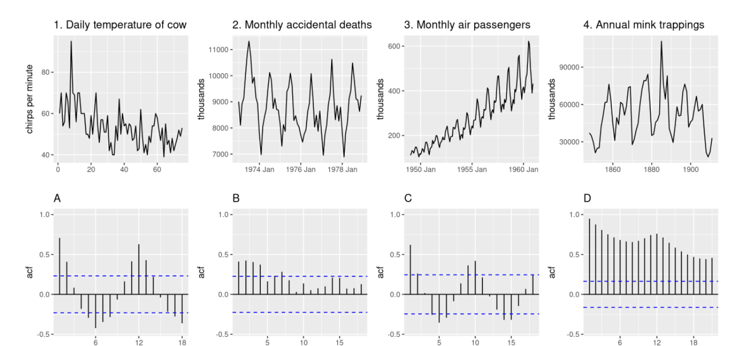
Correlogram – exercise

Slide 16

Correlograms – solution
$$±2√T$$
2 - A
1 - B
4 - C
3 - D

Slide 17
Summary of concepts
1 – Lagged variables, lag plots and ACF
2 – Correlograms and their relationship with lagged variables
3 – Trend and seasonality and their reflection on correlograms
4 – White noise
5 – Some examples of feature identification on correlograms

