Slide 1
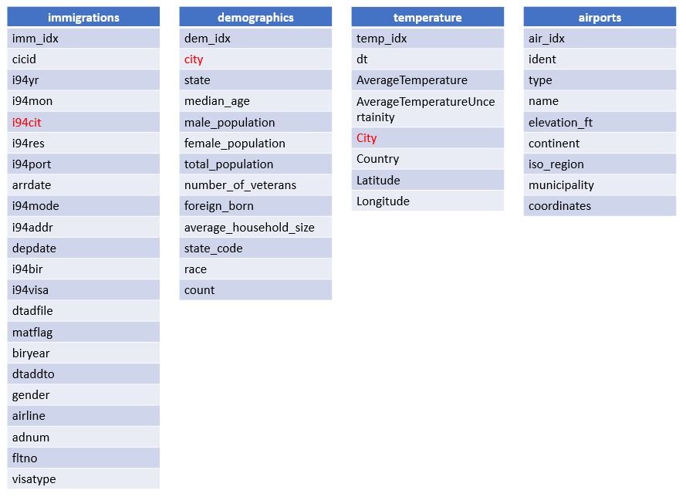
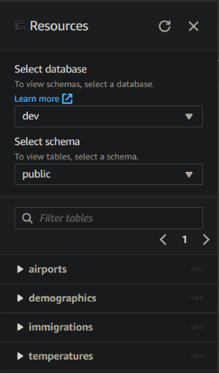


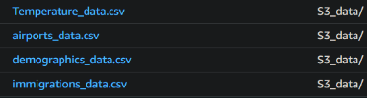
Capstone Project
Creation of Tables
Datasets
ETL

Slide 2
immigrations
imm_idx
cicid
i94yr
i94mon
i94cit
i94res
i94port
arrdate
i94mode
i94addr
depdate
i94bir
i94visa
dtadfile
matflag
biryear
dtaddto
gender
airline
adnum
fltno
visatype
i94_port_of_admission
por_idx
i94port
port
i94_residence
res_idx
i94cit_res
country
i94_usa_state_arrival
arr_idx
i94addr
state
temperature
temp_idx
dt
AverageTemperature
AverageTemperatureUncertainity
City
Country
Latitude
Longitude
demographics
dem_idx
city
state
median_age
male_population
female_population
total_population
number_of_veterans
foreign_born
average_household_size
state_code
race
count

