Slide 1

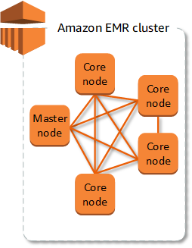


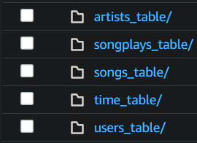
Data Lake
songs
song_id
title
artist_id
year
duration
artists
artist_id
artist_name
artist_location
artist_latitude
artist_longitude
songplays
songplay_id
start_time
month
year
user_id
level
song_id
artist_id
session_id
location
user_agent
Creation of Tables
time
start_time
hour
day
week
Month
Year
weekday
users
user_id
first_name
last_name
gender
level
or
Local
Sparkify Data
Spark Processing
Input
s3a://udacity-dend/
Output
s3a://jinb-sparkify/
Since Spark lacks a system to organize, store and process data files, a EMR cluster can be used to support Spark.
ETL
Datasets
Song data: json files
Log data: json files

