Slide 1
Predicting Median Earnings Post Graduation at U.S. Institutions of Higher Education
Capstone Project at Data Science Immersive, General Assembly
Juan Vega, March 29, 2022

Slide 2
Problem Statement
Millions of Americans enroll in higher education institutions annually in the prospect of increasing their life-time earnings
State education agencies in states such as Florida and Kansas use accountability key performance indicators to allocate funding resources to higher education institutions based on outcomes such as graduates’ post-secondary wages
This analysis will predict median annual wages six years post graduation and consider how changing institutional policies aimed at increasing access to higher education affects student median annual wages six years post graduation

Slide 3
Data and Methodology
Data is sourced from the U.S. Department of Education’s College Scorecard for academic year 2008-2009 and student earnings measured in 2014-2015
The data represents over 1,600 U.S. higher education institutions that award a Bachelor’s or Graduate degree
Exploratory data analysis, multiple linear regression, and additional prediction methods were used to evaluate the institutional and student characteristics that were most predictive of post graduation wages
The model that minimized the prediction error and explained most of the variability in the median earnings outcome was chosen for this analysis

Slide 4
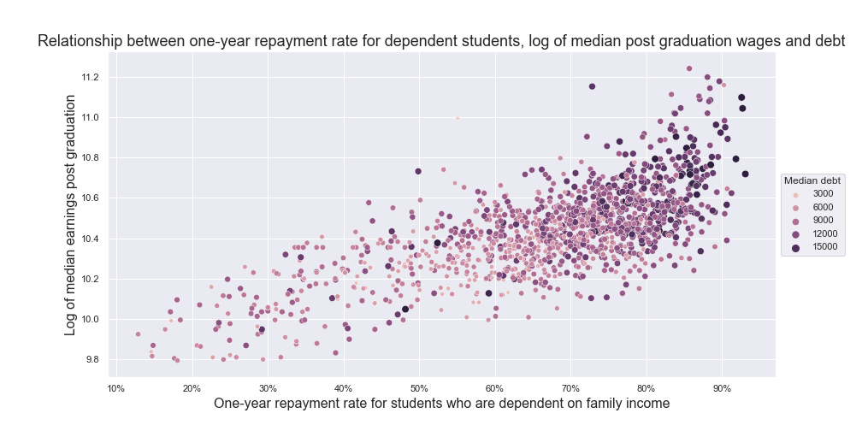
Exploratory Data Analysis - One year debt repayment
A higher share of financially dependent students who are making progress in paying their educational debt one year post graduation is associated with higher logged median earnings

Slide 5
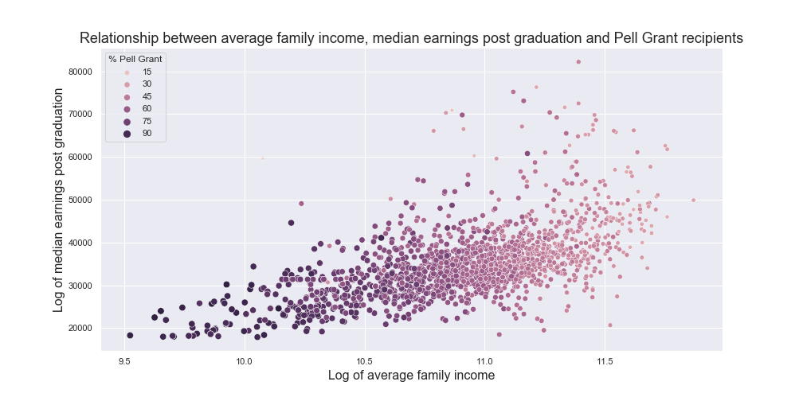
Average family income and share of Pell Grant students
There is a positive relationship between a percentage increase in the average family income and the log of median earnings
However, a higher share of students who have received a Pell Grant is associated with lower median earnings and family incomes

Slide 6
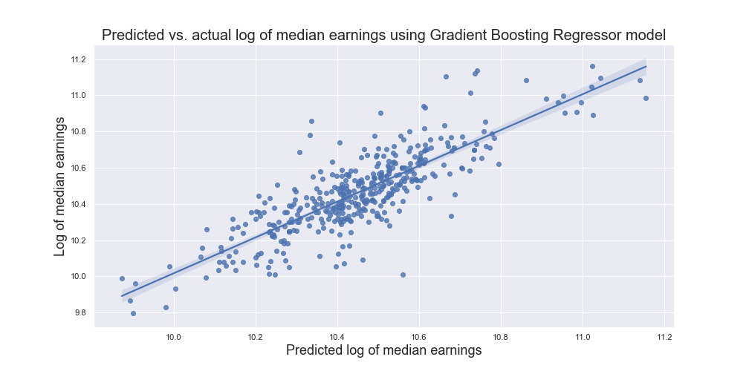
Results
The predicted and actual logged median earnings are visualized here.
The model used to predict the log of median earnings explains around 70% of the variation in median earnings.

Slide 7
Conclusions
Having an open admissions policy does not predict median earnings
Increasing the share of Pell Grant students is associated with lower median earnings over time
This should not be interpreted to mean that students from underserved backgrounds should have lower expectations placed on them, but that more support is needed to improve economic outcomes post graduation for students with higher levels of financial need

Slide 8
Conclusions
Higher two-year cohort default rates are associated with lower median earnings
Higher one year repayment rates among dependent students are associated with higher earnings
These shorter term indicators can be used by higher education institutions to predict median post graduation wages for students as early warning signs of worsened outcomes for students and their impact on state accountability measures

