Slide 1
Predicting Median Earnings Post Graduation at U.S. Institutions of Higher Education
Capstone Project at Data Science Immersive, General Assembly
Juan Vega, March 29, 2022

Slide 2
Problem Statement
Millions of Americans enroll in higher education institutions annually in the prospect of increasing their life-time earnings.
State education agencies in states such as Florida and Kansas use accountability key performance indicators to allocate funding resources to higher education institutions based on outcomes such as graduates’ post-secondary wages
This analysis will predict median annual wages six years post graduation and consider how changing institutional policies aimed at increasing access to higher education affects student median annual wages

Slide 3
Data and Methodology
Data is sourced from the U.S. Department of Education’s College Scorecard for academic year 2008-2009 and student earnings measured in 2014-2015
The data represents over 1,600 U.S. higher education institutions that award a Bachelor’s or Graduate degree
Exploratory data analysis, multiple linear regression, and additional prediction methods were used to evaluate the institutional and student characteristics that were most predictive of post graduation wages
The predictive method that minimized the error and explained most of the variability in the median earnings outcome was chosen for this analysis

Slide 4
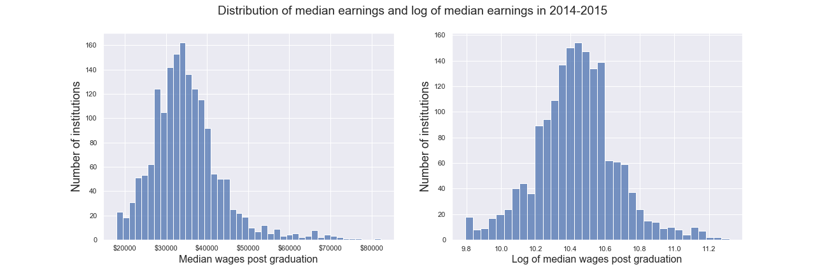
Exploratory Data Analysis - median earnings post grad
The log transformation of the median earnings six years post graduation feature follows a closer to normal distribution and is used as the target in this analysis

Slide 5
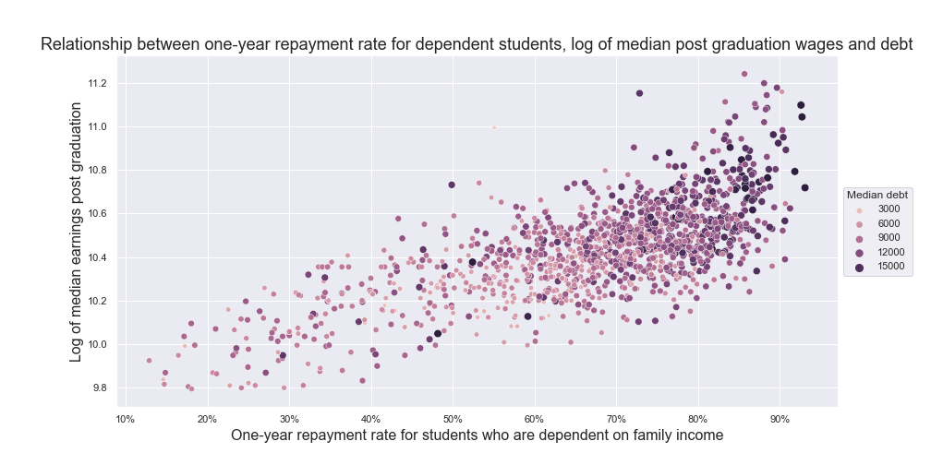
Exploratory Data Analysis - One year debt repayment
A higher share of financially dependent students who are making progress in paying their educational debt one year post graduation is associated with higher logged median earnings

Slide 6
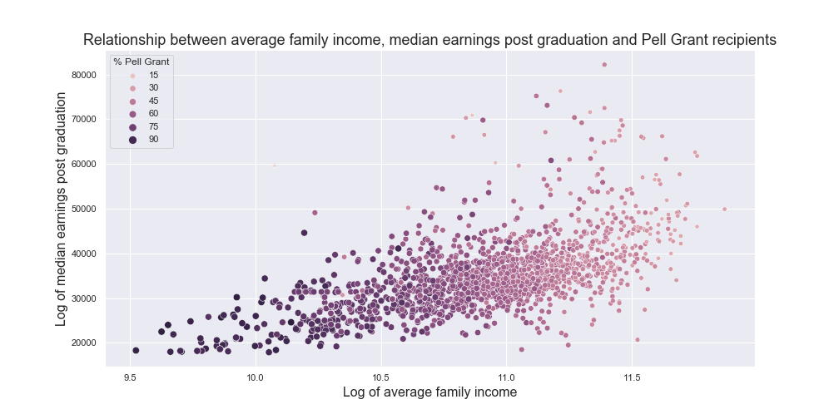
One year debt repayment
There is a positive relationship between a percentage increase in the average family income and the log of median earnings
However, a higher share of students who have received a Pell Grant is associated with lower median earnings and family incomes

Slide 7
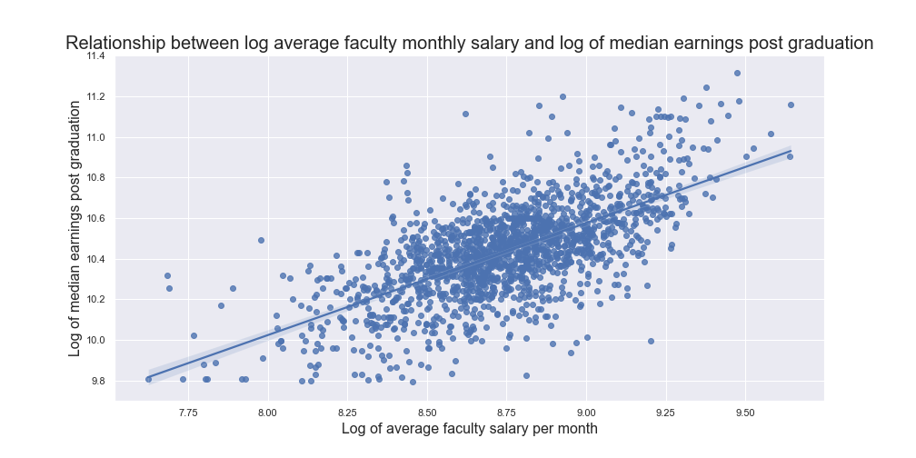
Average faculty monthly salary
On average, there is a positive relationship between a higher logged average faculty salary and logged median earnings
Institutions with more resources may have additional supports available to match students to higher-paying jobs

Slide 8
Missing data imputation
Missing data imputation methods were used to impute missing values using the following methods:
Method | Mean R-squared | R-squared standard dev.
Simple median imputer | 0.6864 | 0.052
K-nearest neighbor imputer | 0.6753 | 0.0637
Iterative imputer | 0.0003 | 0.6591

Slide 9
Preliminary modeling - Lasso regression
Interaction terms between categorical variables including Private/Public status, indicator for open admissions policy, and indicator for whether an institution is research intensive, the following features were selected using Lasso regression with a regularization strength of 0.0012
The feature set was reduced from 64 features including continuous, categorical, and interacted features to 9 features

Slide 10
Preliminary modeling - Features selected
Share of students who received Pell Grants
Share of students who received Pell Grants at public institutions
Log of average faculty salary
Log of average faculty salary at research intensive universities
Indicator of private, non-profit status
One-year repayment rate for dependent students
One year repayment rate for dependent students at public institutions
Percentage increase in median earnings over time
Log of two-year cohort default rate at public institutions

Slide 11
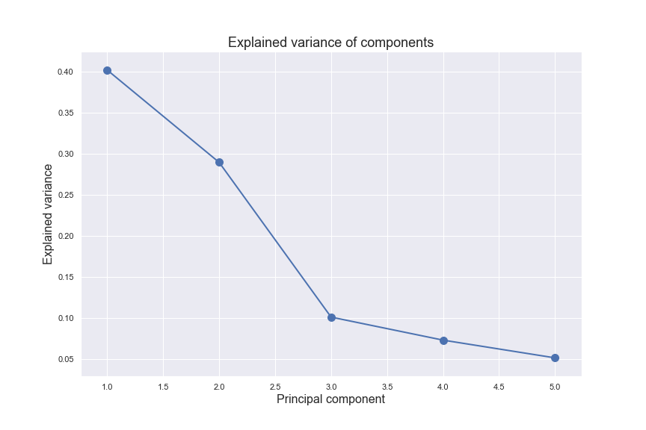
Preprocessing - Principal Component Analysis
Over 95% percent of the variance in the data was explained by the first 5 principal components.
Over 40% of the variance in the data was explained by the first principal component
The first principal component reflects:
Higher shares of Pell students
Higher log average faculty salaries
Lower repayment rates
Higher median earnings growth
Higher log two year cohort default rates

Slide 12
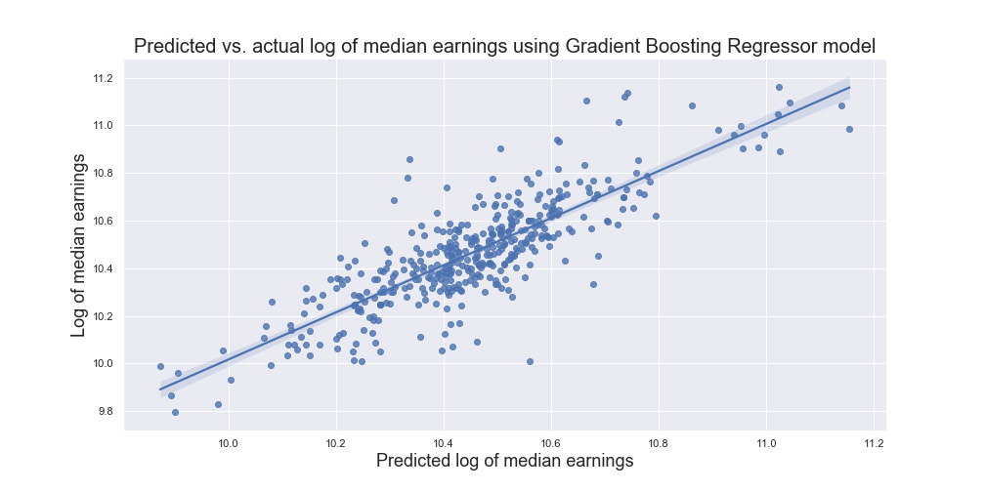
Modeling - Predictions
The predicted and actual logged median earnings are visualized here.
The model used to predict the log of median earnings explains around 70% of the variation in median earnings.

Slide 13
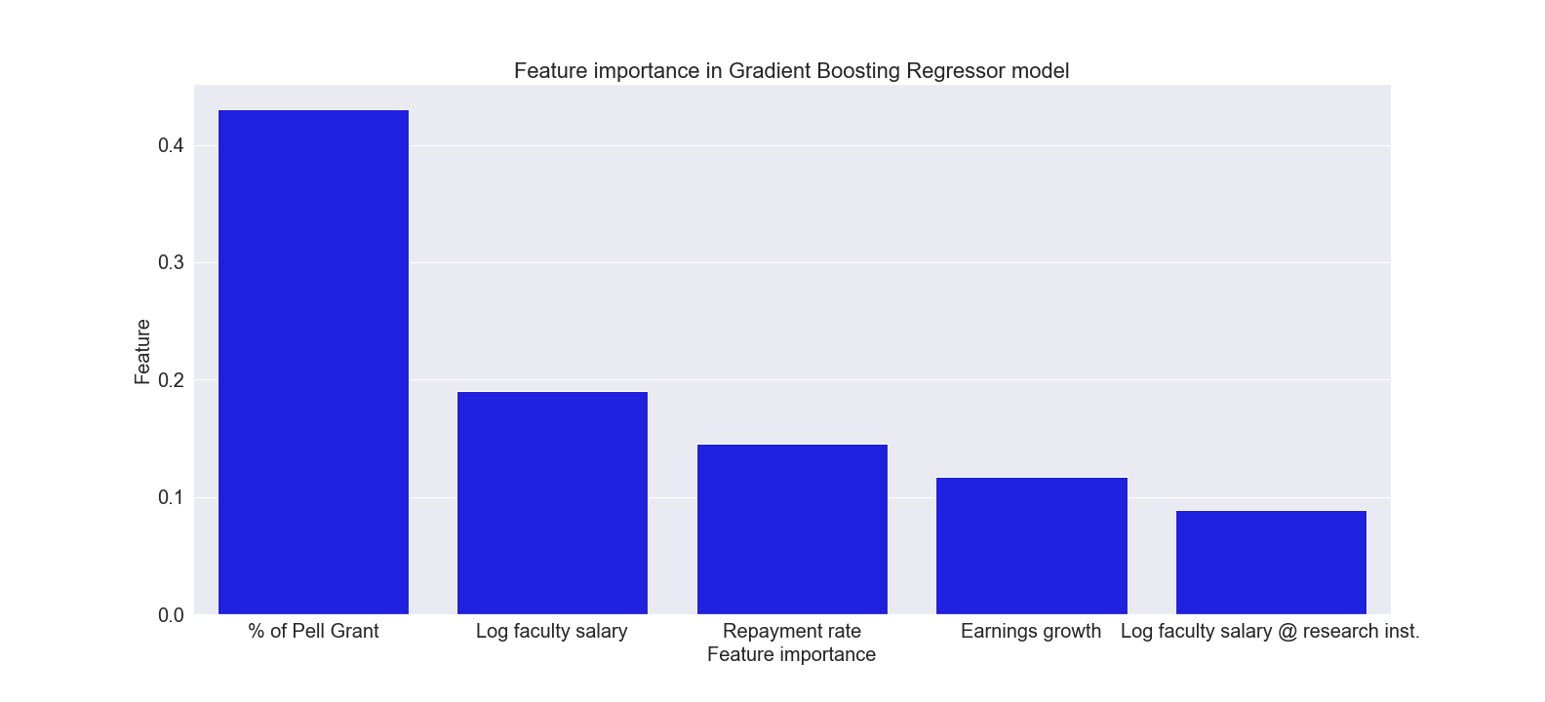
Modeling - Feature importance
Based on the Gradient Boosting model, the share of Pell Grant students is the most important feature in the model, while the least important feature is the log of average faculty salary at research intensive institutions

Slide 14
Modeling
Model | Mean R-squared | R-squared +/- 2 standard deviations
Ordinary least squares | 0.6844 | ±0.007
Lasso | 0.6811 | ±0.0076
Ridge | 0.6845 | ±0.007
Random forest regressor | 0.6801 | ±0.0063
Extra-trees regressor | 0.6829 | ±0.0069
Gradient Boosted regressor | 0.6938 | ±0.0064

Slide 15
Results
All features have a statistically significant relationship with the log of median earnings at a 1% significance level
The coefficients of the log-linear relationships are transformed to linear-linear relationships
The coefficients of the log-log relationships are interpreted as the effect of one percentage increase in the independent variable on the median earnings

Slide 16
Results
Feature | Effect
Share of students who received Pell Grants | -7.3%
Share of students who received Pell Grants at public institutions | 5%
Log of average faculty salary | 7.4%
Log of average faculty salary at research intensive universities | 3.3%
Indicator of private, non-profit status | -3.5%

Slide 17
Results
Feature | Effect
One-year repayment rate for dependent students | 4.9%
One year repayment rate for dependent students at public institutions | -5.5%
Percentage increase in median earnings over time | 6%
Log of two-year cohort default rate at public institutions | -5.4%

Slide 18
Conclusions
Having an open admissions policy does not predict median earnings
Increasing the share of Pell Grant students is associated with median earnings over time
This should not be interpreted to mean that students from underserved backgrounds should have lower expectations placed on them, but that more support is needed to improve economic outcomes post graduation for students with higher levels of financial need

Slide 19
Conclusions
Higher two-year cohort default rates are associated with lower median earnings over time
Higher one year repayment rates among dependent students are associated with higher earnings
These shorter term indicators can be used by higher education institutions to predict median post graduation wages for students as early warning signs of worsened outcomes for students and their impact on state accountability measures
An interactive Flask app can be used to evaluate the effect of policy changes on the median earnings metrics

Slide 20
Next steps
Complete Flask app development
Explore neural network as a potential model to improve model performance
Consult with higher education subject matter experts about additional potential data sources and modeling methods to improve this analysis
Disseminate these findings and analysis through Medium and other venues

