Slide 1
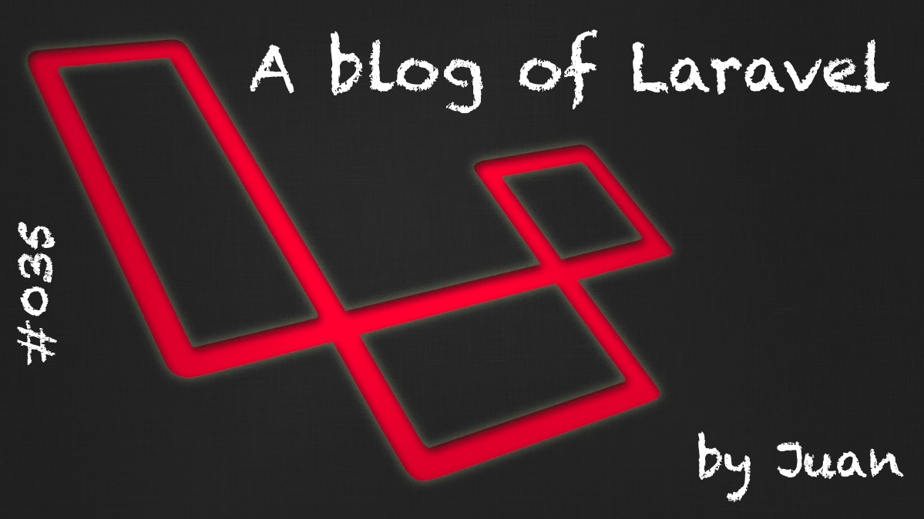

Slide 2
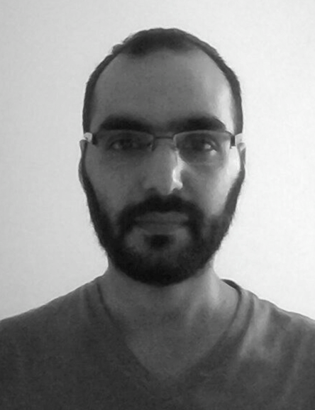



About me ...
$ whoami
Juan Carlos Morales
email: jcmargentina@gmail.com
github: https://github.com/juancarmo
linkedin: https://www.linkedin.com/in/jcmcvm-en/

Slide 3
What are we going to do today? ….

Slide 4
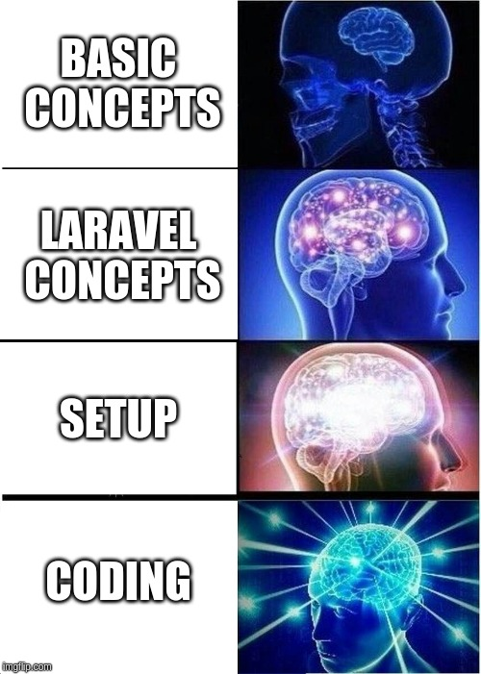

Slide 5

PHP: PHP (PHP: Hypertext Preprocessor) open source programming language. Very popular and specially suitable for the development of web applications. It can also be embedded inside HTML code.

Slide 6
PHP code gets executed in the server-side, and the result becomes part of the response received by the client.
Even Though the client receives the result of the execution of certain php code/script, the client will never know the actual php code.

Slide 7
Example - http://www.app.com/index.php
The user opens the browser and goes to the URL
The URL gets “resolved” in the internet cloud until it gets to the server that hosts the desired website.
The request is handle by the remote server, generally a web server like Apache, NGinx, etc.
The server realizes that the web page is a php webpage, so before the page is send the PHP code needs to be resolved.
The final result of this processing is what the user receives. Only HTML, CSS and Javascript.
<!DOCTYPE HTML>
<html>
<head>
<title>Example</title>
</head>
<body>
<span>
<?php
$t = date("Y-m-d h:i:s");
echo "Startup time: " . $t;
?>
</span>
</body>
</html>
HTML code
PHP code

Slide 8
Example - http://www.app.com/index.php
The user opens the browser and goes to the URL
The URL gets “resolved” in the internet cloud until it gets to the server that hosts the desired website.
The request is handle by the remote server, generally a web server like Apache, NGinx, etc.
The server realizes that the web page is a php webpage, so before the page is send the PHP code needs to be resolved.
The final result of this processing is what the user receives. Only HTML, CSS and Javascript.
<!DOCTYPE HTML>
<html>
<head>
<title>Example</title>
</head>
<body>
<span>
Startup time: 2018-01-02 13:23:44
</span>
</body>
</html>
OK?

Slide 9


Slide 10
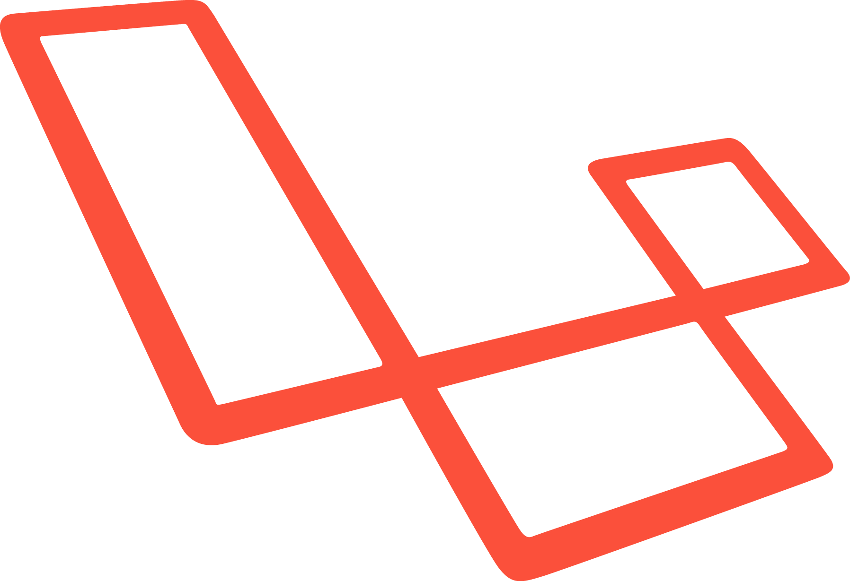
Laravel
What is Laravel?
It’s a framework to create software applications (mostly to create web applications) using the PHP programming language.
Easy to learn.
Well organized and well documented.
Free and Open Source.
MVC programming model.

Slide 11
Model
View
Controller

Slide 12
MVC - Model View Controller
MVC its a software programming architecture style, that pretends to separate the data, the user interfaces and the control logic in 3 components or layers.
Model: It’s an abstract representation of data handled by the system and the business logic.
View: Information that is send to the client and the mechanisms of interaction with it.
Controller: Mediator between the Model and the View, managing the information flow and data transformations between them.

Slide 13





MVC - Model View Controller
Model execution Parameters
Model
HTTP Request
Result
HTTP Response
Result from Model
User
Browser
Controller
View
Content

Slide 14
MVC - Model in Laravel
Model:
Classes written in PHP … that’s it!
They represent the data handled by our application, independently of the database engine used.
Laravel was conceived to work with relational database engines ... at least that was the first approach.
There are packages to extend the framework capabilities in order to provide access to NoSQL databases (eg: MongoDB), as well as databases in the Cloud (eg: firebase).

Slide 15
Independently of the database engine? … but HOW ?

Slide 16
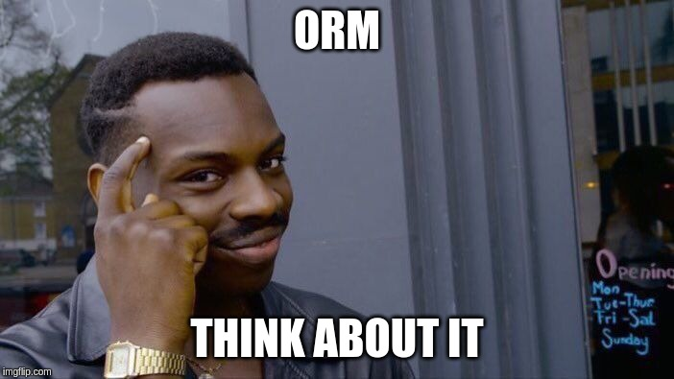

Slide 17
MVC - Model in Laravel
But how ? … think in ORM!
ORM (Object-Relational mapping): programming technique to convert data between the type system used in an object-oriented programming language, and the one used in a relational database engine.
Laravel has an ORM called Eloquent.

Slide 18
Example
MySQL - Table “Users” in DB
PHP Class
<?php
class Users extends Model {
public $table=”users”;
public $id;
public $name;
public $email;
}
?>
ID | NAME | EMAIL
1 | JUAN | j@email.com
2 | CARLOS | c@emai.com
3 | ROOT | r@email.com
4 | LARAVEL | l@email.com
ORM
An instance of our PHP class
will represent one row of our DB table.

Slide 19
Example
PHP Class
MongoDB - Collection “Users”
<?php
class Users extends Model {
public $table=”users”;
public $id;
public $name;
public $email;
}
?>
{
Id: 1,
Name: “JUAN”,
Email:”j@email.com”
},
{
Id: 2,
Name: “CARLOS”,
Email:”c@email.com”
},
{
Id: 3,
Name: “ROOT”,
Email:”r@email.com”
},
{
Id: 4,
Name: “LARAVEL”,
Email:”l@email.com”
}
ORM

Slide 20
Example for relational DB
PHP Code using Model
Result
<?php
$user = Users::find(1)
$user->email = “x@email.com”;
$user->save();
Users::find(2)->delete();
?>
SELECT * FROM Users WHERE Id = 1;
ORM
UPDATE Users SET email = ‘x@email.com’ WHERE id = 1;
DELETE FROM Users WHERE id = 2;

Slide 21
Example using NoSQL MongoDB
Result
PHP Code
db.users.find(
{ Id: 1 }
)
<?php
$user = Users::find(1)
$user->email = “x@email.com”;
$user->save();
Users::find(2)->delete();
?>
ORM
db.users.updateMany(
{ Id: 1 },
{ Email: “x@email.com” }
)
db.users.deleteMany(
{ Id: 2 }
)
Your PHP code remains the same achieving the same result in different DB engines!

Slide 22
MVC - Views in Laravel
They are HTML, CSS and Javascript files, but enriched with extra functionality through special instructions that are processed on the server side.
To enrich our view files, Laravel has a template engine called Blade.
Blade will allow us to add code that will be executed in our server before sending the final HTML result to our client. This code exists with the purpose of helping us to work better our Views.
Laravel does not require us to use Blade, you can choose another template engine, or include pure PHP code in the view files.

Slide 23
MVC - Controller in Laravel
The controllers are classes written in PHP where each method represents the logic to deal with our web requests
(this is generally speaking I mean, because this is just a PHP class so you can use it as a normal class, but conceptually, think about it as the sentence said).
A controller interacts with the models and views, coordinating the cooperation between them.

Slide 24
Basic Architecture and request life cycle in a Laravel app.
Laravel App
Request
ORM
BD
Route the request
Model
Handle the request
Controller
Response
View
Send a Response

Slide 25
In a practical, linear and simple way
Match Requested URL against Url’s declared in our app (Laravel ones)
Controller
Method in the controller to handle request
Logic
Models
Views
Final Response

Slide 26
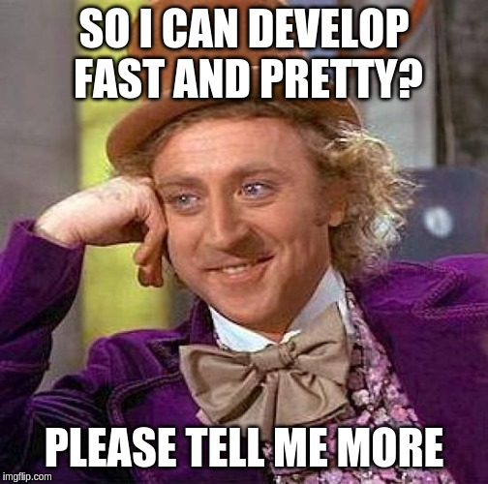

Slide 27
Workshop - Mini-Blog application
Building a Laravel application from zero
Laravel setup
Project configuration
Coding steps (suggested):
DB definition and migrations creation
Models
Routes - Navigation Setup
Migrate regular Views to Blade Views
Initial Controllers and Navigation Ready
Controllers and Views
Users and authentication

Slide 28

Workshop - Setup Composer
Versions for Windows, Linux, Mac, BSD
On Linux - execute the following commands:
curl -sS https://getcomposer.org/installer -o composer-setup.php
sudo php composer-setup.php --install-dir=/usr/local/bin --filename=composer

Slide 29

Workshop - Setup Composer

Slide 30
Workshop - Laravel Installation
Create a Laravel project by executing:
composer create-project --prefer-dist laravel/laravel mini_blog
… and wait
(mini_blog is the name of our application)

Slide 31
Workshop - Laravel Installation

Slide 32
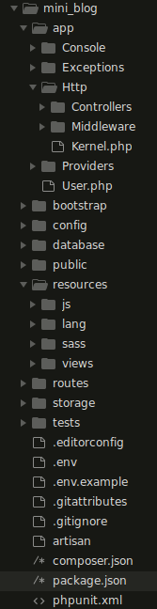
Workshop - Laravel project structure
Models (and Controllers)
Controllers
Default Model for Users
Entry point of our application
Views
Environment variables of our application
artisan , php script really useful … believe me

Slide 33
Workshop - Initial configuration
First, edit/create your .env file, and set the environmental variables related with the execution of our application.
Special attention to this variables:
APP_NAME=miniblog
DB_CONNECTION=mysql
DB_HOST=127.0.0.1
DB_PORT=3306
DB_DATABASE=miniblog
DB_USERNAME=YourDbUserHere
DB_PASSWORD=PasswordForDbUserHere

Slide 34
Workshop - Create your database
Create a database called miniblog, and … why this name?
Because that is what we declared in the .env file.
If you want to have a different name, don’t forget to change the .env file too.

Slide 35
Workshop - First run
Execute the following command in a terminal, located at our project path.
php artisan serve
This will launch a development web server for our application
LIVE CODE

Slide 36
Workshop - Data definition
In Laravel, the data abstraction is achieved by using Models and Migrations
Migrations:
PHP Classes
Define the structure of a data resource at a lower level than a Model (db tables, collections, etc)
We are not force to use them, but used in a proper way, they really help you ;)

Slide 37
Workshop - Definicion de DB
DB Tables for our application
Posts
id
title
body
created_at
updated_at
Comments
id
message
post_id *
created_at
updated_at
1
N
“1 Post can have N Comments // A Comment belongs to only 1 Post”
… Let’s define the migrations for this structures!

Slide 38
Workshop - Migrations creation
To create a migration file, execute the following command in your terminal:
php artisan make:migration <migration_name>
LIVE CODE

Slide 39
Workshop - Models definition
The models of our application
For every DB table, we will create a model representing them.
Post representing the Posts table in our database
Comment representing the Comments table in our database
… Let’s define some models!

Slide 40
Workshop - Models creation
To create a model file, execute the following command in your terminal:
php artisan make:model <name>
LIVE CODE

Slide 41
Workshop - Routes - Navigation Setup
Analyse the static/regular templates again, and let’s define the routes/url’s needed in our Laravel project to bring this static project to life.
Once defined, write them. Routes have to be written in file routes/web.php
Check them using your development web server (php artisan serve)
Check the Templates and … LIVE CODE

Slide 42
Workshop - Views (regular) → Views (Blade)
A not so practical example of HTML files
LIVE CODE

Slide 43
Workshop - Views (regular) → Views (Blade)
Example: Templates as get could get it from an online store
LIVE CODE

Slide 44
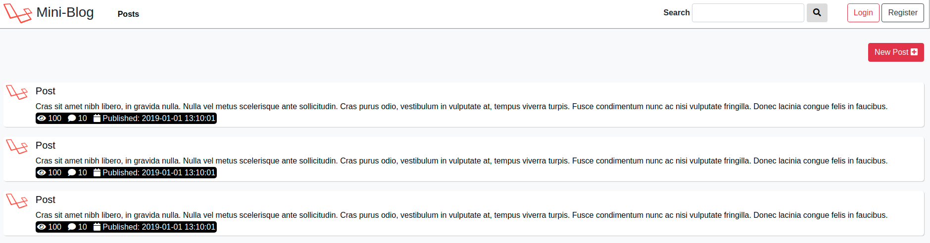
Workshop - Actual structure of the templates
Same header on all views

Slide 45
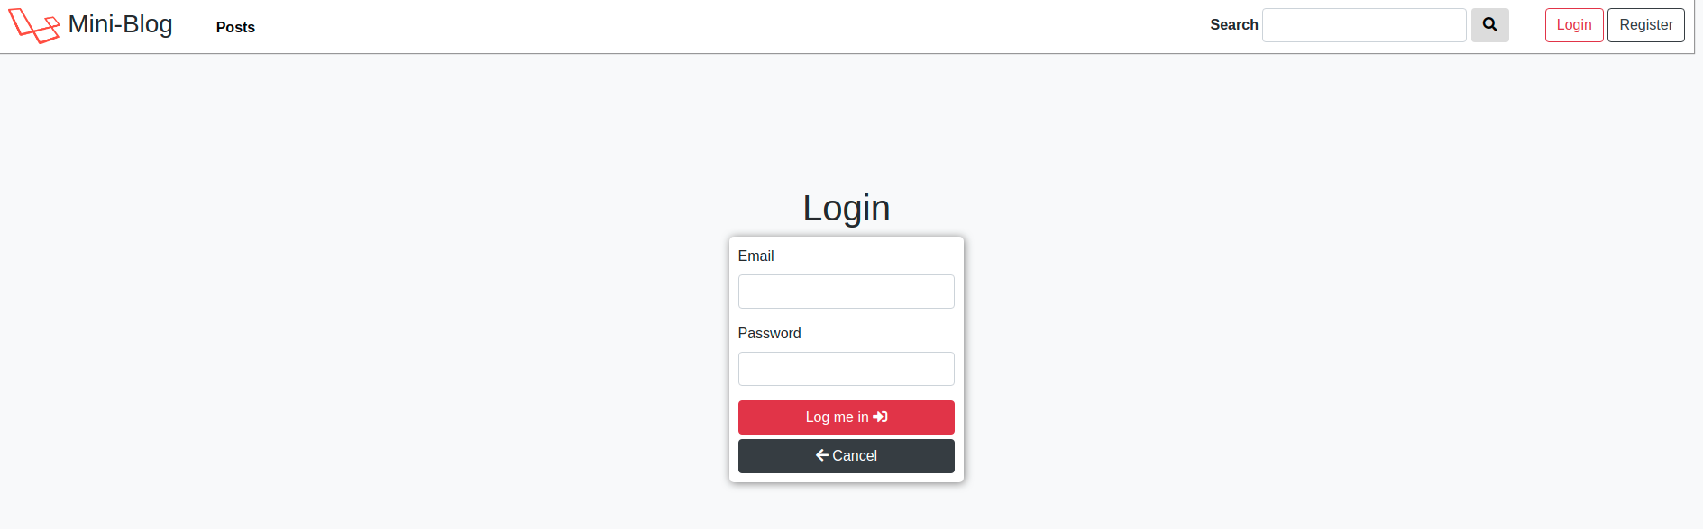
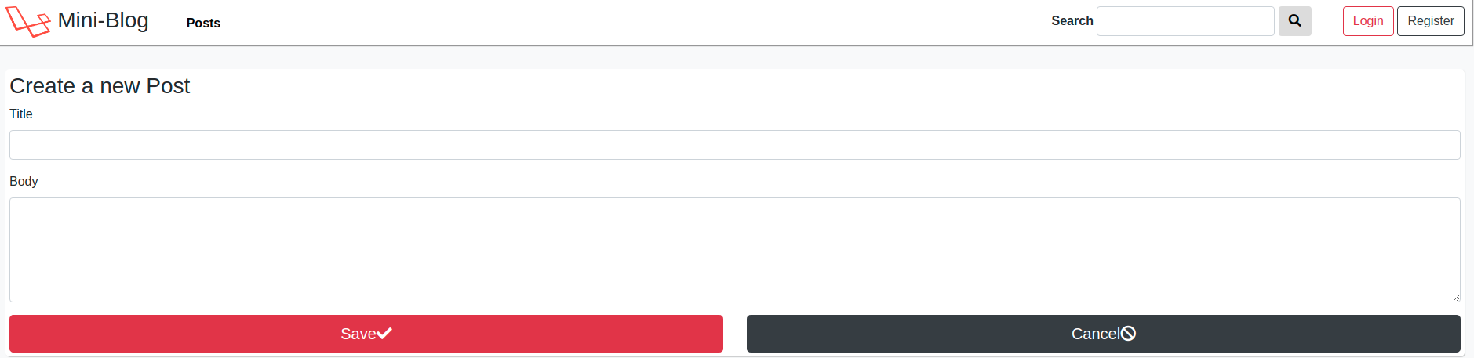
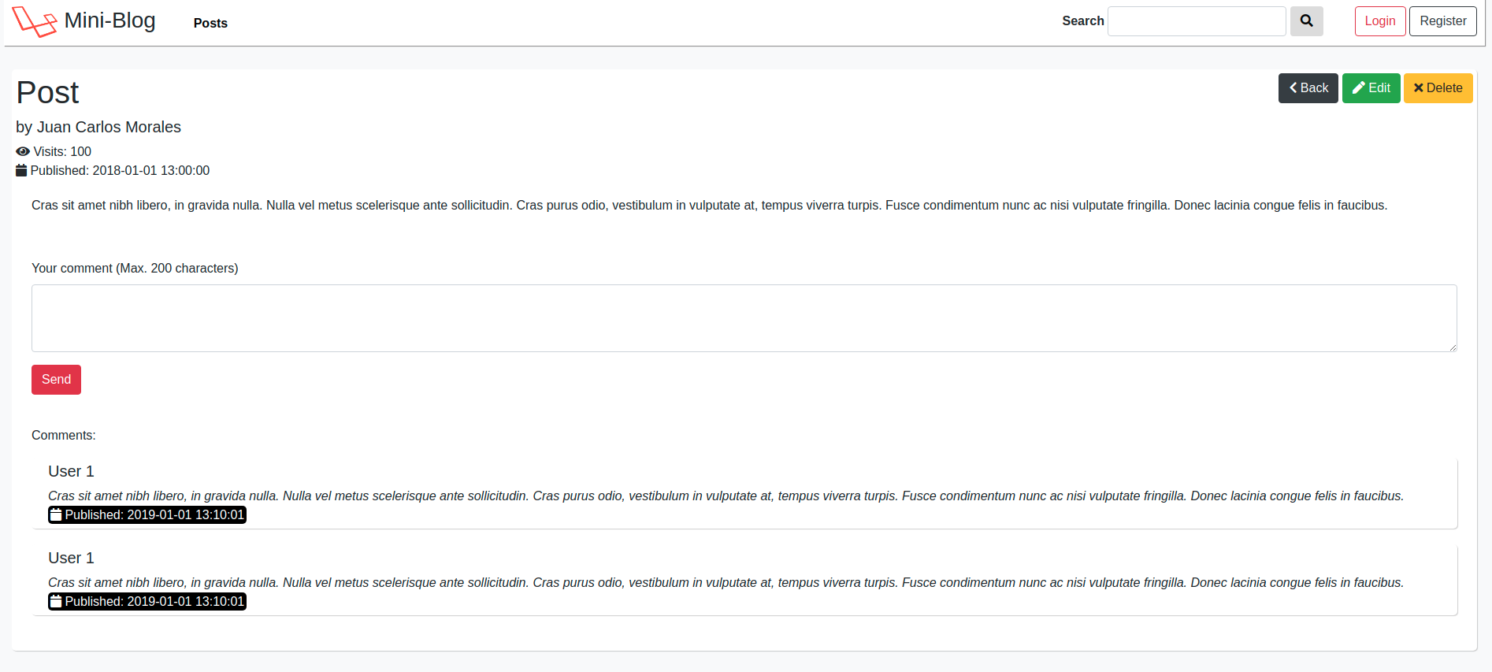
Workshop - Actual structure of the templates
This is telling us something, let’s check the code!
LIVE CODE

Slide 46
Workshop - Actual code structure of the templates
Login
Register
Main
Etc.
CSS
CSS
CSS
CSS
Header
Header
Header
Header
Content
Content
Content
Content
Javascript
Javascript
Javascript
Javascript

Slide 47
Workshop - Actual code structure of the templates
Problem:
Repeated code in all our views
Solution:
Structure our views using Blade

Slide 48
Workshop - Views (regular) → Views (Blade)
New structure
Master Template
CSS
Login
include(CSS)
Register
Access by URL
Header
include(Header)
Posts
Def(Content)
extend
Create
Update
Javascript
include(Javascript)
Etc

Slide 49
Workshop - Views (regular) → Views (Blade)
Let’s structure our code in the Laravel way (Blade):
in 3 … 2 … 1
LIVE CODE

Slide 50
Workshop - Routes and initial Controllers
Our templates are showing us the different sections and functionalities of our application, so now let’s create the URL Routes and Controllers needed to access them.

Slide 51
Workshop - Routes and initial Controllers
URLs Routes:
File: <path_to_project>/routes/web.php
Create the Controllers executing:
php artisan make:controller <name>
LIVE CODE

Slide 52
Workshop - Controllers and Views in detail
At this point we can navigate through our application, now let’s complete the job of creating the controllers and views remaining left.
LIVE CODE

Slide 53
Workshop - Users and Authentication
Laravel provides an authentication system that uses sessions and cookies.
You are not forced to use this of course.
So let’s use this, to provide our application authentication capabilities.
LIVE CODE

Slide 54
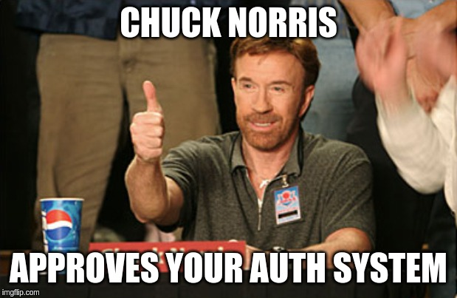

Slide 55
Workshop - Laravel
Questions ?

Slide 56
Workshop - Laravel
Thanks very very much!

