Slide 1
OLX PowerPoint template
Version 1.5
Buenos Aires, March 2014

Slide 2
Template tips!
TIPS FOR USING THIS TEMPLATE
Open the ‘OLX PowerPoint template’ file (which you just did!)
Save this file as ‘your presentation’ (e.g. 130920_Marketing update)
Build your presentation (apply standard slides etc.)
Take out all of the following example slides that you did not use
Save your file.. DONE!
Good luck and have fun!

Slide 3
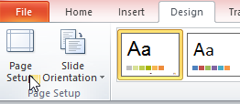
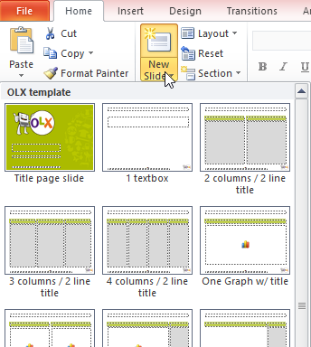
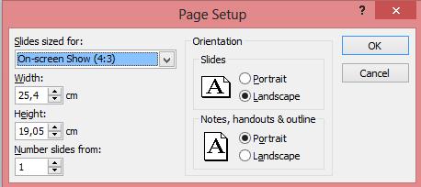
Standard slides: ‘Title’ or tagline from a slide is always ‘Arial (Body)’, 24 pnt, bold and max 2 lines!
NOTE: standard page format is “4:3”
The most common format for slides in the world
This template contains 15 standard slides, use ‘new slide’ (or Ctrl + M) and select the right format

Slide 4
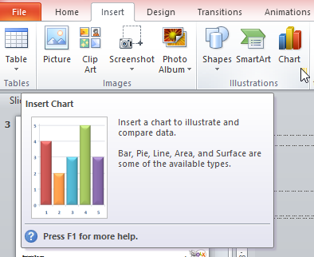
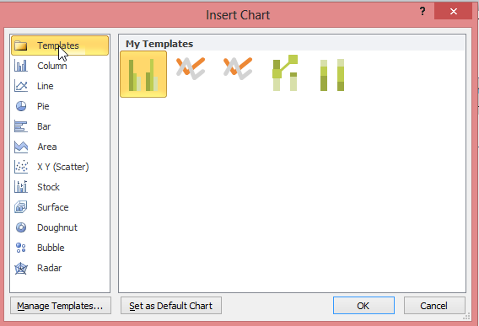
Standard graphs
Template contains 5 standard formats
PowerPoint does not allow for standardizing other graphs.
NOTE: Also you can use the examples that are shown below

Slide 5
Standard elements
Yellow stickers could be used for extra attention
These green header boxes have standard formatting (14 pnt, Arial, not bold, max 2 lines)
Bulleted text and comment boxes
Inserted elements are light grey, black text, 14 pnt, Arial (body)
Example bulleted text
Level 1 (14 pnt)
Level 2 (12 pnt)
You can change boxes in multiple colors like…
Default comment box is light grey, 14 pnt, Arial (body) with Square corners
Green….
….And dark green
Of course, You can change boxes in multiple colors if useful

Slide 6
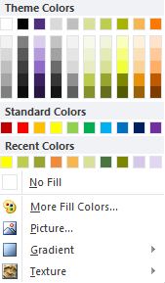
Standard ‘theme colors’
These colors are standard ‘theme colors’ in your PowerPoint template
Below are the standard OLX colors with
Their ‘RGB codes’
R:79 G:45 B:127
R:168 G:180 B:0
R:255 G:121 B:0

Slide 7
Standard figures
WIP
EXAMPLE
TEMPLATE
ESTIMATE
CONCEPTUAL
PRELIMINARY
HYPOTHETICAL
FOR DISCUSSION
INTERNAL USE ONLY

Slide 8





















Standard OLX ID elements 1-2
High resolution logo’s can be requested @ Bs As. design department
Contact: Cintia.skako@olx.com

Slide 9




















































Standard OLX ID elements 1-2
High resolution icons can be requested from Bs As. design department
Contact: Cintia.skako@olx.com

Slide 10
Example slides

Slide 11
A good structure for building your story/presentation is using Situation/ Complication/ Solution
Situation
Describe the situation
Complication
Describe the complication
Question/ Solution
Describe the question

Slide 12
3 phase
Phase 1 Mapping
Phase 2 Action strategy toolkit
Phase 3
Implementation
1
2
3
1.5 months
3 months
TBD
July – Mid Aug.
Aug – Dec.
N/A
Situation
No leading position in market, sub-optimal adoption of mobile
Actions
Free: Gain traction as fast as possible: push the new mobile platform
No ads: keep users happy and returning with a best in class user experience
Situation
On par in reach with leading parties like X and Y
Actions
Keep mobile traction: Offer best content, user experience for free
Start testing advertising models: Include mobile in proposition and open new doors for sales team, sell premium rich ads for fixed price and video post/mid-rolls
Situation
Leading position in the XYZ market
Actions
Ramp up monetization: Roll out paid apps or premium in-app features, preferably subscription model
Think, test, evaluate: unique and or valuable content is needed to succeed

Slide 13
4 phase
Phase 1 Mapping
Phase 2 Action strategy toolkit
Phase 3 Action strategy toolkit
Phase 4
Implementation
1
2
3
4

Slide 14
EXAMPLE: A way to structure the mapping would be to define a couple of central themes as framework
Value chain
What players are in our value chain and how do they move?
What is the influence of social media and group buying on the value chain?
How to tackle the channel conflict?
…
CRM
How can we get to know our customers better?
What is our current state regarding CRM?
What opportunities are there in CRM?
…
Technology
What technology trends shape our business (e.g. mobile shopping, apps)?
What is our current technology state?
How flexible are we in terms of technology in the future?
…
Online knowledge and skills
How much online knowledge do we have at the moment?
How can we secure our online knowledge in the future?
At what strategic level is online in our organization?
…

Slide 15
Actions with costs slide
Product definition
Two mobile hybrid apps
Organization
Sales
Marketing
Actions
Further define product, I
Make full briefing for developer
Develop-ment of web app in HTML5, including design
Develop-ment of hybrid apps for Apple and Android based on web app
Mobile content creation: multiple clip lengths, trending topics, etc.
Keeping up with mobile
Sales training
Create new sales proposition
Activation activities
Additional marketing of mobile platforms

Slide 16
You do not reach the end state in a go, it is rather a phased approach
Free – no ads
Start advertising
Paid apps/features
1
2
3
Gain traction with a best in class platform
Leverage the reach to cross sell to current advertisers
Leverage your key position in the market
Situation
No leading position in market, sub-optimal adoption of mobile
Actions
Free: Gain traction as fast as possible: push the new mobile platform
No ads: keep users happy and returning with a best in class user experience
Situation
On par in reach with leading parties like Telegraaf and Nu
Actions
Keep mobile traction: Offer best content, user experience for free
Start testing advertising models: include mobile in proposition and open new doors for sales team, sell premium rich ads for fixed price and video post/mid-rolls
Situation
Leading position in the
Actions
Ramp up monetization: Roll out paid apps or premium in-app features, preferably subscription model
Think, test, evaluate: unique and or valuable content is needed to succeed

Slide 17
Based on experience, XYZ has designed a four step approach to get you from good to great with in 6 weeks
High level analysis
Detailed analysis per stream
Optimisation direction
Wrap up
1
2
3
4
Actions:
Analysis of key metrics: Revenue differentiation, conversions, visits, page views, etc.
Benchmarks with competitors and foreign online markets
Front end analysis: user experience, proposition and brand
Value chain analysis
Expected result:
Identified possibilities and created focus based on insights gained from analyses
Actions:
Data analysis of important revenue streams
Research interesting competitors
Analysis of the front end of important pages and funnels
Interviews
Expected result:
Detailed insights per revenue stream to base the optimisation themes on
Actions:
Define optimisation opportunities of current revenue streams
Quantify opportunities
Expected result:
Overview of quantified opportunities
Actions:
Overview of all insights and opportunities
Define actionable improvement projects
Create detailed execution direction with mockups
Expected result:
Presentation of overview of the quantified projects with detailed execution direction

Slide 18
The translation from the strategic mapping to an action plan can be done in five steps
Tailor per country
So what?
Working sessions
Prioritize
Wrap up
Detail the high- level insights from phase 1 to individual countries and product ranges
Translate the insights to pragmatic challenges and opportunities for the business that can be tackled
Structured brainstorm towards short -term, med-term and long term actions that tackle the issues at hand
Prioritize the formulated actions by ranking them. Make them actionable by defining timelines and responsibilities and owners
Wrap-up all findings in a strategic action plan/toolkit for each country, that contains clear short term, med term and long term actions

Slide 19
Axis title

Slide 20
Axis title

Slide 21
Axis title
Δ = 100%
Axis title

Slide 22
Combined line and bar graph with conclusion
Title [Unit of measure]
Conclusion
Axis title
Axis title
Axis title

Slide 23
Δ = 99%

Slide 24
Circle
Improving orientation
Experience
…
Driving repeat purchases
Providing after-sales service
Post
Pre
purchase
During
Increasing relative percentage of online sales
…

Slide 25
Concept slide with conclusion
€ (hard conversion)
Xperience (customer journeys)
“Have the highest
Conversion in the
Industry”
“Cater our existing clients and new visitors to their specific needs”
Sweetspot
Elements
CPC
Conversion
CTR
Optimized landing pages
….
Elements
Phase of purchase cycle (inspiration, orientation)
Customer segment
Re- and upsell based on behaviour
Product clusters
….
Add text

Slide 26
Organogram title
Rich and Happy
Rich: increased revenue
Happy: users and advertisers
Insights through reporting
Increased pages displaying Adsense
Improved RPM
Quantitative: Monitor site metrics
Qualitative: surveys
Monitor performance other advertising
Improved CTR
Improved coverage
Improved CPC

Slide 27
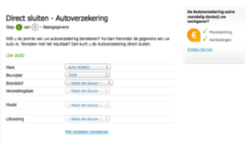
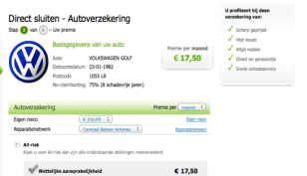
Function ABC is a functionality that can be integrated at the start or end of flow XYZ
Example:
payment flow car insurance
Option 1: pre-purchase in the payment flow
Name & Address
Vehicles
Drivers
Final details
Your rate & Buy
Thank you
Let your shopper share the purchase at the start of the payment flow and give a direct hard discount on the shopping basket
Option 2: post-purchase at the ‘thank you page’
Let your shopper share after the purchase and send a reward (e.g. a gifting voucher)

Slide 28
Questions/ comments/ suggestions
Please send your input to
Jorre.bonjer@olx.com
Your feedback is appreciated!

