Slide 1
8B/10B Coding
64B/66B Coding
Transmission Systems
8B/10B Coding
64B/66B Coding
CIP Demonstrator Test Setup

Slide 2
Transmission system
General
Data
Flip
Flop
D
Q
Clock
C
@ 1 Gbps
= 1 ns
= 20 cm

Slide 3
Transmission system
Propagation Delay
Data
Flip
Flop
D
Q
Clock
C
Unequal propagation delay
10 cm
@ 1 Gbps
?
?
?
?

Slide 4
Transmission system
Clock Data Recovery
Data
Flip
Flop
D
Q
CDR
Clock
PLL
C
Combine Clock and Data!
If there are enough edges
in the data then the clock
can be recovered from
the data using a PLL
PLL

Slide 5
Code Properties
Provide enough edges in the data to enable Clock Recovery

Slide 6
Transmission system
Receiver Threshold
Data
Flip
Flop
D
Q
CDR
Clock
C
Receiver Threshold refers to “Ground” which must be the same potential as “Ground” at the transmitter!
Jitter!

Slide 7
Transmission
Use Differential
signalling!
Data
Flip
Flop
D
Q
CDR
Clock
I_{cm}
C
Receiver Threshold is halfway
positive and negative signal
Common mode voltage difference between transmitter and termination at the receiver can result in excessive currents
Use AC Coupling Capacitors…
Need DC Balance!

Slide 8
DC Balance
1
0
1
0
1
1
0
1
0
1
1
1
1
1
1
1
1
1
?
0
Define a maximum Run Length
Sent equal amount of ‘1’s and ‘0’s (Running Disparity)

Slide 9
Receiver Automatic Gain Control
Gain
Time
Gain
Again: maximum Run Length
Time

Slide 10
Code Properties
Provide enough edges in the data to enable Clock Recovery
Maximum Run Length and DC Balance

Slide 11
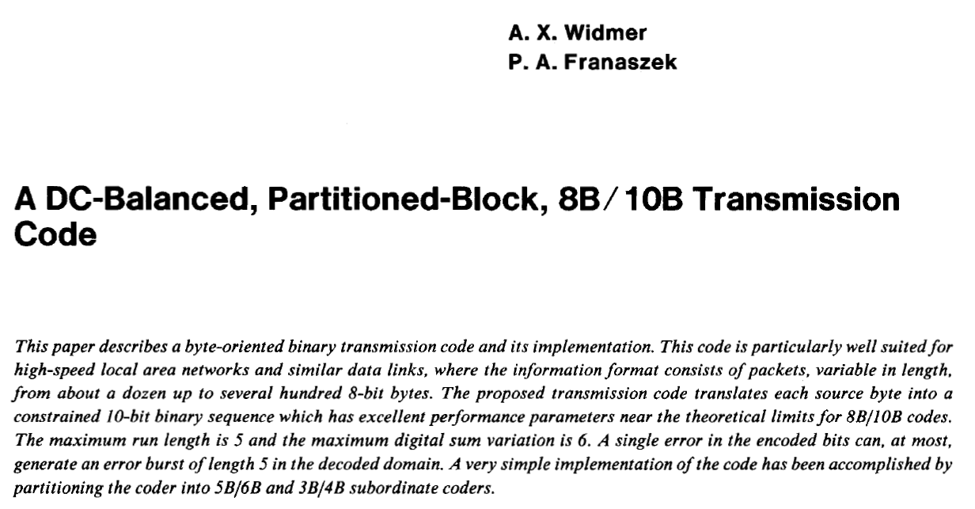
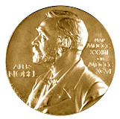
History of 8B/10B coding

Slide 12
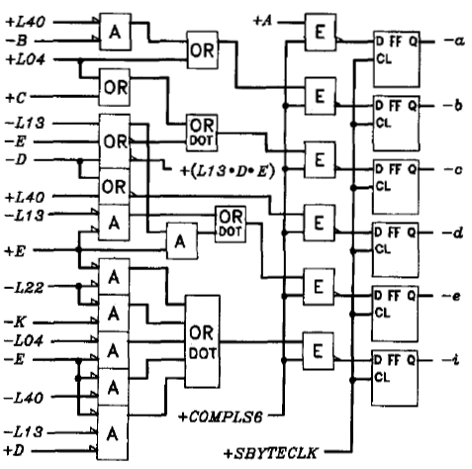
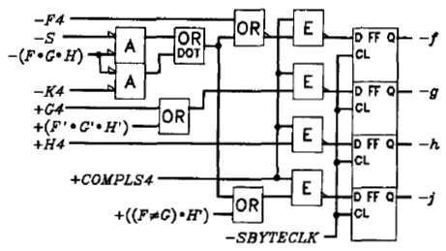
8B/10B coding
Maximum run length = 5
Running Disparity => DC Balance
8 bits => 256 different values
10 bits => 1024 different values
8B10B code is built out of:
    (5 to 6 bit code) + (3 to 4 bit code)

Slide 13
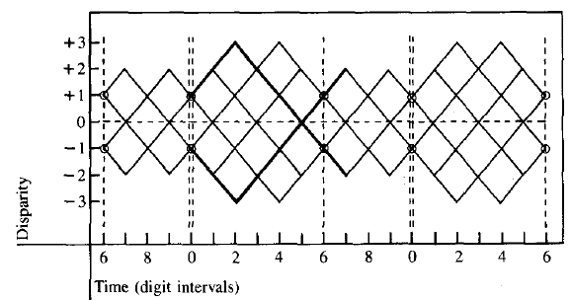
8B/10B coding
Not all 1024 values are useful.
  For example “0100000011” has run length 6
For most of the 256 (8B) values a positive and a negative 10B value is selected depending on the “Current Running Disparity”
  For example:
  D7.0 = 1110001011 (Current RD-)
  D7.0 = 0001110100 (Current RD+)
So about 512 useful values are selected from 1024…
There are still a few codes left!

Slide 14
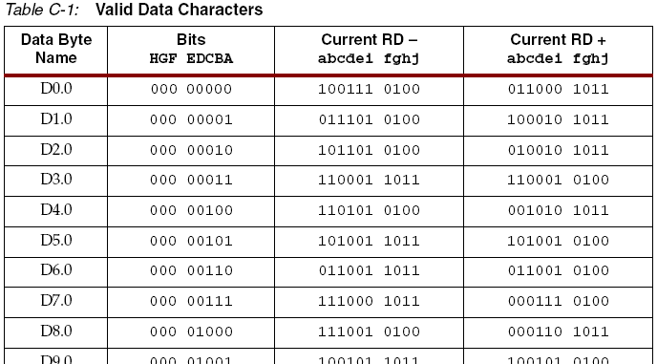
8B/10B coding table
256 “Data” Characters:

Slide 15
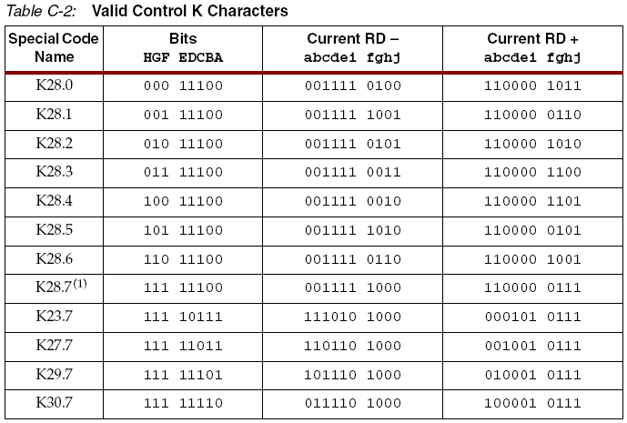
8B/10B coding table
There were still a few codes left!
12 “Special” K Characters:
Comma
Characters
“The only patterns that
have 5 consecutive
‘1’s or ‘0’s

Slide 16
8B/10B code “K” Characters
010101001101100111000001010110111010010100100111010011001001110100111001
010101001101100111000001010110111010010100100111010011001001110100111001
??.?
K28.5
D16.2
D31.3
D11.3
D0.0
Comma characters K28.1/K28.5/K28.7 are used word alignment
Create “ordered sets”
  For example Fibre Channel Start Of Frame (SOF) = K28.5/D21.5/D23.0/D23.0
  K30.7 = Error Propagate
  K28.3 = Carrier Extend

Slide 17
8B/10B code properties
Provide enough edges in the data to enable Clock Recovery
Maximum Run Length and DC Balance
Add special characters
  Comma for word alignment
  Control characters

Slide 18
64B/66B Coding

Slide 19
64B/66B
(IEEE std 802.3ae-2002, Clause 49)
20% of the bandwidth for 8B/10B is overhead
For 64B/66B overhead is 3%
2 bit Sync Header
64 bit (Scrambled)
2 bit Sync Header
00 Code Error
01 64 bit = Data field
10 64 bit = Mixed Data / Control field
11 Code Error
Once every 66 bits there is at least a “01” or a “10” transition => Receiver Block Sync (it may take a while…)

Slide 20
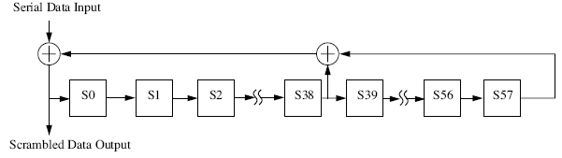
64B/66B Scrambler
Scrambler: X⁵⁸+X³⁹+1
Tries to mix up the data to avoid long sequences of ‘1’s and ‘0’s
Note: there is no guarantee that on a bad day the output of the scrambler produces all ‘0’s or all ‘1’s

Slide 21
64B/66B
2 bit Sync Header
64 bit (Scrambled)
64 bit Data Field (Scrambled)
0
1
D0:8
D1:8
D2:8
D3:8
D4:8
D5:8
D6:8
D7:8
Pure Data
64 bit Mixed Control /Data Field (Scrambled)
1
0
Typ:8
Z0:7
Z1:7
Z2:7
Z3:7
Z4:7
Z5:7
Z6:7
Z7:7
Pure Control (Type = 0x1E)
1
0
Typ:8
7
Z1:7
Z2:7
Z3:7
Z4:7
Z5:7
Z6:7
Z7:7
Mixed Control/Data (Type = 0x87; T₀)
1
0
Typ:8
D0:8
6
Z2:7
Z3:7
Z4:7
Z5:7
Z6:7
Z7:7
Mixed Control/Data (Type = 0x99 ; T₁)
1
0
Typ:8
D0:8
D1:8
5
Z3:7
Z4:7
Z5:7
Z6:7
Z7:7
Mixed Control/Data (Type = 0xaa ; T₂)
1
0
Typ:8
D0:8
D1:8
D2:8
4
Z4:7
Z5:7
Z6:7
Z7:7
Mixed Control/Data (Type = 0xb4 ; T₃)
1
0
Typ:8
D0:8
D1:8
D2:8
D3:8
3
Z5:7
Z6:7
Z7:7
Mixed Control/Data (Type = 0xcc ; T₄)
1
0
Typ:8
D0:8
D1:8
D2:8
D3:8
D4:8
2
Z6:7
Z7:7
Mixed Control/Data (Type = 0xd2 ; T₅)
etc.
Total of 15 Mixed Control /Data Field is defined

Slide 22
64B/66B Example
Transmitting a sequence of 18 bytes could look like:
0x78: S₀ Start
Pure Data Frame
0xB4: T₃ Terminate
Z5
Z6
Z7
1
0
T
D1
D2
D3
D4
D5
D6
D7
0
1
D0
D1
D2
D3
D4
D5
D6
D7
1
0
T
D0
D1
D2
Z4
Z5
Z6
Z7

Slide 23
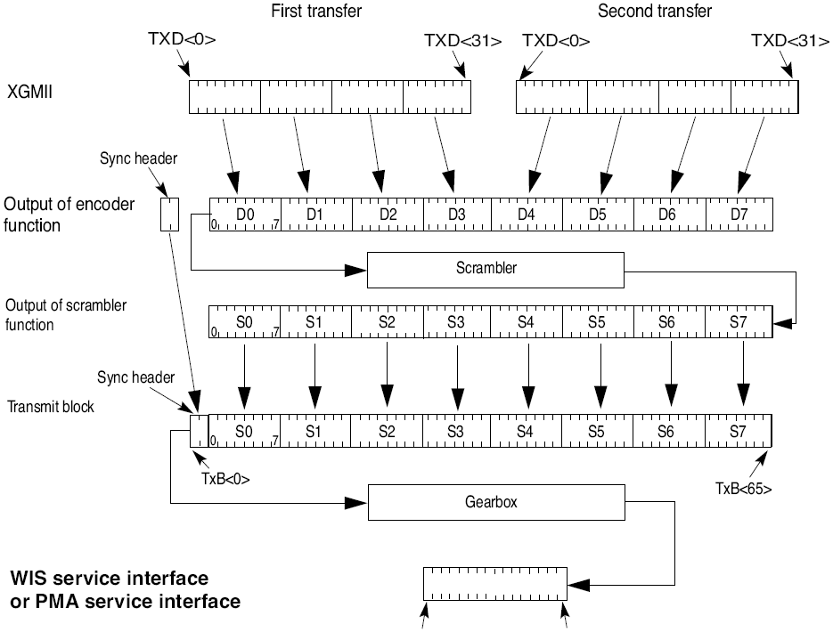
64B/66B Physical Coding Sub layer (PCS) Transmit bit ordering
Gearbox
Adapts between (4x16=) 64 bit width and
66 bit width frames
Tx_Data(0)
Tx_Data(15)

Slide 24
Comparison
 | 8B/10B | 64B/66B
Run Length | 5 | Relies on Scrambler
DC Balance | Excellent | Not guaranteed Demanding for receiver
Bit Synchronization Clock Recovery | Excellent | Relies on Scrambler, but al least one transition per 66 bits
Word Synchronization | "Comma" K-Characters | Sync-Header
Control Characters | K-Characters | Control-Codes

Slide 25
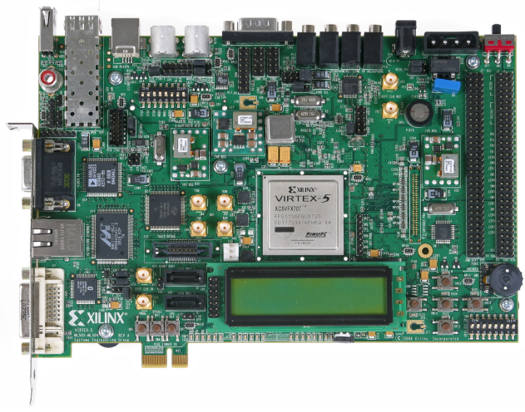
CIP Demonstrator Test Setup
Tx
8B/10B
Encoded
Rx
8B/10B
Encoded
CIP
Test Bed
Delay…?

Slide 26
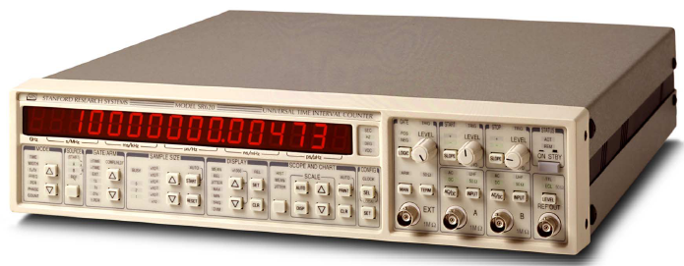
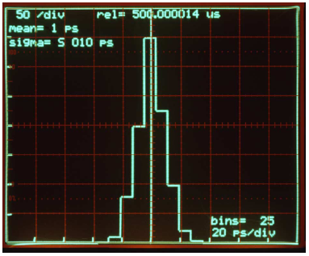
CIP Demonstrator Test Setup
Tx
8B/10B
Encoded
K28.5
D16.2
K23.7
Dx.y
K28.5
D16.2
K28.5
D16.2
K28.5
D16.2
K28.5
D16.2
IDLE
CharExt
IDLE
IDLE
IDLE
IDLE
Start
~ 100 Hz
Stanford Research
Stop
Rx
8B/10B
Encoded
K28.5
D16.2
K28.5
D16.2
K28.5
D16.2
K28.5
D16.2
K23.7
Dx.y
K28.5
D16.2
IDLE
IDLE
IDLE
IDLE
CharExt
IDLE
2 x 10 Km fiber ~ 100 us
2 x 100 Km fiber ~ 1 ms

Slide 27
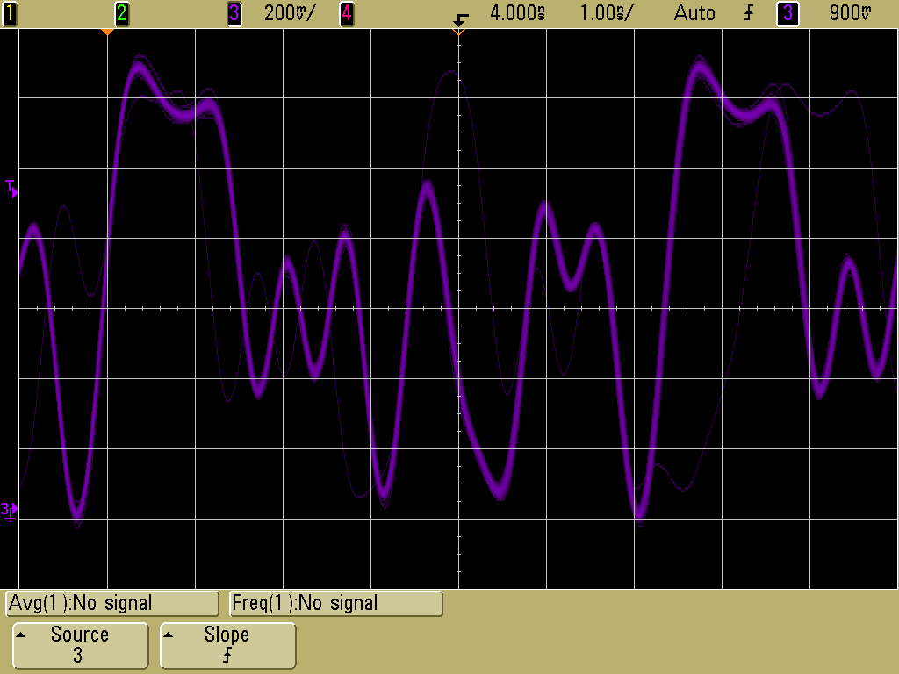
First Results
Tx
8B/10B
Encoded
Rx
8B/10B
Encoded
1 ns/div
10 bits = 3.2 ns
00111110101001000101
3.125 Gbps Measured
With a 1.5 GHz active probe (Agilent 1156A)
K28.5
D16.2

Slide 28
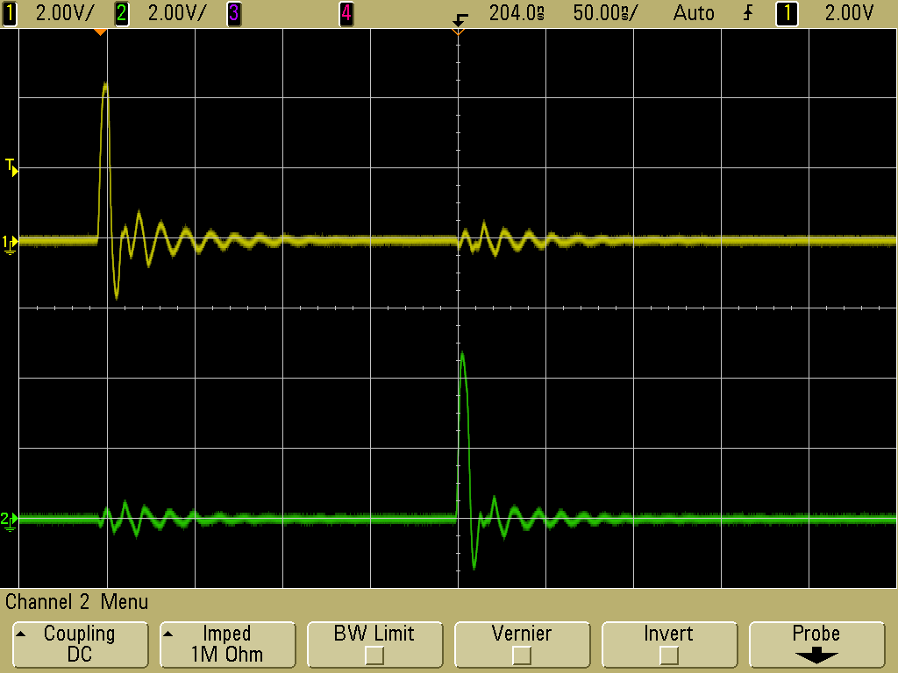
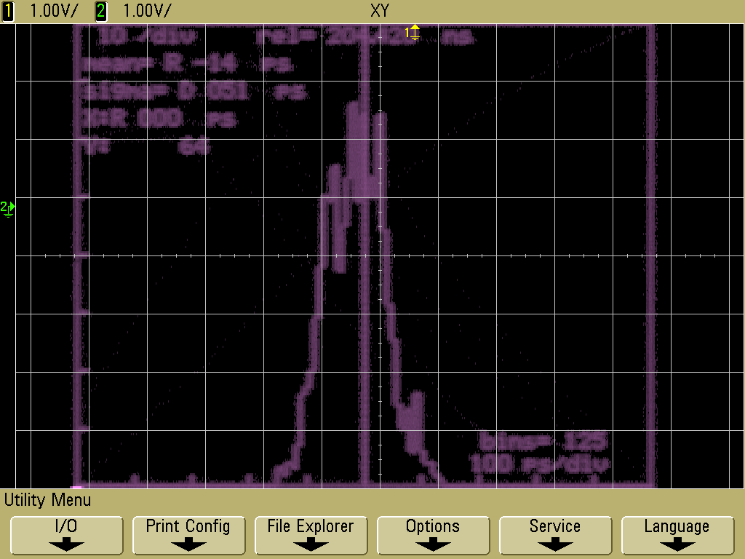
First Results
Start
Tx
8B/10B
Encoded
Rx
8B/10B
Encoded
Stop
Mean: 204.420 ps
Jitter: ~ 50 ps

