Slide 1
Data Analysis
Electronic Engineering
Final assignment
Team: Waveform Warriors
Juanith Mathew Thomas
Kornel Lengl
Notes:
.

Slide 2
Electronic Engineering
Table of contents
Introduction
Data preprocessing
Discussion
Probability Analysis
Law of large numbers
Central limit theorem
Actual vs. Predicted sales
PCA
t-SNE
UMAP
Chi-square test
Notes:
.

Slide 3
Introduction
Electronic Engineering
We analyzed Rossmann Store Sales found on Kaggle: link
The dataset has:
1115 stores
750-980 rows for each store.
Each row consists of Sales, Promotions, Customers, etc.
Store | DayOfWeek | Date | Sales | Customers | Open | Promo | StateHoliday | SchoolHoliday
1 | 5 | 31/07/2015 | 5263 | 555 | 1 | 1 | 0 | 1
2 | 5 | 31/07/2015 | 6064 | 625 | 1 | 1 | 0 | 1
3 | 5 | 31/07/2015 | 8314 | 821 | 1 | 1 | 0 | 1
Dataset shape: 1,017,209 x 9

Slide 4
Data preprocessing
Electronic Engineering
Extracted: 406,974 rows
Null values: 0 cells
Duplicates: 0 rows
No sale days: 69,050 (removed)
Outliers: 11,167 (not removed)
Features engineered: “IsWeekend”
Dataset shape: 337,924 x 10

Slide 5
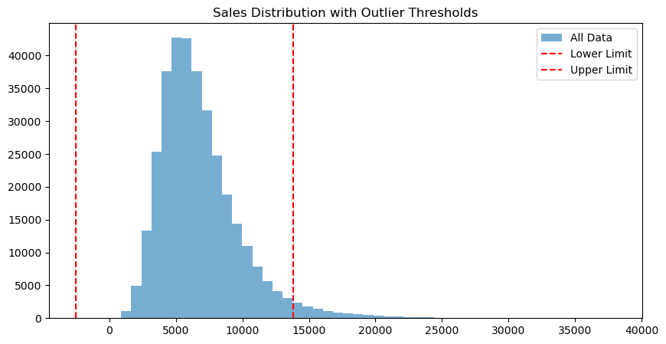
Outliers
Electronic Engineering

Slide 6
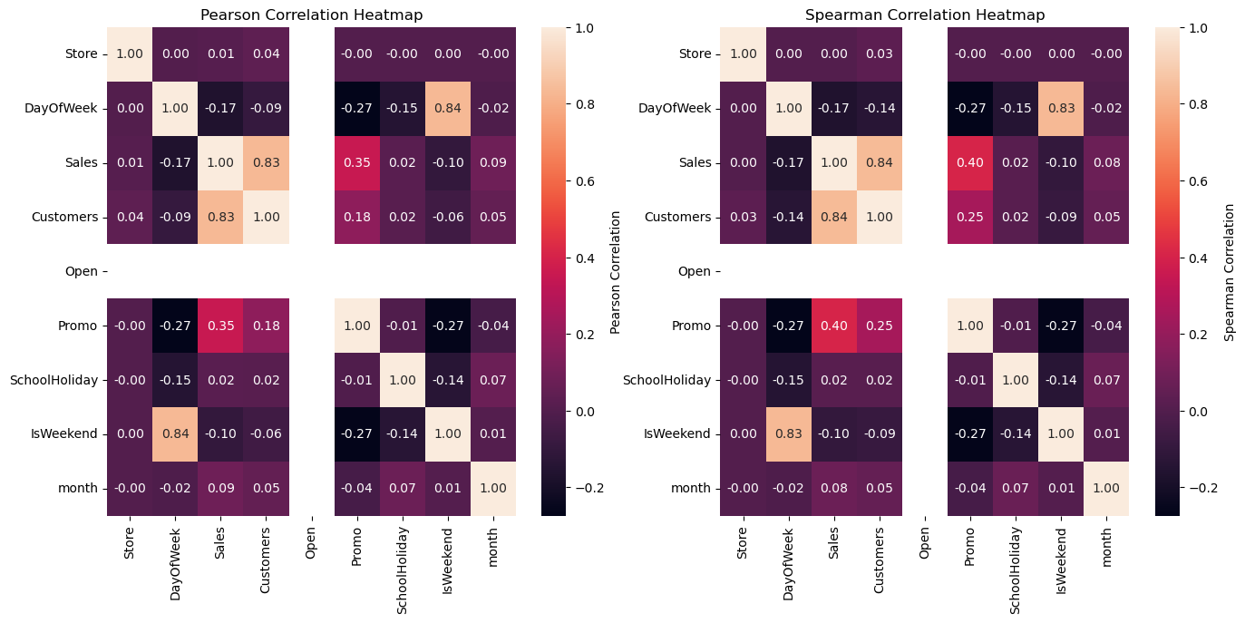
Electronic Engineering
Notes:
SPI has 4 connections: MISO, MOSI, CLK, CS
Module had to provide a CLK (Mode 0), assert the CS (active low), read the serial data on the MISO and forward it in parallel
CLK divided to 10MHz which is the max value for the SPI CLK according to the datasheet of the ADC
Implement a counter for timing
- counts from 0 to 17 and resets - 4x leading 0s - 12 bit data - 2 clk cycles CS deasserted - reset

Slide 7
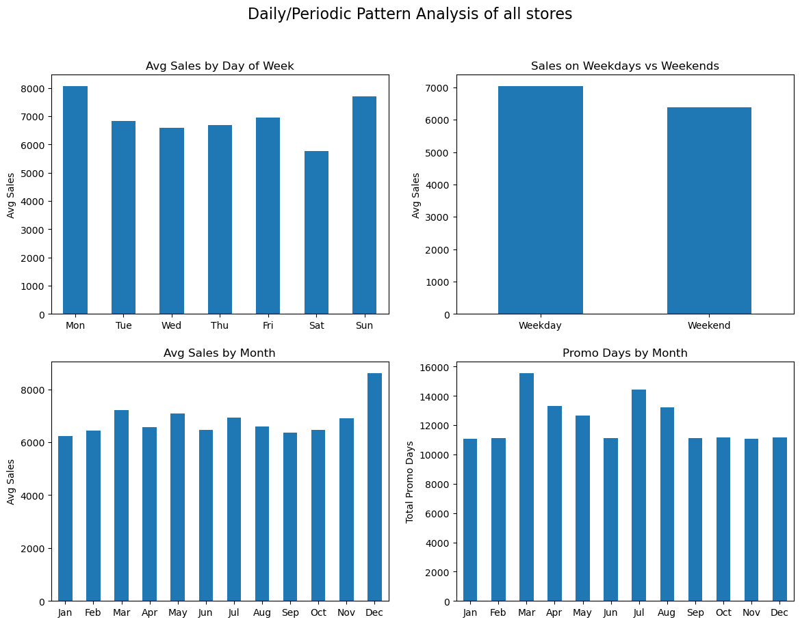
Electronic Engineering

Slide 8
Probability analysis
Electronic Engineering
P(HighSales | Promo=1): 18.03 %
P(HighSales | Promo=0): 3.87 %
IsWeekend | 0 | 1
Promo
0 | 54.97 | 45.03
1 | 80.45 | 19.55
P(LowSales | Promo=1): 0.82 %
P(LowSales | Promo=0): 17.42 %
Notes:
SPI has 4 connections: MISO, MOSI, CLK, CS
Module had to provide a CLK (Mode 0), assert the CS (active low), read the serial data on the MISO and forward it in parallel
CLK divided to 10MHz which is the max value for the SPI CLK according to the datasheet of the ADC
Implement a counter for timing
- counts from 0 to 17 and resets - 4x leading 0s - 12 bit data - 2 clk cycles CS deasserted - reset

Slide 9
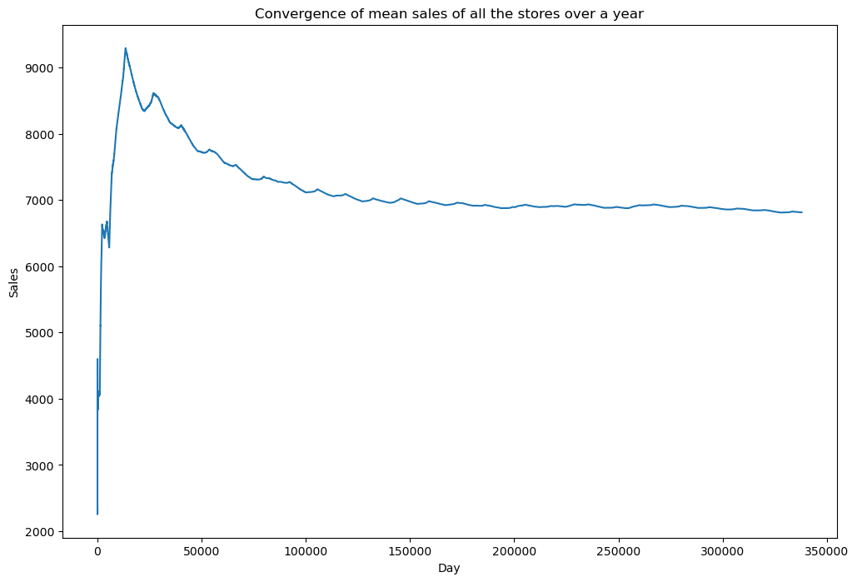
Law of Large Numbers
Electronic Engineering

Slide 10
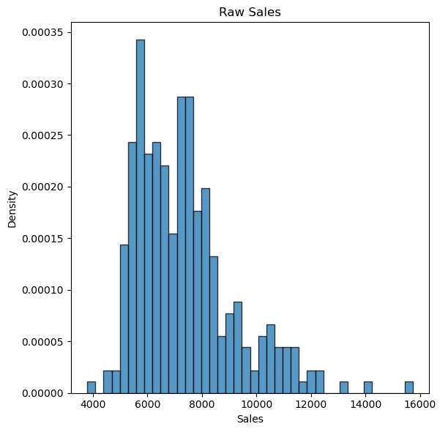
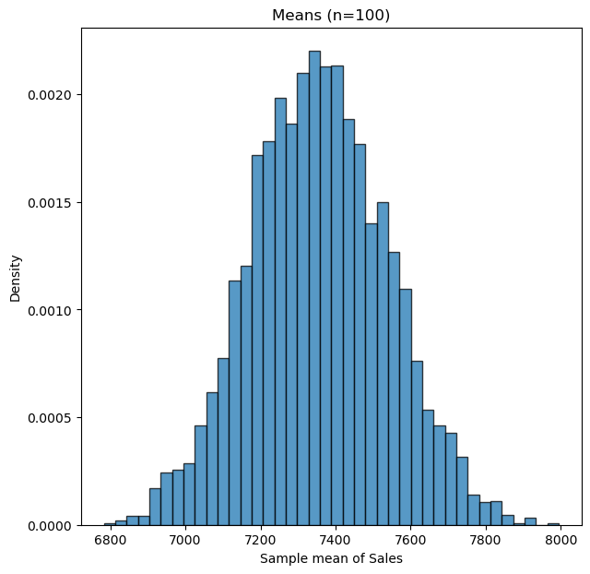
Central Limit Theorem
Electronic Engineering

Slide 11
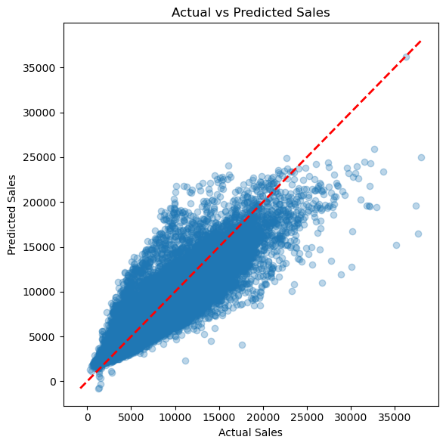
Actual vs. Predicted sales
Electronic Engineering
Mean sales: 6814.95
Root mean square error (polynomial-2 linear regression): 1497.67 (21.97%)
Inaccuracy is likely due to:
1. Calendar patterns
2. Sufficiency problems
3. Varying promotions
R²: 0.77
MAE: 1076.48
Reference notebooks were searched and algorithms such as Random Forest, XGBoost show accuracy reaching ~90% instead of ~83% here.

Slide 12
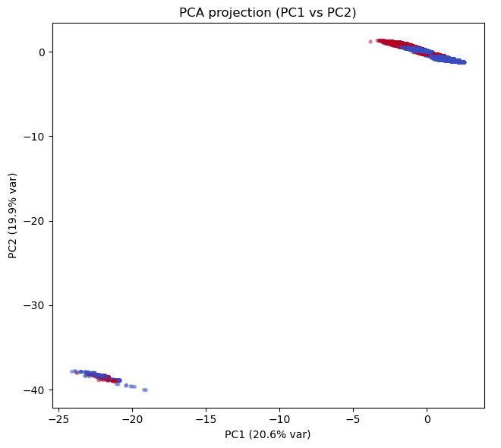

PCA
Electronic Engineering
Explained variance
ratio:
PC1: 20.618%
PC2: 19.853%
PC3: 10.908%

Slide 13
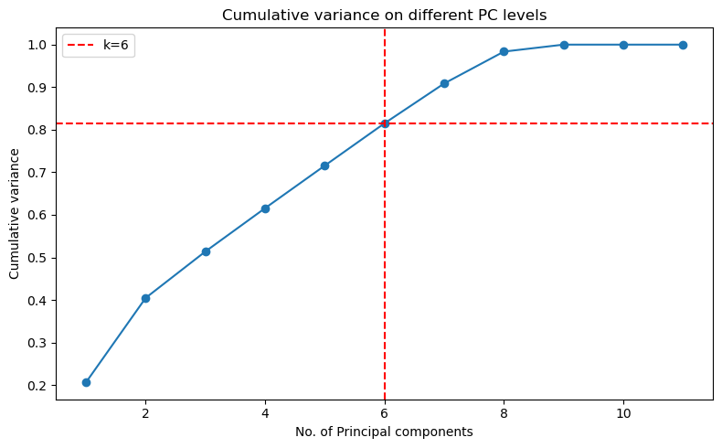
PCA
Electronic Engineering
Cumulative variance:
k=2: 40.47%
k=3: 51.38%
k for 80%: 6
k for 90%: 7

Slide 14
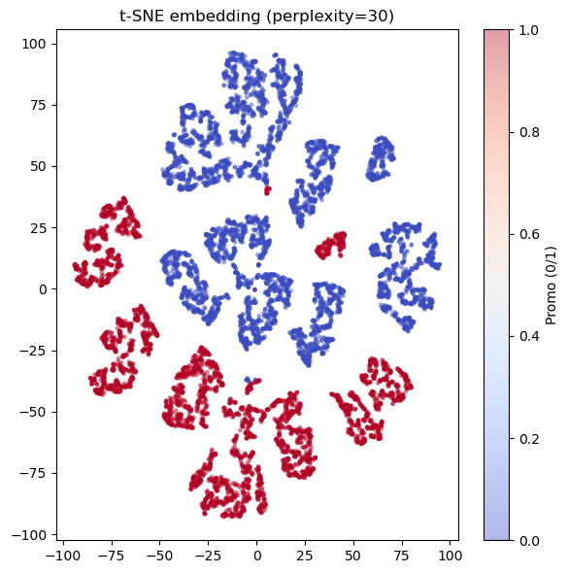
t-SNE
Electronic Engineering
- Since we see that Promo regions are different from non-promo regions, there's a fundamental difference between the two.

Slide 15
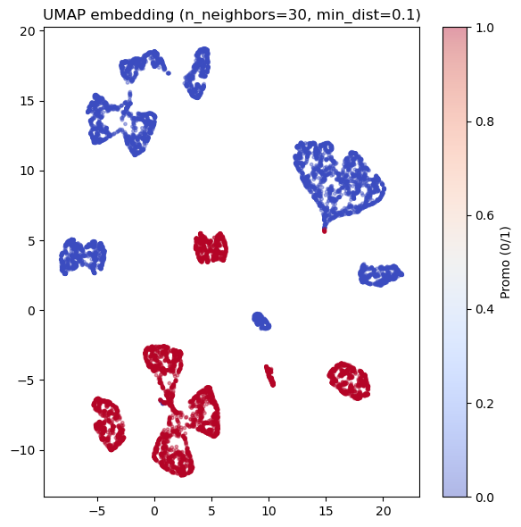
UMAP
Electronic Engineering
- We observe the local neighborhoods being preserved.

Slide 16
Chi-square test
Electronic Engineering
Null Hypothesis: The events “IsWeekend” and “Promo” are independent.
Results for the test:
chi2=24192.940
dof=1
p-value=0
Hypothesis rejected, explanation:
Chances of Promo happening on a weekend: 20%.
Chances of Promo happening on a weekday: 45%.
IsWeekend | 0 | 1
Promo
0 | 104492 | 86444
1 | 118060 | 28928

Slide 17
Questions?
Electronic Engineering

