Slide 1
First layer of code: Reading inputs and defining retrieval procedure
NEMESIS Python classes
Variables
Atmosphere
Measurement
NEMESIS Python classes
Stellar
Optimal Estimation
Input files
Surface
Nested sampling
Spectroscopy
Scatter
CIA
Output files
Layer

Slide 2
Atmosphere
Parameters and attributes
Atmosphere.IPLANET : Planet ID number
Atmosphere.NVMR : Number of gases in reference atmosphere
Atmosphere.ID(NVMR) : Radtran ID of each gas
Atmosphere.ISO(NVMR) : Radtran Isotopologue ID of each gas
Atmosphere.AMFORM: Flag indicating how the molecular weight has to be computed
………………………………………………………….
Methods
Atmosphere.read_ref() : Reads .ref file to fill the parameters and attributes of this class
Atmosphere.calc_grav() : Based on the Planet ID, it calculates the gravity field at each altitude
Atmosphere.calc_molwt() : Based on AMFORM, it calculates the molecular weight at each altitude
Atmosphere.hydrostatP() and Atmosphere.hydrostatH() : Recomputes altitudes or pressure levels based on hydrostatic equilibrium
Atmosphere.adjust_VMR() : If needed, it re-scales the VMR of each gas for all of them to add up to 1.0

Slide 3
Scatter
Parameters and attributes
Atmosphere.ISCAT : Flat indicating what type of scattering calculation is required
Atmosphere.IRAY : Flag indicating the type of calculation for Rayleigh scattering
Atmosphere.IMIE : Flag indicating whether to use Atmosphere.PHASE or Atmosphere.G1 and G2
Atmosphere.NDUST: Number of aerosol populations
Atmosphere.KEXT: Extinction cross section (cm2)
………………………………………………………….
Methods
Scatter.read_xsc() : Reads .xsc file to fill the parameters and attributes of this class
Scatter.write_xsc() : Write .xsc file
Scatter.calc_tau_dust(WAVEC,Layer) : Calculates the vertical opacity of each dust in each layer
Scatter.calc_tau_rayleighj(WAVEC,Layer) : Calculates the vertical opacity of Rayleigh scattering for giant planets

Slide 4
Third layer of code: Generating a forward model
Variables
Variables
Calc_path()
Atmosphere
Atmosphere
Split atmosphere into layers and calculate parameters for each layer (stored in Layer).
Calculate atmospheric paths and set keywords
(stored in Path).
Measurement
Measurement
Stellar
subprofretg()
Stellar
Surface
Model 1
Model 2
Model 3
……………
Surface
Layer
Path
Spectroscopy
Spectroscopy
Scatter
Scatter
CIRSrad
CIA
CIA
Layer
Layer
subspecret()
Model 1
Model 2
Model 3
……………
Convolution
Measurement vector

Slide 5
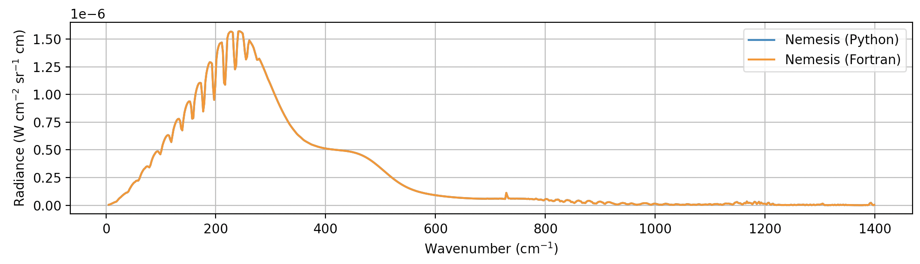
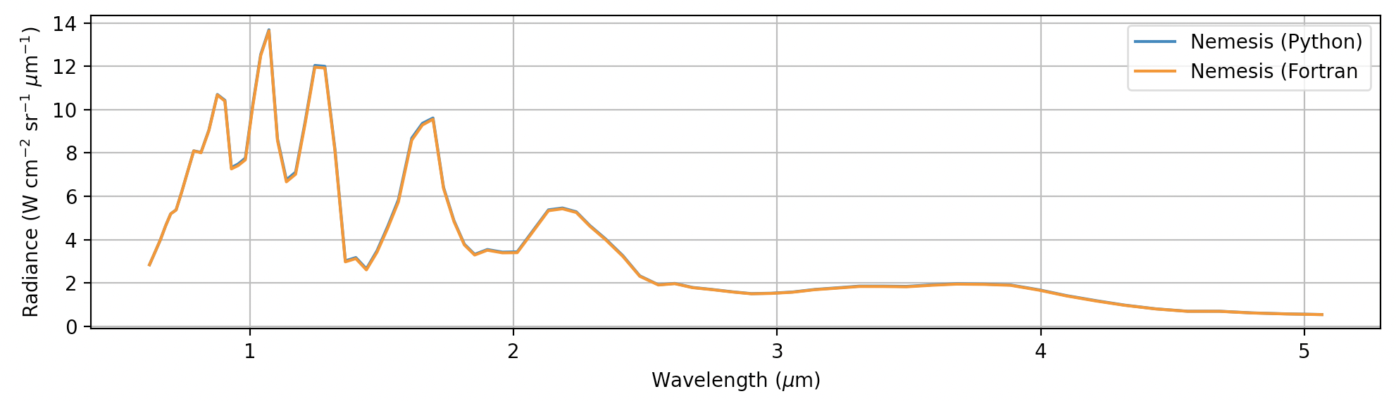
Validation
Classic Jupiter test (correlated-K)
Exoplanet emission with correlated-K defined in irregular grid (delv<0)

Slide 6
Things to discuss
Re-shaping the format of the input files? One file per Python class with little or no overlapping.
Example .inp file (but same for .set and others):
ISPACE
Measurement Class
ISCAT
Scatter Class
ILBL
Spectroscopy Class
NITER
Optimal Estimation Class
What next?
Include more surface parameters and parameterisations:
Surface.NMINERALS
Surface.EMISSIVITY(NWAVE,NMINERALS)
Will allow using Nemesis for surface studies too.
Remove atmosphere?
UV retrievals:
Why not using .lta tables as in the infrared? I created a write_lta() function.
Appears to work for O3 UV forward models in solar occultation.
Include flags to include only certain things: ICIA, ISUR, IATM…
Best way to make it public? We can create a Python package that can be installed anywhere using:
pip install Nemesis

Slide 7
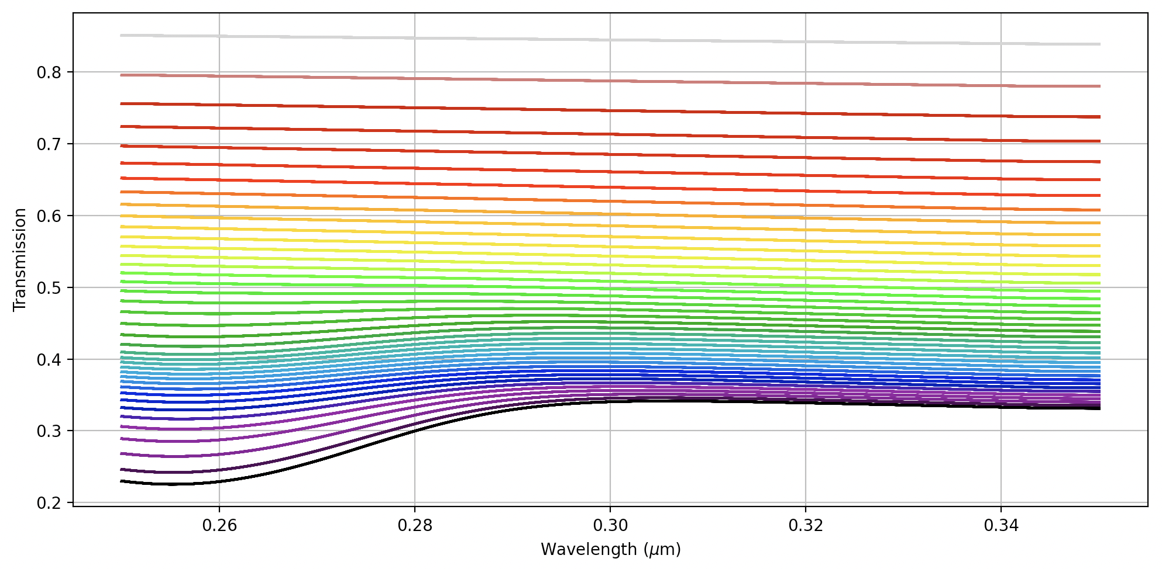
Nemesis for UV
NOMAD UV retrievals in solar occultation

