Slide 1
SGSSI
Criptografía Aplicada
2024/2025
LSI Saila
Juanan Pereira <juanan.pereira@ehu.es>

Slide 2
Criptología
CRIPTOGRAFÍA
+
CRIPTOANÁLISIS

Slide 3
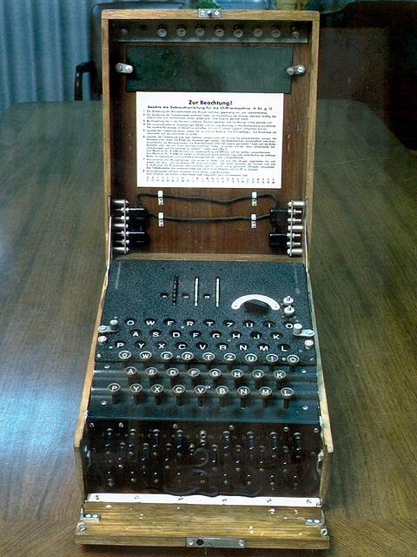
CRIPTOGRAFÍA
Objetivos
  Confidencialidad (cifrado)
  Integridad (el mensaje no ha sido alterado)
  Autenticación (Identificar a la persona que
  ha enviado el mensaje)

Slide 4
CRIPTOGRAFÍA
Historia
  Criptografía pre-científica: ... - 1948
  Criptografía científica: 1948 - 1976
  Criptografía de clave pública: 1976 - ...

Slide 5

CRIPTOGRAFÍA
1948
1945
"A Mathematical Theory of Cryptography”

Slide 6
1. Definición
CRIPTOGRAFÍA
Diseñar y analizar algoritmos para proteger la información y las comunicaciones.
Notes:
Mysql datubasean 100MBeko
“INSERT INTO ...” aginduez osatutako fitxategi
bat inportatu nahi dugu.
Mysql < fitxategia.sql
Egiterakoan, inportatzen du, baina 20 minutu
ematen ditu hori egiten. 5-10 minututan
Berreskuratzeko gai izan beharko ginateke. Zer
Egingo zenuke?
Zertan datza LVM (Logical Volume Management)
biltegiratze kudeaketa?
Zeintzuk dira LVM sistemaren abantailak?
Demagun Mysql datubasea LVM erabiltzen duen
Ext3 fitxategi-sistema bolumen logiko baten gainean
dagoela instalatuta. Bolumenaren edukiera betetzen
Ari da (%80an dago) eta handitu nahiko genuke. Zer
egin dezakegu?

Slide 7
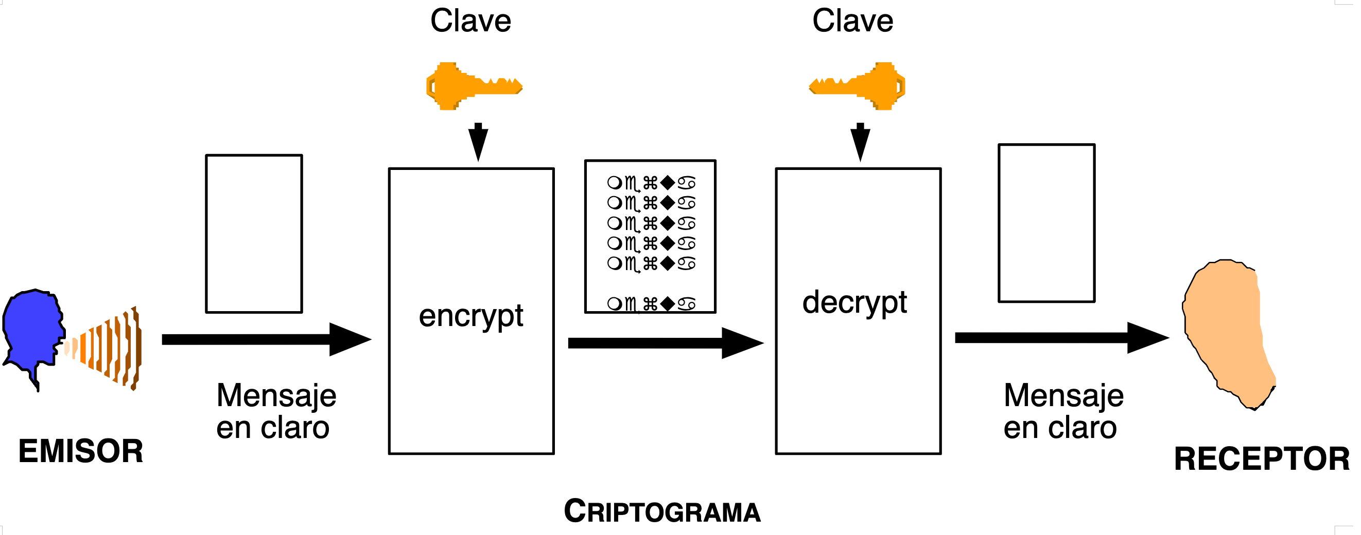
Criptosistema

Slide 8
Criptografía
Objetivos:
  El mensaje debe ser indescifrable (salvo para receptor)
  La información cifrada debe ser recuperable (por el receptor)
  Implementación lo más sencilla y rápida posible
Reversible
Notes:
Note: Different implementations of backup systems frequently use specialized or conflicting definitions of these terms. The most relevant characteristic of a type of incremental backup is which reference point is it using to check for changes. By a common definition, a differential backup copies files that have been created or changed since the last full backup, regardless of whether any other backups have been since then and an incremental backup refers only to a backup that includes just the changes made since the most recent backup of any type. Other variations include multi-level incrementals and incremental backups that compare parts of files instead of just the whole file.
http://en.wikipedia.org/wiki/Backup

Slide 9
Bases de la criptografía
Técnicas básicas de cifrado:
  Transposición:
    (Permutation cipher)
  Sustitución (Substitution Cipher)
    César
    Sustitución por diccionaro
    Vigenère
Notes:
Note: Different implementations of backup systems frequently use specialized or conflicting definitions of these terms. The most relevant characteristic of a type of incremental backup is which reference point is it using to check for changes. By a common definition, a differential backup copies files that have been created or changed since the last full backup, regardless of whether any other backups have been since then and an incremental backup refers only to a backup that includes just the changes made since the most recent backup of any type. Other variations include multi-level incrementals and incremental backups that compare parts of files instead of just the whole file.
http://en.wikipedia.org/wiki/Backup

Slide 10
Transposición
(permutation cipher)
Mensaje a cifrar
EJEMPLO DE CIFRADO POR PERMUTACION
¿Cómo lo ciframos?

Slide 11
Cifrado por transposición
Mensaje original:
'EJEMPLO DE CIFRADO POR PERMUTACION'
Clave: 3142 (Length: 4)

Slide 12
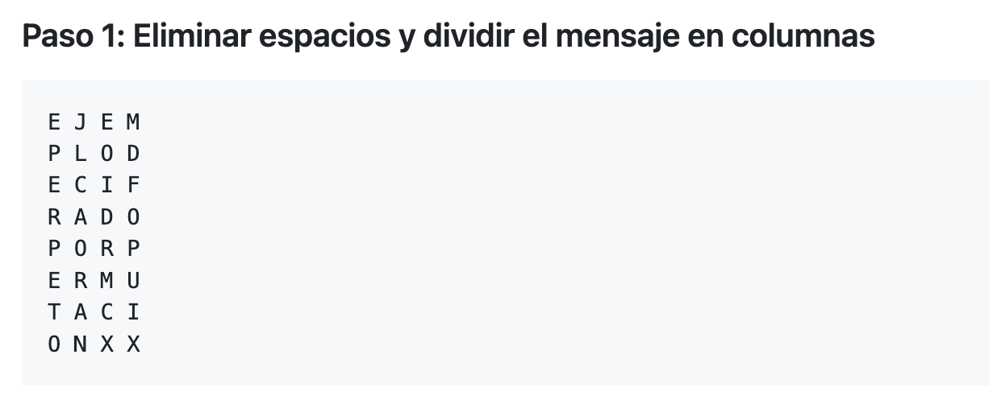
padding

Slide 13
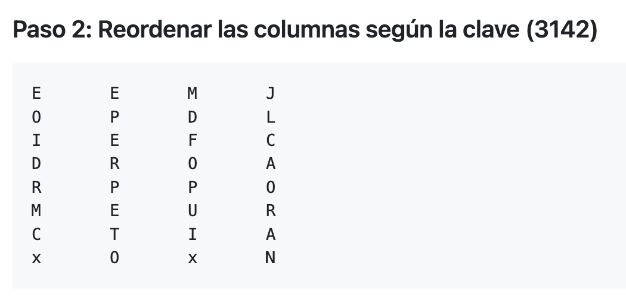
Algoritmo de cifrado por transposición (v1)

Slide 14


Slide 15
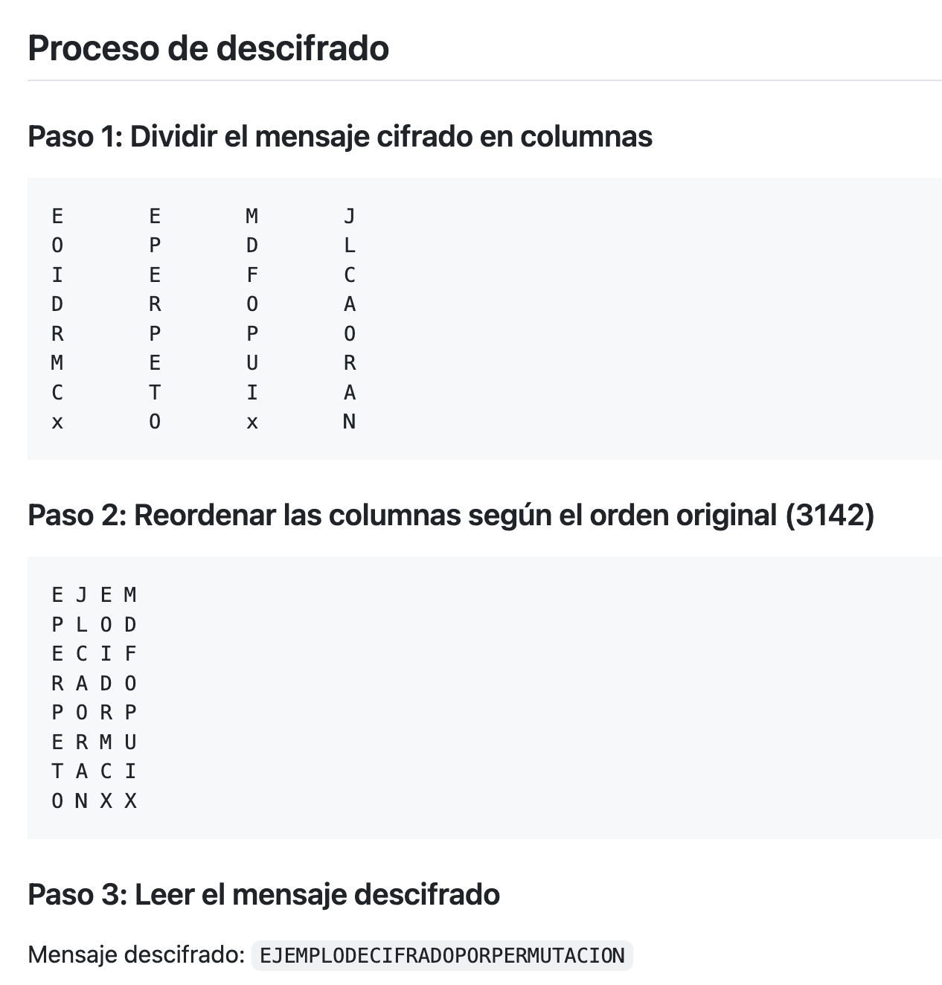

Slide 16
Cifrado por transposición
Algoritmo de cifrado por transposición (v2)
https://crypto.interactive-maths.com/columnar-transposition-cipher.html

Slide 17
Cifrado por sustitución
Cifrado César
(sustitución monoalfabética)
Mensaje en claro:
La bisagra que rechina es la que consigue el aceite
Desplazamiento: +3 (A --> D; 0 --> 3)
ABCDEFGHIJKLMNOPQRSTUVWXYZ
DEFGHIJKLMNOPQRSTUVWXYZABC
Notes:
Note: Different implementations of backup systems frequently use specialized or conflicting definitions of these terms. The most relevant characteristic of a type of incremental backup is which reference point is it using to check for changes. By a common definition, a differential backup copies files that have been created or changed since the last full backup, regardless of whether any other backups have been since then and an incremental backup refers only to a backup that includes just the changes made since the most recent backup of any type. Other variations include multi-level incrementals and incremental backups that compare parts of files instead of just the whole file.
http://en.wikipedia.org/wiki/Backup

Slide 18
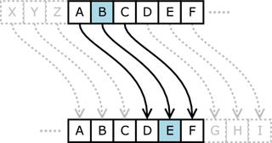
Cifrado por sustitución
Cifrado César (sustitución monoalfabética)
ABCDEFGHIJKLMNOPQRSTUVWXYZ
DEFGHIJKLMNOPQRSTUVWXYZABC
La bisagra que rechina es la que consigue el aceite
CIFRAR
Desplazamiento: 3
Od elvdjud txh uhfklqd hv od txh frqvljxh ho dfhlwh
Notes:
Note: Different implementations of backup systems frequently use specialized or conflicting definitions of these terms. The most relevant characteristic of a type of incremental backup is which reference point is it using to check for changes. By a common definition, a differential backup copies files that have been created or changed since the last full backup, regardless of whether any other backups have been since then and an incremental backup refers only to a backup that includes just the changes made since the most recent backup of any type. Other variations include multi-level incrementals and incremental backups that compare parts of files instead of just the whole file.
http://en.wikipedia.org/wiki/Backup

Slide 19
Rompiendo el cifrado César
(Asumiendo que NO sabemos el desplazamiento utilizado)
Notes:
Note: Different implementations of backup systems frequently use specialized or conflicting definitions of these terms. The most relevant characteristic of a type of incremental backup is which reference point is it using to check for changes. By a common definition, a differential backup copies files that have been created or changed since the last full backup, regardless of whether any other backups have been since then and an incremental backup refers only to a backup that includes just the changes made since the most recent backup of any type. Other variations include multi-level incrementals and incremental backups that compare parts of files instead of just the whole file.
http://en.wikipedia.org/wiki/Backup

Slide 20
Cracking César
(Fuerza bruta)
Key #0: Od elvdjud txh uhfklqd hv od txh frqvljxh ho dfhlwh
Key #1: Nc dkucitc swg tgejkpc gu nc swg eqpukiwg gn cegkvg
Key #2: Mb cjtbhsb rvf sfdijob ft mb rvf dpotjhvf fm bdfjuf
Key #3: La bisagra que rechina es la que consigue el aceite
Key #4: Kz ahrzfqz ptd qdbghmz dr kz ptd bnmrhftd dk zbdhsd
Key #5: Jy zgqyepy osc pcafgly cq jy osc amlqgesc cj yacgrc
Key #6: Ix yfpxdox nrb obzefkx bp ix nrb zlkpfdrb bi xzbfqb
Key #7: Hw xeowcnw mqa naydejw ao hw mqa ykjoecqa ah wyaepa
Key #8: Gv wdnvbmv lpz mzxcdiv zn gv lpz xjindbpz zg vxzdoz
Key #9: Fu vcmualu koy lywbchu ym fu koy wihmcaoy yf uwycny
Key #10: Et ubltzkt jnx kxvabgt xl et jnx vhglbznx xe tvxbmx
Key #11: Ds taksyjs imw jwuzafs wk ds imw ugfkaymw wd suwalw
Key #12: Cr szjrxir hlv ivtyzer vj cr hlv tfejzxlv vc rtvzkv
Key #13: Bq ryiqwhq gku husxydq ui bq gku sediywku ub qsuyju
Key #14: Ap qxhpvgp fjt gtrwxcp th ap fjt rdchxvjt ta prtxit
Key #15: Zo pwgoufo eis fsqvwbo sg zo eis qcbgwuis sz oqswhs
Key #16: Yn ovfnten dhr erpuvan rf yn dhr pbafvthr ry nprvgr
Key #17: Xm nuemsdm cgq dqotuzm qe xm cgq oazeusgq qx moqufq
Key #18: Wl mtdlrcl bfp cpnstyl pd wl bfp nzydtrfp pw lnptep
Key #19: Vk lsckqbk aeo bomrsxk oc vk aeo myxcsqeo ov kmosdo
Key #20: Uj krbjpaj zdn anlqrwj nb uj zdn lxwbrpdn nu jlnrcn
Key #21: Ti jqaiozi ycm zmkpqvi ma ti ycm kwvaqocm mt ikmqbm
Key #22: Sh ipzhnyh xbl yljopuh lz sh xbl jvuzpnbl ls hjlpal
Key #23: Rg hoygmxg wak xkinotg ky rg wak iutyomak kr gikozk
Key #24: Qf gnxflwf vzj wjhmnsf jx qf vzj htsxnlzj jq fhjnyj
Key #25: Pe fmwekve uyi viglmre iw pe uyi gsrwmkyi ip egimxi
Notes:
Note: Different implementations of backup systems frequently use specialized or conflicting definitions of these terms. The most relevant characteristic of a type of incremental backup is which reference point is it using to check for changes. By a common definition, a differential backup copies files that have been created or changed since the last full backup, regardless of whether any other backups have been since then and an incremental backup refers only to a backup that includes just the changes made since the most recent backup of any type. Other variations include multi-level incrementals and incremental backups that compare parts of files instead of just the whole file.
http://en.wikipedia.org/wiki/Backup

Slide 21
Sustitución por diccionario
Diccionario de sustitución:
ABCDEFGHIJKLMNOPQRSTUVWXYZ
ZXCVBNMASDFGHJKLQWERTYUIOP
La bisagra que rechina es la que consigue el aceite
CIFRAR
(Usando el diccionario de sustitución)
Gz xsezmwz qtb wbcasjz be gz qtb ckjesmtb bg zcbsrb
Sustitución monoalfabética
Notes:
Note: Different implementations of backup systems frequently use specialized or conflicting definitions of these terms. The most relevant characteristic of a type of incremental backup is which reference point is it using to check for changes. By a common definition, a differential backup copies files that have been created or changed since the last full backup, regardless of whether any other backups have been since then and an incremental backup refers only to a backup that includes just the changes made since the most recent backup of any type. Other variations include multi-level incrementals and incremental backups that compare parts of files instead of just the whole file.
http://en.wikipedia.org/wiki/Backup

Slide 22
Criptoanálisis
Técnicas para descifrar criptogramas sin tener los componentes secretos del sistema criptográfico
Notes:
Note: Different implementations of backup systems frequently use specialized or conflicting definitions of these terms. The most relevant characteristic of a type of incremental backup is which reference point is it using to check for changes. By a common definition, a differential backup copies files that have been created or changed since the last full backup, regardless of whether any other backups have been since then and an incremental backup refers only to a backup that includes just the changes made since the most recent backup of any type. Other variations include multi-level incrementals and incremental backups that compare parts of files instead of just the whole file.
http://en.wikipedia.org/wiki/Backup

Slide 23

Cracking de algoritmo de sustitución monoalfabético (criptonálisis)
Criptograma:
BAR BS GUR SRNGHERF BS GUR PNRFNE PVCURE BE INEVNGVBAF BS VG GUNG ZNXRF VG RNFVYL PBZCEBZVFRQ VF GUNG RNPU PUNENPGRE AB ZNGGRE UBJ ZNAL CBFVGVBAF VG VF FUVSGRQ VF PBAFVFGRAGYL ERCERFRAGRQ OL GUR FNZR PBEERFCBAQVAT PUNENPGRE VS GUR PVCUREGRKG PUNENPGRE SBE N VF A GURA VG VF NYJNLF A GUEBHTUBHG GUR RAPELCGRQ ZRFFNTR GUVF ZRNAF GUNG PELCGNANYLFVF PNA HFR PUNENPGRE SERDHRAPL NANYLFVF GB ZNXR THRFFRF NG JUVPU PVCUREGRKG PUNENPGREF PBEERFCBAQ GB JUVPU CYNVAGRKG PUNENPGREF

Slide 24
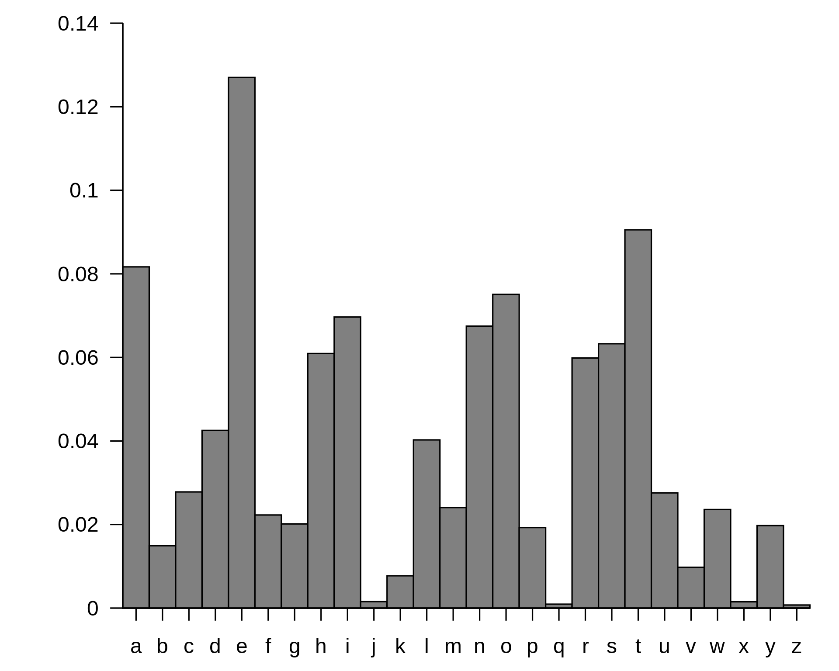
Cracking de algoritmo de sustitución monoalfabético (criptonálisis)
Frecuencia de aparición de letras en inglés:

Slide 25
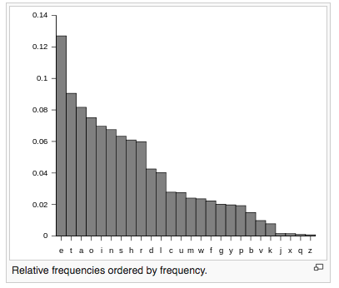
Cracking de algoritmo de sustitución monoalfabético (criptonálisis)
Frecuencia de aparición de letras en inglés:

Slide 26
Cracking de algoritmo de sustitución monoalfabético (criptonálisis)
Criptograma (ciphertext):
BAR BS GUR SRNGHERF BS GUR PNRFNE PVCURE BE INEVNGVBAF BS VG GUNG ZNXRF VG RNFVYL PBZCEBZVFRQ VF GUNG RNPU PUNENPGRE AB ZNGGRE UBJ ZNAL CBFVGVBAF VG VF FUVSGRQ VF PBAFVFGRAGYL ERCERFRAGRQ OL GUR FNZR PBEERFCBAQVAT PUNENPGRE VS GUR PVCUREGRKG PUNENPGRE SBE N VF A GURA VG VF NYJNLF A GUEBHTUBHG GUR RAPELCGRQ ZRFFNTR GUVF ZRNAF GUNG PELCGNANYLFVF PNA HFR PUNENPGRE SERDHRAPL NANYLFVF GB ZNXR THRFFRF NG JUVPU PVCUREGRKG PUNENPGREF PBEERFCBAQ GB JUVPU CYNVAGRKG PUNENPGREF
Caracteres más repetidos en el cripto:
R, G, N, F, E, U,
Caracteres más repetidos en inglés:
E, T, O, A, N

Slide 27
Funciones Hash

Slide 28
Ejemplo práctico
¿Dónde y cómo se gestionan las contraseñas en Linux?
$ sudo cat /etc/shadow
Usando sal (salt), la contraseña no será una palabra que se encuentra en los diccionarios (lo que la hace más robusta)
Además, dos contraseñas iguales, después de aplicar la sal, generarán resúmenes criptográficos diferentes.
test:$6$v/Z3Vau7$ziIipwuJ0C0MA7mSq8y.9dKuCpOlmA2DgHbUs.okDCh
mkSbIwf4krzKnidSn91uJo98wBU2bozCgel25AVe39.:15009:0:99999:7
Jarraitzen duen patroia:
user:$hashalgorithm$salt$H(password || salt):A:B:C:D
A: Cuándo se cambió la contraseña por última vez (1970/01/01+días)
B: Cuántos días deben pasar antes de poder cambiar la contraseña
C: Cuántos días como máximo es válida la contraseña
D: Avisar de caducidad, X días antes de que expire
$hashalgorithm:
1 = MD5
2 = Blowfish
5 = SHA-256
6 = SHA-512
Cómo se generó el hash SHA-512:
https://gist.github.com/juananpe/c648500f0660bcdaedc3fd77489b8b76
epoch time + days converter:
http://www.wolframalpha.com/input/?i=1%2F1%2F1970+%2B+15009+days

