Slide 1
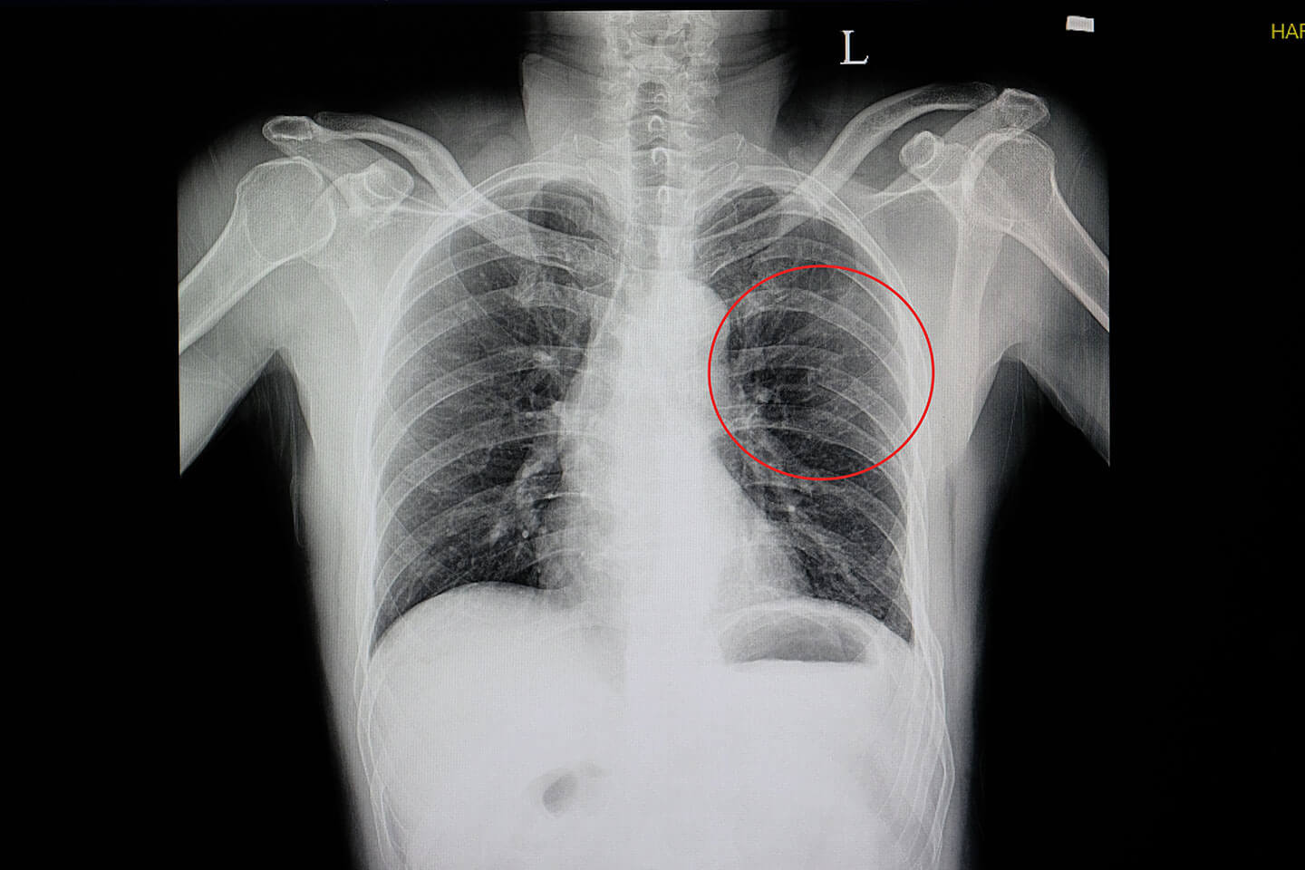
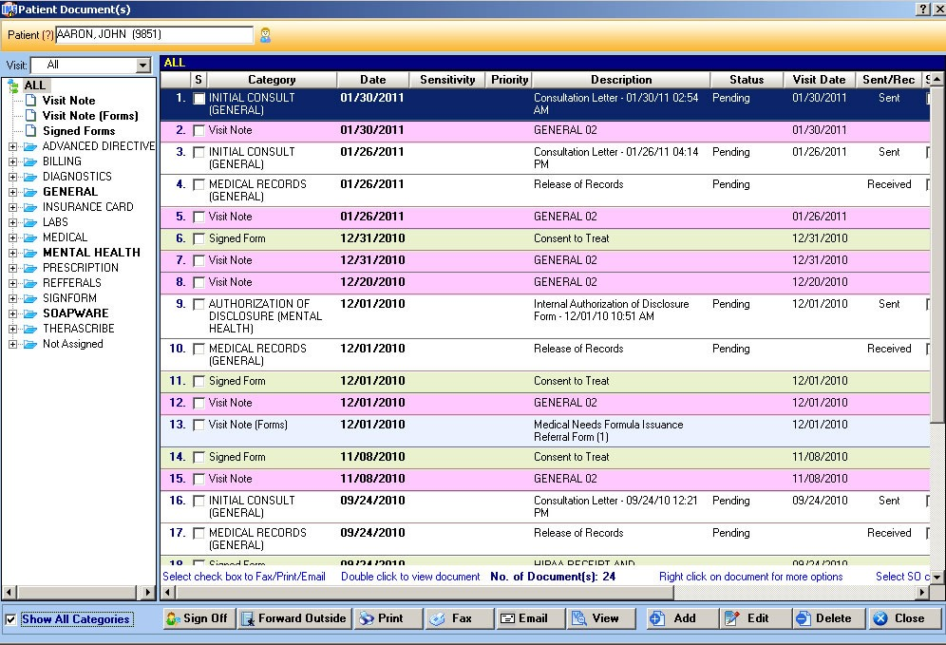
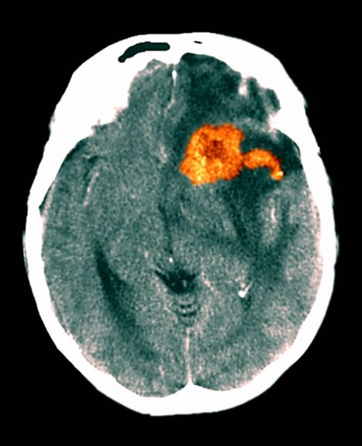
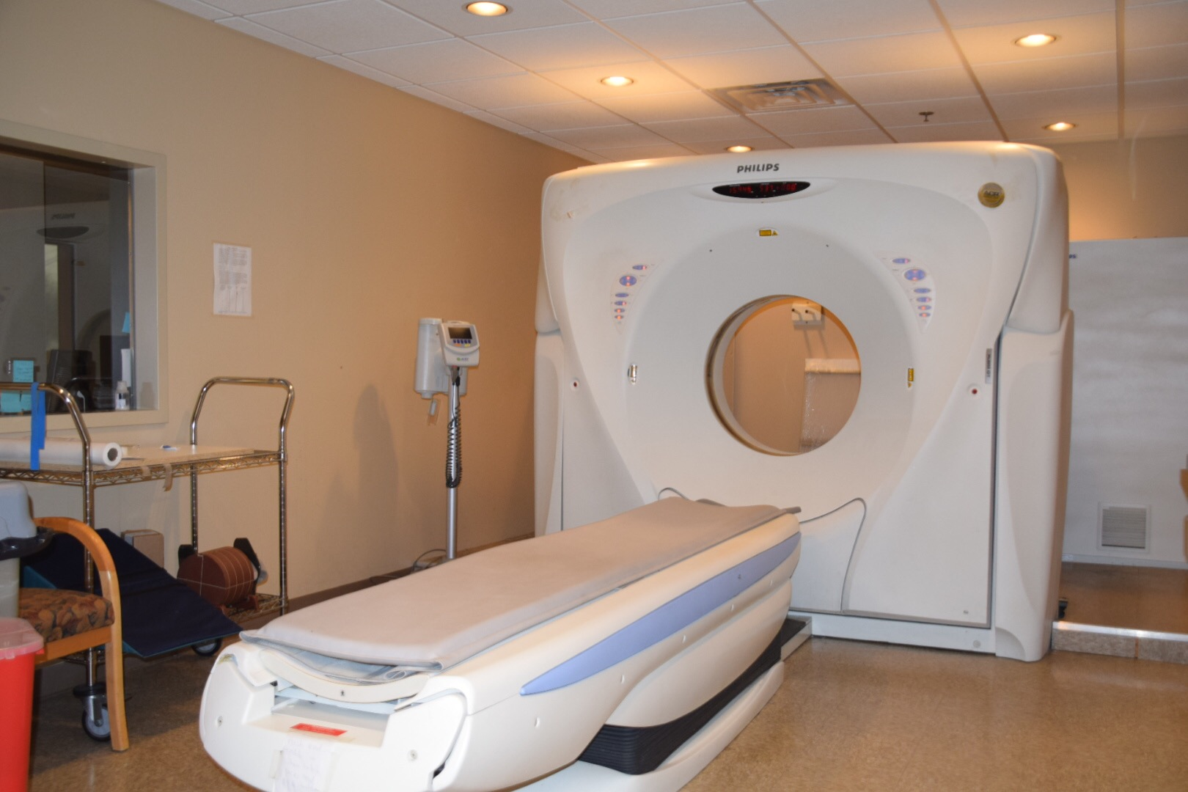
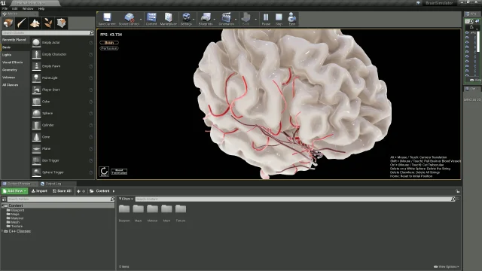

TECHNOLOGY IN HEALTHCARE
Very useful, but there are still some risks to be aware of!
Medical Imaging
Patient Records
X-Rays: Bone structure scans. Takes around 10-15 minutes; results in 10 minutes.
EHR. Includes basic info and medical history.
Source: alexanderorthopaedics.com
Sources: bing.com, nhs.uk
Zoomed image shows a rib break.
Source: bbc.co.uk
CT: Shows internal structures.
Diagnoses blood flow problems, cancer, stroke
If the tool stops working, a backup will be used.
Source: abidss.com
Source: medanets.com
Source: dzone.com
Otherwise, it will be reobtained from the patient, and recorded on paper to be copied later.
Orange represents a brain tumour
CT machine
Source: pdirad.com
Give warnings or errors before going down. E.g, X-Ray tubes should be replaced every few years.
Source: technicalprospects.com
Security
Source: nhs.uk
In some countries/private healthcare etc, financial information may be obtained from the patient (e.g. for insurance
Simulation technology may be used: research/skill practice/modelling.
Use of electronic prescriptions is becoming increasingly widespread. They are also sometimes available to the patient at home/remotely.
Source: elearningindustry.com
Source: safensoft.com
Source: nhs.uk
Simulation of a brain surgery
Source: engineering.com

