Slide 1
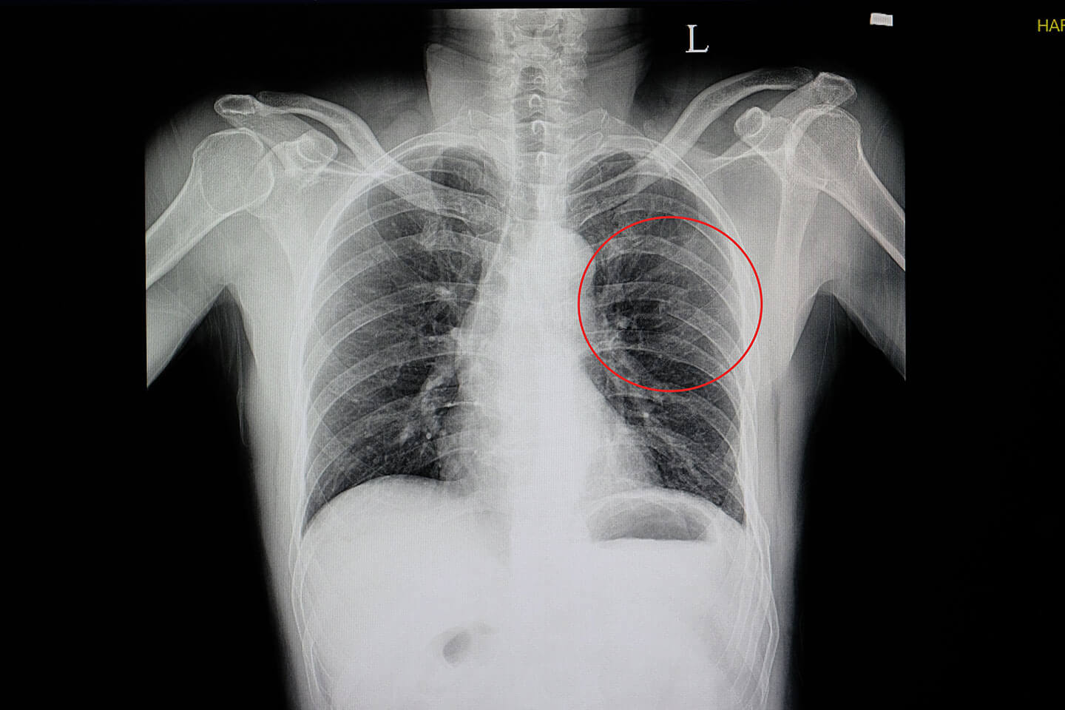
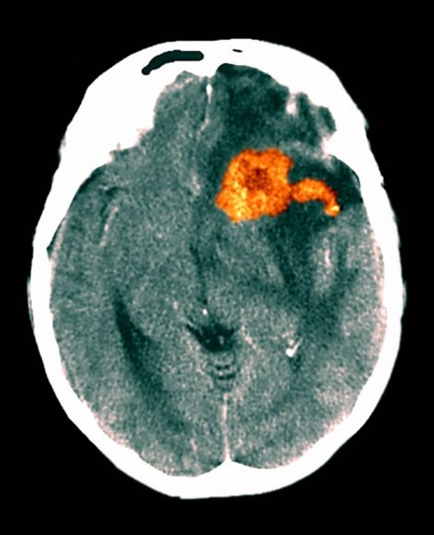
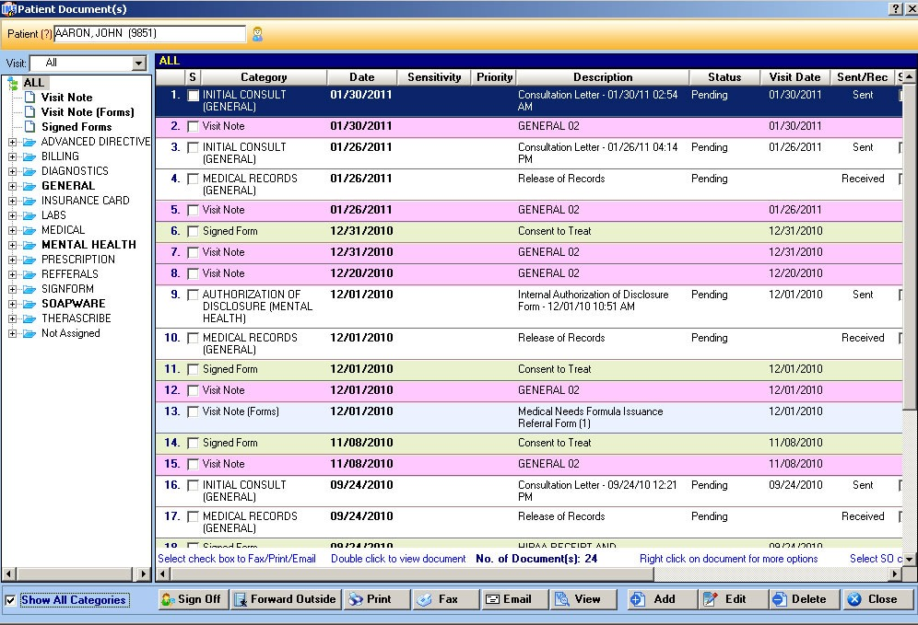
TECHNOLOGY IN HEALTHCARE
Uses and risks, with a dollop of history
Medical Imaging
Patient Records
X-Rays: Bone structure scans. Takes around 10-15 minutes; results in 10 minutes.
EHR. Includes basic info and medical history.
Source: alexanderorthopaedics.com
Sources: bing.com, nhs.uk
Zoomed image shows a rib break.
Source: bbc.co.uk
CT: Shows internal structures.
Diagnoses blood flow problems, cancer, stroke
If the tool stops working, a backup will be used.
Source: abidss.com
Source: medanets.com
Otherwise, it will be reobtained from the patient, and recorded on paper to be copied later.
Orange represents a brain tumour
Source: nhs.uk
Source: dzone.com
Give warnings or errors before going down. E.g, X-Ray tubes should be replaced every few years.
Security
Source: technicalprospects.com

Slide 2
TECHNOLOGY IN HEALTHCARE
Uses and risks, with a dollop of history
Medical Imaging
Patient Records
X-Rays: Bone structure scans. Takes around 10-15 minutes; results in 10 minutes.
EHR. Includes basic info and medical history.
Source: alexanderorthopaedics.com
Sources: bing.com, nhs.uk
Zoomed image shows a rib break.
Source: bbc.co.uk
CT: Shows internal structures.
Diagnoses blood flow problems, cancer, stroke
Backup may be out of date – could mess with medications
Source: abidss.com
Source: medanets.com
Patient/their families may miss things out since they are under stress
Orange represents a brain tumour
Source: nhs.uk
Source: dzone.com
Could be an extra cost. May fail unexpectedly, in which case other patients may also be affected since the remaining machines will have to compensate. Delays may cause health to deteriorate further.
Security
Source: technicalprospects.com

