Slide 1
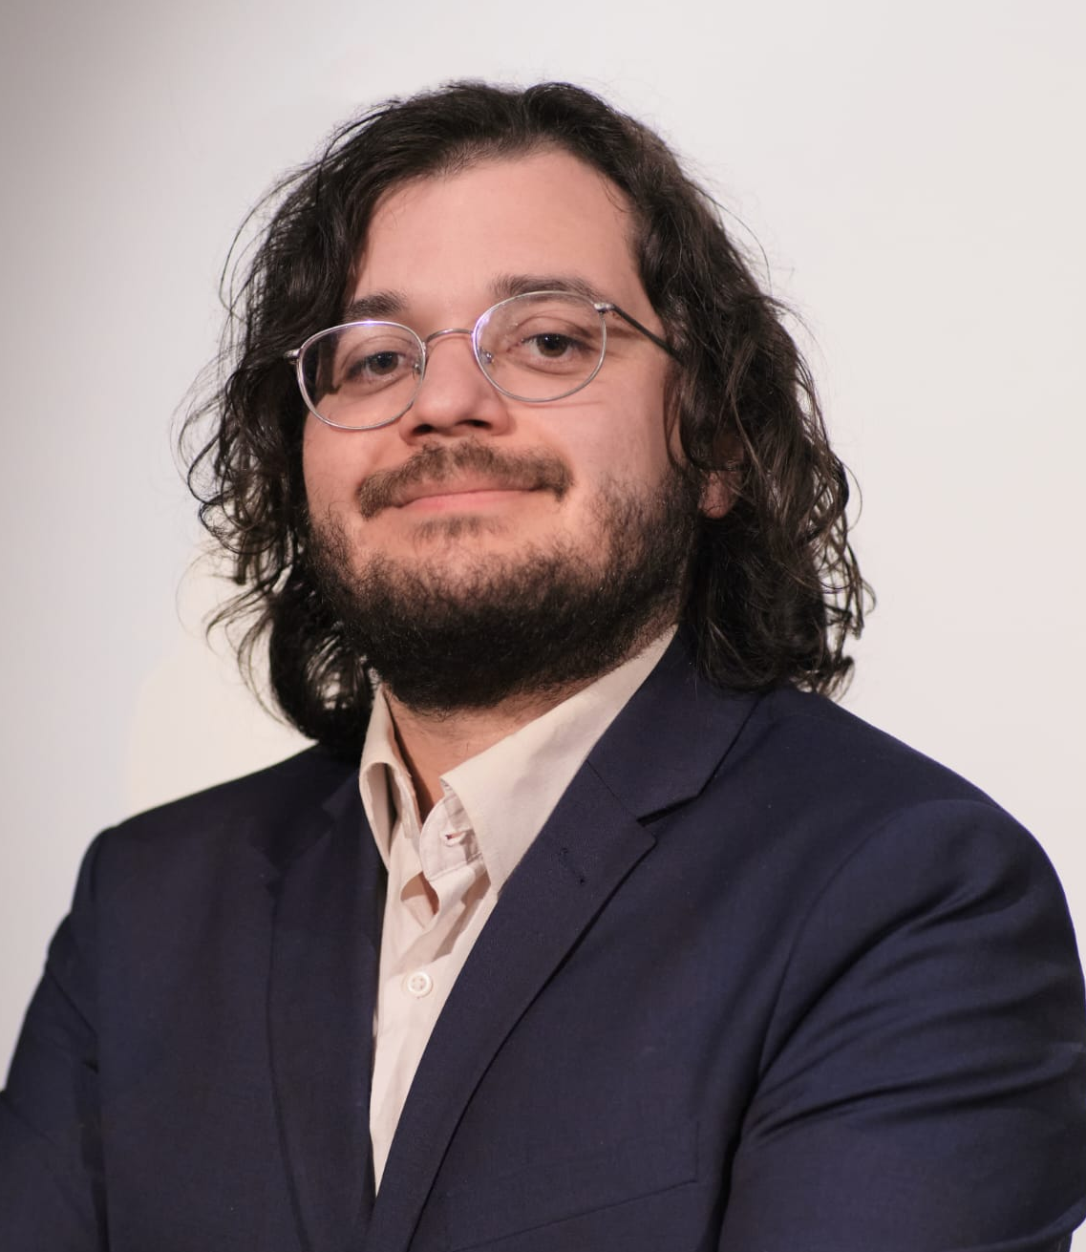
Juan Aponte
Simulation Engineer
Email: jumapontero@unal.edu.co
Phone: +49 1590 6402645
Address: Spinnertraße 35, 38114 Braunschweig
Birthday: 22.11.1994, Bogota - Colombia LinkedIn: linkedin.com/in/juan-aponte-736a79126
Brief profile
[professional_summary]
Professional experience
Since 02/2026
Independent further training in machine learning, AI agents, and self-directed project work in battery systems.
Projekt: Physics-informed, LSTM based digital twin for estimating the battery state of charge. Further information avaliable on GitHub and HuggingFace
Master student at TLK-Thermo GmbH in the field of modeling, simulation and optimization
Master thesis: Optimization of a charging process for a battery system
Description of a 1D battery model with cooling taking into account free convection in Modelica
Modeling of current derating by integrating interpolation tables based on measured values of a vehicle battery
Formulation and solution of an optimal control problem with the CasADi software
Intern and working student at TLK-Thermo GmbH in the field of programming
Further development of backend software for processing and converting data between JSON files and Python classes
Implementation of a graphical user interface for editing and saving the backend softwares
Research assistant at test facilities for adaptive seals in turbomachinery, TU Braunschweig (IFAS Institut)
Test setup, test execution and evaluation of experimental results with MATLAB
04/2024 - 11/2024 Brunswick,
Germany
10/2023 - 03/2024 Brunswick,
Germany
10/2022 - 04/2023 Brunswick, Germany
Page 1 of 2

Slide 2
Educational background
12/2025 – 03/2026
PyTorch for deep learning bootcamp, ZTM Academy
Hands-on course on Deep Learning with PyTorch, including model building, training, deployment, and integration of ML solutions into real-world applications.
Master's degree in mechanical engineering with a focus on energy and process engineering, TU Braunschweig
[master_subjects]
In-depth knowledge of thermodynamics, modeling of thermal systems and numerical methods
Student research project: Implementation of new backplate measurement technology for the operational behavior analysis of carbon floating ring seals
Bachelor of Mechanical Engineering, Universidad Nacional de Colombia
Bachelor thesis: Development of an incompressible flow solver for the investigation of simple turbulence phenomena
[bachelor_subjects]
10/2020 - 11/2024 Brunswick, Germany
01/2013 - 07/2019 Colombia
Other achievements
06/2019 - 06/2020
Usingen
Cultural exchange in Germany as an au pair
04/2012, 2013, 2014
Colombia
Volunteer with the Catholic organization "Assumptionists"
Accompanying and supporting young people in disadvantaged rural areas.
Skills
IT skills
Python Modelica C++
Matlab Inventor MS Office OpenFOAM Abaqus CasADi
Languages
Spanish: Native speaker
German: B2/C1
English: B2
Personal interests
Playing guitar
chess
Knitting and crocheting
Page 2 of 2

