Slide 1

TheLook
eCommerce Data Analysis
June 6th 2022

Slide 2
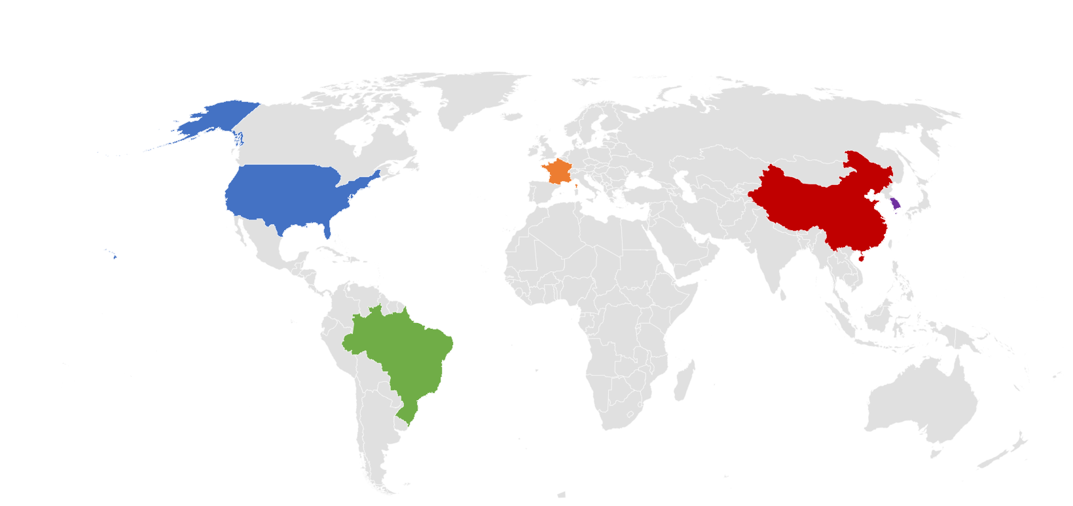
100 thousand users from Europe, Asia, Australia, and The Americas
80% of all users (and 81% of unit sales!) come from these five countries:
Users come from
7,859
cities from around the world
France 4.8%
Of the 100 cities with the most users,
USA 22.8%
South Korea 5.3%
62
China 33.7%
of them are in China, followed by only
Brazil 14.4%
10
in Brazil!

Slide 3





Overall user behaviour
More tan half of all users are adults between 18 and 49 years-old
50% male
users
50% female
users
(Consistent across age groups)
Male users spend
$92 on average per order
Female users spend
$81
on average per order
have made two or more purchases!
Only 38% of all users

Slide 4
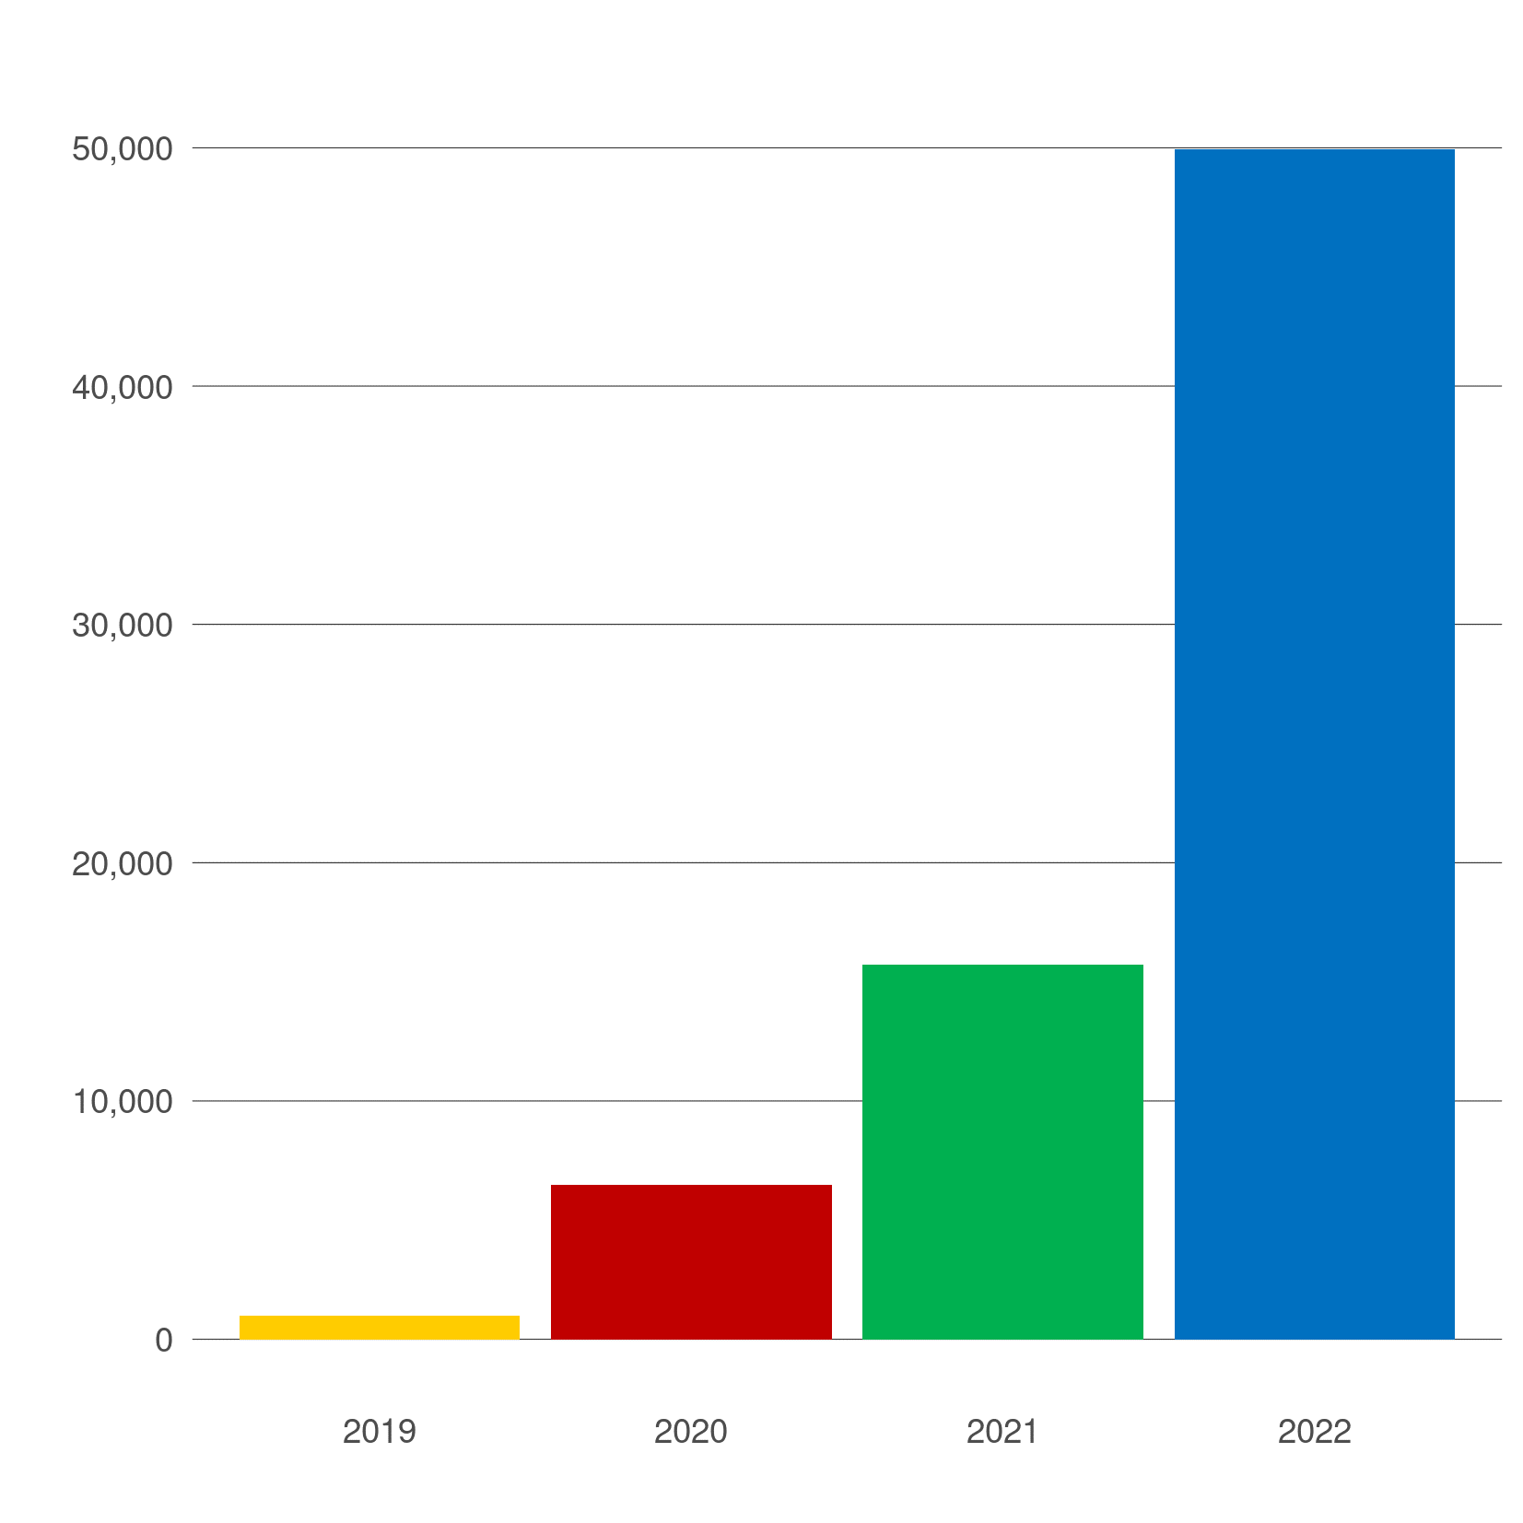
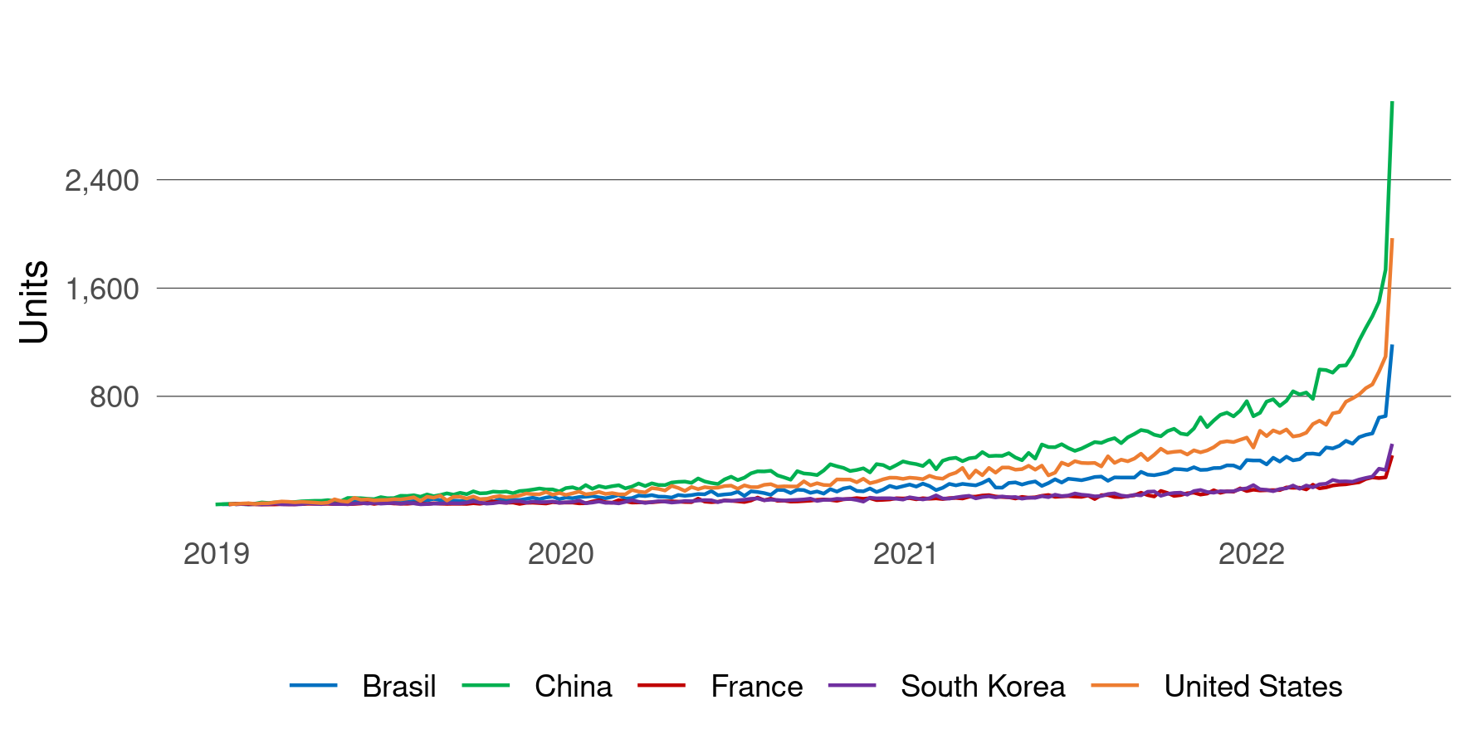
Orders and sales are rising exponentially
Number of orders made (YTD)
Weekly unit sales for the top five countries
Unit sales growth (%) for top five countries (YTD)
 | 2020 | 2021 | 2022
South Korea | 433% | 162% | 225%
China | 634% | 142% | 213%
Brazil | 524% | 146% | 207%
United States | 508% | 140% | 207%
France | 619% | 161% | 184%
Total | 539% | 145% | 208%

Slide 5
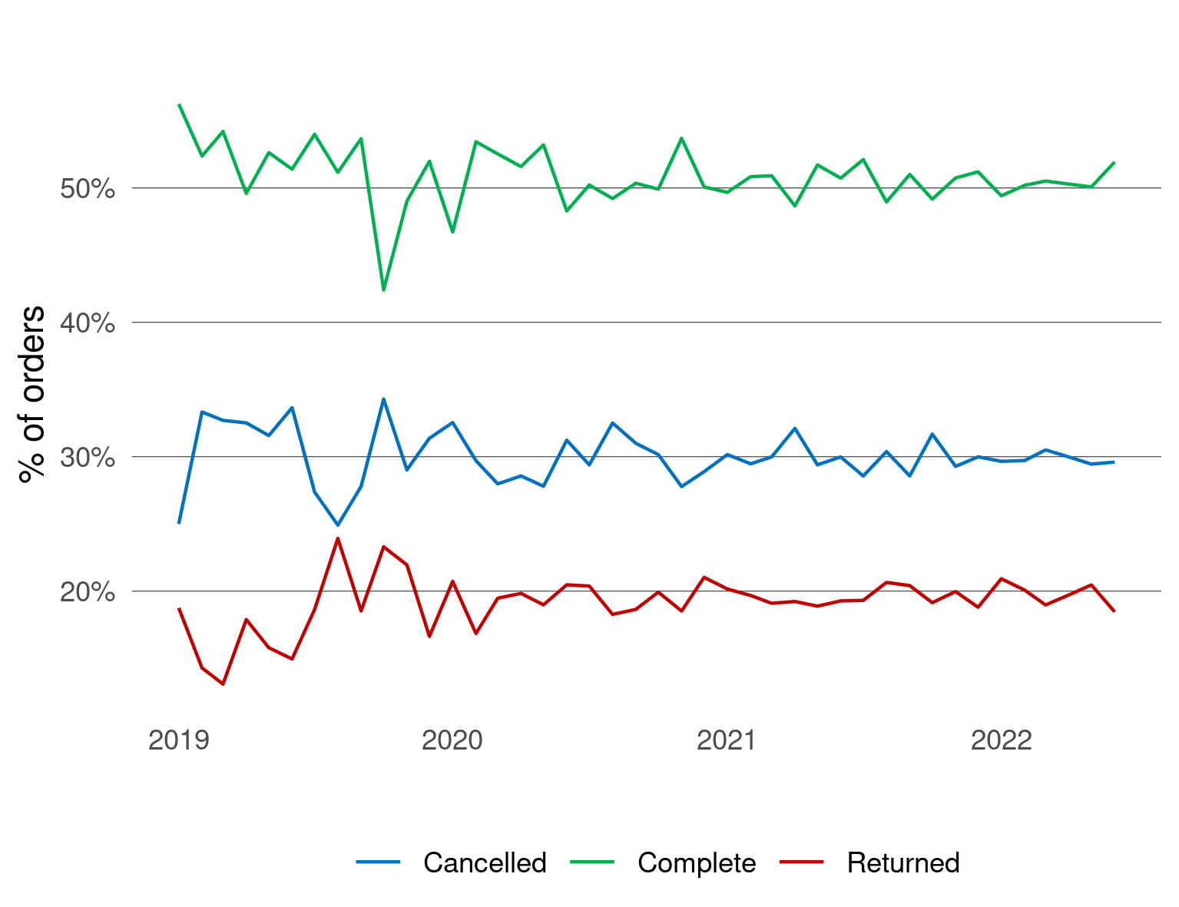

Issues with orders
Order status distribution
Order take on average 4 days from being created to being delivered and only 2.5 days from being shipped to being delivered …
So why are some people still unsatisfied their orders?
Although order status distribution has remained stable through time, half of all orders have been either cancelled or returned!

Slide 6
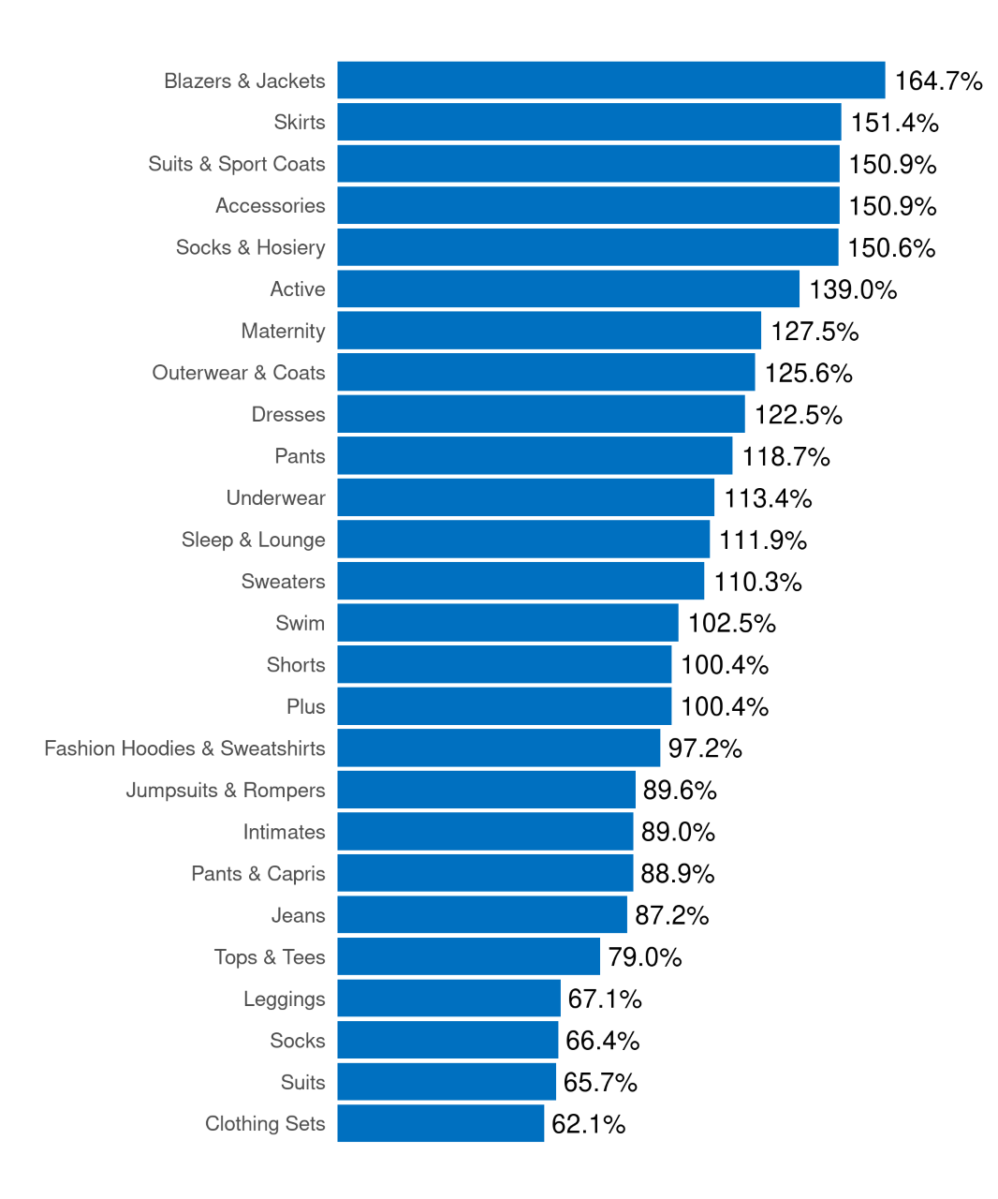
Profit of product categories
Category profit
cost
Profit =
retail price
The most profitable product categories are Blazers & Jackets, Skirts, Suits & Sport Coats, Accessories, and Socks & Hosiery with 150% or more profit each.
Categories like Jeans, Tops & Tees, Leggings, Socks, Suits, and Clothing Sets have all less than 100% profit. These could potentially be sold at higher prices to increase sales.

Slide 7
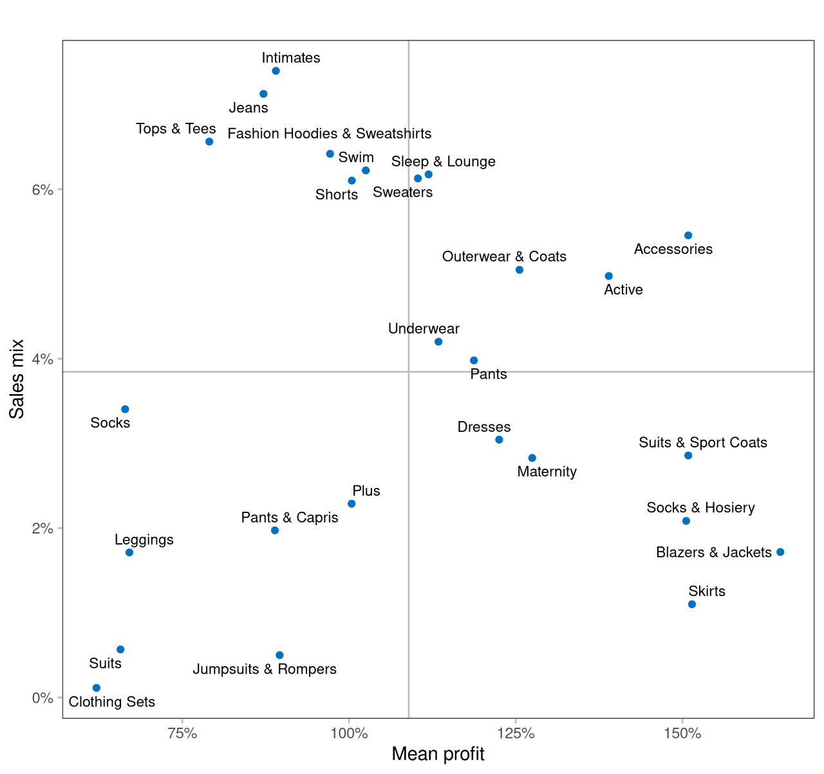
Profit vs. mix
Potential categories
Star categories
Category sales
Sales mix =
Total sales
When crossing categories on profit and sales mix, areas of opportunity arise.
Categories on the two left quadrants could have their retail prices increased, specially those on the upper half (Intimates, Jeans, Tops & Tees, Fashion Hoodies & Sweatshirts, Swim, Shorts), since these already represent the categories with the biggest sales mix.
Second priority

Slide 8
Final thoughts
Why is the Chinese market the most popular? What has been done there that can be replicated in other countries to gain more users?
How to encourage first-time users to incur in new purchases?
Why have users been cancelling / returning half of the orders? What can be done to reduce this proportion?
Some product categories could be sold at higher prices, specially those with higher sales mix.

