Slide 1
Smart Retry
Which loans to retry, when, and for how much. A working MVP and the product strategy behind it.
Notes:
Smart Retry decides, for every loan in the portfolio, whether to retry collection now, wait, or send it to a person, and turns approved retries into payment requests. It is a working local app.

Slide 2
What this deck answers
1
Problem and data
What is broken, what the data shows, our hypotheses and scope
2
Logic and process
Heuristics, trade-offs and the end-to-end flow
3
The product
How a Belvo operator uses it, what they see, how parameters work
4
Impact and measurement
Potential impact and the results that earn a green light
5
Scale and strategy
From MVP to a Belvo product, Brazil and beyond, GTM, vision

Slide 3
Problem and data
What is broken, what the two files show, and what we set out to test

Slide 4
Retries keep hitting the same empty accounts
97.6%
68%
12
of 253,006 payment requests in the history failed
of today's retry candidates have never paid once
median insufficient-funds failures in a row for a candidate
The brief: retries run without discretion, cause chargebacks and waste bandwidth on accounts with no funds or blocked accounts.
Job to be done: give a Belvo operator a defensible list of which loans to debit, when, and for how much, and stop the rest.
Notes:
3,062 loans, 253,006 requests over 22 months, 1,383 chargebacks. 273 of the 400 seven-day retry candidates never had a successful request.

Slide 5
Data analysis: one failure reason dominates
What else the files show
85% of failures are insufficient funds (04): recoverable in principle
15% are hard failures (cancelled, blocked, stop order): retrying rarely works
Requests come in batches: 166,747 single, 23,929 split in three (5/25/70), 2,141 with six
Snapshot debt is already updated; 29 loans have no history
Notes:
Failure codes and messages are preserved as received (Spanish). The latest batch, with every member, is the unit of decision.

Slide 6
Hypotheses we tested against the data
Hypothesis | Evidence in the history | Status
Insufficient-funds failures can recover after a wait | Kept attempts succeed 4.37%, twice the 2.22% average | Supported
Hard failures (cancelled, blocked) don't recover | Retries right after one: 0.19% success | Supported
Long insufficient-funds streaks rarely pay | 20+ in a row: 0.60% success on 45% of requests | Supported
Chargebacks repeat | 22.9% of retries after a chargeback were charged back again | Supported
Calendar paydays raise success | 1.88% on paydays vs 1.85% other days | Rejected
Retrying beats not retrying | No counterfactual in the data | To test (holdout)
Notes:
Final statuses only, surviving overdue loans: associations, not causal proof. That is why the last hypothesis needs a holdout.

Slide 7
Scope and constraints we set
In scope
Out of scope, on purpose
Known limits
Mexico, MXN (inferred from bank codes)
All 3,062 loans, one decision each
Fixed evaluation date: 2025-11-11 23:59:59 Mexico City
Payment requests in the bank's own nine-column format
Sending money or connecting to a bank
Per-loan amount choice or predictive scoring
Manual overrides of a decision
Multi-merchant tenancy
No live check of authorization, account or current debt
History has final statuses only
No cost per attempt, so no peso savings claimed
Small holdout today (about 40 loans)

Slide 8
Logic and process
The heuristics, the trade-offs behind them and the end-to-end flow

Slide 9
Ten ordered rules; the first match decides
Needs attention
Rules 1-7
Missing balance, no history, inconsistent times, chargeback, mixed or repeated attempts, a success to reconcile, or any failure other than insufficient funds (code 04)
Resting
Rule 8
20+ insufficient-funds failures in a row: wait 30 days instead of the cooldown
Waiting
Rule 9
Insufficient funds, cooldown (3, 7 or 14 days) not over yet: shows the next check date
Retry candidate
Rule 10
Insufficient funds and the wait has passed: gets three draft payment requests
Notes:
Only the latest attempt decides and every request in it counts. SQL is the only decision engine; each loan stores the matched rule and the date math.

Slide 10
Heuristics in plain words
Look at the latest attempt, all of it
When in doubt, a person decides
Six simultaneous requests are six pieces of evidence, never deduplicated
Anything ambiguous or not clearly 'no funds' is never retried automatically
Give money time to arrive
Stop the treadmill
Wait 3, 7 or 14 days after an insufficient-funds failure, from the attempt's completion date in Mexico City
After 20 failures in a row, rest 30 days instead of retrying weekly
Ask for less, in steps
Prove it with a control
Requests split 5%, 25% and 70% of the balance, the most common historical pattern
10% of candidates are held out to measure what retrying adds

Slide 11
Deliberate trade-offs
Choice | Gain | Cost
Conservative rules | Nothing ambiguous is retried automatically | More work for reviewers (713 loans)
Rest instead of review for fatigue | Review queue stays at 713, not 2,477 | Fatigued loans are still retried monthly
SQL as the only engine | Every decision can be inspected and reproduced | Needs real-engine tests
Two-person approval | Four eyes on money | Handoff friction
Fixed 5/25/70 split | Matches how operations already work | Not optimized per loan
Holdout group (10%) | Measures what retrying actually adds | Those loans aren't retried during the test

Slide 12
End-to-end process
Operator
System
System
Operator
Reviewer
Rails
Upload portfolio
Check
Classify
Submit
Approve
Send and respond
History already in the system
Columns, IDs, money, links to history
SQL rules; drafts payment requests
All 3,062 decisions plus drafts
Sees amounts; approval releases
Outside the MVP; same file format
Responses become new history; a follow-up analysis is evaluated at the end of the latest response day
Analysis states: Draft → Checking → Ready to generate → Generating → Ready for review → Awaiting reviewer → Approved (or Changes requested → new revision). Failed or interrupted runs never publish partial results.

Slide 13
The product
How a Belvo operator uses the MVP, what they see and how parameters work

Slide 14
How a Belvo operator interacts with the MVP
1
Sign in
2
Set the policy
3
Upload the portfolio
Two roles: Operator prepares, Reviewer approves
Wait period, fatigue rest and holdout size
Checked on upload against the system's history
4
Generate results
5
Work the queues
6
Submit
One decision and reason for every loan
Open any loan to see what to do and why
The whole revision goes to a different person
After approval: download the released payment requests, hand them to the rails, import the bank's responses and start a follow-up analysis. Every step is one primary button for the person whose turn it is.
Notes:
The operator never sees SQL or rule codes on the main screens.

Slide 15
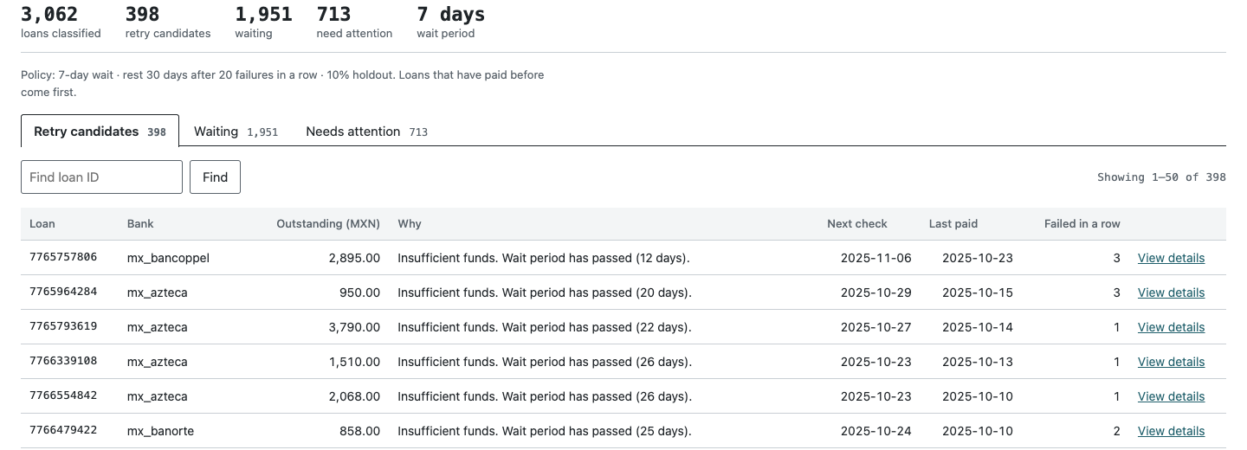
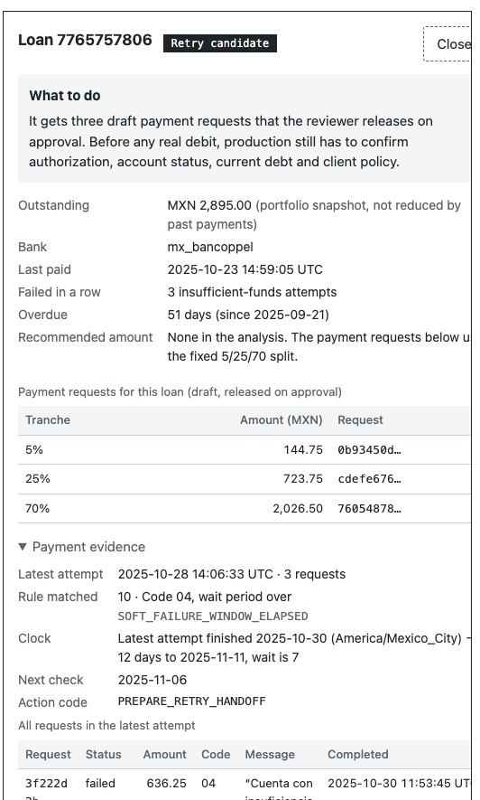
What the operator sees: queues, reasons and evidence
Totals for the whole run, kept apart from the rows on screen
Three tabs: Retry candidates (previous payers first), Waiting (soonest check first), Needs attention (filter by reason)
Table: loan, outstanding, plain-language why, next check, last paid, failures in a row
Side panel: what to do, the three requests, matched rule, date math, every request in the latest attempt

Slide 16
Buttons, panels and the dashboard view
Element | What it does | Who sees it
Generate results | Runs the SQL rules and drafts payment requests | Operator
Submit for review / Withdraw | Sends the whole revision to the reviewer, or pulls it back | Operator
Approve and release payments | Accepts the analysis and releases its requests | Reviewer
Request changes | Returns it with a required comment | Reviewer
Payment requests panel | Requests, total by tranche, holdout, download, import responses | Both
Holdout experiment panel | Retried vs held-out loans and recovery once measured | Both
Totals strip | The run at a glance: loans, retry, waiting, attention, policy | Both
No separate dashboard yet, on purpose: the totals strip and the two panels are the operational view. A portfolio dashboard across analyses is a post-MVP item.

Slide 17
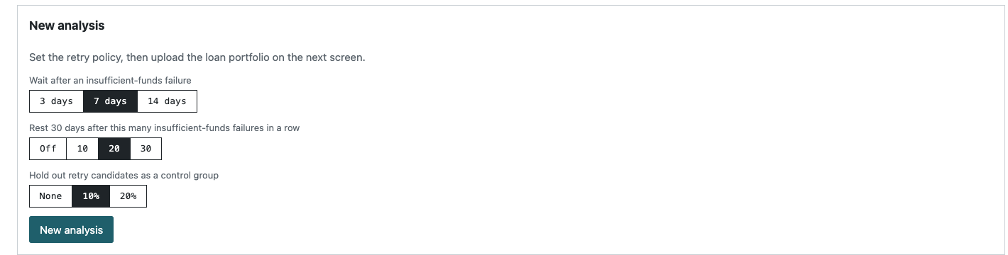
How parameter configuration works
Parameter | Options | Default | Effect (7-day wait)
Wait after insufficient funds | 3, 7, 14 days | 7 | Retry 404 / 400 / 396
Fatigue rest | Off, 10, 20, 30 | 20 | Resting 0 / 1,752 / 1,623 / 1,326
Holdout | 0, 10, 20% | 10% | About 0 / 40 / 80 loans held out
Set per analysis, before checking the portfolio; shown to the reviewer next to the totals
Locked once results exist: a change means a new revision, so approved results never change underneath anyone
A revision inherits the parent's policy unless the operator changes it
The evaluation date is fixed for the exercise and not editable; the review set (713) doesn't move with any parameter
Notes:
Only these three parameters exist. A longer wait can only remove retry candidates, never add them. Fatigue off reproduces the reference counts exactly.

Slide 18
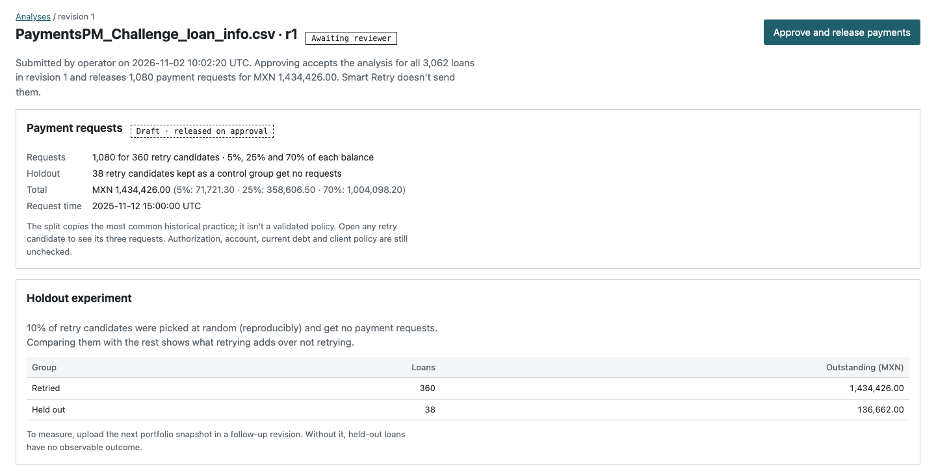
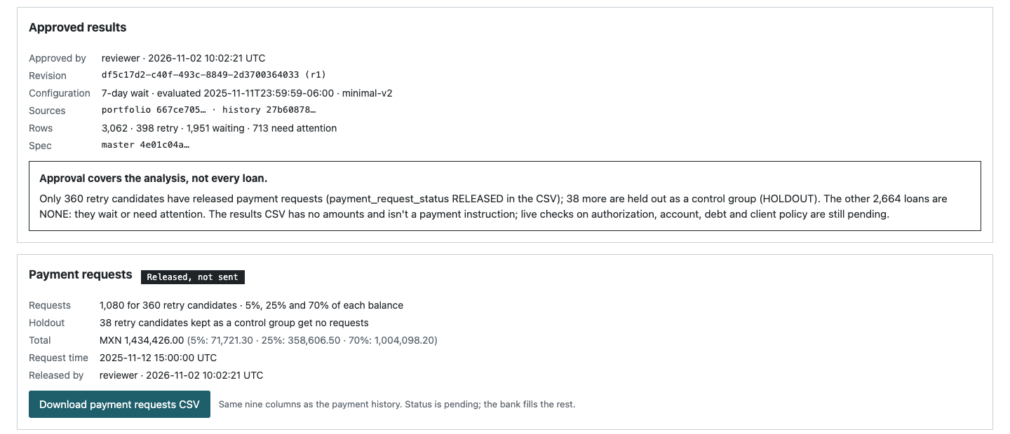
Approval puts four eyes on the money
Before approving, the reviewer sees how many requests and how much money will be released
'Released, not sent': ready for Belvo's rails. The MVP has no bank connection by design
Only retry candidates outside the control group get released requests; everyone else is NONE in the CSV

Slide 19
Impact and measurement
What the rules would have changed, and what earns a green light

Slide 20
398 to retry, 1,951 to wait, 713 for a person
Why 713 need a person
605 account, authorization or unknown failure
37 last attempt charged back
29 no payment history
27 last attempt succeeded: reconcile
15 simultaneous attempts disagree
Fatigue off reproduces the reference: 400 / 1,949 / 713.

Slide 21
60% fewer requests across 22 months of history
2.1x
MXN collected per 1,000 requests: 4,719 today, 9,734 on the attempts kept
2,240
fewer debit attempts per 1,000 loans per month
17.4% is a ceiling, not a loss: rested loans are retried after 30 days. The holdout measures the real figure.
Notes:
Replay over 193,629 historical attempts. No peso savings claimed: attempt and chargeback costs are not in the data.

Slide 22
What we'll measure to give the green light
Metric | Definition | Green light when
Retained recovery (north star) | MXN recovered per eligible loan over 90 days, net of reversals, treatment vs holdout | Loss vs control within the threshold agreed with the lender before the test
Requests avoided | Debit attempts per loan per month vs the lender's baseline | Clearly lower; target set from the lender's own replay
Chargeback rate | Chargebacks per 1,000 attempts | Lower than baseline
Recovery per attempt | MXN per 1,000 requests | Higher than baseline
Guardrails | Complaints, unauthorized or excess debits, review queue age, errors | No increase; zero unauthorized debits
Decision rule: a policy ships to a client only after a 90-day holdout clears every row. Kill if recovery loss exceeds the threshold.

Slide 23
Verified by executed tests, not by claims
42
16
0
backend tests on real SQLite and the original files
browser tests covering acceptance scenarios E01-E15 and the payment loop
loans where the SQL streak differs from an independent Python check
Proven: reference counts at 3, 7 and 14 days, decisions unchanged by row order, permissions and stale-approval races, approved-only export, request split and reconciliation.
Not proven: recovery lift, avoided chargebacks, operator time saved, live eligibility.

Slide 24
Scale and strategy
From MVP to a scalable Belvo product, other markets, GTM and vision

Slide 25
From MVP to a scalable Belvo product
Layer | MVP today | Scalable product
Inputs | Portfolio CSV; history imported at setup | API and webhooks from Belvo's own payment events, near real time
Decision engine | One SQL rule set, one market | Versioned policy packs per market and rail, per-client settings with guardrails
Failure codes | Mexican direct-debit codes | A dictionary per rail mapping bank codes to soft, hard and dispute
Execution | Released file, sent by someone else | Scheduled through Belvo's rails after release, with limits
Learning | One holdout per run | Always-on holdouts and cross-lender benchmarks by bank and code
Tenancy | One demo merchant, two users | Multi-client, roles, audit trail, SSO

Slide 26
Brazil changes where Smart Retry adds value
Mexico
Brazil
Colombia
Direct debit (domiciliación)
Pix Automático (since June 2025)
Pay-by-bank recurring payments
The lender decides when to retry. Smart Retry decides whether, when and how much: the MVP as built.
The payer's bank retries within a window set by the central bank (details to confirm). Value moves upstream: which charges to schedule, amounts, and when to stop and switch to a hardship path.
Same decision layer, plus a new code dictionary and policy pack. Start once the Mexico and Brazil packs are proven.
What scales across markets: the ordered rules, the holdout method, the review flow and the evidence trail. What changes: failure codes, legal retry limits, rail timing. Brazil is Belvo's largest market, so the policy-pack design matters early.
Notes:
Pix Automático retry rules: public sources disagree (same-day retries by the payer's bank vs retries over several days). Confirm against the central bank's regulation before designing the Brazil pack.

Slide 27
Four strategies weighed; one is worth pursuing
A. Rules in Managed Collections
Start here
B. Income-aware intelligence
Recommended
For: Cheap and shippable now; the impact shown comes from rules alone
Against: Easy to copy; value plateaus after the obvious waste
For: Debit when each borrower actually gets paid, using consented open-finance data Belvo already has
Against: Consent from delinquent borrowers and real lift are unproven
C. Standalone ML scoring
No
D. Outcome-priced recovery
Later
For: Bigger market beyond Belvo's rails
Against: Competes with lenders' own models; no data moat
For: Highest revenue per loan
Against: Takes credit, compliance and ops risk before the evidence

Slide 28
Why Belvo can win this
1
2
3
Rails
Income data
Collections
Direct debit from any Mexican bank account; Pix Automático in Brazil since its launch day
Incomes API summarizes 365 days of a consented account's inflows; IMSS employment records
Managed Collections and an income estimator already in market
Calendar paydays don't help: attempts on days 1, 2, 15, 16, 30 and 31 succeeded 1.88% of the time vs 1.85% on other days. If timing matters, it is each borrower's own timing, and only consented account data shows it.
Notes:
Sources checked 2026-11-02: Belvo developer docs, Belvo 2025 recap, The Paypers.

Slide 29
Go-to-market: lead with a free waste audit
Who first
Lenders already collecting through Belvo direct debit in Mexico, with delinquent portfolios and high failure rates
Hook
Replay their own history through the rules: requests avoided, chargebacks avoided, recovery at risk
Pilot
2-3 design partners: shadow-run, then a 90-day holdout with a loss threshold agreed up front
Package and price
Paid tier of Managed Collections, per loan under management; income-aware tier once lift is proven
Channels
Existing account teams and the J.P. Morgan and dLocal direct-debit partnerships
Then
Brazil policy pack for Pix Automático, sold to Belvo's largest client base
Notes:
The replay is the sales asset: about a day of analysis per lender, producing their own numbers, with the same caveats as ours.

Slide 30
Short and long term: each step earns the next
Horizon | Bet | Success metric | Gate to move on
0-6 months | Rules and holdout in Managed Collections with 2-3 design partners | Requests avoided, chargebacks, recovery per loan vs control | Recovery loss within the agreed threshold
6-18 months | Income-aware timing and amounts with consent; Brazil policy pack | Success per attempt and recovery vs rules-only | Enough consent; significant lift in a holdout
18-36 months | One layer across Mexico, Brazil and Colombia rails; learn across lenders | Cost per peso recovered; share under managed policy | Privacy controls and per-client policy audit
3-5 years | Collections OS: hardship and restructuring routes when debits stop making sense | Net recovery, cure and complaint rates | Proven economics; regulatory review

Slide 31
How it makes money, and when to stop
Business model
Stop or narrow if
Paid tier of Managed Collections, priced per loan under management
Income-aware tier once a holdout proves lift
Share of incremental recovery only after its risks are covered
For Belvo: fewer failed debits per peso moved, healthier bank relationships
Recovery loss exceeds the threshold agreed with the lender
Consent is too low for income signals to reach enough loans
Using account data on delinquent borrowers raises regulatory or reputational concern
A lender won't keep a control group: no policy change ships without one

Slide 32
Next steps to market
Run the waste audit on 2-3 design-partner portfolios
Agree each lender's loss threshold, then a 90-day holdout
Measure borrower consent for income-aware timing; confirm Pix Automático rules
Notes:
Included: the MVP with one-command setup, result, payment-request and testing CSVs, happy-path and edge-case demo videos, the user guide and the PRD.

