Slide 1
Smart Retry
Which loans to retry, when, and for how much. A working MVP on the two challenge files, and the product strategy behind it.

Slide 2
Retries keep hitting the same empty accounts
97.6%
68%
12
of 253,006 payment requests in the history failed
of today's retry candidates have never paid once
median insufficient-funds failures in a row for a candidate
The brief: retries run without discretion, cause chargebacks and waste bandwidth on accounts with no funds or blocked accounts.
Job to be done: give a Belvo operator a defensible list of which loans to debit, when, and for how much, and stop the rest.

Slide 3
Data analysis: one failure reason dominates
What else the files show
85% of failures are insufficient funds (04): recoverable in principle
15% are hard failures (cancelled, blocked, stop order): retrying rarely works
Requests come in batches: 166,747 single, 23,929 split in three (5/25/70), 2,141 with six
Snapshot debt is already updated; 29 loans have no history

Slide 4
Hypotheses we tested against the data
Hypothesis | Evidence in the history | Status
Insufficient-funds failures can recover after a wait | Kept attempts succeed 4.37%, twice the 2.22% average | Supported
Hard failures (cancelled, blocked) don't recover | Retries right after one: 0.19% success | Supported
Long insufficient-funds streaks rarely pay | 20+ in a row: 0.60% success on 45% of requests | Supported
Chargebacks repeat | 22.9% of retries after a chargeback were charged back again | Supported
Calendar paydays raise success | 1.88% on paydays vs 1.85% other days | Rejected
Retrying beats not retrying | No counterfactual in the data | To test (holdout)

Slide 5
Scope, constraints and trade-offs
Choice | Gain | Cost
Conservative rules | Nothing ambiguous retried | 713 loans to review
Rest, not review, for fatigue | Queue stays at 713, not 2,477 | Still retried monthly
Two-person approval | Four eyes on money | Handoff friction
Fixed 5/25/70 split | Matches current practice | Not optimized per loan
10% holdout | Measures what retrying adds | Those loans wait
In scope
Mexico, MXN; all 3,062 loans, one decision each; fixed evaluation date; requests in the bank's nine-column format
Out of scope, on purpose
Sending money, per-loan amounts, predictive scoring, overrides, multi-merchant tenancy
Known limits
No live checks of authorization or current debt; final statuses only; no cost per attempt; small holdout

Slide 6
Logic: ten ordered rules, the first match decides
Needs attention
Rules 1-7
Missing balance, no history, bad times, chargeback, mixed or repeated attempts, a success to reconcile, or any failure other than insufficient funds (04)
Resting
Rule 8
20+ insufficient-funds failures in a row: wait 30 days instead of the cooldown
Waiting
Rule 9
Insufficient funds, cooldown (3, 7 or 14 days) not over: shows the next check date
Retry candidate
Rule 10
Insufficient funds and the wait has passed: three draft requests, 5/25/70 of the balance
Heuristics: look at every request in the latest attempt; when in doubt a person decides; give money time to arrive; stop the treadmill after 20 failures; ask for less in steps; prove it with a 10% control group.

Slide 7
End-to-end process
Operator
System
System
Operator
Reviewer
Rails
Upload portfolio
Check
Classify
Submit
Approve
Send and respond
History already in the system
Columns, IDs, money, links to history
SQL rules; drafts payment requests
All 3,062 decisions plus drafts
Sees amounts; approval releases
Outside the MVP; same file format
Responses become new history; a follow-up analysis is evaluated at the end of the latest response day
Analysis states: Draft → Checking → Ready to generate → Generating → Ready for review → Awaiting reviewer → Approved (or Changes requested → new revision). Failed or interrupted runs never publish partial results.

Slide 8
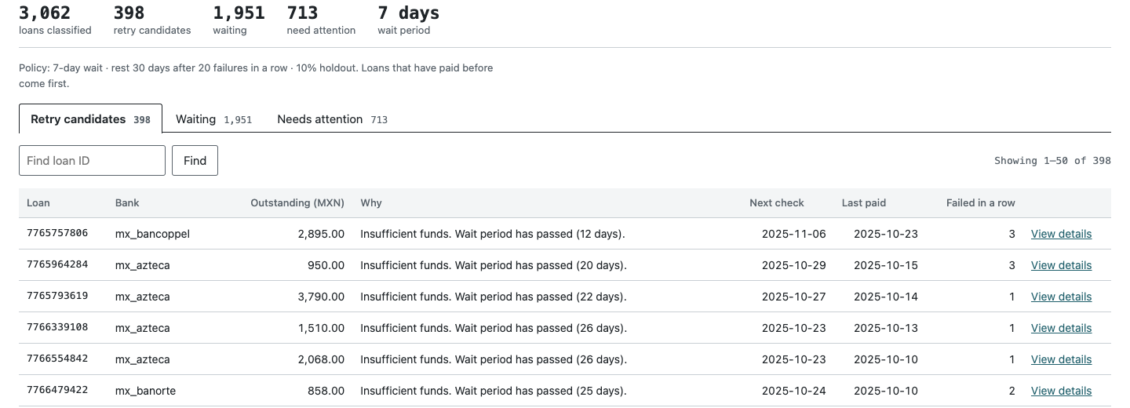
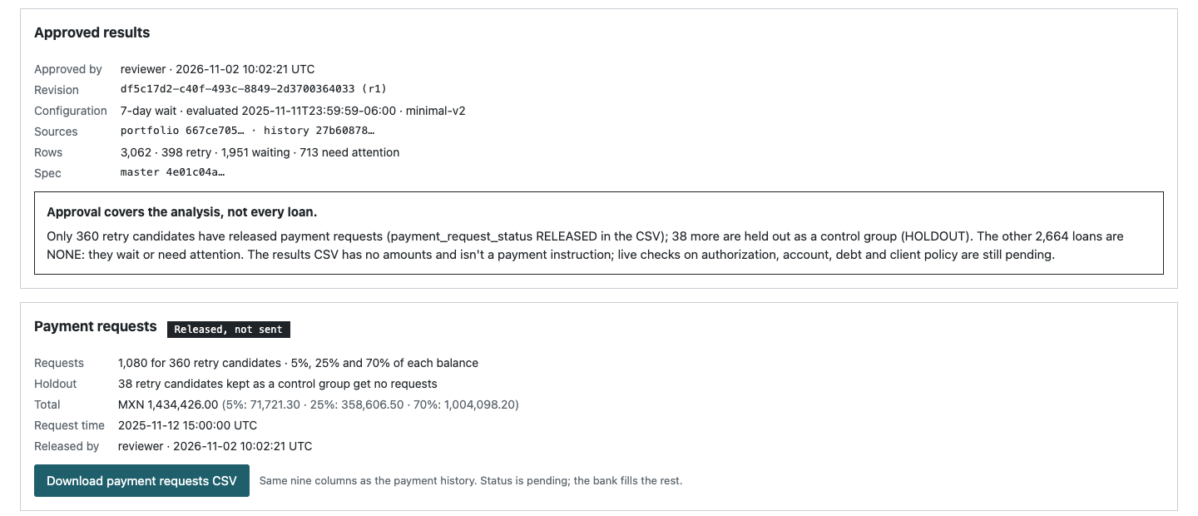
How the operator works, and what they see
Sign in: the Operator prepares, a different Reviewer approves
Set the policy: wait period, fatigue rest, holdout
Upload the portfolio: checked against the system's history
Generate results: one decision and reason per loan
Work the queues: Retry (previous payers first), Waiting (soonest check), Needs attention (filter by reason)
Open a loan: what to do, its three requests, matched rule and date math
Submit; the reviewer sees the amounts and approves, which releases the requests
Notes:
'Released, not sent': the file is ready for Belvo's rails; the MVP has no bank connection by design.

Slide 9
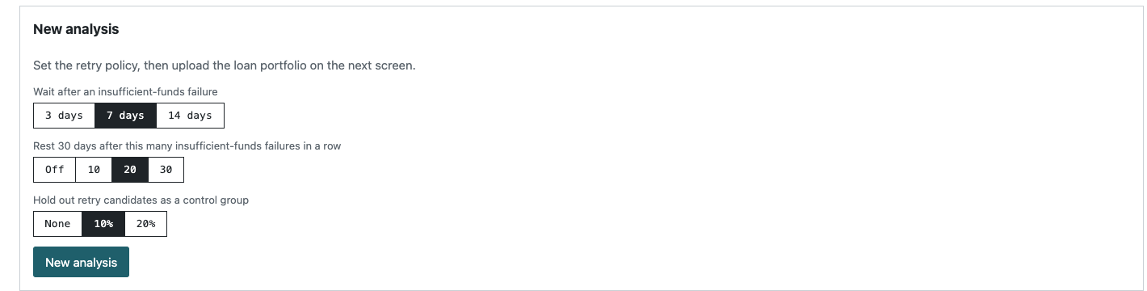
Configuration, buttons and the dashboard view
Buttons and panels
Generate results: SQL rules plus draft payment requests (operator)
Submit for review / Withdraw (operator)
Approve and release payments / Request changes with comment (reviewer)
Payment requests panel: totals by tranche, holdout, download, import responses
Holdout experiment panel: retried vs held-out loans
Totals strip: the dashboard view; a portfolio dashboard is post-MVP
Parameter | Options | Default | Effect (7-day wait)
Wait after insufficient funds | 3, 7, 14 days | 7 | Retry 404 / 400 / 396
Fatigue rest | Off, 10, 20, 30 | 20 | Resting 0 / 1,752 / 1,623 / 1,326
Holdout | 0, 10, 20% | 10% | About 0 / 40 / 80 loans
Set per analysis before the check; locked once results exist (a change means a new revision); inherited by revisions.

Slide 10
398 to retry today, and 60% fewer requests
Today (7-day wait)
398 retry 1,951 wait 713 person
1,623 of the waiting are resting; 58 tests pass
2.1x
MXN collected per 1,000 requests: 4,719 today, 9,734 on the attempts kept
17.4% is a ceiling, not a loss: rested loans are retried after 30 days. The holdout measures the real figure.

Slide 11
What we'll measure to give the green light
Metric | Definition | Green light when
Retained recovery (north star) | MXN recovered per eligible loan over 90 days, net of reversals, treatment vs holdout | Loss vs control within the threshold agreed with the lender before the test
Requests avoided | Debit attempts per loan per month vs the lender's baseline | Clearly lower; target set from the lender's own replay
Chargeback rate | Chargebacks per 1,000 attempts | Lower than baseline
Recovery per attempt | MXN per 1,000 requests | Higher than baseline
Guardrails | Complaints, unauthorized or excess debits, review queue age, errors | No increase; zero unauthorized debits
Decision rule: a policy ships to a client only after a 90-day holdout clears every row. Kill if recovery loss exceeds the threshold.

Slide 12
A scalable Belvo product, and what Brazil changes
Mexico
Direct debit
Brazil
Pix Automático
Colombia
Pay-by-bank recurring
The lender decides when to retry. Smart Retry decides whether, when and how much: the MVP as built.
The payer's bank retries in a central-bank window (to confirm). Value moves upstream: which charges, how much, when to stop.
Same decision layer with its own code dictionary and policy pack, after Mexico and Brazil.
From MVP to product
Inputs: from a CSV to Belvo's own payment events; execution: scheduled through Belvo's rails after release, with limits
Versioned policy packs per market and rail, each with its failure-code dictionary and legal retry limits
Always-on holdouts, cross-lender benchmarks by bank and code, multi-client roles and audit trail

Slide 13
Strategy worth pursuing, and how we take it to market
Option | Verdict
A. Rules in Managed Collections | Start here
B. Income-aware intelligence | Recommended
C. Standalone ML scoring | No
D. Outcome-priced recovery | Later
Go-to-market
Who first: Mexican lenders already on Belvo direct debit with delinquent portfolios
Hook: a free waste audit replaying their own history through the rules
Pilot: 2-3 design partners, shadow-run, then a 90-day holdout
Price: paid tier of Managed Collections per loan under management
Channels: account teams, J.P. Morgan and dLocal partnerships
Then: Brazil policy pack for Belvo's largest market
Why Belvo wins: it owns the rails (direct debit, Pix Automático), the income data (365 days of consented inflows, IMSS) and the collections product. Paydays alone don't help (1.88% vs 1.85%), so timing must be personal.

Slide 14
Short and long term, and the next steps
Horizon | Bet | Gate to move on
0-6 months | Rules and holdout in Managed Collections with 2-3 design partners | Recovery loss within the agreed threshold
6-18 months | Income-aware timing and amounts with consent; Brazil policy pack | Enough consent; significant lift
18-36 months | One layer across Mexico, Brazil and Colombia; learn across lenders | Privacy controls and policy audit
3-5 years | Collections OS with hardship routes when debits stop making sense | Proven economics; regulatory review
Next steps: run the waste audit on 2-3 design partners; agree each lender's loss threshold, then a 90-day holdout; measure borrower consent and confirm Pix Automático rules.
Stop if recovery loss exceeds the threshold or consent is too low for income signals.

