Slide 1
Interactive Story Editor
Kai Wang, Zhanna Sarsenbayeva, Furqan Ahmed, Juan Camilo Garcia, Yifei Zuo

Slide 2
Introduction
Digital story application
Entertainment: media resources
Interactive and exploratory: NFC tags, QR codes, location
Challenges: spelling, quiz
Learn new things

Slide 3
Related work
Interactive whiteboards and talking books.
Game is very important to a child.
Children like exploring things.
When children are provided with rich, interesting experiences during their early years, they view learning as a positive experience and develop skills and strategies that are the foundations for longlife learning.

Slide 4
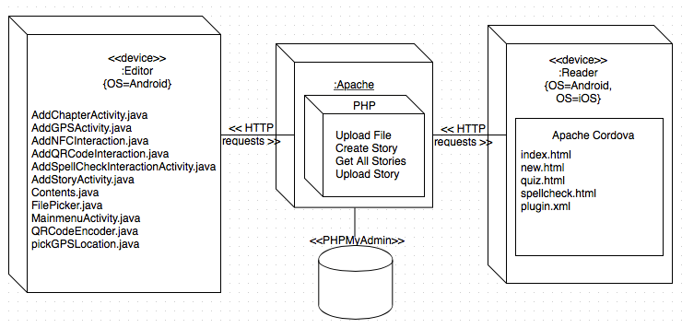
Architecture
Figure 1. Architecture Diagram

Slide 5
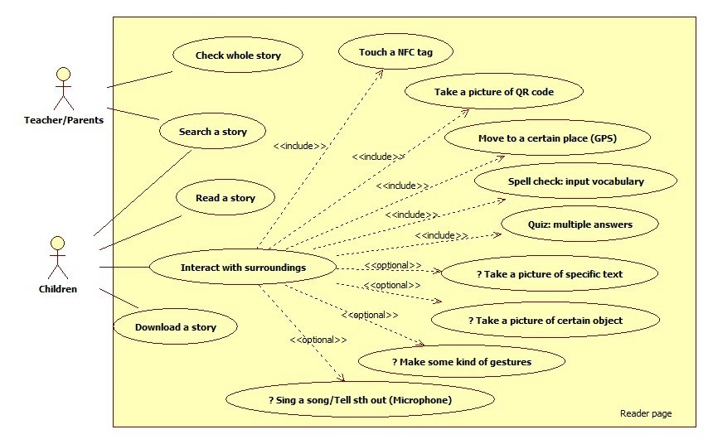
Use case diagram(1)
Figure 2. Use case diagram for reader

Slide 6
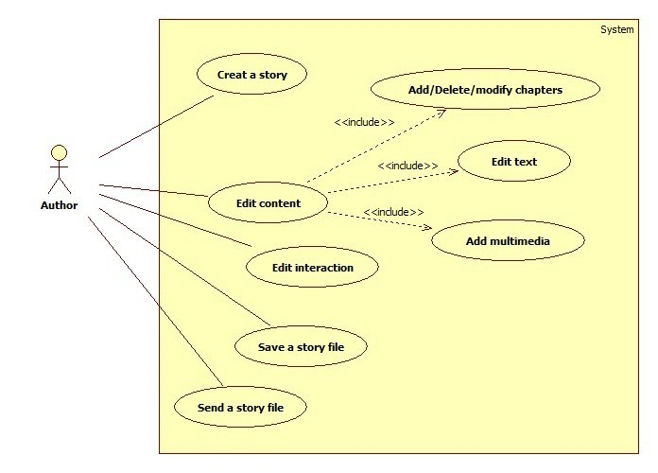
Use case diagram(2)
Figure 3. Use case diagram for editor

Slide 7
Implementation: reader(1)
Tools: Apache Cordova
Programming languages: html, css, javascript, etc.
APIs
  NFC: phonegap-nfc
  QR code scanner: BarcodeScannerPlugin
  QR code generator: Google Chart API
  Database: Cordova SQLitePlugin

Slide 8
Implementation: reader (2)
Functionalities
  Load the whole story file (json) from server.
  Read story file.
  Display story, including text, images, video and audio.
  Interactions:
    Touch NFC tags
    Scan QR code
    Go to special location (GPS)
    Spell new word
    Answer quiz

Slide 9
Licenses
Plugin | License | Function
com.phonegap.plugins.barcodescanner 2.2.0 "BarcodeScanner" | MIT | QR code
com.bridge.open 0.6.0 "Open" | GPLv2 | Open video file with installed application
com.brodysoft.sqlitePlugin 1.0.4 "Brodysoft SQLitePlugin" | MIT | Access to native SQLite Database
com.chariotsolutions.nfc.plugin 0.6.1 "NFC" | MIT | NFC interaction
com.megster.cordova.FileChooser 0.0.0 "File Chooser" | No license | Get the json file from phone. It can be changed to another with a license. It's a project in github.
org.apache.cordova.console 0.2.13 "Console" | Apache 2.0 | To print in the console to make logs and easy debugging
org.apache.cordova.device 0.3.0 "Device" | Apache 2.0 | Already included in the default project
org.apache.cordova.file 1.3.3 "File" | Apache 2.0 | File management like copying to cache to playback and getting certain paths.
org.apache.cordova.file-transfer 0.5.0 "File Transfer" | Apache 2.0 | Download file from url.
org.apache.cordova.geolocation 0.3.12 "Geolocation" | Apache 2.0 | GPS interaction
org.apache.cordova.media 0.2.16 "Media" | Apache 2.0 | Playback audio for feedback of interactions

Slide 10
Implementation: editor
Tools: Android Studio
Functionalities
  Create/save/share a story, including chapters, at any time
  Edit text and insert image, video and audio
  Add interactions:
    Write messages in a NFC tag
    Generate a QR code image with some texts
    Create location information
    Edit spelling problem
    Edit quiz
Web service

Slide 11
Evaluation
Usability test
  Android tablet/phone
  iOS phone
  improvement: web service
Unit test: not finish yet

Slide 12
Future work(1)
Unit test
UI design
Test with real teacher and children, and improve it according to their opinions

Slide 13
Future work(2)
Functionalities
  Application could have non-linear storyline (one beginning, several ends).
  Application should require user-authorisation (signup and login).
  Reader could download the desired story from online website.
  Application could have text recognition and image recognition implemented (Take picture interaction) .
  Smartphone Application could allow audio recording as a type of interaction.
  Interactions could be selected randomly for each chapter (multiple interactions).
  Story editor could have editing options such as change font or font size, themes, etc.
  NFC interaction to send story from editor to reader.

Slide 14
Conclusion
Unit test: not finished.

Slide 15
References
[1] Martin, Sheena. "Interactive whiteboards and talking books: a new approach to teaching children to write?." Literacy 41.1 (2007): 26-34.
[2] Teck, Wong Kung. "Affordances of Interactive Whiteboards and Associated Pedagogical Practices: Perspectives of Teachers of Science with Children Aged Five to Six Years." Turkish Online Journal of Educational Technology-TOJET 12.1 (2013): 1-8.
[3] Luckin, Rosemary, et al. "Children's interactions with interactive toy technology." Journal of Computer Assisted Learning 19.2 (2003): 165-176.
[4] Holmqvist, Mona, Göran Brante, and Charlotte Tullgren. "Learning study in pre-school: teachers' awareness of children's learning and what they actually learn." International Journal for Lesson and Learning Studies 1.2 (2012): 153-167.
[5] Hoisington, Cindy, et al. "Promoting Children's Science Inquiry and Learning Through Water Investigations." YC Young Children 69.4 (2014): 72.
[6] Hutinger, Patricia. Young Children as Explorers: Interactive Learning Experiences. Center for Best Practices in Early Childhood Education, Western Illinois University, 2004.
[7] Subrahmanyam, Kaveri. "The Impact of Interactive Technology on Children's & Adolescents' Cognitive and Social Skills." (2002).
[8] Jones, Margie, and Min Liu. "Introducing Interactive Multimedia to Young Children: A Case Study of How Two-Year-Olds Interact with the Technology." Journal of computing in childhood education 8.4 (1997): 313-43.

Slide 16
Demo

