Slide 1

References (manager)
Version control
- final.doc
- final-final.doc
- really final.doc
External components
(copy & paste
figures, tables, etc.)
Collaboration
- track changes
- emails
- dropbox

Slide 2
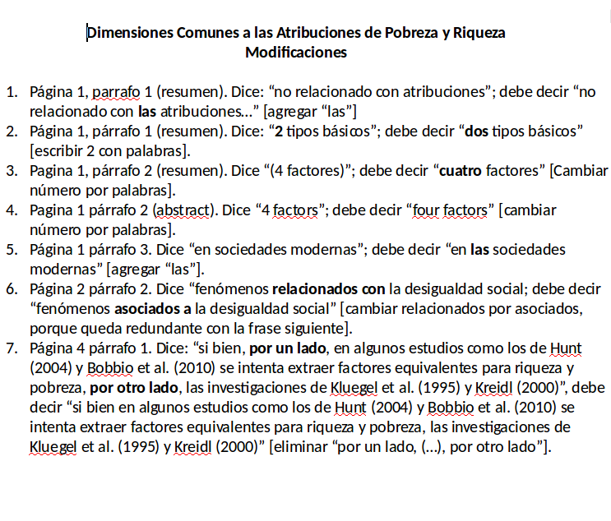
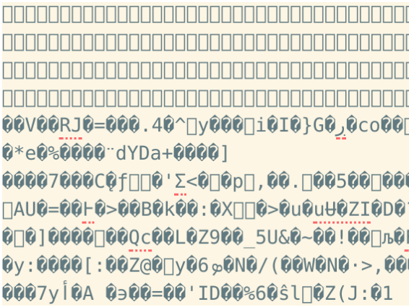

Slide 3
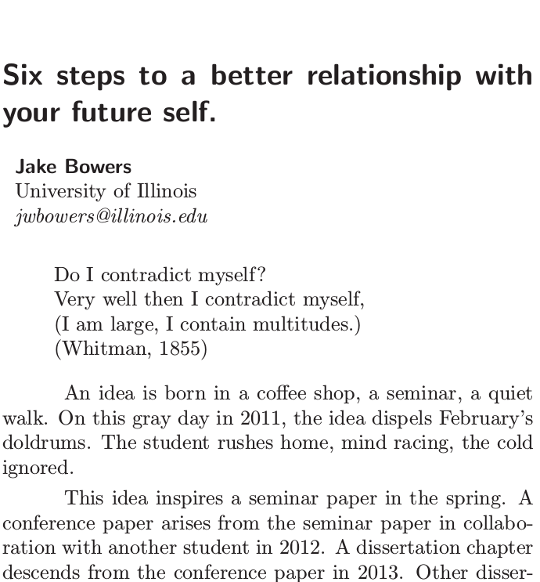

2011 - The political methodologist 18(2)2-8
www.plain-text.co

Slide 4

Writing
Citing
Results
Version Control
Git
Markdown
Zotero
BetterBibTex
R
Knitr/Kable
Github
Collaboration
Zotero-Picker
R box
Hydrogen
Language-Markdown
Mk.-preview-enhanced
Wordcount
Spell-check
Pandoc-convert
Git-plus
Time-machine
Git-diff-details
...many others

