Slide 1

Angular and Node.js Workshop
DAV University
23rd April, 2018

Slide 2
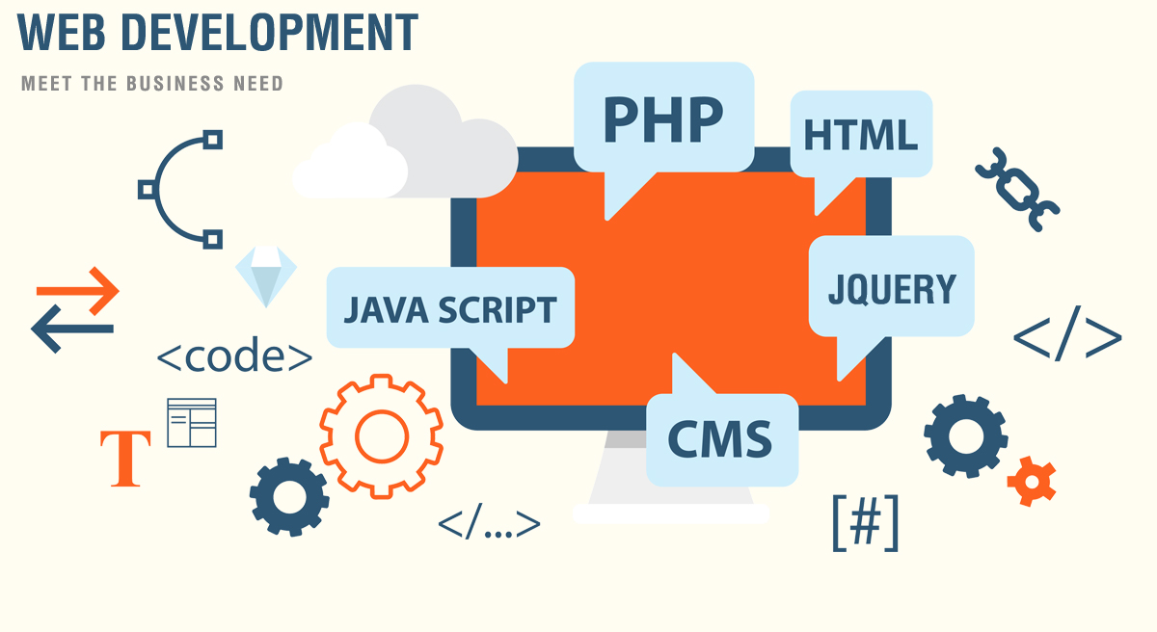

Slide 3
Web Development
Web development is the creation of dynamic web applications. Examples of web applications are social networking sites like Facebook or e-commerce sites like Amazon.
Web Development
Front-end Development
Back-end Development
Two broad divisions of web development –
front-end development (also called client-side development)
back-end development (also called server-side development).

Slide 4
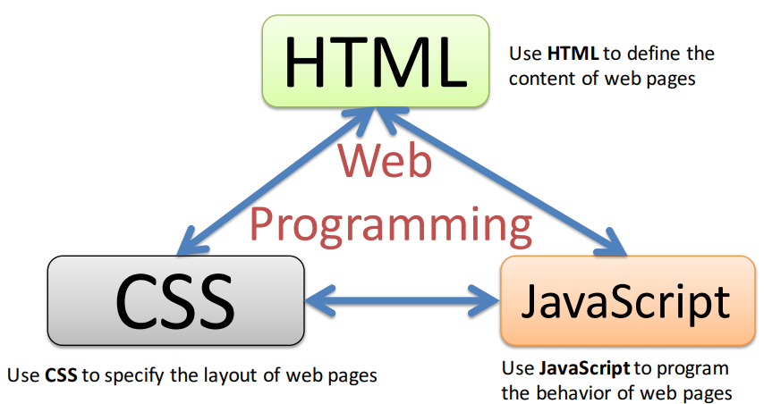
Front-End Development
Constructing what a user sees when they load a web application – the content, design and how you interact with it.
Done with three codes – HTML, CSS and JavaScript.

Slide 5
Back-End Development
Back-end development controls what goes on behind the scenes of a web application. A back-end often uses a database to generate the front-end.
Back-end scripts are written in many different coding languages and frameworks, such as…
Java
Node.js
Python
PHP
Ruby on Rails
ASP.NET

Slide 6
Latest trends in Web Development
Real time applications
Progressive web applications
Blockchain
Push Notification With Websites
Single-Page Websites
Virtual reality (VR)
Mobile friendly website
Chatbots, AI, and machine learning

Slide 7
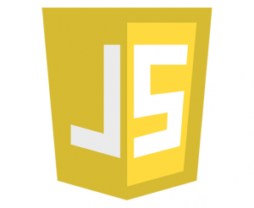
Javascript

Slide 8
What is JavaScript ?
Interpreted, client-side, event-based, object oriented scripting language
Used to add dynamic interactivity to your web pages.
Written in plain text, like HTML, XML, Java, PHP In this code
JavaScript is not Java, though both languages look similar when written.
Java is a full featured and comprehensive programming language similar to C or C++, and although JavaScript can interact with Java web applications, the two should not be confused

Slide 9

JavaScript - Syntax
JS can be implemented using JavaScript statements that are placed within the <script>... </script>.
Script tag takes two important attributes −
Language - Specifies what scripting language you are using
Type - To indicate the scripting language in use and its value should be set to "text/javascript".

Slide 10
Advantages of JavaScript
Less server interaction
Immediate feedback to the visitors
Increased interactivity
Richer interfaces
JavaScript is an easy language to learn
Easy to debug and test
Platform independent
Event-Based Programming language

Slide 11
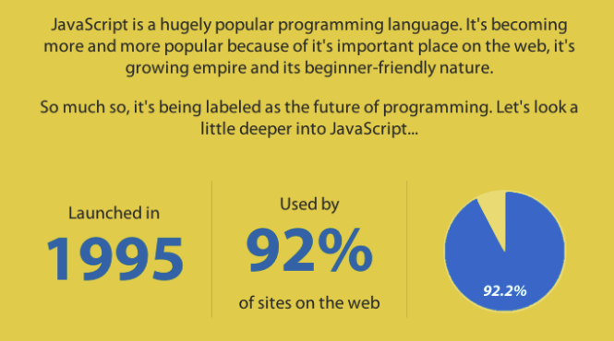
Why javascript is the future of programming?

Slide 12
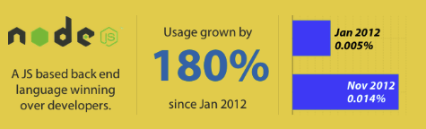
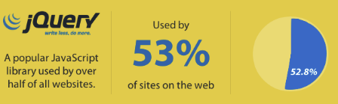
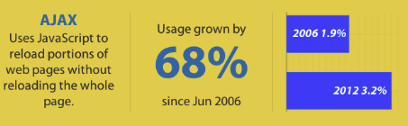
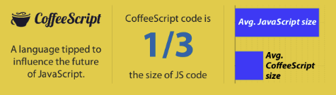
Why javascript is the future of programming?

Slide 13
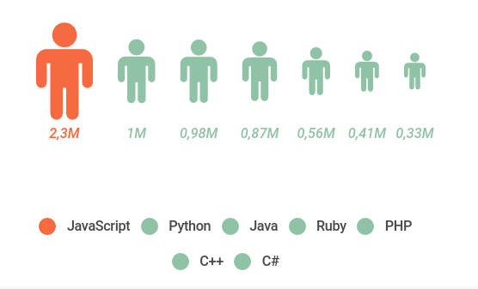
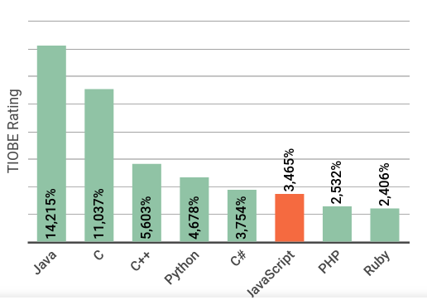
Career Scope of JS
GitHub Octoverse
Most popular languages on GitHub by opened pull requests (displayed in millions).
TIOBE Rating: (January 2018)
The TIOBE rating is an indicator of the popularity of programming languages.

Slide 14
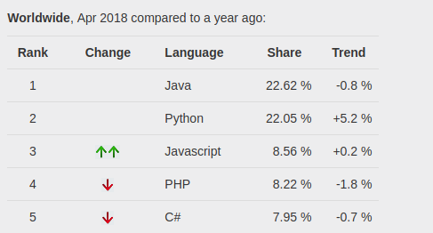
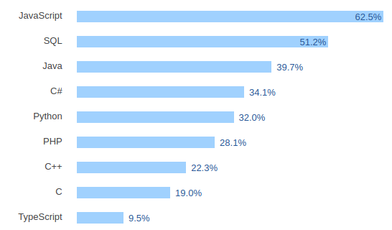
Career Scope of JS
PYPL PopularitY of Programming Language (April 2018)
The PYPL PopularitY of Programming Language Index is created by analyzing how often language tutorials are searched on Google.
Stack Overflow Developer Survey 2018

Slide 15

Angular JS

Slide 16
What is AngularJS
AngularJS is a client side JavaScript MVC framework to develop a dynamic web application. AngularJS was originally started as a project in Google but now, it is open source framework.

Slide 17
Why AngularJS
Structure, Quality and Organization
Lightweight ( < 36KB compressed and minified)
Free
Separation of concern
Modularity
Extensibility & Maintainability
Reusable Components

Slide 18
Features of AngularJS
Two-way Data Binding – Model as single source of truth
Directives – Extend HTML
MVC
Dependency Injection
Testing
Deep Linking (Map URL to route Definition)
Server-Side Communication

Slide 19
MVC
Model (Data)
View (UI)
Notifies
Changes
Notifies
Controller (Logic)
Model
JS Objects
View
DOM
Controller
JS Classes

Slide 20
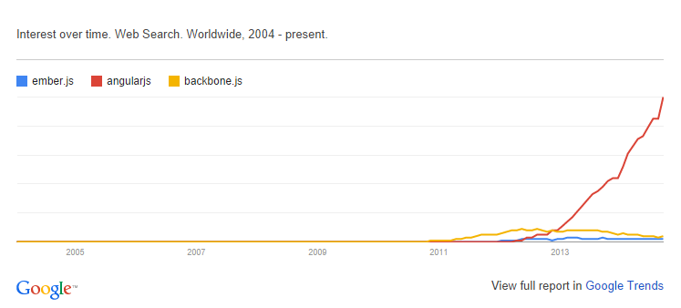
Other Javascript Frameworks
BackboneJS
EmberJS

Slide 21
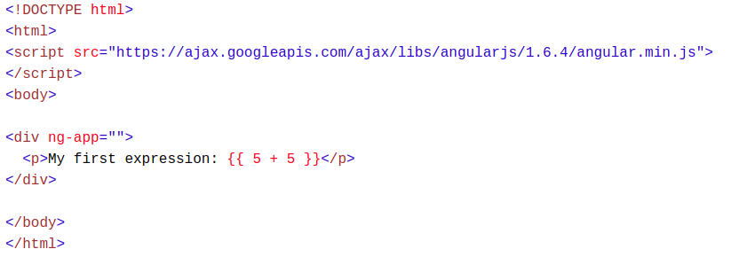
Expressions
AngularJS expressions can be written inside double braces: {{ expression }}.
AngularJS expressions can also be written inside a directive: ng-bind="expression".
Example {{ 5 + 5 }} or {{ firstName + " " + lastName }}

Slide 22
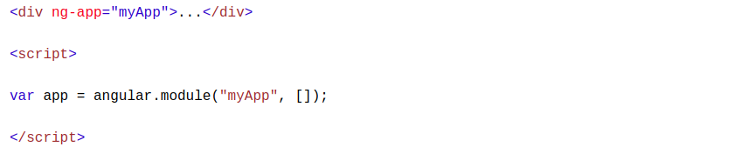
Modules
An AngularJS module defines an application.
The module is a container for the different parts of an application.
The module is a container for the application controllers.
Controllers always belong to a module.

Slide 23
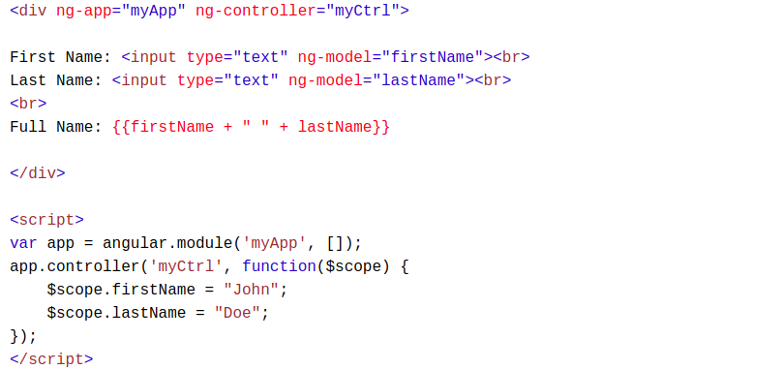
Controllers
AngularJS controllers control the data of AngularJS applications.
AngularJS controllers are regular JavaScript Objects.
The ng-controller directive defines the application controller

Slide 24
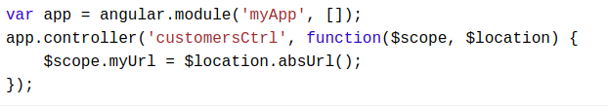
Services
In AngularJS, a service is a function, or object, that is available for, and limited to, your AngularJS application.
AngularJS has about 30 built-in services. One of them is the $location service.
The $location service has methods which return information about the location of the current web page

Slide 25
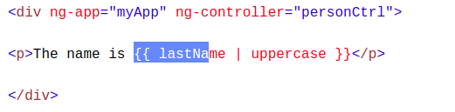
Filters
currency Format a number to a currency format.
date Format a date to a specified format.
filter Select a subset of items from an array.
json Format an object to a JSON string.
limitTo Limits an array/string, into a specified number of elements/characters.
lowercase Format a string to lower case.
number Format a number to a string.
orderBy Orders an array by an expression.
uppercase Format a string to upper case.

Slide 26
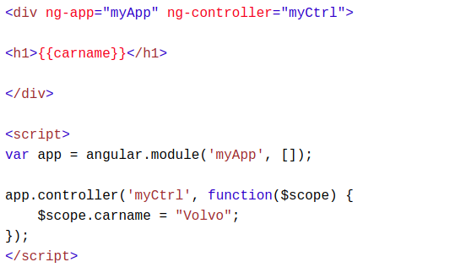
Scope
The scope is the binding part between the HTML (view) and the JavaScript (controller).
The scope is an object with the available properties and methods.
The scope is available for both the view and the controller.

Slide 27

Node JS

Slide 28
What is NodeJs
A JavaScript runtime environment running Google Chrome’s V8 engine
A server-side solution for JS
Compiles JS, making it really fast
Runs over the command line
Designed for high concurrency
Without threads or new processes
Never blocks, not even for I/O
Uses the CommonJS framework
Making it a little closer to a real OO language

Slide 29
Node JS vs Apache
It is fast
It can handle tons of concurrent requests
It is written in JavaScript (which means you can use the same code server side and client side)
Platform | Number of request per second
PHP ( via Apache) | 3187,27
Static ( via Apache ) | 2966,51
Node.js | 5569,30

Slide 30
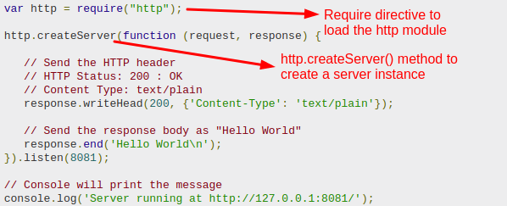
Creating Node.js Application
Execute the main.js to start the server as below

Slide 31
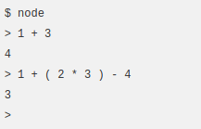
REPL Terminal
REPL stands for Read Eval Print Loop
Node comes bundled with a REPL environment. It performs the following tasks −
Read − Reads user's input, parses the input into JavaScript data-structure, and stores in memory.
Eval − Takes and evaluates the data structure.
Print − Prints the result.
Loop − Loops the above command until the user presses ctrl-c twice.

Slide 32
Node Package Manager (NPM)
Node Package Manager (NPM) provides two main functionalities −
Online repositories for node.js packages/modules which are searchable on search.nodejs.org
Command line utility to install Node.js packages, do version management and dependency management of Node.js packages.
Installing Modules using NPM
npm install <Module Name>

Slide 33
Non-blocking I/O
Servers do nothing but I/O
Scripts waiting on I/O requests degrades performance
To avoid blocking, Node makes use of the event driven nature of JS by attaching callbacks to I/O requests
Scripts waiting on I/O waste no space because they get popped off the stack when their non-I/O related code finishes executing

Slide 34
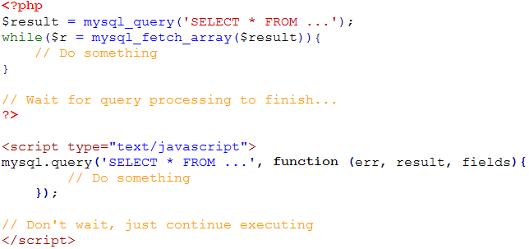
I/O Example

Slide 35

NOSQL & MONGO DB

Slide 36
Overview
In one day:
24 million transactions processed by Walmart
100 TB of data uploaded to Facebook
175 million tweets on Twitter
……….
How to store, query and process these data efficiently?

Slide 37
Overview
Problems with Relational Database:
Overhead for complex select, update, delete operations
Select: Joining too many tables to create a huge size table.
Update: Each update affects many other tables.
Delete: Must guarantee the consistency of data.
Not well-supported the mix of unstructured data.
Not well-scaling with very large size of data.
NoSQL is a good solution to deal with these problems.

Slide 38
Overview
What is NoSQL:
NoSQL = Non SQL or Not only SQL
Wikipedia’s definition:
A NoSQL database provides a mechanism for storage and retrieval of data that is modeled in means other than the tabular relations used in relational databases.

Slide 39
Overview – MongoDB
An open source and document-oriented database.
Data is stored in JSON-like documents.
Designed with both scalability and developer agility.
Dynamic schemas.

Slide 40
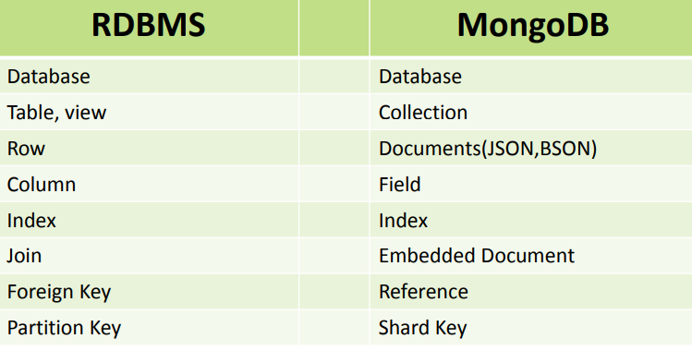
RDBMS VS MONGO DB

Slide 41
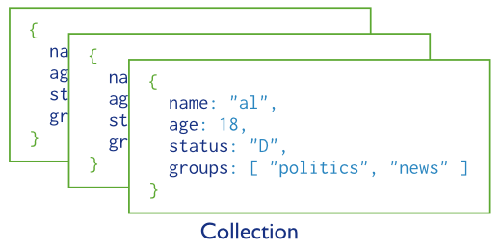
MongoDB Data Model
A collection includes documents.

Slide 42
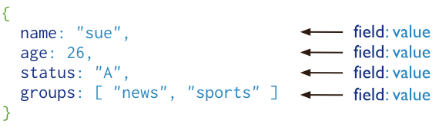
MongoDB Data Model
Structure of JSON-Document
The value of field:
Native data types
Arrays
Other documents

Slide 43
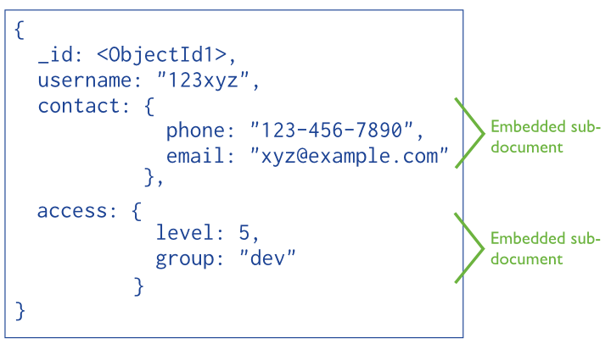
MongoDB Data Model
Embedded documents:

Slide 44
MongoDB Queries:
CRUD (Create – Update – Delete)
Create a database: use database_name
Create a collection: db.createCollection(name, options)
options: specify the number of documents in a collection etc.
Insert a document:
db.<collection_name>.insert({“name”: “nguyen”, “age”: 24, “gender”: “male”})
Query [e.g. select all]
db.<collection_name>.find().pretty()
Query with conditions:
db.<collection_name>.find( { “gender”: “female”, “age”: {$lte:20} }).pretty()

Slide 45
MongoDB Queries:
CRUD (Create – Update – Delete)
Update document
db.<collection_name>.update(<select_criteria>,<updated_data>)
Eg: db.students.update({‘name':‘nguyen'}, { $set:{‘age': 20 } } )
Replace the existing document with new one: save method:
db.students.save({_id:ObjectId(‘string_id’), “name”: “ben”, “age”: 23, “gender”: “male”}

Slide 46
Ask For Queries If Any?

Slide 47

Email: info@wtlabs.in Phone: 0181-5041415, 7973726189
Web: www.wtlabs.in
www.facebook.com/wtlabs

Slide 48


