Slide 1
Angular 2

Slide 2
Javascript
JavaScript is a high-level, dynamic, untyped, and interpreted programming language.
JavaScript was originally developed in May 1995 by Brendan Eich.
Standardized version named ECMAScript in June 1997

Slide 3
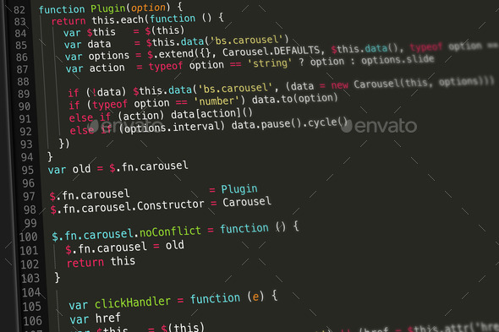
Javascript
The current edition of the ECMAScript standard is 6, released in June 2015.

Slide 4
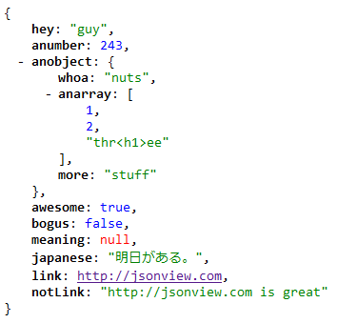
JSON
JSON is a language-independant data format.
Key-value pairs

Slide 5
Angularjs
Open source
Maintained by google and community
Frontend framework
Adjusts and adapts traditional HTML in order to present dynamic content through the two way data biding which allows instantaneous synchronization of views and models.

Slide 6
Angularjs 2
Still in development(Current version RC1)
Using TypeScript
Many modern browsers support it (Even IE9)

Slide 7
Typescript
TypeScript is a typed superset of JavaScript that compiles to plain JavaScript
Optional tipization and object oriented
Supports ECMAScript 2015 features like async functions and decorators
October 2012 (v0.8) Microsoft-a

Slide 8
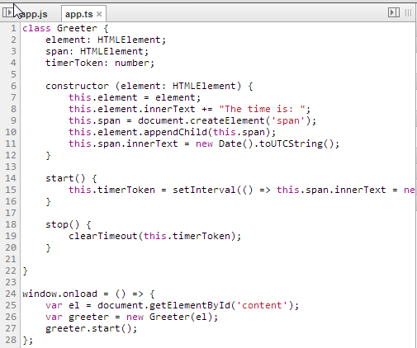
Typescript

Slide 9
Typescript
Additional functionalities
Modules, classes, interfaces, “arrow” syntaks, namespaces, enumerated types
Weakly or dynamically typed (:any)
Strongly typed (:string, :number, :Class)

Slide 10
Angularjs 2
Moduls
Contains parts of the application which we export
Components
Application logic which controls parts of the user interface
Templates
Renders the component on the page
Metadata
Infomations about the angular application parts

Slide 11
Moduli
Angular application is separated in modules
Modules export parts of Angular application (components, services) so they can be used in other parts of the application
Export / Import

Slide 12
METAdata
With metadata we describe parts of the Angular application and bind those parts together
@Component decorator

Slide 13
Komponente
Contains application logic
Control part of the user interface
1 root component
Bootstrapping component

Slide 14
Template
Mostly HTML with the parts of the angular code
Define how the component is rendered
@Component decorator for binding components with the templates
Inline template / Linked template

Slide 15
Data binding
Used for coordination of communication between component and template
Based on unidirectional dataflow(better performances)

Slide 16
Data Binding
One way data binding
Interpolation (Component > Template)
Using {{ }} we display values from component into template
Property binding (Component > Template)
Properties are DOM elements, not attributes
[ ] are used
Element property, component property, Directive property
[attr.aria-label ] for attributes, [class.class1] for classes, [style.color] for css

Slide 17
Data Binding
One way data binding
Event biding(Template > Component)
( ) are used
Events like clicked, mouse enter, changed…
Two way data binding
Sends values from component to template, and returns changed values from template to component
[( )]

Slide 18
Directives
Angular transforms DOM based on instruction from directives
Built in directives
Attribute directives
ngStyle, ngClass – [class.ClassName], [style.color]
Structural directives
They change DOM
*ngIf, *ngFor
*ngIf or [style.visibility]
# local variable

Slide 19
Pipes
Allow formatting of data while they are rendered on the template
Lowercase, date, number...

Slide 20
Services
Represent shared logic
Share data or functions between different parts of angular application
They minimize number of lines of code (code reusability)
@Injectable() decorator

Slide 21
Dependency injection
The way we give an instance of the object to some other part of the angular application
Instances of services are given through the constructors

Slide 22
Services
Services are registered in @Component decorator
Services are registered in the highest ranked component in the hierarchy which use the service

Slide 23
Lifecycle hooks
They allow us to tap at certain points in the lifecycle of the component
ngOnChanges, ngOnInit, ngAfterViewInit, ngOnChanges, ngOndestroy

Slide 24
http
Service that allows data to be returned or saved using Promises or Observables
Registering HTTP_PROVIDERS

Slide 25
Rxjs
RxJs (Reactive Js)
Observables
You need to subscribe to an observable
If something is changes observable notifies all subscribed parts

Slide 26
Routing
The way we move through the application
<base href=“/”>
ROUTER_PROVIDERS, @Routes, <Router-outlet>, [routerLink]

Slide 27
One Common Goal

