Slide 1
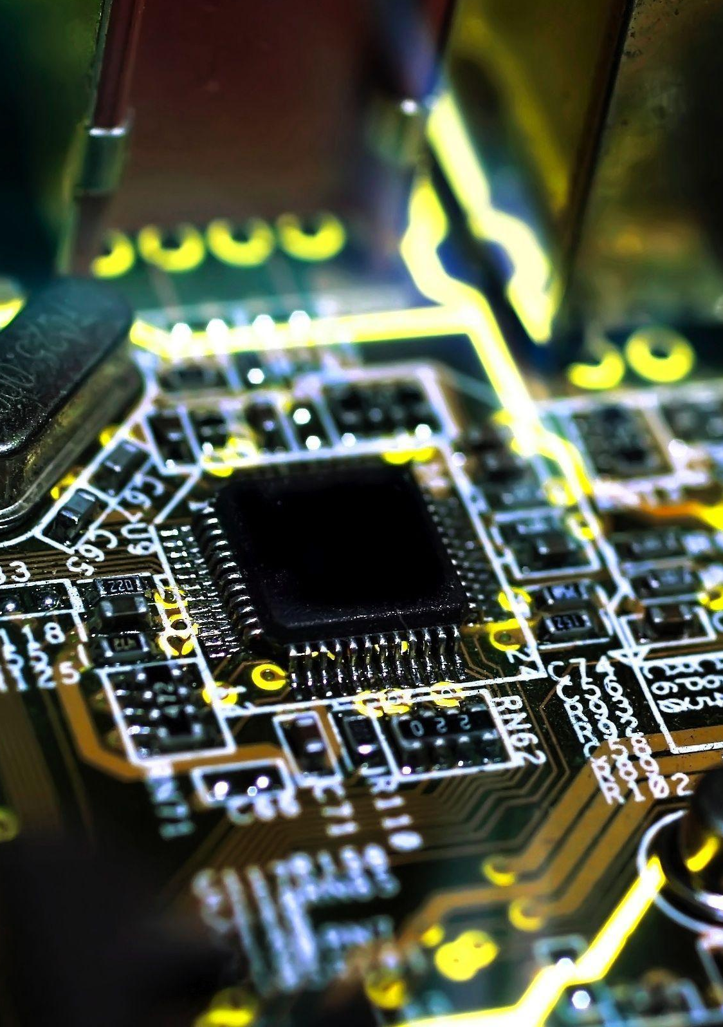
Reuniões Semanais #6 PC2023:0001:V3
ATA
Alencar Tecnologia da Amazonia.
CNPJ: 45.845.459/0001-24

Slide 2

Agenda
Hardware Overview;
Components Description;
Power Consumption;
Data Sampling;
Application;
Alencar Tecnologia da Amazonia
CNPJ: 45.845.459/0001-24
ATA

Slide 3
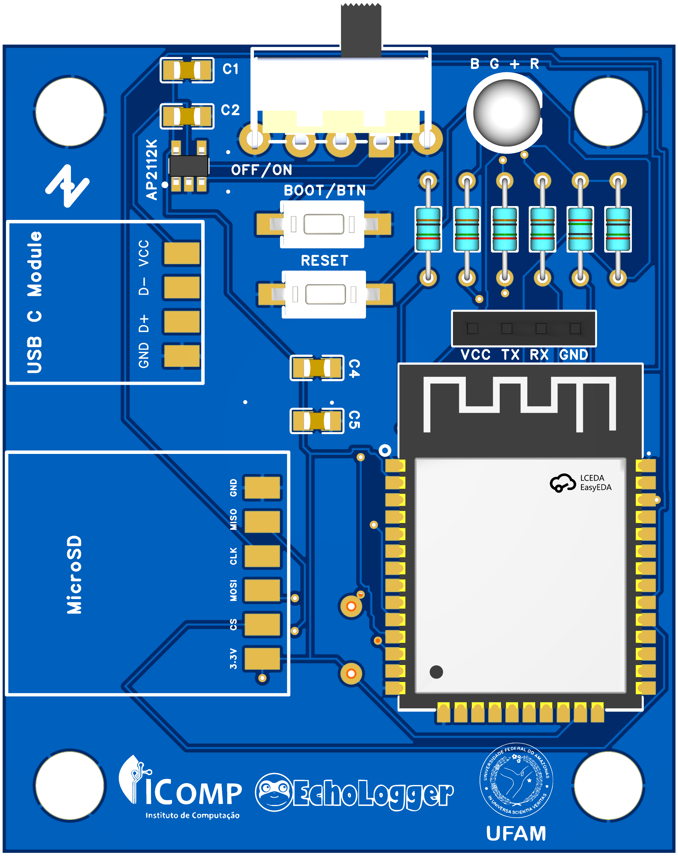
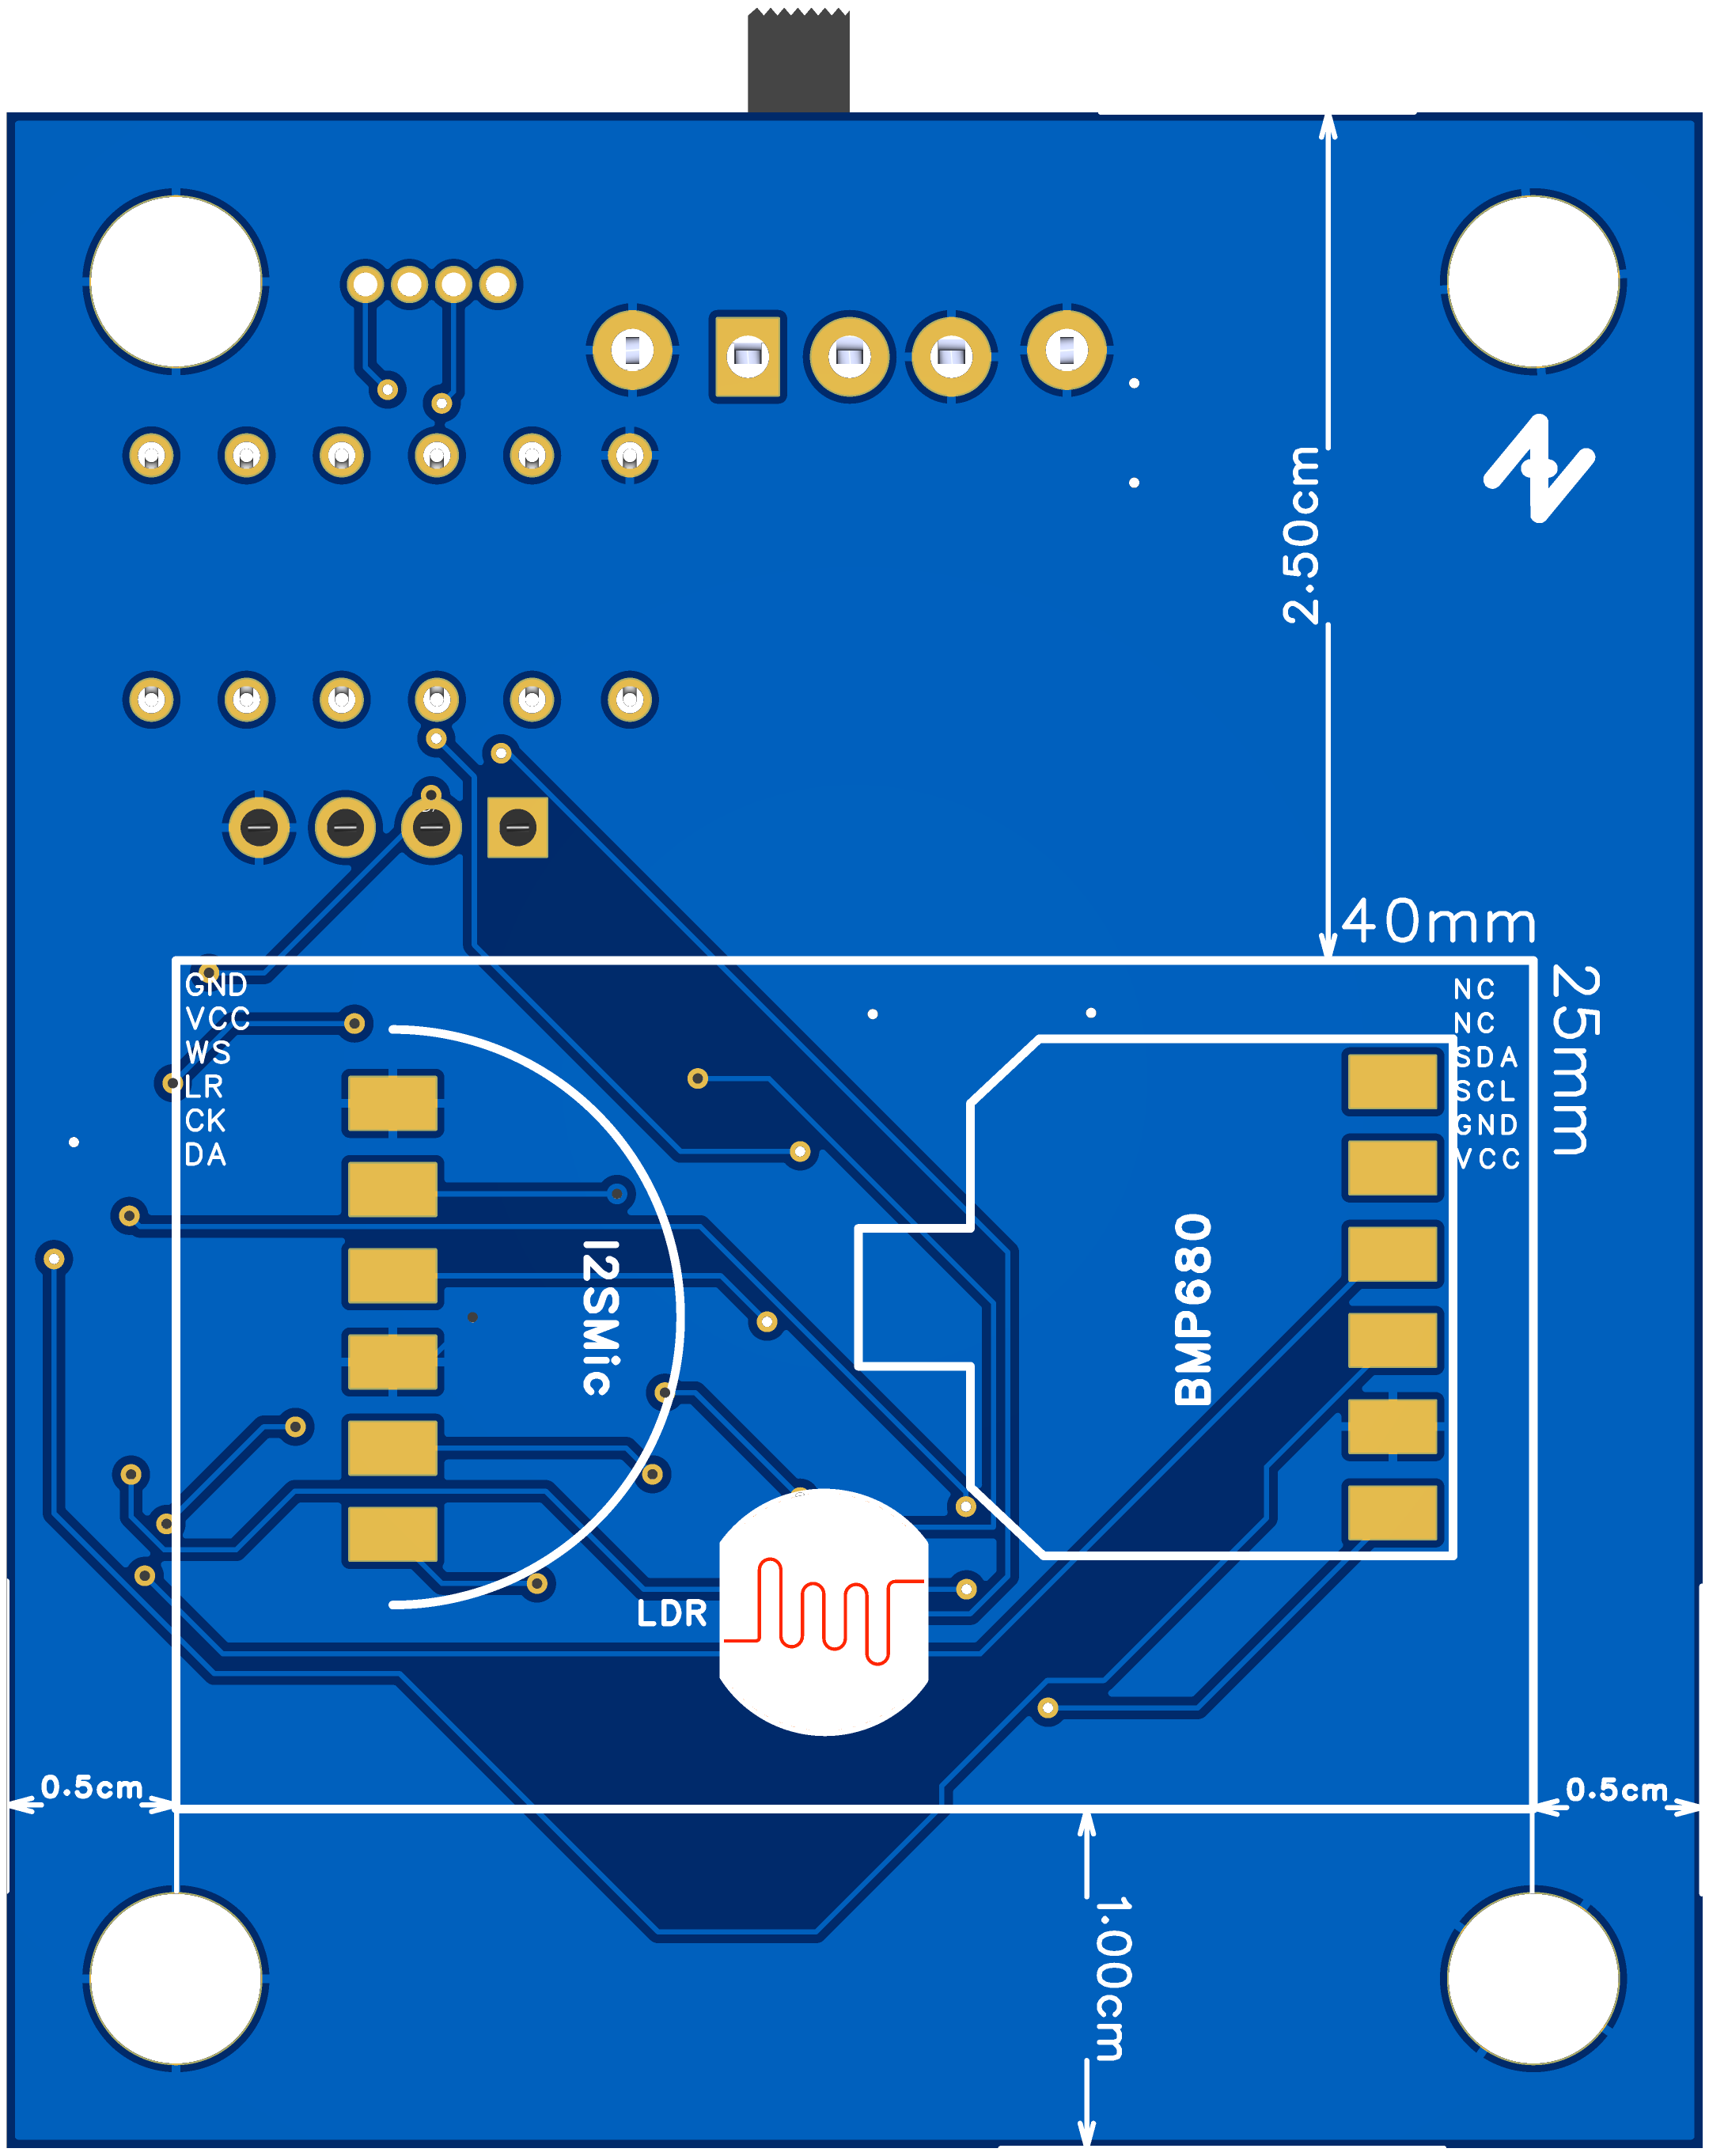
Hardware Overview
Custom Board
Controller:
ESP32 WROOM (BLE v4.0 & Wifi 802.11 b/g)
Embedded RTC
Firmware Micropython 1.20
Storage:
micro SD Card Slot
Sensors:
4x1 I2C Temperature, Humidity, Air Pressure and Air Quality
Mic I2S
LDR 5mm (ADC)
Alencar Tecnologia da Amazonia
CNPJ: 45.845.459/0001-24
ATA

Slide 4
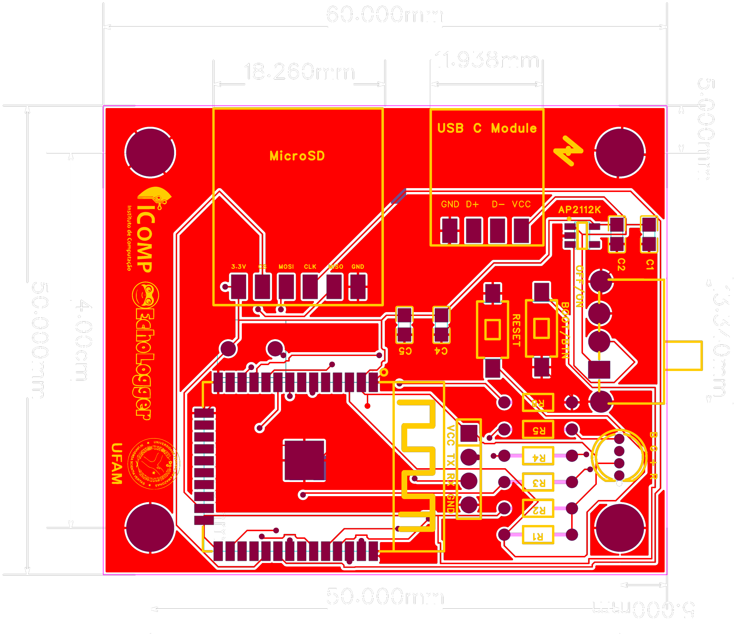
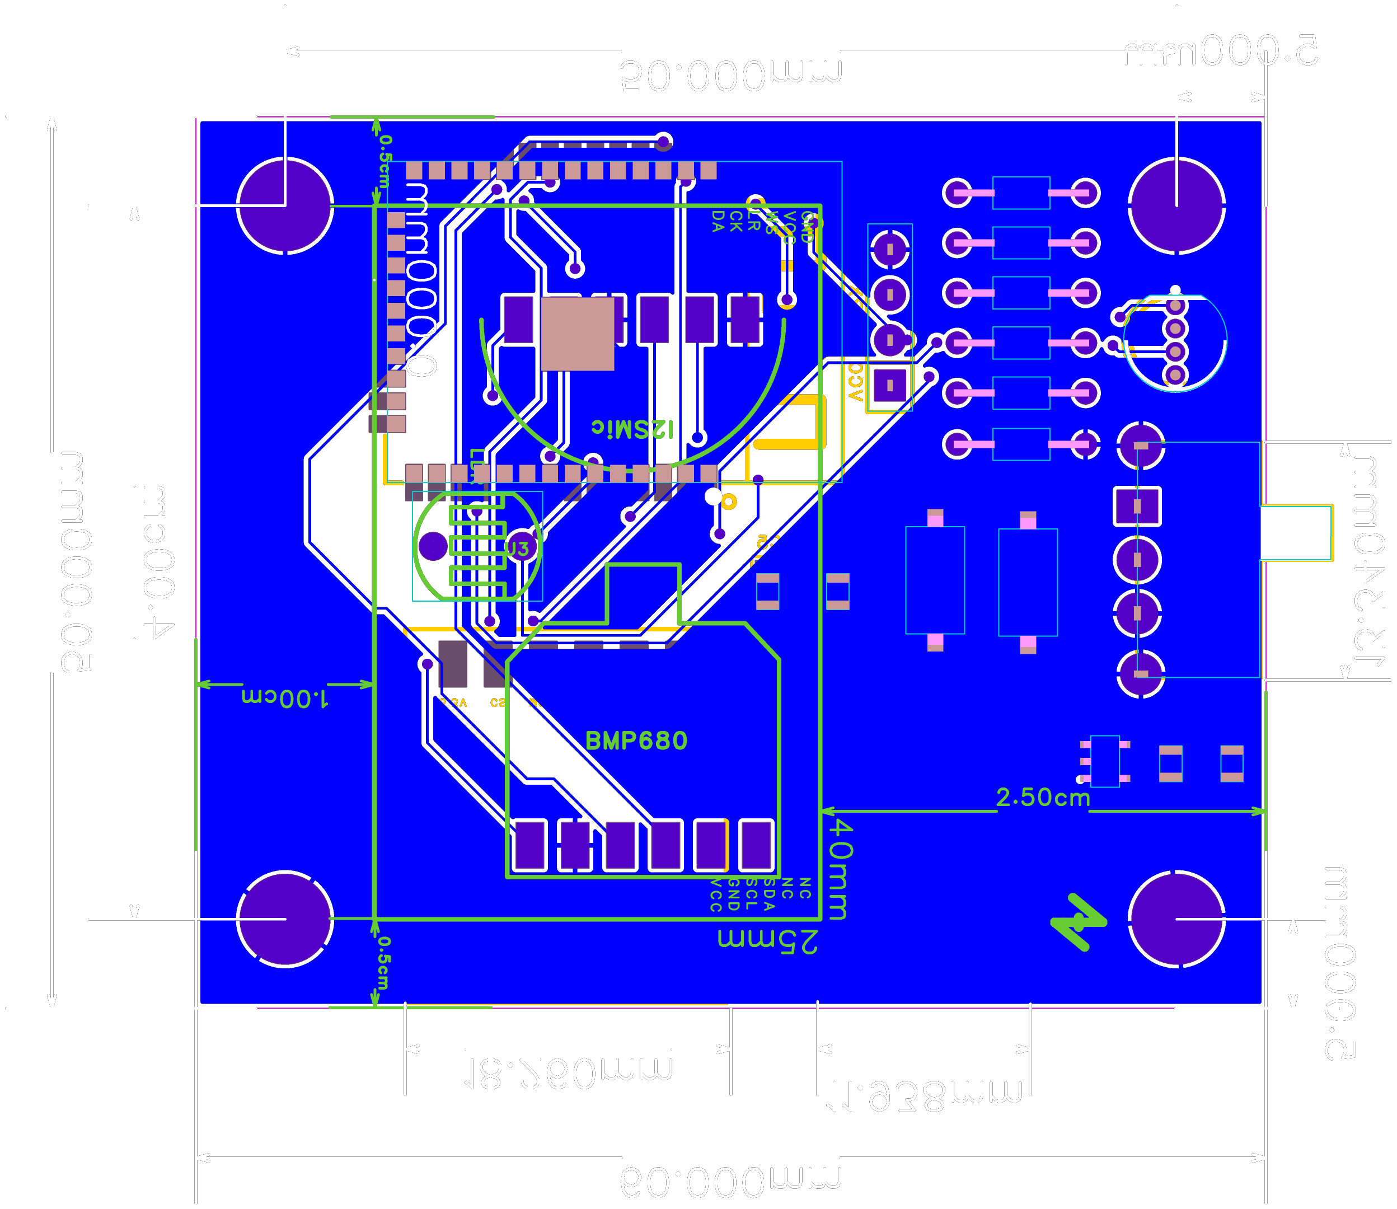
Hardware Overview
Custom Board
Dimensions:
60mm x 50mm x 20mm
Other characteristics:
4x Holes for board supporting: 5mm
1x Led RGB THP
2x Pushbuttons: Reset / Boot (firmware writing or regular button)
USB Breakout Pads
Voltage Regulator AP2112K-TGR-3.3v
Exposed UART vias
Alencar Tecnologia da Amazonia
CNPJ: 45.845.459/0001-24
ATA

Slide 5
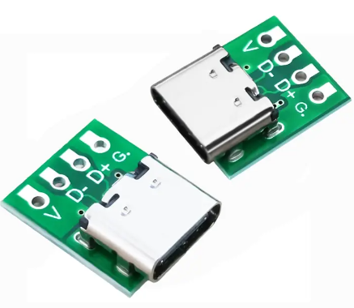
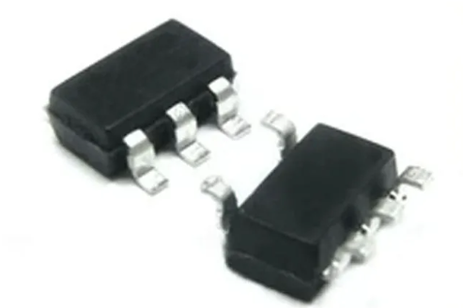
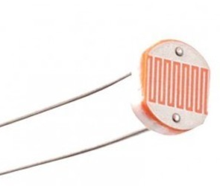
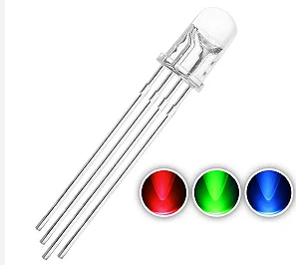
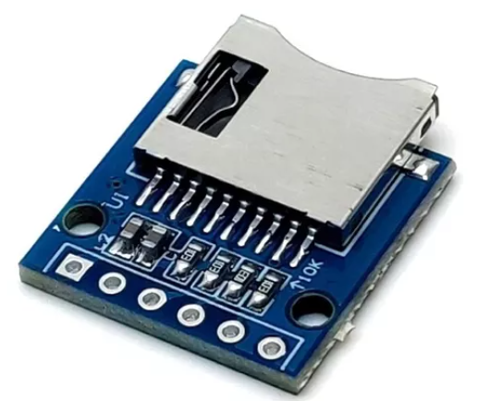
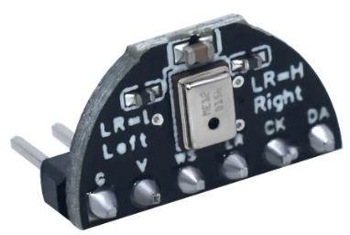
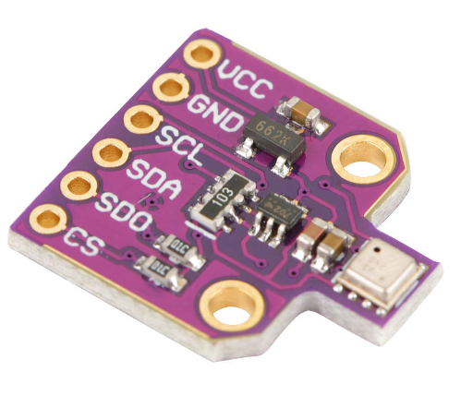
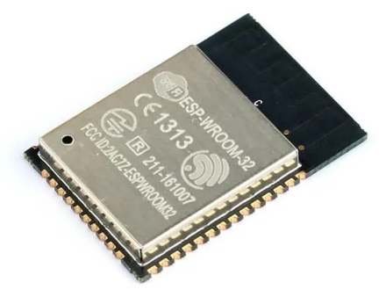
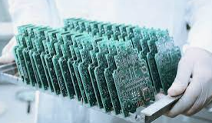
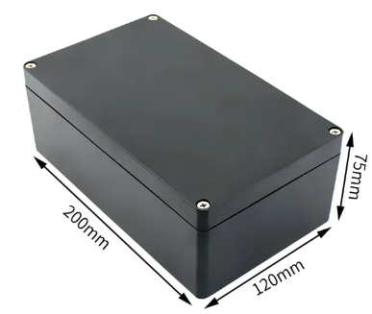
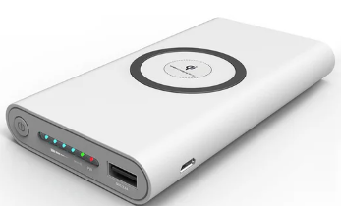
Components Descriptions
Component | Value
USB Power Supply (Module) | ~ 0.40
Voltage Regulator (AP2112) | ~ 0.10
LDR (Photoresistor) 5mm | ~ 0.01
Led RGB THP 5mm | ~ 0.02
MicroSD Module | ~ 0.25
I2S Mic | ~ 1.80
BME680 4x1 Sensor | ~ 3.70
ESP32-WROOM-32 | ~ 3.50
PCB | ~ 5.00
PowerBank (50A) | ~ 20.00
Waterproof Box – IP67 – 20x12x7.5cm | ~ 10.00
ESTIMATED COST | ~ 44,78
Alencar Tecnologia da Amazonia
CNPJ: 45.845.459/0001-24
ATA

Slide 6

Power Consumption
Power Supply:
APK2112: 2.8V ~ 6.5V @ 800A - 3.3V @ 600mA
Operation mode:
Reading Sensors: 50mA
SD Writing: 70mA
Deepsleep: 15mA
Waking up: 100mA
BLE: 170mA (TX) ~ 200mA (RX)
Alencar Tecnologia da Amazonia
CNPJ: 45.845.459/0001-24
ATA

Slide 7

Power Consumption
Consumption Estimation:
Routine: 1 min recording, 5 min sleeping;
Cycle: Sleep (5min), Wakeup (2s), Record (1min), Writing (2s)
Repetat the cycle for 1 hour (~ 10 cycles / hour)
Current (mA/h) | Activity (duration/hour)
12,5 | Sleeping (~50 min/hour)
0,555556 | Waking Up (~20sec/hour)
8,333333 | Recording (~10min/hour)
0,388889 | Writing (~20sec/hour)
21,77778 | Routine Consumption (mAh)
Estimation 30mAh (3.3V - 0.15 Wh)
Alencar Tecnologia da Amazonia
CNPJ: 45.845.459/0001-24
ATA

Slide 8
Data sampling
Alencar Tecnologia da Amazonia
CNPJ: 45.845.459/0001-24
ATA

Slide 9
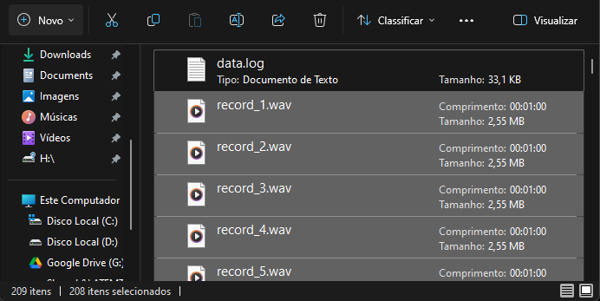
Data sampling
Audio Samples:
File name: record_N.wav
Format: WAV
Storage Consumption: 2.55MB/min
Audio splited in 1 min chunks
Alencar Tecnologia da Amazonia
CNPJ: 45.845.459/0001-24
ATA

Slide 10
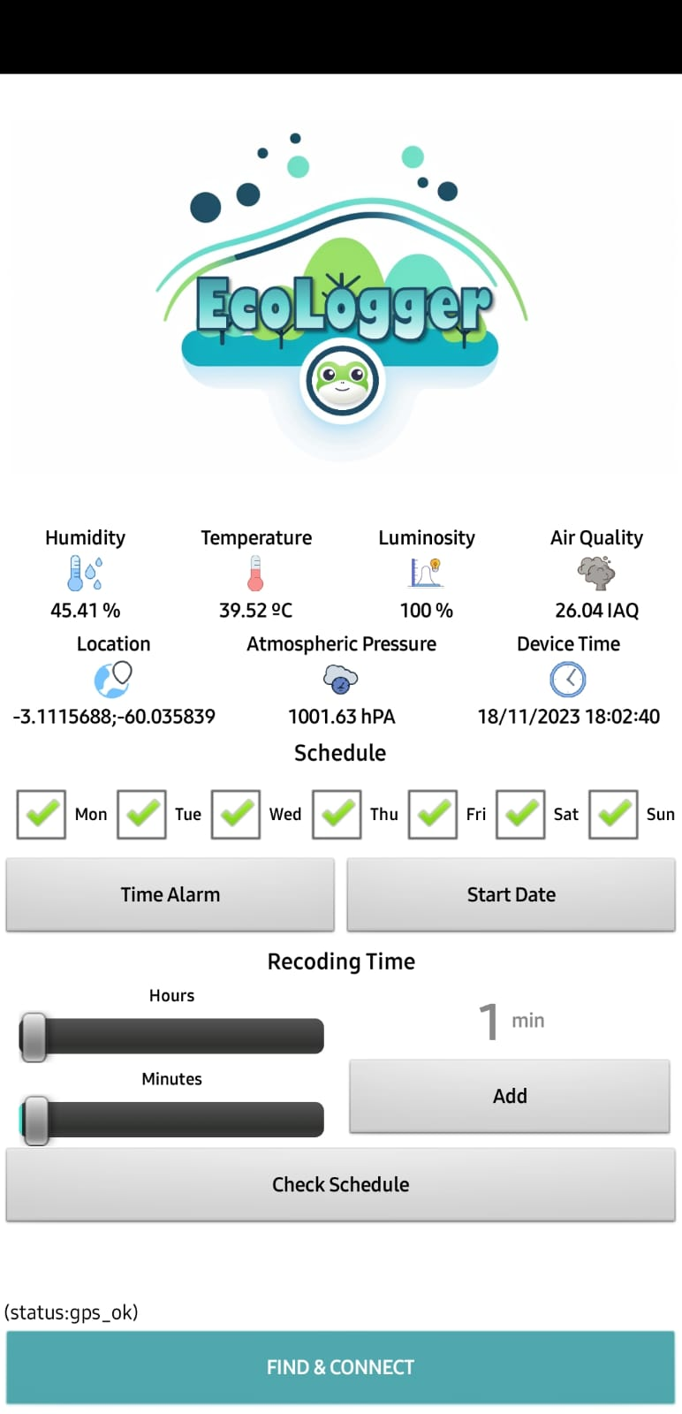
Application
Bluetooth Low Energy Configuration
Real time data (Sensor Readings)
Date Time / GPS Coordinates Sync
Scheduling Management
Activity Scheduling
Days of Week
Start Time
Start Date
Recording Interval: 0 (disabled) ~ 24h
Multiple Scheduling
Alencar Tecnologia da Amazonia
CNPJ: 45.845.459/0001-24
ATA

Slide 11
Obrigado!
PC2023:0001:V3
ATA
Alencar Tecnologia da Amazonia.
CNPJ: 45.845.459/0001-24

