Slide 1

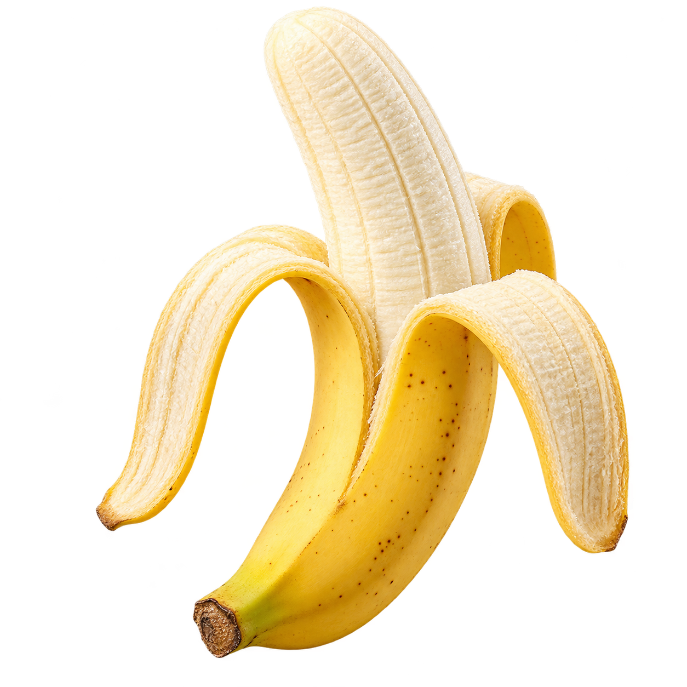
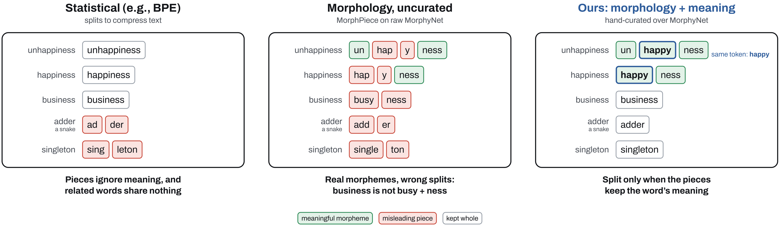


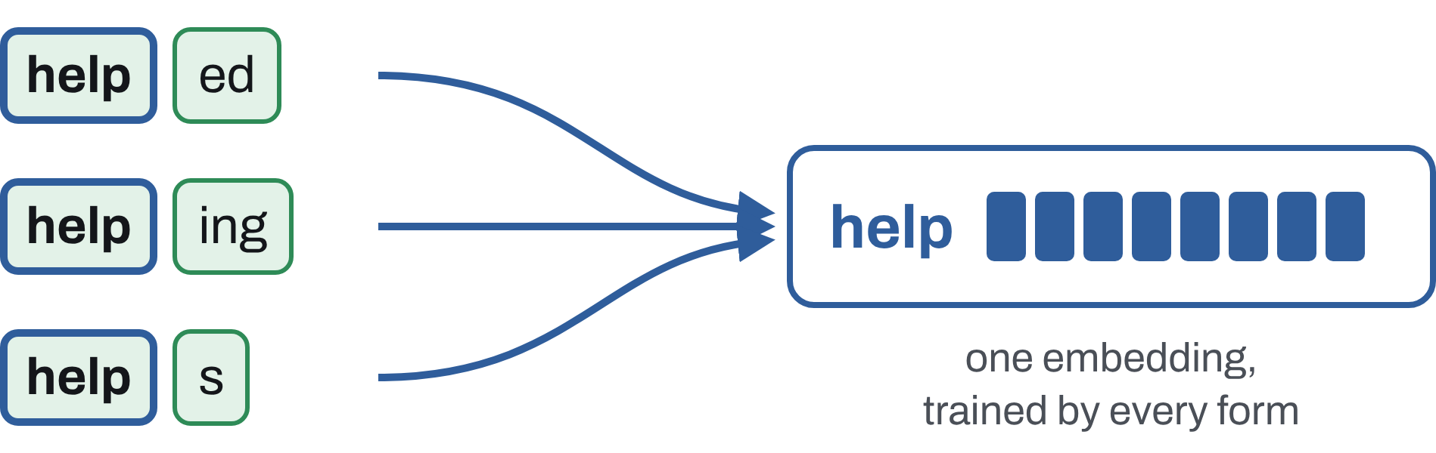
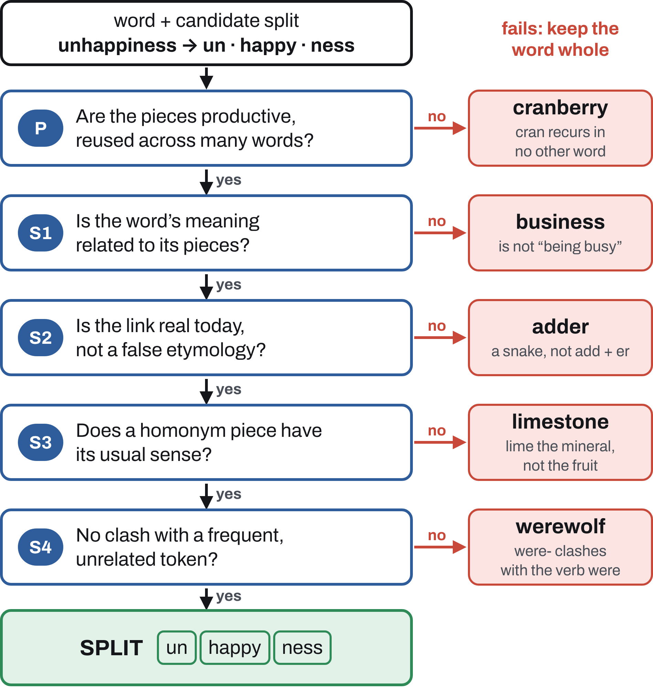
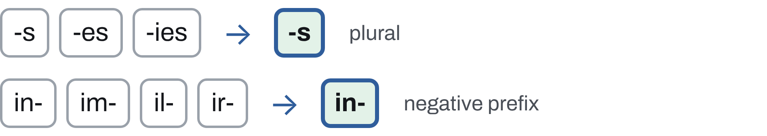
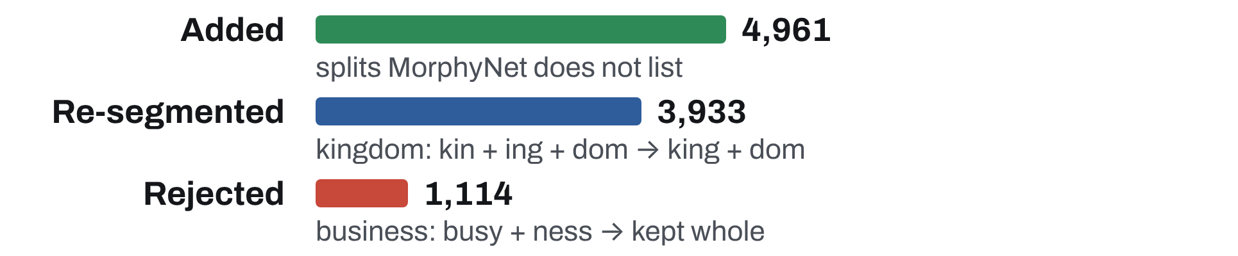
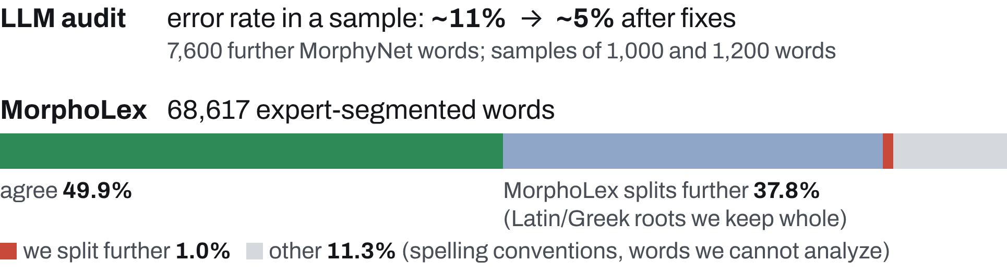


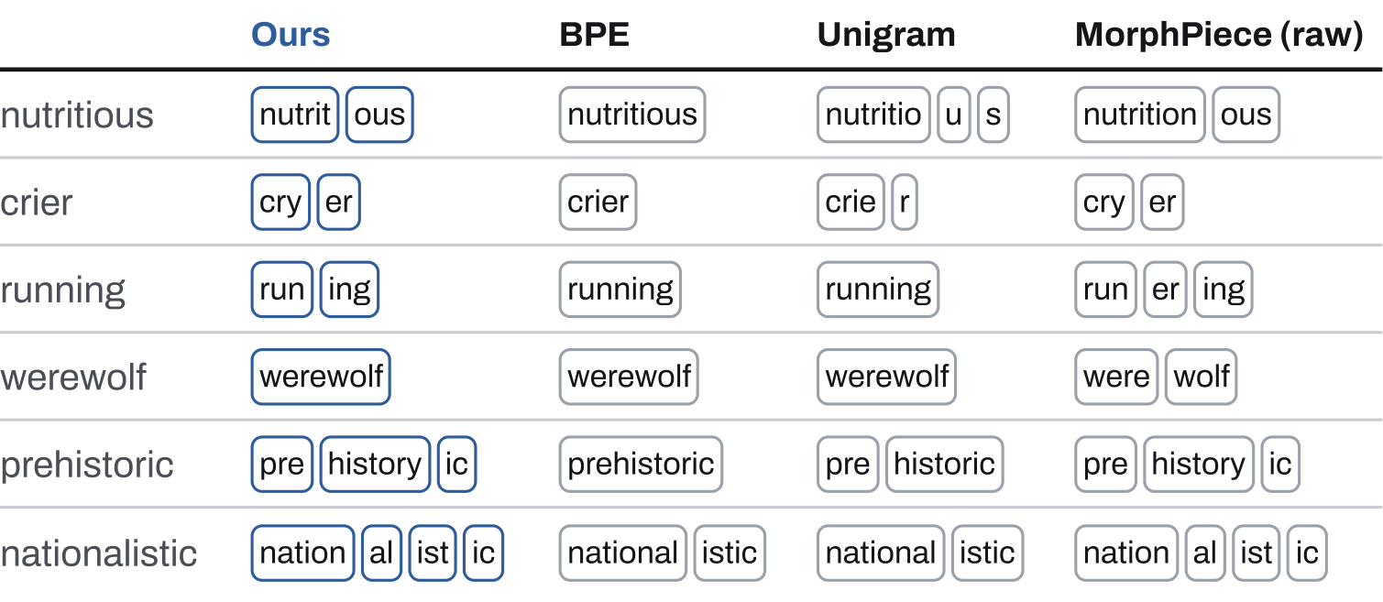
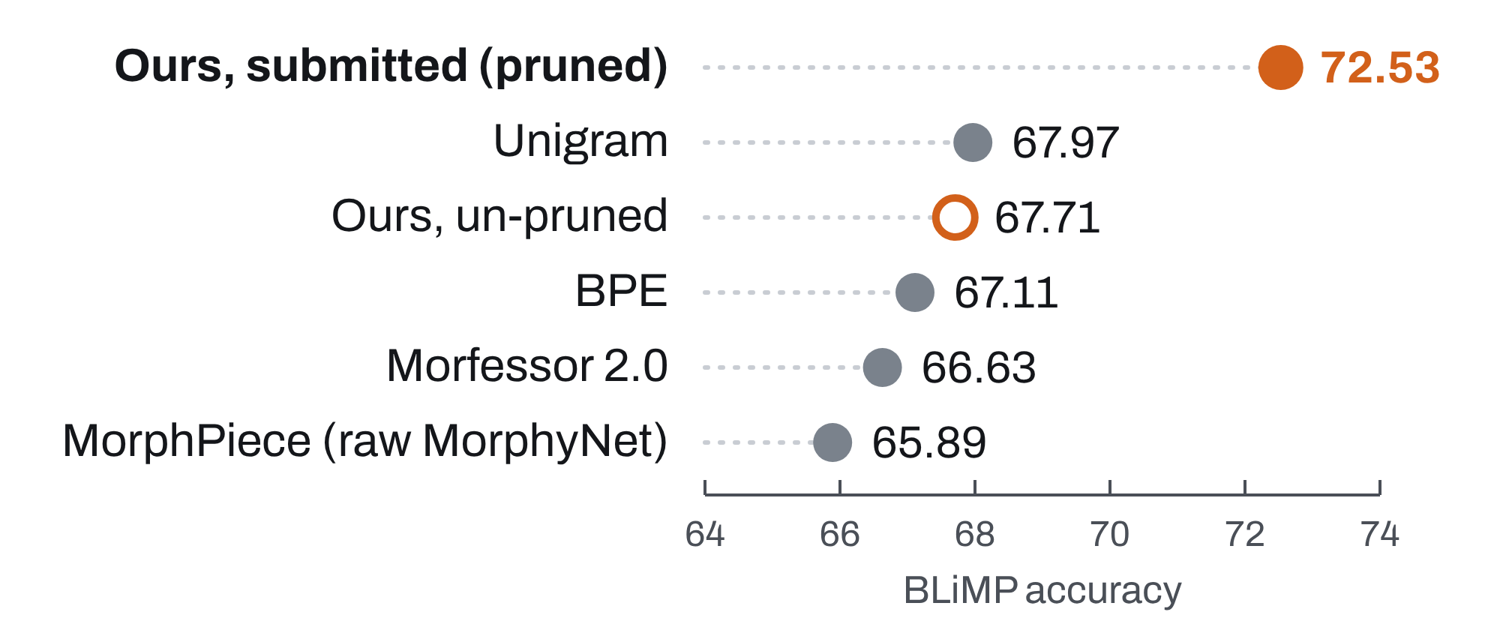



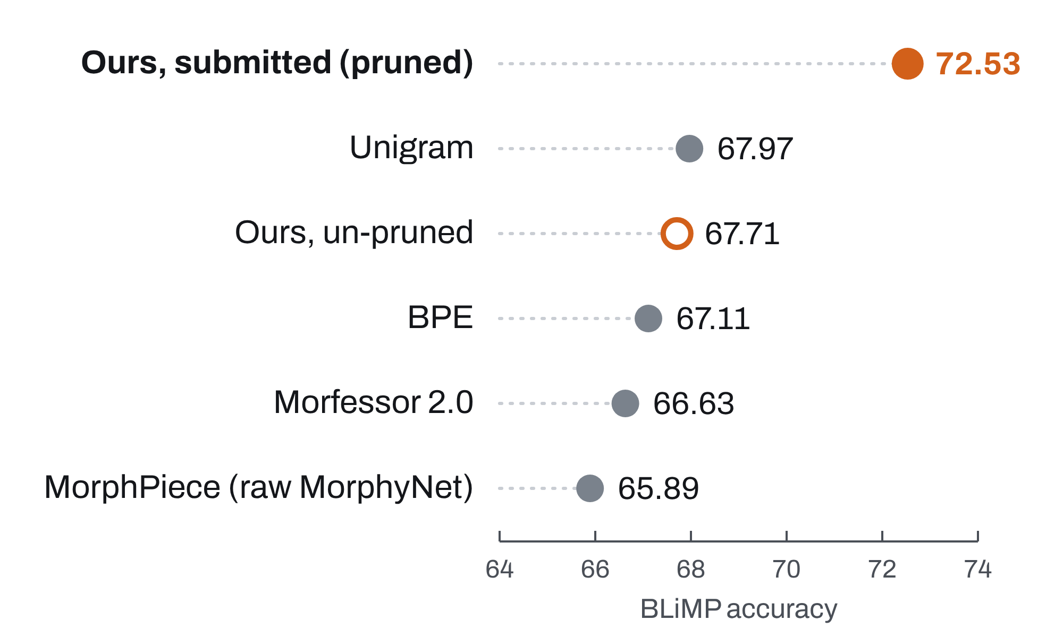
Tokens of Meaning: Semantically-Informed Morphological Tokenization in Low-Resource Language Modeling
Juan Diego Rodriguez
The University of Texas at Austin
Code
Split words into morphemes
but only when the split is meaningful
Every token counts at 10M words
Method: a meaning-aware morphological tokenizer
The BabyLM challenge restricts language models to a child-level training budget of 10M - 100M words, so many words rarely appear. Children readily extend morphological patterns (one wug, two wugs). A tokenizer can do the same: if semantically-related forms share a stem token, every form trains it.
1
When to split a word
2
How to split it
A candidate split is accepted only if it passes every check. Failing any one of them keeps the word whole.
Emit lemma-level morphemes, so spelling variants share the same token:
3
Annotation process
A typical shared stem appears in about 3 word forms. That gives it about 36% more training signal than its most frequent form alone.
MorphyNet supplies candidate splits. Its inflection table is clean enough to use almost as is. Its derivation table records history, not modern structure (king → kin ing), so it only proposes candidates, which we then filter.
Statistical tokenizers ignore meaning
We hand-segmented 22,137 frequent words, rejecting about 53% of the MorphyNet derivational splits they overlapped.
LLM agents (Claude Code) reviewed candidates adversarially; the author made every final decision.
BPE, WordPiece and Unigram split text to compress it. Their pieces often mean nothing (adder → ad der), and related words can end up with no token in common (unhappiness, happiness).
Meaning-preserving morpheme boundaries
36,638
morphemes in the vocabulary
1.0%
out-of-vocabulary tokens, with no subword fallback
41.9%
of morphemes shared by two or more word forms
Splitting adder, a snake, into add er teaches the model that an adder is someone who adds, and it pollutes both pieces.
In this work, we split helps only if the split is:
Two other cases where words stay whole:
genuinely ambiguous forms (leaves: leaf + s or leave + s)
proper names with no common-noun use.
4
What curation changed
5
Quality checks
Productive: each piece is reused across the vocabulary.
Semantic: the pieces are related to the word’s meaning.
28,571 explicit decisions; about 10,000 change MorphyNet:
What we did: We hand-curated an English morphological tokenizer that splits a word only when both conditions hold. We then trained child-scale language models with it, comparing it against other tokenizers and evaluating it on the BabyLM 2026 Challenge tasks.
Results
Leaderboard. On the BabyLM 2026 strict-small leaderboard, our submitted model ranks 2nd on COMPS (54.67) and 3rd on EWoK (53.2), with 72.53 on BLiMP.
Same training recipe, only the tokenizer changes
Curation is what helps. Against an uncurated tokenizer built from the same MorphyNet source, with the same model, data and seed, ours gains +1.4 BLiMP (66.35 vs 64.96).
Setup. Llama-style decoder (12 layers, 768 hidden), trained for 10 epochs on the 10M-word strict-small corpus with the Muon optimizer. Comparisons change only the tokenizer. The submitted model (about 135M parameters) adds masked next-token prediction.
The submitted tokenizer also drops morphemes seen fewer than three times and spells out unknown pieces as characters.

