Slide 1


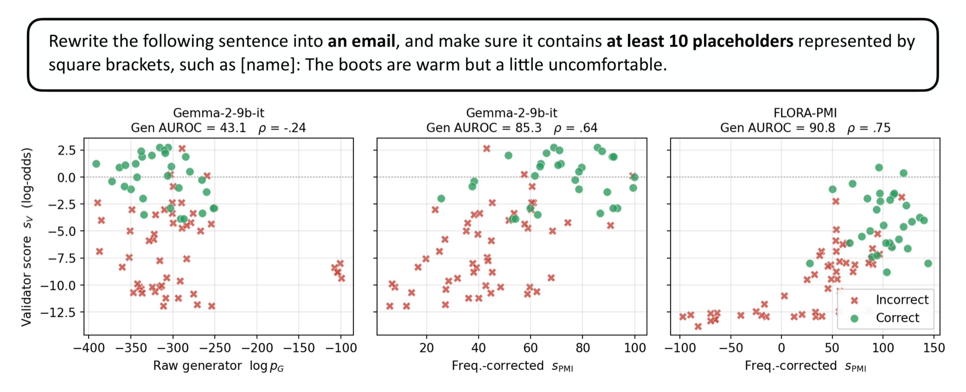
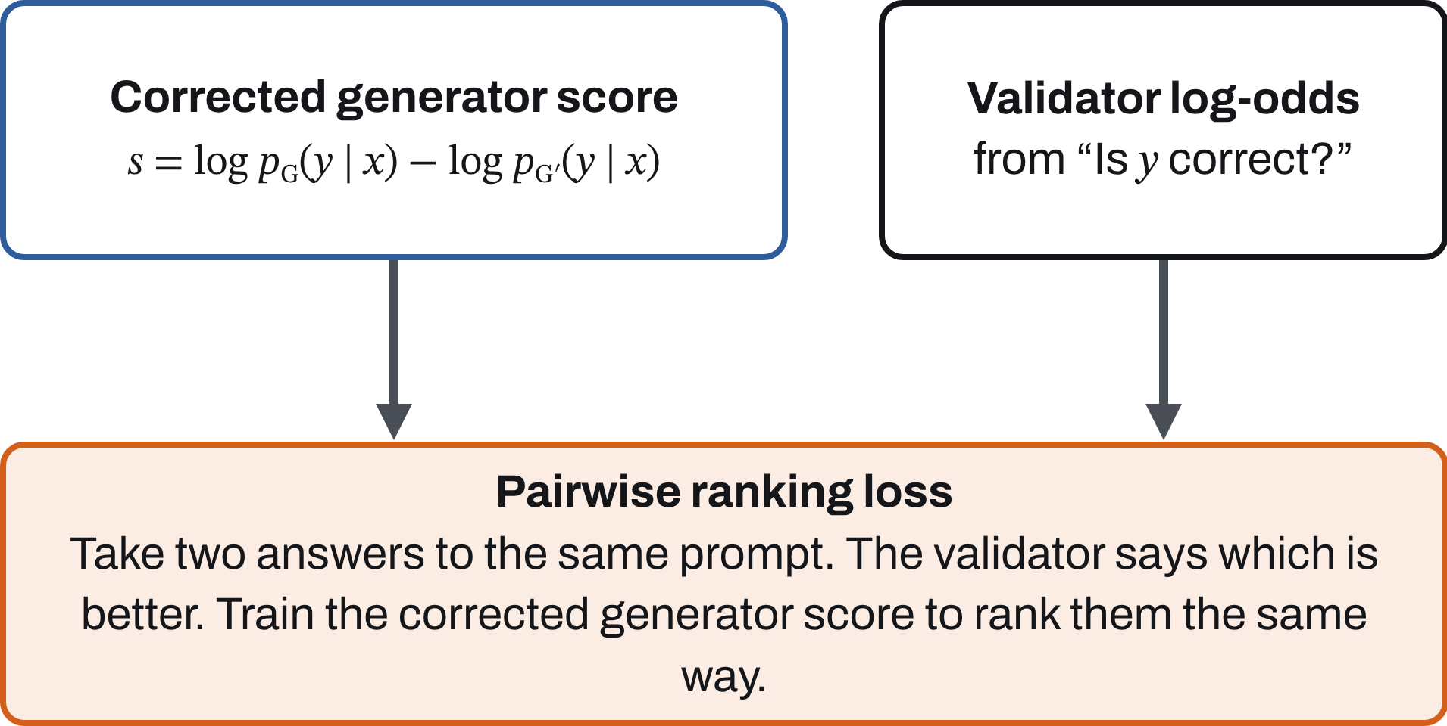
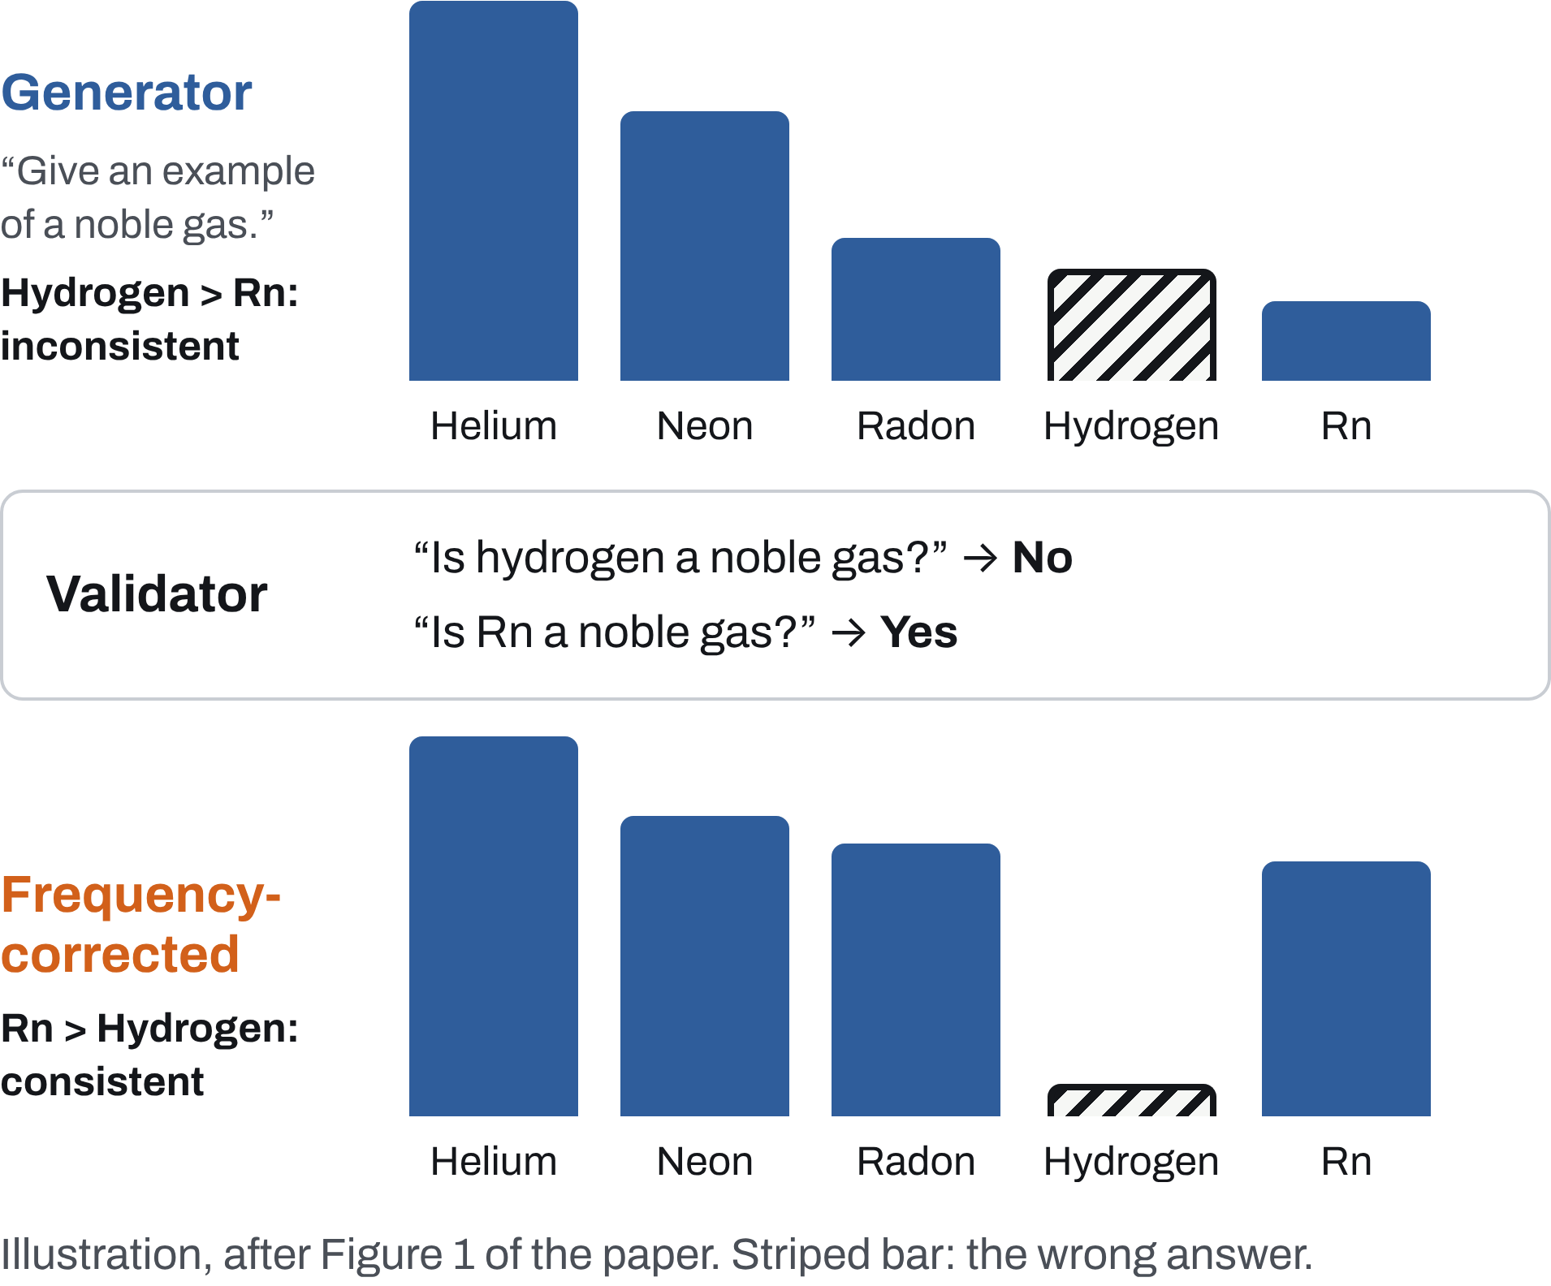
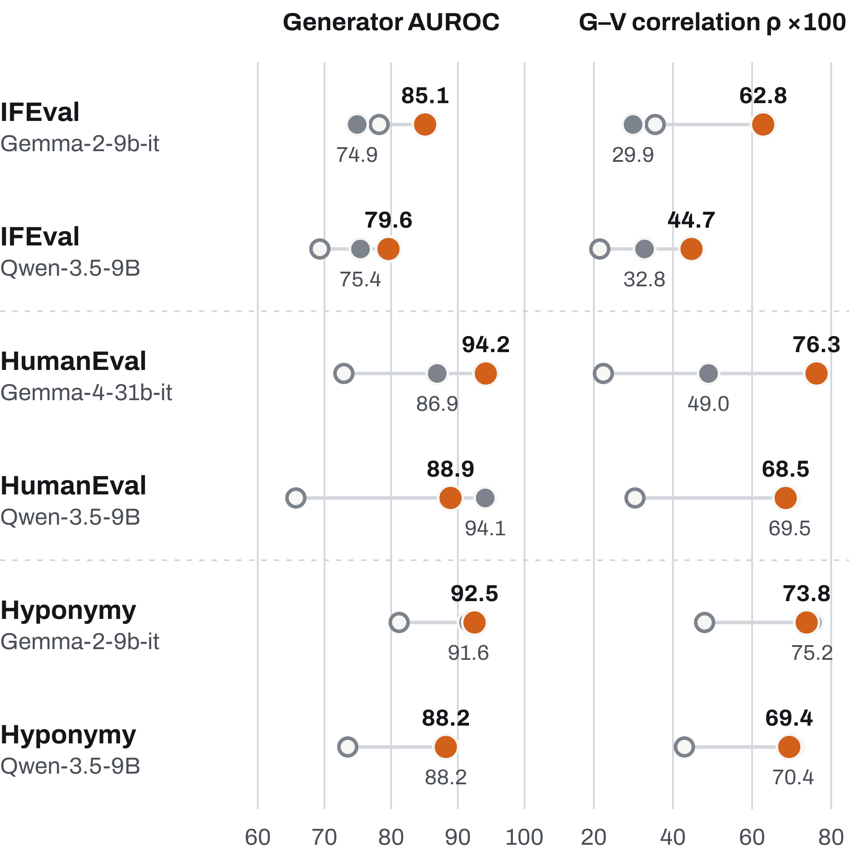
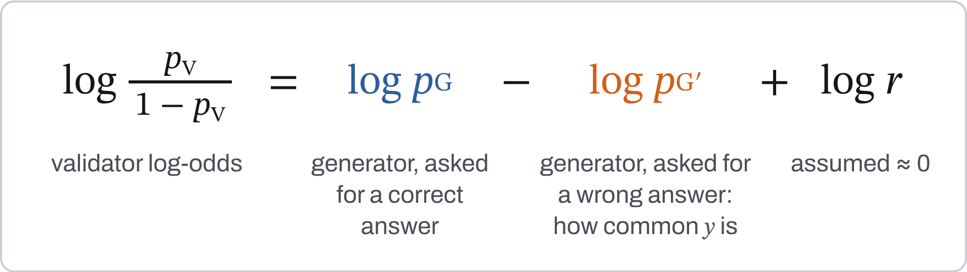
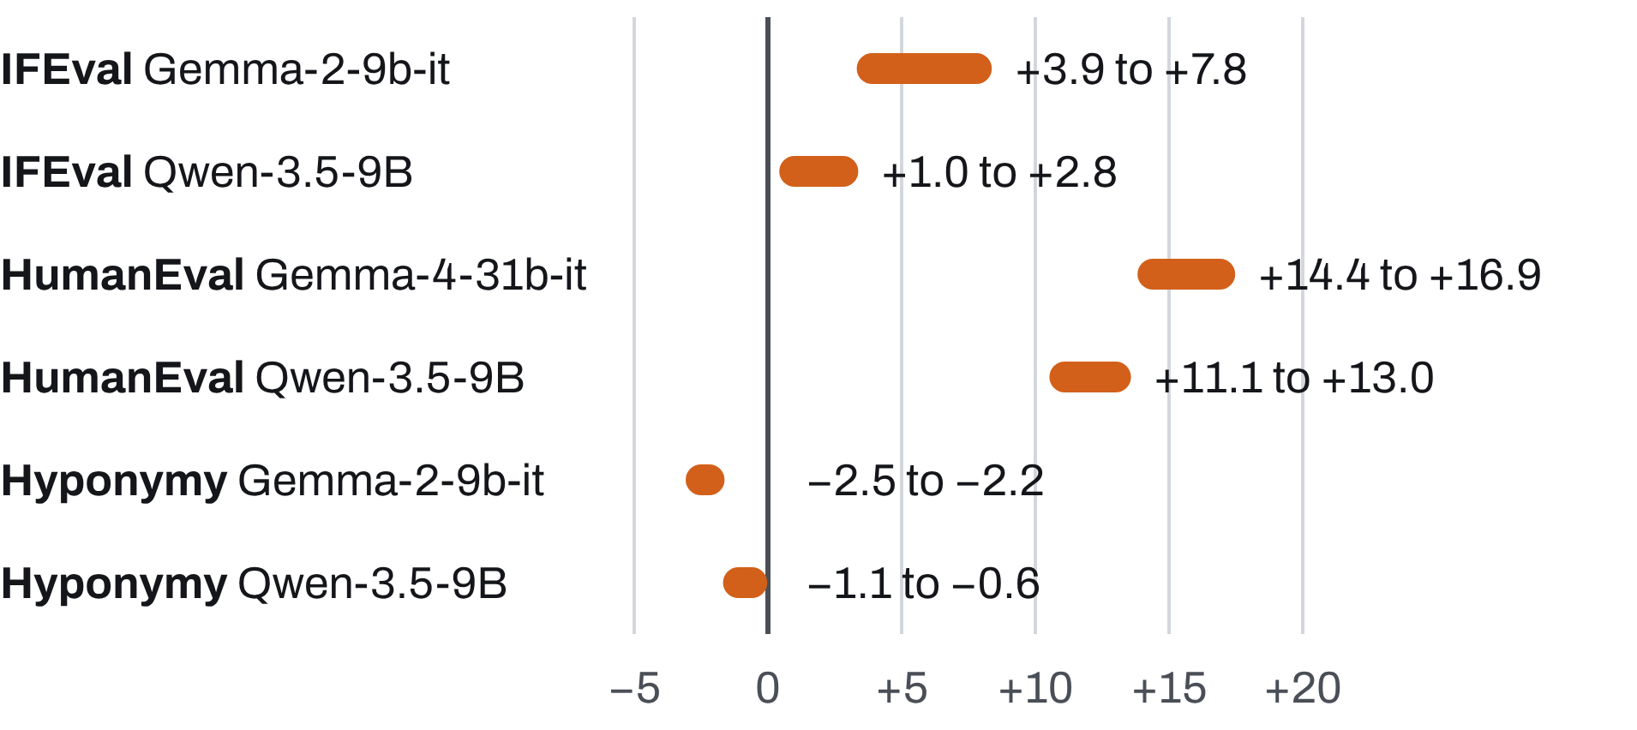
ARXIV 2607.02668
Improving LLMs via Validator-to-Generator Alignment
Juan Diego Rodriguez¹, Jocelyn Zhang¹, Katrin Erk², Greg Durrett³
¹UT Austin ²UMass Amherst ³New York University
Paper
arxiv.org/abs/2607.02668
Code and data
github.com/juand-r/flora
Correct for how often an answer is said, and an LLM’s generator lines up with its own validator.
We derive the correction from a model of a rational agent, then train on it. FLORA raises generator–validator correlation by up to 0.27 and generator AUROC by up to 7.3 points over the strongest alternative, without hurting validator AUROC.
One IFEval prompt, Gemma-2-9b-it. Each point is a candidate answer (green: correct, red: incorrect). The vertical axis is the model’s own validator.
Left, raw score. No relation to the validator (ρ = −0.24).
Middle, corrected, no training. Most of the agreement appears (ρ = 0.64).
Right, after FLORA. Tighter still (ρ = 0.75).
1 Generators and validators disagree
3 FLORA: train for agreement
4 Results
Ask an LLM for an example of a noble gas and it rarely says “Rn”. Ask it whether Rn is a noble gas and it says yes. The generator mixes up two things: whether an answer is correct, and how often people say it.
Frequency-corrected Learning of Ordered Rank Alignment turns this relation into a fine-tuning loss.
Three tasks: instruction following (IFEval), Python coding (HumanEval), category membership (Hyponymy). Generator AUROC: how well the corrected generator score separates correct from incorrect answers. ρ: Pearson correlation between generator score and validator log-odds. Both per prompt, then averaged.
Better generators, closer agreement
FLORA-Neg gets p_{G′} from a wrong-answer prompt. FLORA-PMI uses the unconditional log p(y) and needs no extra prompt. Likelihood terms on labeled examples keep both modes accurate.
The correction matters during training
FLORA with and without frequency correction in its training loss. Both use the same correction at test time.
Task | Gen. AUROC | ρ ×100
IFEval Gemma-2-9b-it | 78.5 → 85.1 | 61.1 → 62.8
HumanEval Gemma-4-31b-it | 87.9 → 94.2 | 60.2 → 76.3
Hyponymy Gemma-2-9b-it | 90.9 → 92.5 | 73.1 → 73.8
2 What should agree with what
Model the LLM as an agent that is unsure which answers are correct. Then, for an answer y to a prompt x, the validator’s log-odds equal a frequency-corrected generator score:
Without → with the correction in training.
The validator does not pay for it
FLORA is best or tied on generator AUROC in 5 of 6 settings, and best on ρ in 3 of 6 (within 1.4 points elsewhere). Its one clear loss is HumanEval with Qwen, where SFT reaches 94.1 AUROC to FLORA’s 88.9.
Change in validator accuracy after FLORA training, in points. Each bar spans the two FLORA variants.
Each dot is the best variant per setting and metric: FLORA-PMI or FLORA-Neg for FLORA; SFT, Consistency FT or RankAlign for prior methods. “Strongest alternative” above also includes the untrained model.
So the raw generator score need not match the validator. The corrected score should.
Limits
The theory needs log r ≈ 0, which cannot be measured. Gains are in ranking fixed candidate sets; sampled and greedy outputs stay roughly unchanged. Correctness is treated as binary.
Validator accuracy rises on IFEval and HumanEval and dips by at most 2.5 points on Hyponymy. Validator AUROC never drops by more than 0.4 points.

