Slide 1
We ask that you prepare to tell us about a time when you used data to tell a story.
It can be a work project, a passion project, a university assignment or a Kaggle competition, as long as you had to process the data and draw insights from it.
We want you to describe the problem you were tackling, why it was important,
how you approached it
what you discovered along the way.

Slide 2

Itaú: Prediction of Banking Products Usage
Juan D. Chacon
5th to 11th Dec 2020
Notes:
Choosing a problem to present was not something easy, because many options came to my mind. Like the time when as part of my job I use null hypothesis testing to detect land mines based on backpropagation of thermal neutrons data. Or the time when we wanted to determine the credit risk in a factoring operation based on the historic commercial relationship between two companies. However, at the moment I got the email for preparing this short talk I was working in a data competition and I thought why not this one?
This competition was about prediction of banking products usage and was released by Itau bank, a former brazilian bank with operations mainly in latin american and with almost a hundred thousand employees.
I have to mention that I knew late about this competition and I had the chance to work just one week on it

Slide 3
Presentation Outline
The Challenge
Our approach
Exploratory Data Analysis
Modeling
Getting Insights
Notes:
I will start by introducing the challenge
Then I will describe our approach, including the Exploratory data analysis, the modeling process and I will finish showing some Insights about the problem

Slide 4
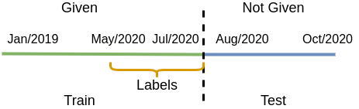
The Challenge
Obtain predictive models that allow predicting the purchase of 5 banking products, to better guide future campaigns.
Description:
Data: Transactions + Campaigns + Communications (January 2019 to July 2020) + Customers demographic information
The outcome: List of products to be used from August to October 2020
Metric: (mean average precision) mAP@5 for information retrieval
Notes:
The challenge was to obtain predictive models that allow know the purchase intentions of a client for 5 out of 16 Itau banking products.
Why is it important? or better what were the challenger intentions? They expect that having such models will help them to better guide future campaigns for these five products.
The data includes client demographic information, historic information about transactions, campaigns and communications between the bank and the customers going from january 2019 to july 2020 (this is the given data).
The outcome of the model should be a list of products to be used by a given client in the quarter august to october 2020. (This information was not given.)
The proposed metric for the challenge was the mAP at level 5 from information retrieval

Slide 5
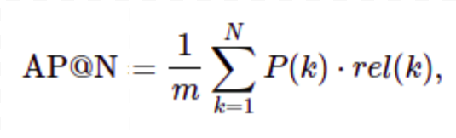
The mAP@N
Let’s suppose we have 3 different products A, B, and C.
We have to predict which of these 3 products the client will use next period
Example:
Actual | Our Prediction | AP@3
{A, C} | [A, B, C] [A, B, C] [A, B, C] | (1/1*(1)+ 1/2*(0)+ 2/3*(1)) * (1/2) = 0.83
{A, C} | [B, A, C] | (0/1*(0)+ 1/2*(1)+ 2/3*(1)) * (1/2) = 0.58
{A, C} | [C, A, B] | (1/1*(0)+ 2/2 *(1)+ 2/3*(0)) * (1/2) = 1
{} | [A, B, C] | 0
Notes:
Let’s talk about this metric first
The mAP in just the mean of the average precisions (AP’s) over all the clients.
Now the average precision is described by this little and confusing summation but let’s better go with an example
Suppose we have three different products A, B and C, and we have to predict which of these three products the client will use the next period.
First suppose that the client buys A and C, and we predict the list A, B and C. The average precision at level 3 will be the sum of three thing: at the first level (the one in blue) we got 1 out of one, because A is in the actual list. At the second level (the one in red) we have one out of two times zero this is because A is in the list but B is not. (here the relevance is zero because B is not in the list). Finally, we add 2 over 3 because we hit two out of three items at the third level and the relevance is one because C is in the list. Finally we divide by two which is the number of actual products. In conclusion making a mistake in the second position our score is 0.83
Now if we make the mistake at the first position rather than in the second one the score is harmed seriously. going from 0.83 to 0.58
The perfect score is one, no matter if we add extra elements at the end.
For this competition if the actual set is empty the precision is zero. This will imply that the maximum mAP is the percentage of clients using at least one product during the specified quarter

Slide 6

The mAP@N
Let’s suppose we have 3 different products A, B, and C.
We have to predict what of these 3 products the client will use next period
Example:
The Take Aways:
The Order Matters! Bad predictions at the beginning harm a lot!
The maximum score is the proportion of clients using products in a given period
Actual | Our Prediction | AP@3
{A, C} | [A, B, C] | (1/1*(1)+ 1/2*(0)+ 2/3*(1)) * (1/2) = 0.83
{A, C} | [B, A, C] | (0/1*(0)+ 1/2*(1)+ 2/3*(1)) * (1/2) = 0.583
{A, C} | [C, A] | (1/1*(0)+ 2/2 *(1)+ 2/3*(0)) * (1/2) = 1
{} | [A, B, C] | 0
Notes:
The take aways are two:
First, The Order Matters! Bad predictions at the beginning harm a lot!
And Second, The maximum posible score is the proportion of clients using products in a given period

Slide 7
Our Approach
Exploratory
Data
Analysis
Modeling
&
Evaluation
Interpretability
Notes:
The stages on our approach when tackling this problem were Exploratory data analysis, the modeling and evaluation process and the model Interpretability. But instead of being a linear process we iterate a couple of times

Slide 8
Our Approach
Modeling
&
Evaluation
Exploratory
Data
Analysis
Interpretability
Notes:
Getting something more like this. I will go through each of the stages only once but it was not how it worked for us.

Slide 9
Exploratory Data Analysis
Modeling
Exploratory
Data
Analysis
Interpretability
Checking types an ingesting data
Transactions | Client Demographics | Campaigns
(customer_id, product-type, amount, date, ...) [2019-2020/07] | (Age-rank, Sex, Income, City...) N = 79539 | (product-type, date, campaign type, …) [2020]
Product Types:
A-A, B-B, C-D,
D-E, E-E
Notes:
The first step on our exploratory data analysis was to check data types and ingest the data. We used pandas and pyspark dataframes for data transformations, aggregation and analysis.
The data was fully anonymized, so we don't know about the name of the clients or even what are the products we are working with.
The released database included the following tables
a transactions table: which includes details about the client identificator, the product-type, the amount and date of transactions among others.
By the way, the five products of interest are labeled as A-A, B-B, C-D, D-E and E-E
Now, The client demographics table reports the client attributes like: The age-rank, the sex, income range (etc) adcedera for almost 80 thousand clients
The campaigns table has information regarding the 2020 campaigns such as the product type, the dates and the type of campaign for four of the five target products

Slide 10
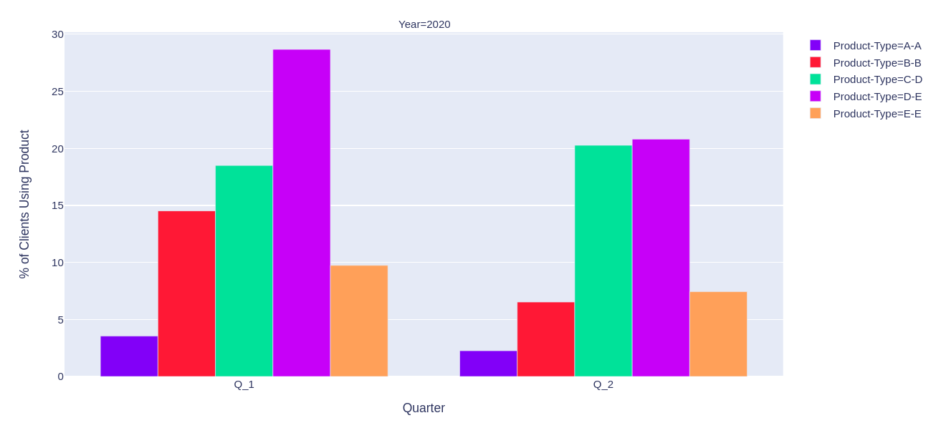
Exploratory Data Analysis
Modeling
Exploratory
Data
Analysis
Interpretability
Checking usage proportions
Notes:
One way to see this challenge is as a sorting problem. Then why not to check the general rank of usage of the five target products?
This bar plot shows the percentage of clients using at least once one of the five products during the first two quarters of 2020. Each color represents a different product.
Here is important to note that a client may use more than one product at the same period.
From this visualization we could rank the products D-E and C-D at the first and second place because the chances of use them seems to be larger, on the hand A-A should go to the last place. It is a little harder to say something about B-B and E-E as they present differences between quarters

Slide 11
Exploratory Data Analysis
Modeling
Exploratory
Data
Analysis
Interpretability
Checking usage proportions
[D-E, C-D, B-B, E-E, A-A]
Notes:
By now but let’s rank B-B over E-E as it was more popular on the first quarter. We will use this rank later.

Slide 12
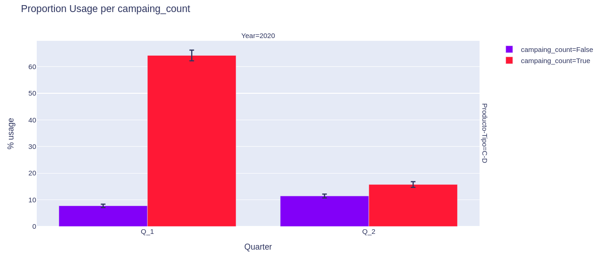
Exploratory Data Analysis
Modeling
Exploratory
Data
Analysis
Interpretability
Checking usage proportions using the campaigns as a factor
Notes:
Now we wanted to check if the proportions of clients using the products changes or not for the clients targeted with the campaign. (This is kind of computing probabilities conditioning on a given factor in this case if there was campaign or not)
To illustrate what I mean, let’s consider the following bars plot for the product C-D, it is presenting the % clients using the product in the first two quarters of 2020 discriminated by if they recieve or not a campaign ( for red they received, blue they don’t). For example, the first red bar indicates that during the first quarter of 2020 the percentage of clients using the product given they were targeted by at least one campaign in this quarter was about 65%. On the other hand less than 10% of the not targeted clients used the product!
Here we need to be very careful. Because we cannot conclude this effect is caused by the campaign itself. The bank could target with the campaign clients with previous usage of the product and this could be one of the reasons explaining the differences between these proportions.
Something that I forgot mentioning was that the y_error bar on top of each bar represents the 99% confidence interval of the estimation of the proportion, obtained from the central limit theorem.
We did similar analysis to determine if some other categorical variables, like range of income, sex or age, are important factors for the usage proportions.

Slide 13
Exploratory Data Analysis
Modeling
Exploratory
Data
Analysis
Interpretability
Checking usage proportions using the campaigns as a factor
The Take Aways:
The rank of products from more to less usage is:
[D-E, C-D, B-B, E-E, A-A]
The campaigns count seems to be relevant to determine if a client buy a product.
Notes:
The Take Aways are two:
First, the rank of products from more to less usage is [D-E, C-D, B-B, A-A]
Second, The campaigns count seems to be relevant to determine if a client buy a product.

Slide 14
Modeling
Modeling
Exploratory
Data
Analysis
Interpretability
Baseline model: [D-E, C-D, B-B, A-A]
{}
Model
[D-E, C-D, B-B, A-A]
mAP@5 test = 35.92%
Notes:
Now let’s move to the modeling stage
Initially we proposed a simple model that will work as baseline for the future models. This was based on the rank of usage from more to less popular that we obtained before. The performance over the test set (it means from august to october 2020) was 35.92%. We will expect that any of our models performs at least as well as this simple model

Slide 15
Modeling
Modeling
Exploratory
Data
Analysis
Interpretability
Best Model (5 classifiers / 1 per prod)
The classes are unbalanced (Over sampling)
1st: First, Models competition CV (Random Forest, XGBoost, LightGBM)
2nd:Then GridSearchCV to fine tuning (most of the times LightGBM)
Notes:
For each of the five classifiers we first take care of the balance of the classes by using oversampling of the positive class, otherwise the model also learns about the class unbalance and the output probabilities are not comparable between models.
We train in two stages: first a competitions between Logistic Regression, Random Forest, XGBoost and LightGBM models using 10 folds cross validation.
then we use 3 folds Cross validation GridSearch to fine tune the best model, which was LightGBM most of the times.

Slide 16
Modeling
Modeling
Exploratory
Data
Analysis
Interpretability
Baseline model: [D-E, C-D, B-B, A-A]
Best Model (5 classifiers, 1 per prod)
Features:
Transactions: Last 12 months (agg Month, Quarter)
Demographic: (Income, Age, City, Principality ...)
Campaigns: Last 3 months Campaigns
{}
Model
[D-E, C-D, B-B, A-A]
mAP@5 test = 35.92%
Notes:
We trained Five classifiers (one per product) and use the models outcome as an score to be ranked in the final list.
After a couple of iterations we obtained a multioutput classification model using as features the last year transactions history aggregated by months and quarters, some demographics attributes of the customer like the income range, customer age and the principality (which is a measure of fidelity of a client), and the campaigns history in the last quarter.

Slide 17
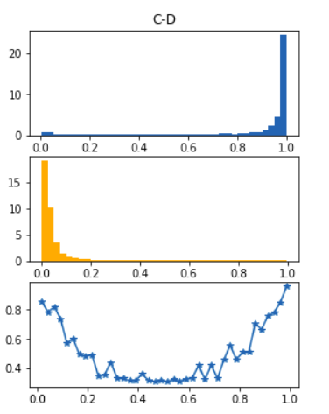
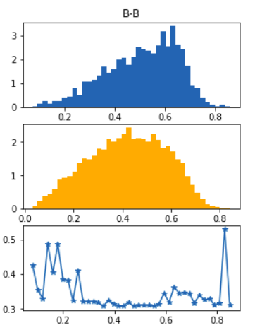
Modeling: Ordering Products
Order by model outcome
Normalized Histograms and certainty.
Ordering Rules:
ytest=1
ytest=1
approx. density
ytest=0
ytest=0
approx. density
Model output | Certainty | Final Score
High | High | High
Low | High/Low | Low
High | Low | Low
certainty
model pred
model pred
mAP@5 test = 50.36%
Notes:
STOP! I will skip this slide about the ordering strategy. I will just mention that we order based on an estimation of the model certainty and its outcome. And that our best mAP on the test set using this strategy was 50.36.
As the order in the final list is important we proposed a ranking approach based on the certainty of the output.
The graph on the right shows normalized histograms of the model predictions by actual outcome on the test set.
For example to get this one (in upper left corner) we filtered the the individuals in the test set that bought at least once the product C-D in the quarter 2020-apr to 2020-jun. only those, and then we got the normalized histogram of the model outputs.
We can see the model doesn’t always output high probabilities for the filtered individuals, there are some low probabilities that will be false negatives. That is an issue but more dangerous is the fact that some clients that do not use the product B-B are getting high scores
That is why we decide to include a measure of the certainty of the model outcomes. This was defined in terms of the entropy of a given interval of predictions (which is just a measure of the purity of the values in a given interval). For example, if we consider the interval 0.7 to 1 on product B-B there is not certainty about if the outcome of the model represents or not a product usage. But this is more clear for the product C-D.
You can see in the last row this measure of certainty as o function of model outcome
The ordering rules go as describe in the table, high model output and high certainty imply higher final score, any fail on satisfying this two conditions will produce a low score. In particular, high output with low certainty should product a low final score.
Our final model has mean average precision of 50.36% on the test set.

Slide 18
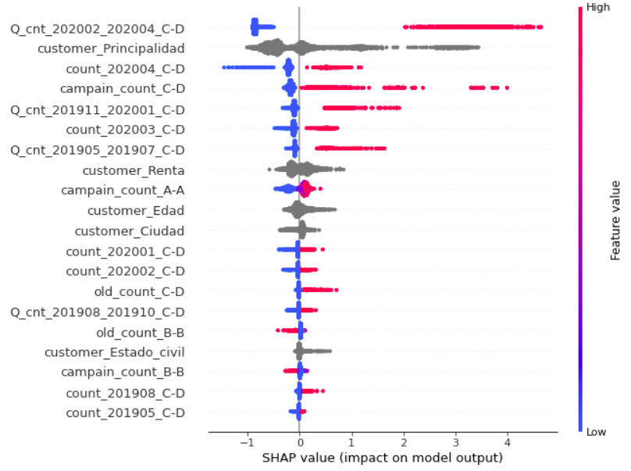
Interpretability
Modeling
Exploratory
Data
Analysis
Product C-D Model Shap Values (Validation Set)
Interpretability
A newbie using Shap Values
Variables ranked by feature importance
Positive and Negative correlations on outcome impact
Notes:
Now let’s move to the final stage, the model interpretability
It was when I was reading this job description that I discovered about shap values (I haven’t heard about them before) and I realized it is a powerful tool for model interpretability. So I decided to apply it to the trained models and see if I could get some insights. For time reasons I will show this analysis only for product C-D.
This shap summary plot is made for a subsample of the validation set for product C-D. and It demonstrates some interesting facts:
First, the variables are ranked by feature importance in descending order. And the variables related to C/D product previous history, the client principality and C-D campaign seem to have the larger impacts on the model output.
For a given observation, or dot, the color shows whether the feature value is high (in red) or low (in blue). So, for example one can notice that when the variables related to previous C-D usage are high it impacts positively the model outcome, it means that if the client used the product before then they are more likely to use it again.
We can also see that Clients targeted with C-D campaign are more likely to use the product (as expected) [Here we need to be careful, because correlation doesn’t mean causality!]
On the other hand, Although the impact is minor, the variables related to product B-B seems to be negatively correlated with the model outcome, it means that a client using the product B-B in the past is less prone to use C-D in the future. This may make sense because B-B is an banking outcome product (maybe a savings product) and C-D is banking income product (may be a credit). we know it because of the positive or negative sign of the transactions amount related to this products.

Slide 19
Some Conclusions about C-D future usage
Clients using this product in the past are more likely to use this product in the future.
Fidelity matters it is not clear the type of correlation as this a categorical variable was not ordered. (Requires further analysis)
Clients targeted with C-D campaigns are more likely to use this product in the future. [Careful: correlation doesn’t mean causality!]
Clients using the product B-B in the past are less prone to use C-D in the future.
Notes:
In this last slide I just restate this conclusions

