Slide 1
How to make a quote
Helix package quotes · pick a package, fill in the blue cells, click Make PDF
368 Event Management × Hellhound Audio

Slide 2
What it does
1
2
3
→
→
You type the details
You click Make PDF
You get the quote
Client, date, package
One button
A clean one-page PDF, saved in Drive
No math. No line items. Prices come from the Packages tab.

Slide 3
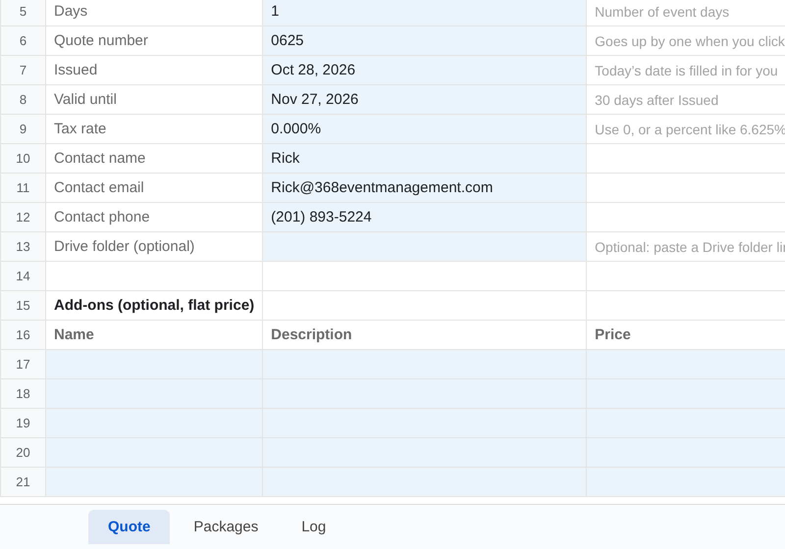
STEP 1
Open the sheet. Click the Quote tab.
Open Helix Package Quotes in Google Drive.
The tabs are at the bottom of the screen.
Click here

Slide 4
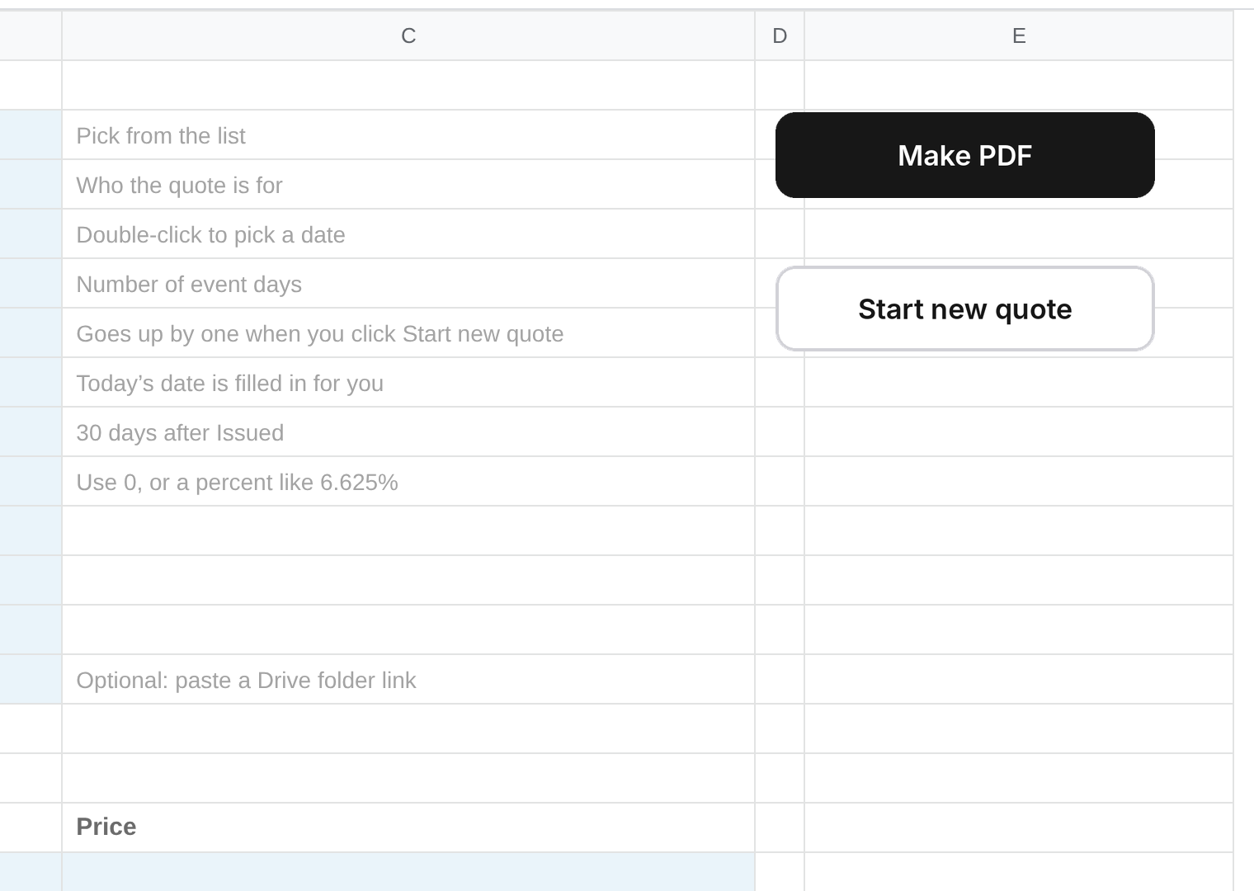
STEP 2
Click Start new quote.
Click here
It clears the old client and date.
The quote number goes up by one on its own.

Slide 5
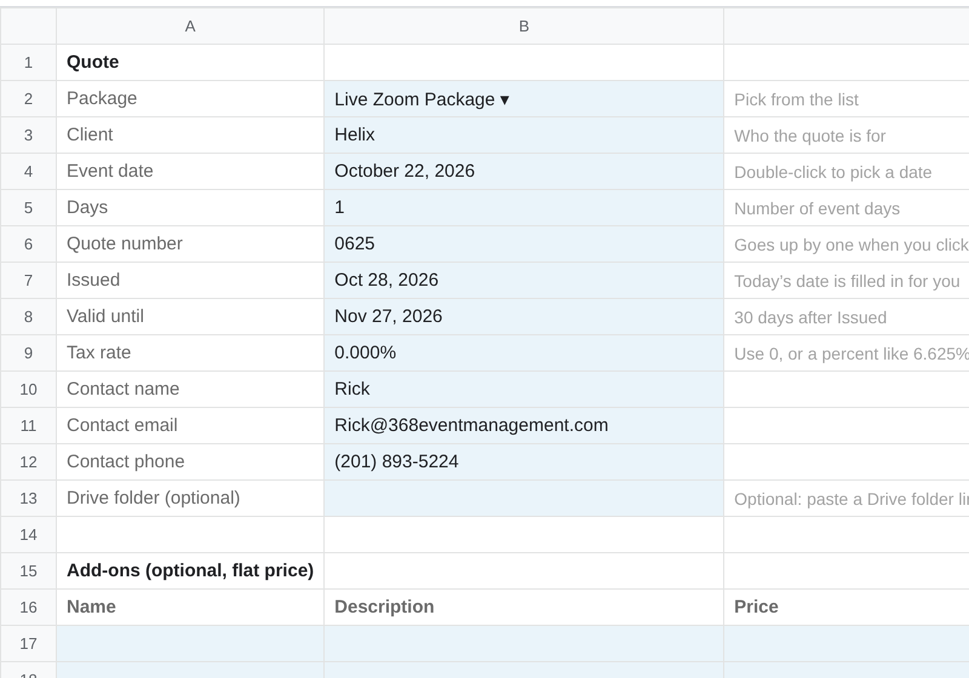
STEP 3
Pick the package.
Pick from the list
Click the Package cell.
Pick from the list. Don't type it.

Slide 6
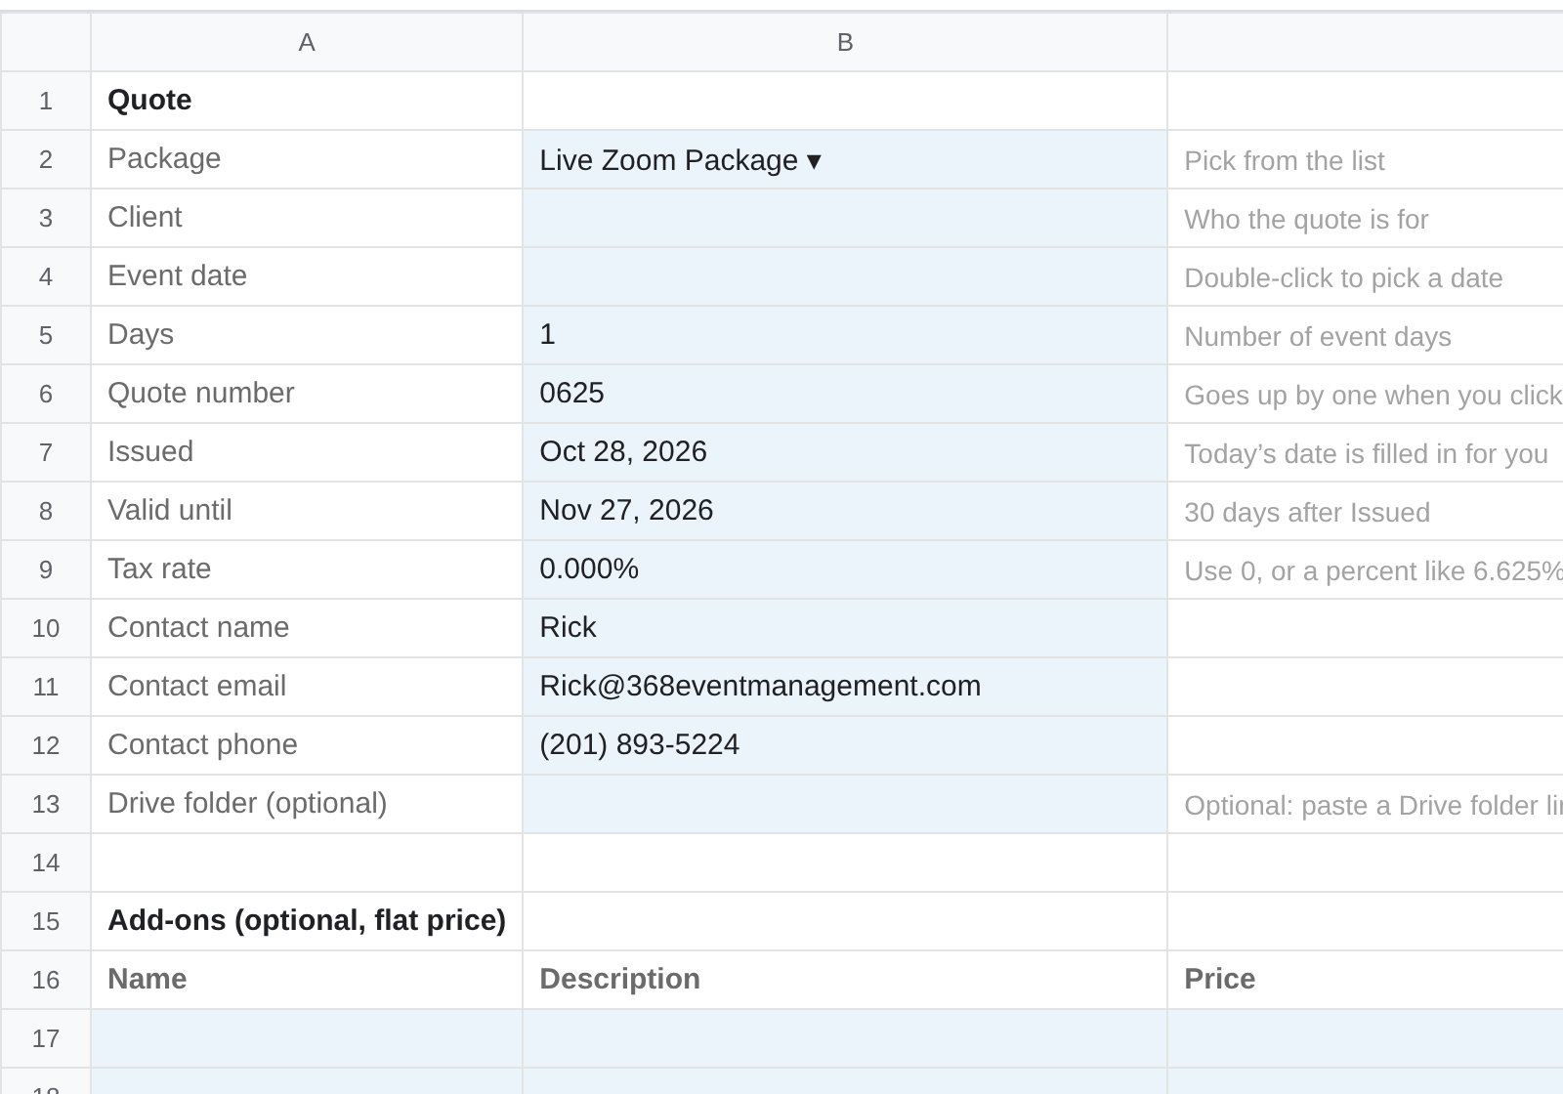
STEP 4
Fill in the blue cells.
Type these in
Only type in the blue cells.
The gray words next to each one tell you what goes there.
Add-ons at the bottom are optional.

Slide 7
STEP 5
Click Make PDF.
Click here
Wait a few seconds.
If something is missing, it tells you what to fix.

Slide 8
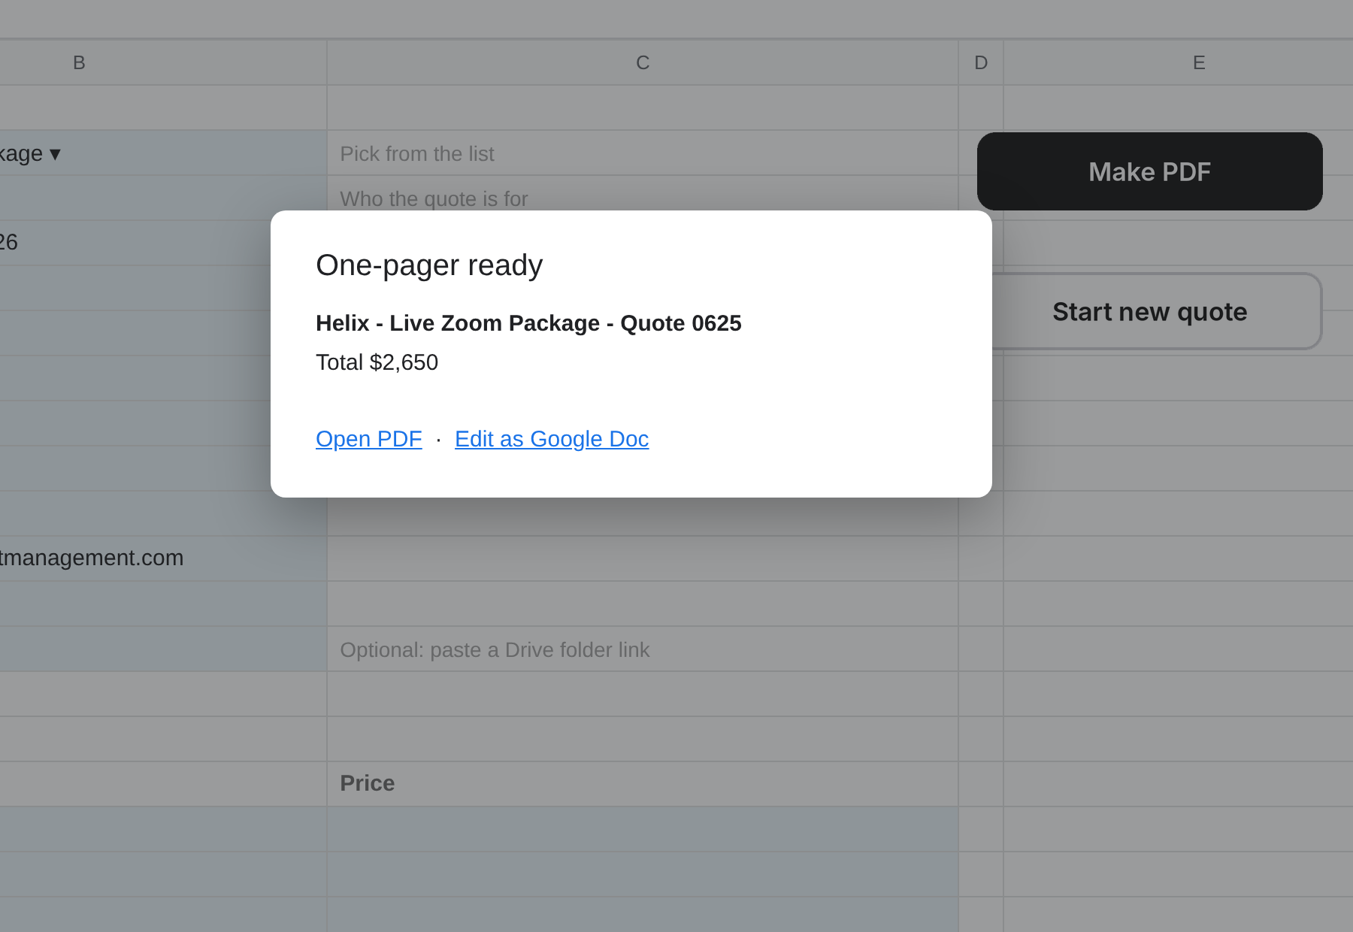
STEP 6
Click Open PDF.
That's the quote. Send it to the client.
Need to change a word? Click Edit as Google Doc.
Click here

Slide 9
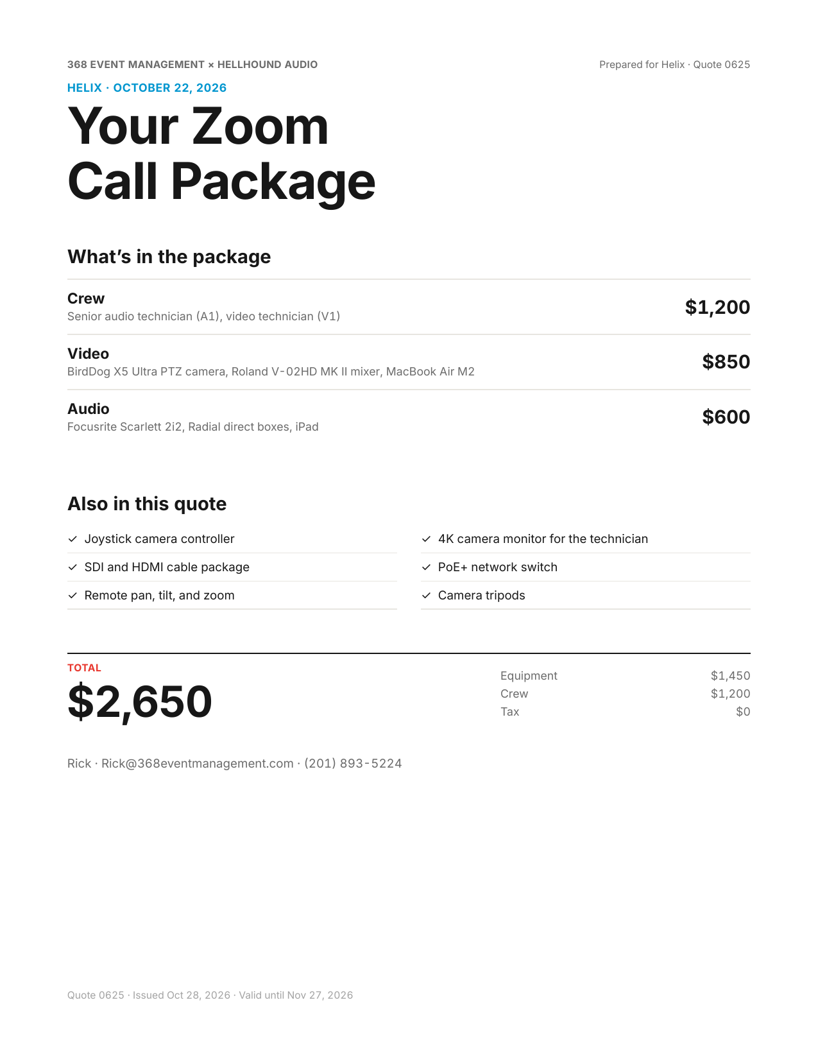
Your PDF looks like this.
One page. Letter size.
The package, the price, and nothing extra.
Ready to print or email.

Slide 10
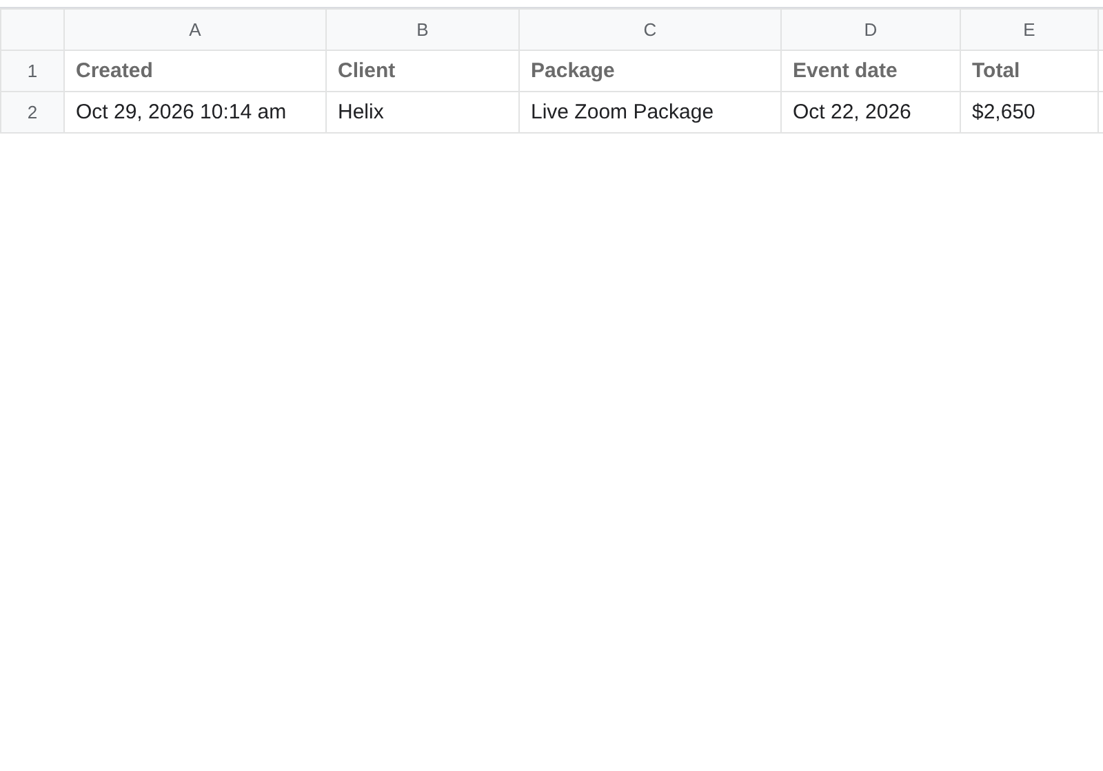
WHERE FILES GO
Where your files go.
Every quote, saved
Every PDF is saved in the Helix Quotes folder in Google Drive.
The Log tab lists every quote, with links.

Slide 11
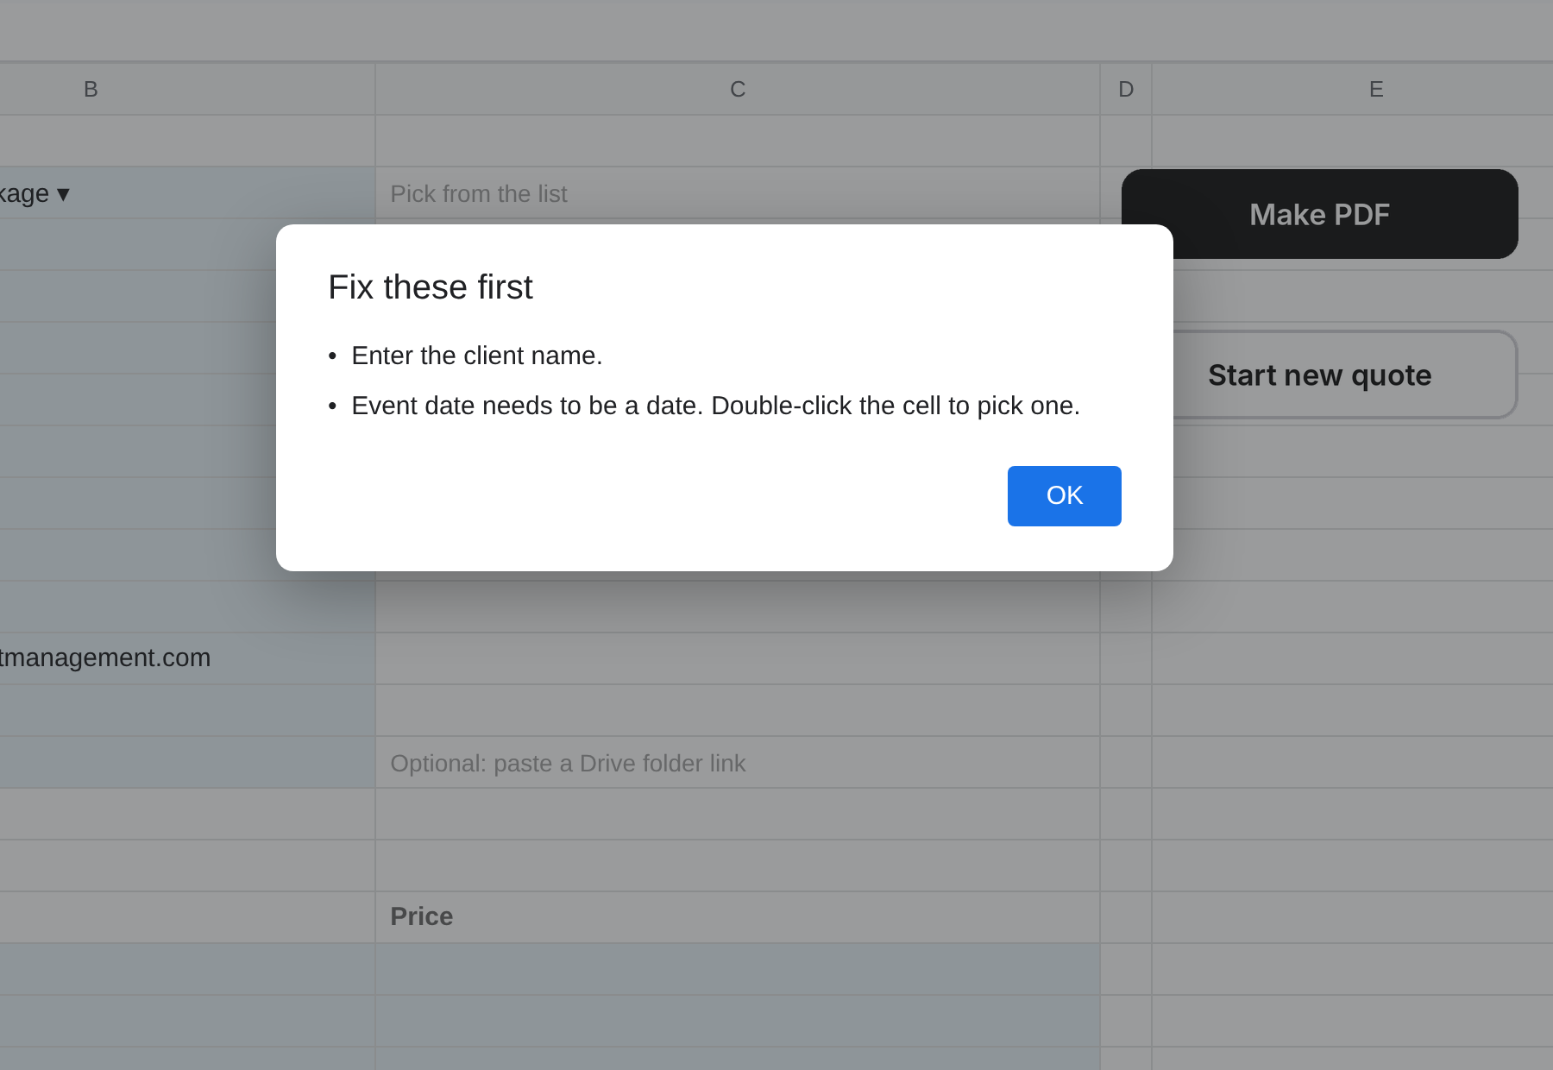
IF IT STOPS
Read this list
It says “Fix these first.”
That means a blue cell is empty or wrong.
Read the list. Fix those cells. Click Make PDF again.

Slide 12
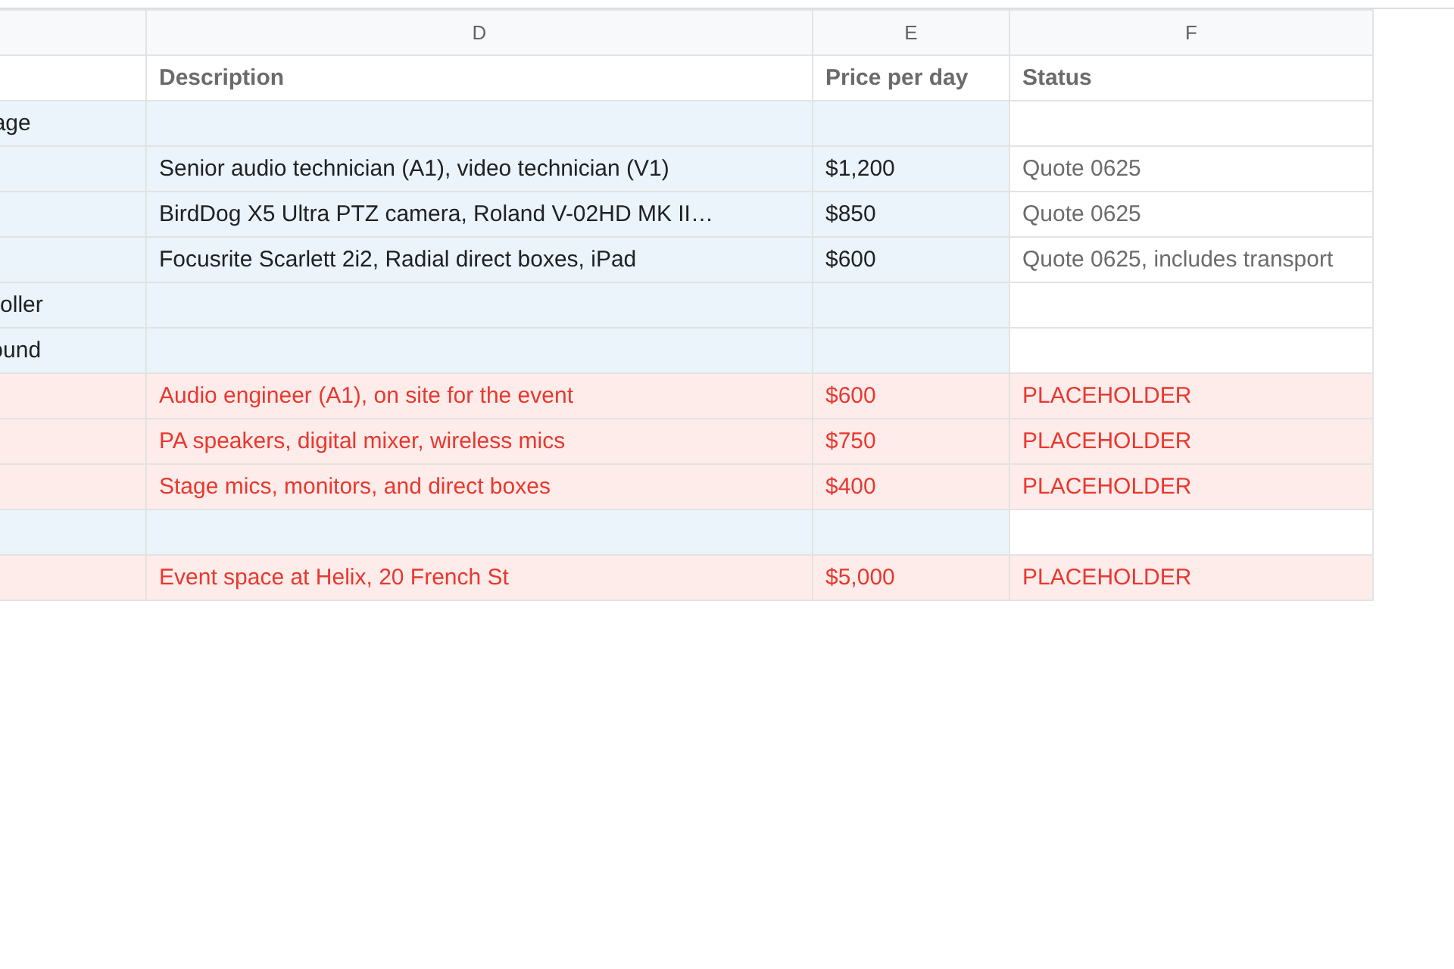
PRICES
Change a price.
Go to the Packages tab. Type the new price.
Red rows have fake prices. Put the real price in, then delete the word PLACEHOLDER.
Fake price: fix these

Slide 13
Three rules
1
Only type in blue cells.
Everything else fills itself in.
2
Red rows are fake prices.
Fix them before quoting that package.
3
Use a computer.
The buttons don't work in the phone app. Use the Quotes menu there.

Slide 14
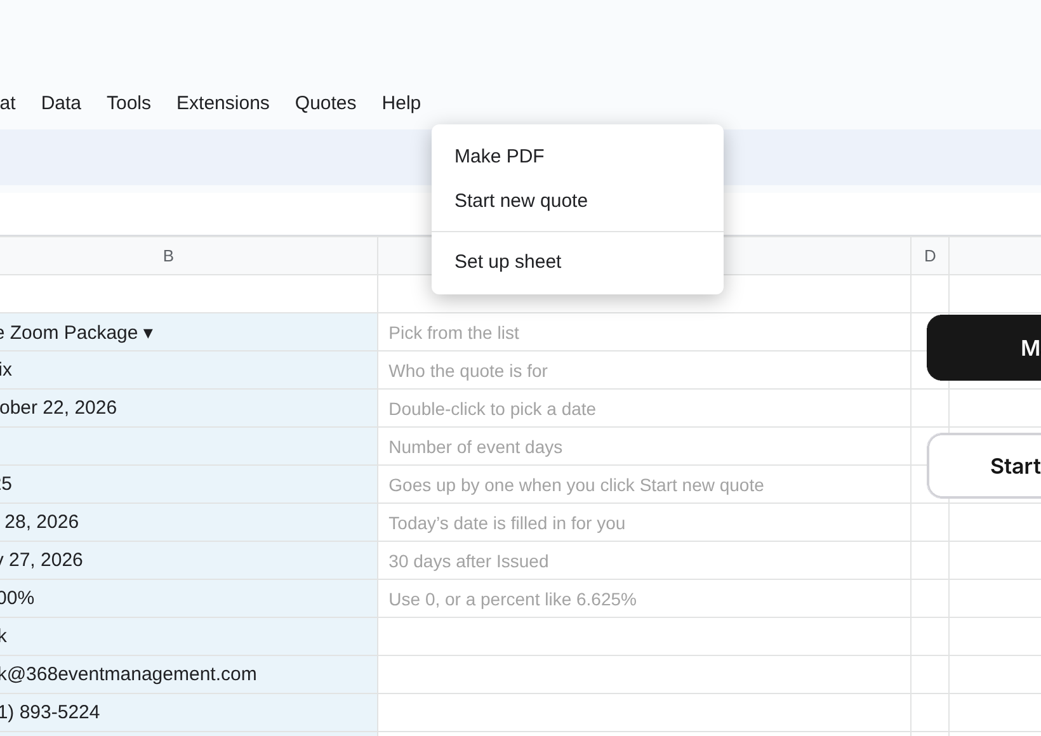
SETUP
One-time setup.
Only do this once.
1. Make a blank Google Sheet.
2. Extensions › Apps Script. Paste the script. Save.
3. Reload the sheet.
4. Quotes › Set up sheet. Click Allow.
5. Share it with the sales team.
Click once

