Slide 1
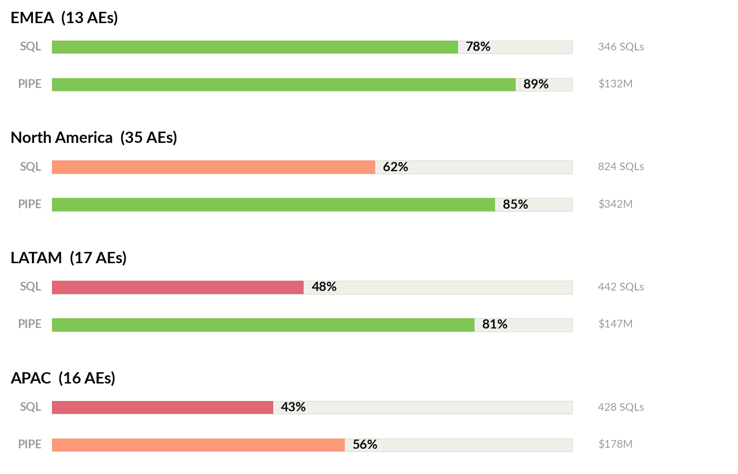
EMEA leads all territories; APAC pipeline at 56% signals systemic underperformance
Territory attainment vs. target | 81 AEs across 4 regions | Q4
57.7%
Overall SQL
Attainment
78.7%
Overall Pipeline
Attainment
$630M
Pipeline
Generated
21pp
SQL-Pipeline
Gap
1/6

Slide 2
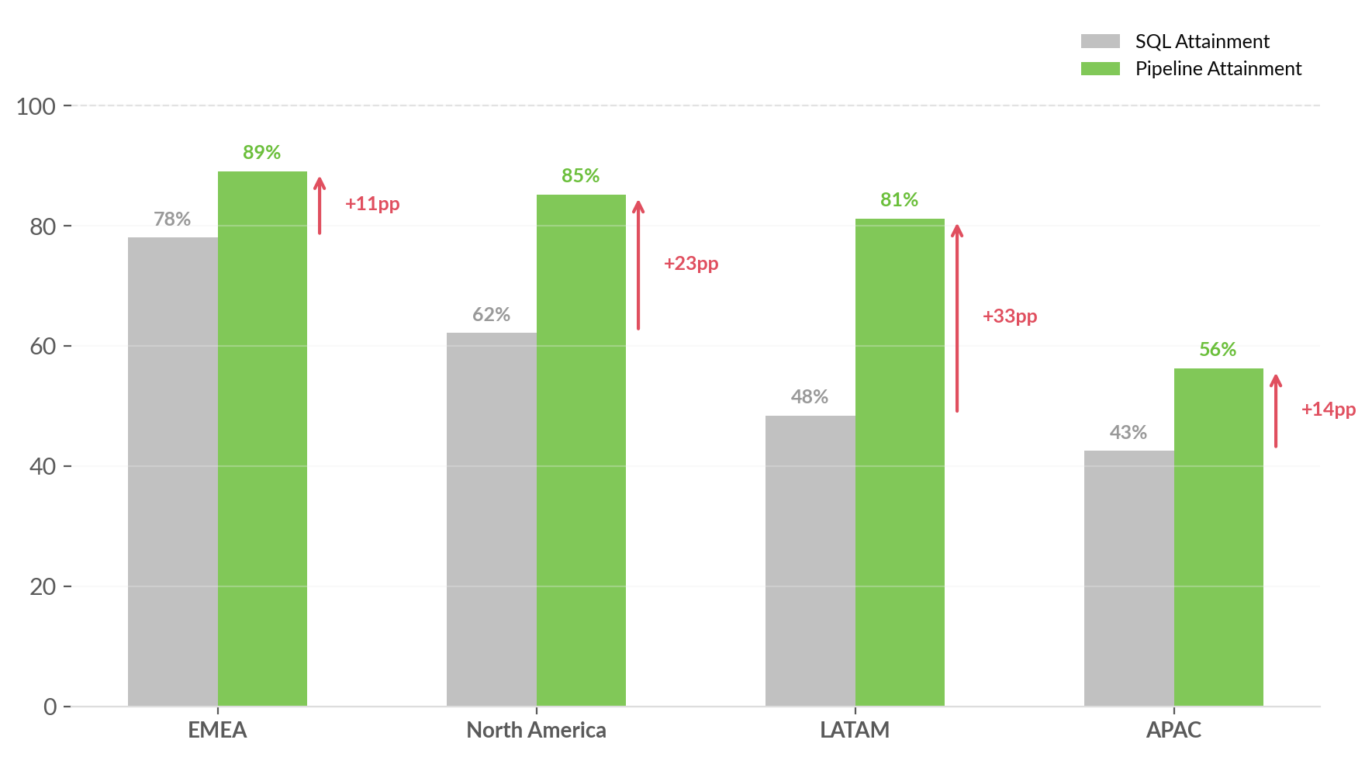
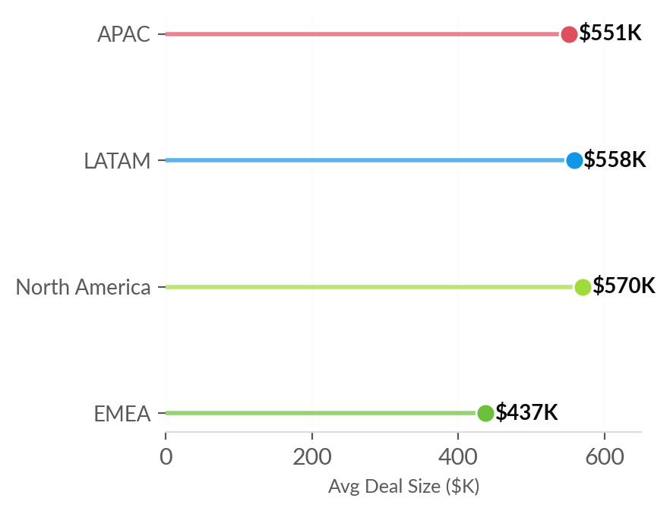
Pipeline attainment outpaces SQL by 11-33pp — fewer leads, but larger deals compensate
The persistent gap suggests SQL targets may be structurally miscalibrated relative to pipeline reality
Avg Deal Size by Territory
SQL Targets
May not reflect market reality. Only 3 of 46 fully ramped AEs exceed 100% SQL.
Deal Quality
LATAM/NA generate $558K-$570K avg deals vs $437K EMEA — fewer but larger.
Qualification
Reps self-select higher-value deals over volume — explains gap but masks risk.
2/6

Slide 3
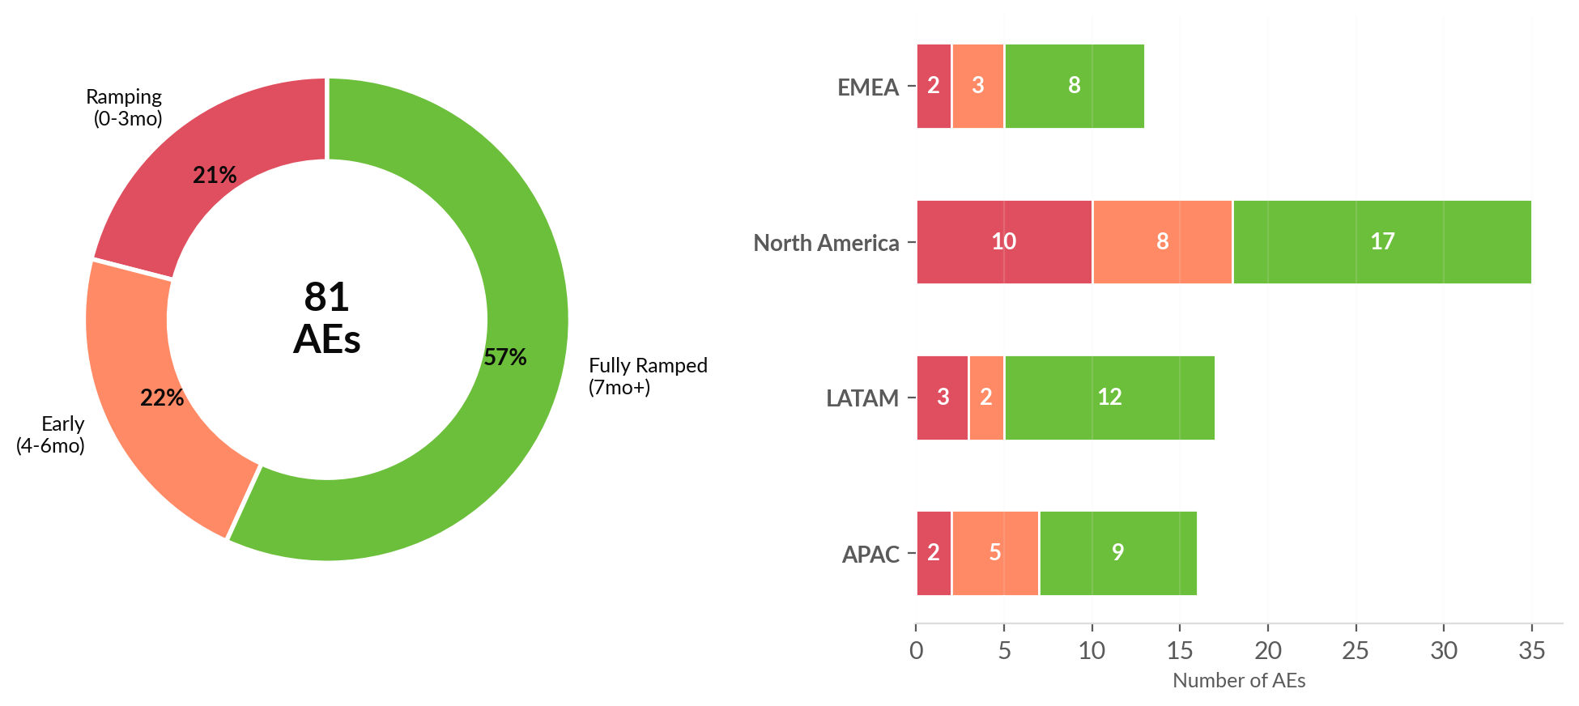
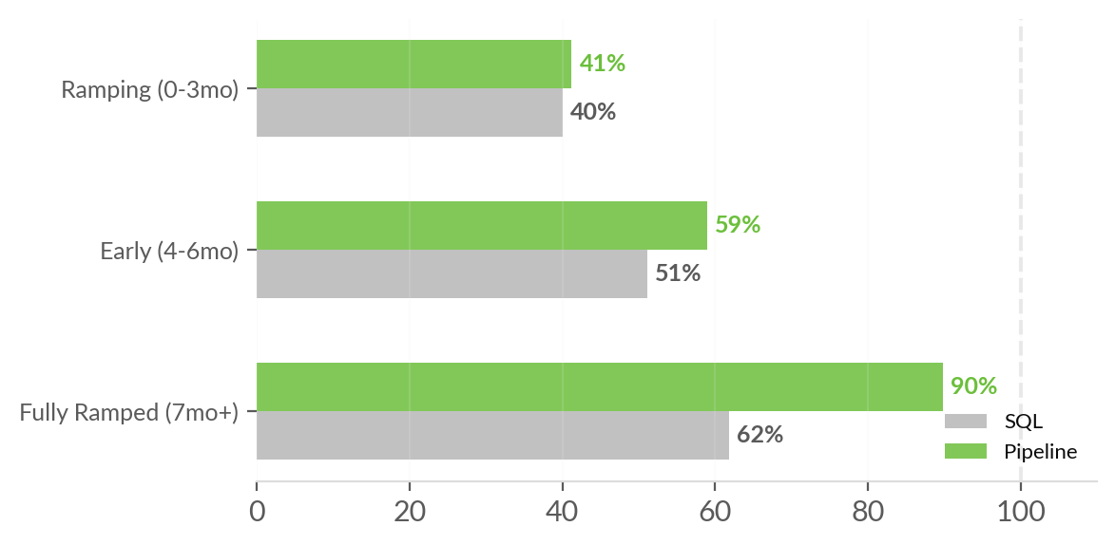
21% of the team is still ramping — fully ramped AEs deliver 2.2x better pipeline results
17 AEs in ramp (0-3mo) | 18 AEs early (4-6mo) | 46 AEs fully ramped (7mo+)
10 of 35
NA AEs ramping
North America Ramp Burden
Only 46% of NA is fully ramped vs. 71% in LATAM and 69% in EMEA.
2.2x
Pipeline lift
Pipeline Multiplier
Fully ramped AEs at 89.9% pipeline vs. 41.2% for ramping — retention and ramp acceleration are highest-leverage.
r = 0.37
Correlation
Attainment by Ramp Stage
Tenure Effect
Moderate positive correlation between tenure and pipeline. Coaching quality and territory likely play larger roles than tenure alone.
3/6

Slide 4
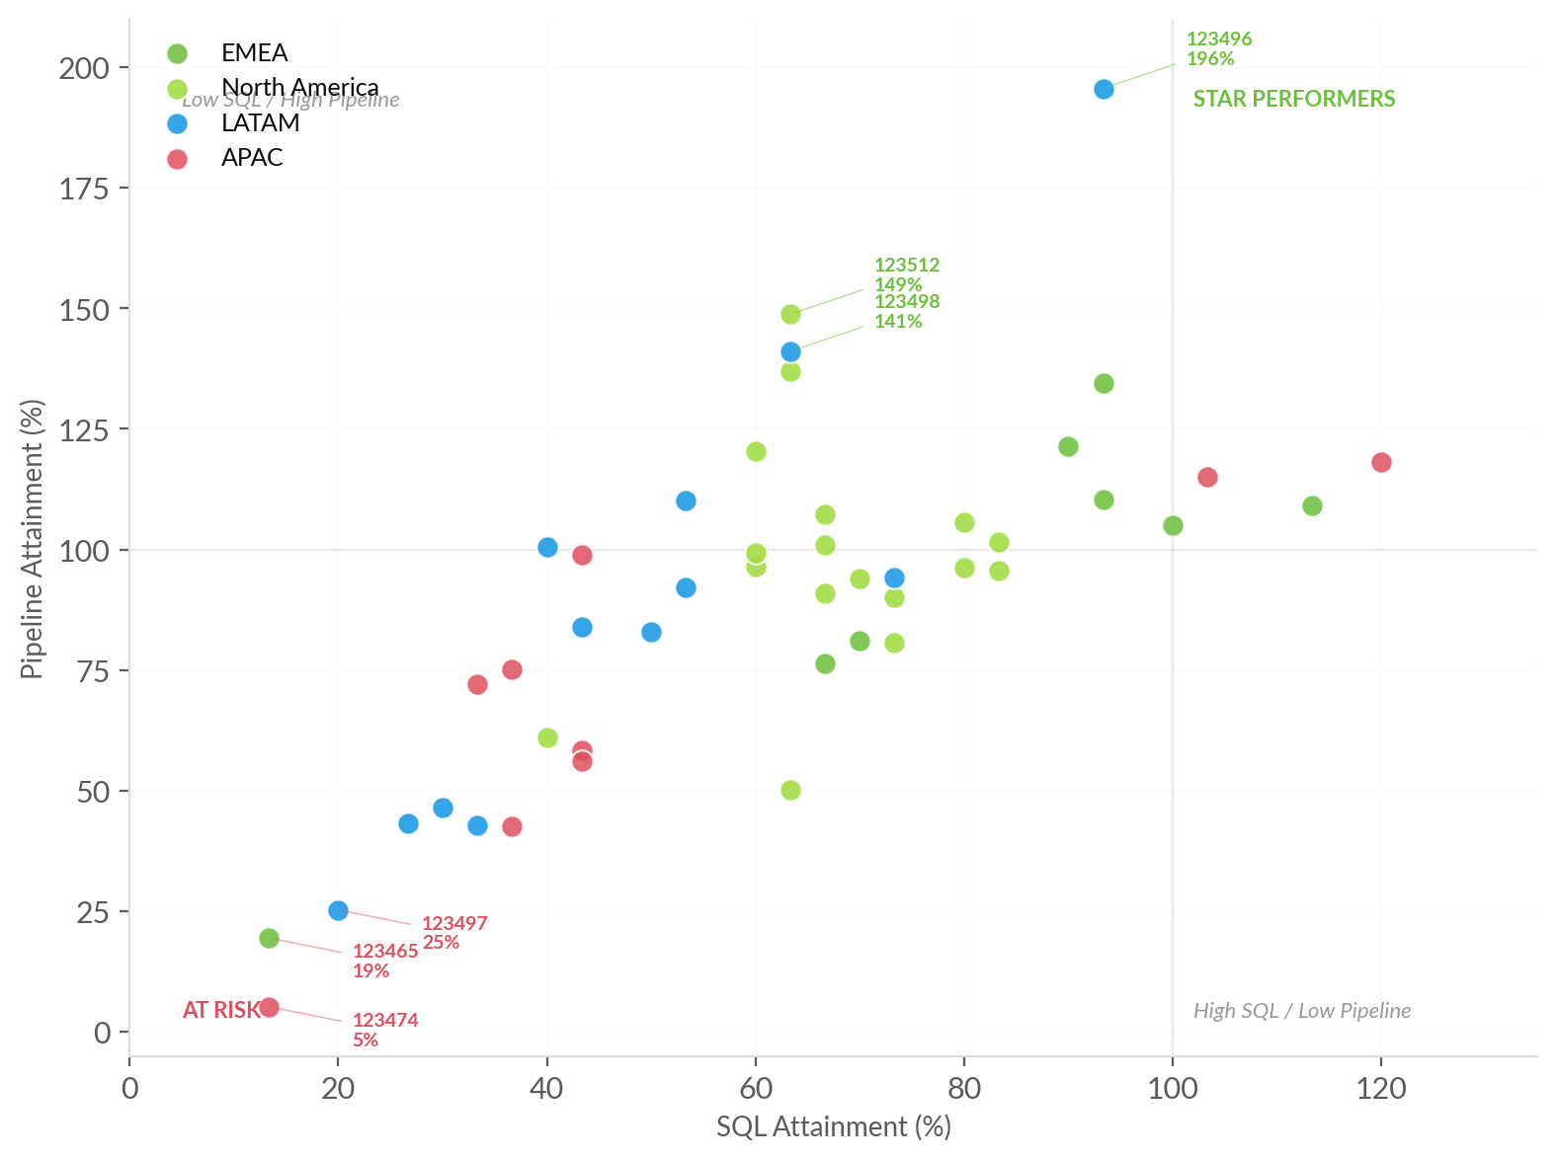
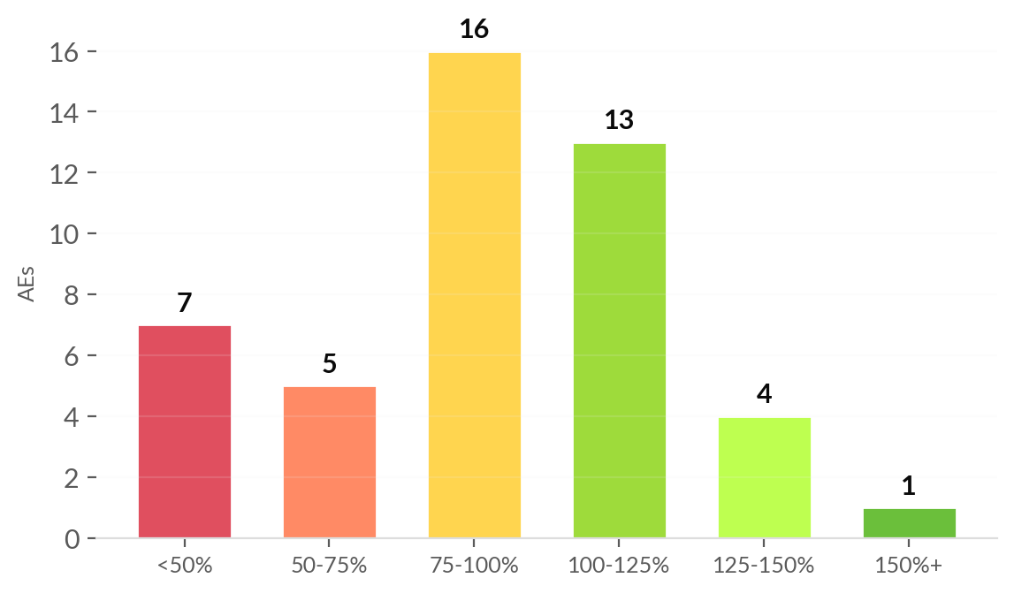
39% of fully ramped AEs hit target, but 15% are below 50% — a tail that needs intervention
Quadrant analysis and pipeline distribution for 46 fully ramped Account Executives
Pipeline Attainment Distribution
TOP PERFORMERS
123496
LATAM
196%
SQL 93%
14mo
$698K
123512
NA
149%
SQL 63%
13mo
$979K
123498
LATAM
141%
SQL 63%
10mo
$743K
AT RISK
123474 (APAC, 5%, 7mo) | 123465 (EMEA, 19%, 7mo) | 123497 (LATAM, 25%, 8mo) | 123482 (APAC, 43%, 11mo)
4/6

Slide 5
Five hypotheses to validate — each requires specific data to confirm or rule out
Structured investigation framework to move from observation to action
SQL targets are miscalibrated
VALIDATE WITH
1
Historical SQL trends, market sizing, ICP penetration analysis
57.7% SQL attainment while pipeline reaches 78.7%
APAC has structural issues beyond ramp
VALIDATE WITH
2
Win/loss analysis, competitive landscape, product-market fit data
Even fully ramped at only 71.3%; two reps near-zero with 6+ months
Recent hiring wave dilutes aggregate metrics
VALIDATE WITH
3
Hiring dates, planned ramp timelines, onboarding effectiveness
17 of 81 AEs (21%) are ramping; NA has 10 of 17
Top performers master large-deal strategy
VALIDATE WITH
4
Deal-level data, vertical breakdown, expansion vs. new logo
LATAM/NA avg deals $558K-$570K vs. $437K EMEA
Bottom performers need formal intervention
VALIDATE WITH
5
Manager mapping, coaching logs, PIP history, activity metrics
7 fully ramped AEs below 50% pipeline attainment
5/6

Slide 6
Prioritized action plan: recalibrate, fix APAC, manage performance, accelerate ramp
Time-phased recommendations organized by expected impact
NOW
0-30 Days
NEXT
30-60 Days
LATER
60-90 Days
HIGH
MED
LOW
Audit SQL Targets
Accelerate Ramp Programs
Territory Redesign
Conduct bottoms-up capacity model. The 21pp gap is structural, not execution.
Buddy programs with top performers, territory playbooks, milestone targets. 21% ramping is significant drag.
Quotas range $10M-$12.5M while deal sizes vary 30%. Ensure equitable targets.
HIGH
MED
LOW
Deep-dive APAC
Build Deal Quality Metric
Monitor NA Hiring Cohort
Product-market fit, competitive review, enablement. Individual plans for reps <50%.
Pipeline/SQL, Win Rate, Avg Deal Size — composite score to normalize cross-territory comparison.
10 ramping reps is a big bet. Validate manager bandwidth, lead flow, enablement.
HIGH
Performance-manage bottom 7
Structured conversations for 7 fully ramped AEs <50% pipeline. Coach, adjust, or PIP.
Expected outcome: Recalibrated targets within 30 days → APAC stabilized by Q1 → Bottom cohort resolved → Ramp time reduced 20%
6/6

