Slide 1

REVENUE OPERATIONS
Sales Team Performance Analysis
Q4 Quarterly Review | PerkyTravel
Prepared by Juan Daniel Amézquita | Revenue Operations Manager
1/7

Slide 2
The team is underperforming on SQL generation, but pipeline quality partially compensates
Overall: 57.7% SQL attainment vs. 78.7% pipeline attainment across 81 AEs in 4 territories
81
4
57.7%
78.7%
Account Executives
Territories
SQL Attainment
Pipeline Attainment
Key Insight
Pipeline attainment outpaces SQL attainment by 21 percentage points. This persistent gap across all territories and ramp stages suggests that while fewer leads are generated, those that convert carry higher deal values. This could indicate either strong qualification discipline or structurally miscalibrated SQL targets that need recalibration.
Territory Snapshot
EMEA
13 AEs
North America
35 AEs
LATAM
17 AEs
APAC
16 AEs
Pipeline: 89%
Pipeline: 85%
Pipeline: 81%
Pipeline: 56%
2/7

Slide 3
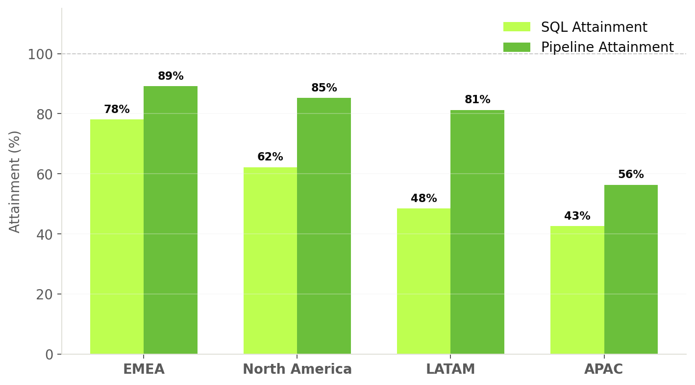
EMEA leads across both dimensions;
APAC is the clear underperformer at 56% pipeline
SQL and Pipeline attainment by territory — all AEs included
EMEA
78% SQL | 89% Pipeline
Top performer. Smallest team (13 AEs) but highest attainment. Fully ramped cohort at 94.6% pipeline. Mature team composition.
North America
62% SQL | 85% Pipeline
43% of headcount. Fully ramped reps hit 98.6% pipeline — nearly at target. However, 10 of 35 AEs are still ramping, pulling down aggregate.
LATAM
48% SQL | 81% Pipeline
Striking disconnect: lowest SQL attainment but strong pipeline. Avg deal size of $558K (vs. $437K EMEA) indicates fewer but larger deals.
Category | EMEA | North America | LATAM | APAC
AEs | 13 | 35 | 17 | 16
SQL Att | 78% | 62% | 48% | 42%
Pipeline Att | 89% | 85% | 81% | 56%
Avg Tenure | 8.5 mo | 8.3 mo | 9.5 mo | 8.4 mo
APAC
43% SQL | 56% Pipeline
Systemic underperformance. Even fully ramped cohort at only 71.3% pipeline. Two reps with 6+ months at near-zero output.
3/7

Slide 4
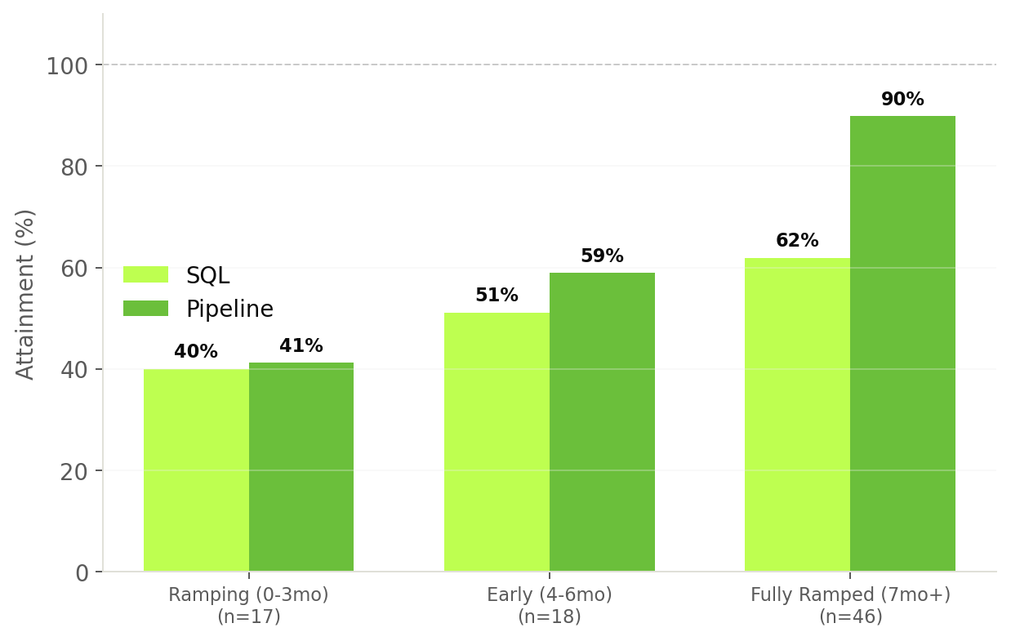
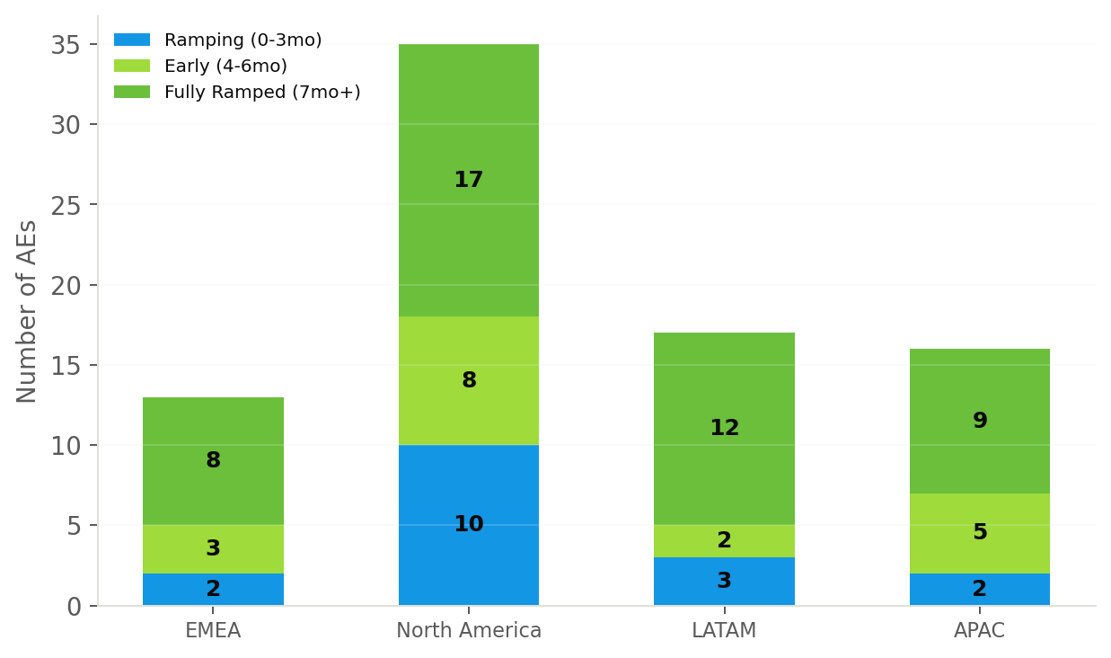
21% of the team is still ramping — fully ramped AEs deliver 2.2x better pipeline results
Performance by ramp status and team composition across territories
Ramp Burden
Pipeline Multiplier
Tenure Correlation
North America carries 10 of 17 ramping reps — only 46% fully ramped vs. 71% in LATAM. This dilutes NA aggregate metrics significantly.
Fully ramped AEs generate 89.9% pipeline attainment vs. 41.2% for ramping reps — a 2.2x improvement. Retention and ramp acceleration are high-leverage.
Moderate positive correlation (r = 0.37) between tenure and pipeline performance. Tenure helps, but is not the dominant driver — high and low performers exist across bands.
4/7

Slide 5
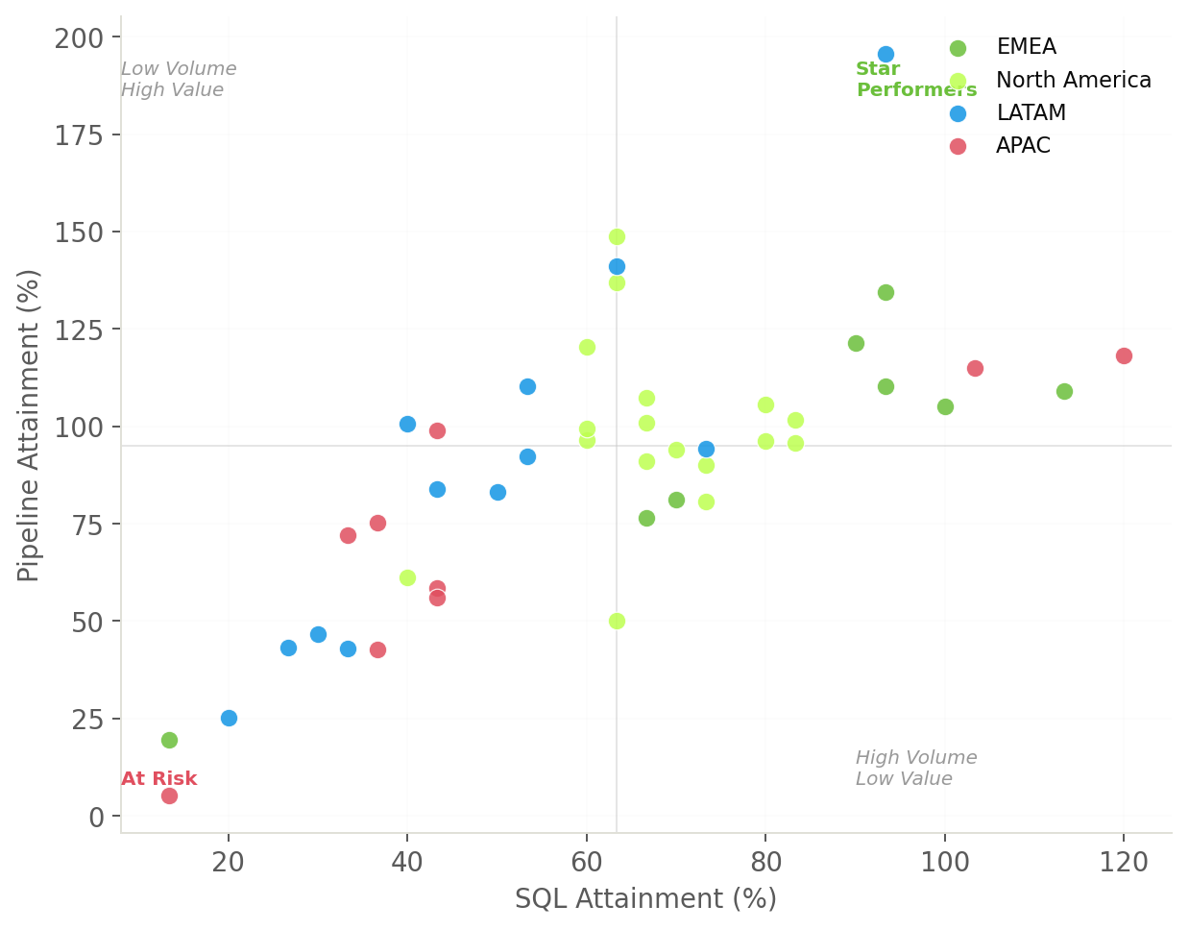
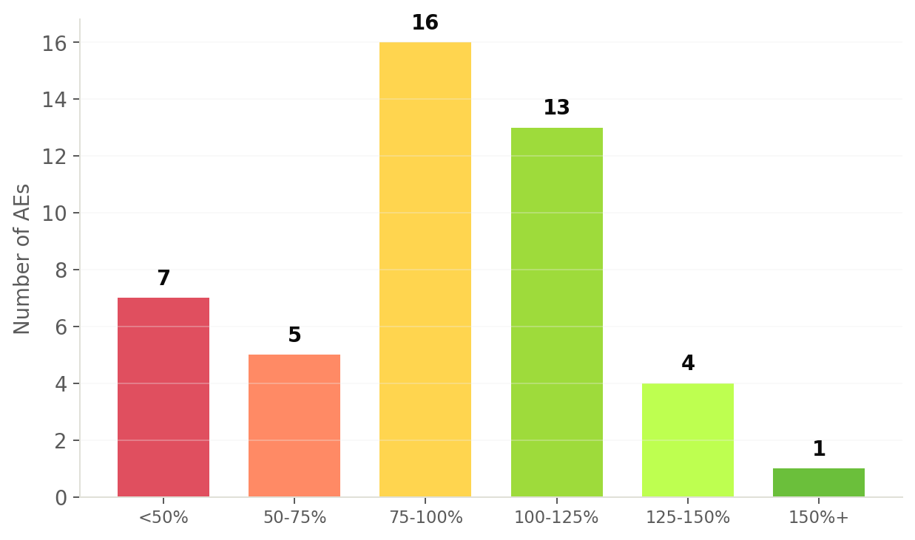
39% of fully ramped AEs are at or above target, but 15% sit below 50% — requiring intervention
Individual performance distribution and SQL vs. Pipeline quadrant analysis (fully ramped, n=46)
Top 3 Performers
123496 (LATAM, 196%) | 123512 (NA, 149%) | 123498 (LATAM, 141%)
Bottom 3 Performers (Fully Ramped)
123474 (APAC, 5%, 7mo) | 123465 (EMEA, 19%, 7mo) | 123497 (LATAM, 25%, 8mo)
5/7

Slide 6
Five hypotheses to validate — each requires specific data to confirm or rule out
Structured investigation plan to move from observation to action
SQL targets are miscalibrated
Data needed:
1
Historical SQL trends, market sizing, ICP penetration
57.7% SQL attainment while pipeline reaches 78.7% — gap persists even among fully ramped reps
APAC has structural issues beyond ramp
Data needed:
2
Win/loss analysis, competitive landscape, product-market fit, SDR support
Even fully ramped APAC reps at only 71.3%; two reps at near-zero with 6+ months
Recent hiring wave dilutes metrics
Data needed:
3
Hiring dates, planned ramp timelines, historical ramp curves
17 of 81 AEs (21%) ramping; NA has 10 of 17 ramping reps
Top performers master large-deal hunting
Data needed:
4
Deal-level data, vertical breakdown, expansion vs. new logo
LATAM/NA compensate low SQL with $558K-$570K avg deals
Bottom performers need formal intervention
Data needed:
5
Manager mapping, coaching logs, PIP history, activity data
7 fully ramped AEs below 50% pipeline attainment
6/7

Slide 7
Prioritized action plan: recalibrate targets, fix APAC, accelerate ramp, build deal quality metrics
Recommendations organized by time horizon and expected impact
IMMEDIATE (0-30 DAYS)
MEDIUM-TERM (30-90 DAYS)
Audit SQL target methodology
Accelerate ramp programs
Conduct bottoms-up capacity model to recalibrate. The persistent 21pp gap between SQL and pipeline attainment signals structural mis-set, not just execution gaps.
Invest in structured onboarding: buddy programs with top performers, territory-specific playbooks, milestone-based targets. 21% ramping is a significant drag.
Deep-dive into APAC
Build deal quality composite metric
Launch focused review with APAC sales leader: product-market fit, competitive positioning, enablement resources. Build individual remediation plans for reps below 50%.
Pipeline per SQL, Win Rate, Avg Deal Size — create a single score to understand quality vs. quantity tradeoffs and normalize cross-territory comparison.
Performance-manage bottom cohort
Review territory design & quota equity
Seven fully ramped AEs below 50% pipeline attainment need structured conversations — coaching plan, territory adjustment, or formal PIP based on root cause.
Pipeline targets range $10M-$12.5M while deal sizes vary by 30%. Ensure quotas reflect territory potential. Monitor the NA hiring wave (10 ramping reps).
7/7

Slide 8
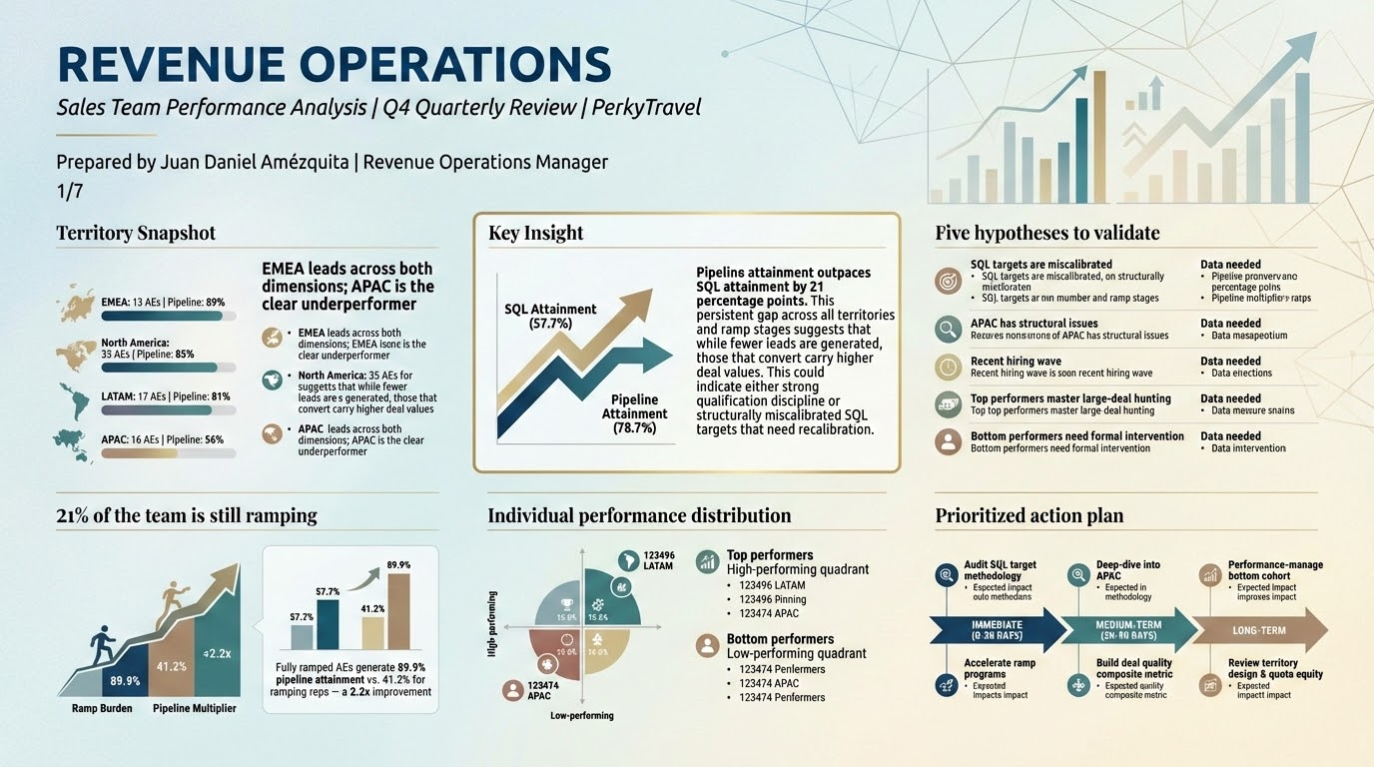

Slide 9
