Slide 1
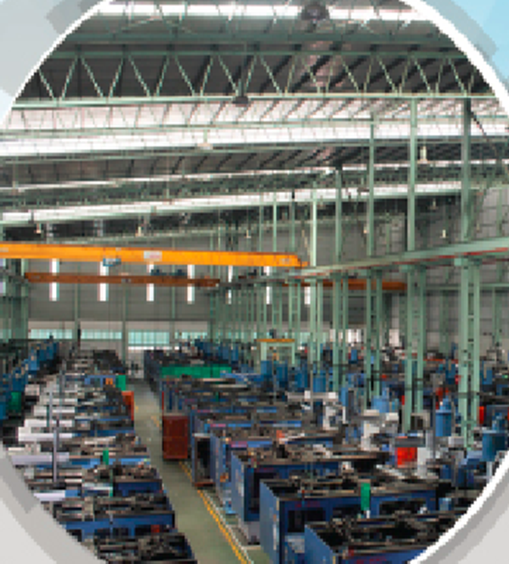

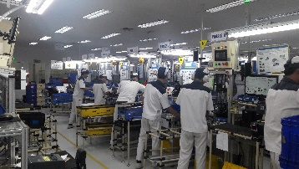
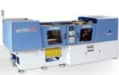
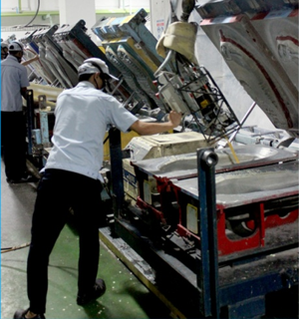
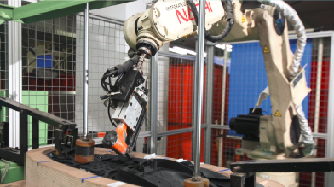
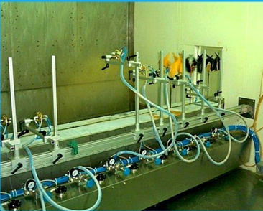
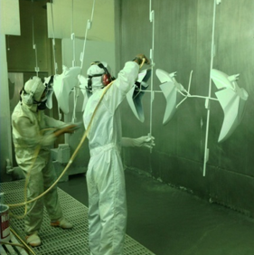
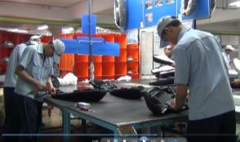
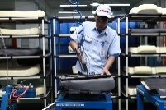
Business Line
Plastic Injection Line
Mirror Assy 4W
130 Unit MC (30-1600 Ton)
6 Line Assy
Seat Assy
Mirror Assy 2W
3 Line Foaming
7 Line Assy Seat 2W
2 Line Assy Seat 4W
1 Line Assy Robot
2 Line Assy
Painting
2 Line Manual
1 Line Automatic

