Slide 1
FIELD INTELLIGENCE
ASCO 2025
Executive Intelligence Summary
OVT-209 | NSCLC Program
June 3, 2025 | CONFIDENTIAL – INTERNAL USE ONLY

Slide 2

OVT-209 Clinical Data Reception at ASCO 2025
Abstract #8502
PRESENTATION ATTENDANCE & DATA HIGHLIGHTS
SAFETY PROFILE – KOL SCRUTINY
Session attendance: Room was ~70% full
ORR of 47% (95% CI: 39–55%): Mentioned 1 time; noted audible audience reactions
Median PFS 7.2 months: Cited 1 time; noted as meaningful vs. SOC (~4 months)
Duration of response: Median not reached; cited 1 time as early durability signal
EGFR wild-type subgroup signal: Mentioned 1 time during Q&A; noted by multiple KOLs who were observed writing it down
ILD (Grade 2+, 4.2%): Raised in "literally every conversation" per field note (multiple mentions)
No Grade 5 ILD events: Noted 1 time as reassuring
Grade 3+ AEs of 18%: Cited 1 time; noted as lower than expected for ADC class
Nausea, fatigue, peripheral neuropathy: Cited 1 time as main tolerability issues; KOLs generally felt "workable"
ILD monitoring protocol: Directly requested by 1 KOL (Dr. Martinez, MSK) in post-session conversation
CONFIDENTIAL – INTERNAL USE ONLY | ASCO 2025 Field Intelligence

Slide 3
KOL Engagement Summary
Dr. James Okonkwo
Dr. Yuki Tanaka
Dr. Elena Vasquez
MD Anderson
National Cancer Center Japan
Hospital Clinic Barcelona
Efficacy data: described as "very positive"
Sequencing & treatment algorithm fit: raised 1 time as main concern
Post-IO progression settings (2L vs. 3L+): mentioned 1 time
EGFR mutant subgroup: asked about 1 time; expressed strong interest
Phase 3 site participation: expressed openness 1 time
PMDA accelerated approval pathways for ADCs: mentioned 1 time as increasingly open
Phase 2 ORR data supporting PMDA submission: raised 1 time
Japanese sites in Phase 3: suggested 1 time
Korean MFDS following PMDA within 6–12 months: cited 1 time as strategic opportunity
OS data: requested 1 time as prerequisite for enthusiasm
PFS vs. OS debate: "PFS is nice but my patients want to know if they'll live longer" — 1 direct quote
Safety profile: described as encouraging 1 time
EMA requiring more mature data than FDA: noted 1 time
Spain site enrollment: expressed conditional willingness 1 time
CONFIDENTIAL – INTERNAL USE ONLY | ASCO 2025 Field Intelligence

Slide 4
Competitive Intelligence & Field Observations
LUNEXORIMAB (AXELION) – ABSTRACT #8504
OTHER FIELD OBSERVATIONS
ORR 42%: Presented 1 time; numerically below OVT-209 47% with overlapping CIs
PFS 6.8 months: Cited 1 time; slightly below OVT-209 7.2 months
ILD ~5% Grade 2+: Noted 1 time; slightly higher than OVT-209; "several KOLs noted" this difference
"Basically equivalent options" framing: Overheard 1 time between 2 thoracic oncologists at poster session
"Cleaner safety signal" for OVT-209: Mentioned by 1 HCP with caveat of wanting more ILD follow-up
Axelion Phase 3 initiation rumor: Heard 1 time at BIO reception; unverified; possible Q3 investor day announcement
Dato-DXd (TROPION-Lung01) 2L+ NSCLC positioning: Noted 1 time; TROP2 target vs. OVT-209's novel conjugate; will compete for same patient pool
Tagrisso resistance creating 2L+ demand: Mentioned 1 time; unverified; flagged as potential tailwind
Large pharma BD interest in ADC players: Heard 1 time at BIO reception; attributed to "conference chatter"
HER2-low breast cancer poster (OVT-209): Noted 1 time; described as strong data; deferred to separate team for debrief
CONFIDENTIAL – INTERNAL USE ONLY | ASCO 2025 Field Intelligence

Slide 5
Synthesized Field Themes & MSL Intelligence
MSL-DERIVED*
Themes observed across ASCO 2025 and longitudinal MSL engagement
IMMEDIATE FOLLOW-UPS FLAGGED
EVOLVING HCP SENTIMENT SINCE ESMO 2024
MSL follow-up with Dr. Martinez (MSK) requested: ILD monitoring protocol — 1 direct request logged
Dr. Okonkwo (MDA) connection to clinical team for Phase 3 site expansion — 1 engagement
Regulatory team briefing on APAC pathway intel from Dr. Tanaka — 1 item flagged
Competitive intel team tasked to monitor Axelion investor communications — 1 directive
EGFR wild-type subgroup analysis requested from biostatistics — 1 data pull requested
MSL survey responses and internal meetings indicated interactions since ESMO 2024, MSLs have noted a measurable shift in KOL framing — HCPs who previously asked "does it work?" are now asking "where exactly does it fit?" This signals movement from skepticism to practical adoption planning, and is the most consistent theme MSLs are hearing heading into Phase 3 site selection discussions.
In 2025, ILD rates decreased from 5.3% in 2024, increasing sentiment overall.
2024 and 2025 MSL survey scores indicated that HCPs want visually engaging PDFs detailing monitoring protocols, indicating the need for more engaging content to keep up with competitor education initiatives.
CONFIDENTIAL – INTERNAL USE ONLY | ASCO 2025 Field Intelligence

Slide 6
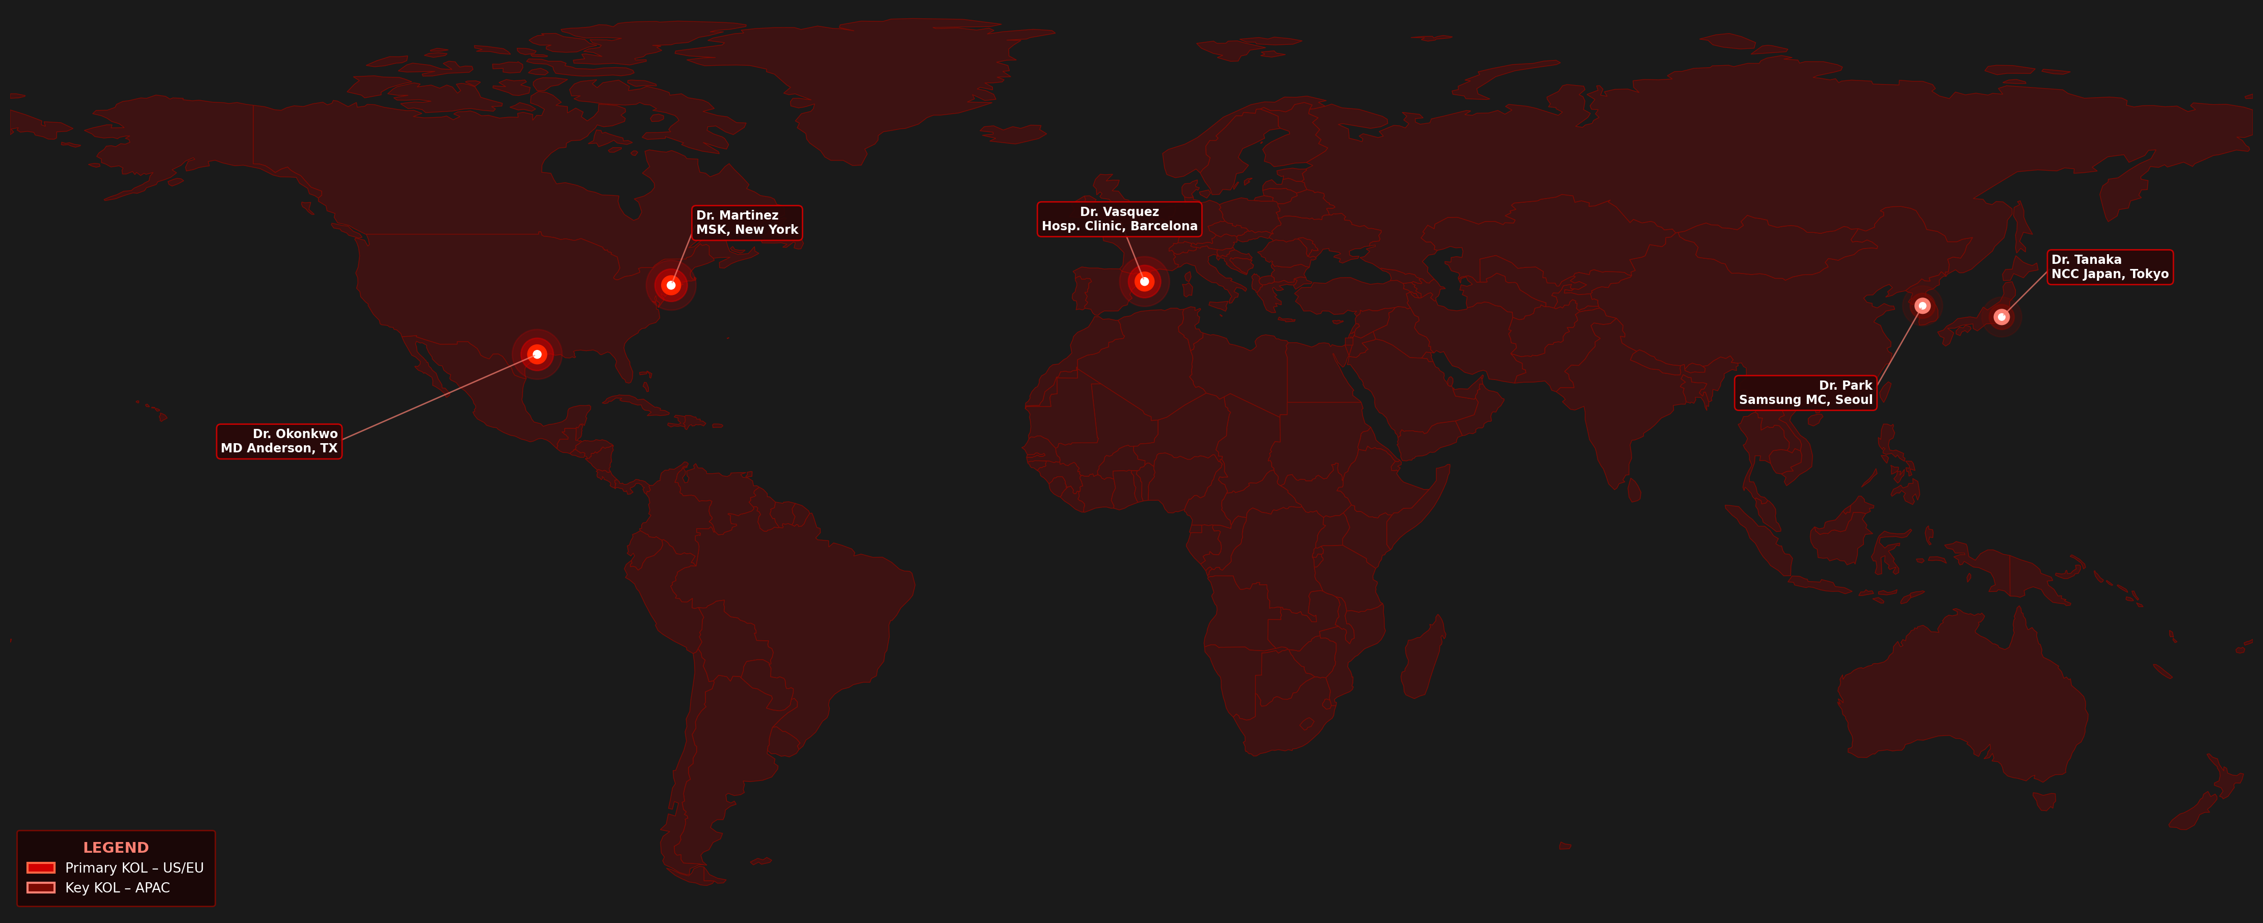
APPENDIX: KOL Geographic Distribution
ASCO 2025 Engaged HCPs
CONFIDENTIAL – INTERNAL USE ONLY | ASCO 2025 Field Intelligence

