Slide 1

Insights Advisor for
Red Hat OpenShift
Juan Díaz
Check the GitHub repo!

Slide 2












About me

Slide 3
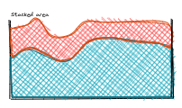

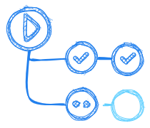








What's OpenShift?

Slide 4








What's Insights Advisor?

Slide 5
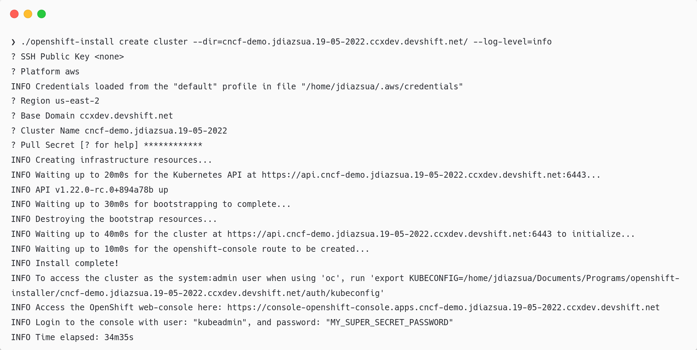
Demo time:
Create a cluster

Slide 6
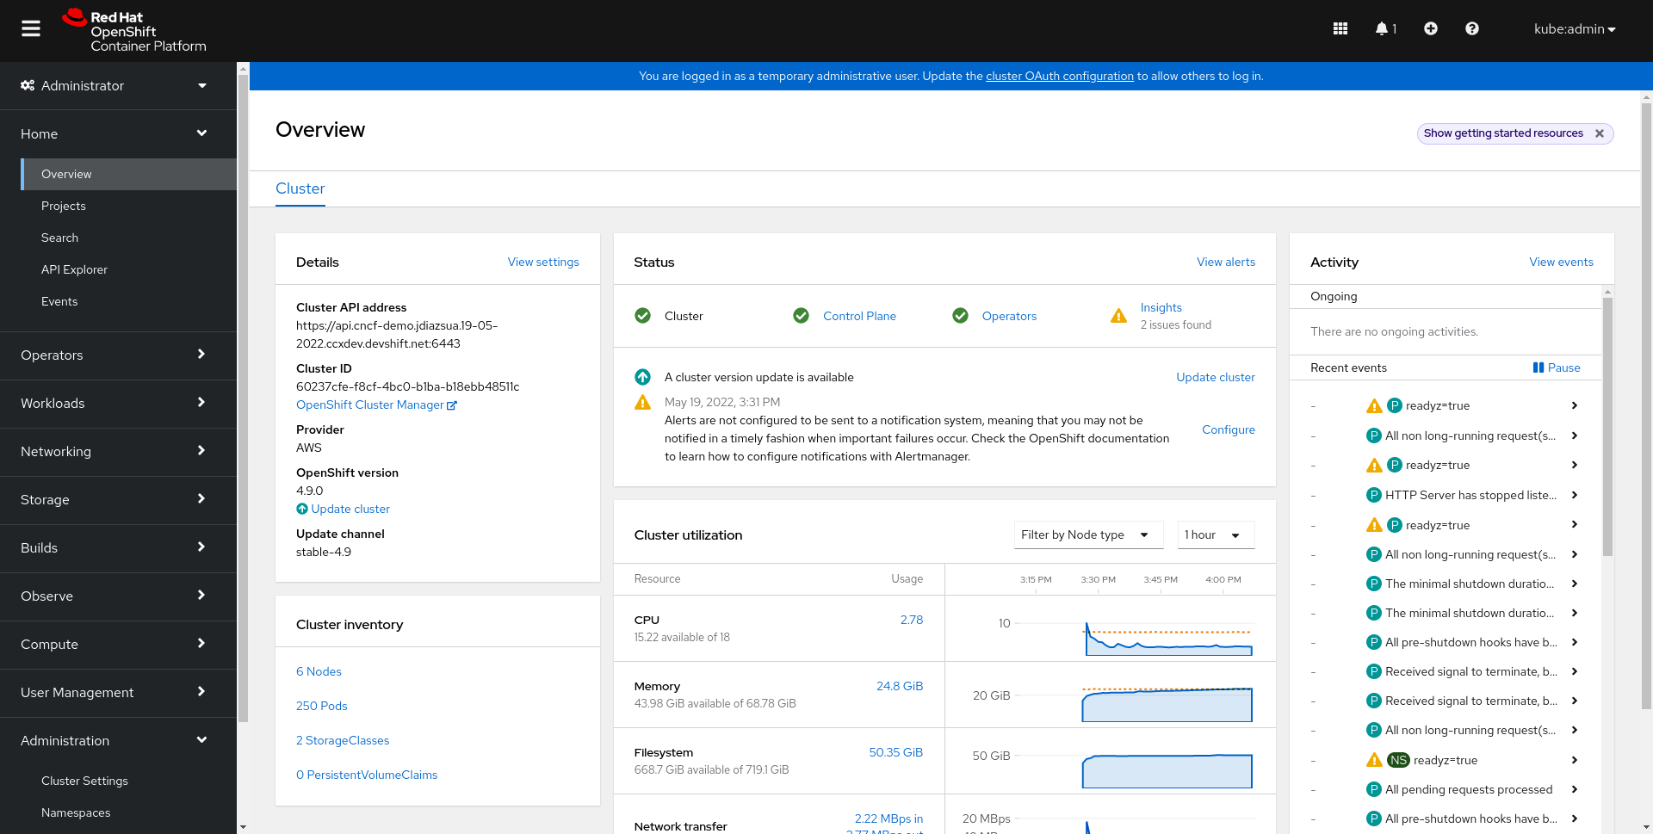
Demo time:
Explore the OpenShift console

Slide 7
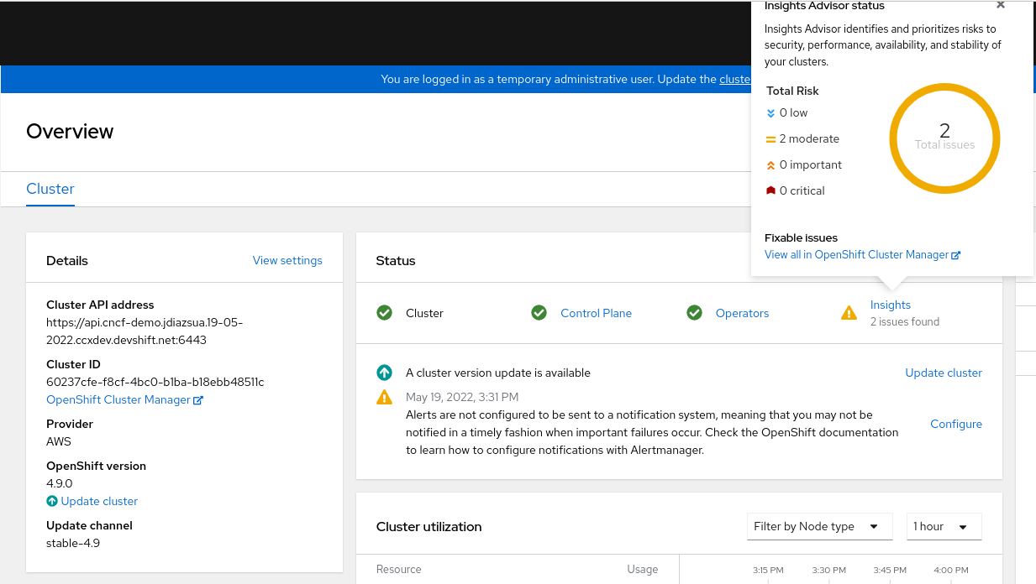
Demo time:
Explore the OpenShift console: see some issues

Slide 8
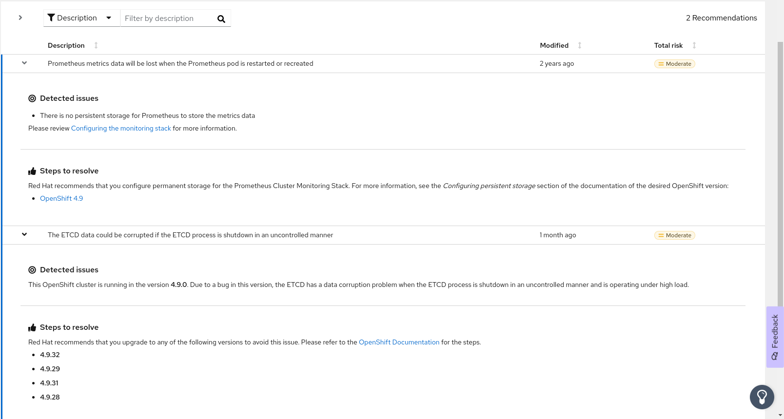
Demo time:
Explore the OpenShift console: see the issues detail

Slide 9
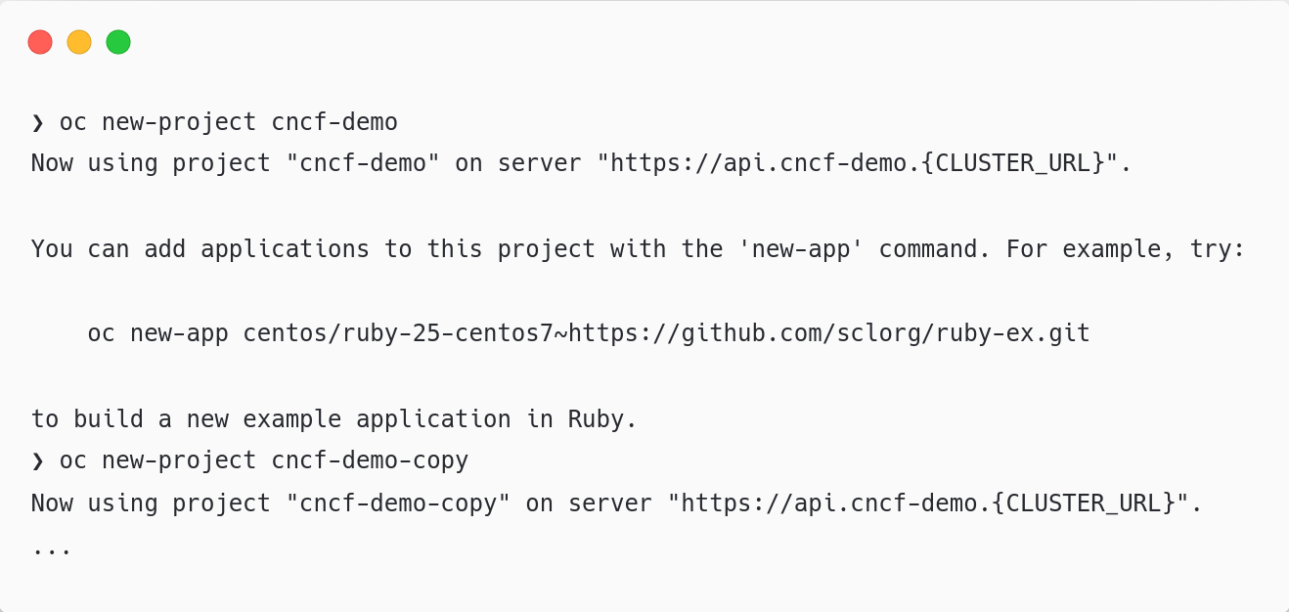
Demo time:
Break the cluster: prepare two different projects

Slide 10
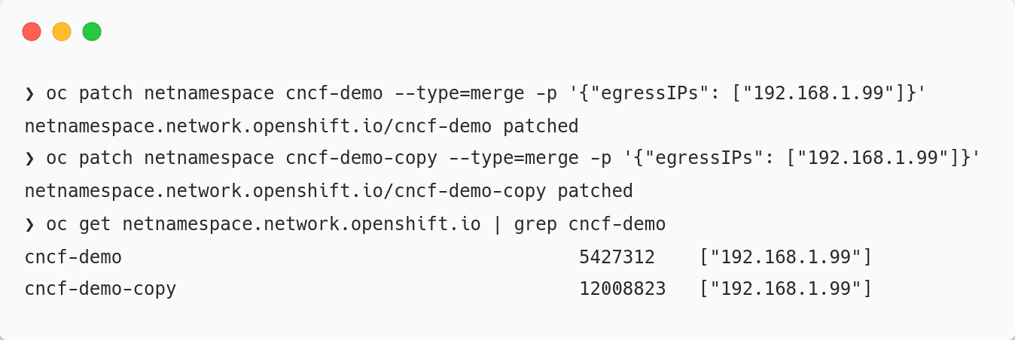
Demo time:
Break the cluster: use the same IP for their egress

Slide 11
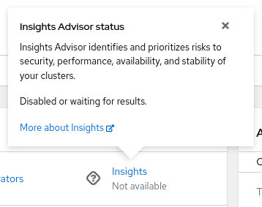
Demo time:
Break the cluster: wait for results

Slide 12
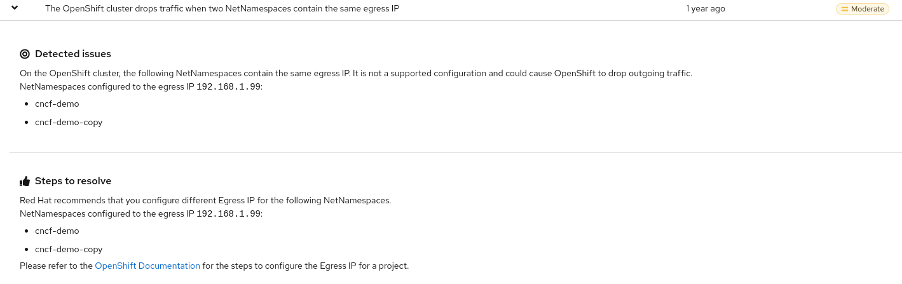
Demo time:
Break the cluster: see the new issues - 2 namespaces same egress IP

Slide 13
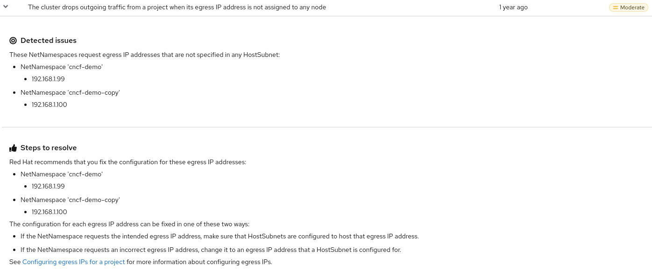
Demo time:
Break the cluster: see the new issues - no node assigned egress IP

Slide 14
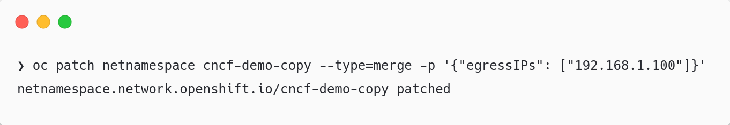
Demo time:
Fix the cluster: 2 namespaces same egress IP

Slide 15
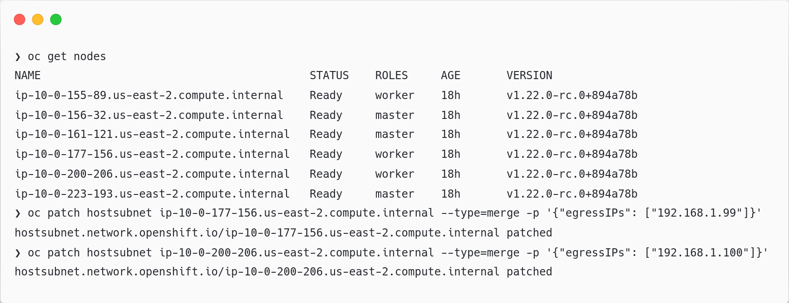
Demo time:
Fix the cluster: no node assigned egress IP

Slide 16
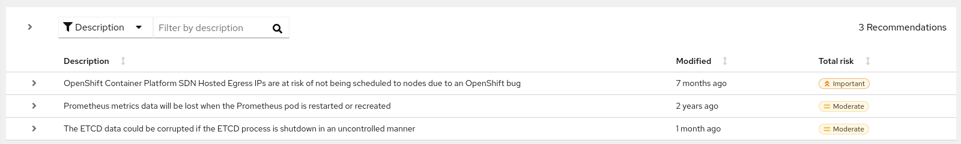
Demo time:
Fix the cluster: see the fixed issues in the Advisor

Slide 17
Insights Advisor for
Red Hat OpenShift
Juan Díaz
Check the GitHub repo!

