Slide 1
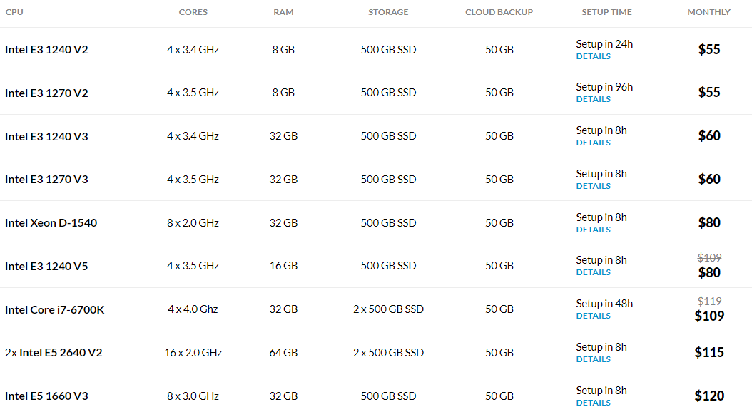
SERVERMANIA (WINDOWS OR LINUX)
Legacy Collection | ServerMania

Slide 2
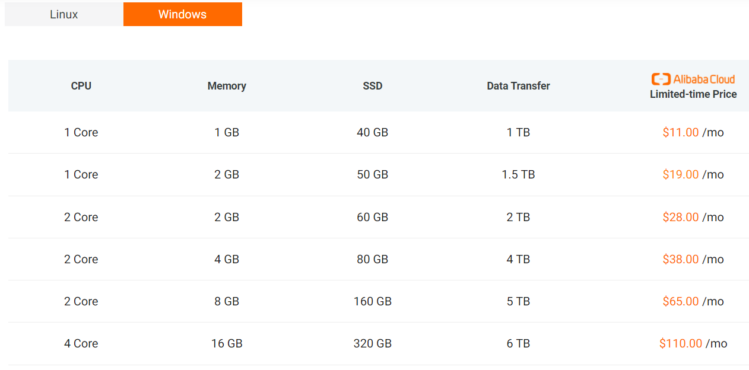
Alibaba Cloud
https://bit.ly/3yckN7u

Slide 3
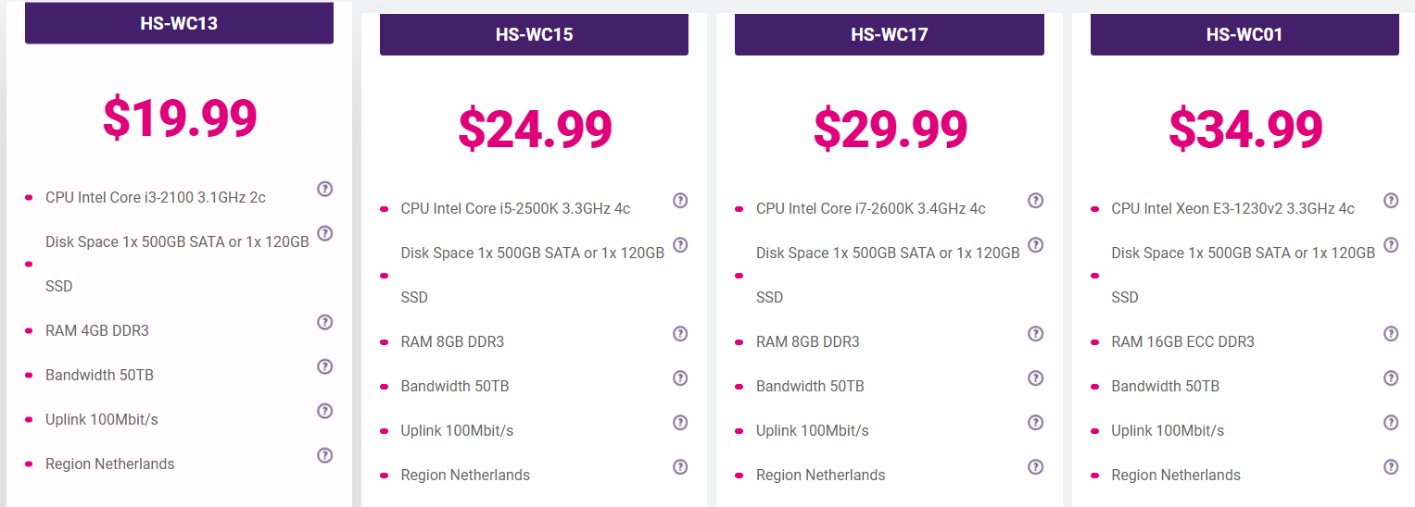
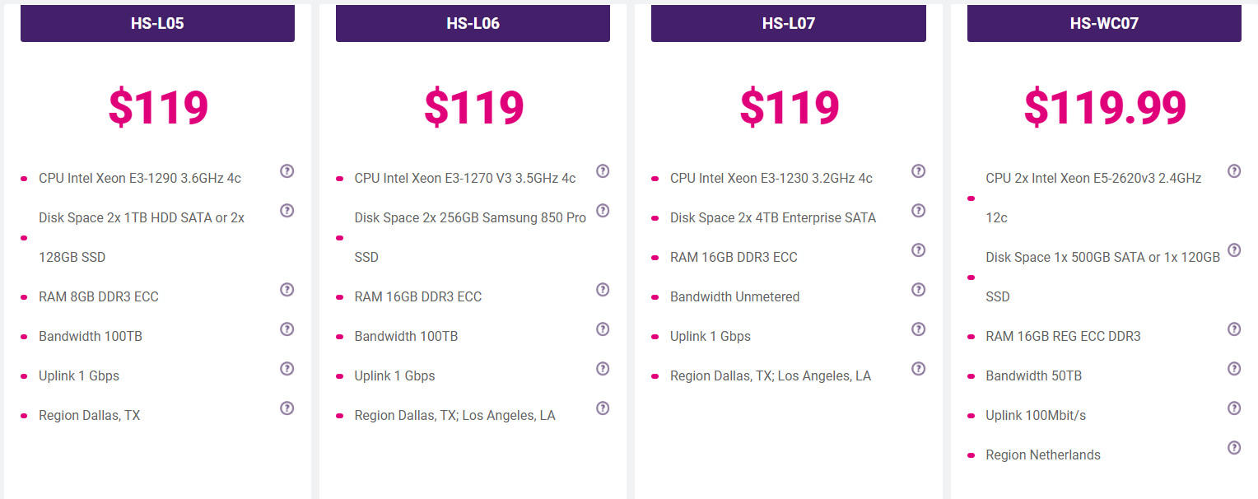
Hostimul
https://bit.ly/3j9TKFG

