Slide 1
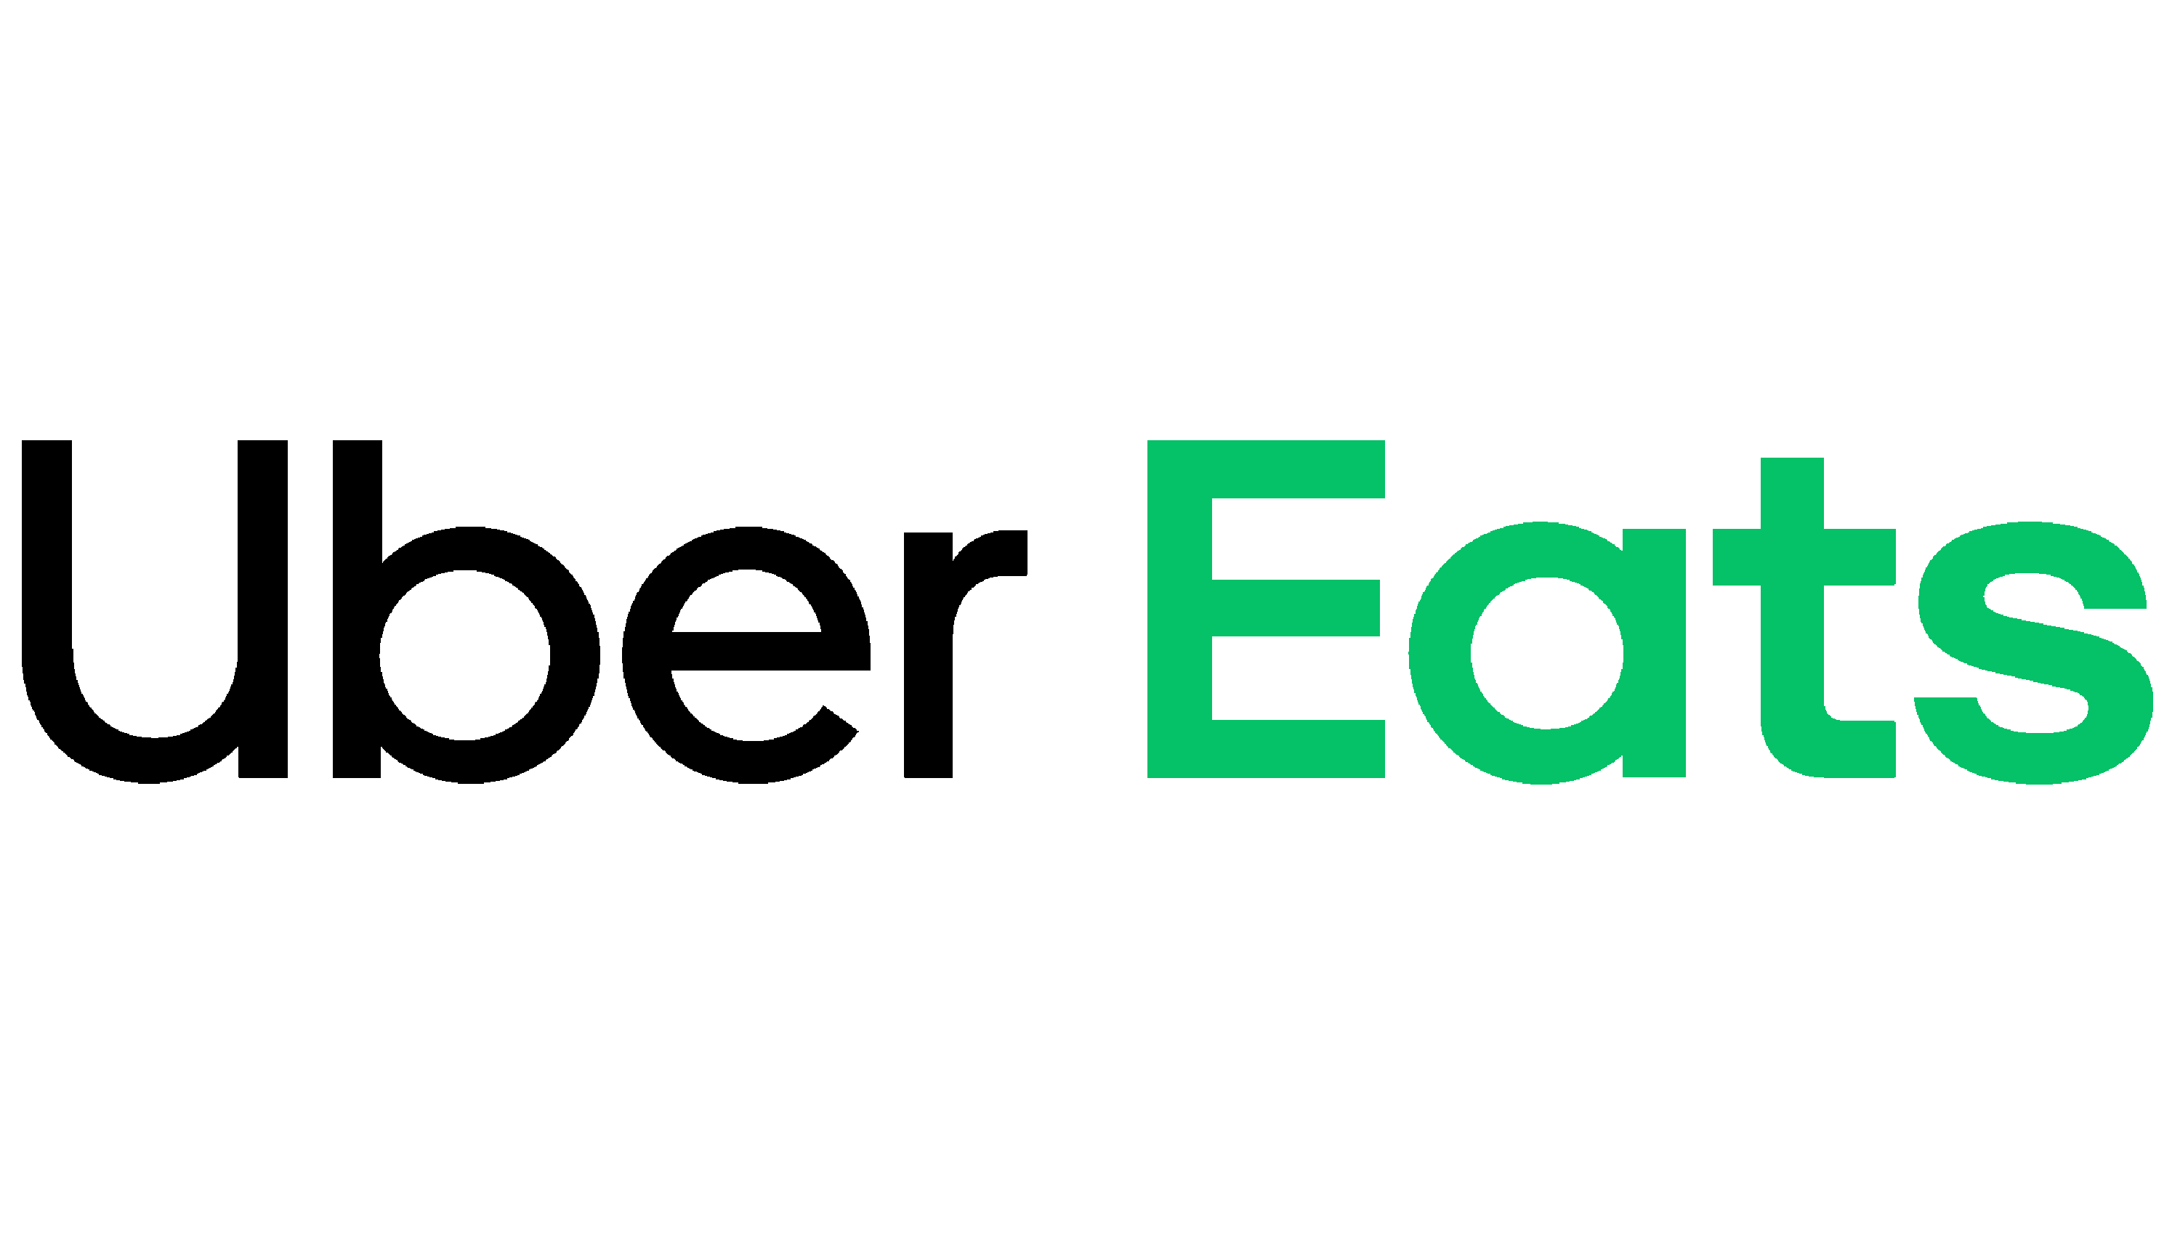
Delivery economics and #KeepPromises
Juan Felipe Hernández Molina
Notes:
Good Afternoon everybody My name is Juan Felipe hernandez molina, and today i Will presenting you, my solution for the tech test, this Will be

Slide 2



Challenge 1: Delivery economics
Clean the data
Calculate economical units
Graphics and solutions
Brought the data set to a more understandable model
Different costs Uber eats had over these months
Behavior of the economical units (losses) over time
Notes:
2- I did not included the Delivery fee couse the task mentioned It already was in there

Slide 3
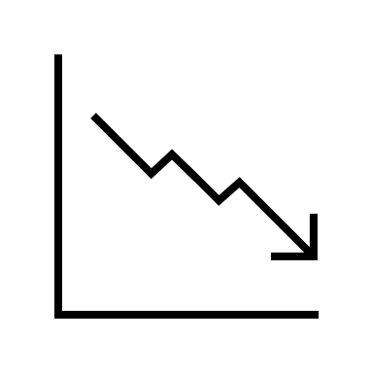
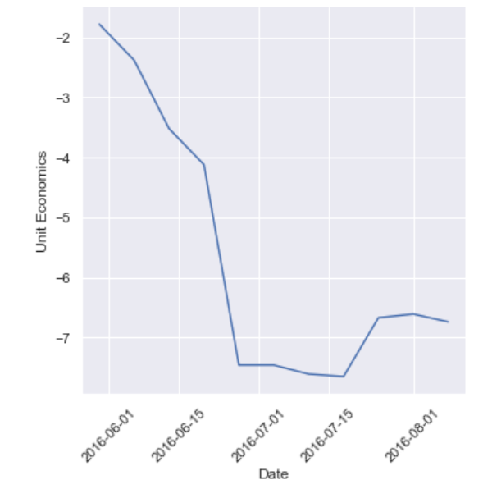
Challenge 1: Delivery economics
Decrease of the average net revenue over time per EATER
Average losses per deliver per month
Month | Unit economics
5 (May) | -1.78
6 (June) | -4.37
8 (August) | -6.67
7 (July) | -7.34

Slide 4
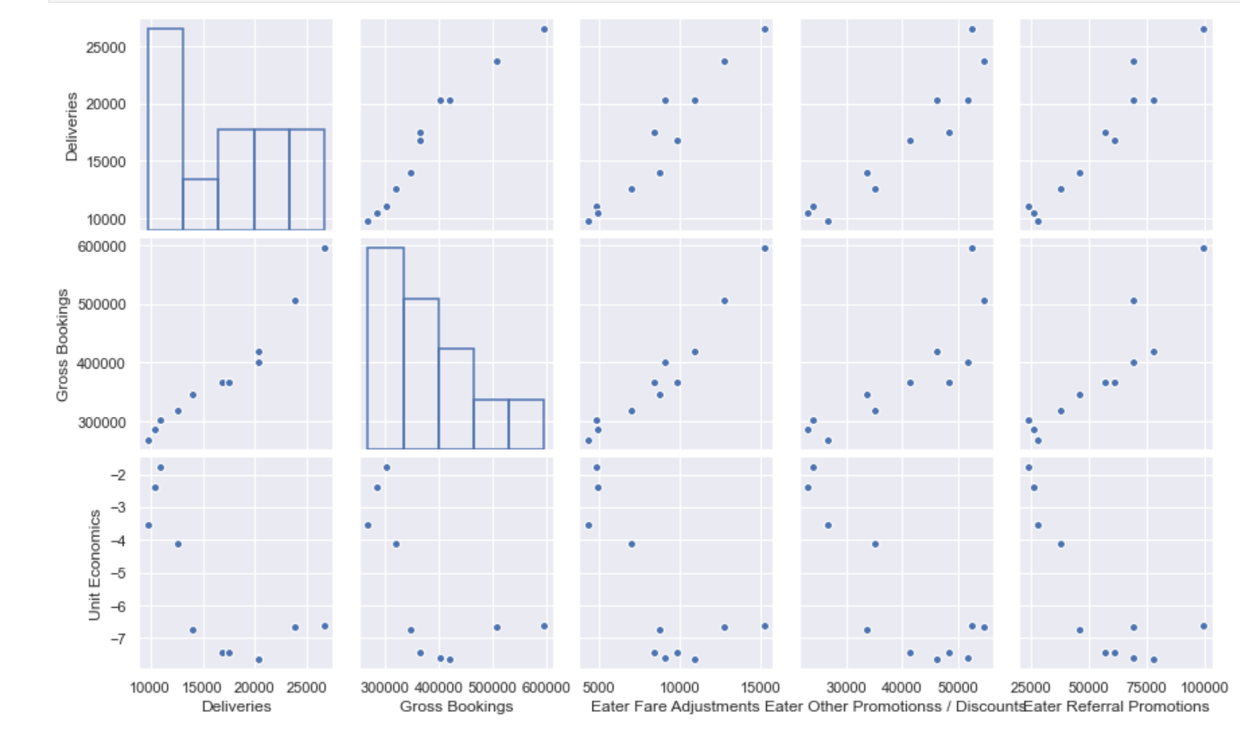
Challenge 1: Delivery economics
Delivery and Gross Boocking
Increase with the other variables
Unit economics
It´s being affected by several variables but specially Eater Other Promotions / Discounts", "Eater Referral Promotions"

Slide 5
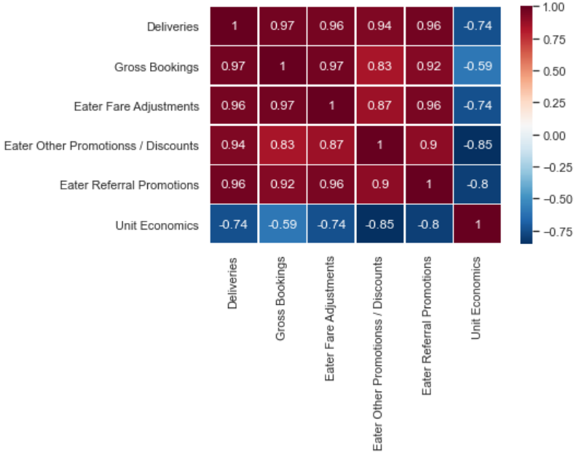


Challenge 1: Delivery economics
Pearson correlation coefficient
-0.8
-0.85
Eater Referral Promotions
Eater Other Promotions/ Discounts
Notes:
Eater Other Promotions / Discounts and Eater Referral Promotions are the features that are affecting the most the negativity of the total net gross per client (Unit Economics)
I assume the idea do give promotions for every referral comes from the idea that bringing more customers = more sales but this may not be true at all
there is a portion of the population that takes advantage of the discount and stop using the app
I don't have the amount of people that is new to the app, make a referral and then keep using the app after the promotions but by the negatives results it can be inferred that is not enough to make the business profitable

Slide 6

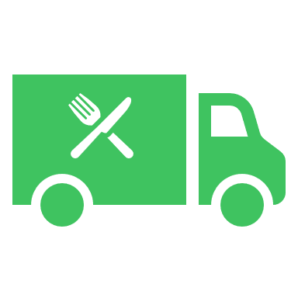
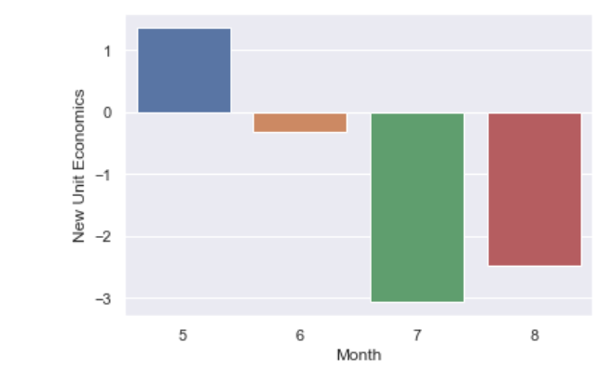
Challenge 1: Delivery economics
Reduce the % of discount for every referral
Promote codes of discount after certain meal order
Month | New Unit Economics
5 (May) | 1.37
6 (June) | -0.31
8 (August) | -2.47
7 (July) | -3.07
Notes:
either reduce the % discount the EATER gets every time he/she refer a new client or limit the number of clients he can refer, assuming it is now being unlimited.
promote the codes of discount after the EATER has ordered 10 meals in that way the eater will feel the need to order more in order to get a prize in that way the amount of deliveires per Eater may increase and the number of discounts can be reduced
Reducing 3.5 times the Eater Other Promotions / Discounts and 4 times the Eater Referral Promotions we can finally see some earnings for the month 5 (May) and even though the losses were reduced significantly, for the rest of the months, they still being negative.

Slide 7

Challenge 1: Delivery economics
Proposal for increasing revenue
1. Bring food where the competition can´t
2. exclusive restaurants and meals for EATER
Notes:
Another way to increase the profitability would be by increasing the amount of deliveries the business can make. two option I propose are
bring food where the competition can not. Zones, neighborhoods, etc where other apps are not available.
exclisivity. Restaurants that are openning can offer their food throught the app or special dishes that just can be found in Uber Eats.
Under this conditions, the city is not profitable for the company

Slide 8
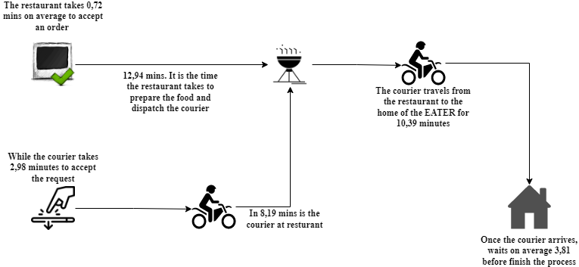
Challenge 2: UberEats #KeepPromises
Our End-to-End process

Slide 9
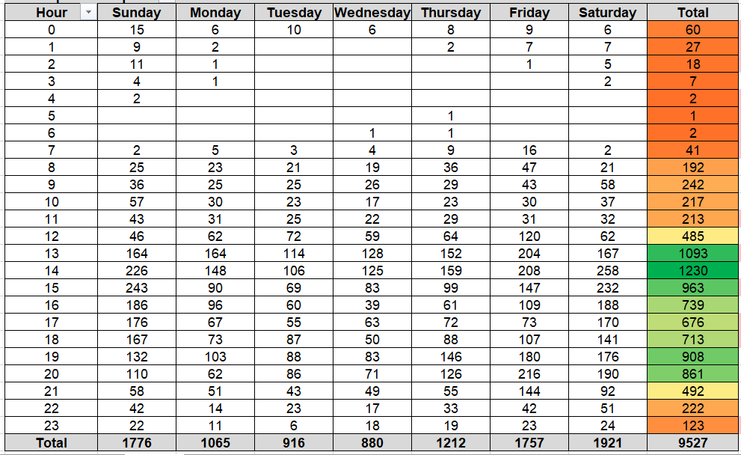


Challenge 2: UberEats #KeepPromises
Between 12-21 hours the flow of request increase
In the weekend Uber has most orders
Sunday at 3 pm is when people usually order the most

Slide 10

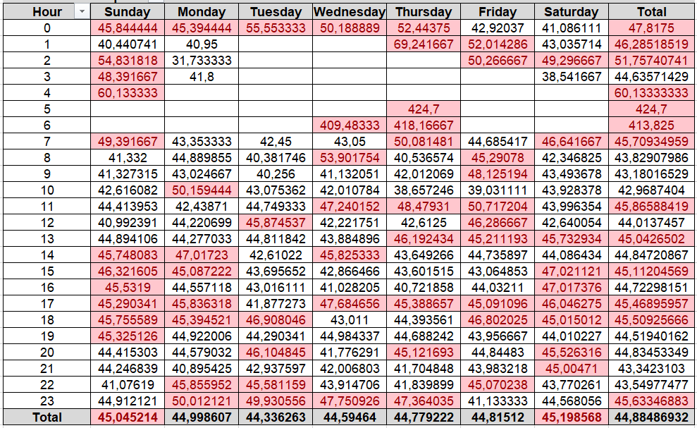

Challenge 2: UberEats #KeepPromises
Saturday and Sunday > 45 min
Thursday at 10am is the best time to order
Sunday at 4pm is the worst time to order
Notes:
sabados y domingos en promedio no se cumple con el tiempo estimados < 45
los jueves a las 10 am es el mejor instante para ordenar y cuando mas rapido llegara el pedido
El domingo a las 4 pm es el instante en que mas se demorara el producto en llegar

Slide 11


Challenge 2: UberEats #KeepPromises
Now
Target
60%
Trips completed <45 min
95%
PLAN: increase by 35% the amount of trips completes in less 45 min
1. Courier shares ubication on the app.
2. Once the app gets a new request it localizes the closest courier between the client and the restaurant.
3. If there´s not courier in the zone, the app will increase the area until it reaches a courier that is close enough.

Slide 12
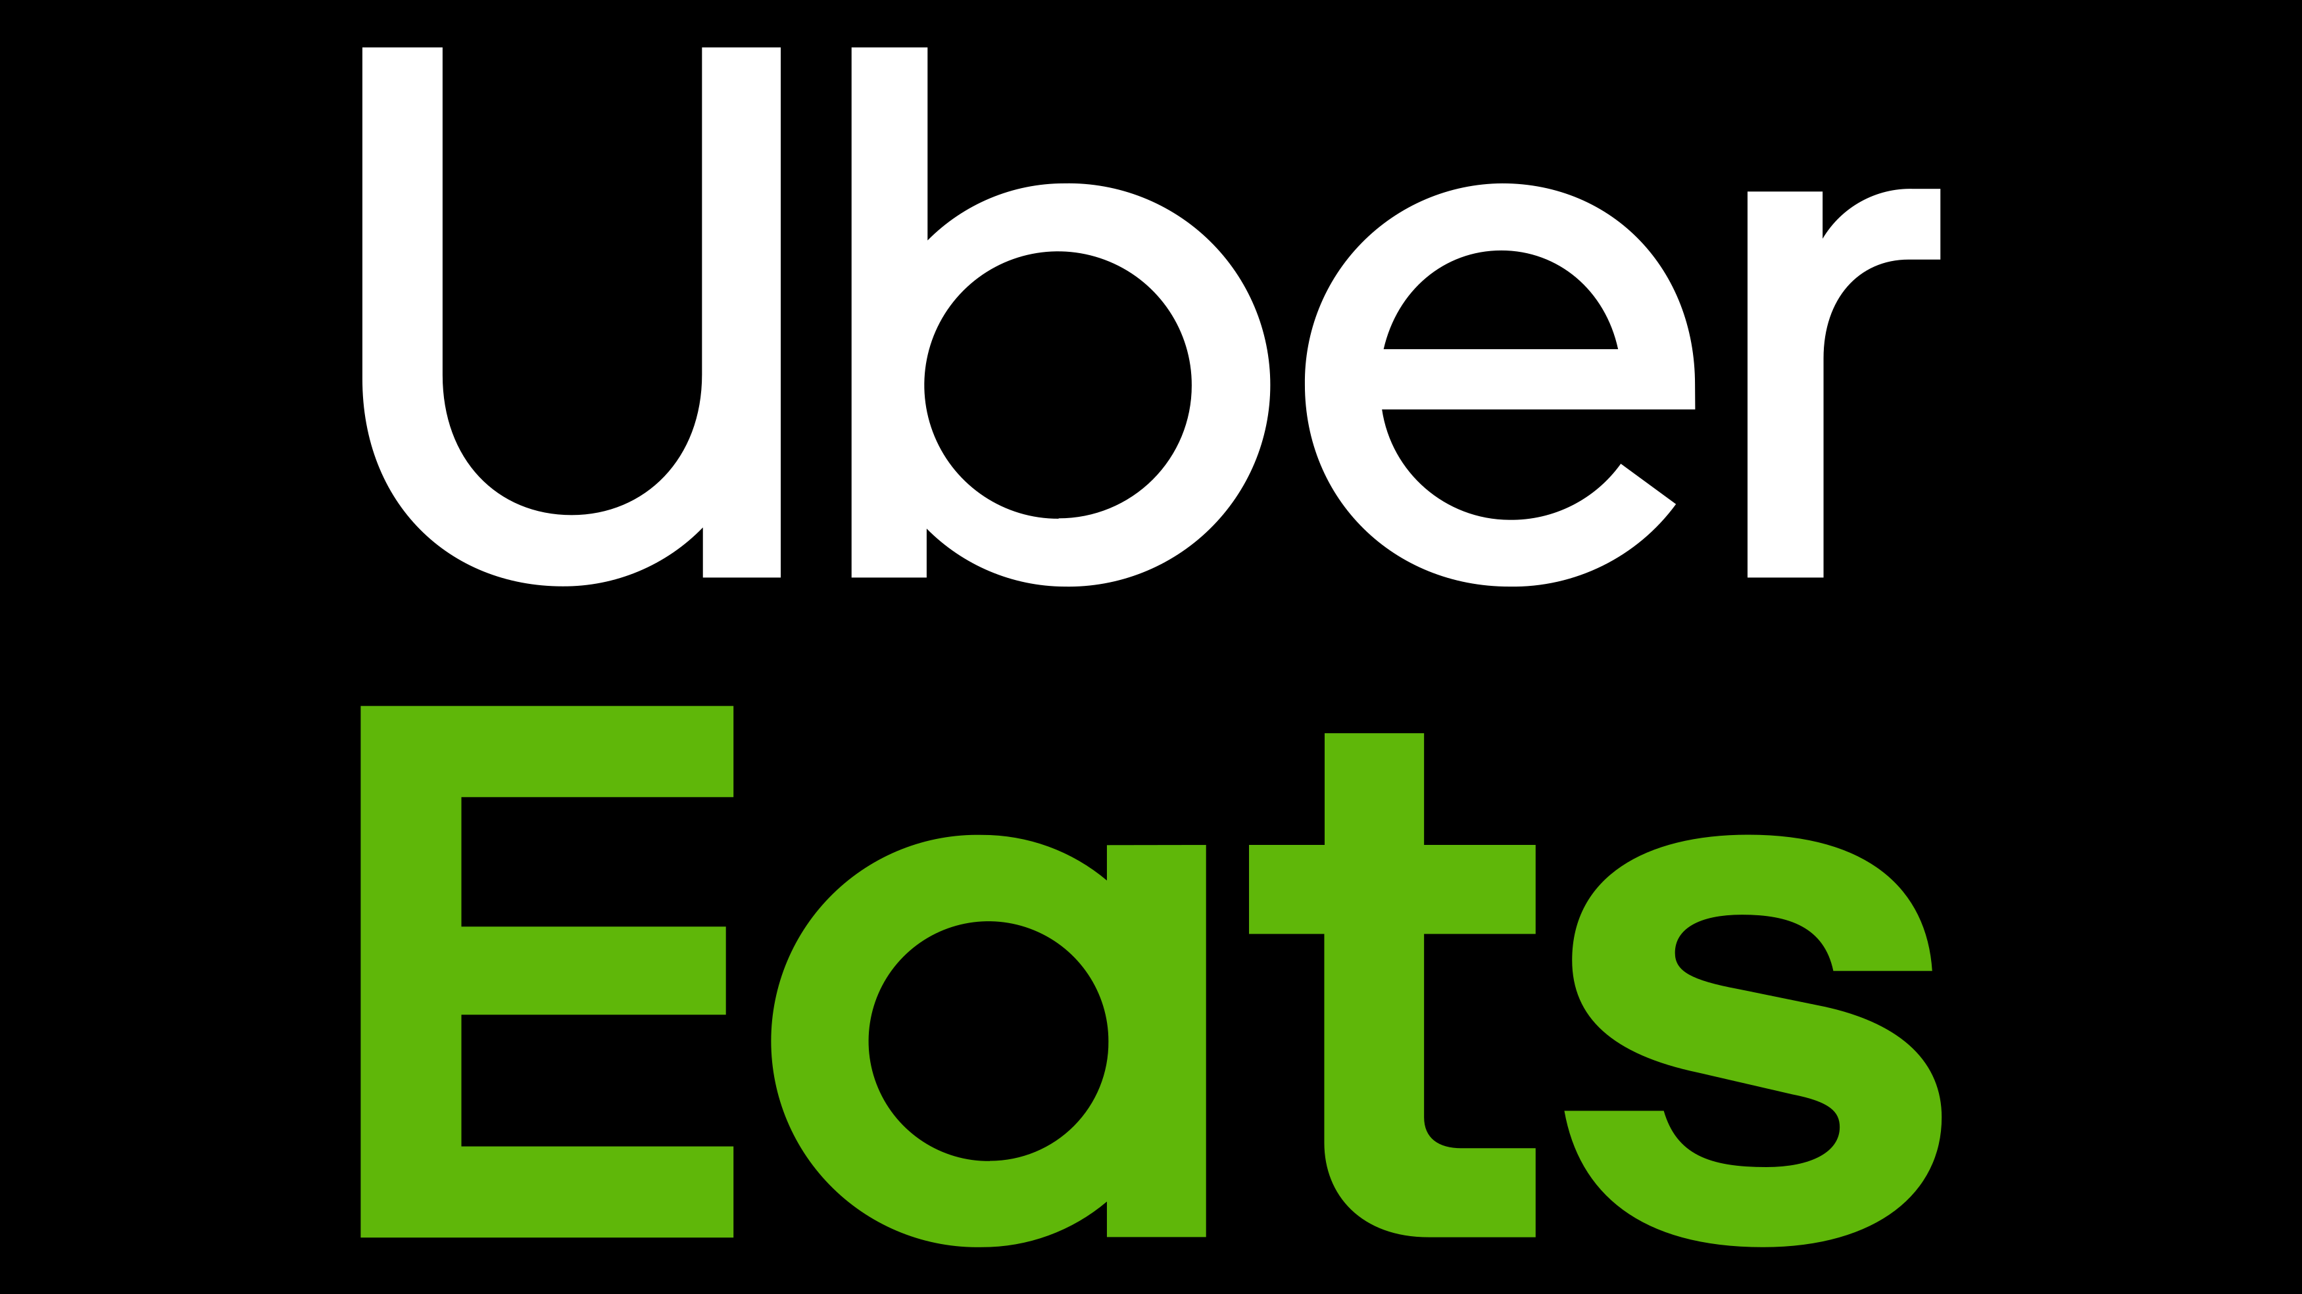
ANY QUESTIONS?

