Slide 1

Delivery economics and #KeepPromises
Juan Felipe Hernández Molina
Notes:
Good Afternoon everybody My name is Juan Felipe hernandez molina, and today i Will presenting you, my solution for the tech test.

Slide 2



Challenge 1: Delivery economics
Clean the data
Calculate economical units
Graphics and solutions
Brought the data set to a more understandable model
Different costs Uber eats had over these months
Behavior of the economical units (losses) over time
Notes:
The proccess I implemented was the following:
1. CLEAN THE DATA: here, the idea was to bring the data into a more readable format, changing data types, and replacing characters like $ and (,) so the number can be operables.
All this was made in Python and can be seen in the notebook I shared during with the presentation on the email.
2. CALCULATE THE ECONOMICAL UNITS, or according to the results, losses that is uber having over time
3. ANALYSIS AND POSSIBLE SOLUTIONS, which is as it sounds, the behaivor of the different features ot the data over time.

Slide 3
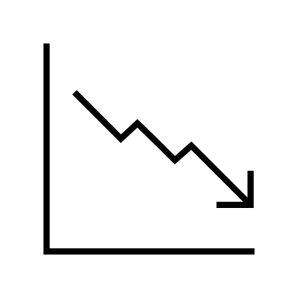
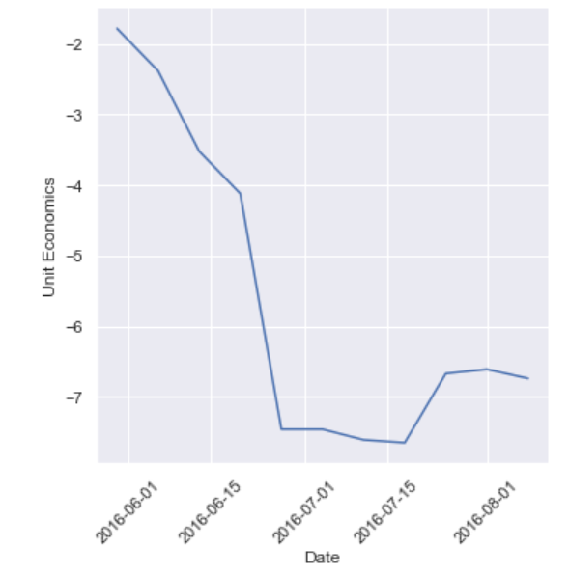
Challenge 1: Delivery economics
Decrease of the average net revenue over time per EATER
Average losses per deliver per month
Month | Unit economics
5 (May) | -1.78
6 (June) | -4.37
8 (August) | -6.67
7 (July) | -7.34
Notes:
To calculate the Units economics or net revenue, I used the Gross Bookings, and subtracted the different costs. Take in count, i did no use Delivery fee because this was already included with in the Gross bookings.
In the table we can see how the average net revenue per client per month decreases. Having its maximum in July which is the month where uber eats got the greatest Number of deliveries.
And to support this idea we can see this graph which represents the average net revenue over time, showing how it decreases the most in July, but start going up a Little bit in August.

Slide 4
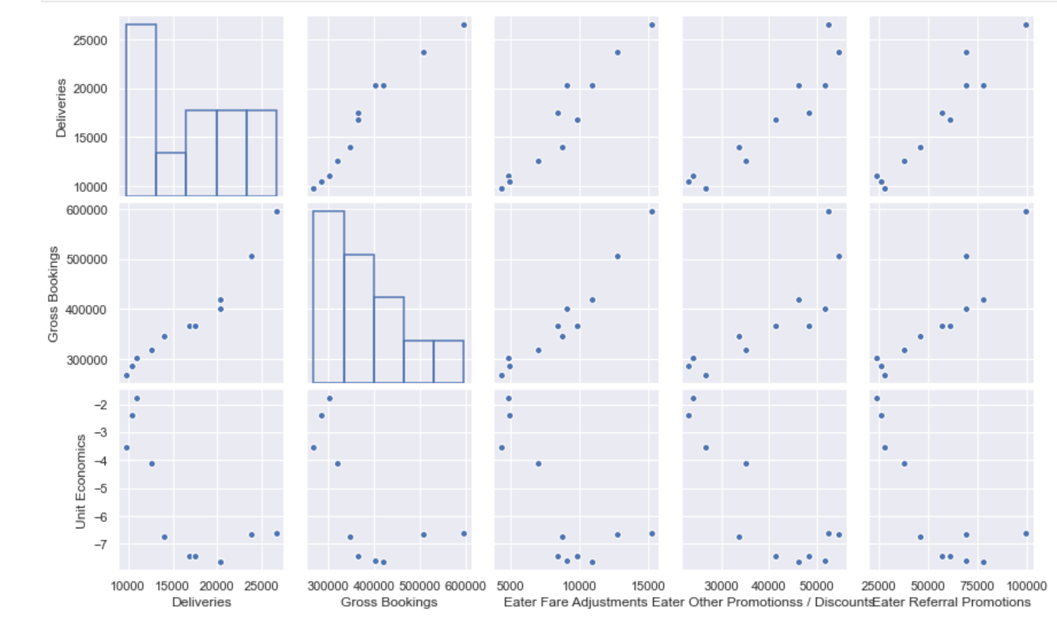
Challenge 1: Delivery economics
Delivery and Gross Booking
Increase with the other variables
Unit economics
It´s being affected by several variables but specially Eater Other Promotions / Discounts", "Eater Referral Promotions"
Notes:
Moving forward, I built some different relational plots to see how is the behavior from on feature based in the other. And in summary, we can see how either Deliveries, and gross booking increase as the other variables do it as well.
But the key aspect is here, where the unit economical have a strong relationship with this two variables, Eater Other Promotions/Discounts and Eater referral Promotions. Please notice I exclude other costs like restaurant and Courier payments under the assumption they are untouchable. But how strong is this relationship ?

Slide 5
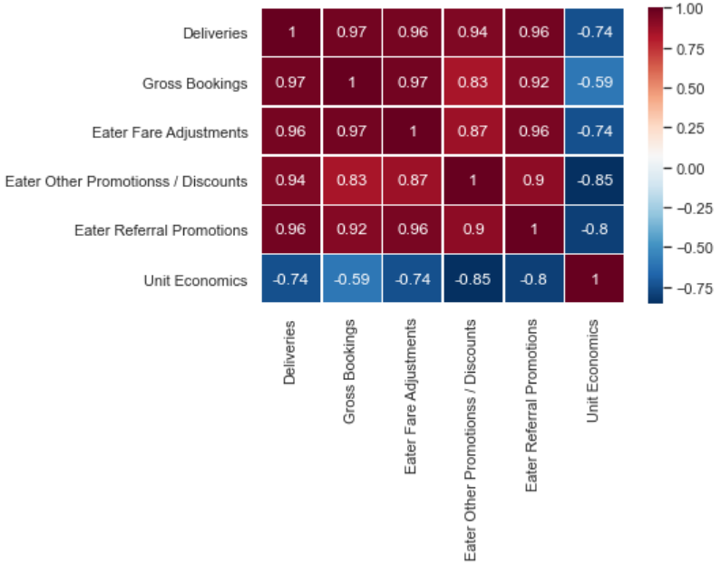


Challenge 1: Delivery economics
Pearson correlation coefficient
-0.8
-0.85
Eater Referral Promotions
Eater Other Promotions/ Discounts
Notes:
Using the Pearson correlation coefficient, I was able to calculate how negative the tendence was, and in this graph, we can see it. With -0.85 and – 0.80, respectively.
I assume that giving promotions for every referral comes from the idea that bringing more customers = more sales but this may not be true at all
there is a portion of the population that takes advantage of the discount and stop using the app
I don't have the amount of people that is new to the app, make a referral and then keep using the app after the promotions but by the negatives results it can be inferred that is not enough to make the business profitable
either reduce the % discount the EATER gets every time he/she refer a new client or limit the number of clients he can refer, assuming it is now being unlimited.
promote the codes of discount after the EATER has ordered 10 meals in that way the eater will feel the need to order more in order to get a prize in that way, the number of deliveries per Eater may increase and the number of discounts can be reduced

Slide 6


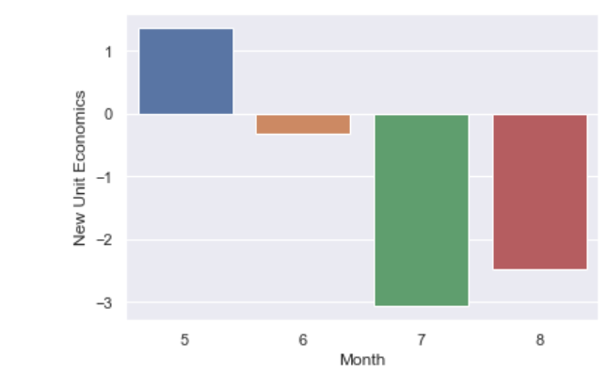
Challenge 1: Delivery economics
Reduce the % of discount for every referral
Promote codes of discount after certain meal order
Month | New Unit Economics
5 (May) | 1.37
6 (June) | -0.31
8 (August) | -2.47
7 (July) | -3.07
Notes:
Reducing 3.5 times the Eater Other Promotions / Discounts and 4 times the Eater Referral Promotions we can finally see some earnings for the month 5 (May) and even though the losses were reduced significantly, for the rest of the months, they still being negative.
Under this conditions, the city is not profitable for the company

Slide 7

Challenge 1: Delivery economics
Proposal for increasing revenue
1. Bring food where the competition can´t
2. exclusive restaurants and meals for EATER
Notes:
Another way to increase the profitability would be by increasing the number of deliveries the business can make. two option I propose are
bring food where the competition can not. Zones, neighborhoods, etc. where other apps are not available.
exclusivity. Restaurants that are opening can offer their food through the app or special dishes that just can be found in Uber Eats.

Slide 8
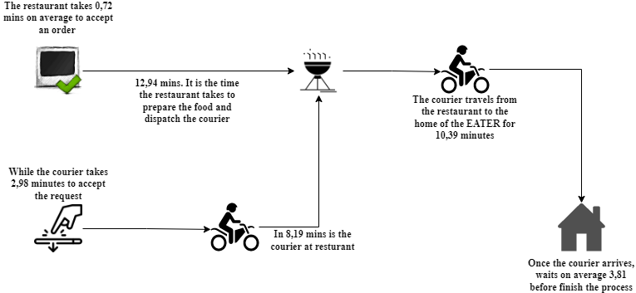
Challenge 2: UberEats #KeepPromises
Our End-to-End process

Slide 9
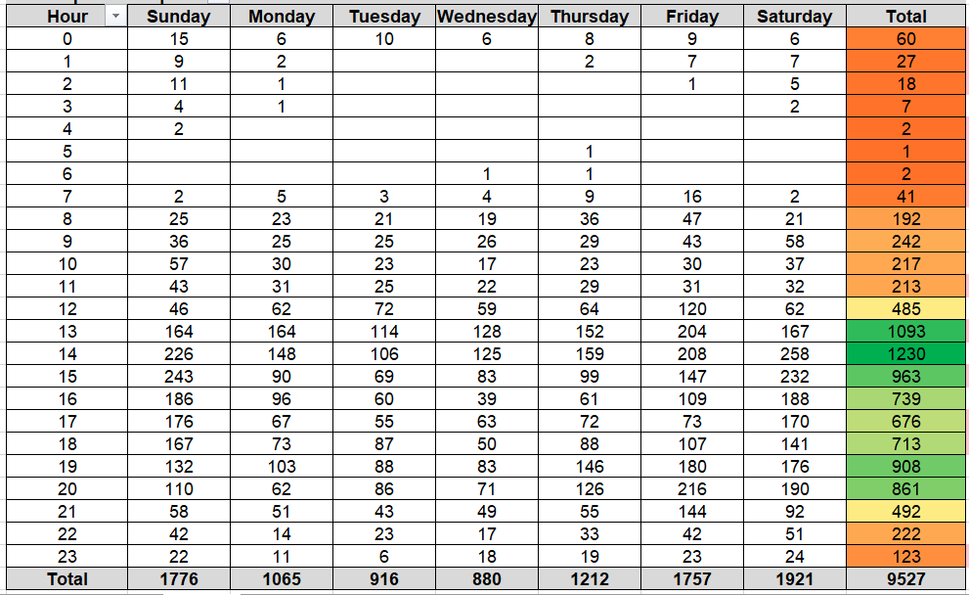


Challenge 2: UberEats #KeepPromises
Between 12-21 hours the flow of request increase
In the weekend Uber has most orders
Sunday at 3 pm is when people usually order the most
Notes:
Analyzing the data set, I can provide the following insights.

Slide 10

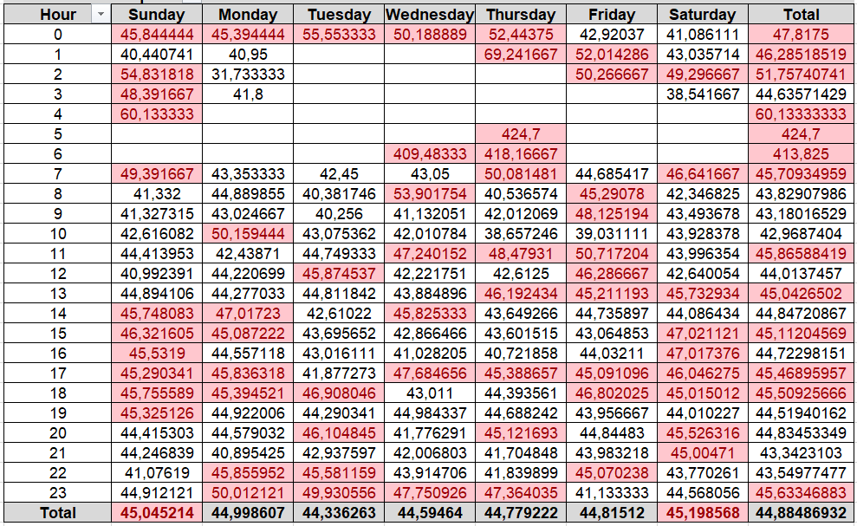

Challenge 2: UberEats #KeepPromises
Saturday and Sunday > 45 min
Thursday at 10am is the best time to order
Sunday at 4 Am is the worst time to order
Notes:
sabados y domingos en promedio no se cumple con el tiempo estimados < 45
los jueves a las 10 am es el mejor instante para ordenar y cuando mas rapido llegara el pedido
El domingo a las 4 Am es el instante en que mas se demorara el producto en llegar

Slide 11


Challenge 2: UberEats #KeepPromises
Now
Target
60%
Trips completed <45 min
95%
PLAN: increase by 35% the amount of trips completes in less 45 min
1. Courier shares ubication on the app.
2. Once the app gets a new request it localizes the closest courier between the client and the restaurant.
3. If there´s not courier in the zone, the app will increase the area until it reaches a courier that is close enough.

Slide 12

ANY QUESTIONS?

