Slide 1


Interference-Aware Beam Hopping Scheduling for LEO Satellite Networks using Soft-Conflict Graph Coloring
Jihane Lghoury, Guilherme Iecker Ricardo, Sebastian Euler,
Xiaotian Fu, Ioannis Xirouchakis, Riadh Dhaou

Slide 2
Agenda
01 | Context
02 | System Model
03 | Graph Coloring- based beam scheduling optimization problem
04 | Experimental Setup
05 | Numerical Results

Slide 3
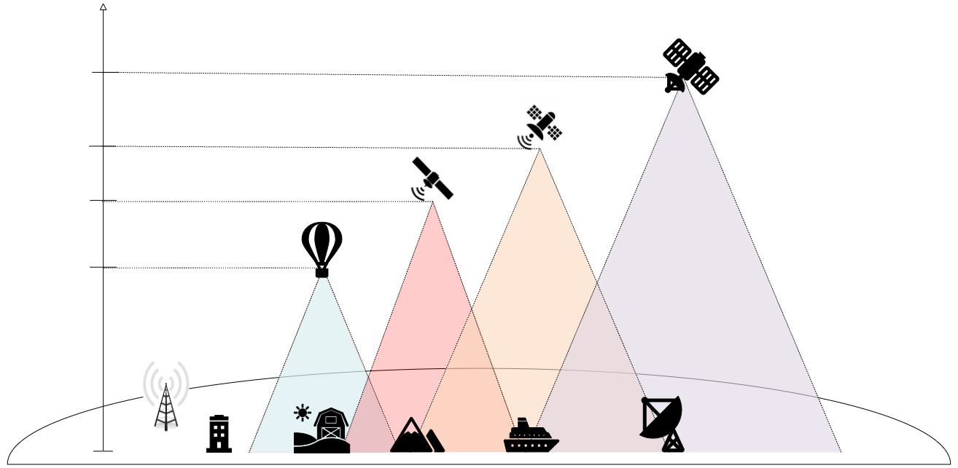
Non-terrestrial Networks (NTN):
Context
Satellites
Altitude
GEO
36000 km
MEO
2000 km
LEO
600 km
HAPS
25 km
BS
Notes:
Non-terrestrial networks (NTNs) have gained increasing attention as a means to complement terrestrial networks by providing coverage to hard-to-reach areas such as mountains, oceans, and deserts, thereby enhancing service availability and network resilience.

Slide 4
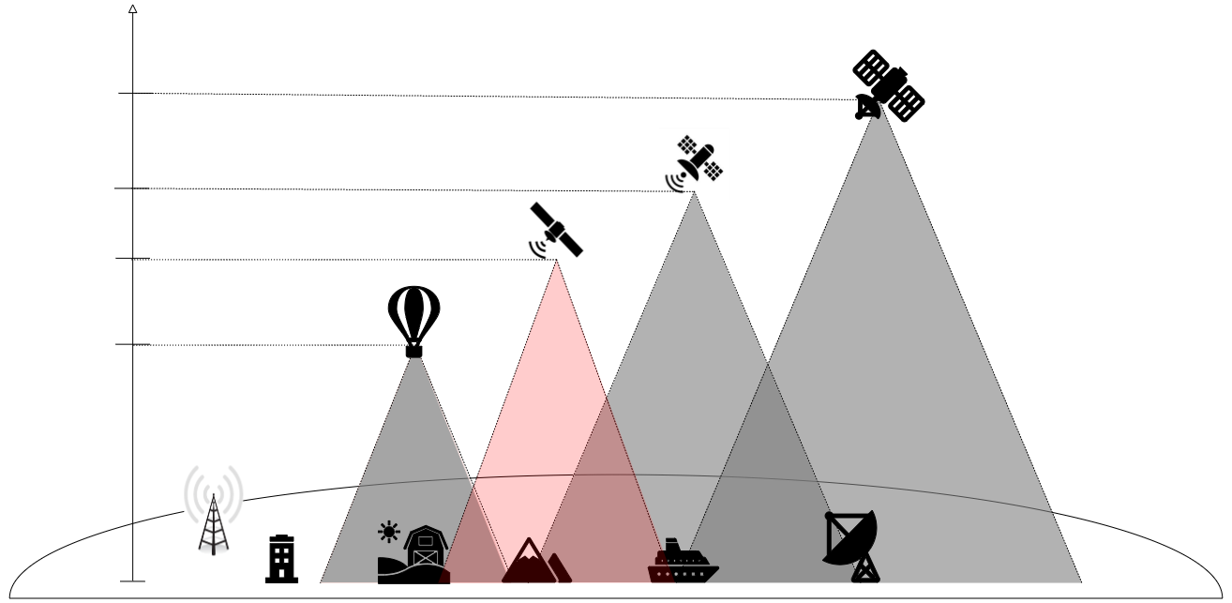
Non-terrestrial Networks (NTN):
Satellites
Altitude
GEO
36000 km
MEO
2000 km
LEO
600 km
HAPS
25 km
BS
Notes:
These networks are typically comprised of satellites, high-altitude platform systems (HAPS), as opposed to traditional terrestrial networks that rely on ground-based towers and cables.

Slide 5
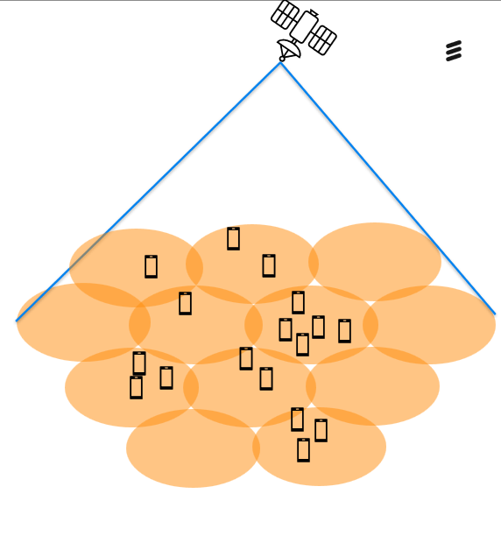
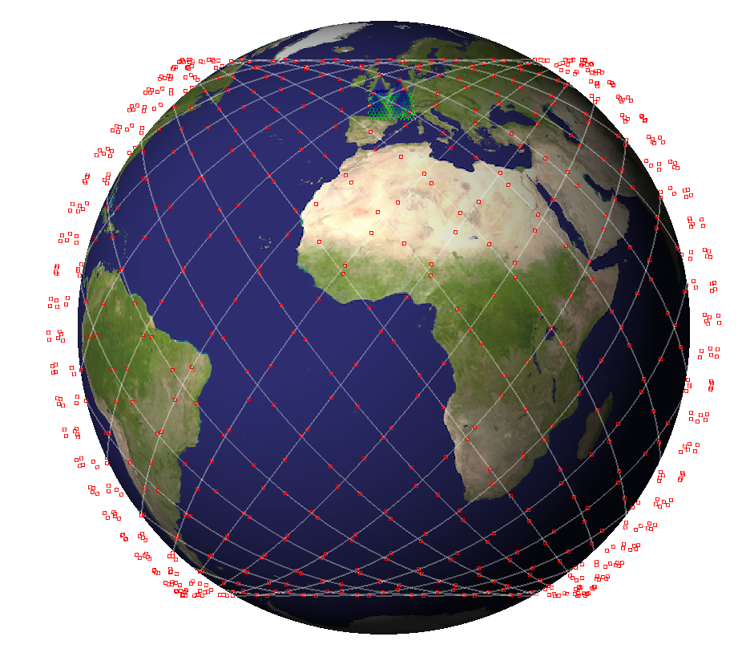
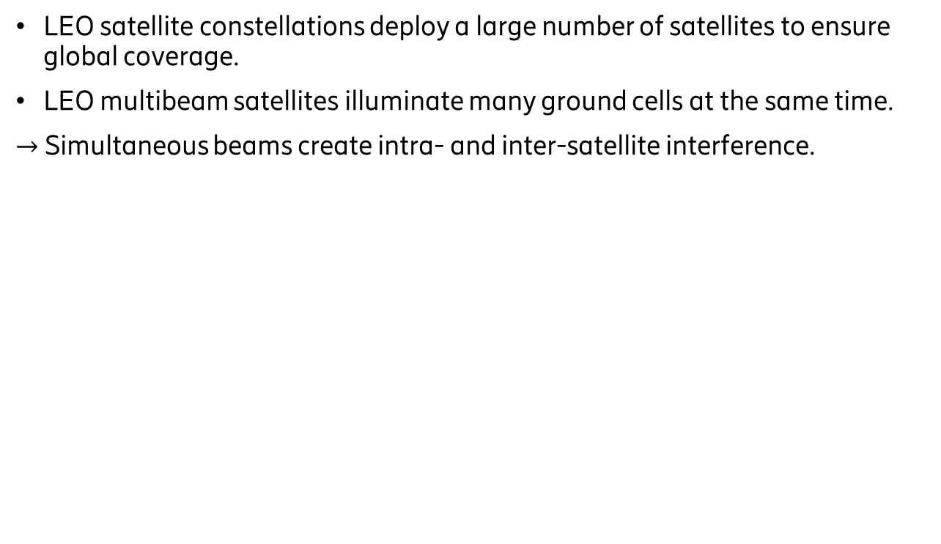
Context
LEO satellite constellations deploy a large number of satellites to ensure global coverage.
LEO multibeam satellites illuminate many ground cells at the same time.
$→$ Simultaneous beams create intra- and inter-satellite interference.
Notes:
One of the major problem of RRM in NTN is beam hopping

Slide 6
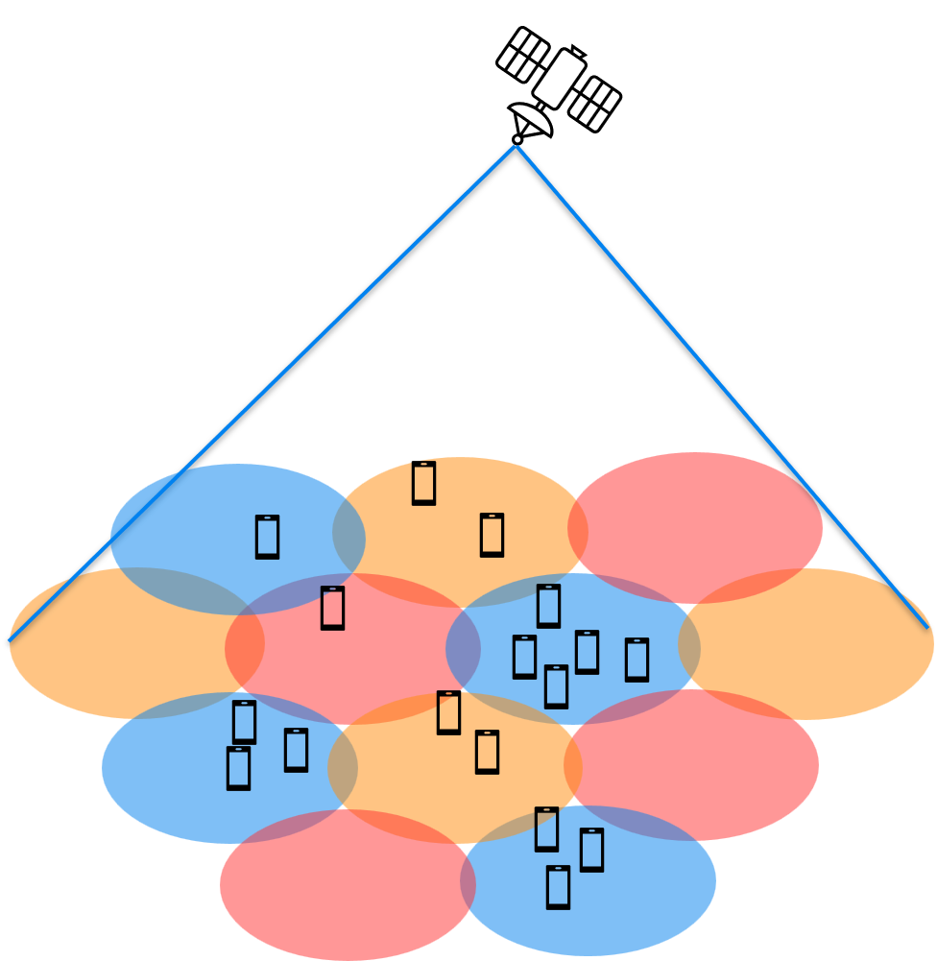
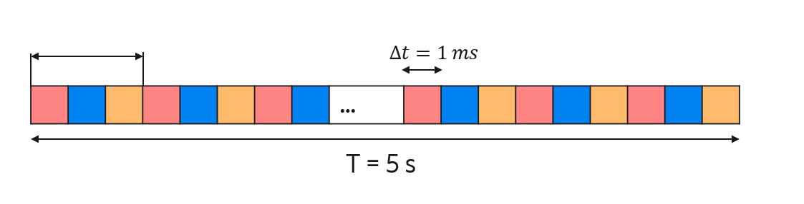
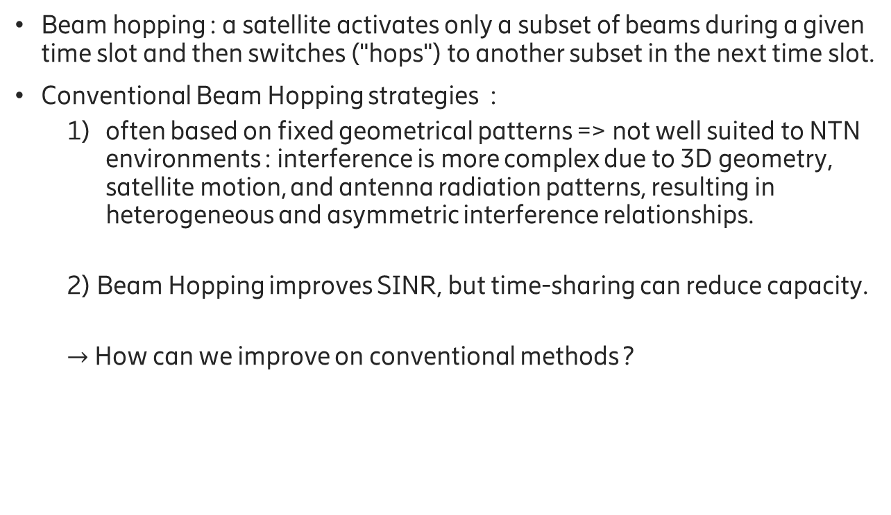
Context
Beam hopping : a satellite activates only a subset of beams during a given time slot and then switches ("hops") to another subset in the next time slot.
Conventional Beam Hopping strategies :
  often based on fixed geometrical patterns => not well suited to NTN environments : interference is more complex due to 3D geometry, satellite motion, and antenna radiation patterns, resulting in heterogeneous and asymmetric interference relationships.
  2) Beam Hopping improves SINR, but time-sharing can reduce capacity.
  $→$ How can we improve on conventional methods ?
Notes:
One of the major problem of RRM in NTN is beam hopping

Slide 7
Related work
References | Limitations
[1] : Yaxin Wang et al. “A Flexible Resource Allocation Algorithm in Full Bandwidth Beam Hopping Satellite Systems”. In: 2019 IEEE 3rd Advanced Information Management, Communicates, Electronic and Automation Control Conference (IMCEC). 2019 [2] : Zhiyuan Lin et al. “Multi-Satellite Beam Hopping Based on Load Balancing and Interference Avoidance for NGSO Satellite Communication Systems”. In: IEEE Transactions on Communications 71.1 (2023) | Interference is approximated using spatial separation or geometric patterns, which does not capture heterogeneous and asymmetric NTN interference.
[3] : Ruishuo Mu et al. “Dynamic Beam Hopping for LEO Satellites with Differentiated Traffic Demands”. In: WSCP2023. 2023, pp. 621–626. DOI: 10.1109/ WCSP58612.2023.10405252 [4] : Huimin Deng et al. “Satellites Beam Hopping Scheduling for Interference Avoidance”. In: IEEE Journal on Selected Areas in Communications 42.12 (2024), | Interference is considered in optimization objectives, but does not explicitly structure the scheduling decisions.
[5] : Zijun Liu et al. “Multi-Satellite Coordinated Beam Hopping for Interference Mitigation Under Tilted Beam Effects: A Graph-Theoretic Approach”. In: IEEE Wire less Communications Letters 15 (2026), pp. 2313–2317. DOI: 10.1109/LWC.2026.3676112. | Beam Scheduling based on dynamic satellite–cell assignment and graph coloring.
Notes:
Several approaches of Beam Hopping rely on spatial sep aration to mitigate interference between simultaneously active beams. These simplified spatial assumptions that may not fully capture the heterogeneous and asymmetric interference patterns observed in NTN systems. Subsequent works investigated Beam Hopping under different constraints. For example, in [5], the authors study dynamic Beam Hopping for LEO satellite systems with differentiated traffic demands. The problem is formulated to maximize a fairness-oriented metric (traffic satisfaction rate) across cells, while considering interference avoidance. Also, in [6], the Beam Hopping problem is formulated as a throughput driven or satisfaction-driven optimization problem for integrated satellite–terrestrial networks. Also, in [7], the authors formulate a scheduling problem that accounts for service requirements, resource constraints, and co-channel interference, and propose a metaheuristic solution based on an enhanced artificial bee colony algorithm. However, in these approaches, although interference is taken into consideration, it does not explicitly structure the beam scheduling decisions. More recently, Beam Hopping has been investigated from a structural perspective. [8] proposes a graph-theoretic Beam Hopping approach for multi-satellite LEO systems based on dynamic satellite–cell assignment and graph coloring. The method first generates an initial Satellites to Cells assignment while respecting the maximum number of beams per satellite. Then, a Tabu Search combined with graph coloring iteratively explores new assignments to reduce inter ference conflicts. The interference threshold is progressively relaxed until a conflict-free solution is obtained. In this work, we also adopt a graph coloring perspective for beam scheduling in LEO satellite systems, but consider a different problem setting: Unlike [8], we assume that the satellite–cell association is given and fixed over the considered scheduling window, as satellite coverage can be considered quasi-static over short time intervals. In this framework, the interference graph is constructed based on pairwise interference metrics, with a parameter controlling the set of interferers.

Slide 8
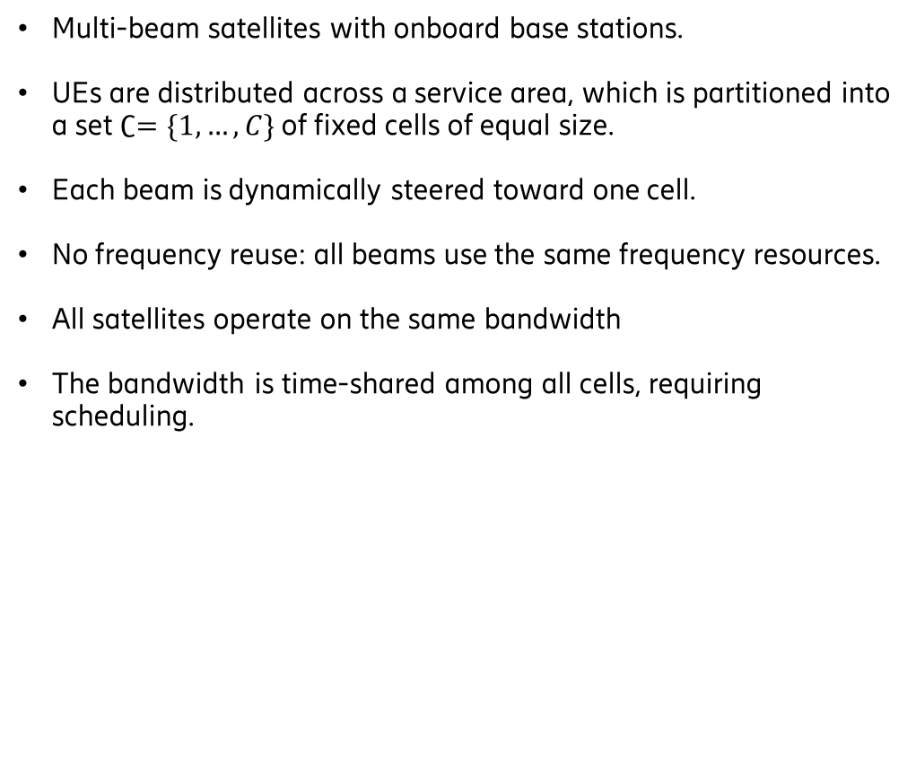
System model
Sat A
Sat B
Multi-beam satellites with onboard base stations.
UEs are distributed across a service area, which is partitioned into a set $∁=\{1,…,C\}$ of fixed cells of equal size.
Each beam is dynamically steered toward one cell.
No frequency reuse: all beams use the same frequency resources.
All satellites operate on the same bandwidth
The bandwidth is time-shared among all cells, requiring scheduling.

Slide 9
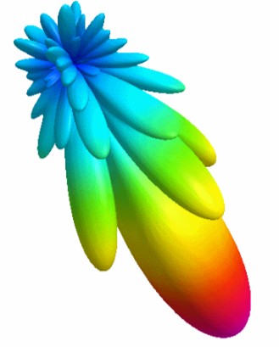
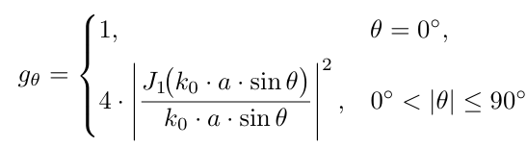
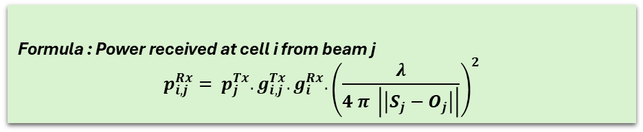







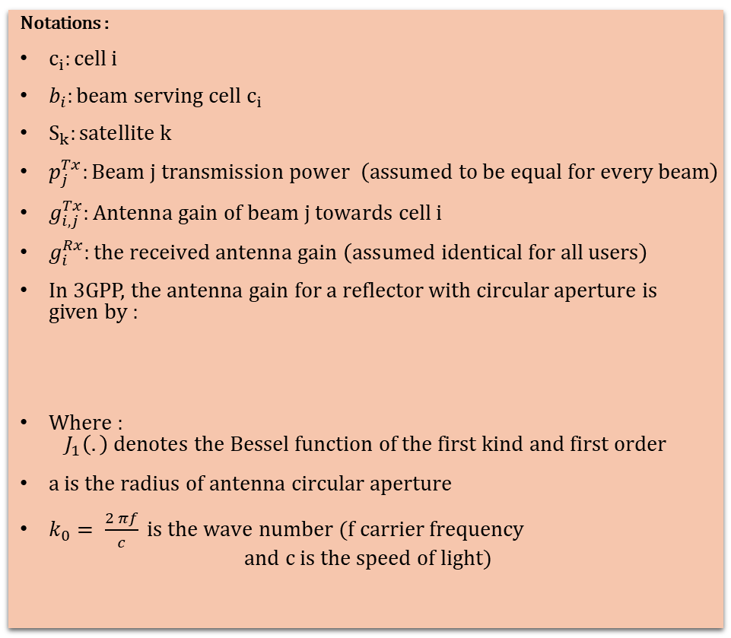


Notations :
$c_{i}:cell i$
$b_{i}:beam serving cell c_{i}$
$S_{k}:satellite k$
$p_{j}^{Tx}:Beam j transmission power \left(assumed to be equal for every beam\right)$
$g_{i,j}^{Tx}:Antenna gain of beam j towards cell i$
$g_{i}^{Rx}:the received antenna gain \left(assumed identical for all users\right)$
In 3GPP, the antenna gain for a reflector with circular aperture is given by :
Where :
$J_{1}\left(.\right) denotes the Bessel function of the first kind and first order$
$a is the radius of antenna circular aperture$
$k_{0}= \frac{2 πf}{c} is the wave number (f carrier frequency$
$$and c is the speed of light)$$
$Angle θ$
$S_{j}$
$$S_{i}$$
$Angle θ$
Beam $b_{j}$
Beam $b_{i}$
Formula : Power received at cell i from beam j
$$p_{i,j}^{Rx}= p_{j}^{Tx}. g_{i,j}^{Tx}. g_{i}^{Rx}. {\left(\frac{λ}{4 π \left|\left|S_{j}−O_{j}\right|\right|}\right)}^{2}$$
.
.
$$O_{j}$$
$$O_{i}$$
Cell $c_{j}$
Cell $c_{i}$

Slide 10
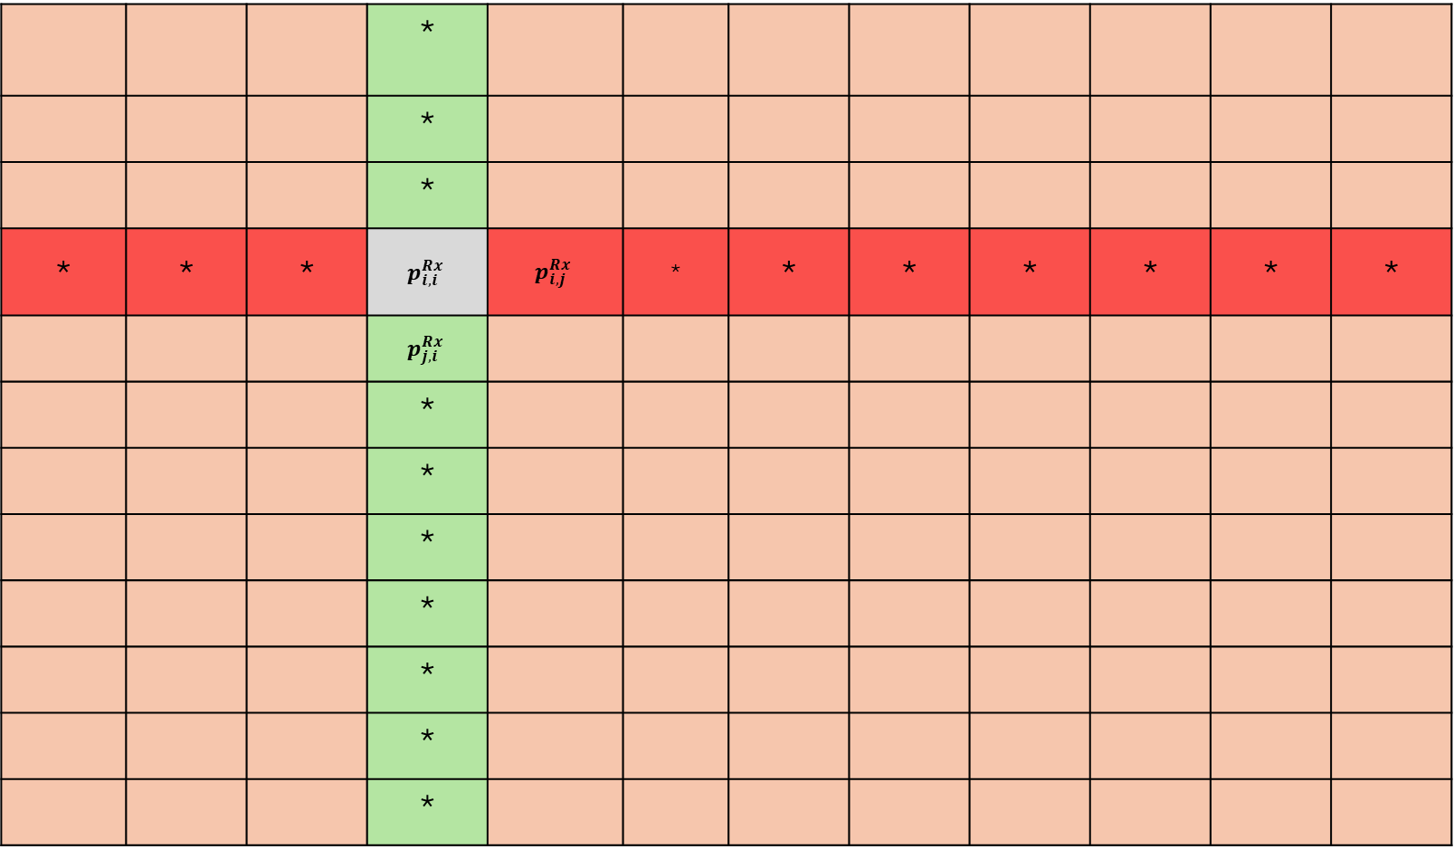
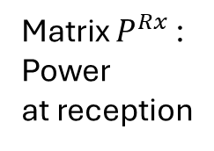
 |  |  | *
 |  |  | *
 |  |  | *
* | * | * | $$p_{i,i}^{Rx}$$ | $$p_{i,j}^{Rx}$$ | * | * | * | * | * | * | *
 |  |  | $$p_{j,i}^{Rx}$$
 |  |  | *
 |  |  | *
 |  |  | *
 |  |  | *
 |  |  | *
 |  |  | *
 |  |  | *
Matrix $P^{Rx}$ :
Power
at reception
Cell of interest i
when served by
beam i
*
: victims of beam i
*
: aggressors to cell i
Notes:
Cells : raws
Beams : columns

Slide 11
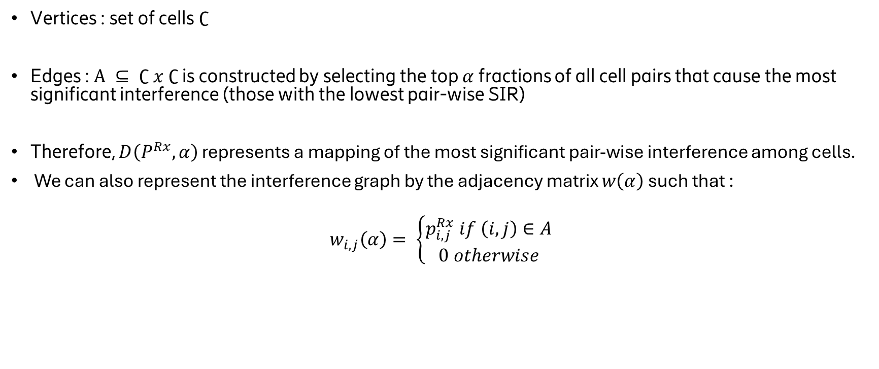

Interference Di-graph $D(P^{Rx},α)$
Vertices : set of cells $∁$
Edges : $Α ⊆ ∁ x ∁$is constructed by selecting the top $α$ fractions of all cell pairs that cause the most significant interference (those with the lowest pair-wise SIR)
Therefore, $D\left(P^{Rx},α\right)$ represents a mapping of the most significant pair-wise interference among cells.
We can also represent the interference graph by the adjacency matrix $w\left(α\right)$ such that :
$w_{i,j}\left(α\right)= \left\{\begin{aligned}p_{i,j}^{Rx} if \left(i,j\right)∈Α \\ 0 otherwise\end{aligned}\right.$

Slide 12
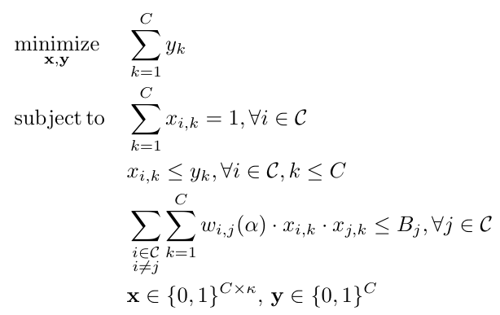
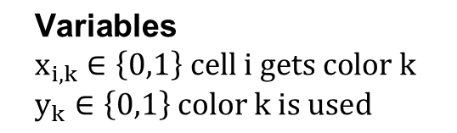
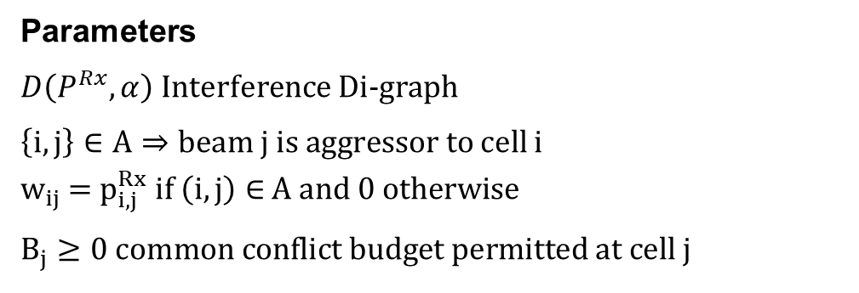
Graph coloring optimization problem
$$\text{Variables} \\ x_{i,k}∈\left\{0,1\right\} cell i gets color k \\ y_{k}∈\left\{0,1\right\} color k is used$$
(1)
Parameters
$D\left(P^{Rx},α\right)$Interference Di-graph
$\left\{i,j\right\}∈A⇒beam j is aggressor to$cell i
$w_{ij}$ = $p_{i,j}^{Rx} if \left(i,j\right)∈$ $Α and 0 otherwise$
$$B_{j}≥0 common conflict budget permitted at cell j$$
(2)
(3)
(4)
Why minimizing the number of colors ?
$→$ By minimizing the number of colors, we make sure that we avoid the excessive bandwidth time splitting +
We have a constraint on the interference limit

Slide 13
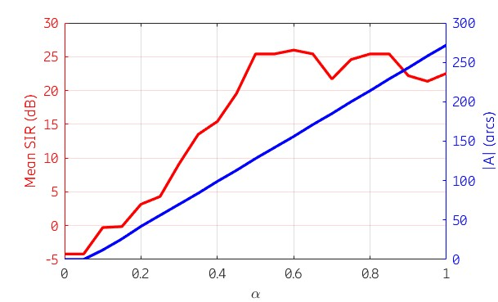
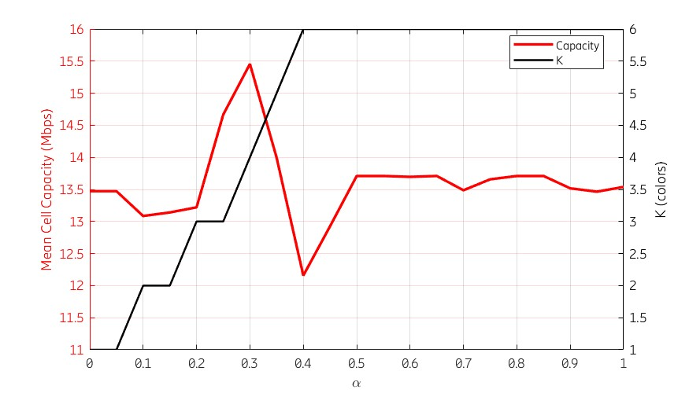
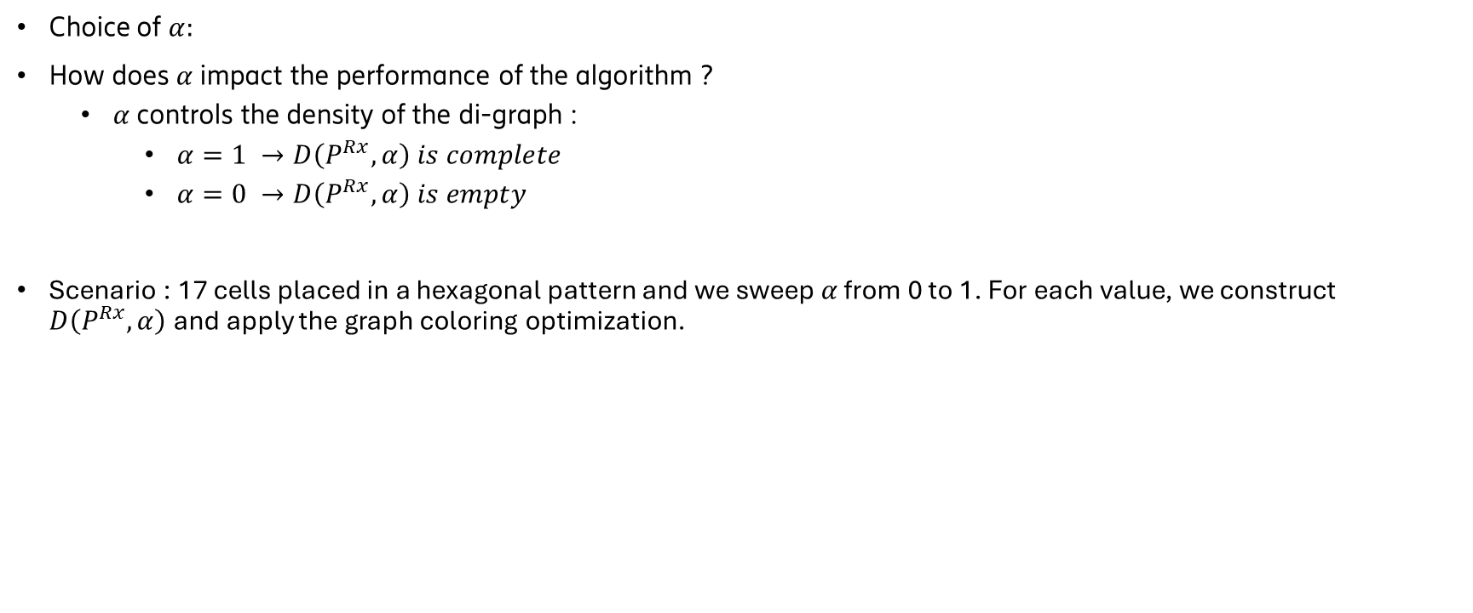
Choice of $α:$
How does $α$impact the performance of the algorithm ?
  $α$controls the density of the di-graph :
    $α=1 →D\left(P^{Rx},α\right) is complete$
    $α=0 →D\left(P^{Rx},α\right) is empty$
Scenario : 17 cells placed in a hexagonal pattern and we sweep $α$ from 0 to 1. For each value, we construct $D\left(P^{Rx},α\right)$and apply the graph coloring optimization.
Fig 1 : Mean SIR and graph density as a function of $α.$
Fig 2: Mean cell capacity and K as a function of $α$.
Notes:
We take as a scenario, 17 cells placed in a hexagonal pattern (more details in section V). We sweep α from 0 to 1. As shown in Figure 3, as α increases, the number of arcs |A| increases linearly, meaning more cell pairs are identified as aggressors. These aggressors are taken into account by the scheduling optimization, which separates them into different time slots, thereby improving the SIR. However, beyond α = 0.5, the SIR does not improve anymore: once the dominant interferers are already separated, the additional arcs only capture weak interferers whose contribution to the total interference is negligible regardless of their scheduling. Fig. 4 illustrates the mean cell capacity and the number of colors K as a function of α. For low values of α (α ∈ [0,0.2]), K remains low (from 1 to 3), meaning the optimization scheduler cannot fully separate the interferers with few avail able slots. As a result, some dominant aggressors remain co scheduled, limiting the SIR and cell capacity improvement. For (α ∈ [0.2,0.3]), the cell capacity reaches its maximum of approximately 15.5 Mbps. Here, K is just large enough to separate the dominant interferers into different slots, and the SIR gain outweighs the bandwidth loss from dividing by K. At α ≈0.4, a sharp degradation occurs: the cell capacity drops to about 12.1 Mbps while K jumps to 6. At this point, the SIR has not yet improved enough to compensate for the increased number of colors, resulting in a cell capacity loss.
For larger values (α ∈ [0.5,1]), the SIR improves and saturates as shown in Figure 3, but K remains high. The SIR gain partially recovers the capacity to around 13.5–13.7 Mbps, but the bandwidth division by K prevents it from reaching the optimal value observed at α ≈ 0.3. These results confirm the existence of an optimal operating point, in this scenario at α ≈ 0.3, and show that increasing α to include more aggressors does not necessarily improve performance. Beyond this point, adding more arcs to the graph increases K without proportional SIR benefit, leading to less scheduled slots per cell.

Slide 14
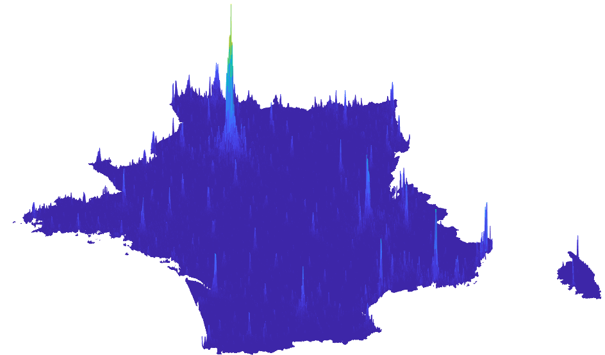
Experimental setup
600 LEO satellites at an altitude of 440 km
Each satellite generates beams with HPBW 4.33°
The service link operates in L-band at a carrier frequency of 1 GHz with a bandwidth of 30 MHz
The region of interest covers 17 cells, arranged in a hexagonal grid with an inter-site distance of 22.2 km.
Each cell serves 0 to 50 randomly dispersed UEs.

Slide 15
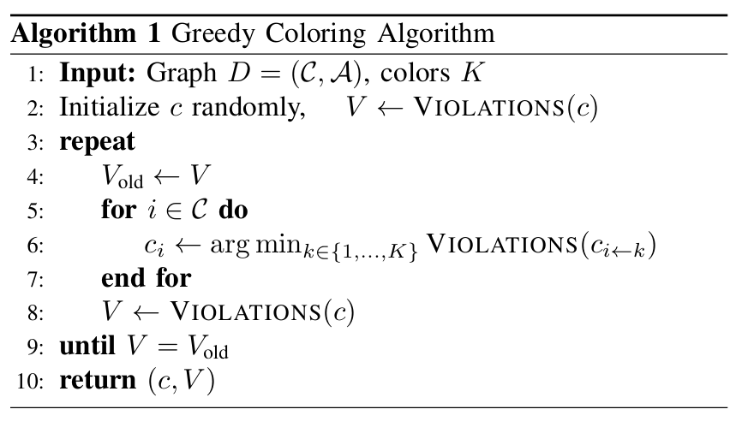
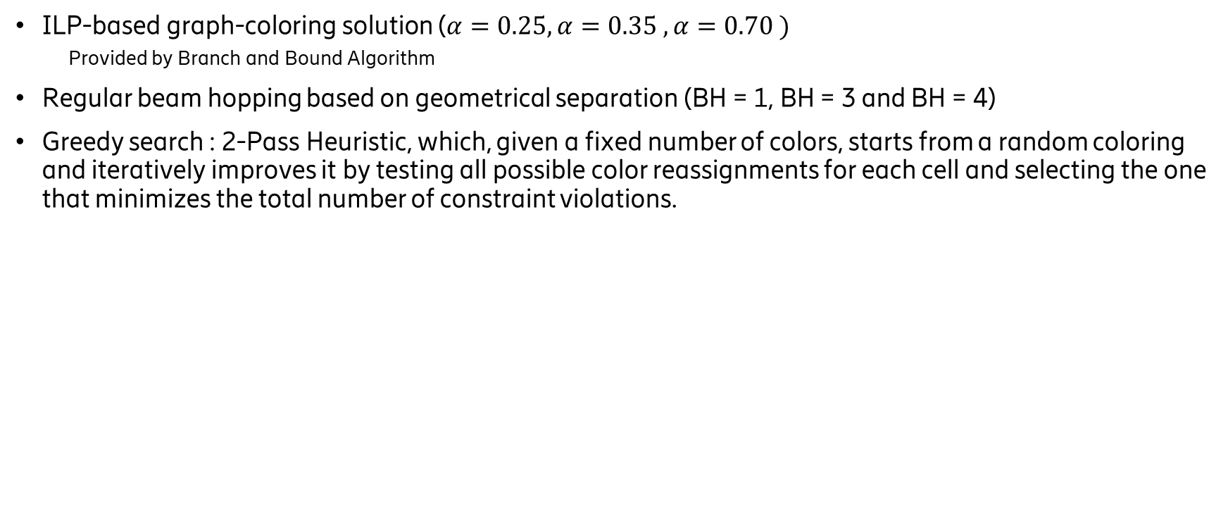
Baseline Algorithms
ILP-based graph-coloring solution ($α=0.25, α=0.35 , α=0.70 )$
  Provided by Branch and Bound Algorithm
Regular beam hopping based on geometrical separation (BH = 1, BH = 3 and BH = 4)
Greedy search : 2-Pass Heuristic, which, given a fixed number of colors, starts from a random coloring and iteratively improves it by testing all possible color reassignments for each cell and selecting the one that minimizes the total number of constraint violations.
Notes:
In our experiments, we compare the performance of three algorithms: (i) the solution provided by the classical Branch and-Bound algorithm to solve Problem 2, which yields the minimum chromatic number required to achieve zero SIR constraint violations (17); (ii) a fixed Beam Hopping pattern that takes the number of colors as input and assigns them to cells based on their geographical position in a cyclic manner, without performing any interference-aware optimization; and (iii) a 2-Pass Heuristic described in Algorithm 1, which, given a fixed number of colors, starts from a random coloring and iteratively improves it by testing all possible color reassign ments for each cell and selecting the one that minimizes the total number of constraint violations (17), until no further improvement is found.

Slide 16
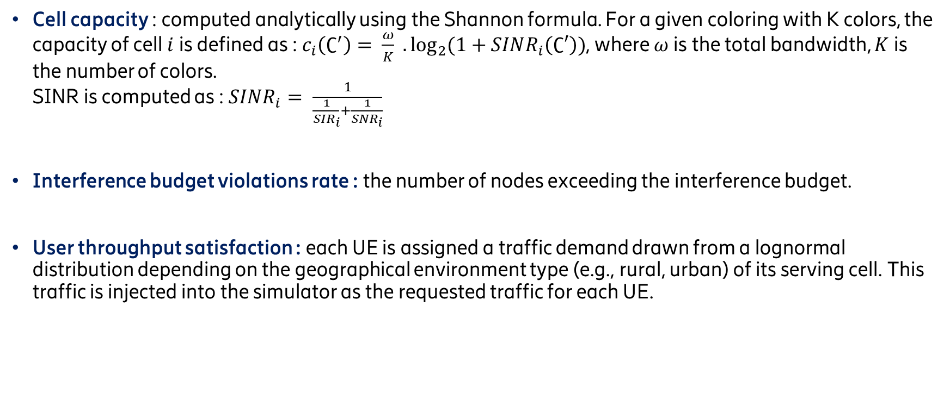
Metrics
Cell capacity : computed analytically using the Shannon formula. For a given coloring with K colors, the capacity of cell $i$is defined as : $c_{i}\left(∁^{′}\right)= \frac{ω}{K} .\log_{2}{(1+SINR_{i}\left(∁′\right))}$, where $ω$is the total bandwidth, $K$is the number of colors.
SINR is computed as : $SINR_{i}= \frac{1}{\frac{1}{SIR_{i}}+\frac{1}{SNR_{i}}}$
Interference budget violations rate : the number of nodes exceeding the interference budget.
User throughput satisfaction : each UE is assigned a traffic demand drawn from a lognormal distribution depending on the geographical environment type (e.g., rural, urban) of its serving cell. This traffic is injected into the simulator as the requested traffic for each UE.
Notes:
The simulator then executes the queuing model for each cell : it aggregates the requested traffic from all co-located UEs, determines the achievable bitrate of each UE based on its SINR, and solves the birth-death process to obtain the served traffic that the system can actually deliver given the beam activity fraction and the shared radio resources.
A satisfaction rate is then defined as the ratio between served and requested traffic

Slide 17
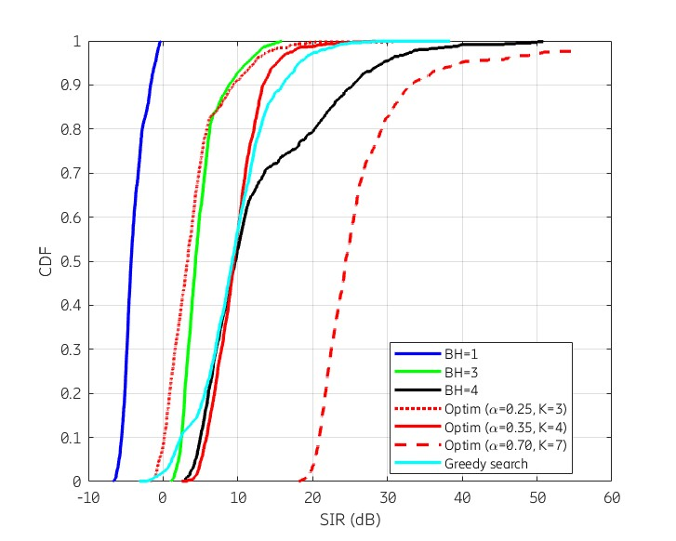
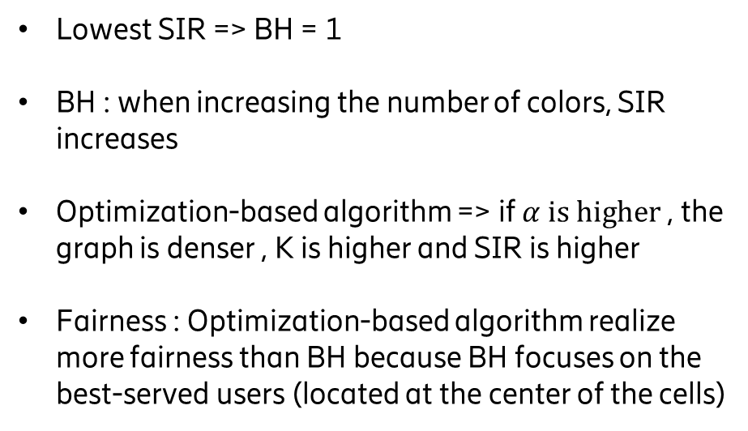
Numerical results
Lowest SIR => BH = 1
BH : when increasing the number of colors, SIR increases
Optimization-based algorithm => if $α is higher$, the graph is denser , K is higher and SIR is higher
Fairness : Optimization-based algorithm realize more fairness than BH because BH focuses on the best-served users (located at the center of the cells)
Fig 3. SIR CDFs for all methods
Notes:
Figure 5 presents the CDF of SIR at cell level, aggregated over all time steps. As expected, the baseline scenario BH=1, where all beams are simultaneously active, yields the lowest SIR due to maximum inter-beam interference. For regular beam hopping schemes, increasing the number of colors (i.e., time slots) reduces the number of co-channel beams per slot, thereby improving SIR. Similarly, for the optimization-based approach, increasing α leads to a denser aggressor graph, resulting in a higher chromatic number K and consequently higher SIR values. When comparing the optimization approach with regular beam hopping at the same number of colors, both methods achieve comparable average SIR performance. However, at K =4, a significant fairness gap emerges between the two approaches for this scenario, with Jain’s Fairness Index values of 0.71 and 0.02 for the optimization and the BH=4, respec tively. This indicates that regular beam hopping, which only relies on geometrical patterns, show high SIR improvement for best-served users that are generally located at the cell centers whereas the graph-coloring optimization produces a more balanced allocation for all users, even the ones at the edge. Finally, the greedy heuristic algorithm with 4 colors achieves performance comparable to the ILP-based optimization with 4 colors, offering a computationally efficient alternative for practical deployment scenarios.

Slide 18
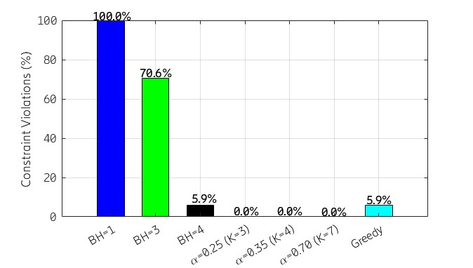
Numerical results
BH=1 exhibits 100% constraint violations.
BH=3 less violations.
Optimization based algorithms achieve 0% constraint violation.
Greedy search : 5.9%
Fig 4. Constraint violations for all methods
Notes:
Figure 6 presents the interference budget constraint viola tions for each scheduling strategy. The baseline BH=1 exhibits 100% violations, as all beams are simultaneously active. Regular beam hopping BH=3 reduces violations to 70.6%, but remains far from satisfying the constraints. All three optimiza tion variants achieve 0% violations by construction, regardless of α value. The greedy heuristic achieves 5.9% violations, rep resenting a significant improvement over regular beam hopping with 3 colors while maintaining low computational complexity.

Slide 19
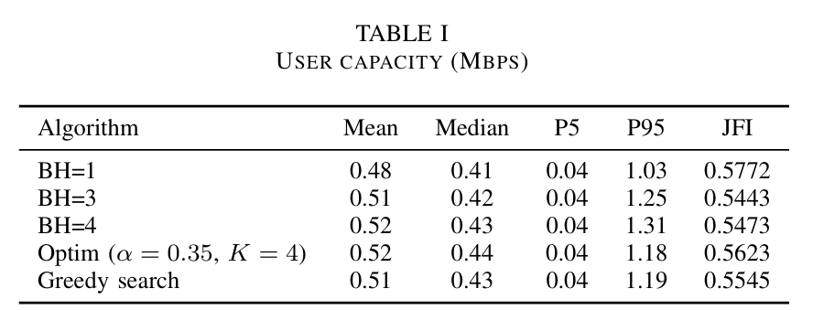
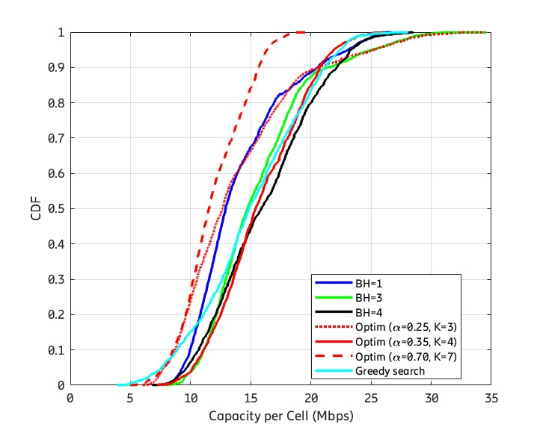
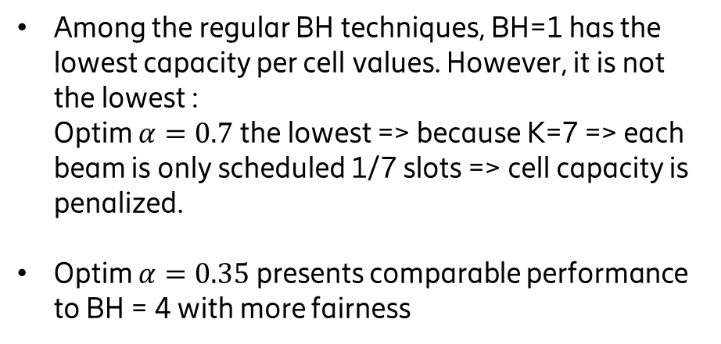
Numerical results
Among the regular BH techniques, BH=1 has the lowest capacity per cell values. However, it is not the lowest :
Optim $α=0.7$the lowest => because K=7 => each beam is only scheduled 1/7 slots => cell capacity is penalized.
Optim $α=0.35$presents comparable performance to BH = 4 with more fairness
Fig 5. Capacity per cell CDFs
Notes:
Figure 7 compares the per-cell capacity distributions. Among regular fixed beam hopping schemes, BH=1 yields the lowest capacity due to maximum interference, yet it is not the worst performing configuration overall. Two optimization variants produce also very low per-cell capacity, for different reasons. The configuration α = 0.25 generates a sparse aggressor graph that fails to filter significant interferers; resulting in low SINR. Conversely, α = 0.70 achieves good SIR levels through aggressive interference identification, but the resulting chromatic number K = 7 means each beam is only scheduled once every 7 slots, dividing the usable bandwidth by 7 and severely penalizing cell capacity. The configuration α = 0.35 (K = 4) emerges as the best trade-off between interference mitigation and spectral resource utilization
Table I details the per-UE capacity statistics : mean, median, percentiles 5% and 95% and Jain Fairness Index.
As shown in Table I, the optimization with α = 0.35 achieves the highest mean capacity (0.52 Mbps), the high est median (0.44 Mbps), and the best Jain’s Fairness Index (0.5623) among all evaluated schemes. Compared to the regu lar BH=4, which achieves the same mean but a higher P95, the optimization provides more fairness and median performance. While BH=4 benefits the best-served users, it does so at the expense of overall fairness. The greedy heuristic performs comparably to BH=3.

Slide 20
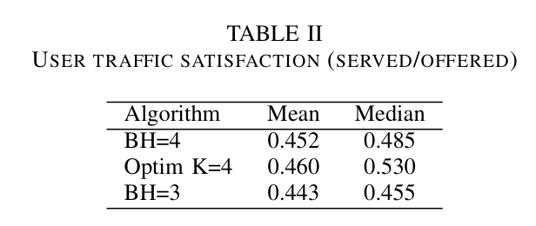
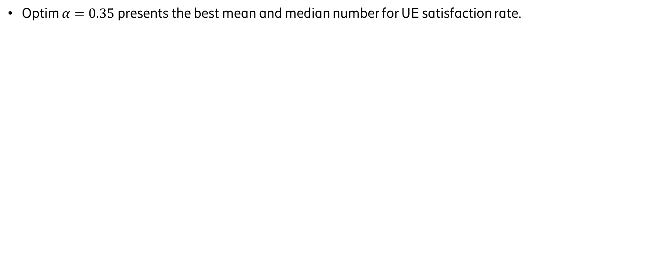
Numerical results
Optim $α=0.35$ presents the best mean and median number for UE satisfaction rate.
Notes:
Table II reports the user satisfaction (served/offered) for the considered configurations. The optimized scheme (opti K = 4) achieves the highest mean and median values for this scenario, indicating an improvement in the typical user experience compared to the baseline BH=4 configuration.

Slide 21
Conclusion
We proposed an interference-aware Beam Hopping scheduling framework for LEO satellite networks based on soft-conflict graph coloring that provides a good balance between limiting interference and avoiding excessive time-slot fragmentation.
Unlike conventional Beam Hopping schemes that rely on predefined geometric patterns, the proposed algorithm rely on physical interference to take scheduling decisions.
Adaptable approach to heterogeneous and irregular NTN deployments where interference relationships may be highly irregular and difficult to capture through fixed reuse patterns.
Future work
Cell planning for NTN cells
Notes:
In this paper, we introduced an interference-aware Beam Hopping scheduling framework for LEO satellite networks based on soft-conflict graph coloring. By representing inter ference relationships through a parameterized conflict graph, the proposed approach jointly controls interference levels and temporal resource utilization. Unlike conventional Beam Hopping schemes that rely on predefined geometric patterns, the proposed framework exploits physical interference in formation to derive scheduling decisions. This makes the approach inherently adaptable to heterogeneous NTN deploy ments where interference relationships may be highly irregular and difficult to capture through fixed reuse patterns. Numerical results demonstrate that the proposed optimization framework achieves performance comparable to fixed regular Beam Hop ping schemes while guaranteeing interference constraints and providing a significantly more flexible scheduling mechanism. The results also show that there exists a range of values for α, interfereres selection parameter, that provides a good balance between limiting interference and avoiding excessive time-slot fragmentation. Beyond the specific scenario considered in this paper, the proposed formulation provides a generic founda tion for future NTN resource management problems. It can naturally accommodate irregular cell layouts, heterogeneous traffic demands, multi-satellite coordination, and adaptive in terference management strategies. Future work will investigate dynamic graph construction, learning-based adaptation of α, and the integration of traffic-awareness into the scheduling process.

Slide 22
Thank you

Slide 23
References
[1] : Yaxin Wang et al. “A Flexible Resource Allocation Algorithm in Full Bandwidth Beam Hopping Satellite Systems”. In: 2019 IEEE 3rd Advanced Information Management, Communicates, Electronic and Automation Control Conference (IMCEC). 2019
[2] : Zhiyuan Lin et al. “Multi-Satellite Beam Hopping Based on Load Balancing and Interference Avoidance for NGSO Satellite Communication Systems”. In: IEEE Transactions on Communications 71.1 (2023)
[3] : Ruishuo Mu et al. “Dynamic Beam Hopping for LEO Satellites with Differentiated Traffic Demands”. In: WSCP2023. 2023, pp. 621–626. DOI: 10.1109/ WCSP58612.2023.10405252
[4] : Huimin Deng et al. “Satellites Beam Hopping Scheduling for Interference Avoidance”. In: IEEE Journal on Selected Areas in Communications 42.12 (2024),
[5] : Zijun Liu et al. “Multi-Satellite Coordinated Beam Hopping for Interference Mitigation Under Tilted Beam Effects: A Graph-Theoretic Approach”. In: IEEE Wire less Communications Letters 15 (2026), pp. 2313–2317. DOI: 10.1109/LWC.2026.3676112.

Slide 24
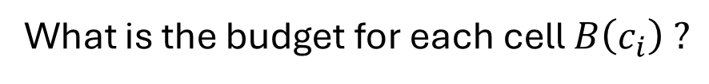
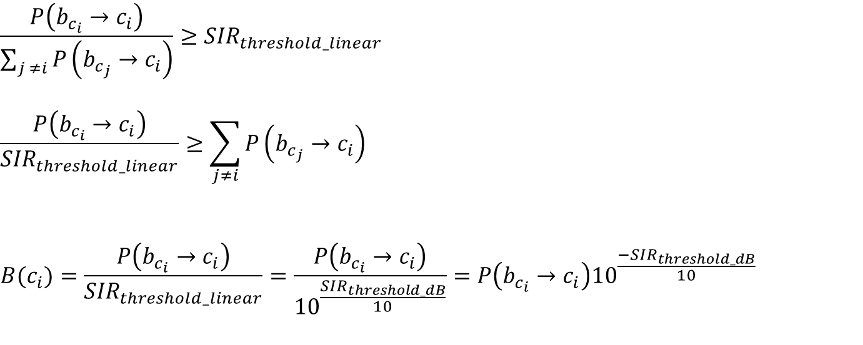
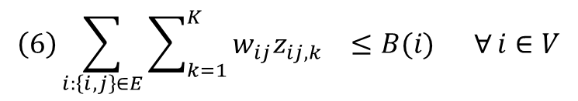
What is the budget for each cell $B\left(c_{i}\right) ?$
$$\frac{P_{ }\left({b_{c_{i}}→c}_{i}\right)}{\sum_{j ≠i}{P_{ }\left({b_{c_{j}}→c}_{i}\right)}}≥{SIR}_{threshold_linear}$$
$$\frac{P_{ }\left({b_{c_{i}}→c}_{i}\right)}{{SIR}_{threshold_linear}}≥\sum_{j≠i}{P\left({b_{c_{j}}→c}_{i}\right)}$$
$$B(c_{i})=\frac{P\left({b_{c_{i}}→c}_{i}\right)}{{SIR}_{threshold_linear}}=\frac{P\left({b_{c_{i}}→c}_{i}\right)}{{10}^{\frac{{SIR}_{threshold_dB}}{10}}}=P\left({b_{c_{i}}→c}_{i}\right){10}^{\frac{{−SIR}_{threshold_dB}}{10}}$$
$$\left(6\right)\sum_{i:\left\{i,j\right\}∈E}{\sum_{k=1}^{K}{w_{ij}z_{ij,k} ≤B(i) ∀}}i∈V$$

