Slide 1
Kinéis wide area network for satellite IoT
Performance and protocol optimisation
NTN Days Conference – October 2026

Slide 2

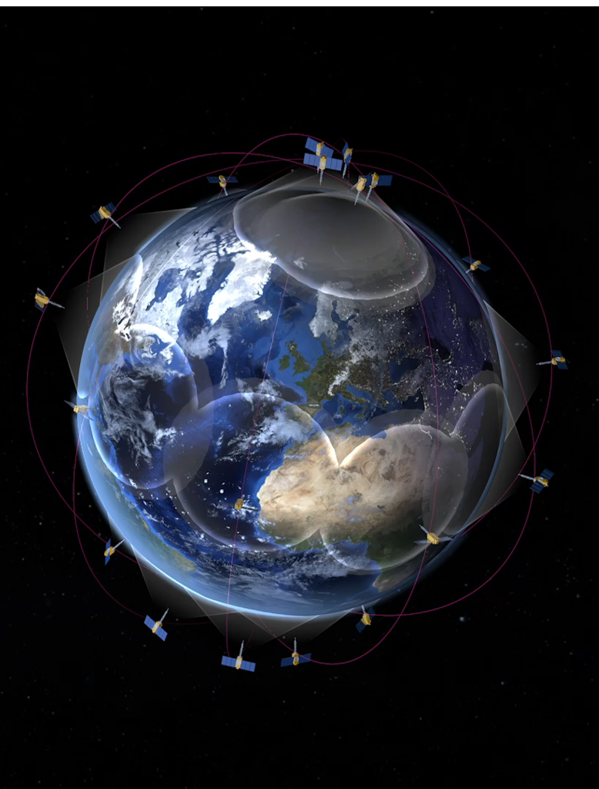

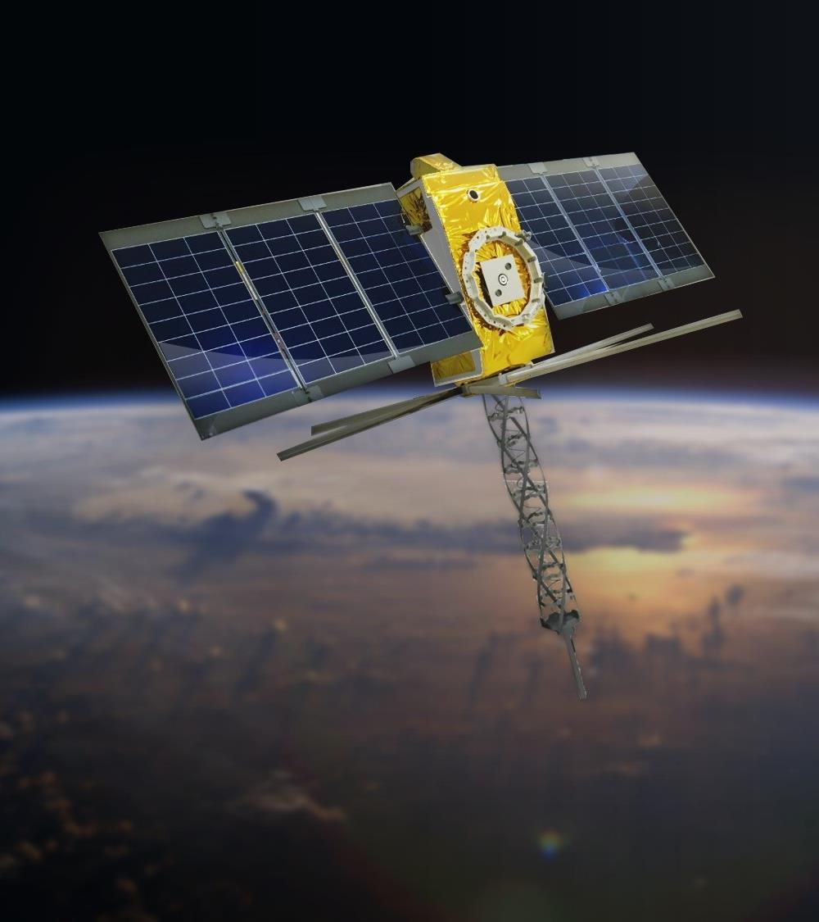




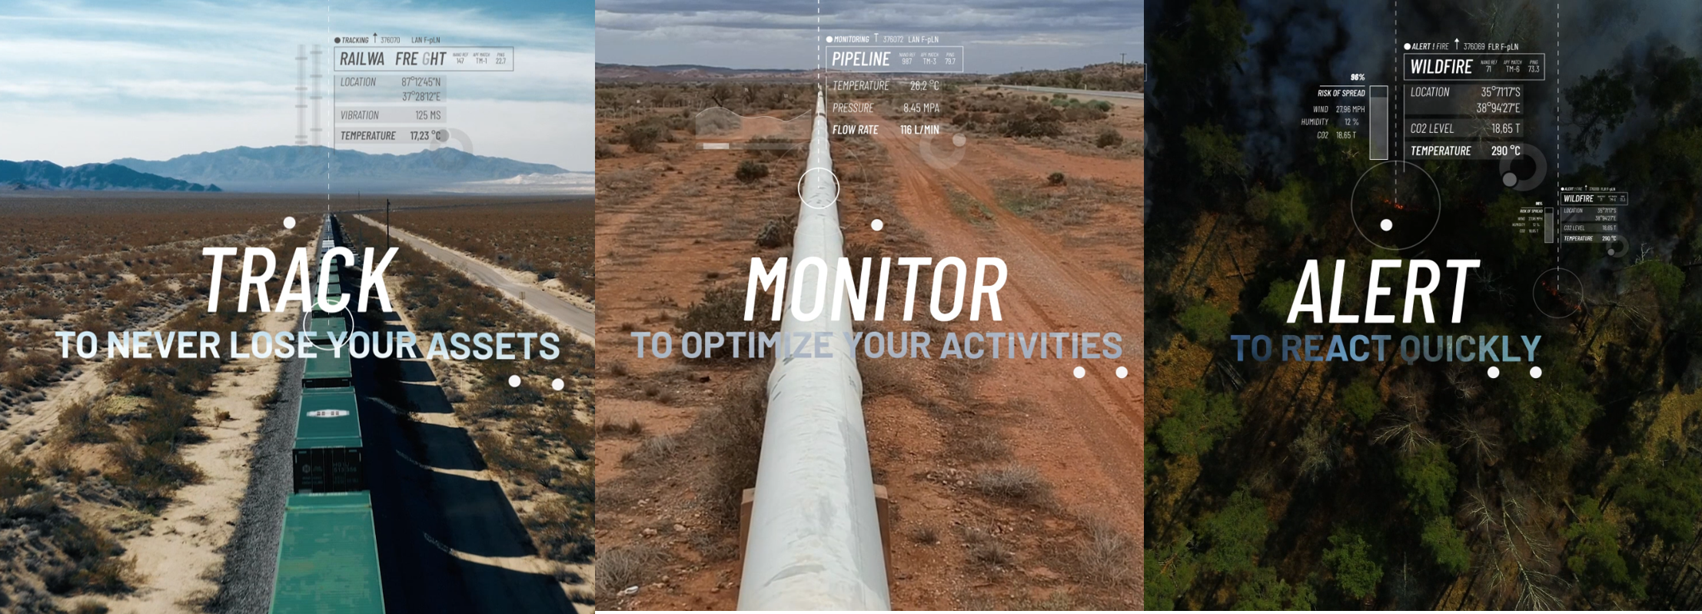
Kinéis gen1 connect 100% of the planet
25 satellites (5x5 planes)
20 ground stations
Global IoT Network
Kineis Wide Area Network

Slide 3

Network Challenges for gen2 system design
Satellite Low End IoT is a complex optimization problem
Use cases range from mobile tracking to fixed command & control
Devices are half duplex, low cost, low power, small and often custom-built
Satellites have limited spectrum, RF and processing power
Protocol and waveform drive performance
Reliable transmission is hard with uplink only and discontinuous coverage
Users want configurability while the operator must guarantee stability
Use cases require downlink both for signaling and data, which becomes the real bottleneck
No existing standard covers all satellite IoT needs
NB-IoT works, but is heavy and energy-hungry for payloads under 100 bytes
Pure random-access protocols are non-standard and limited in configuration
For the low end IoT, a new protocol must combine the best of both
NEXT
Building Kinéis gen2 System and Protocol
Real-time connectivity with guaranteed QoS
Massive random access, higher downlink capacity
Cheaper modem and air-time Easier integration and use
r2
Low end IoT
5G/6G IoT

Slide 4
kiWAN r2 PHY layer: Optimal efficiency over the RA channel
Benchmark PHY candidates
Bring LoRa to
satellite operator context
Design advanced receivers
Optimize coded waveforms
Classical and novel PHY layers, evaluated on:
Adaptation of LoRa to licensed spectrum:
Ultra-narrowband and spread spectrum for all IoT use cases:
New receivers, designed for:
Robust processing of coded GMSK signals
Multi-user detection in UNB and DSSS contexts
Co-channel interference mitigation
Energy efficiency
Robustness to jamming and coexistence with legacy signals
Receiver complexity
Spectral efficiency in multiple random access
UHF
L & S band
UNB
FHSS
DSSS
Optimisation of waveform for full duplex, licensed bands

Slide 5
kiWAN r2: discipline between RA and DAMA
Free transmission
Devices transmit at will: light and cheap, but complexity forwarded to the users and network cannot manage load or interference.
Disciplined
Random access with higher resiliency (load, priority and interference control), and flexibility (link adaptation).
Connected
The network assigns resources to each device (DAMA): reliable, but heavy for small payloads. Limited network control
kiWAN r2 shall keep random access and adds network control, resiliency and flexibility
 | Free transmission LoRaWAN, Argos | Disciplined kiWAN | Connected NB-IoT
Best efficiency | <100 bytes | <500 bytes | >500 bytes
Access scheme | Random access (RA) | Random access (RA) | Assigned (DAMA)
System duplex | Half duplex | Full duplex | Full duplex
Connection | None | None | Double handshake
Uplink ack | Optional | Optional | Mandatory
User configurability | Very open | Open, under control | None
Load control | No | Yes | No
Priority management | No | Yes | No
Link adaptation (ADR) | No | Yes | Yes
Interference management | No | Yes | No

Slide 6
Protocol and system trade-offs methodology
Protocol
access scheme • diversity • retransmissions • downlink listening • ACK strategy • store-and-forward routing • collision handling
Capacity
Energy
consumption
traffic load supported
mWh / message received
Trade-off
tool
Delay
Reception
rate
time to first reception
messages delivered (%)
System
constellation • ground stations • ISL • link budget • terminal antennas • satellite passes • terrain masks • interference • antenna patterns

Slide 7
FLoRaSat now simulates KiWAN end to end
Recent additions
Base modules
Open-source discrete-event simulator (Inria) on OMNeT++ / INET / FLoRa, extended for KiWAN
Architecture: refactored, with end-to-end connectivity from device to ground station
APP
Traffic generation: inter-packet law (uniform, exponential, custom), first-packet time, number of packets
NET
Store-and-forward routing
ISL + routing solutions
MAC
KiWAN UL: Blind, SatDetect, ACK + retransmissions
Modular downlink frame with periodic beacon
PHY
Link budget validated on Kinéis measurements
Collisions from an ad hoc PHY receptor simulator validated on lab measurements
Orbit & system
Kinéis constellation (real TLE) with antenna modelling
20 ground stations with measured terrain masks
Terminal fleets with field masks and antenna patterns
KPIs
Capacity
traffic load supported
Energy consumption mWh / message received
Delay
time to first reception
Reception rate
messages delivered (%)
A. Y. Choquenaira-Florez, B. Coeugnet, R. Ohs, J. A. Fraire, and H. Rivano, “FLoRaSat 2: Simulating cross-linked direct-to-satellite IoT LEO constellations with joint access and routing evaluation,” Authorea, 2025, doi: 10.22541/au.175647870.00758886/v1.

Slide 8
Conclusion
CHALLENGE FOR GEN 2
Gen2 design must scale without losing simplicity
Finding the right operating point between system/device cost, complexity and performance
Guaranteeing quality of service is a must, not possible with Uplink only transmission
Need for a novel protocol to overcome the challenge of low end IoT
DESIGN DRIVERS
Tailoring and Optimisation of the system & protocol
Real-time connectivity with guaranteed QoS
Massive random access, with novel waveforms suited to licensed bands
Downlink capacity becomes a major challenge for signaling and data
Lower modem and air-time cost, easier integration & use
kiWANr2
Random Access under network control & discipline
Keeps light random access, adds network control of load and interference
Optimized performance for each use case, while keeping it simple to use
Evaluated end to end in FLoRaSat, validated on Kinéis measurements

Slide 9



Satcom IoT Operator
DO YOU HAVE
ANY QUESTIONS?
vdeslandes@kineis.com
Thanks!

