Slide 1
NTN-IoT performance survey
From simulation to in-orbit testing
Oussama Lachgar - Antonin Le Floch

Slide 2
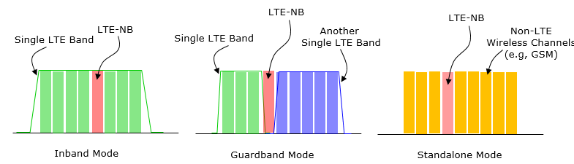
A brief Context of NB-IoT NTN
NB-IoT is « just » LTE with a smaller bandwidth
Feature | LTE | NB-IoT
UE bandwidth | 1.4 to 20 MHz | 180 kHz
DL waveform | OFDMA | OFDMA
UL | SC-FDMA | Single-tone / multi-tone
UL subcarrier spacing | 15 kHz | 15 kHz or 3.75 kHz
DL data | PDSCH | NPDSCH
UL data | PUSCH | NPUSCH
DL control | PDCCH | NPDCCH
Random access | PRACH | NPRACH
Broadcast | PBCH | NPBCH
Synchronization | PSS / SSS | NPSS / NSSS
Main objective | Broadband | Coverage / low power / low complexity
PHY repetitions | Limited role | Fundamental mechanism
Scheduling | Fast, throughput-oriented | Coverage / repetition-oriented
Mobility | Full | Reduced
MIMO | Supported | Mostly SISO
180 kHz channel -> Fine ressource allocation in scarse L/S band
Native compatibility over existing GEO sat
Improved Link Budget
  Simpler Modulation with Repetition
  SCS 3,75 kHz
Small packet optimization
-> High flexibility
https://www.sharetechnote.com/html/Handbook_LTE_NB_LTE.html
© 2026 Kinéis. All rights reserved

Slide 3


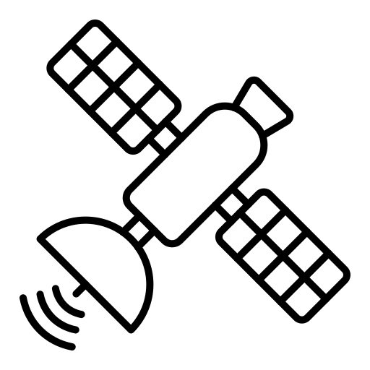

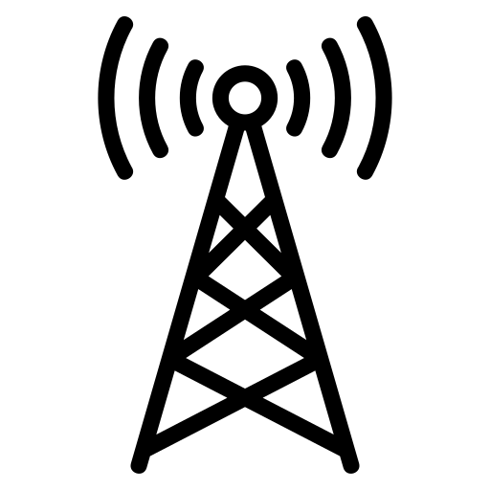
A brief Context of NB-IoT NTN
NTN
NTN R17 work and is commercially aviable
What are the performances and how to improve performances -> We need tools
Doppler Pre-compensation
Math
Simple propagation channel, Link Budget
Simulation
Implement communication principles
Exp
Hardware limitations
Emulation
Real-time implementation
Capacity / performances magnitude
Protocol integration
Controlled impairments
Real-world conditions
End-to-end validation
Performance assessment
Long propagation delay
© 2026 Kinéis. All rights reserved

Slide 4





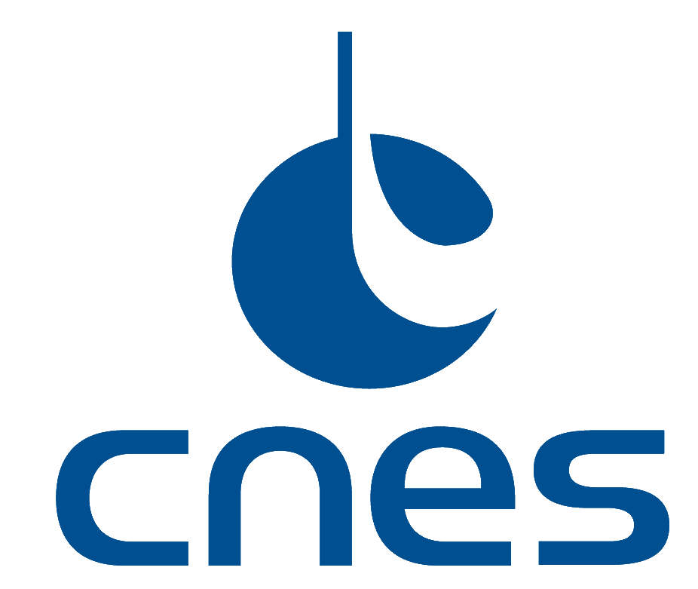
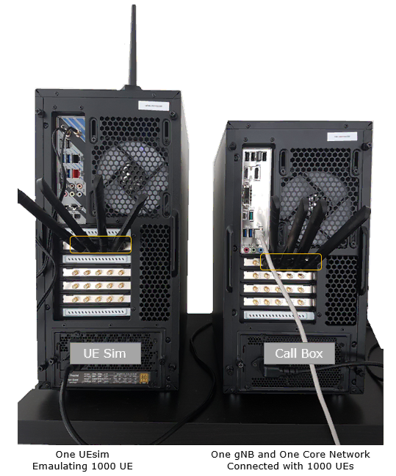
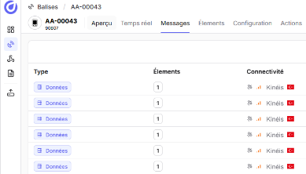
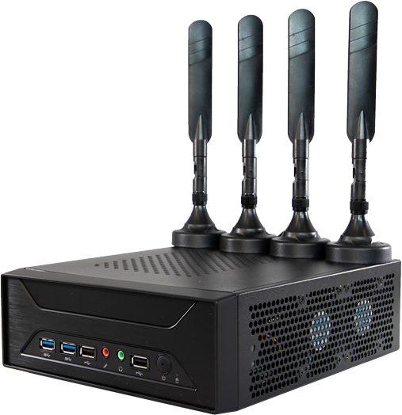
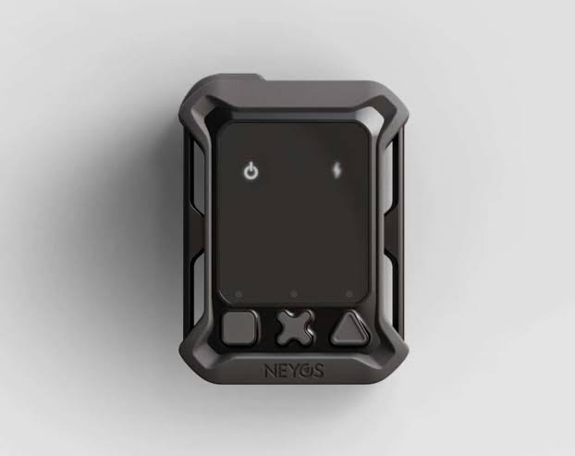
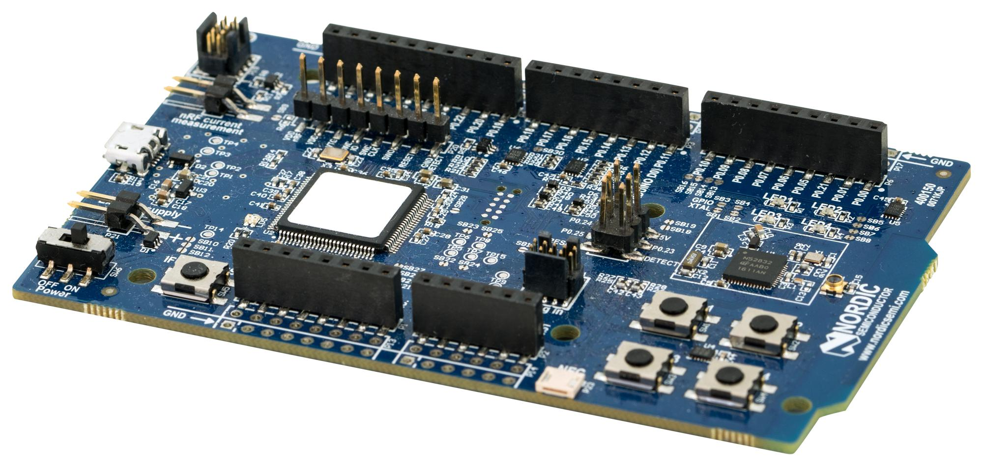
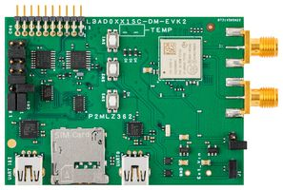



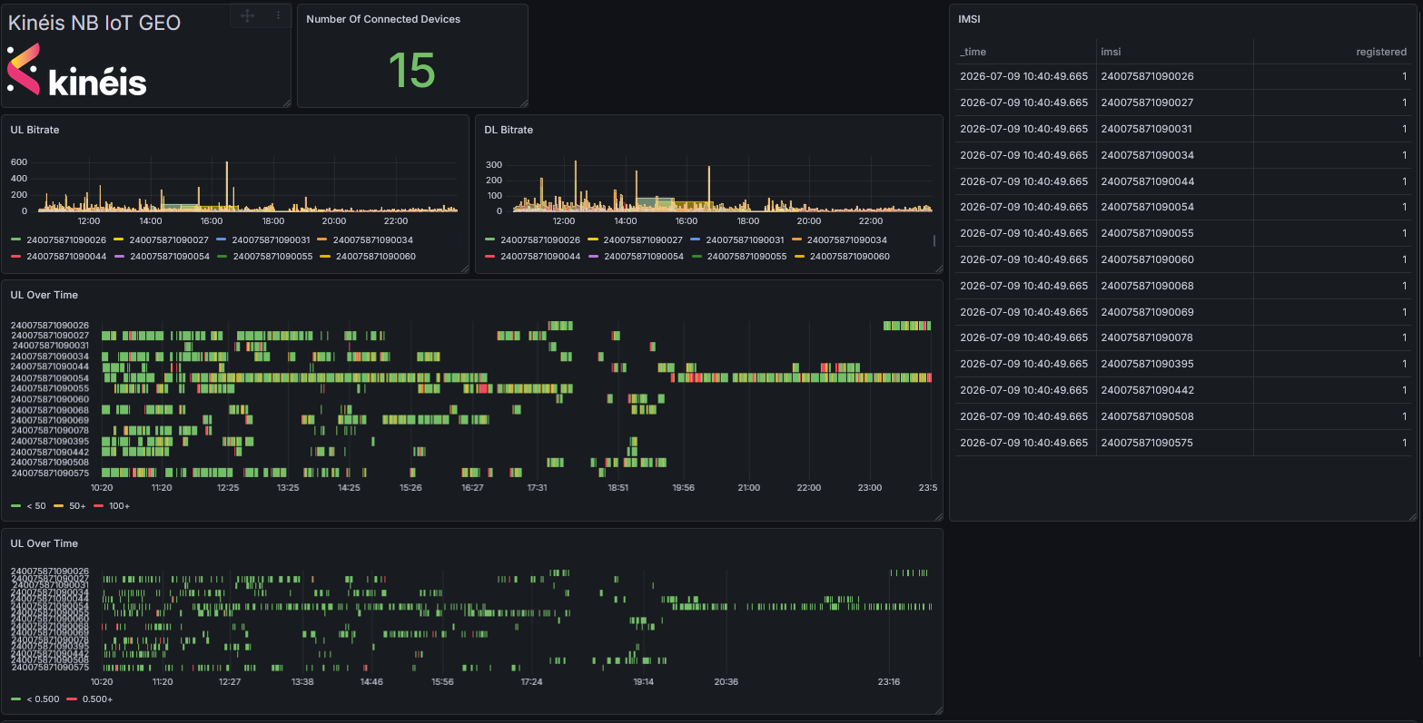
Kinéis toolbox
How to estimate NB-IoT performances on NTN
Simulation
Emulation
Bench Tests
In Orbit Testing
LENA-NB-IoT-NTN
A fork of LENA NB-IoT modified for NTN
A powerfull tool to evaluate thousands of connected devices
Calibration on UESIM and In-Orbit Testing
Validate / Compare LENA-NB-IoT-NTN
Evaluate system under load
Capacity estimation
Channel optimization
Devices and radio evaluation
© 2026 Kinéis. All rights reserved

Slide 5
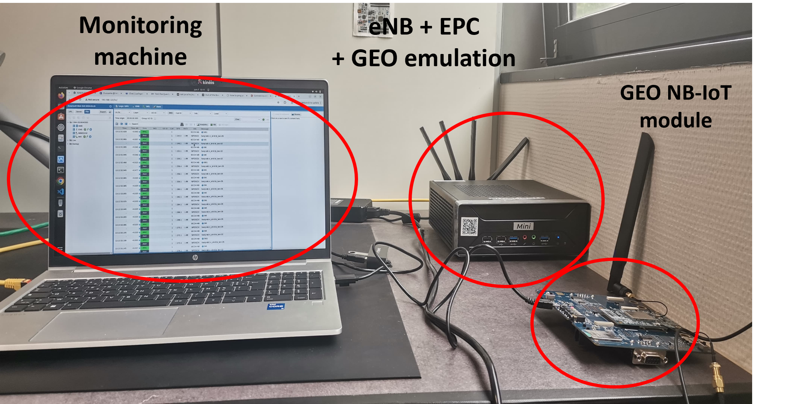
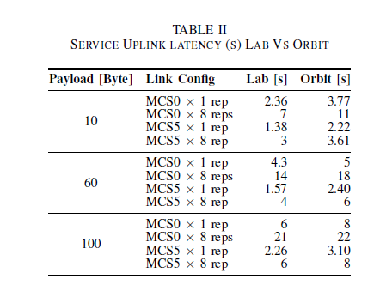
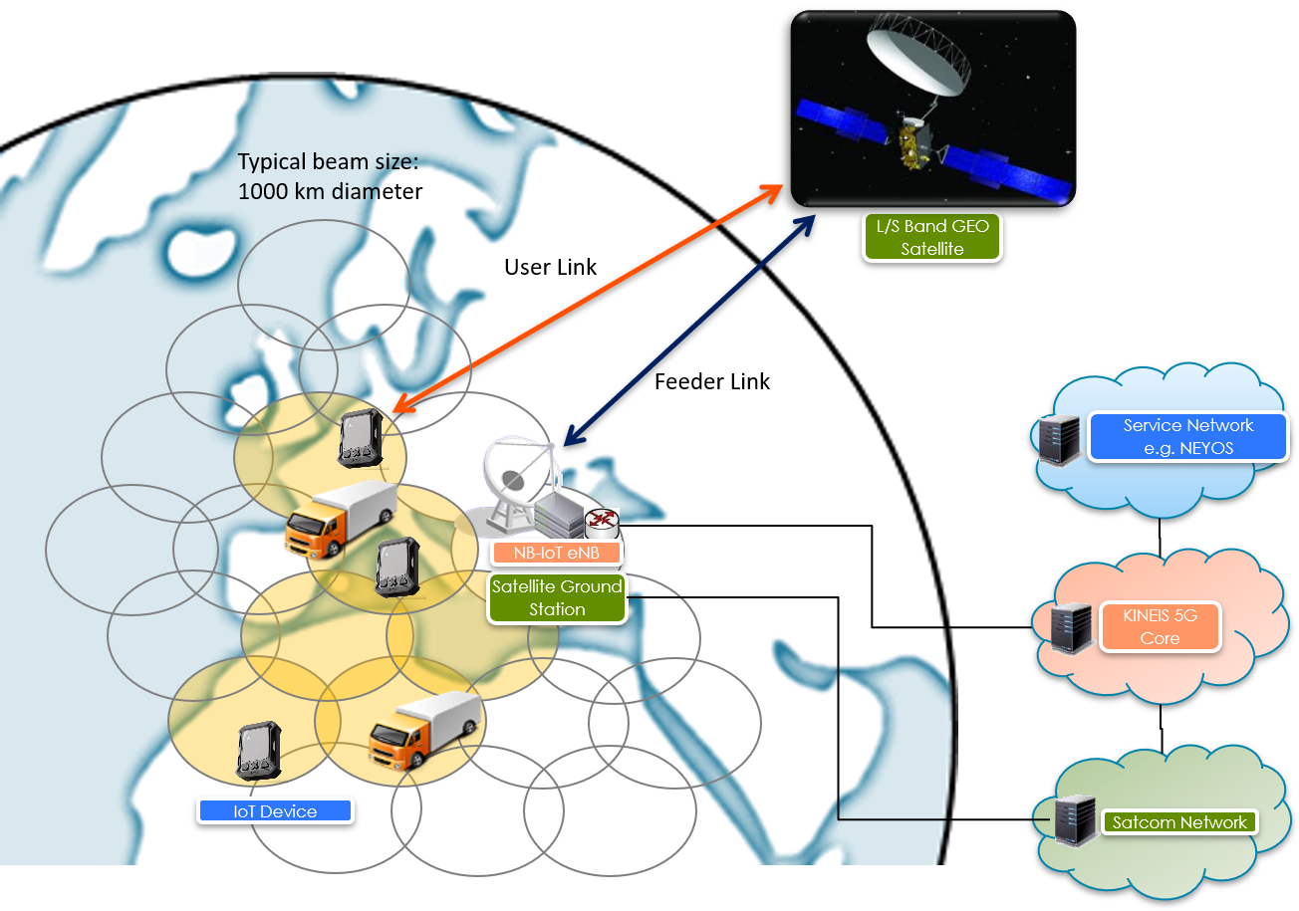
First experimental work over GEO satellite
In LAB
Latency strongly variate in function of packet size & link adaptation ( coding rate , repetition).
Results highlight the need for careful channel aware Link adaptation with QoS / resource optimization in GEO satellite NB-IoT systems​.
In Orbit
"Experimental Evaluation of NB-IoT Uplink Limits over GEO satellite", in Proc. Int. Wireless Communications and Mobile Computing Conf. (IWCMC, Shanghai), IEEE, 2026
© 2026 Kinéis. All rights reserved
Notes:
Opening (0:00–0:20)
“I’m Oussama Lachgar, a PhD student working jointly with IRIT Lab and Kinéis specifecally within R&D team. I’m here to present our research work on NTN NB-IoT.
Nowadays, NB-IoT over satellite is a reality: tiny devices reach a GEO satellite at thousands of kilometres away. My thesis asks the next question: how good does it work, and how do we make it work better? I’ll answer that in three steps: measure, optimise, scale.”
Slide 1: IWCMC, Measure (0:20–1:50)
“First, we needed real numbers. So, We built two setupsin order to measure real performance.
On the upper left the testbed at kineis lab: a commercial NB NTN module connected Amarisoft eNB and core with GEO delay emulation,.
Below is the real orbit setup: with the same netowrk components but this time, a real satellite and ground station are between the iot device and eNB.
The table in the right shows the uplink service latency for both set ups. We measured it for three payload sizes and four link configurations. The table reveals an interesting point: latency is highly dynamic, and it depends strongly on the link configuration.
Take an example. In orbit, moving from MCS0 with 8 repetitions to MCS5 with no repetition cuts the delay by a factor of five to seven, depending on the packet size. Knowing that this is only a small part of the configuration space. MCS can go up to 10 & for robustness, NB-IoT allows up to 128 repetitions.
The takeaway:
Which means, over GEO, link adaptation isn’t a detail. It decides the service you get. A bad choice wastes the satellite’s scarce resource. That led us to the next question:

Slide 6

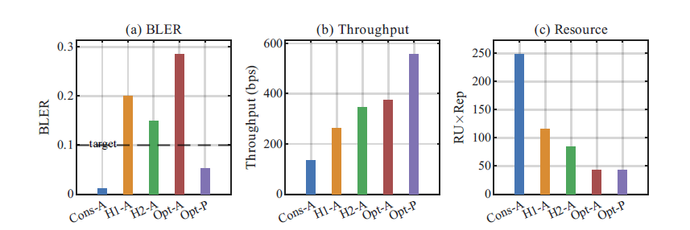
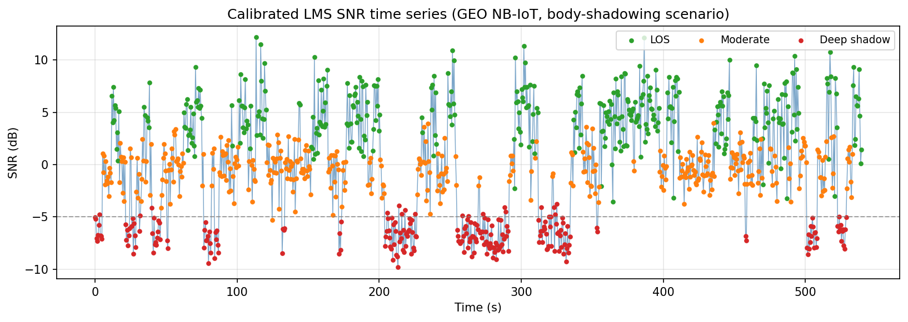
Optimization : Link Adaptation (LA) Algorithms
Channel traces on Kineis GEO NB-IoT system from Body-worn tracker
Performances of our proposed LA schemes
Delayed CSI significantly decrease LA scheme performance.
We proposed H2 : a realistic LA solution, that optimize resource consumption & throughput at the same time.
SNR between -10..13 dB /Slow varying channel / Delayed Information
“Link Adaptation for NB-IoT over GEO NTN: A Joint Throughput and Resource Optimization”, (MSWiM, Paris), 2026. Accepted, to appear soon.
© 2026 Kinéis. All rights reserved
Notes:
How link adaptation should be designed for NB-IoT over GEO?”
This is what we studied in our second contribution, accepted at MSWiM conference this year in Paris.
Channel
To design a realistic Link Adaptation algorithm, we needed first a realistic channel model.
So we used channel traces from a tracker terminal, in a race competition covered by Kinéis GEO NB-IoT system.
The traces was used eventually to calibrate an LMS channel model, where SNR moving between three states: line of sight, moderate shadowing, and deep shadow.
The channel had an autocorrelation of 0,77, which means it’s variying slowly, However, the delayed channel state information really hurted Link Adaptation decisions.
Results
We can see it in the BLER chart. The red bar, Opt-A, is an optimiser that trusts delayed channel information. It’s aggressive and it landing far above the reliability target. The purple bar is the same optimiser with perfect knowledge. That’s our upper bound, and nobody gets it in practice.
Our key finding is heuristic H2 in with green bar, it is the pragmatic winner. Compared to the conservative baseline, it uses less than its half resources and gives two times more throughput, while staying close to the reliability target. Compared to the Optimal with delayed CSI, it approches from the same throughput but at two times its resource consumption.
In short: It’s a realistic solution that gives more data for less satellite resource, without breaking reliability target.

Slide 7

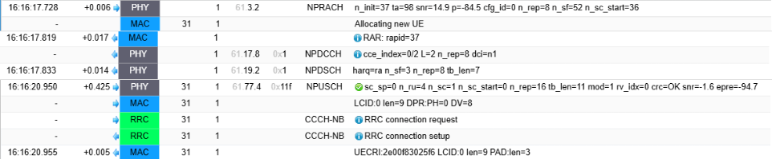
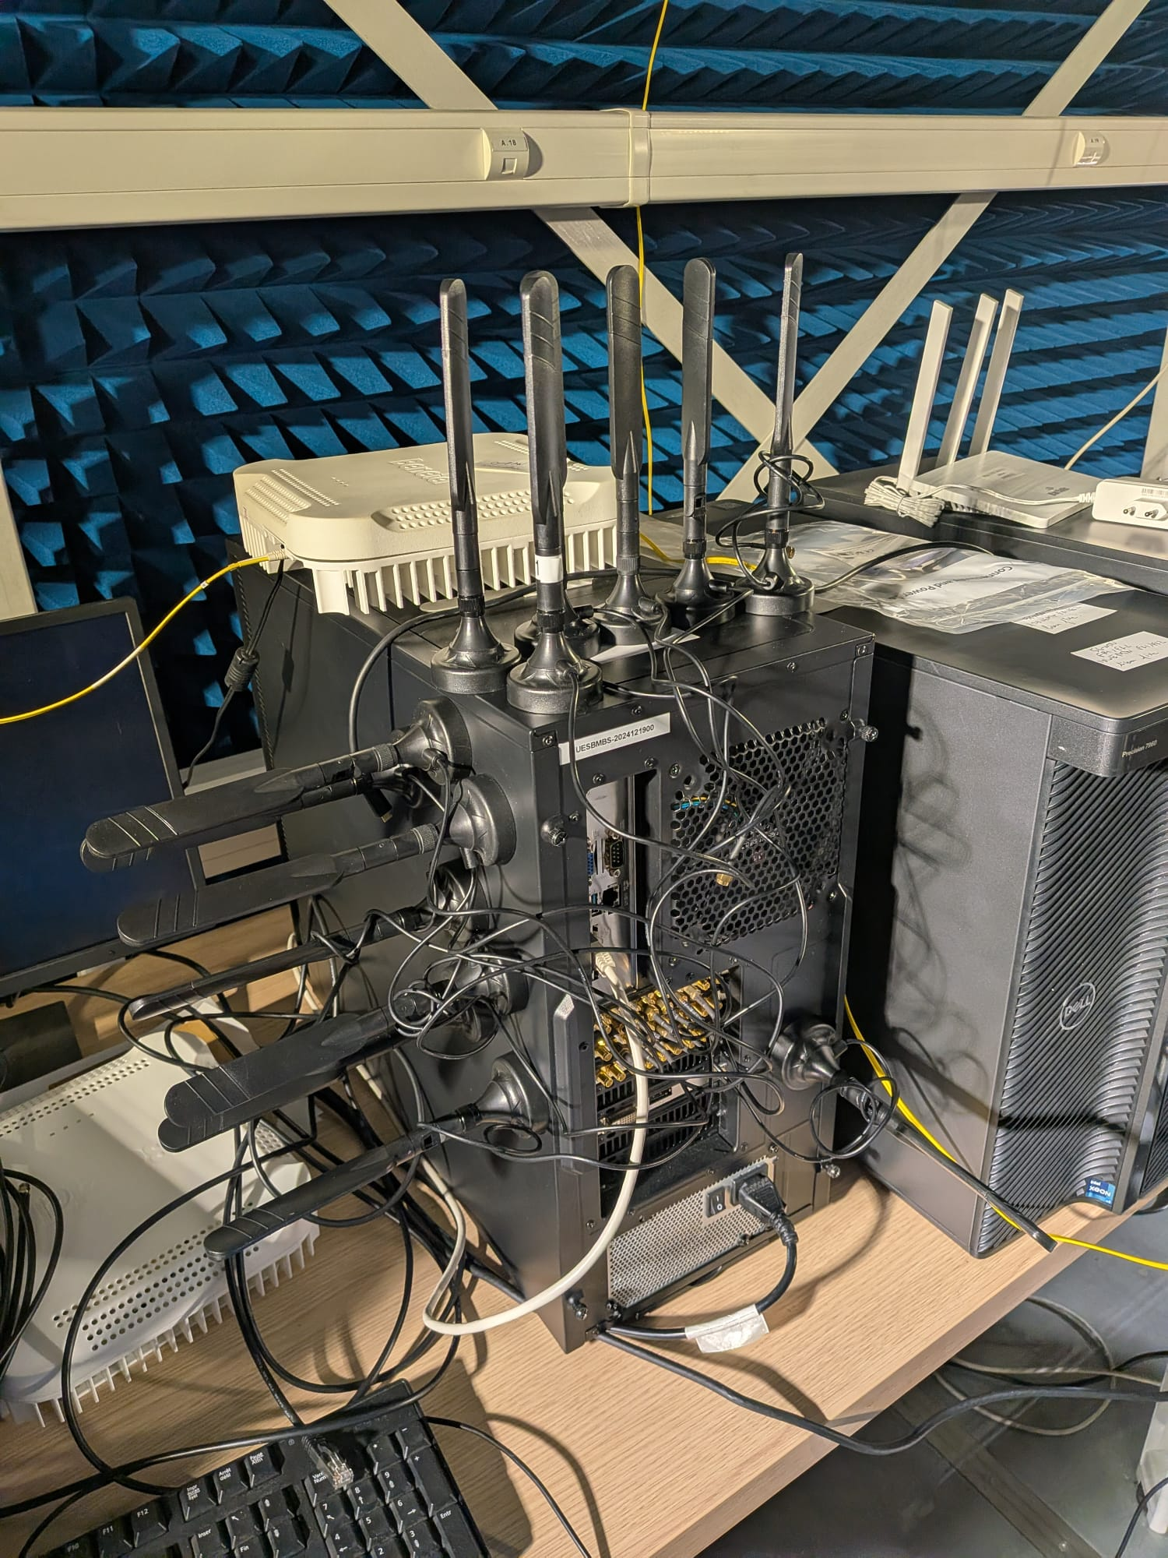
Simulation at scale : LENA-NB-NTN
LENA-NB-NTN message exchange
Amarisoft UESIM message exchange
Extension to ns-3 LENA-NB frame work to satellite context.
High fidelity simulation
  Realistic Satellite system modeling.
  Protocol & Performance validation versus Amarisoft UESIM.
Multi ue scenarios : testing link adaptation & resource allocation under charge.
Simulator is ready to integrate LEO features.
Validation set up : UESIM Testbed
LENA-NB-NTN : An end to end simulator for NB-IoT over GEO validated through experimentation ( Contribution underway )
© 2026 Kinéis. All rights reserved
Notes:
So far, every result involved one single device. A real satellite network serves thousands. Testing that in orbit is impossible, so we’re building a simulator.
LENA-NB-NTN extends the open-source ns-3 LENA-NB to the satellite case. It’s a end to end simulator running full stack of NB-IoT Release 17 protocol.
The important part is that the simulator is validated through experimentation using Amarisoft UESIM.
Its architecture in the centre, it can run up to 128 UEs sharing one eNb carrier through a satellite emulator.
The first version of our simulator is GEO only. But it’s ready to let us extend our study yo multi users scenario. In particular, test our link-adaptation algorithms under charge.
One Last thing , The simulator is prepared to integrate also LEO features in the near future.

Slide 8
Notes:
“To sum up: we measured the real limits in orbit, we optimised the link with an algorithm that saves two-thirds of the resource, and we’re scaling to many users with a validated simulator.
Thank you.”

