Slide 1
What is a multi-copy gene family — built from RNA reads, step by step
Two relations on expressed loci; the family is where both hold
Each object is produced from the one before by a stated operation; the de-novo loci come from the read-coherence assembly (the one imported step).

Slide 2
The question, and the answer we will build
• Question: given only RNA long-reads, which loci form a multi-copy gene family?
• Answer (assembled over the next slides):
– a family = a set of expressed loci that are BOTH read-coupled AND backbone-sharing.
• 'Read-coupled' = the aligner cannot tell the loci apart (relation ~R).
• 'Backbone-sharing' = the loci's copies align over a common backbone (relation ~B).
• The rest of this deck derives every word of that sentence from the reads.

Slide 3
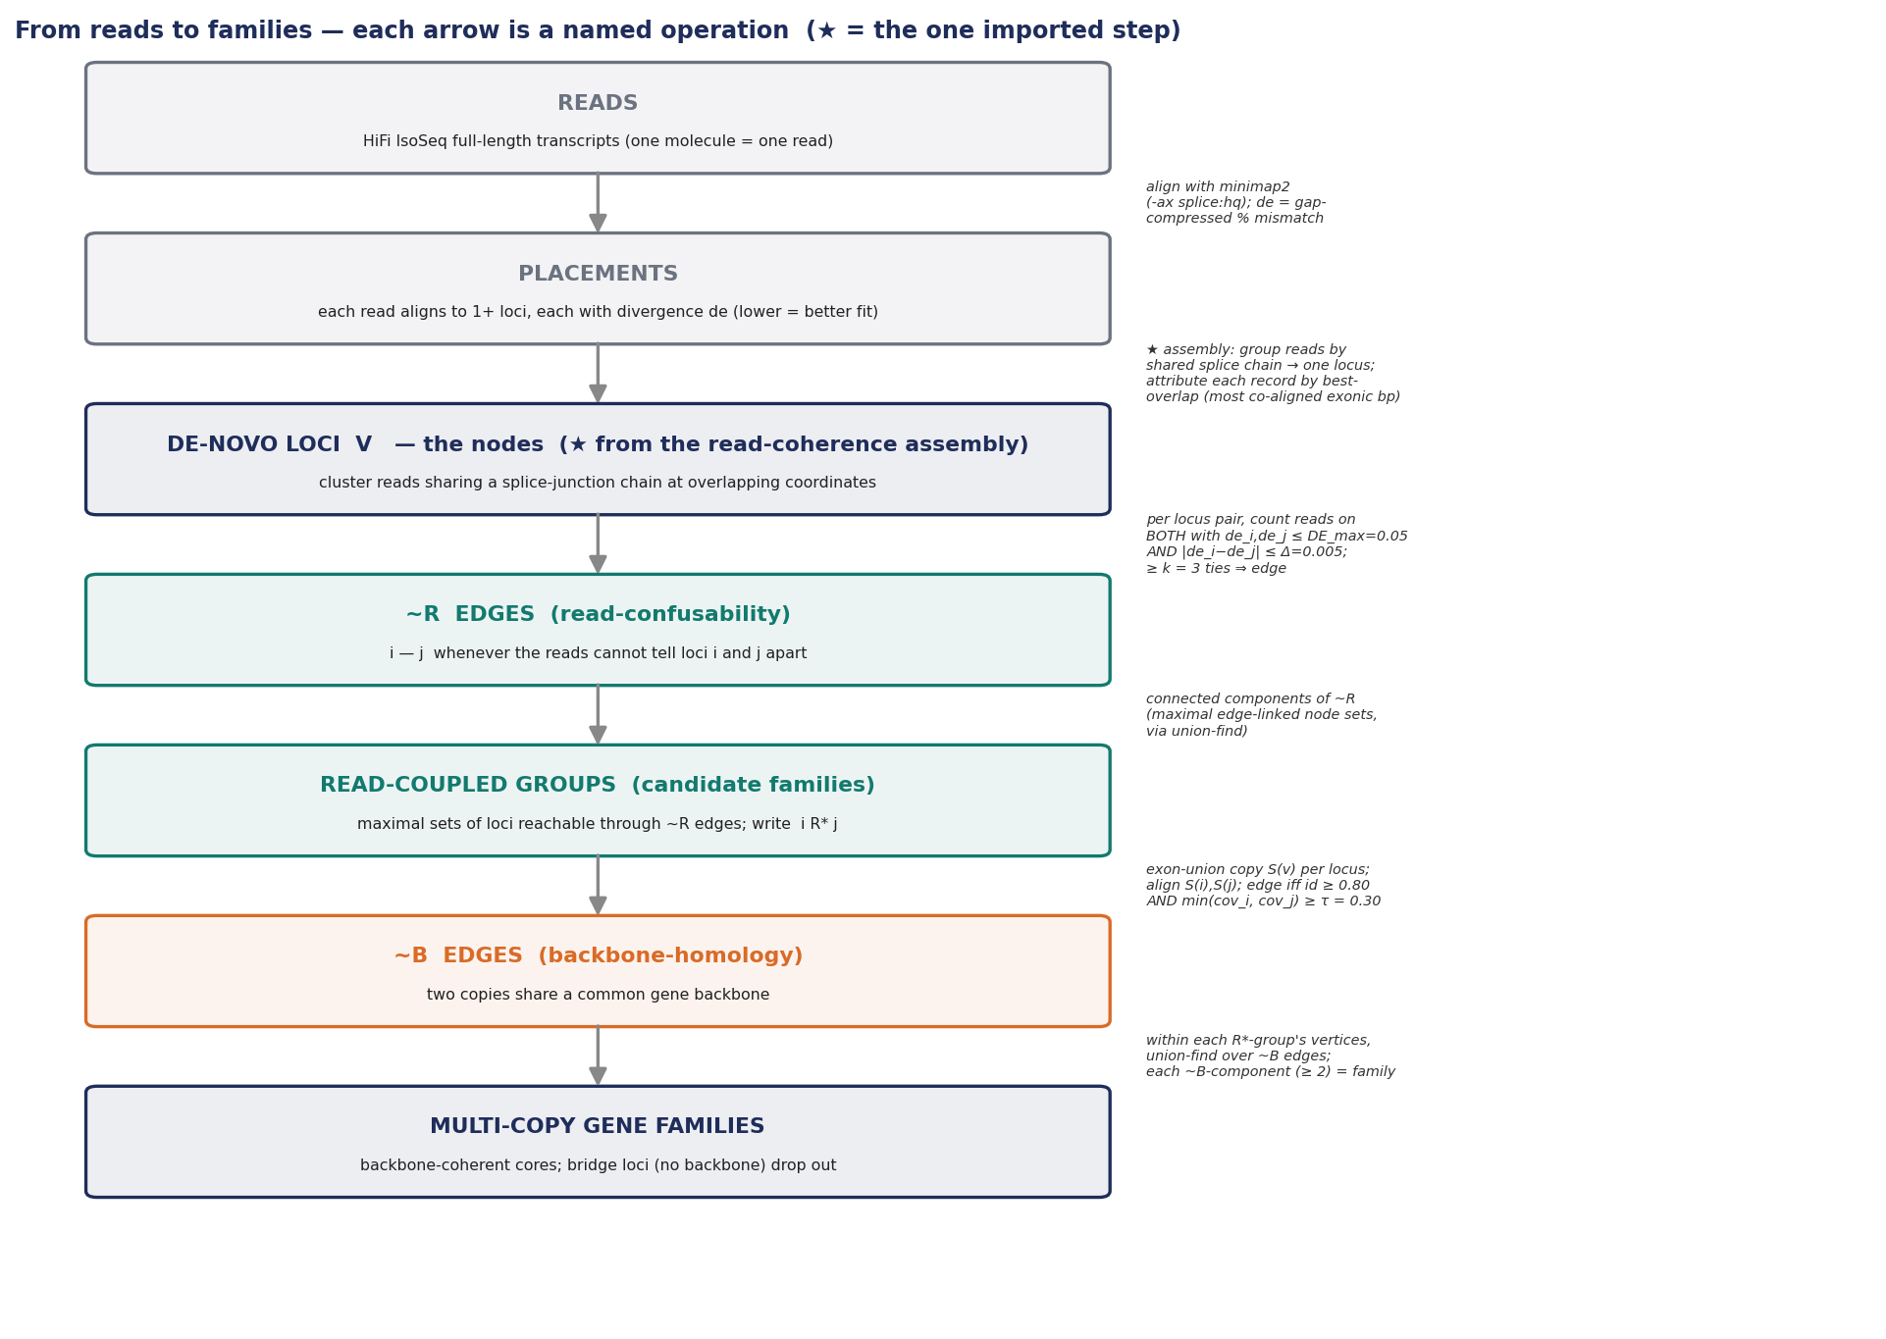
The whole chain, end to end (we walk each arrow next)
Each box is an object; each arrow is the operation that produces the next object from it.

Slide 4
Step 1 — what we start with: the reads
• Input = HiFi IsoSeq reads: one molecule → one full-length transcript read.
• Each read is a spliced sequence (exons, with the introns removed).
• No annotation is used — everything downstream is derived from these reads.
• (For a multi-copy gene, reads from different copies look almost identical — that is the whole problem.)

Slide 5
Step 2 — align the reads → placements (where each read can sit)
• Operation: align every read to the genome with minimap2 (-ax splice:hq).
• A read that fits two near-identical copies gets MULTIPLE placements (a primary + secondaries).
• Each placement carries a number: de = gap-compressed per-base divergence (how well the read fits there).
– de ≈ 0 means the read matches that locus almost perfectly.
• So after this step every read is a set of (locus, de) placements — the raw material for 'confusability'.

Slide 6
Step 3 — turn placements into LOCI (the nodes of our graph)
• (a) Build the loci [★ the read-coherence assembly — the one step we import]:
– cluster reads that share the same splice-junction chain at overlapping coordinates → one DE-NOVO LOCUS.
– ⇒ a de-novo locus = one expressed transcription unit = one NODE (vertex V). No gene name is used.
• (b) Attribute each alignment RECORD to its single best-overlap locus:
– best-overlap = the locus with the most co-aligned exonic bases (ties broken by lower de).
– ⇒ a read on two copies contributes two DISTINCT records → genuine multimapping, not double-counting;
– and a read can never be 'confused' with a locus that merely nests inside its own.
★ This is the only object imported from upstream; everything after Step 3 is derived here.

Slide 7
Step 4 — the first relation: ~R (read-confusability) = the EDGES
• For each PAIR of loci (i, j), look at the reads that placed on BOTH.
• A read 'ties' i and j when it fits both well AND equally:
– de_i, de_j ≤ DE_max = 0.05 (fits both) AND |de_i − de_j| ≤ Δ = 0.005 (equally well).
– Δ = single-read divergence resolution at HiFi error (≈ 4σ, not tuned); DE_max = loose copy-vs-other-gene ceiling.
• Draw an edge i — j when at least k = 3 reads tie (a quorum — one stray read can't make an edge).
• Worked example — RABL2A vs RABL2B (illustrative de values):
– a read fits RABL2A at de≈0.001 and RABL2B at de≈0.0035 → both ≤ DE_max, |diff|=0.0025 ≤ Δ → it ties them.
– 47 reads tie (measured) ⇒ we draw the edge RABL2A — RABL2B.

Slide 8
Step 5 — edges → graph → CONNECTED COMPONENTS (this is the jump, made explicit)
• We now have a graph: nodes = loci, edges = 'their reads can't be told apart'.
• A CONNECTED COMPONENT = a maximal set of nodes where you can walk from any node to any other along edges.
– Computed by union-find: start each node alone; every edge merges the two nodes' sets; the final sets are the components.
• Why this is the right grouping: if reads confuse A with B, and B with C, then A, B, C form one tangle of
– mutually-confusable loci — exactly the unit on which read-to-copy assignment is one coupled problem.
• ⇒ each connected component is a CANDIDATE family. We say two loci in one component are READ-COUPLED: write i R* j.
This is how 'reads' became 'connected components': align → place → count ties → edges → union-find components.

Slide 9
Step 6 — why candidates are not yet families: ~R over-couples
• ~R alone makes a mistake: a shared repeat or a retrocopy makes reads of UNRELATED loci cross-map.
• Measured example: OCLN and SEPTIN7 — 3,369 reads tie them, so ~R draws an edge — yet they are not copies.
– the reads are confused via a shared element, not because the genes are the same.
• So a connected component can fuse a real family with a bridged intruder. We need a second, independent test.
OCLN~SEPTIN7 (3,369 ties; backbone 0.05 on the next slides) is from the genome-wide read-conflict scan — see family_definition_formal.md.

Slide 10
Step 7 — build the COPIES: aggregate isoforms into one exon-union per locus
• A copy is a locus (one node); its reads are different ISOFORMS (alternative transcripts) of that copy.
• Operation: union the exonic intervals of ALL reads at a locus → the locus's exon-union sequence.
– 'the full gene minus introns' (a retained intron shows up where reads span it).
• ⇒ one copy model S(v) per locus. Many isoforms collapse to ONE copy — splicing can't masquerade as extra copies.
– (verified: 100s–1000s of distinct isoforms per locus → a single exon-union.)

Slide 11
Step 8 — the second relation: ~B (backbone-homology) = the validation EDGES
• Operation: align the two copy models S(i), S(j) to each other (minimap2).
• Measure coverage in EACH direction: cov_i = fraction of S(i)'s bases that align, cov_j likewise.
• Draw a backbone edge i ~B j iff identity ≥ 0.80 AND min(cov_i, cov_j) ≥ τ = 0.30.
– the MIN (reciprocal) is the point: a real copy aligns over most of BOTH; a repeat-bridge over only a short insert of one.
• Worked example (measured):
– RABL2A ~ RABL2B copies align over 0.94 of each (min-cov 0.94) → backbone edge ✓.
– OCLN ~ SEPTIN7 align over only 0.05 of one and ~0 of the other → NO backbone edge ✗.

Slide 12
Step 9 — the family: the ~B-connected core inside each read-coupled group
• Operation: take the vertices of ONE ~R-component; on those vertices only, run union-find over ~B edges;
– each resulting ~B-component of size ≥ 2 is a family. A locus with no ~B edge to a family-mate drops out.
• DEFINITION: a multi-copy gene family = a ~B-connected component (size ≥ 2) inside a read-coupled (R*) group.
– Equivalently: connected components of ~B ∩ R* (R* = 'reads couple them' from Step 5; ~B = 'they share a backbone').
• RABL2A–RABL2B: read-coupled ✓ and backbone-connected ✓ → a FAMILY.
• OCLN–SEPTIN7: read-coupled ✓ but NO backbone → the bridge is cut → NOT a family.

Slide 13
The definition, fully assembled (every term now derived)
• A multi-copy gene family is a set of de-novo loci that is:
• (1) read-coupled — its loci are mutually confusable: a connected component of ~R
– (≥ 3 reads tie each link at |de_i−de_j| ≤ Δ), AND
• (2) backbone-connected — its copies (all-isoform exon-unions) share a common backbone: ~B
– (identity ≥ 0.80, reciprocal coverage ≥ τ).
• ~R alone over-couples (repeat bridges); ~B alone is plain homology (ignores expression/confusability).
• The family is where BOTH hold — exactly the unit where copy-assignment is both needed and well-posed.

Slide 14
What this correctly handles — and why (by the two relations)
• Domain-sharers (adjacent genes sharing one exon) → 0 conflicting reads (best-overlap) → not ~R → excluded.
• Repeat / retro bridges between non-copies → no shared backbone → not ~B → excluded (OCLN~SEPTIN7).
• Isoforms of one copy → collapse into one exon-union → never counted as extra copies.
• Single pairs (size-2, the largest class — 73/196 here) → admitted: one ~B edge in a coupled group, no density needed.
• Read-resolvable diverged paralogs → fewer than 3 reads tie → not ~R → out of scope by design.

Slide 15
Evidence
• Hand-labelled panel (17 IsoSeq candidates): TP = 7, TN = 10, FP = 0, FN = 0.
• ~B is the decisive lever: per candidate, repeat/retro bridges score ≤ 0.1 vs real copies ≥ 0.8.
• Genome-wide, OOM-safe (de-novo loci): 212 candidate components → 196 validated families.
– cutting 14 backbone-less member loci dissolves/refines 16 components; cross-chrom bridges 20 → 12; size-2 80 → 73.
– Honest cost: of the cut edges, 9 had no DNA homology vs 12 DNA-paralog/sub-bar → conservative (cuts confident bridges).
• Six alternative refinements (clustering, read coverage/intron, junction concordance) tested and rejected;
– only ~B (backbone) and external repeat-masking survive — ~B is the one that closes the repeat-bridge gap.

Slide 16
Summary — one sentence, fully grounded
• A multi-copy gene family = de-novo loci whose reads cannot be told apart (~R)
• and whose all-isoform copies share a common backbone (~B).
• Built only from reads: align → attribute per record → loci → count ties → ~R edges → components
• → exon-union copies → align → ~B edges → backbone-connected core = family.
• Scope (honest): expressed + confusable copies only; copy NUMBER (PSV haplotypes) is the next step, deferred.

