Slide 1
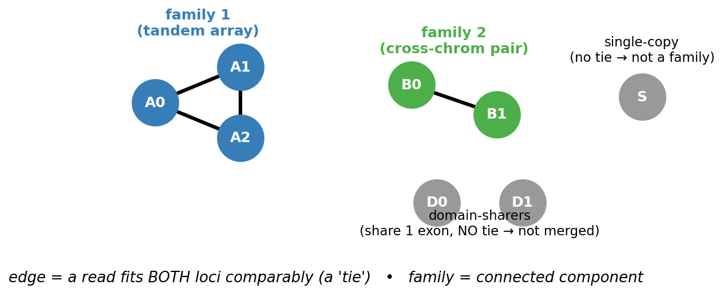
1 · What is a multi-copy gene family (our definition)?
A set of loci the READS cannot tell apart — a family = a connected component of the read-conflict graph (an edge = some read fits both loci comparably). Relational, annotation-free; no absolute-similarity bar.

Slide 2
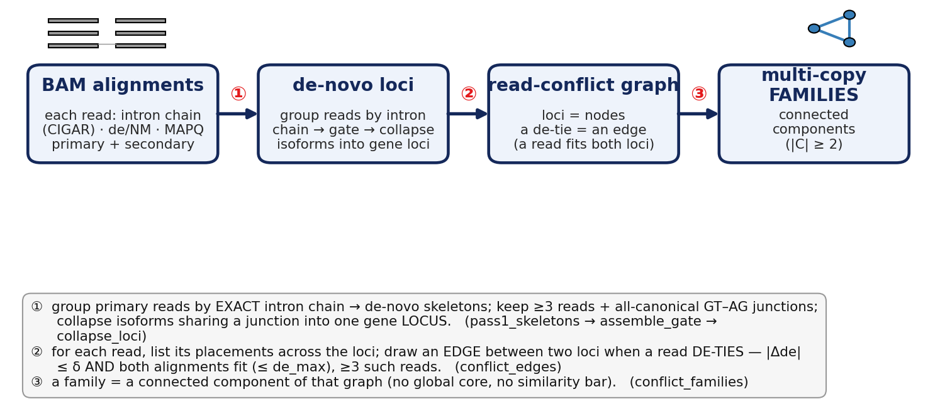
2 · From reads (BAM alignments) to families — the pipeline
isoform = a distinct splice variant of a gene — a particular intron chain (which exons are joined). One gene can express several isoforms; step ① collapses isoforms that share a junction into ONE gene LOCUS, so a family is a set of loci (genes/copies), not of isoforms.

Slide 3
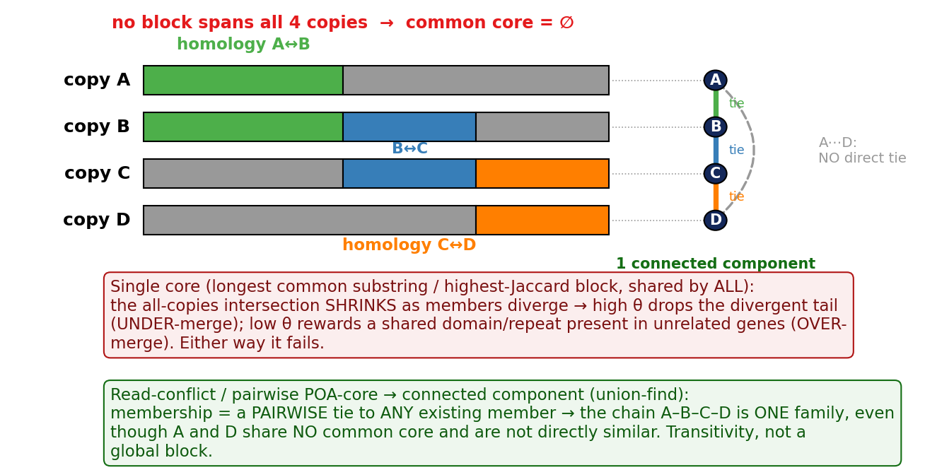
3 · Why a single common core can't discover all members

Slide 4
4 · Methods to detect multi-copy gene families (gathered)
Method | Signal / level | Approach | Limit on RECENT near-identical paralogs
OrthoFinder | protein homology | DIAMOND all-vs-all + MCL + gene trees | near-identical copies collapse / over-merge
Pfam / InterPro | domain HMM | group by shared domain architecture | groups domain-sharers (FP); domain ≠ copy
Ensembl Compara | phylogenetic | gene-tree ↔ species-tree reconciliation | fails on recent near-identical paralogs
Mash / minimizer-Jaccard | alignment-free | MinHash / minimizer distance | cannot separate domain-sharers
SEDEF / BISER | DNA self-align | Jaccard + chaining → segdup pairs | strong on recent SDs; DNA only, no expression
Soto 2025 (HSD) | DNA + copy-number | SD98 + shared-exon + famCN grouping | human gold standard; DNA, no RNA/isoform
Eichler 2024 (TBC1D3) | long-read RNA | map FLNC; assign read iff AS ≥ 10 | ONE family; not de-novo / genome-wide
longcallR | long-read RNA | CNN SNP + MEC phasing + ASE/ASJ | uniquely-mappable only; never assigns to COPIES
RSEM / Salmon / kallisto | RNA quant (EM) | EM apportions multireads | needs a PRE-DEFINED transcript set; no discovery
IsoCon | long-read RNA | NN cluster/correct + real-vs-error test | closest prior art; WITHIN a known family, targeted
★ OURS (read-conflict) | long-read RNA, de-novo | loci a read CAN'T tell apart (conflict graph) + copy assign | fills the empty niche: de-novo · genome-wide · RNA · copy-level
The RNA / long-read / de-novo / copy-level niche was empty — IsoCon is the closest, but only WITHIN a known family.

Slide 5
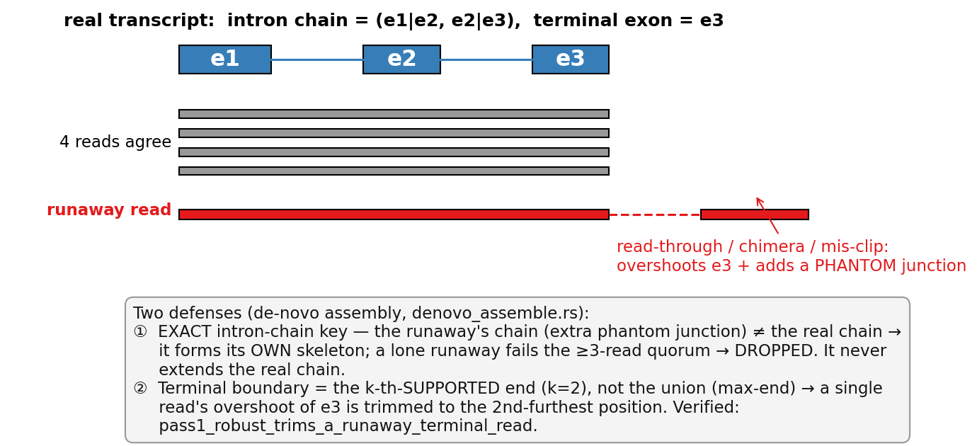
5 · A runaway read can't wrongly extend the intron chain

