Slide 1
What is a multi-copy gene family?
Copies that share a whole-gene backbone (~B) — a structural fact, expressed or not.
Today: defining the family (~B). Next meeting: telling the copies apart (identifiability, PSVs).
Illustrated on one real family

Slide 2
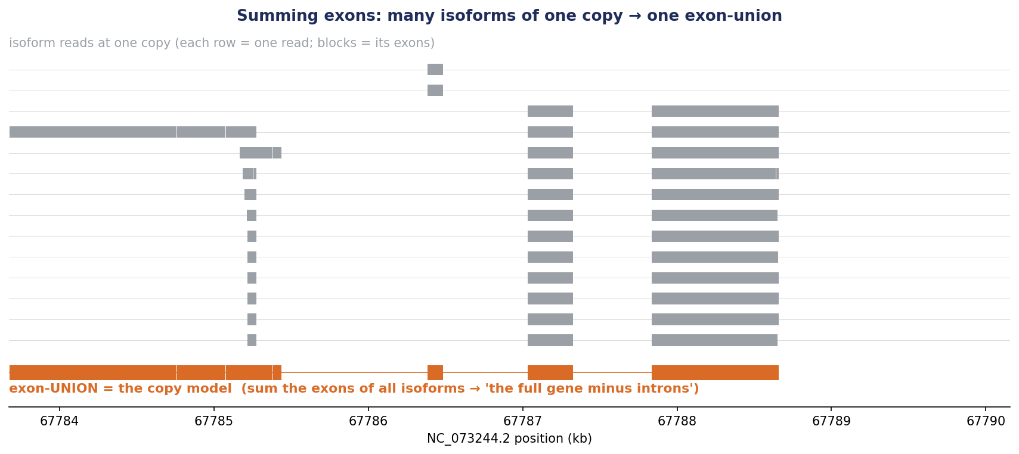
From reads to a copy model: sum the exons of all isoforms
A copy's many isoforms (grey) sum to one exon-union (orange) = its copy model — so splicing can't masquerade as extra copies. This is what ~B aligns.

Slide 3
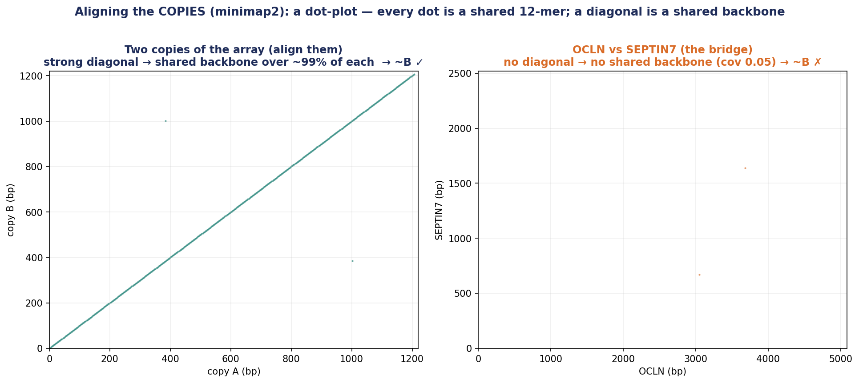
The family test: align the copy models → shared backbone? (~B)
Copy-vs-copy minimap2 (not the read 'de' tag): a diagonal over the whole of each = shared backbone (~B ✓, one family); a bridge with no diagonal = ~B ✗ (cut).

Slide 4
The definition
A multi-copy gene family = a set of gene loci whose copies
share a WHOLE-GENE backbone (~B: copy models align reciprocally).
A structural property — it holds whether or not the family is expressed.
Expression (observed / silent) and identifiability (can we resolve the copies?) are LABELS, not gates.
Identifiability — telling the copies apart — is the NEXT step (PSVs, copy-assignment).

Slide 5
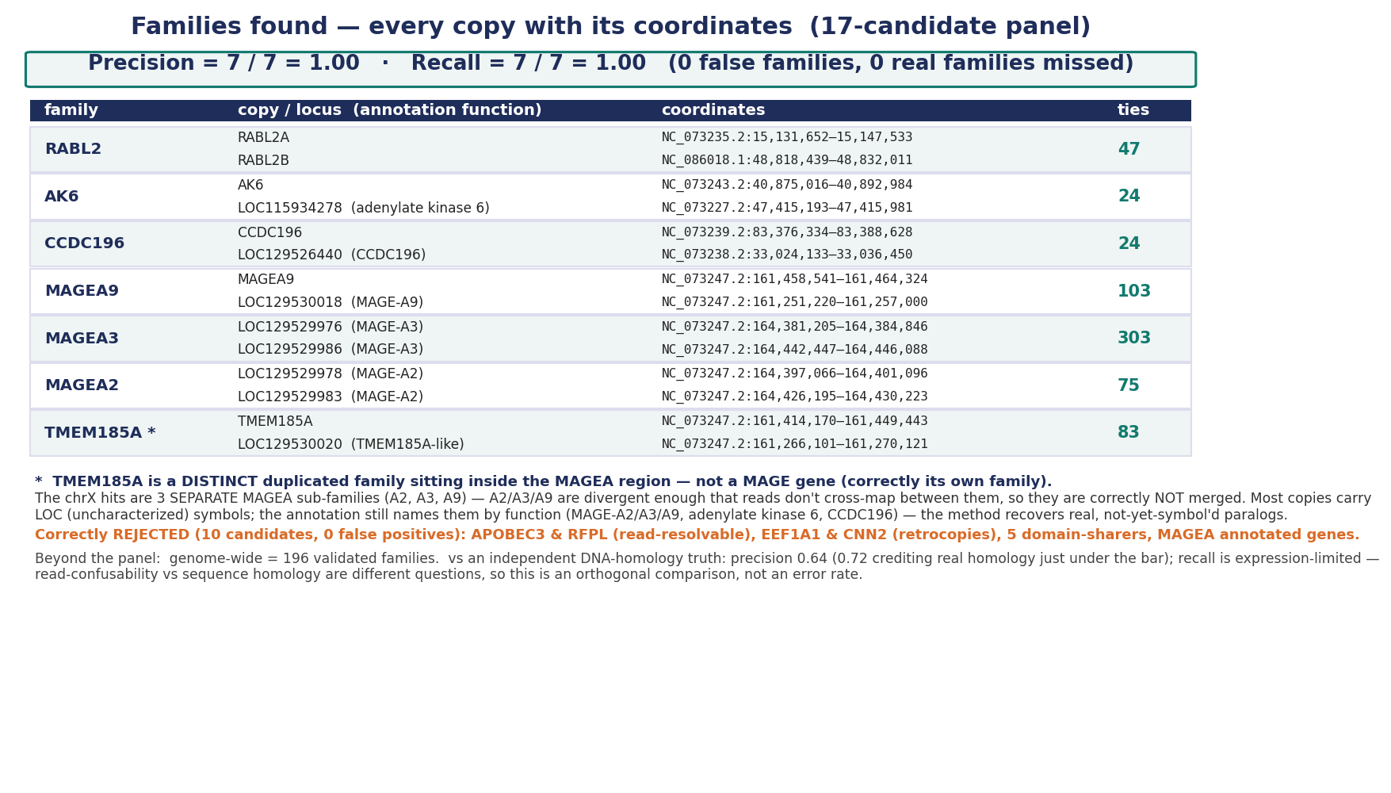
Results: gene families found (precision / recall)
On the 17-candidate panel with hand-checked ground truth: precision = recall = 1.00 (0 false families, 0 missed).

Slide 6
Part 2 — the complete family definition (~B)
~B DEFINES the family · all families, expressed or silent · good vs bad alignment · the named families it covers
A family is a structural fact (~B): ~1,000 families, ~half expressed, ~half silent. Identifiability — resolving the copies — is the NEXT meeting (PSVs).

Slide 7
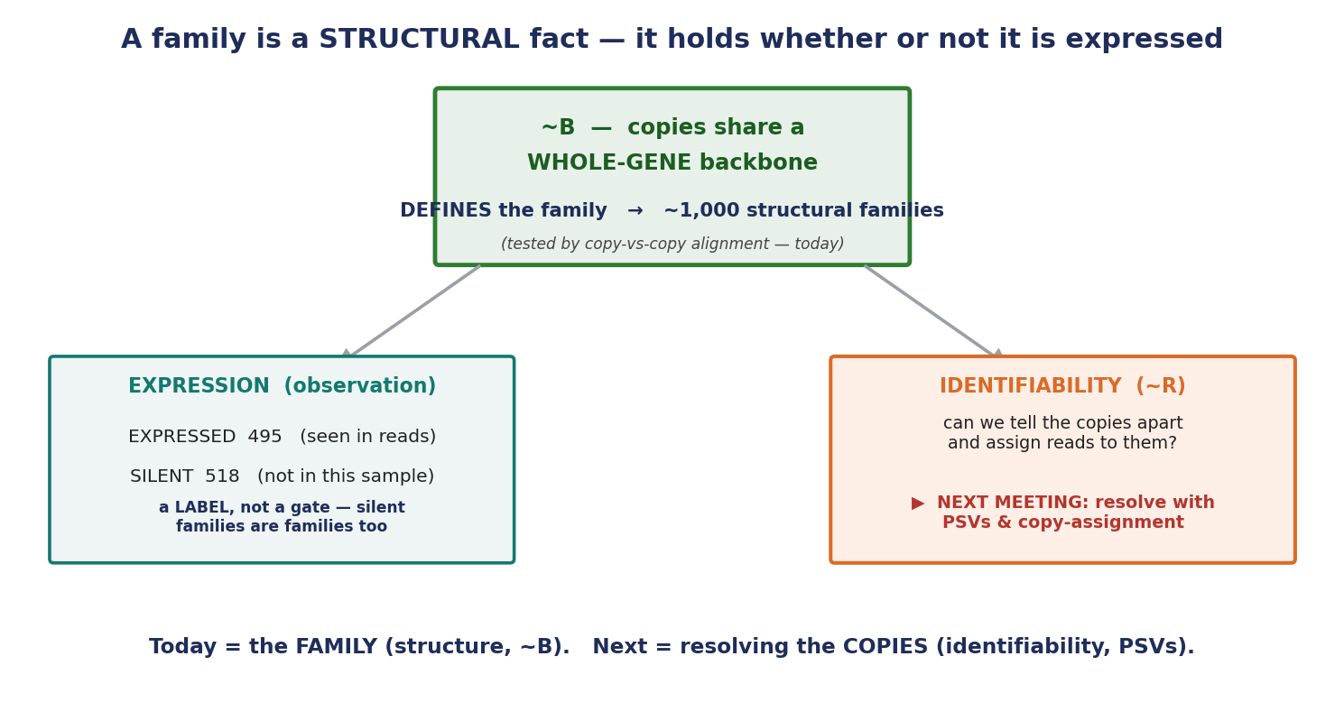
The complete definition — ~B defines the family
~B (copies share a whole-gene backbone) DEFINES the family — a structural fact. Expression (495 seen / 518 silent) and identifiability (can we resolve the copies?) are LABELS, not gates. Identifiability is next meeting.

Slide 8
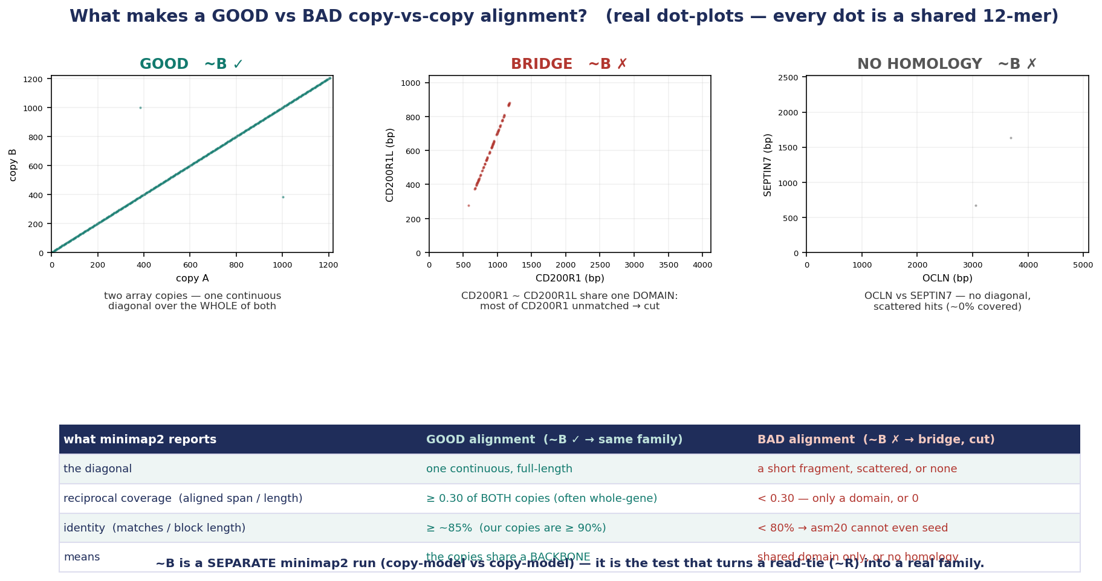
Good vs bad ~B alignment — real dot-plots + the criteria
~B is a copy-vs-copy alignment. GOOD = one continuous diagonal over ≥30% of BOTH at ≥~85% id (array copies). BAD = a domain-only partial diagonal (CD200R1~CD200R1L), scatter, or — below ~80% id — no alignment (OCLN~SEPTIN7).

Slide 9
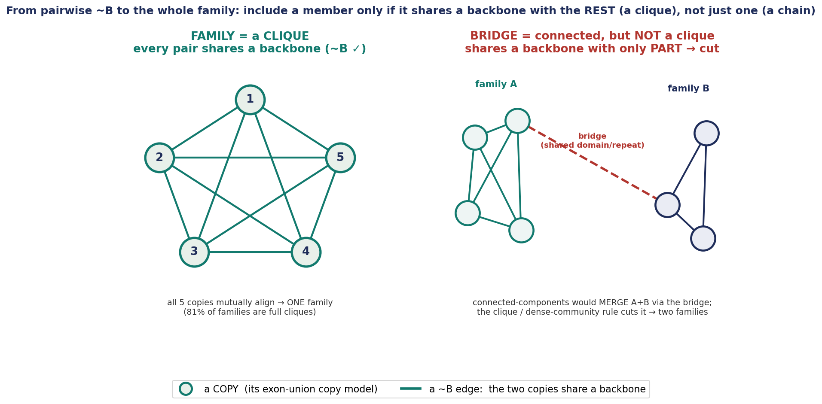
From pairwise ~B to the family — a clique, not a chain
~B is pairwise; the family is the set whose members ALL mutually share a backbone (a clique / dense cluster). 81% of families are full cliques. A bridge member shares with only PART → it never joins the clique → cut, so a single bridge can't merge two families.

Slide 10
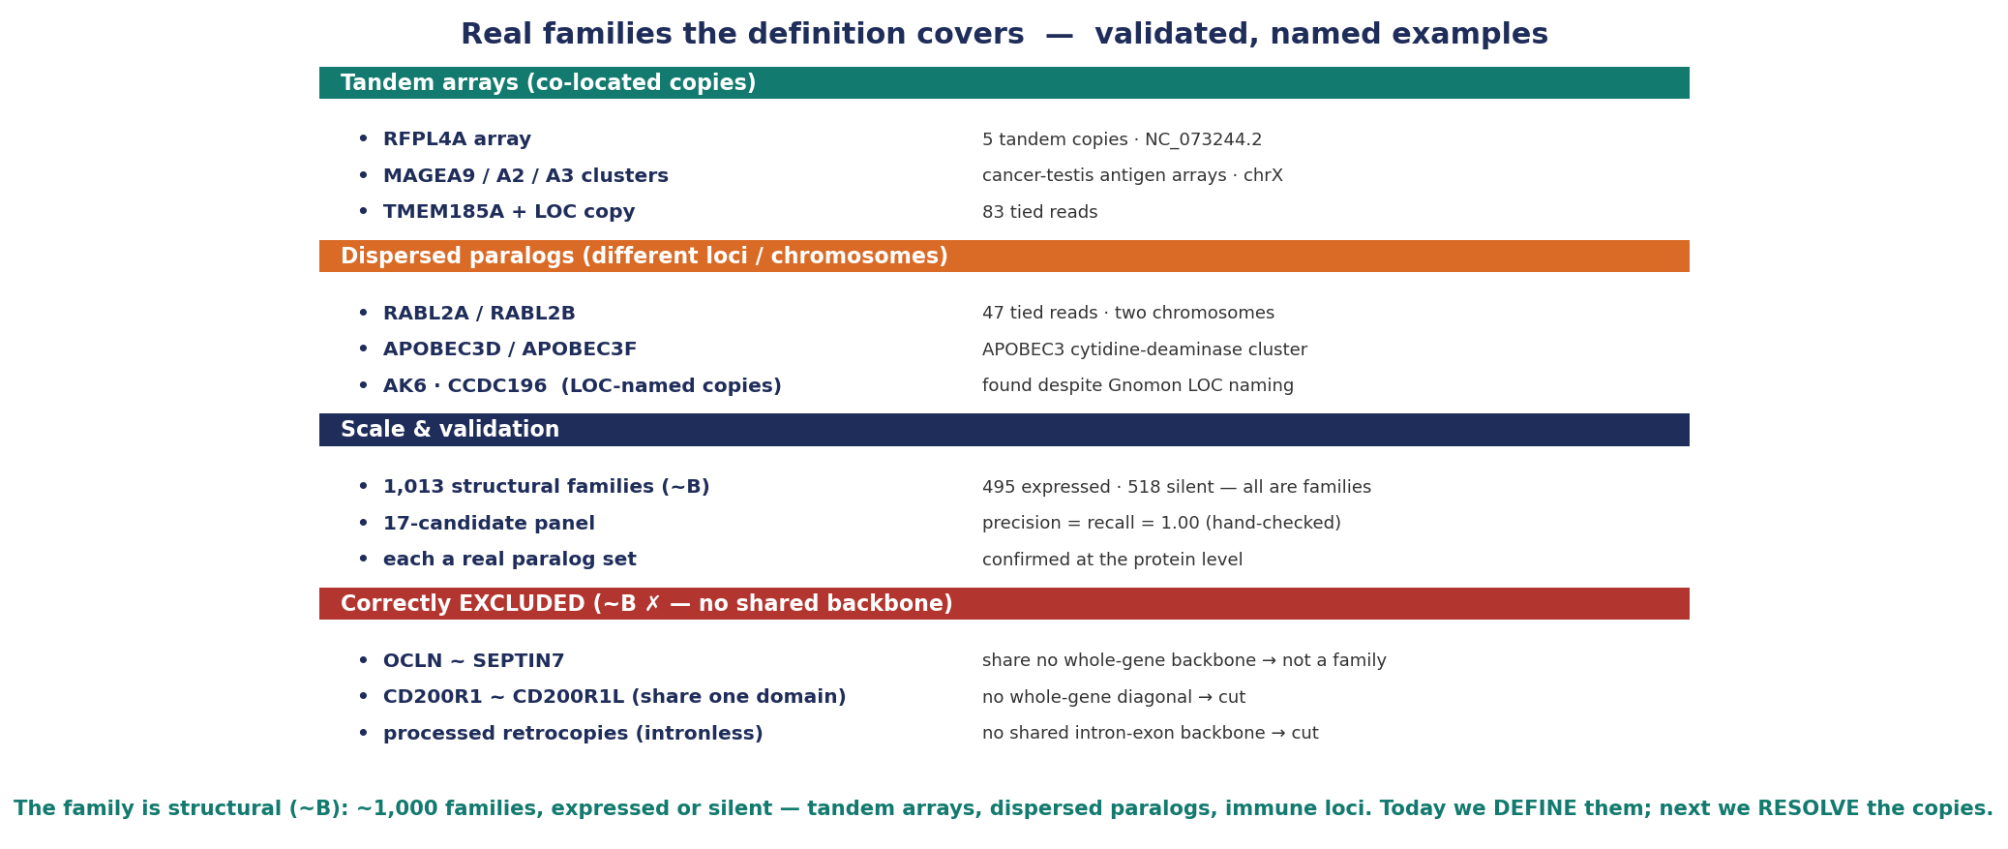
Real families the definition covers
Validated named families — tandem arrays (RFPL4A, MAGEA), dispersed paralogs (RABL2, APOBEC3, AK6), immune loci — and the bridges it correctly excludes. Each a real paralog set.

Slide 11
Next meeting — identifiability: resolving the copies
Today we DEFINED the families (~B). Next: within a family, which copies can reads actually tell apart — and how do we assign the ambiguous reads?
The tool: PSVs (copy-distinguishing variants) + copy-assignment. A preview of the read signal follows.

Slide 12
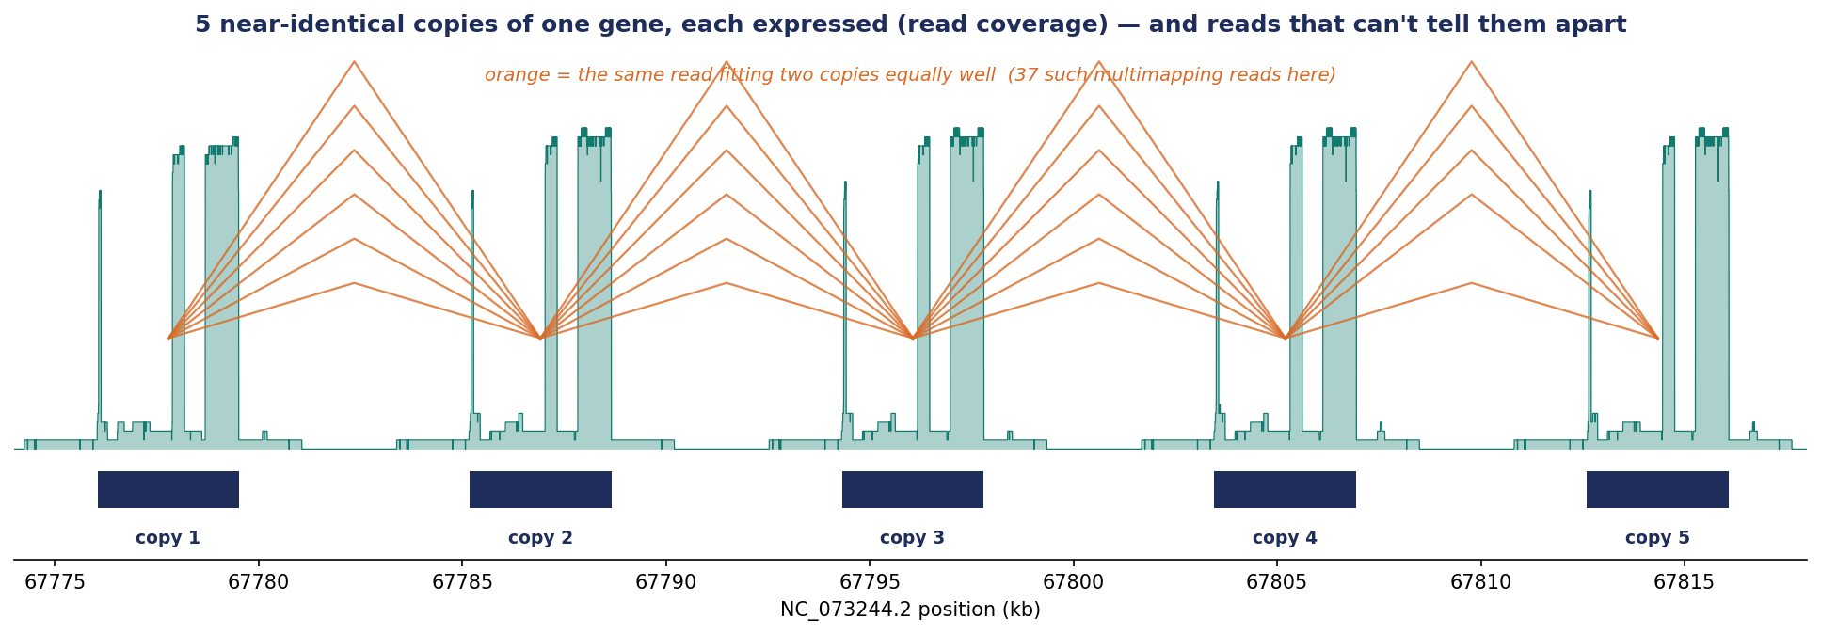
Preview: reads that can't tell the copies apart (~R)
Within a family, some reads fit several copies equally well (orange) — these are the reads copy-assignment must resolve. ~R measures how confusable the copies are. [next meeting]

Slide 13
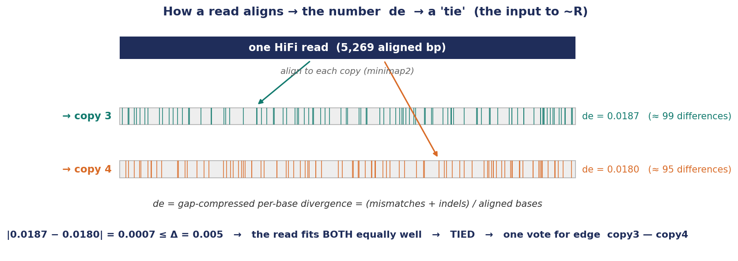
Preview: the read signal — 'de' and a 'tie'
minimap2's de = differences per base; two copies within Δ of each other on a read = a tie = read-confusable. This identifiability signal is where PSVs come in. [next meeting]

Slide 14
Appendix — how it actually works
what we align & how we know what to align to · error vs. real difference · digesting a read into exons
minimap2 does the ALIGNMENT (reads → placements, de, CIGAR — we do not implement an aligner). Our method is everything downstream — choosing WHAT to align, the two relations, the graph, the definition.

Slide 15
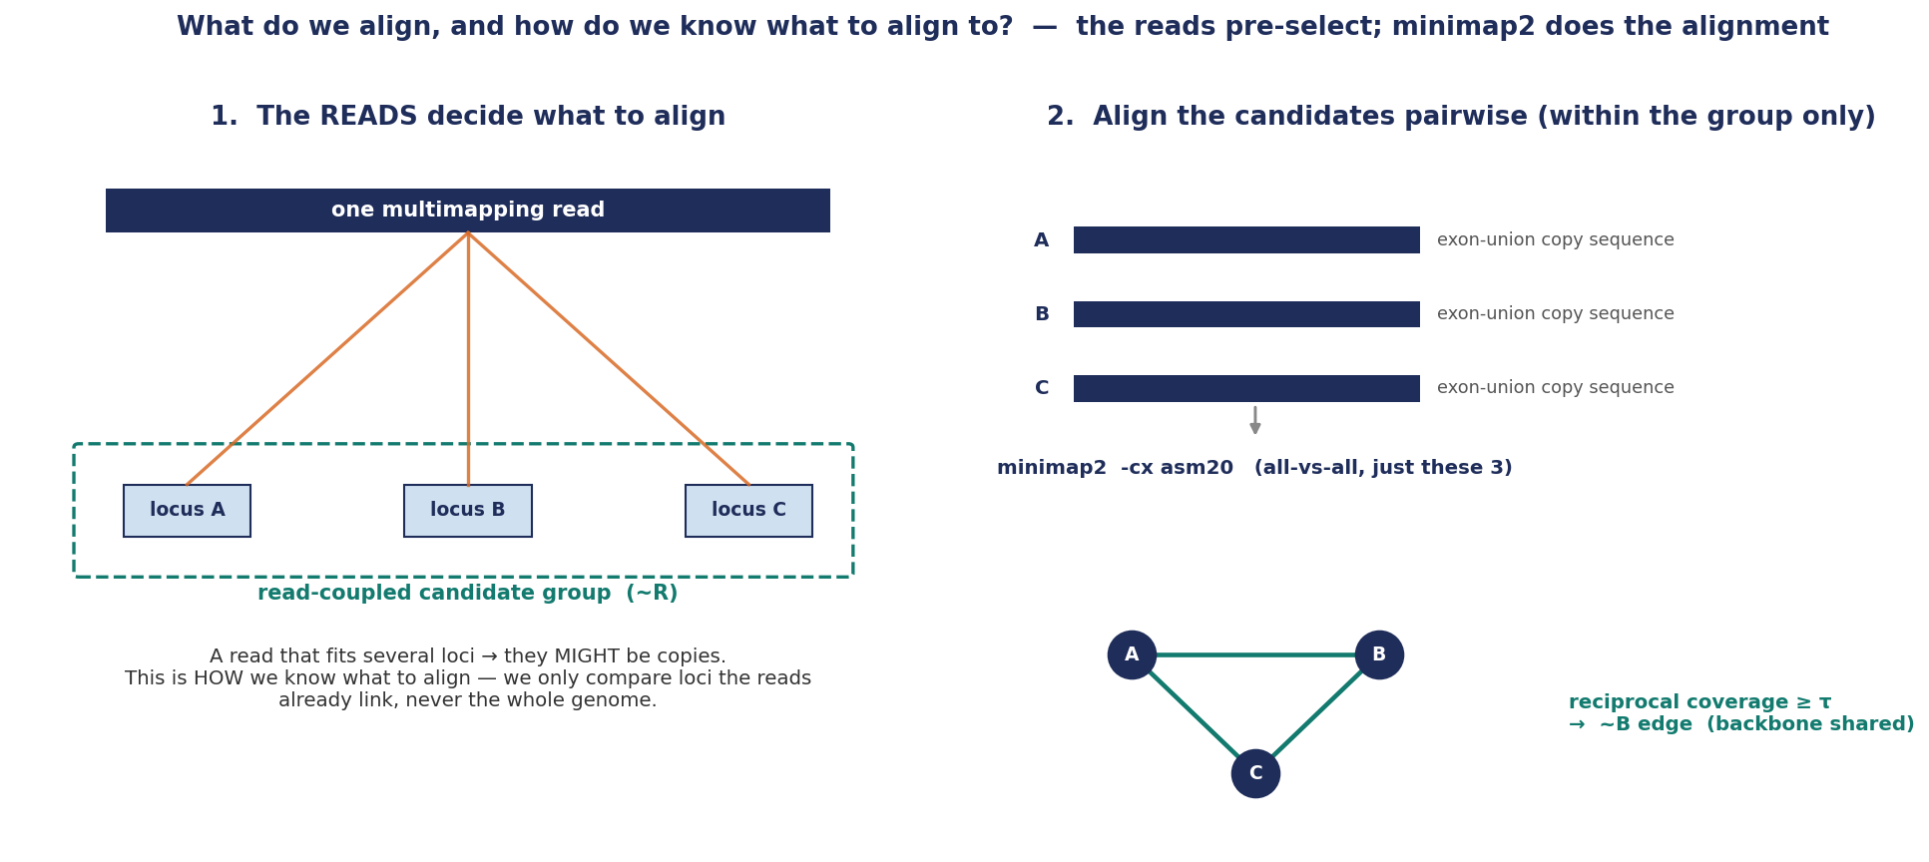
What do we align — and how do we know what to align to?
The reads pre-select: a multimapping read says which loci might be copies (~R); we align only those, copy-vs-copy (minimap2 asm20) → ~B.

Slide 16
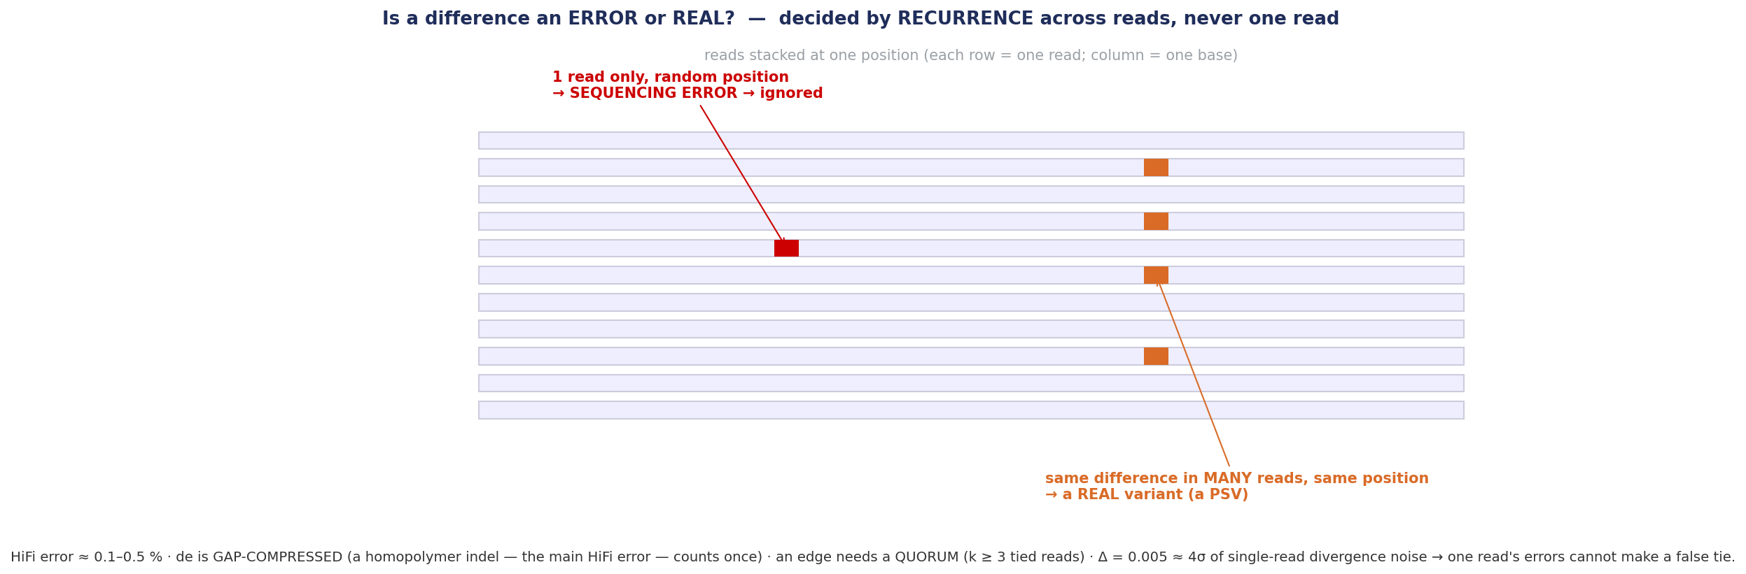
Error or real? — by recurrence across reads
A difference in one read = error (ignored); the same difference in many reads = a real variant. Edges need a quorum (k≥3).

Slide 17
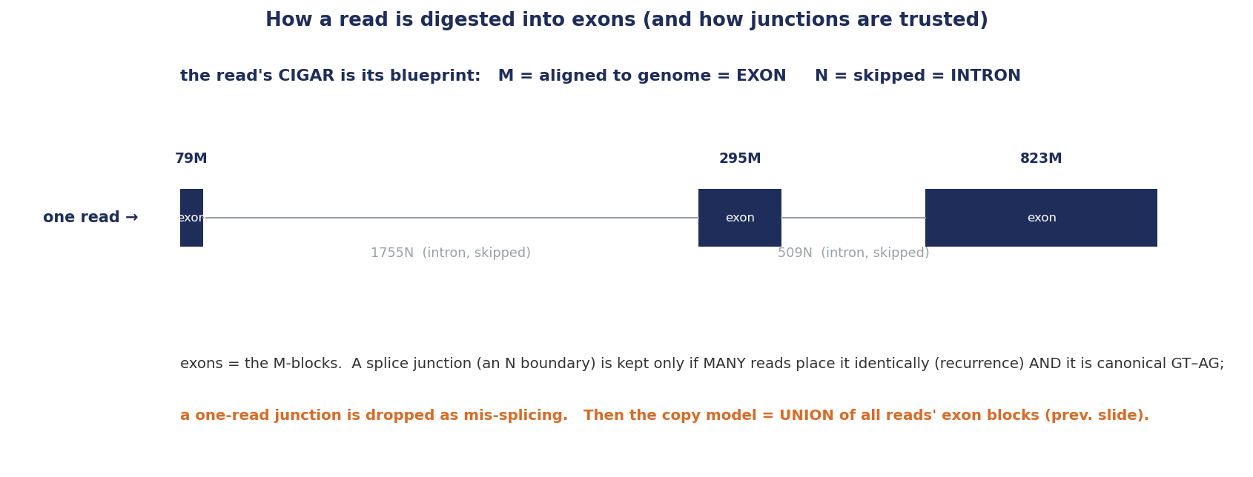
Digesting a read into exons (CIGAR → exons → union)
Each read's CIGAR marks exons (M) and introns (N); junctions are trusted by recurrence + canonical GT–AG; exons are then unioned.

