Slide 1
What is a multi-copy gene family?
Loci whose reads can't be told apart (~R) AND whose copies share a backbone (~B).
Shown on one real family — the RFPL4A array, 5 tandem copies.

Slide 2
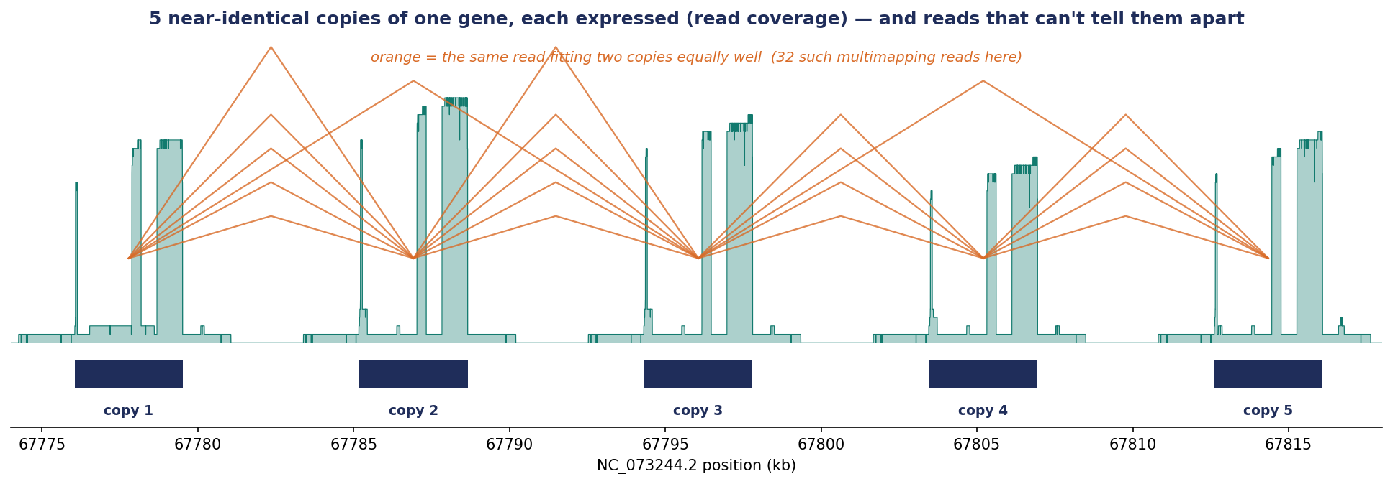
Reads can't tell the copies apart → the relation ~R
5 copies, all expressed; 32 reads fit several copies equally well (orange) — each such read links two copies.

Slide 3
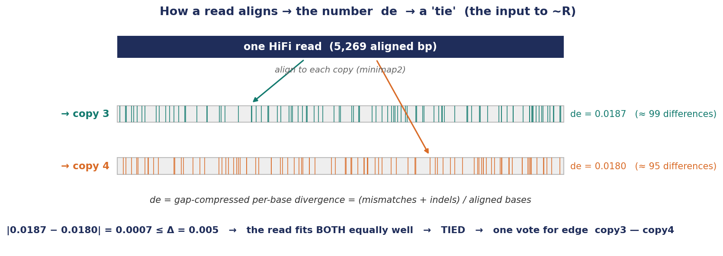
How a read aligns: the number 'de', and what a 'tie' is
minimap2 aligns the read to each copy; de = differences per base. Two copies within Δ of each other = a tie = one ~R vote.

Slide 4
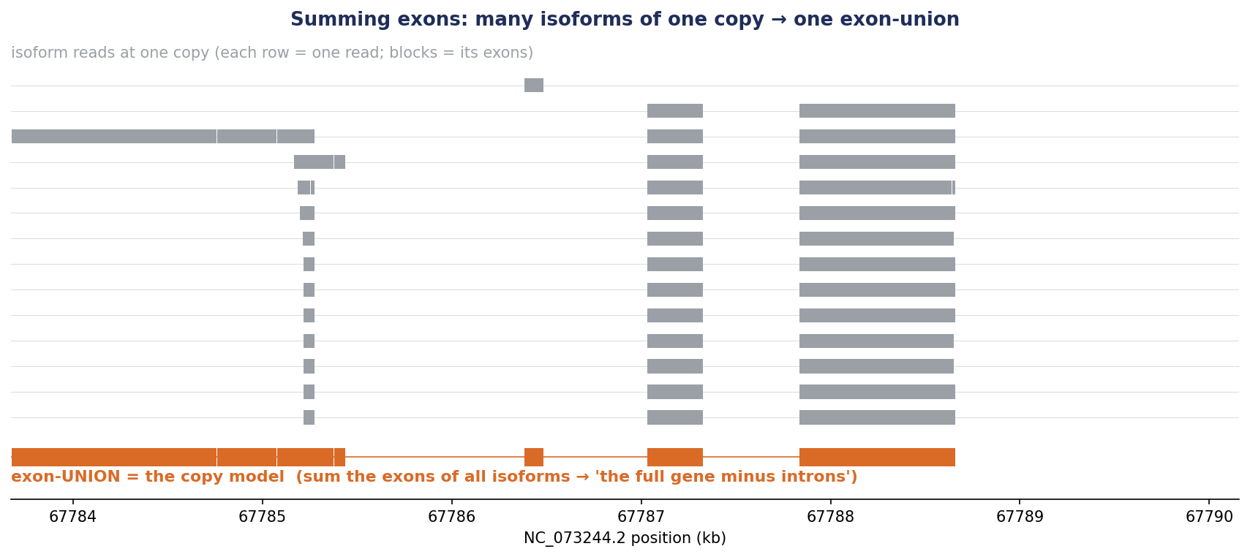
Sum the exons of all isoforms → one copy model
A copy's many isoforms (grey) sum to one exon-union (orange) — so splicing can't masquerade as extra copies.

Slide 5
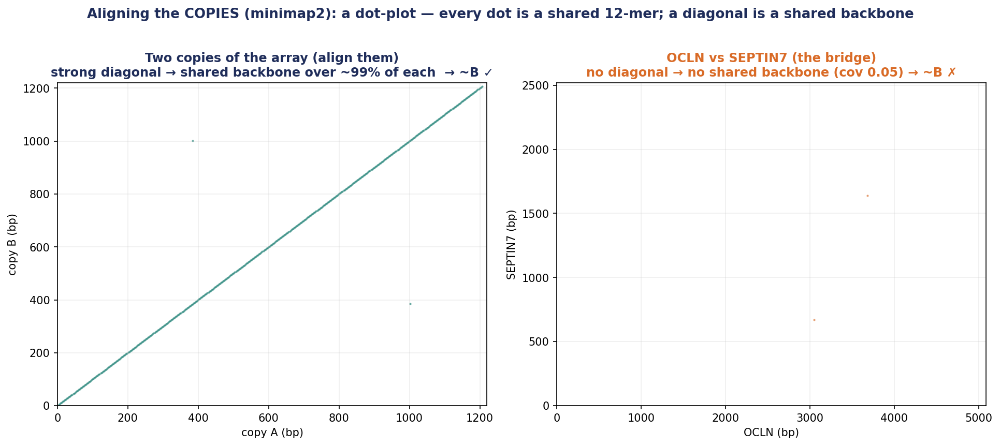
Aligning the copies: a dot-plot → backbone or not (~B)
A SECOND, separate minimap2 run aligns copy-vs-copy (not the read 'de' tag): diagonal = shared backbone (~B ✓); bridge = none (~B ✗).

Slide 6
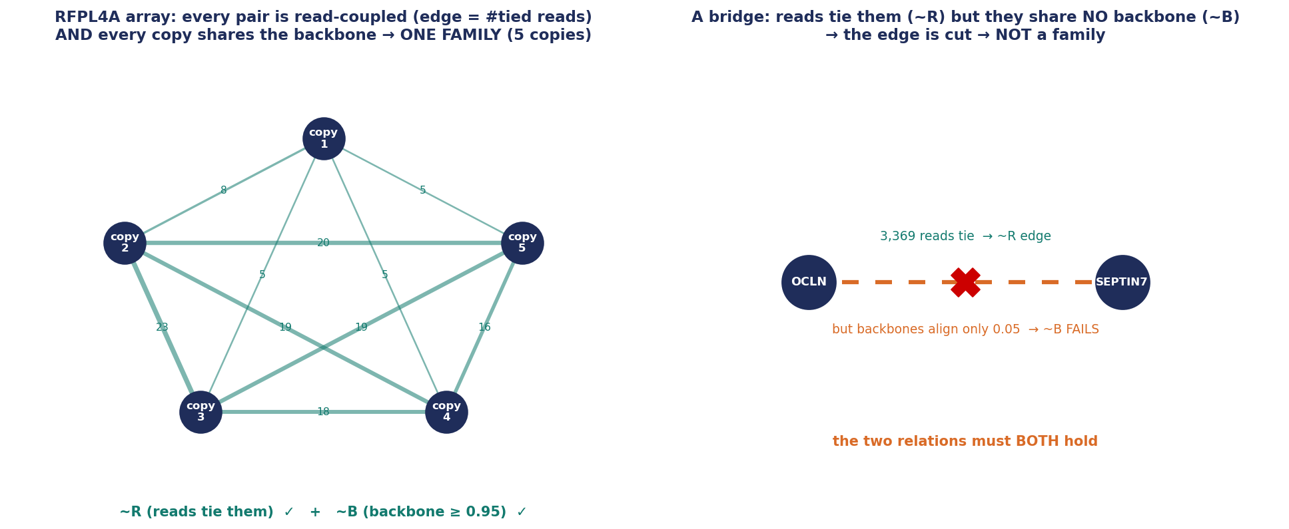
Ties → edges → graph (~R), confirmed by the backbone (~B) = FAMILY
Left: every pair ties AND shares a backbone → one 5-copy family. Right: a bridge ties but shares no backbone → cut.

Slide 7
The definition
A multi-copy gene family = a set of de-novo loci that is
read-coupled (~R: ≥3 reads tie each link) AND backbone-connected (~B: copies align reciprocally).
Built only from reads: align → loci → count ties → ~R graph → components → exon-union copies → align → ~B → family.

Slide 8
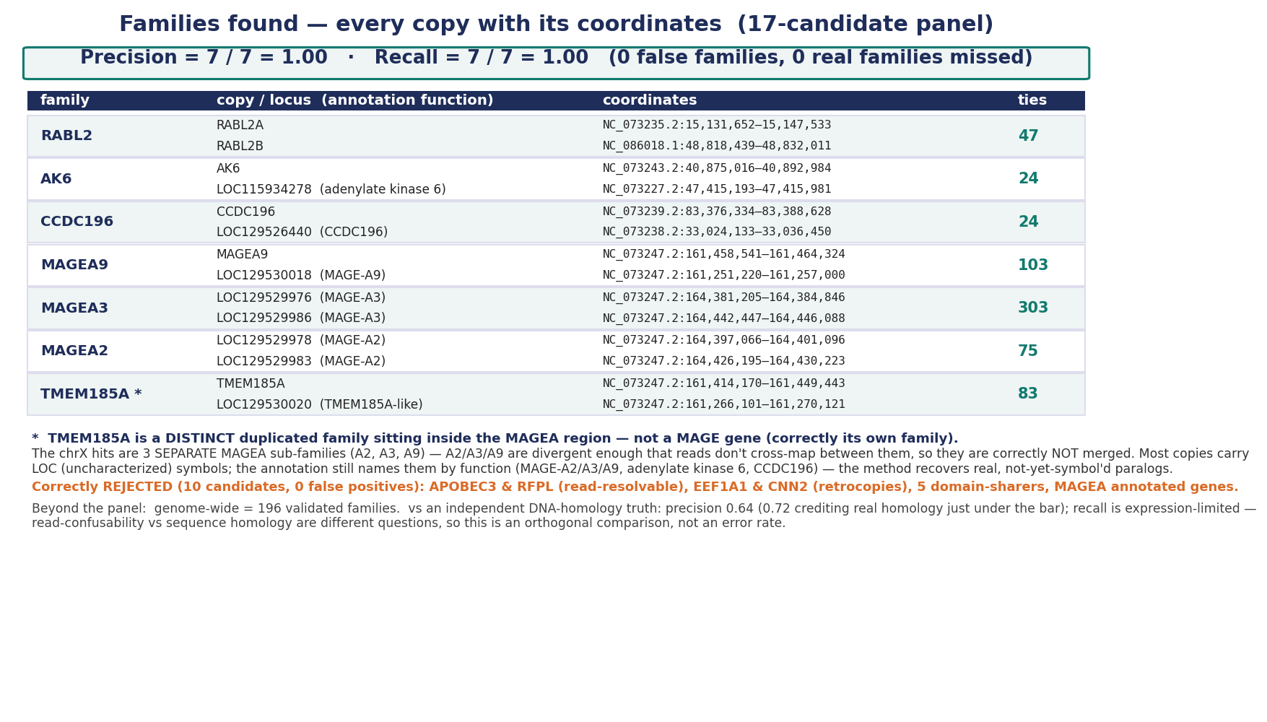
Results: gene families found (precision / recall)
On the 17-candidate panel with hand-checked ground truth: precision = recall = 1.00 (0 false families, 0 missed).

Slide 9
Appendix — how it actually works
the alignment algorithm & scoring · error vs. real difference · digesting a read into exons
What is minimap2's vs ours: minimap2 does the ALIGNMENT (reads → placements, de, CIGAR — we do not implement an aligner). Our method is everything downstream — the two relations, the graph, the definition.

Slide 10
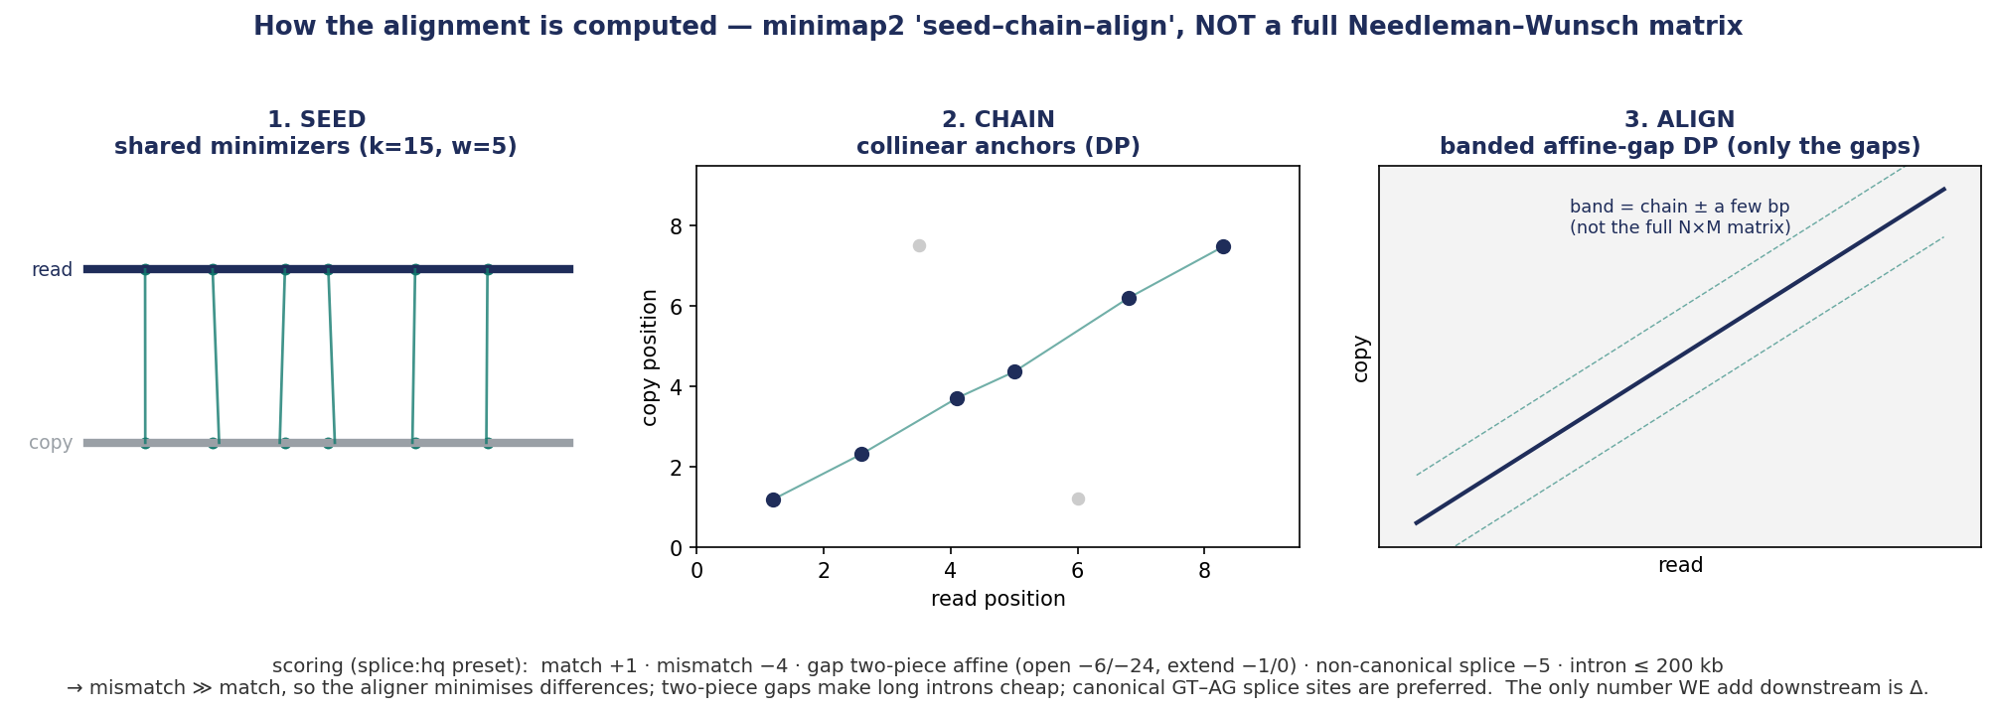
How the alignment works (minimap2's job, not ours; not Needleman–Wunsch)
minimap2 — not us — does seed–chain–align (minimizer seeds → chaining → banded affine-gap DP). We only consume its output.

Slide 11
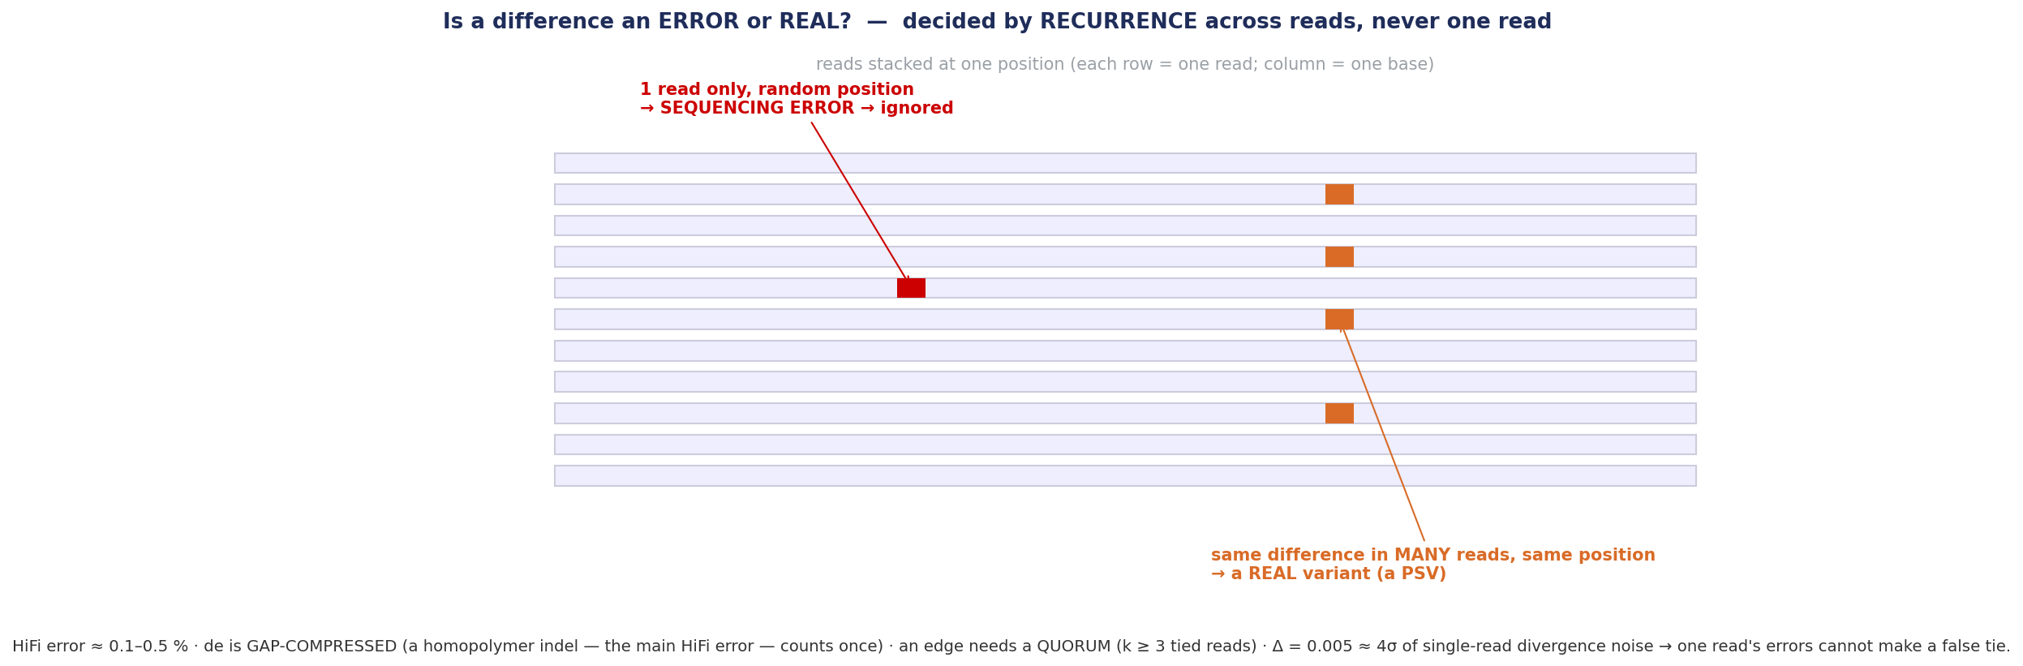
Error or real? — by recurrence across reads
A difference in one read = error (ignored); the same difference in many reads = a real variant. Edges need a quorum (k≥3).

Slide 12
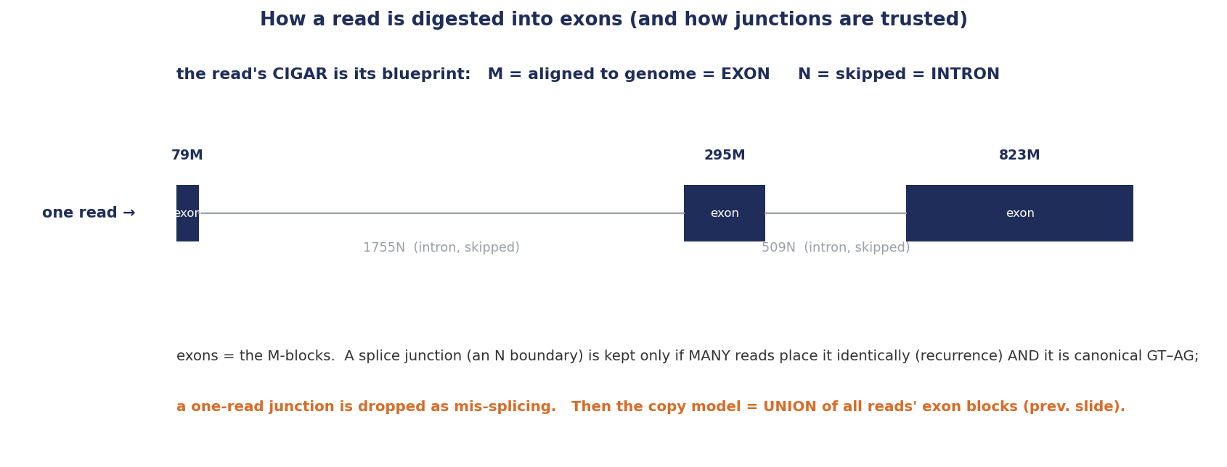
Digesting a read into exons (CIGAR → exons → union)
Each read's CIGAR marks exons (M) and introns (N); junctions are trusted by recurrence + canonical GT–AG; exons are then unioned.

