Slide 1
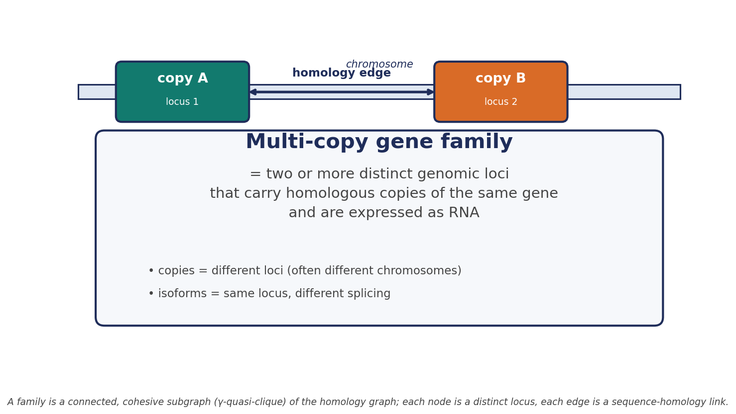
What is a multi-copy gene family?
A family is ≥2 distinct genomic loci carrying homologous, expressed copies of one gene. Copies are different loci (often on different chromosomes); isoforms are different transcripts from the same locus.

Slide 2
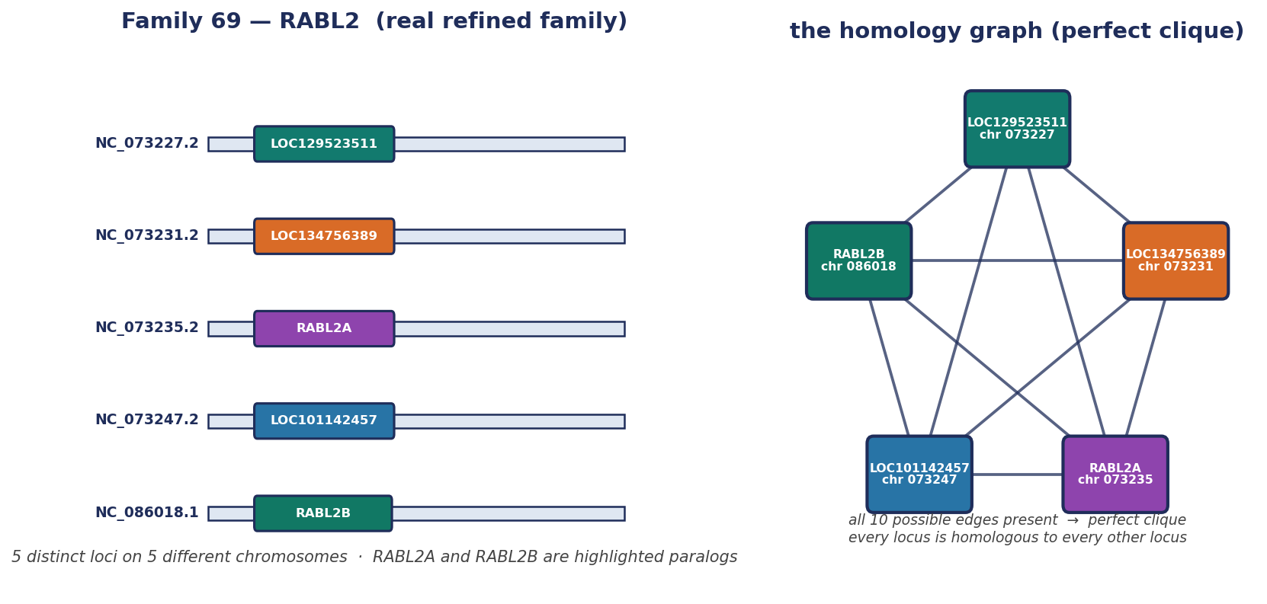
Birdseye view: a real family as a clique
Family 69 (RABL2) has five copies on five gorilla chromosomes. The homology graph is a perfect clique: every locus is linked to every other locus, so the group is one cohesive family.

Slide 3
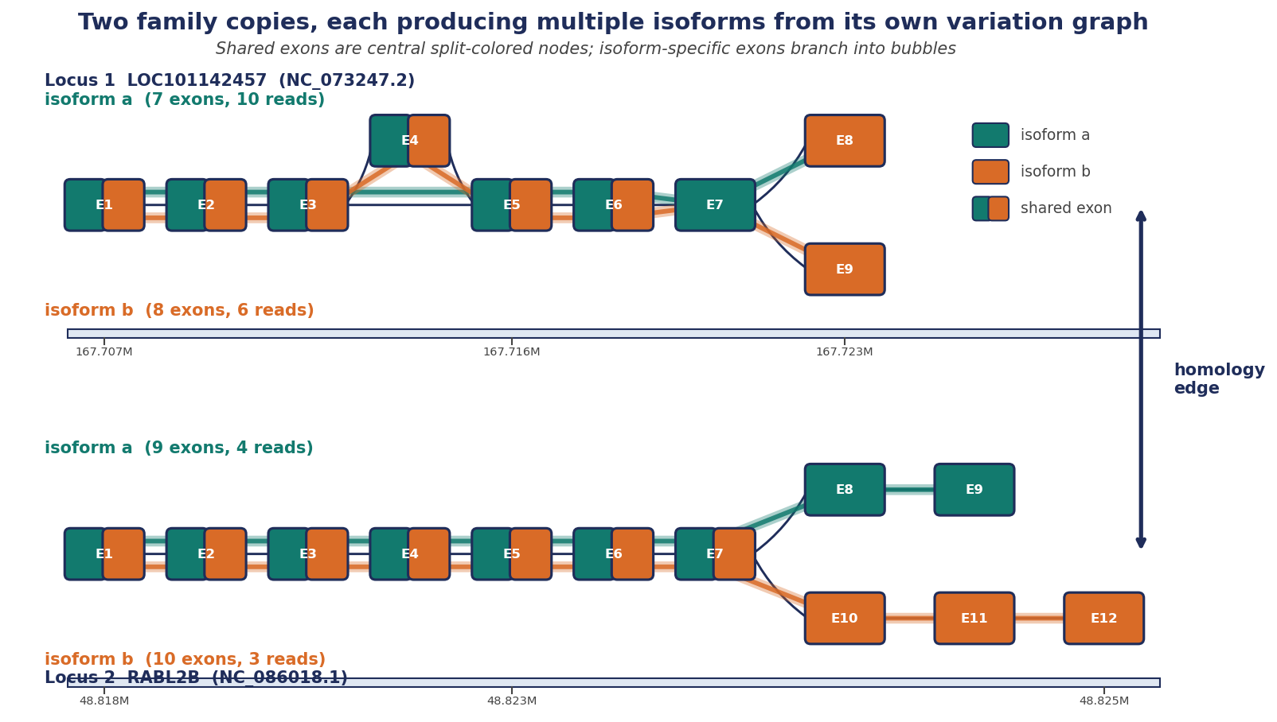
Zoom: two copies, each with multiple isoforms
Two RABL2 family copies (LOC101142457 on NC_073247.2 and RABL2B on NC_086018.1) each produce two isoforms as paths through their own variation graphs. A homology edge links the two loci; isoforms are collapsed to one locus before families are called.

Slide 4
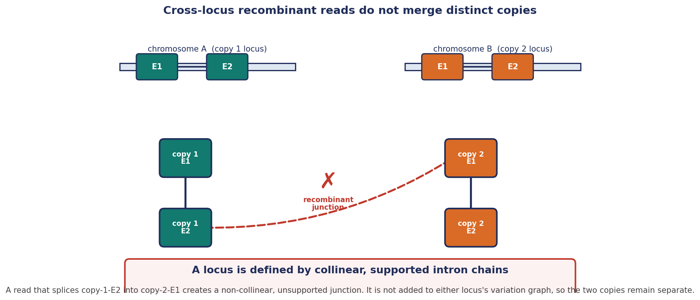
Why recombinant reads don't merge copies
Copy 1 (chromosome A) and copy 2 (chromosome B) each have E1 and E2. A spurious read that splices copy-1-E2 into copy-2-E1 forms a non-collinear, unsupported junction; it is rejected, so the two loci stay separate.

Slide 5
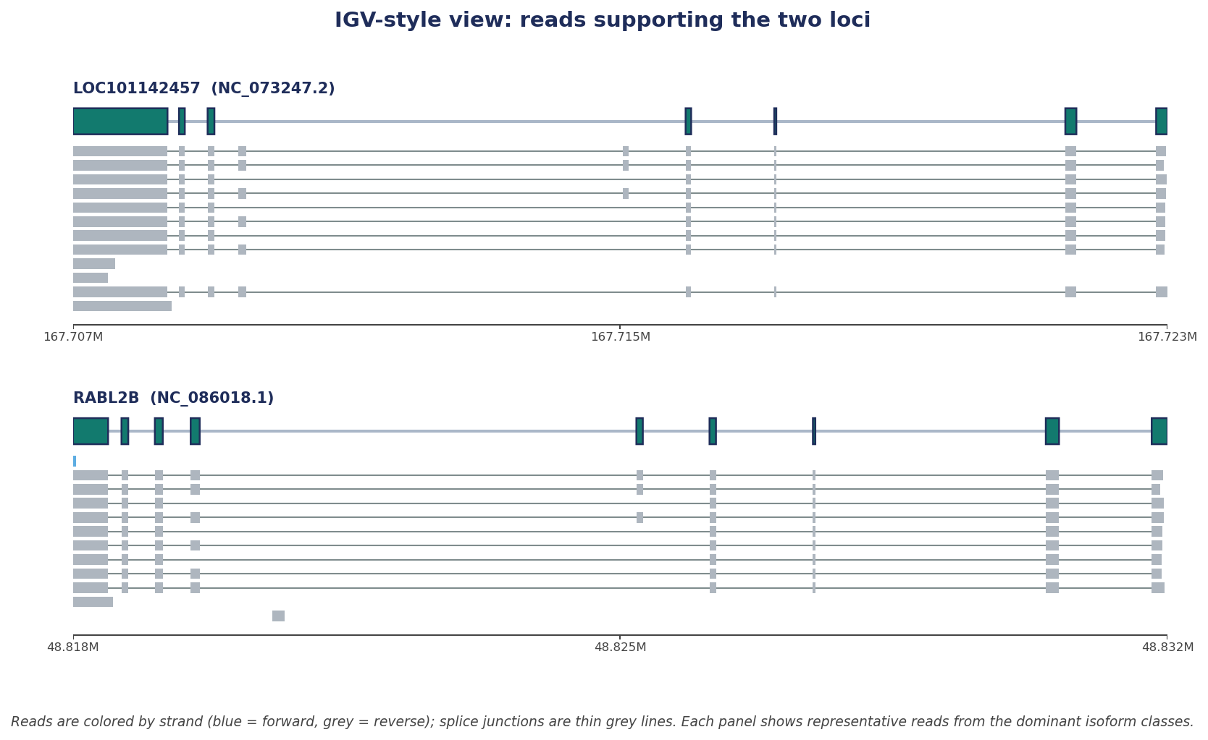
IGV-style read support for two family copies
Representative RNA-seq reads from GGO.bam over LOC101142457 (NC_073247.2) and RABL2B (NC_086018.1). Exons are teal blocks, reads are horizontal bars, and grey lines are splice junctions.

Slide 6
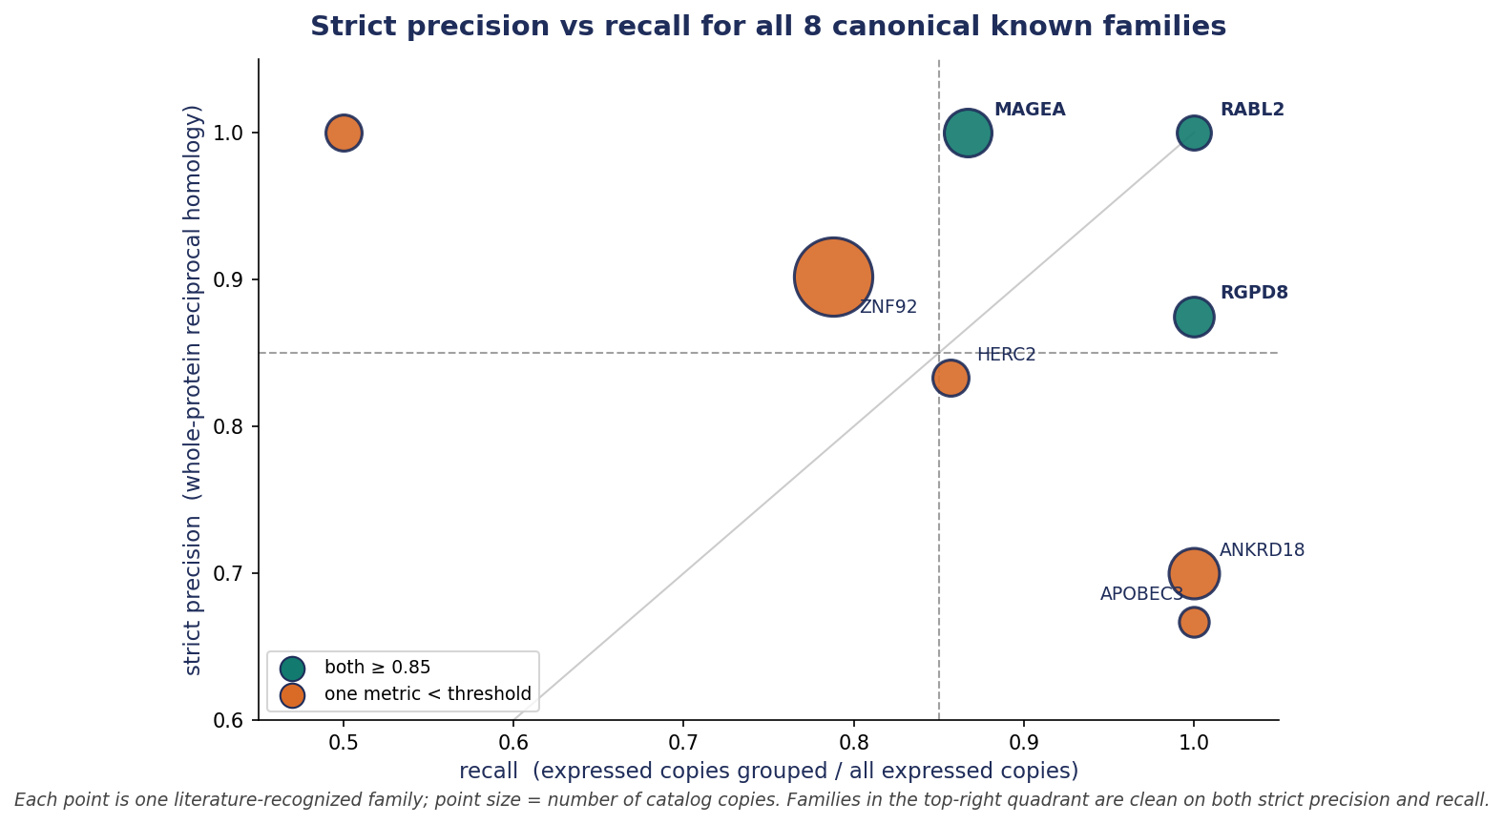
Strict precision vs recall on canonical known families
All eight literature-recognized multi-copy families from the gorilla catalog. Point size reflects copy number; teal points pass both thresholds.

Slide 7
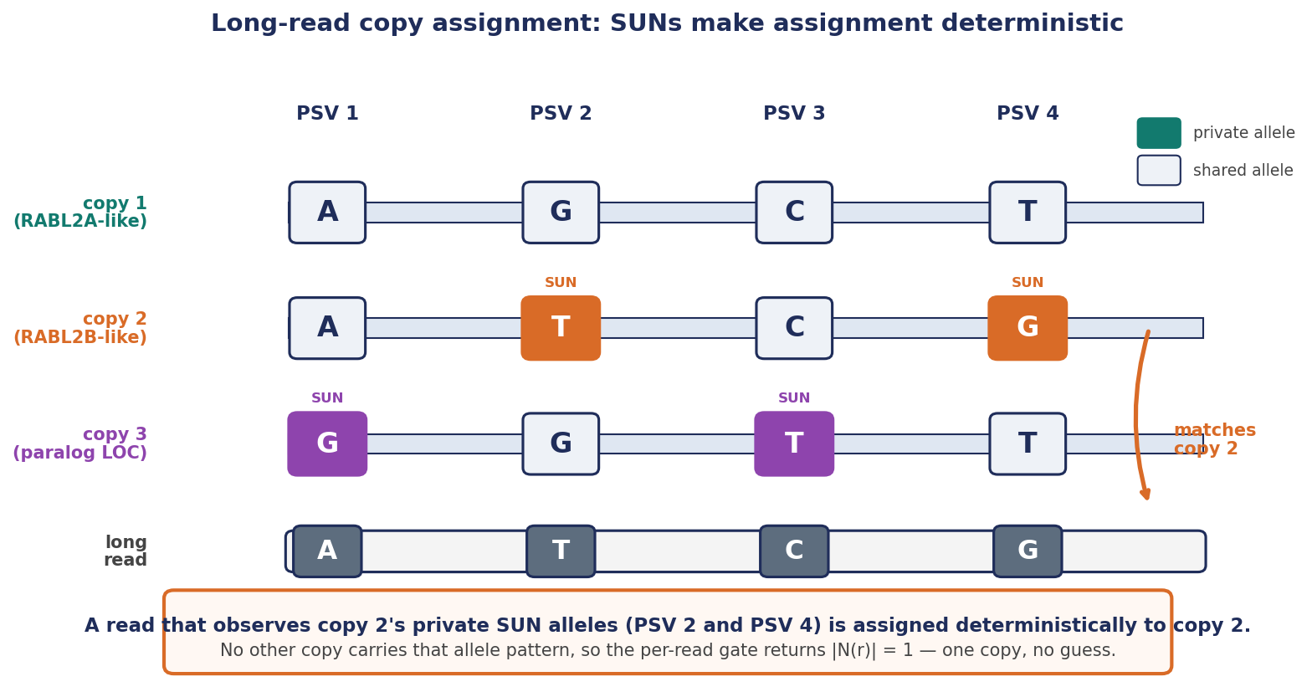
Long-read copy assignment via SUNs
Each copy carries private Singly Unique Nucleotides (SUNs). A long read spanning a SUN observes a copy-specific allele and is assigned deterministically to that copy, even when the read maps equally well to several copies overall.

Slide 8
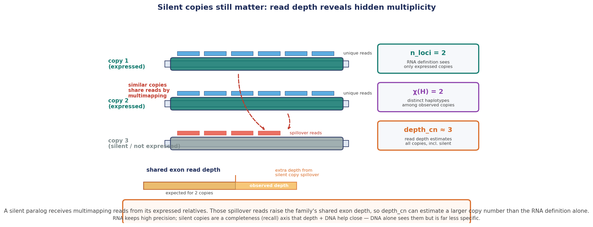
Silent copies still matter for copy-number quantification
A silent paralog is invisible to the RNA family definition, but it still receives multimapping spillover reads from expressed relatives. That extra depth raises the depth_cn estimate above χ(H) and n_loci, helping recover the true genomic copy number.

