Slide 1
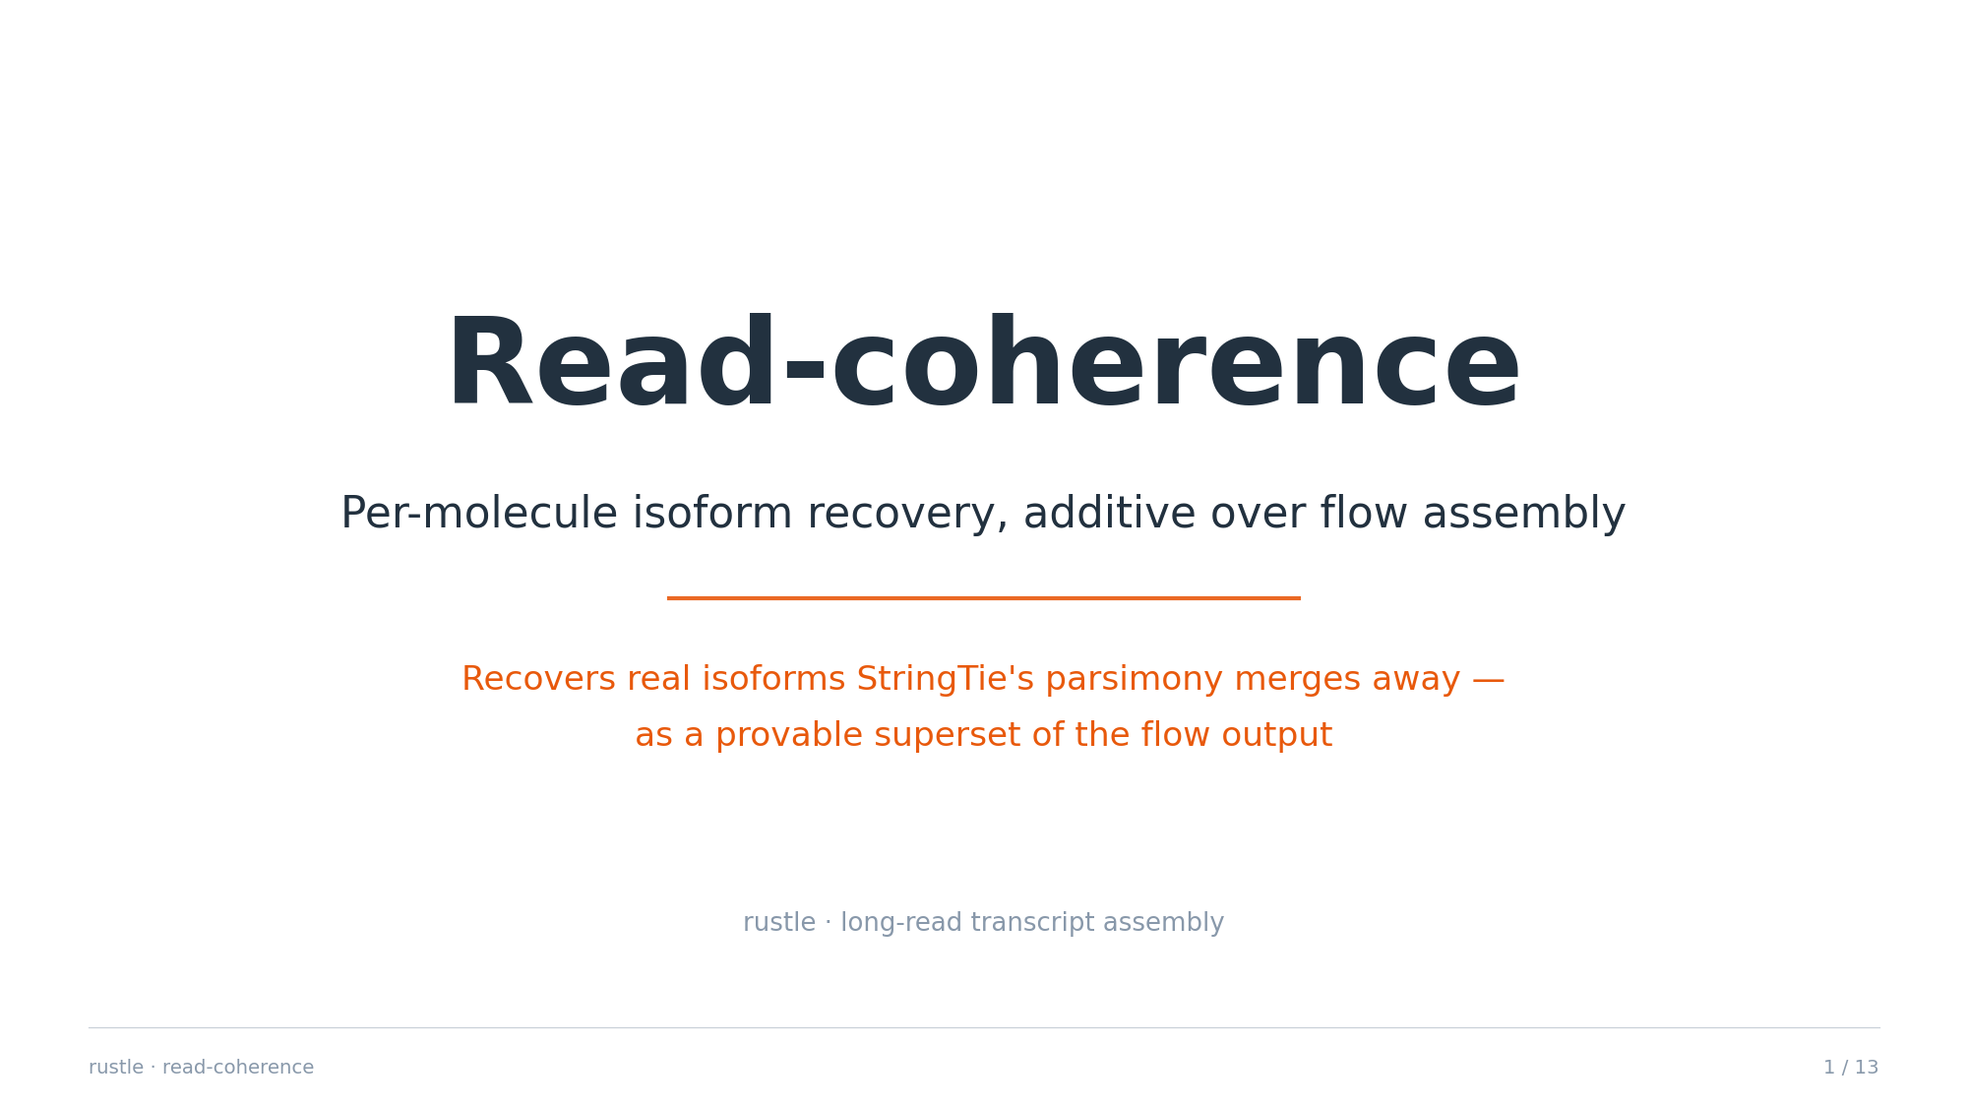

Slide 2
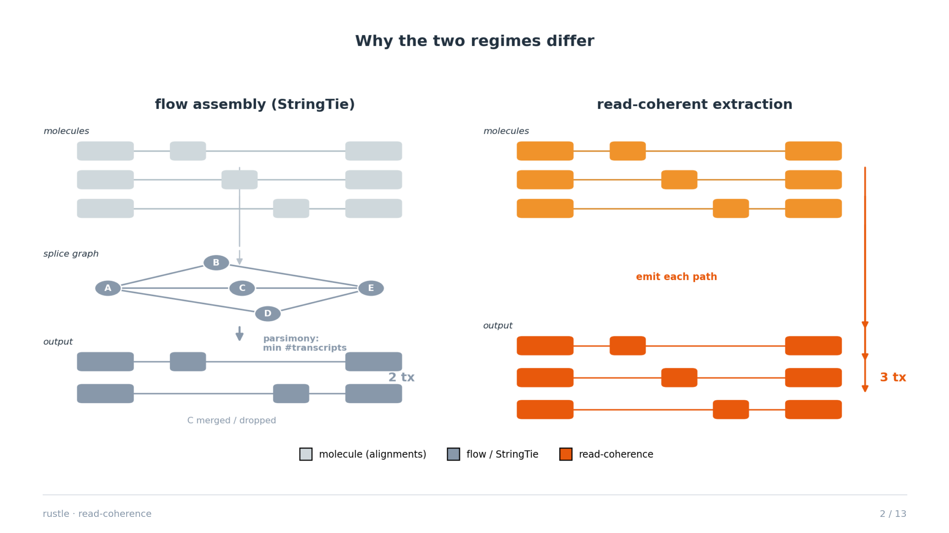
Notes:
Flow assembly builds one splice graph from all reads and picks the FEWEST paths that explain coverage (parsimony) — so real but low-abundance / overlapping isoforms get merged or dropped. Read-coherence instead emits each molecule's own spliced path.

Slide 3
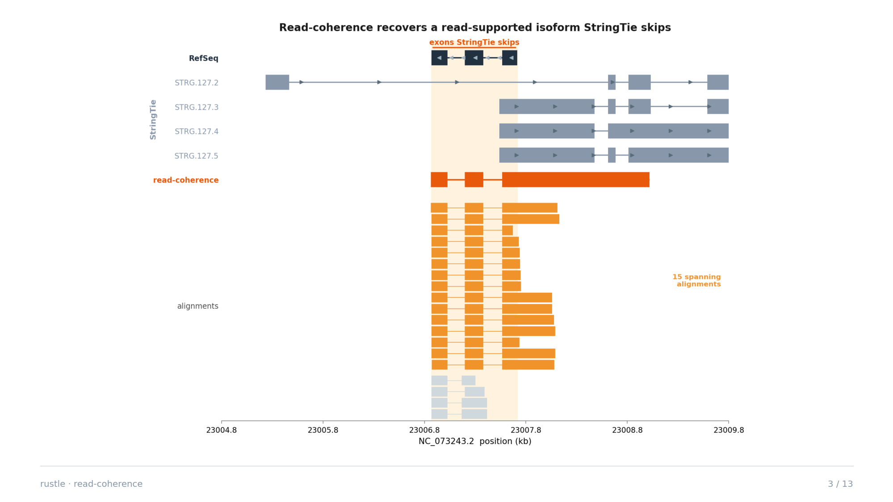
Notes:
Real chr19 locus (NC_073243.2). The four StringTie variants splice a long intron straight over the internal exons; the read-coherence isoform retains them, and 15 spanning long-read alignments are the evidence. Eyeball-verifiable in IGV.

Slide 4
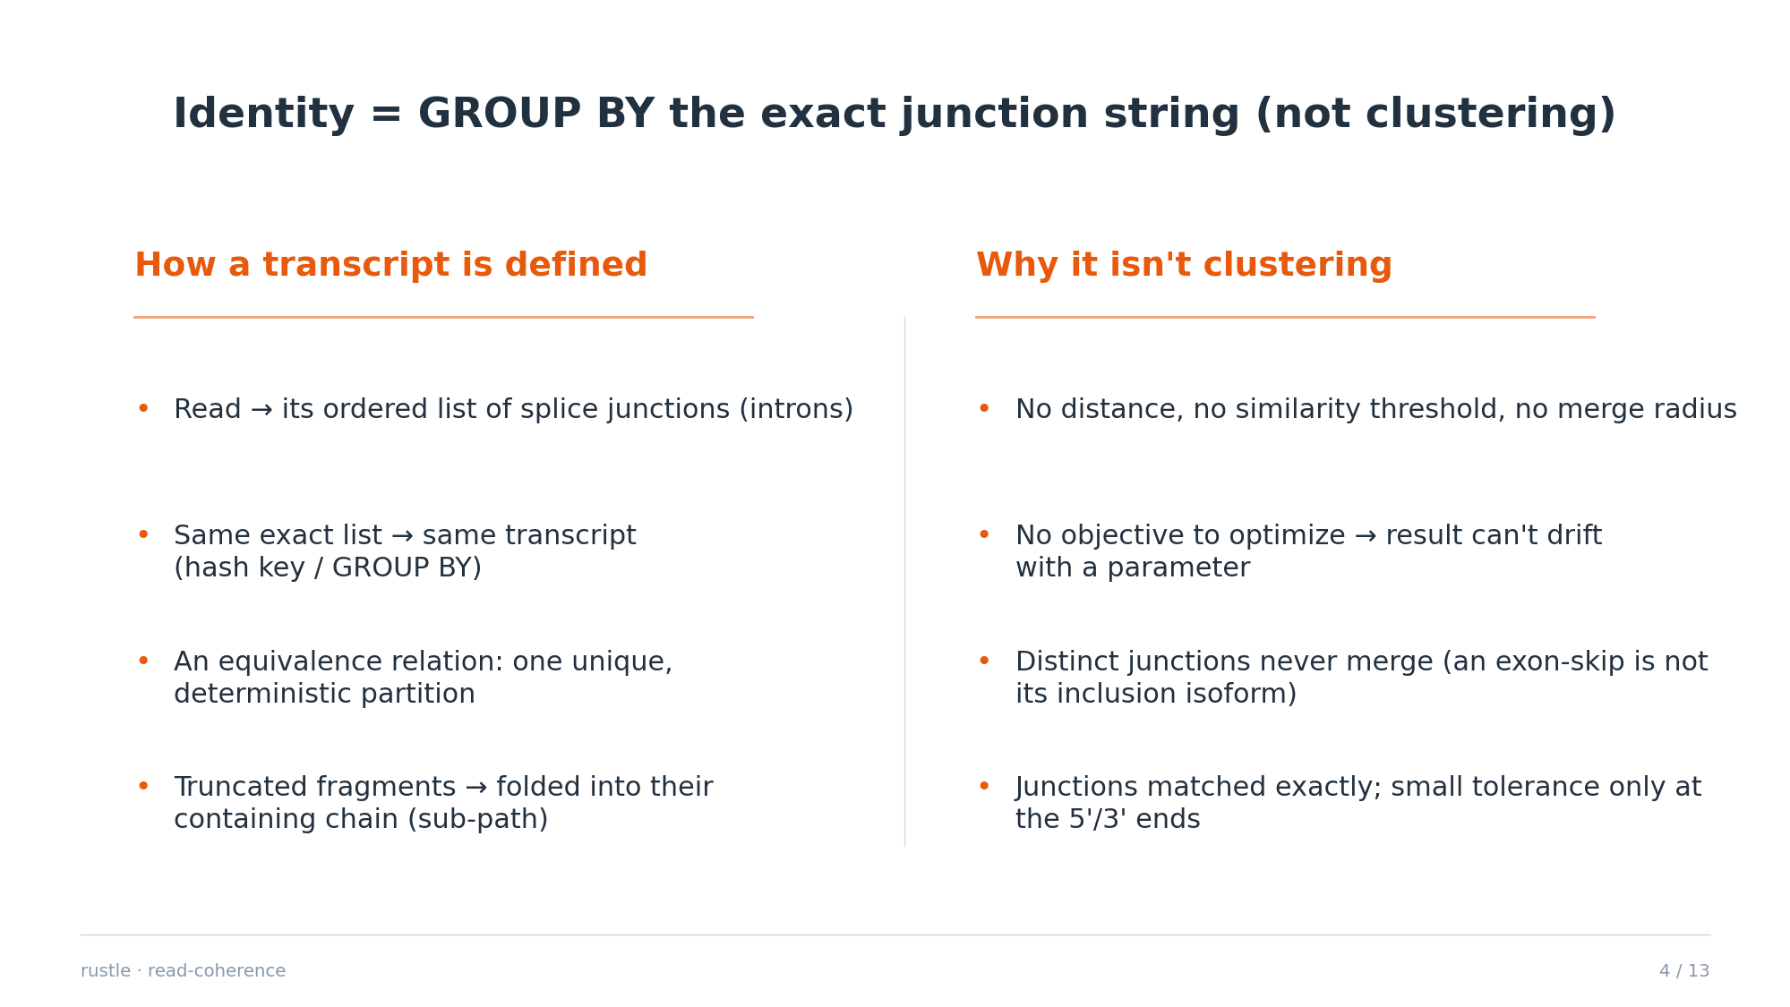
Notes:
Clustering needs a distance + threshold and can merge distinct molecules; this is a discrete equivalence on junction chains (a GROUP BY), parameter-free and deterministic. Fragment folding is sub-path containment, not similarity. Junctions are matched exactly (fuzzy-merge off by default); the only tolerance is a few bp at the ragged 5'/3' ends.

Slide 5
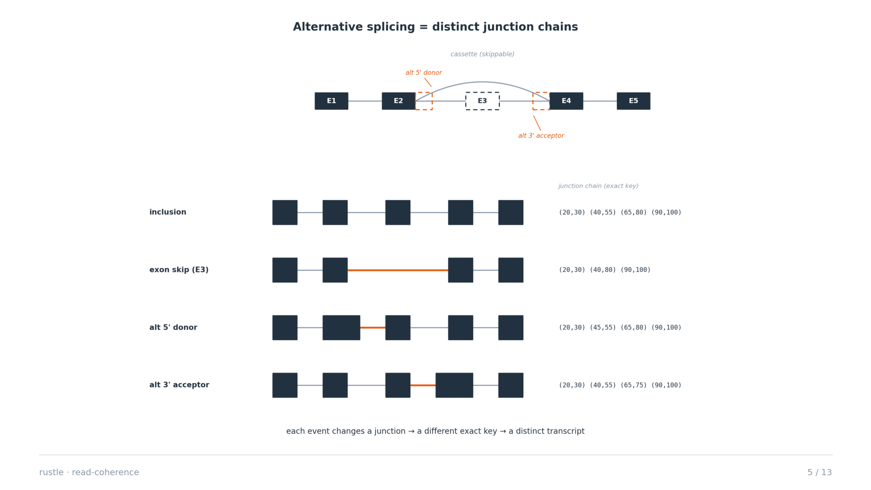
Notes:
Alternative splicing is NOT special-cased. A cassette-exon skip, an alternative 5' donor, an alternative 3' acceptor, or intron retention each change the junction list, so each is automatically a different exact key and a distinct transcript. The splice graph (the same one flow uses) represents the alternatives as branch points; read-coherence reads each molecule's realized path through it.

Slide 6
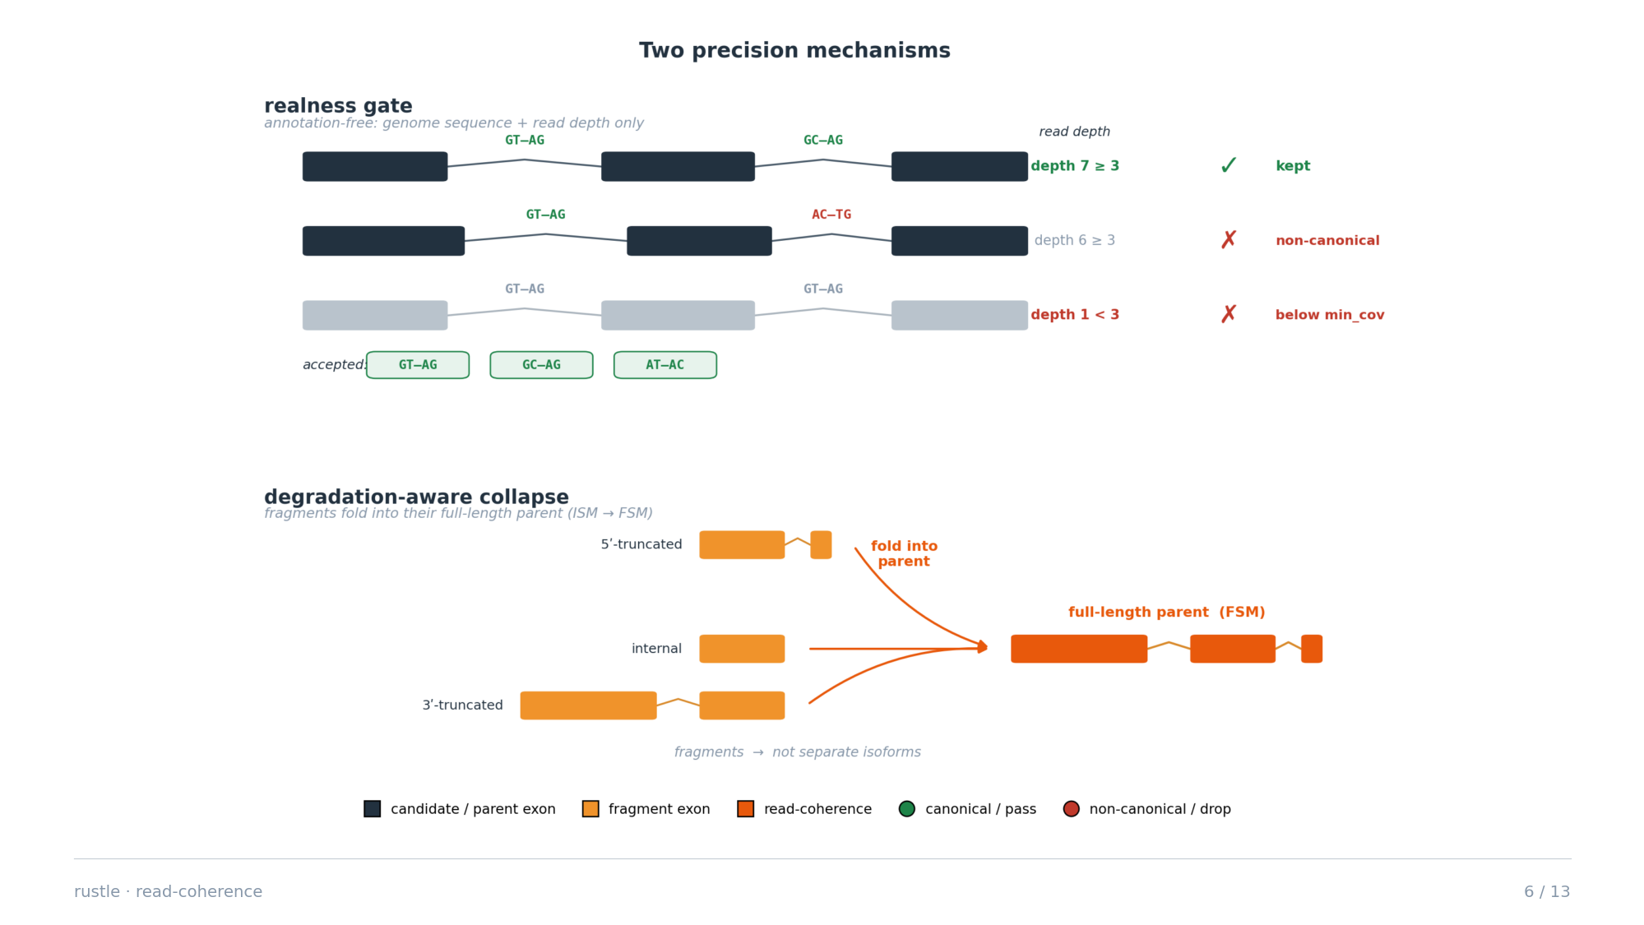
Notes:
Two precision mechanisms, both annotation-free. The realness gate keeps a read-chain isoform only if every junction is canonical, it has no RT-switch repeat signature, and read-depth >= min_cov. Degradation-aware collapse folds 5'/3'/internal fragments into their full-length parent (ISM -> FSM).

Slide 7
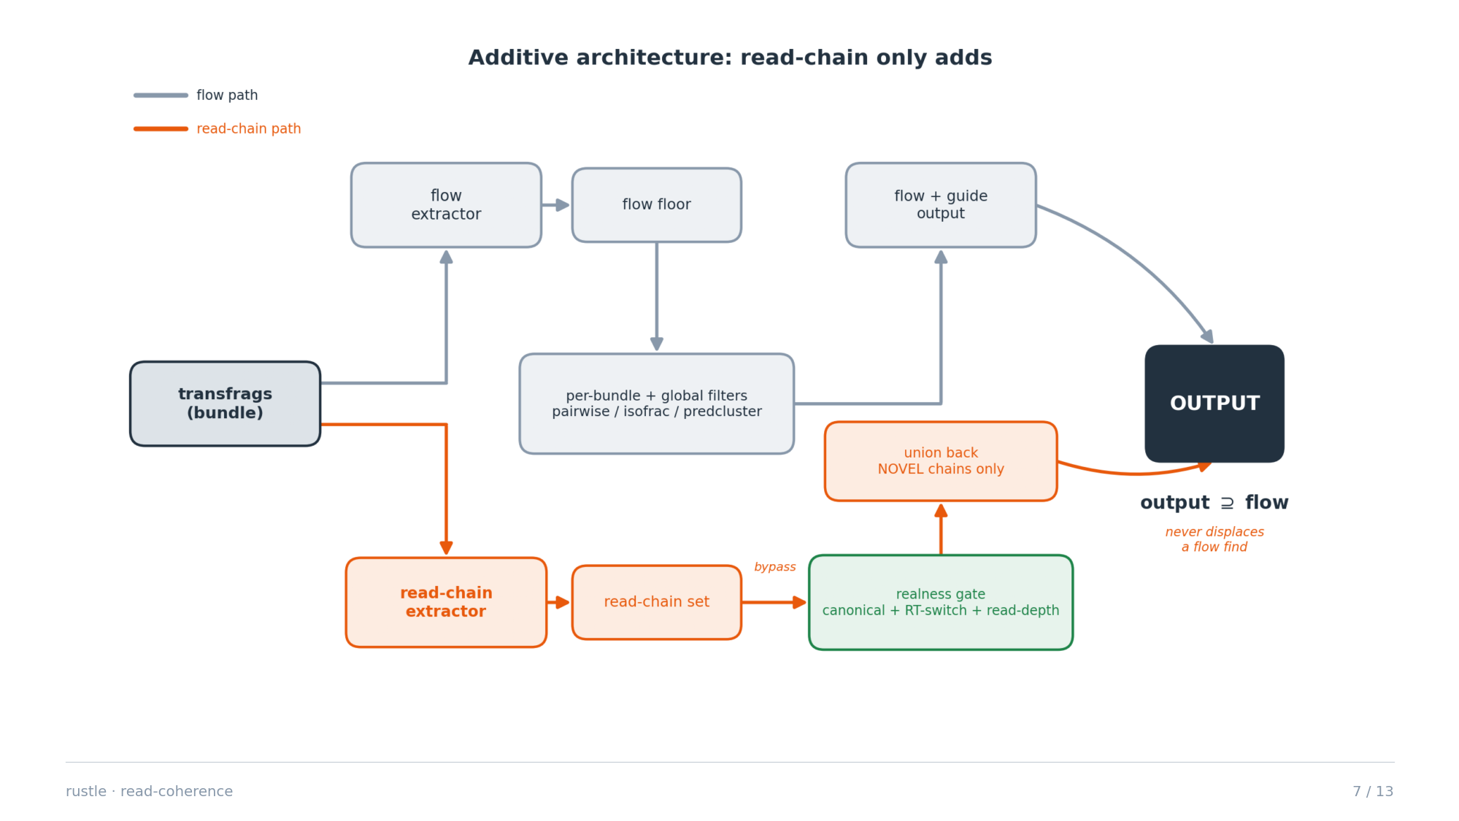
Notes:
Read-chain is held out of every per-bundle and global filter that could displace a flow transcript, then unioned back only as NOVEL intron chains and passed through the gate. So the output is a provable superset of the flow baseline: genome-wide gd\rcg = 0 and st\rcg = 0 (never loses a flow find or a StringTie guide).

Slide 8
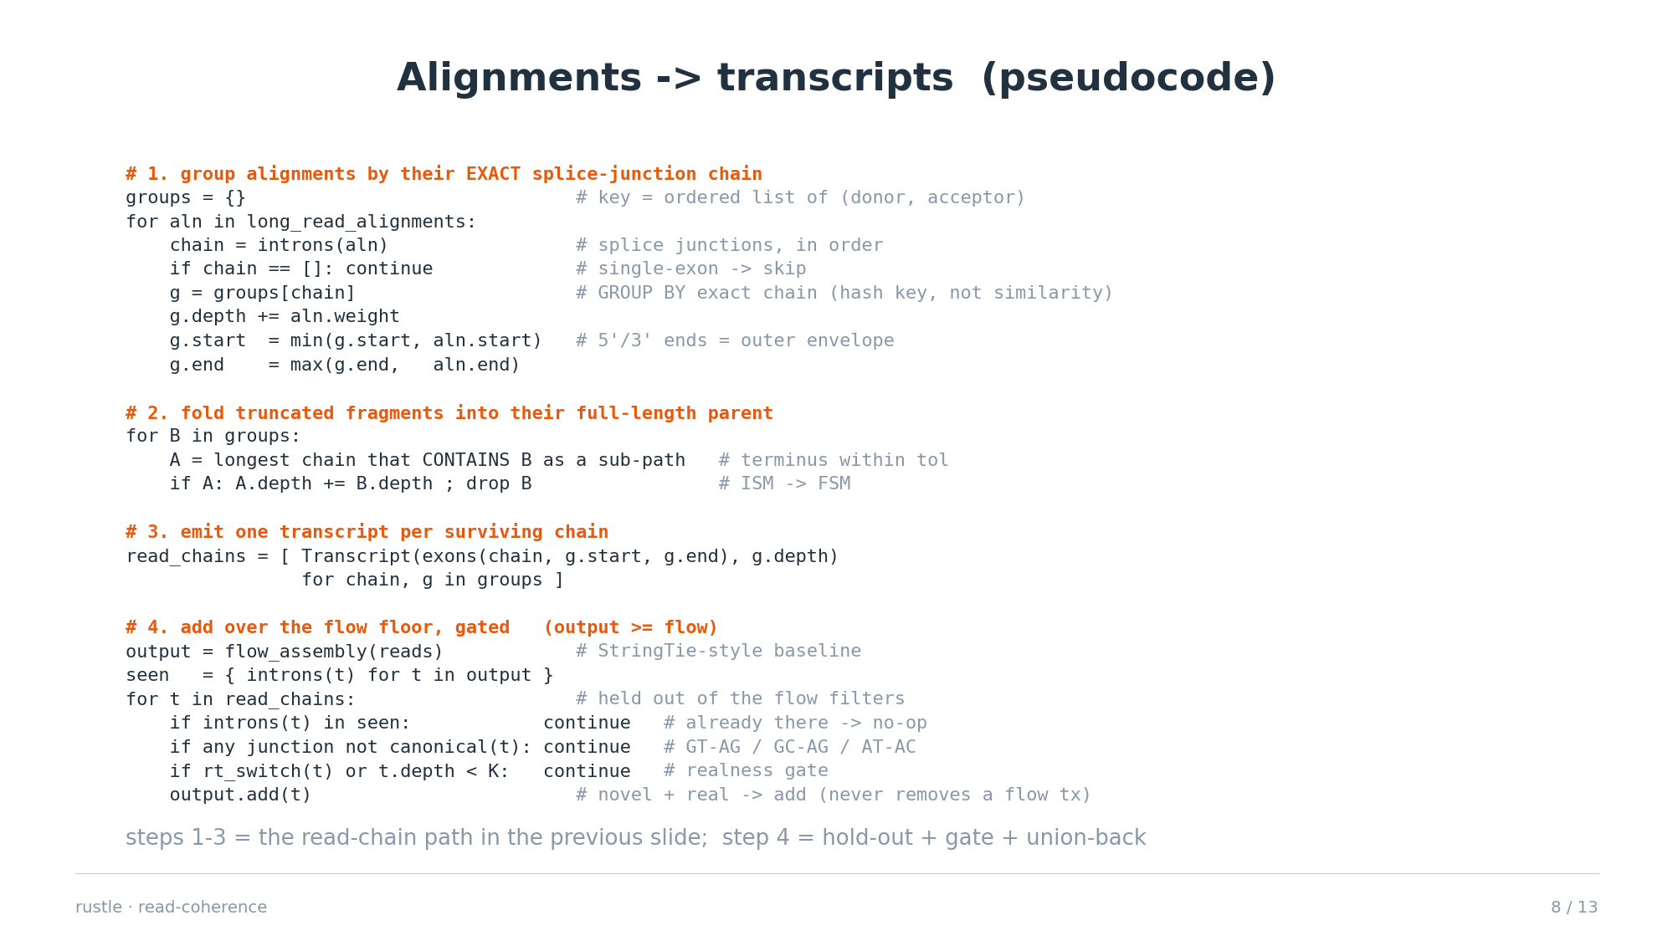
Notes:
This is figure 3 in code. Steps 1-3 are extract_transcripts_readchain: GROUP BY the exact intron chain (a hash key, an equivalence relation - not a distance/threshold), envelope the ragged 5'/3' ends, fold truncated fragments into their containing full-length chain. Step 4 is the additive merge: the flow assembly is the floor; read-chains are held out of the flow filters, then only NOVEL chains that pass the annotation-free realness gate (every junction canonical, no RT-switch, depth >= K) are added - so output is a provable superset of the flow output.

Slide 9
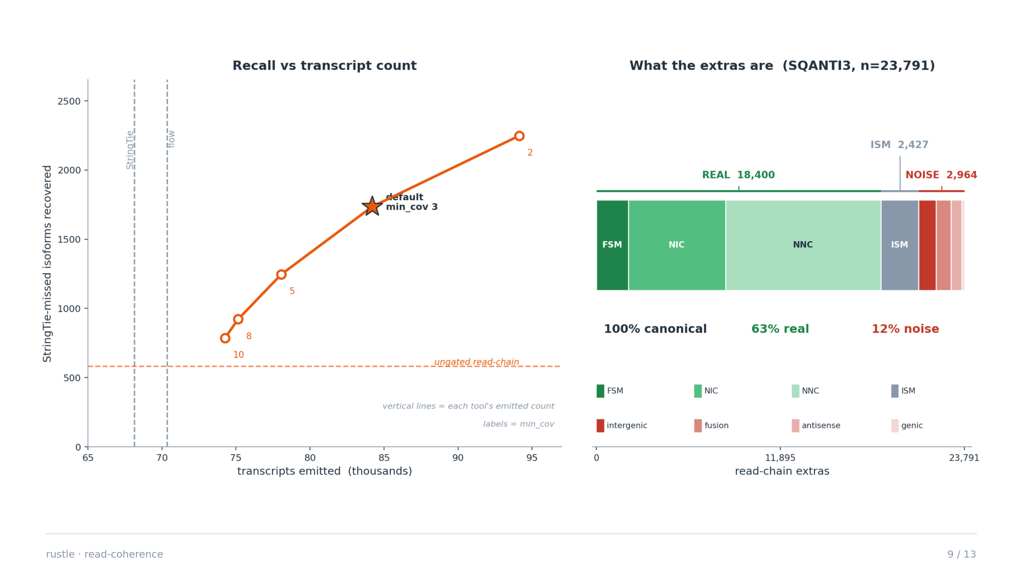
Notes:
Genome-wide (25 chromosomes). At the shipped default min_cov=3 (the precision/recall knee), read-coherence recovers +1,735 exact (FSM) annotated isoforms StringTie misses — about 3x the raw per-molecule approach. Of the gated read-chain extras: 100% canonical, 63% real, 12% noise.

Slide 10
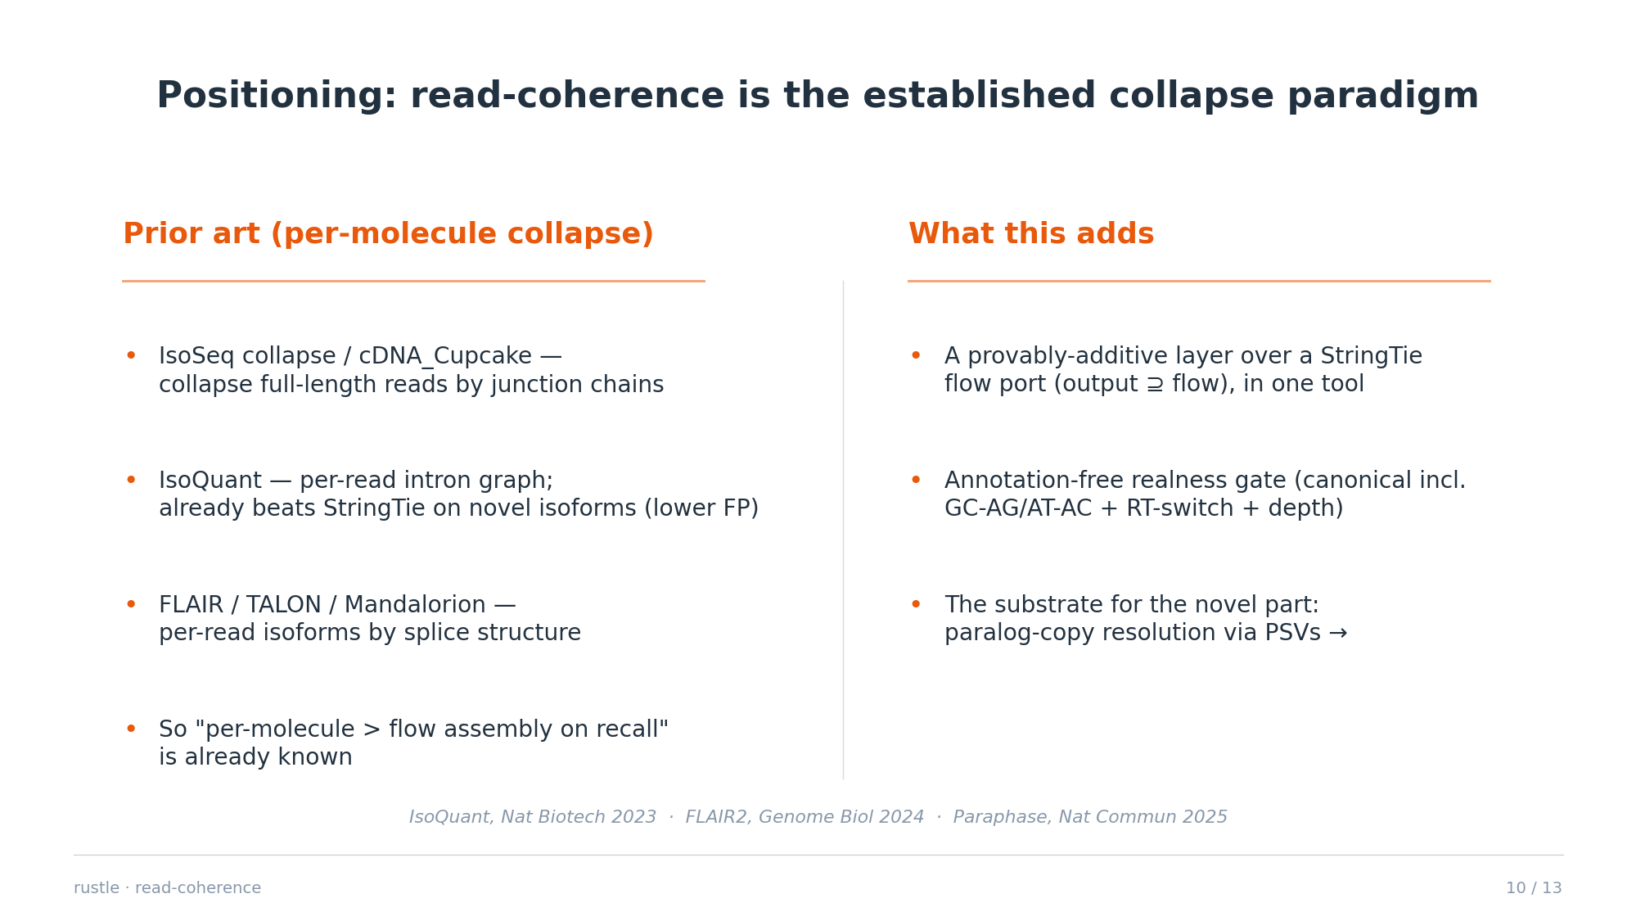
Notes:
Be upfront: grouping reads by intron chain is the standard long-read collapse (Cupcake, IsoSeq, FLAIR, TALON, IsoQuant, Mandalorion), and IsoQuant already showed per-read methods beat StringTie's graph/flow assembly on novel isoforms with lower FP. So the algorithm and the beat-StringTie result are prior art. What is ours: doing it as a provably-additive layer over a StringTie flow port (output superset of flow) in one tool, plus the annotation-free realness gate. The genuine novelty is the next slide — paralog-copy resolution via PSVs on a shared family graph.

Slide 11
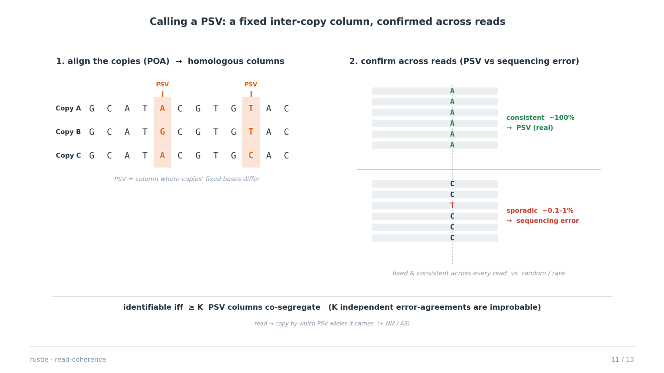
Notes:
How a PSV is determined. Homologous columns come from aligning the copies with POA (partial-order alignment, the graph generalization of Needleman-Wunsch); a column where the copies carry fixed different bases is a candidate PSV. It is accepted as real (not sequencing error or within-copy SNP) when the allele is consistent across essentially all reads of a copy and co-segregates with other PSVs; a family is declared identifiable only with >= K such columns, because K independent error-agreements are improbable at long-read error rates. Reads are then assigned to a copy by which PSV alleles they carry, plus the NM/AS gap.

Slide 12
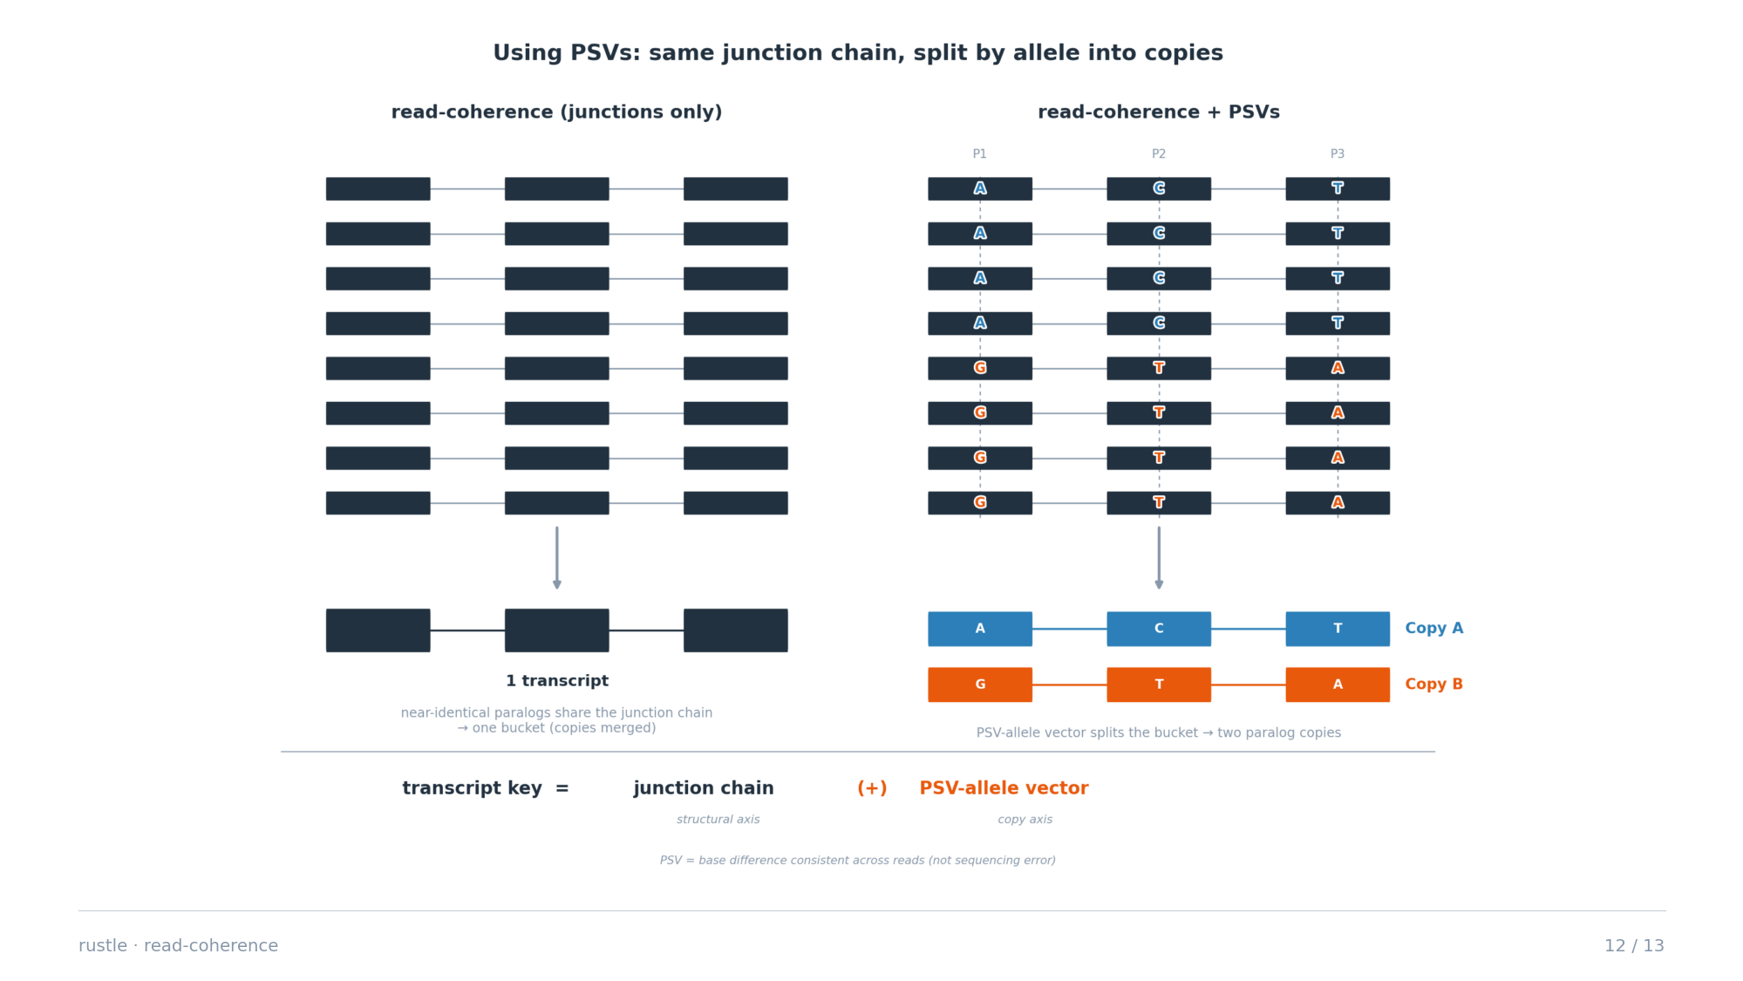
Notes:
This is the novel direction and answers 'how would you use PSVs here'. For near-identical paralog copies that share the SAME junction chain, read-coherence alone can't separate them — same key, one bucket. PSVs (paralog-sequence variants: bases that differ consistently between copies) add a second axis: among reads in that bucket, partition by their PSV-allele vector to recover the individual copies. The transcript key extends from (intron chain) to (intron chain + PSV-allele vector): junctions give the structural identity, PSVs give the copy identity, both read off the SAME molecule. Closest prior art stops short: FLAIR2 phases per-read isoforms by HAPLOTYPE (alleles of one gene), Paraphase does PSV-based paralog resolution at the DNA/gene level — neither does paralog-copy-resolved isoform assembly. Caveat: bounded by identifiability — copies separate only when reads span enough PSVs above the error floor.

Slide 13
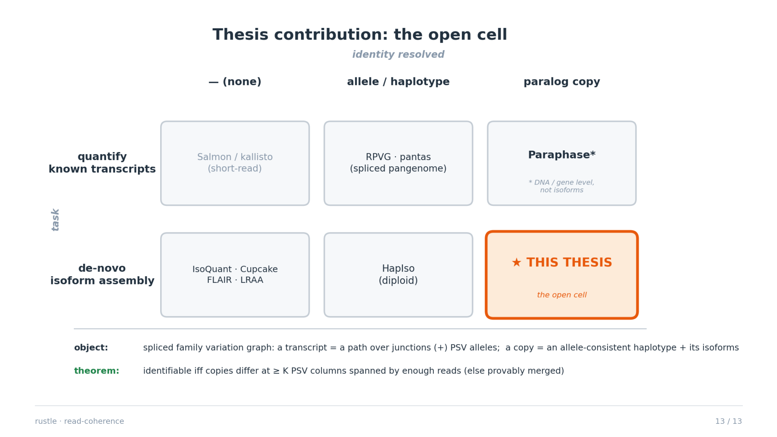
Notes:
The contribution in one slide: every existing method occupies a cell except de-novo, per-molecule isoform assembly resolved to paralog COPIES. read-coherence (per-molecule structure) plus PSVs (copy identity) on one spliced family variation graph fills it, with a provable identifiability boundary: copies are recoverable iff they differ at >= K PSV columns spanned by enough reads above the error floor; otherwise they are provably merged.

