Slide 1
The method, in punchlines
Multi-copy gene families at the RNA level — one idea per slide

Slide 2
THE PROBLEM
When gene copies are ~identical, what happens?
A read fits several copies equally, so the aligner gives up — MAPQ 0 — and the copies “collapse” into one. We define and RESOLVE these multi-copy gene families straight from the RNA reads. We are not an assembler.
Short reads recover only 0.85% of the paralog-specific variants in these regions (Soto 2025) — long reads + a per-read model are the way in.

Slide 3
O1 · WHAT IS A MULTI-COPY GENE FAMILY?
What is a multi-copy gene family — for us?
A set of mutually-homologous loci: a cohesive, dense cluster (a γ-quasi-clique) in the transcribed-homology graph, over ≥ 2 distinct loci.
The boundary is a relational homology tie — no “≥ X% identical” cutoff, annotation-free. Copy number = χ_H, the chromatic number of the read-conflict graph (Minimum Copy Cover, Lemma 1) — a lower bound.

Slide 4
O2 · COPY ASSIGNMENT
Why not Eichler's rule — assign a copy only if the best alignment beats the runner-up by ≥ 10 — or just Liftoff?
Near-identical copies never differ by that margin, so Eichler's whole-read rule resolves 0% of the COLLAPSED paralogs. Liftoff only re-places copies the assembly already has — and collapses the near-identical ones. We score the PSV columns PER READ, and assign-or-abstain with a certificate. Never 1/k.
AS ≥ 10: 0% at every K in the collapsed regime (it works fine on divergent copies — blind only sub-threshold). Scoring only the PSVs: 60% (K=1) → 100% (K≥2), 0.99–1.00 accuracy. Liftoff missed copies we recover.

Slide 5
THE ENGINE · VARIATION GRAPH
How does the variation graph “thread” the PSVs?
All copies collapse onto ONE graph: the shared backbone is the spine, the copy differences are BUBBLES (the PSVs). A copy is a consistent PATH of alleles; a read walks the graph and VOTES at each bubble it spans → assign or abstain.
A SUN — a copy's private allele — pins that copy from a single read. Multimapping reads become SHARED evidence, threaded, not divided 1/k.

Slide 6
RIGOR · IS THE PSV REAL?
How do we know a PSV is a real copy-difference, not a sequencing or alignment error?
It must survive five independent gates — an error clears none of them:
RECURRENCE
an error hits one read (prob ε); a real PSV recurs at the same column → εᵏ → 0
CALIBRATION
a per-read significance test; if it isn't significant we ABSTAIN — we don't guess (no 1/k)
LINKAGE
real copy-variants co-segregate into ONE consistent path; independent errors don't
EDITING ≠ PSV
A→I editing (A→G / T→C) is flagged and down-weighted, not counted as a copy difference
OPTIMAL ALIGNMENT
a misplaced gap invents a PHANTOM PSV — our exact banded DP aligner is provably optimal

Slide 7
O4 · REFERENCE-ABSENT COPIES
How do we find copies that aren't even in the reference?
When the reads need MORE copies than the reference hosts — χ(H) at a locus exceeds its annotated copies — the ambiguity can't be explained by what's there. That surplus IS a reference-absent copy.
The same assignment engine, turned OUTWARD: detect-and-flag. (Whether the surplus is a new copy vs an allele needs DNA.)

Slide 8
O3 · ALLELE-SPECIFIC JUNCTIONS
Does the same idea reach beyond copy number?
Yes — the SAME per-molecule threading links an ALLELE to the splice JUNCTION it uses, on ONE read. Which variant a molecule carries, and which isoform it splices to, are read off the same molecule — so there is nothing to phase, and nothing to divide 1/k. That is allele-specific splicing, straight from single reads.
A different question — cis-regulation, not copy number — from the SAME engine (a PSV bubble separates copies; an allele bubble separates haplotypes; a junction is an edge choice). Shipped: 54 strand-bias-clean links; the genome-false over-calls were checked against DNA and retracted — reported honestly.

Slide 9
WHY IT HOLDS UP
Is any of this real, or wishful thinking?
Planted sim (non-circular): identical copies → 0 invented PSVs (120/120 certified tied); real PSVs recovered. Independent DNA (Soto, Cell 2025): we AGREE on his human-specific families. Same code on HUMAN testis: it tracks the real expansions — MAGEA 2→11, TSPY 5→33 — not the gorilla numbers.
One line: a family = read-threaded paths through one PSV-bubble graph; assignment is assign-or-abstain over provable structure (χ(H) = min copies; facility location). No thresholds, no 1/k.

Slide 10
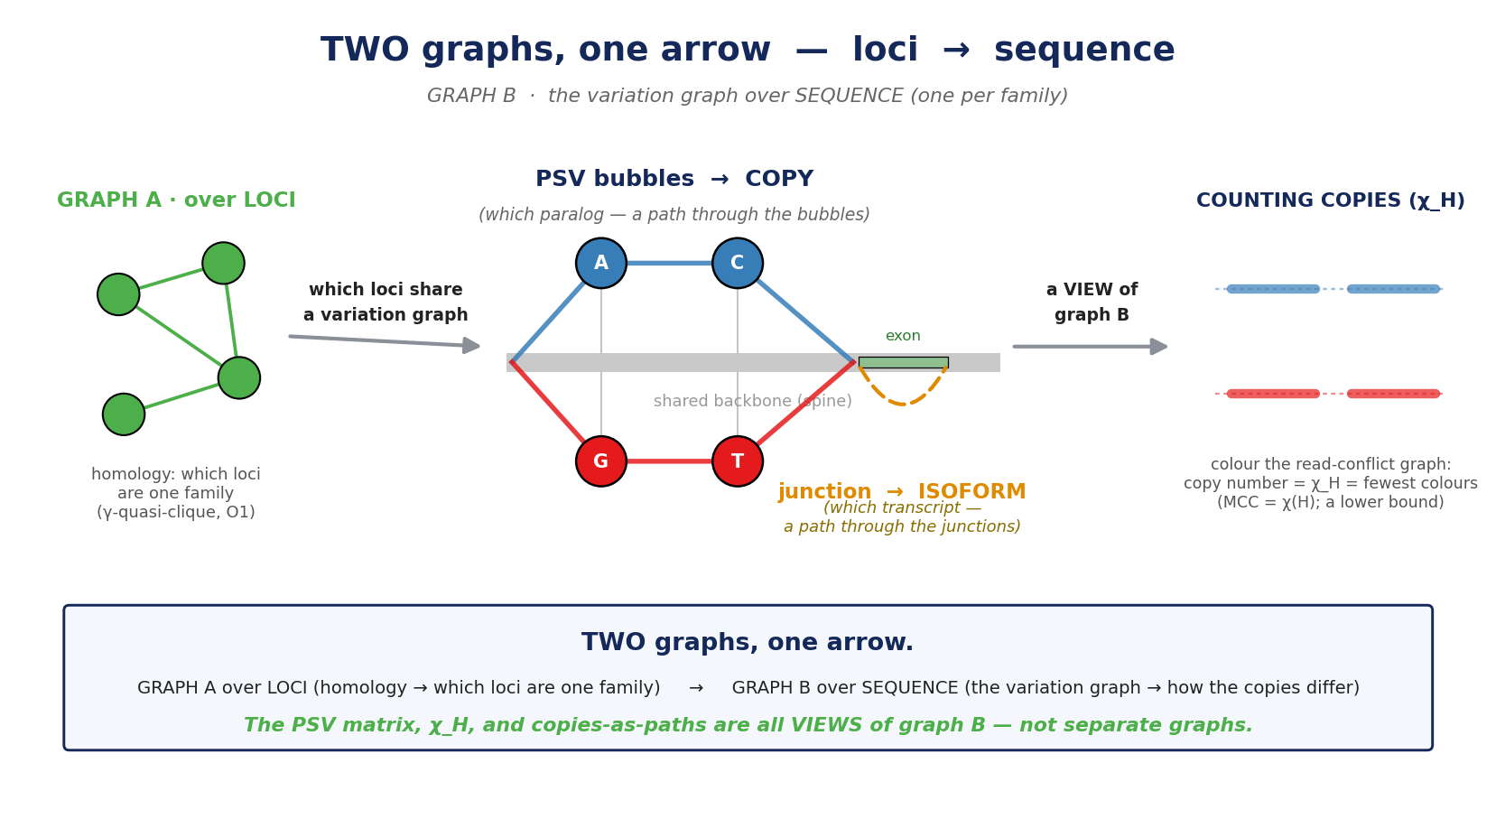
BACKUP · one framework, not four graphs
if asked how the graphs relate: they are ONE object — the variation graph — at different scopes / views

Slide 11
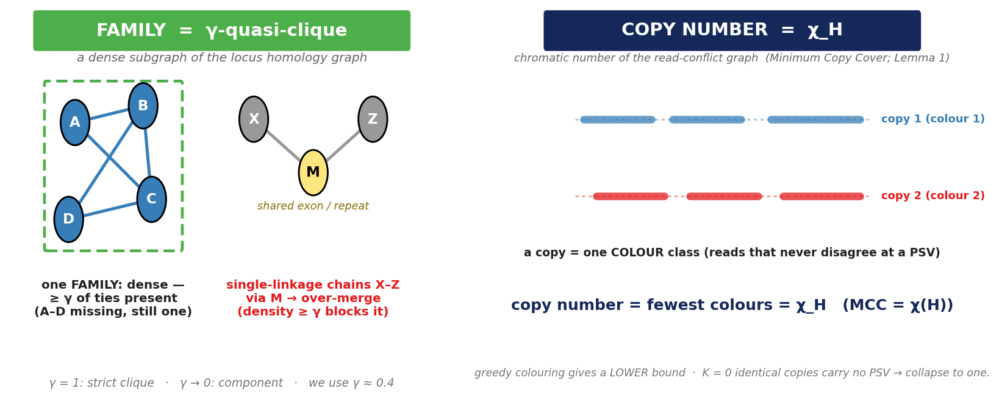
BACKUP · the two formal objects
if asked for the formalism: what exactly IS a family, and what is the copy number?
family = γ-quasi-clique (dense homology cluster — not a chain, not a strict clique) · copy number = χ(H) = fewest copies that explain the reads = min clique cover (a lower bound)

Slide 12
BACKUP · glossary (1/2) — sequence & method
THE SEQUENCE WORLD
OUR METHOD OBJECTS
copy — a genomic instance of a gene — a path through the graph
isoform — a splice variant of ONE gene — a path through the junctions
exon / intron — kept in the mRNA / spliced out
splice junction — where two exons join (a branch point)
allele — the base at a variant position
PSV — a position where copies differ (a bubble)
SUN — a PSV private to ONE copy (SUN ⊆ PSV) → one read pins it
variation graph — spine + PSV bubbles + junction branches; copies/isoforms = paths
bubble — where paths diverge — a PSV or a junction
family (O1) — a cohesive homology cluster of loci (γ-quasi-clique)
copy number χ_H — chromatic number of the read-conflict graph = Minimum Copy Cover (Lemma 1); a lower bound
assignment (O2) — which copy-path a read is on (facility location; no 1/k)
reference-absent (O4) — a copy the individual has but the assembly lacks
allele-specific jn (O3) — an allele linked to its junction on one read
K=0 floor — identical copies carry no PSV → certified TIED, not guessed

Slide 13
BACKUP · glossary (2/2) — evolution
THE EVOLUTION WORLD
paralog — two genes related by DUPLICATION (within a lineage)
ortholog — two genes related by SPECIATION (the same gene in two species)
multi-copy gene family — ≥ 2 paralogs present in one genome — the state we measure
segmental duplication (SD) — a duplicated DNA block (≥ 1 kb, high identity); SD98 = ≥ 98%
expansion — copies GAINED on a lineage vs its ancestor (needs an outgroup)
contraction — copies LOST on a lineage
pseudogene — a copy that lost function (processed = intronless retrocopy)
retrocopy / retrogene — an mRNA-derived, intronless copy
exonization — non-coding sequence (intron / Alu) becoming a new EXON
the relationships that trip people:
SUN ⊆ PSV · paralog = the relationship, multi-copy family = the state we measure, SD = the DNA mechanism, expansion = the cross-species change · copy (bubbles) vs isoform (junctions) = two axes of ONE variation graph

