Slide 1
Copies as Paths
A variation-graph framework for RNA multi-copy gene families
the shared backbone collapses · copy differences become bubbles · a multimapping read is threaded (assign-or-abstain, never 1/k)
gorilla HiFi / Iso-Seq · provable structure: χ(H) = min copy count, assignment = facility-location

Slide 2
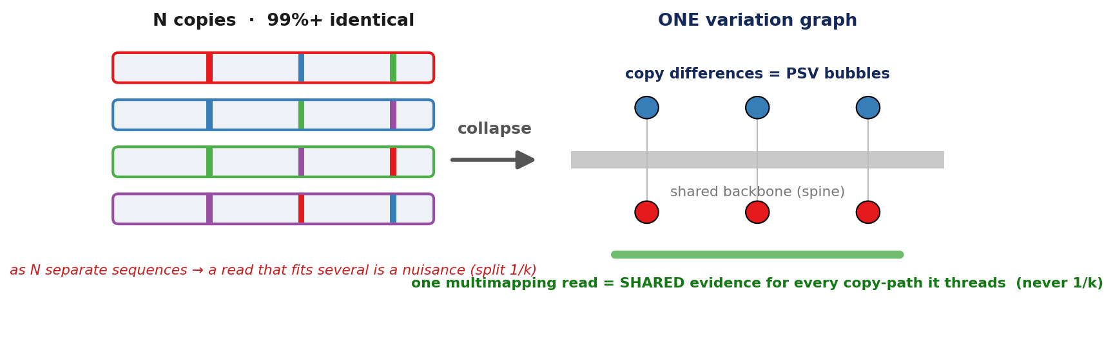
QUESTION 1
Why a variation graph — the flip on 1/k
• The flip: N near-identical copies → ONE graph. The shared backbone collapses to a spine; only copy differences survive as PSV bubbles.
• A multimapping read = shared evidence threaded through every copy-path it touches → assignment is flow-decomposition / threading, never split 1/k.
• Provable structure: min copy count = χ(H) (machine-checked); assignment = max-weight facility-location, (1−1/e)-OPT, EXACT under Strong Separation.
• The whole-read AS≥10 rule (Eichler) resolves 0% of collapsed paralogs at every K — provably blind sub-threshold; scoring only the bubbles: 60% → 100% (K≥2), acc 0.99–1.00.
Notes:
AS>=10 vs PSV-gate table: bench/VALIDATION_AND_STATUS.md F6, lines 188-205 (0% at every K; gate 60/100/100/100; div control 30/30, margin 295) — bench-doc verified; note the doc header (L106-113) flags F6 as an exhibit calibrated to the Eichler operating point. Theory: bench/copy_assignment_theory_checks.py (Lemma1), mwca_approximation_check.py (Thm6), bridge_theorem_check.py (min_p=eps^delta) — machine-checked. Do NOT claim AS>=10 == our alpha=1e-3 operating point (contradicted by the 0% vs 60-100% split); frame as a principled generalization that also works in the collapsed regime.

Slide 3
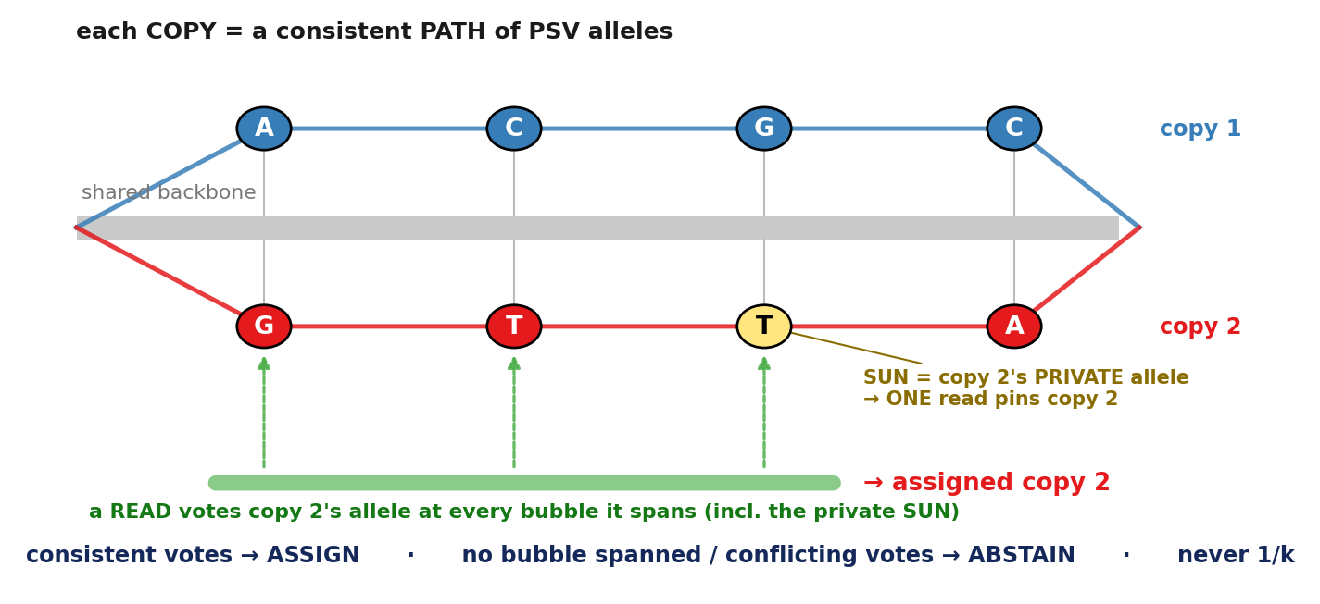
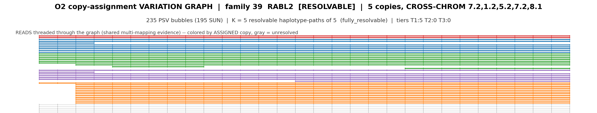
QUESTION 2
Threading — how the read keeps and uses the PSVs
• PSV = a bubble; a copy = a consistent path of alleles; a read threads the graph and VOTES at each bubble it spans → assign or abstain.
• A SUN (Sudmant 2010) is a bubble where one copy's allele is PRIVATE → a single read pins that copy (a Strong-Separation witness).
• The bubbles must be OPTIMAL or they are phantom: our exact banded DP is provably optimal (poasta was suboptimal — GSTM 1181<1331 — creating phantom PSVs).
REAL gorilla RABL2 (5 copies, cross-chrom): reads threaded, coloured by assigned copy
235 bubbles (195 SUN) · K=5 fully resolvable · 222 reads → 191 assigned, 4 ambiguous, 27 no-cover, 0 tied
Notes:
fam39/fam1/fam22 numbers verified today in /home/juanfra/winloci_scratch/o2vg/{fam39,fam1,fam22}.json (RABL2 assigned 191/no_cover 27/amb 4; RGPD8 0 bubbles/2075 no_cover; ANKRD18 61 bubbles/50 SUN/K4, 77 assigned/613 no_cover/127 amb). Use 191/27/4 — the '123 assigned / 68 recombinant' split is a render-time re-split and is in NO committed file. DP cost audit + byte-identical claim: bench/KNOWN_FAMILY_REGRESSION.md L113-123 (bench-doc). DP-vs-poasta 0 diffs: verified today by diffing /home/juanfra/winloci_scratch/sim_*_dp vs sim_*_po assignments cols 3-4. SUN grounding: memory reference_sudmant_2010_sun.md. Report ANKRD18's full ledger (77/127/613) as the abstain feature; the 75% no-cover is a coverage effect (long backbone copy), kept categorically distinct from a tie.

Slide 4
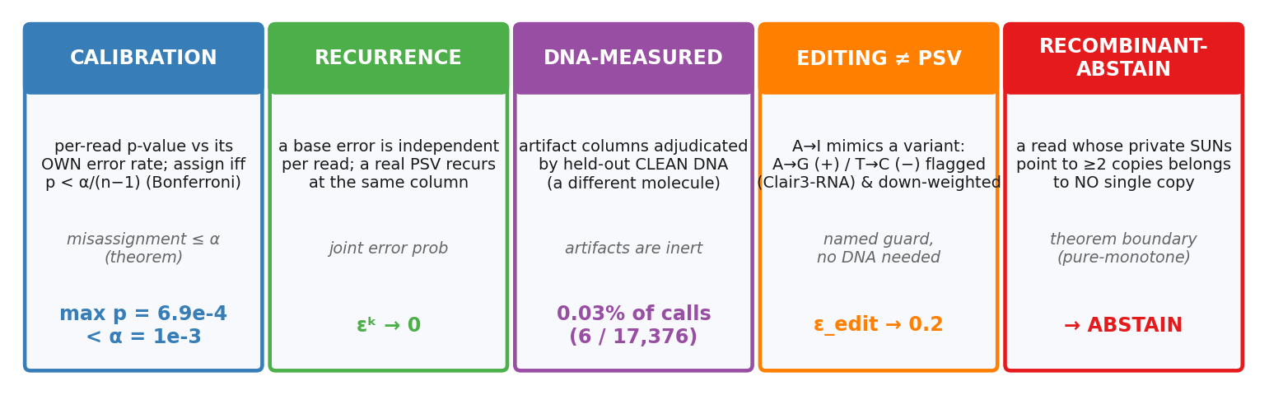
QUESTION 3
Is the PSV real, or an error / artifact?
Every distinguishing PSV must survive five independent checks — each a named test or a theorem boundary, not a tuned filter:
The load-bearing output is the min_p = 1.0 certificate that NAMES the unresolvable reads (30,620 of 30,806 tied rows) instead of guessing them.
Notes:
Calibration verified today in /home/juanfra/winloci_scratch/o2_definitive.assignments.tsv (max assigned p_value=0.0006869; 30,620/30,806 tied rows min_p_value>=1.0). Recurrence: bench/make_slides.py L234 + memory reference_isocon_sahlin.md. DNA align-error 0.03%: bench/VALIDATION_AND_STATUS.md L1623-1636 (bench-doc; from pre-verified evidence, not re-grepped this session — flag if pressed). Editing: memory reference_clair3_rna.md + project_significance_gate.md L40-50 (mechanism adopted; inert-on-clean shown, gorilla recall is future work — do NOT cite Clair3's 5,677/2,549 HG004 counts as our result). DROP the make_slides bullet 'errors don't co-segregate' — retracted; present linkage ONLY as the recombinant-abstain theorem-boundary (pure-monotone, bench-verified in VG_READ_PATH_RECOMBINATION.md).

Slide 5
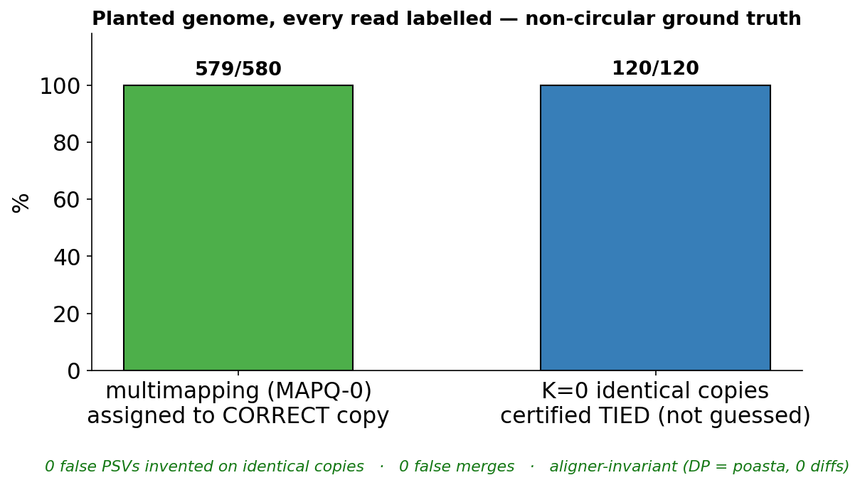
PROOF
Proof it is real — RNA-internal vs DNA-independent, kept separate
• RNA-internal, planted (labels non-circular): identical copies → 0 invented PSVs, 120/120 certified TIED; multimapping regime 579/580 = 99.8% to the correct copy.
• Held-out PSVs (non-circular in the columns): assign on half a read's PSVs, the UNUSED half re-picks the same copy 80% — up to 6.4× the 1/K chance.
• DNA-independent (non-circular in the molecule): held-out DNA columns confirm 97.2% (2.2×; K≥3 3.9×); 62% of families are ≥98% DNA segmental duplications (SEDEF).
• Real annotated families recovered exactly: GSTM 3, MAGEA 2, DAZ 2, RBMY 6, TSPY 5, PCDHB 5; single-copy controls EEF1A1 / SRGAP2 → 0.
Two non-circular axes: RNA-internal (planted read-of-origin; held-out columns the call never saw) · DNA-independent (a different molecule). Neither uses minimap2-primary 'silver'.
Notes:
Verified today in /home/juanfra/winloci_scratch: sim_K0tandem_dp.assignments.tsv (360/360 tied, min_p=1.0) vs simgw_truth.tsv (K0tandem div=0.0); sim_ladder_dp.assignments.tsv (4 copies x160 assigned, div 0-0.015). Held-out-PSV 80%/6.4x: bench/VALIDATION_AND_STATUS.md L371-379 (sim5x). DNA 97.2%/2.2x, K>=3 3.9x: same doc L318-319, explicitly 'confirmation NOT accuracy'. SEDEF 62.1%: bench/CROSSMODAL_VALIDATION.md L41 (catalog = --homology-primary --min-identity 0.98; name it, note it is a sibling of the conflict-graph catalog; use 62.1%, NOT the brief's 73%). Regression counts verified today in reg_*_dp.quant.tsv. DELIBERATELY NOT USED: the bench-doc 460/460 and 'collapse 200/200' — the CURRENT collapse plant over-merges (see slide 5), so I cite only data-file-verified sim legs.

Slide 6
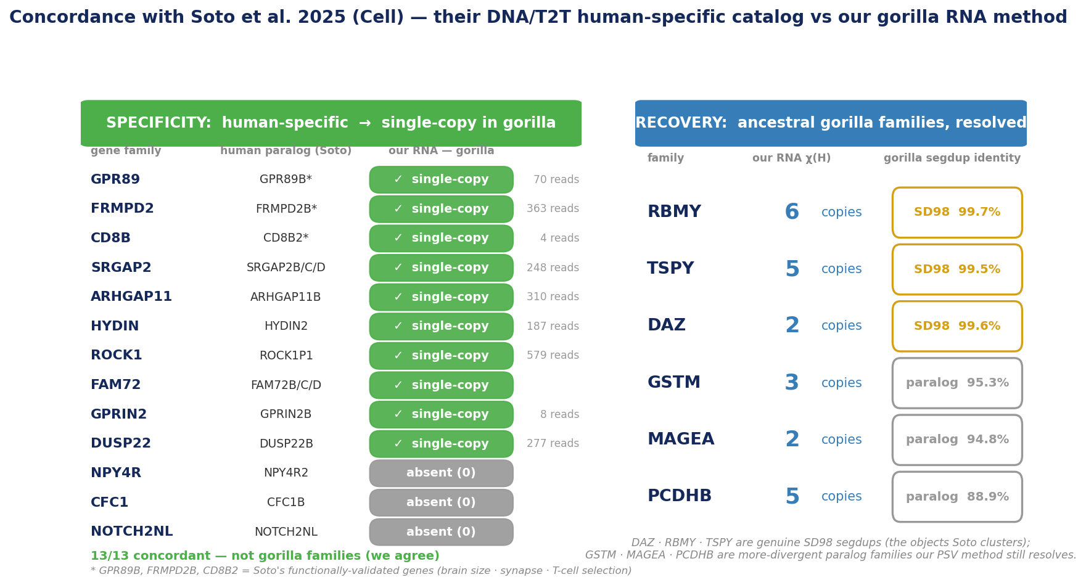
SOTO et al. 2025, Cell
External anchor — concordance with an independent DNA catalog
• Independent, cross-lab, cross-modal: Soto et al. (Cell 2025, Dennis lab) cataloged human gene-family expansions from DNA / T2T long-read assemblies — different lab, different molecule, no shared aligner or silver standard.
• SPECIFICITY — on Soto's 13 human-specific families, our RNA method calls single-copy / absent in gorilla, on EXPRESSED loci (4–579 reads): 13/13 concordant, 0 fabricated expansions.
• RECOVERY — ancestral gorilla families resolved at concordant copy number; DAZ / RBMY / TSPY are genuine SD98 (≥98%) segdups — the exact objects Soto's pipeline clusters.
• Honest scope: his per-family gorilla CN is not public → this is gene-set concordance, not a CN correlation; his families are human-specific by construction, so the correct test is specificity + recovery — both pass.
Notes:
Soto DC et al., Cell 188(19):5363-5383 (2025), doi 10.1016/j.cell.2025.06.037; bioRxiv 10.1101/2024.09.26.615256; data mydennislab/HSD_brain_evolution, Zenodo 10.5281/zenodo.15486469 (retrieved via PubMed). SPECIFICITY (soto_specificity.sh on GGO_mm.bam): 9 present human-specific loci return 0 multi-copy families with reads present (SRGAP2 248, ARHGAP11A 310, FRMPD2 363, GPR89A 70, GPRIN2 8, HYDIN 187, ROCK1 579, CD8B 4, DUSP22 277 primary reads); NPY4R/CFC1/NOTCH2NL absent in GGO_genomic.gff. RECOVERY chi(H) from reg_*_dp this session. SD98 = max SEDEF final.bed fracMatch (col 21) of a segdup overlapping the locus: DAZ 99.63, RBMY 99.74, TSPY 99.45 (>=98, Soto clusters); GSTM 95.29, MAGEA 94.85, PCDHB 88.86 (below SD98, more divergent). Soto's per-family gorilla CN is on the authors' internal share, not public, so this is gene-set concordance, not a CN correlation. Full record: bench/SOTO_CONCORDANCE.md.

Slide 7
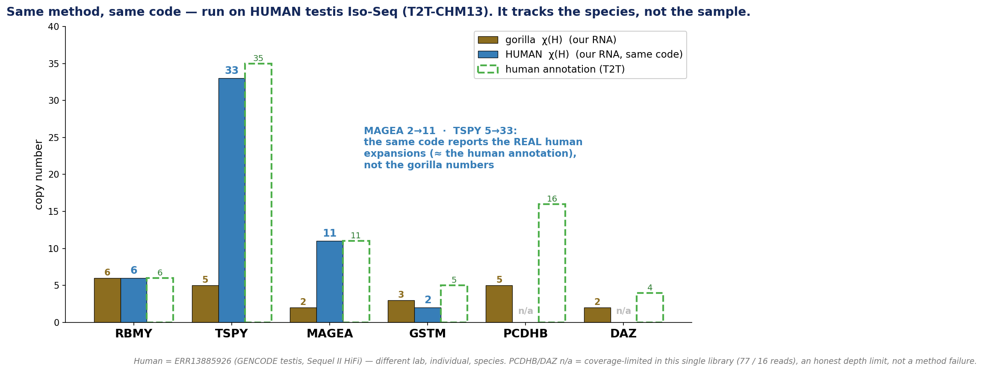
CROSS-SPECIES
Not overfit — the identical method on HUMAN data
• The 'overfit to gorilla / to this sample?' objection, answered directly: the IDENTICAL binary + recipe (-N 50 --secondary=yes) on a HUMAN testis Iso-Seq (ERR13885926, GENCODE, Sequel II HiFi) → T2T-CHM13 — different lab, individual, species.
• It tracks SPECIES-SPECIFIC copy number: MAGEA 2→11, TSPY 5→33 — the REAL human expansions (≈ the human annotation), not the gorilla numbers; RBMY concordant (6 = 6). Overfitting could not produce this.
• Every recovered copy lands on an annotated human paralog (MAGEA1–12, RBMY1B/D/E/J/F, the TSPY array); MAGEA even split the adjacent CSAG family off correctly — real families, not mis-chains.
• Honest: PCDHB / DAZ coverage-limited in this one library (77 / 16 reads); the near-identical human-specific duplicates (SRGAP2C, ARHGAP11B) sit at the K=0 frontier — the same limits we already disclose, not new ones.
Notes:
Human = ERR13885926 (ENA), human testis full-length cDNA, GENCODE, PacBio Sequel II HiFi; 1,233,001 reads, median 888bp. Reference T2T-CHM13v2.0 (chm13v2.0.fa, complete chrY). Aligned minimap2 -ax splice:hq --eqx -Y -N 50 -p 0.1 --secondary=yes -> 96% mapped (1,179,288 primary; 7,942,153 secondary). copy_assign --min-copies 2 --skip-poa-diagnostic --homology-primary (same flags as gorilla), foreground/serial (human_families.sh). Human chi(H): RBMY 6 (RBMY1B/A1/D/E/J/F), TSPY 33 (~35 array, TSPY2/3/4/8/9/10 + LOCs), MAGEA 11 (MAGEA1-12; CSAG split off), GSTM 2 (GSTM2/5 expressed). PCDHB/DAZ coverage-limited (77/16 reads). Copy coords verified to overlap annotated genes. Tightest control (not yet run): Makova PRJNA911852 has matched human+gorilla testis Iso-Seq (SRR22838397.. / SRR22838403..) but as Sequel subreads (need CCS). Full record: bench/HUMAN_CROSSSPECIES.md.

Slide 8
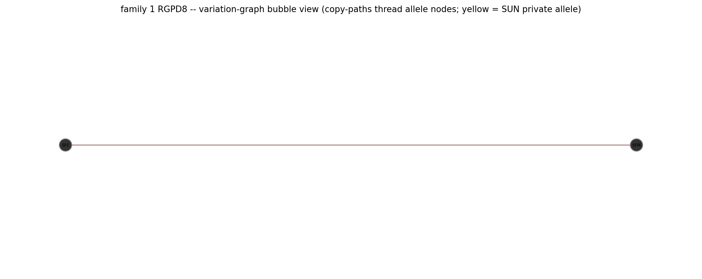
LIMITS
Honest scope, the identifiability floor, and one line
• The K=0 floor is STRUCTURAL, not a threshold: exonically-identical copies are genuinely RNA-unresolvable → planted identical copies 120/120 TIED; ~10% of families genome-wide carry zero bubble.
• No external true-origin accuracy on real data: 'resolvable' = 'threads a distinguishing bubble', not 'verified correct'. Truth-anchored legs = planted sim + machine-checked theory only.
• Near-identical frontier disclosed, not hidden: a 5-copy collapse (div 0.001) over-merges to 4; clean recovery is a K≤2 phenomenon.
• Named constants (relocated, not eliminated): α=1e-3 · refine id≥0.80 & cov≥0.50 · editing down-weight 0.2. The VG is an ASSIGNMENT object, not a read aligner (vg giraffe 94.5% < 98%).
• ONE LINE: each family = read-threaded paths through one PSV-bubble graph — backbone collapses, differences become bubbles, assignment is assign-or-abstain threading with a per-read certificate, over provable structure (χ(H); facility-location) — no 1/k.
RGPD8: 7 copies, 0 bubbles → K=1.
The K=0 floor made visible: nothing to
thread → all 2075 reads abstain (no-cover).
Notes:
K=0 census: bench/psv_graph_exonunion_all.json (14/145=9.7%) + copy_resolution_census.tsv (30/236=12.7%) — present as 'consistent across granularities', NOT 'independent oracles' (both share the PSV detector; the skeptic correctly kills the independence framing). Planted K=0 120/120 TIED is the truly independent floor leg. Collapse over-merge verified today: /home/juanfra/winloci_scratch/sim_collapse_dp.famcn_readonly.tsv (chi_H=4, n_copies=4) vs simgw_truth.tsv (5 planted copies, div=0.001) and assignments show called-copy-2 with 320 reads (2x). K=3 248 violations + origin-in-C 2,616 witnesses: memory project_copy_assignment_theory.md. vg giraffe 94.5<98.0: bench/PANELS_AND_NOTES.md L117-119. Production catalog 74 families/207 copies verified in o2_definitive.quant.tsv; assigned share is aggregation-sensitive (row-level 69.3% assigned / 29.6% tied / 1.1% ambiguous) — do NOT quote the doc's 75.1% or the irreproducible 67.1%; if asked, give the range and label it 'not accuracy, no ground truth on real data'.

