Slide 1
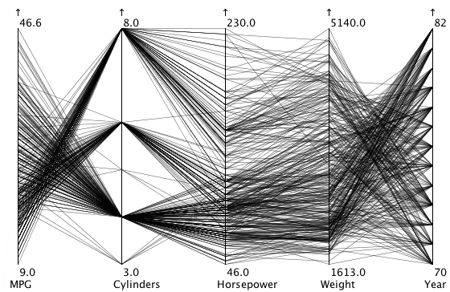
Parallel Coordinates: Example [4]
Cars Collection

Slide 2
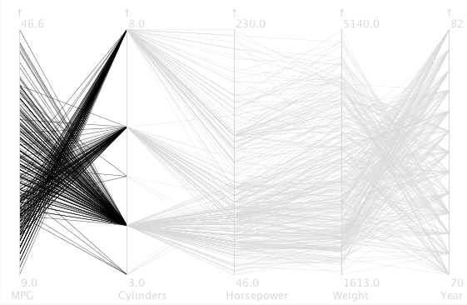
Parallel Coordinates: Example [4]
Cars Collection
Notes:
In the space between MPG and cylinders, you can tell that eight-cylinder cars generally have lower mileage than six- and four-cylinder ones. Just follow the lines and look at how they cross: lots of crossing lines are an indication of an inverse relationship, and that is clearly the case here: the more cylinders, the lower the mileage.
- mileage: the number of miles or the average distance that a vehicle can travel on a specified quantity of fuel:

Slide 3
Parallel Coordinates: Example [4]
In the example, the number of cylinders is an entire information that assumes few values Data of this nature, or categorical data are not very suitable for using The technique does not show useful information in this case MPG ratio - cylinders: it is possible to identify that usually 8-cylinder cars walk less with one liter of fuel than cars with
6 or 4 cylinders
Inverse correlation: more cylindrical -> fewer kilometers per liter

Slide 4
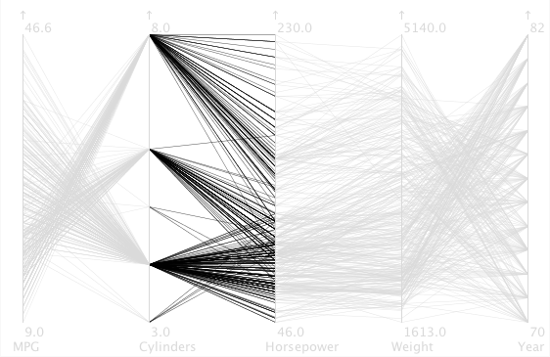
Parallel Coordinates: Example [4]
Cars Collection
Notes:
The correlation is much more direct between cylinders and horsepower: more cylinders means more horses. There are some crossing lines here as well, of course, so more cylinders do not always mean more power, but the general trend is clearly there.

Slide 5
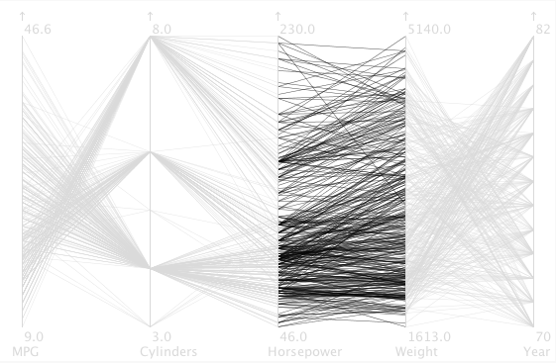
Coordenadas Paralelas: Exemplo [4]
Cars Collection
Notes:
Between horsepower and weight, the situation is similar: more horsepower means heavier cars in general, but there is some spread in the values of course. There is also one exception of a high-horsepower eight-cylinder car that is very light.

Slide 6
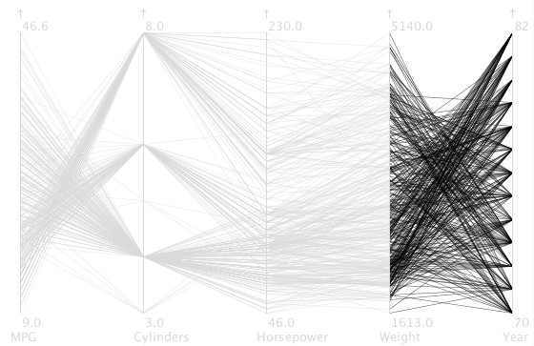
Parallel Coordinates: Example [4]
Cars Collection
Retirado de [4]
Notes:
Finally, the lines between weight and year cross over a lot, indicating that cars got lighter over the years. You can also easily tell that the year axis only records a small number of different values, similar to the cylinders, from the triangular shapes converging on a few points.

Slide 7
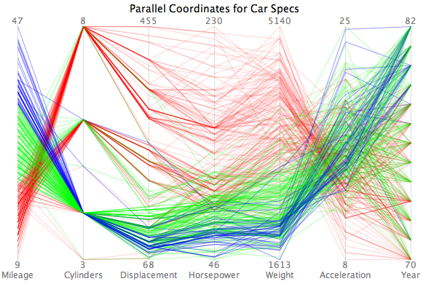
Parallel Coordinates
Wiley C., University of San Francisco

Slide 8
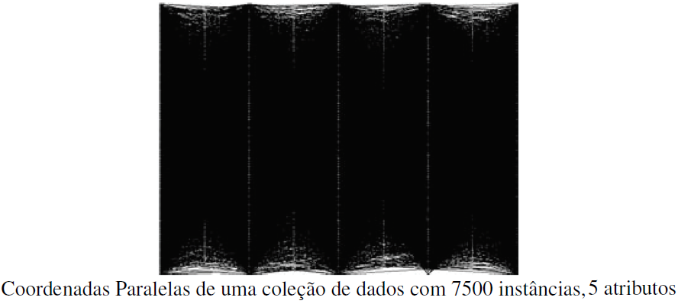
Parallel Coordinates
Limitations
Number of rows can cause too much overlap Estimated maximum of 1000 lines Order of parallel axes influences visualization

Slide 9
Scatter Matrices
Mapping the m-dimensional space to the two-dimensional plane using a scatterplot set Each scatter plot shows the relationship between the values of two attributes, one mapped to the vertical axis and the other to the horizontal axis Focus on correlation analysis between attributes, given by chart pattern

Slide 10
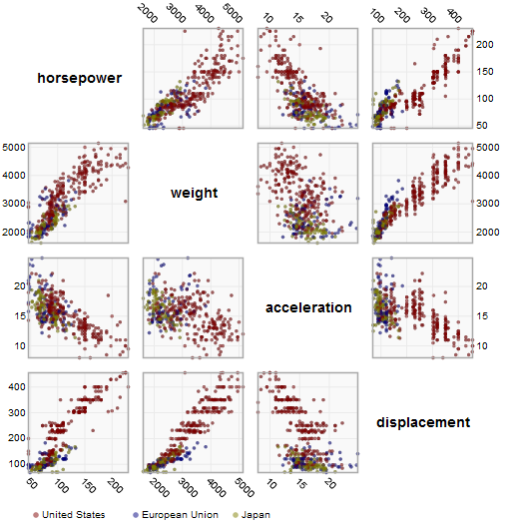
Scatter Matrices
Heer et al., Stanford University

Slide 11
Scatter Matrices
Limitations: Amount of attributes generates very large array Many combinations Organization of matrices can position relationships distant from each other, making it difficult to identify relationships

Slide 12
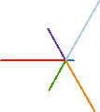
Idioms: radial bar chart, star plot
radial bar chart
– radial axes meet at central ring, line mark
star plot
– radial axes, meet at central point, line mark
bar chart
– rectilinear axes, aligned vertically
accuracy
– length unaligned with radial
less accurate than aligned with rectilinear
[Vismon: Facilitating Risk Assessment and Decision Making In Fisheries Management. Booshehrian, Möller, Peterman, and Munzner. Technical Report TR 2011-04, Simon Fraser University, School of Computing Science, 2011.]
29

Slide 13
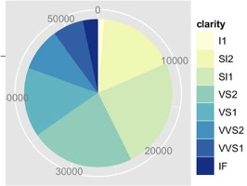
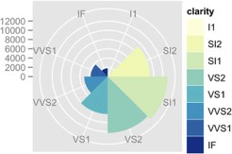
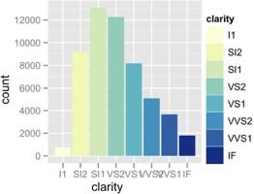
Idioms: pie chart, polar area chart
pie chart
– area marks with angle channel
– accuracy: angle/area less accurate than line length
arclength also less accurate than line length
polar area chart
– area marks with length channel
– more direct analog to bar charts
data
– 1 categ key attrib, 1 quant value attrib
task
– part-to-whole judgements
[A layered grammar of graphics.Wickham. Journ. Computational and Graphical Statistics 19:1 (2010), 3–28.] 30

Slide 14
Idioms: normalized stacked bar chart
task
– part-to-whole judgements
100%
90%
65 Years and Over
80%
70%
45 to 64 Years
60%
50%
40%
25 to 44 Years
30%
18 to 24 Years
normalized stacked bar chart
– stacked bar chart, normalized to full vert height
– single stacked bar equivalent to full pie
high information density: requires narrow rectangle
20%
14 to 17 Years
10%
5 to 13 Years
0%
UT TX ID AZ NV GA AK MS NMNE CA OK SD CO KS WY NC AR LA IN IL MN DE HI SCMOVA IA TN KY AL WAMD ND OH WI OR NJ MT MI FL NY DC CT PA MAWV RI NH ME VT
Under 5 Years
35M
Population
65 Years and Over
45 to 64 Years
25 to 44 Years
30M
18 to 24 Years
14 to 17 Years
5 to 13 Years
25M
Under 5 Years
20M
15M
pie chart
– information density: requires large circle
10M
5.0M
0.0
CA TX NY FL IL PA OH MI GA NC NJ VA WA AZ MA IN TN MO MD WI MN CO AL SC LA KY OR OK CT IA MS AR KS UT NV NMWV NE ID ME NH HI RI MT DE SD AK ND VT DC WY
45-64
^{≥65} <5
5-13
http://bl.ocks.org/mbostock/3887235, http://bl.ocks.org/mbostock/3886208, http://bl.ocks.org/mbostock/3886394.
14-17
18-24
25-44
31

Slide 15
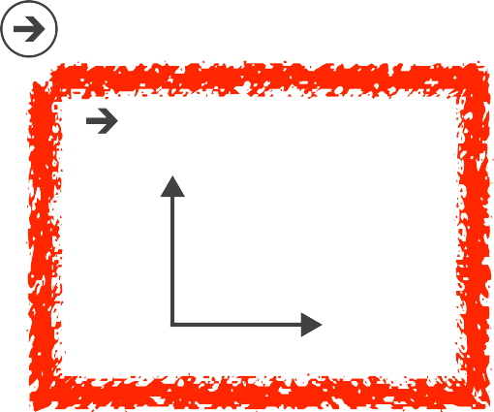
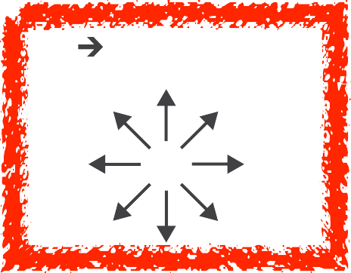
Idiom: glyphmaps
rectilinear good for linear vs nonlinear trends
radial good for cyclic patterns
Axis Orientation
Rectilinear
Parallel
Radial
[Glyph-maps for Visually Exploring Temporal Patterns in Climate Data and Models.Wickham, Hofmann,Wickham, and Cook. Environmetrics 23:5 (2012), 382–393.]

Slide 16
Orientation limitations
Axis Orientation
Rectilinear
rectilinear: scalability wrt #axes
2 axes best
3 problematic
– more in afternoon
4+ impossible
parallel: unfamiliarity, training time
radial: perceptual limits
– angles lower precision than lengths
– asymmetry between angle and length
can be exploited!
[Uncovering Strengths and Weaknesses of Radial Visualizations - an Empirical Approach. Diehl, Beck and Burch. IEEETVCG (Proc. InfoVis) 16(6):935--942, 2010.]
Parallel
Radial

Slide 17
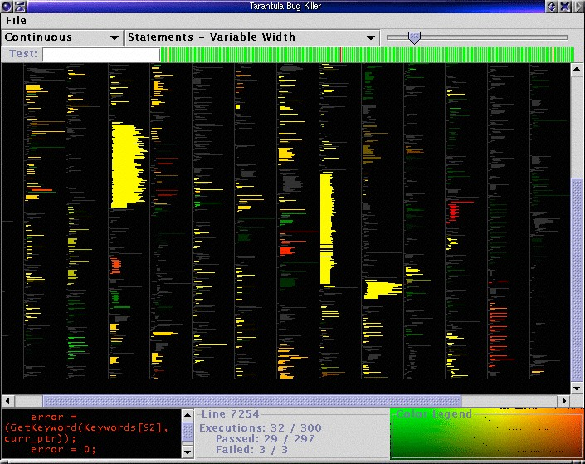















dense software overviews
Layout Density
Dense
[Visualization of test information to assist fault localization. Jones, Harrold, Stasko. Proc. ICSE 2002, p 467-477.]
34

Slide 18
Ch 10: Map Color and Other Channels

Slide 19







VAD Chap 10: Map Color and Other Channels
Encode Map
Color Size, Angle, Curvature, ...
Color Encoding Length
Hue Saturation
Color Map
Categorical
Luminance
Angle
Area
Curvature
Ordered
Sequential
Volume
Diverging
Bivariate
Shape
Motion
Motion Direction, Rate, Frequency, ...

Slide 20
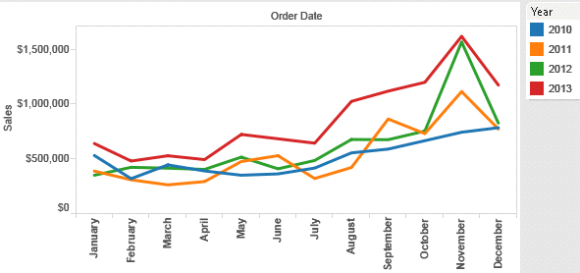
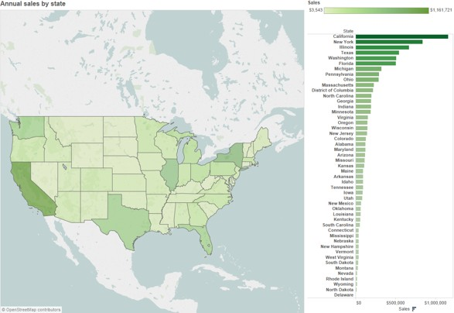
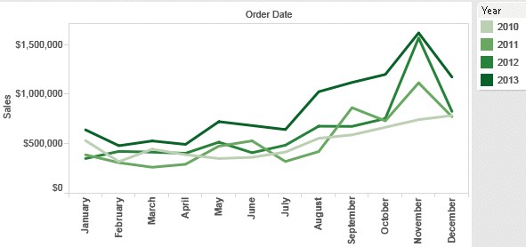
Categorical vs ordered color
[Seriously Colorful: Advanced Color Principles & Practices. Stone.Tableau Customer Conference 2014.]

Slide 21
Decomposing color
first rule of color: do not talk about color!
– color is confusing if treated as monolithic
decompose into three channels
ordered can show magnitude
luminance: how bright
saturation: how colorful
categorical can show identity
hue: what color
Luminance
Saturation
Hue
channels have different properties
what they convey directly to perceptual system
how much they can convey: how many discriminable bins can we use?
38

Slide 22



















Colormaps
Categorical
C
Categorical
Binary
Categorical
ategorical
Ordered
Sequential
Diverging
Bivariate
Diverging
Sequential
after [Color Use Guidelines for Mapping and Visualization. Brewer, 1994. http://www.personal.psu.edu/faculty/c/a/cab38/ColorSch/Schemes.html]

Slide 23

Colormaps
Categorical
Categorical
Binary
Categorical
Categorical
Ordered
Sequential
Diverging
Bivariate
Diverging
Sequential
after [Color Use Guidelines for Mapping and Visualization. Brewer, 1994. http://www.personal.psu.edu/faculty/c/a/cab38/ColorSch/Schemes.html]

Slide 24


Colormaps
Categorical
Categorical
Binary
Categorical
Cate
gorical
Ordered
Sequential
Diverging
Bivariate
use with care!
Diverging
Sequential
after [Color Use Guidelines for Mapping and Visualization. Brewer, 1994. http://www.personal.psu.edu/faculty/c/a/cab38/ColorSch/Schemes.html]

Slide 25
Colormaps
Categorical
Categorical
Binary
Categorical
Cate
gorical
Ordered
Sequential
Diverging
Bivariate
Diverging
Sequential
color channel interactions
– size heavily affects salience
small regions need high saturation
large need low saturation
– saturation & luminance: 3-4 bins max (level of saturation)
also not separable from transparency
after [Color Use Guidelines for Mapping and Visualization. Brewer, 1994. http://www.personal.psu.edu/faculty/c/a/cab38/ColorSch/Schemes.html]

Slide 26
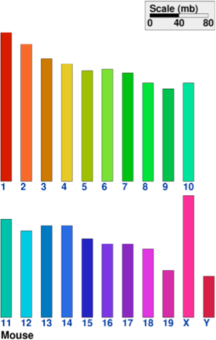
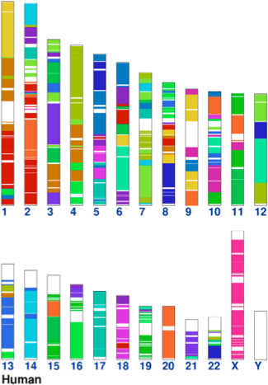
Categorical color: limited number of discriminable bins
human perception built on relative comparisons
– great if color contiguous
– surprisingly bad for absolute comparisons
noncontiguous small regions of color
– fewer bins than you want
– rule of thumb: 6-12 bins, including background and highlights
[Cinteny: flexible analysis and visualization of synteny and genome rearrangements in multiple organisms. Sinha and Meller. BMC Bioinformatics, 8:82, 2007.]

Slide 27

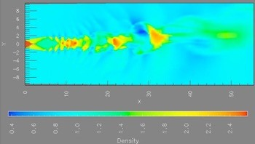
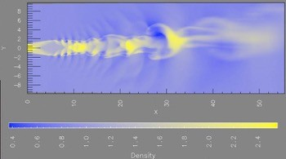
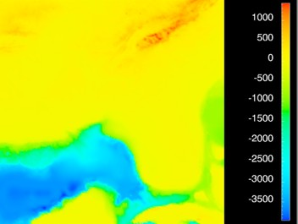
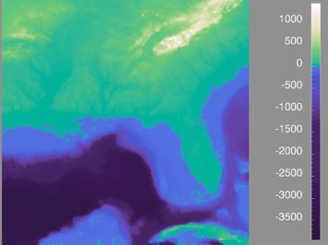
Ordered color: Rainbow is poor default
problems
– perceptually unordered
– perceptually nonlinear
benefits
– fine-grained structure visible and nameable
[A Rule-based Tool for Assisting Colormap Selection. Bergman,. Rogowitz, and.Treinish. Proc. IEEEVisualization (Vis), pp. 118–125, 1995.]
[Why Should Engineers Be Worried About Color? Treinish and Rogowitz 1998. http://www.research.ibm.com/people/l/lloydt/color/color.HTM]
27
[Transfer Functions in Direct Volume Rendering: Design, Interface, Interaction. Kindlmann. SIGGRAPH 2002 Course Notes]

Slide 28
Ordered color: Rainbow is poor default
problems
– perceptually unordered
– perceptually nonlinear
benefits
– fine-grained structure visible and nameable
alternatives
– large-scale structure: fewer hues
[A Rule-based Tool for Assisting Colormap Selection. Bergman,. Rogowitz, and.Treinish. Proc. IEEEVisualization (Vis), pp. 118–125, 1995.]
[Why Should Engineers Be Worried About Color? Treinish and Rogowitz 1998. http://www.research.ibm.com/people/l/lloydt/color/color.HTM]
28
[Transfer Functions in Direct Volume Rendering: Design, Interface, Interaction. Kindlmann. SIGGRAPH 2002 Course Notes]

Slide 29
Ordered color: Rainbow is poor default
problems
– perceptually unordered
– perceptually nonlinear
benefits
– fine-grained structure visible and nameable
alternatives
– large-scale structure: fewer hues
– fine structure: multiple hues with monotonically increasing luminance [eg viridis R/python]
Luminance ordered
[A Rule-based Tool for Assisting Colormap Selection. Bergman,. Rogowitz, and.Treinish. Proc. IEEEVisualization (Vis), pp. 118–125, 1995.]
[Why Should Engineers Be Worried About Color? Treinish and Rogowitz 1998. http://www.research.ibm.com/people/l/lloydt/color/color.HTM]
29
[Transfer Functions in Direct Volume Rendering: Design, Interface, Interaction. Kindlmann. SIGGRAPH 2002 Course Notes]

Slide 30
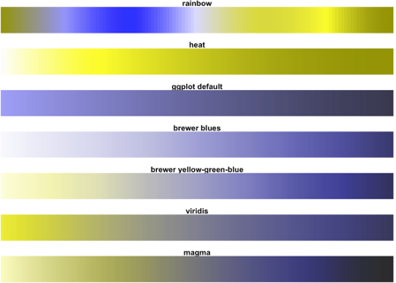
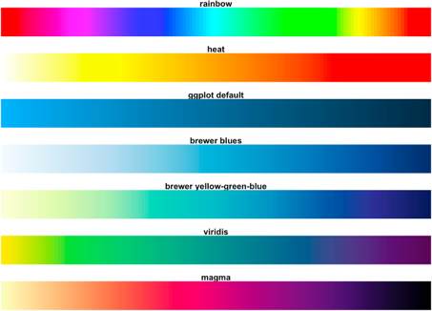
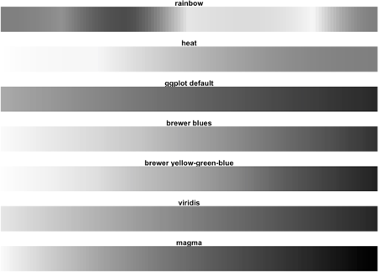

Viridis
colorful, perceptually uniform, colorblind-safe, monotonically increasing luminance
https://cran.r-project.org/web/packages/ viridis/vignettes/intro-to-viridis.html
55

Slide 31

Ordered color: Rainbow is poor default
problems
– perceptually unordered
– perceptually nonlinear
benefits
– fine-grained structure visible and nameable
alternatives
– large-scale structure: fewer hues
– fine structure: multiple hues with monotonically increasing luminance [eg viridis R/python]
– segmented rainbows for binned or categorical (Maximum distingusishable)
[A Rule-based Tool for Assisting Colormap Selection. Bergman,. Rogowitz, and.Treinish. Proc. IEEEVisualization (Vis), pp. 118–125, 1995.]
[Why Should Engineers Be Worried About Color? Treinish and Rogowitz 1998. http://www.research.ibm.com/people/l/lloydt/color/color.HTM]
56
[Transfer Functions in Direct Volume Rendering: Design, Interface, Interaction. Kindlmann. SIGGRAPH 2002 Course Notes]

Slide 32
















Spectral sensitivity
Wavelength (nm)
UV
IR
Visible Spectrum
39

Slide 33
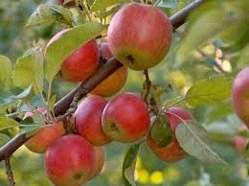
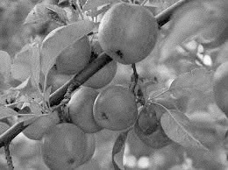
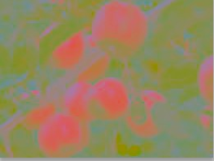
Luminance
need luminance for edge detection
fine-grained detail only visible through luminance contrast
legible text requires luminance contrast!
intrinsic perceptual ordering
Luminance information
Color information
[Seriously Colorful: Advanced Color Principles & Practices. Stone.Tableau Customer Conference 2014.]
40

Slide 34
Opponent color and color deficiency
perceptual processing before optic nerve
one achromatic luminance channel (L*)
– edge detection through luminance contrast
2 chroma channels
– red-green (a*) & yellow-blue axis (b*)
“color blind”: one axis has degraded acuity
8% of men are red/green color deficient
blue/yellow is rare
Luminance information
Chroma information
[Seriously Colorful: Advanced Color Principles & Practices.
Stone.Tableau Customer Conference 2014.]
41

Slide 35
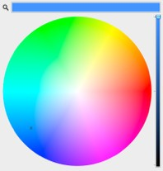
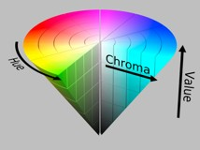
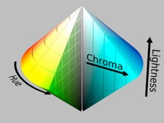
Color spaces
CIE L*a*b*: good for computation
L* intuitive: perceptually linear luminance
a*b* axes: perceptually linear but nonintuitive
RGB: good for display hardware
poor for encoding
HSL/HSV: somewhat better for encoding
hue/saturation wheel intuitive
beware: only pseudo-perceptual!
lightness (L) or value (V) ≠ luminance or L*
Luminance, hue, saturation
good for encoding
but not standard graphics/tools colorspace
Corners of the RGB color cube
L from HLS All the same
Luminance values
L* values

Slide 36

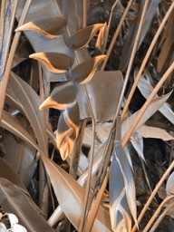
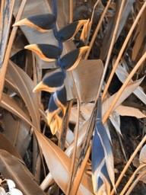

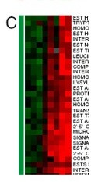
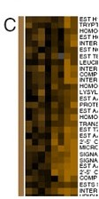
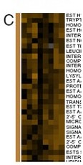
Designing for color deficiency: Check with simulator
Normal vision
Deuteranope Protanope
Tritanope
http://rehue.net
[Seriously Colorful: Advanced Color Principles & Practices. Stone.Tableau Customer Conference 2014.]

Slide 37
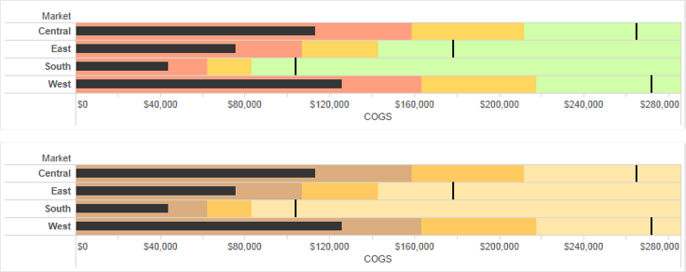
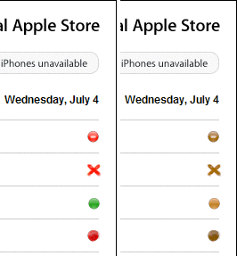
Designing for color deficiency:Avoid encoding by hue alone
redundantly encode
vary luminance
change shape
Deuteranope simulation
Change the shape
Vary luminance
[Seriously Colorful: Advanced Color Principles & Practices. Stone.Tableau Customer Conference 2014.]
44

Slide 38
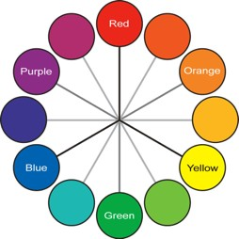
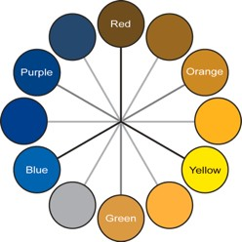
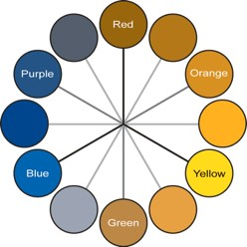
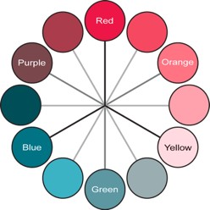
Color deficiency: Reduces color to 2 dimensions
Normal
Protanope
Deuteranope Tritanope
[Seriously Colorful: Advanced Color Principles & Practices. Stone.Tableau Customer Conference 2014.]
45

Slide 39
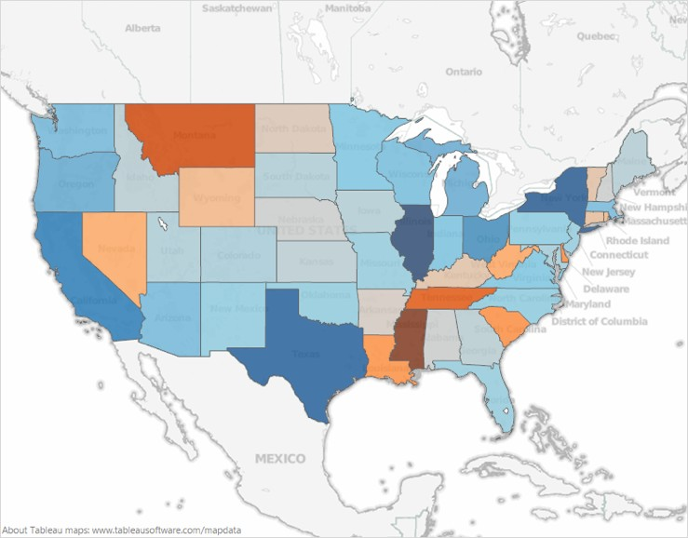
Designing for color deficiency: Blue-Orange is safe
[Seriously Colorful: Advanced Color Principles & Practices. Stone.Tableau Customer Conference 2014.]
46

Slide 40
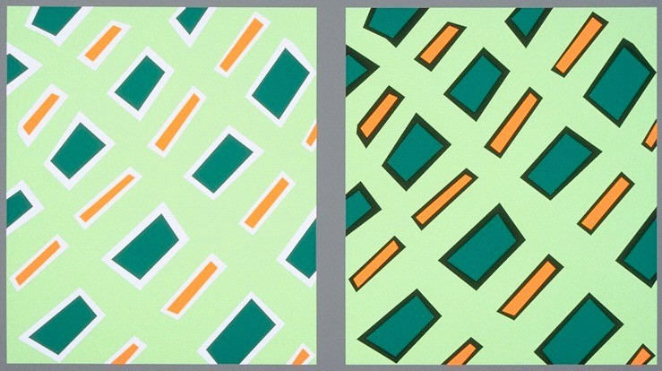
Bezold Effect: Outlines matter
color constancy: simultaneous contrast effect
[Seriously Colorful: Advanced Color Principles & Practices. Stone.Tableau Customer Conference 2014.]
47

Slide 41
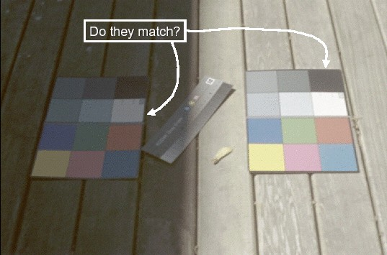
Color/Lightness constancy: Illumination conditions
Image courtesy of John McCann

Slide 42
Color/Lightness constancy: Illumination conditions
Image courtesy of John McCann

Slide 43
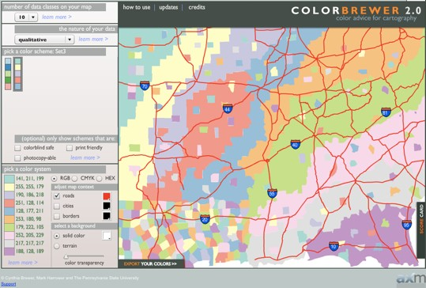
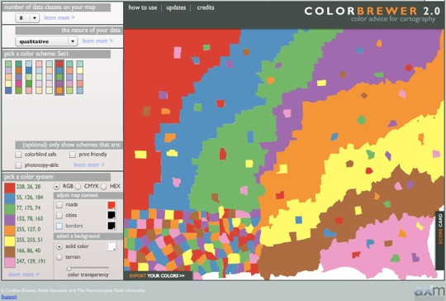
ColorBrewer
http://www.colorbrewer2.org
saturation and area example: size affects salience!

Slide 44




Map other channels
size
– length accurate, 2D area ok, 3D volume poor
angle
– nonlinear accuracy
horizontal, vertical, exact diagonal
shape
– complex combination of lower-level primitives
– many bins
motion
– highly separable against static
binary: great for highlighting
– use with care to avoid irritation
Size, Angle, Curvature, ...
Length
Angle
Area
Curvature
Volume
Shape
Motion
Motion Direction, Rate, Frequency, ...

Slide 45
Angle
Sequential ordered
line mark or arrow glyph
Diverging ordered arrow glyph
Cyclic ordered arrow glyph

