Slide 1
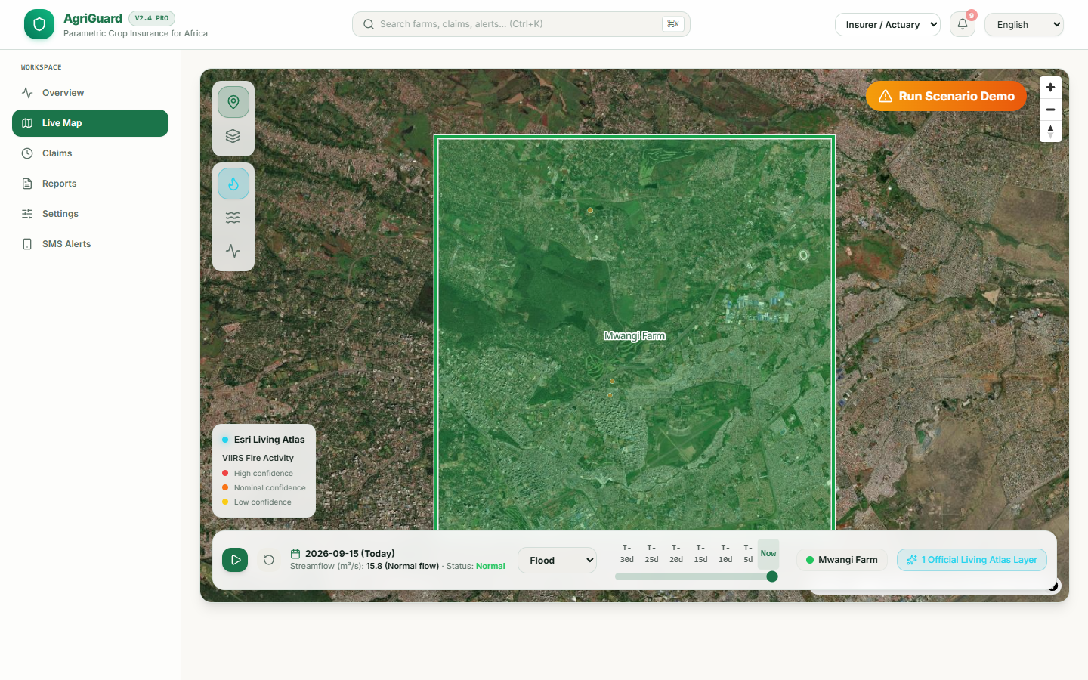
AGRIGUARD
GNSS-anchored parametric insurance and early warning for African smallholder farmers
GNSS boundaries
Earth observation
Crop-specific rules
Auditable settlement status
From hazard signal to auditable claim
The public demo keeps settlement in PENDING mode when Web3 credentials are not configured.
Public demo | September 2026
Notes:
Sources: project README and verified live deployment at https://agri-guard-api-live.vercel.app. Public demo inspection on 15 September 2026.

Slide 2
The insurance gap for smallholder farms
Traditional field verification does not scale to small, dispersed plots.
$9.3B
<3%
4-12 weeks
10-15%
Annual climate-related crop losses in Africa
Agricultural insurance penetration
Common manual claim cycle
Fraud risk cited for subjective claims
The operational problem
AgriGuard evaluates a measurable hazard footprint against a GNSS-defined farm boundary. The goal is faster evidence collection and a transparent claim status, not automated blame or payout without controls.
Manual loss adjustment requires field visits, paperwork, and subjective assessment. Those costs are difficult to recover on small policies, so many farms remain excluded.
AgriGuard | G4-SAA Challenge II
02
Notes:
Sources: project submission materials and cited climate insurance benchmarks. Market and impact figures are targets or external benchmarks, not measured AgriGuard results.

Slide 3
AgriGuard workflow
Each step produces an inspectable record that can be audited.
01
02
03
04
05
Capture
Match
Evaluate
Record
Settle
GNSS/WGS84 farm polygon with optional receiver, accuracy, and capture-time metadata.
PostGIS intersects the farm boundary with an event footprint or labeled demo area.
Crop-specific flood, wildfire, drought, and heatwave rules calculate confidence.
A claim, SHA-256 evidence hash, alert, and timeline are created.
A configured ERC-20 transfer is attempted. Otherwise the claim remains PENDING.
Evidence boundary
Live map layers are integrated. Threshold ingestion from GEOGLOWS and VIIRS remains roadmap work. Public demos label simulated metrics and never fabricate a transaction hash.
AgriGuard | G4-SAA Challenge II
03
Notes:
Sources: README.md, docs/TRIGGER_LOGIC_AND_CODE.md, and the public demo. The implemented workflow and roadmap are separated explicitly.

Slide 4
System architecture
A Django and PostGIS workflow with a replaceable data and settlement layer.
GNSS/WGS84 boundaries
NASA EONET event footprints
Esri Living Atlas map layers
Labeled demo metrics
Data
Django REST API
PostGIS ST_Intersects
Crop-specific rule engine
Celery tasks
Processing
Risk alert
Claim and timeline
SHA-256 evidence hash
WebSocket update
Records
React dashboard
MapLibre and ArcGIS views
SMS fallback path
Seven-language UI
Delivery
Authoritative source files: core/models.py, core/engine.py, core/tasks.py, core/services/blockchain_service.py, frontend/src/components/MapView.jsx
AgriGuard | G4-SAA Challenge II
04
Notes:
Sources: docs/ARCHITECTURE.md, core/models.py, core/engine.py, core/tasks.py, and frontend component structure.

Slide 5
Farm boundaries and live Earth observation
The map combines operational context with a clearly labeled scenario runner.
What judges can verify
Farm polygons are visible as GNSS/WGS84 geofences.
ArcGIS Living Atlas layers provide VIIRS fire activity, GEOGLOWS streamflow, and stream gauges.
The scenario button posts to the real API and creates a new claim workflow. No fake payout or hash is produced.
AgriGuard | G4-SAA Challenge II
05
Notes:
Source: public demo inspection on 15 September 2026. The map includes live ArcGIS layers while the demo threshold metrics are labeled as simulated.

Slide 6
Parametric decision rules
Thresholds vary by crop and peril. The table shows maize examples from the current engine.
Peril | Trigger tested by the engine | Example threshold | Confidence
Flood | Water depth and duration, optional rainfall anomaly | 2.5 m for 3 days | 0.85 to 0.95
Wildfire | Fire area intersecting the farm footprint | 5 ha | 0.99
Drought | Normalized Difference Water Index | NDWI below -0.2 | 0.90
Heatwave | Temperature anomaly and persistence | +2.0 C for 3 days | 0.92
Area guardrail: 0.5 ha minimum, 5 ha maximum insured area for payout arithmetic.
Claim value = $25 per hectare x capped insured area x severity x confidence. Severity levels below 3 apply a 50% partial-claim multiplier.
AgriGuard | G4-SAA Challenge II
06
Notes:
Sources: core/engine.py and core/tests.py. The table is a crop-specific example and does not imply that every hazard source is production-grade.

Slide 7
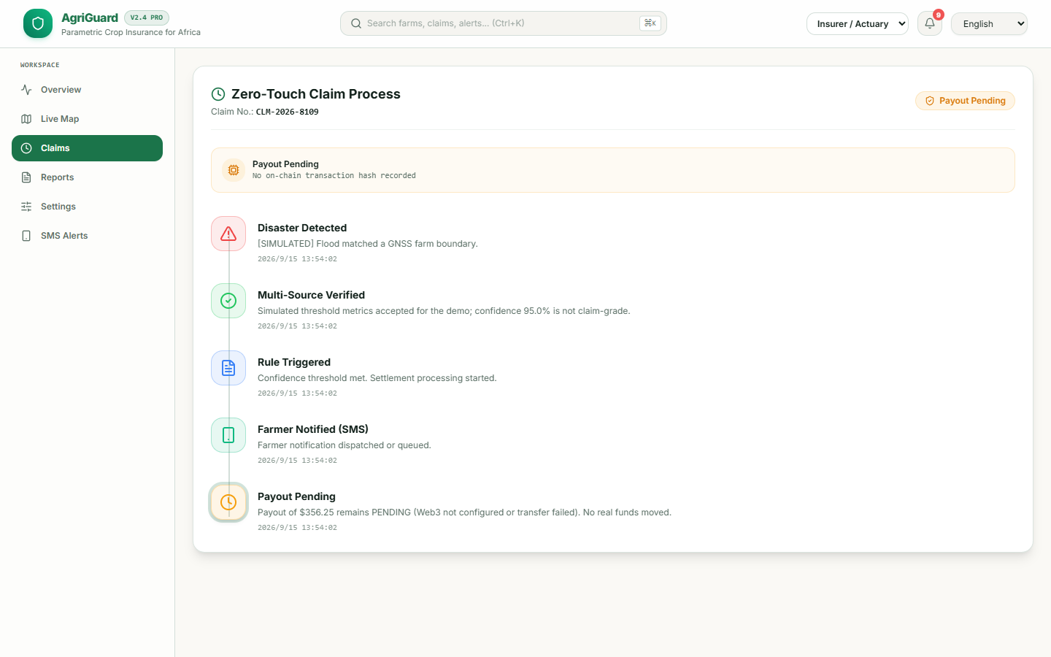
Claim lifecycle and evidence
A claim moves through a fixed status history with no fabricated payment state.
DETECTED
Hazard detected inside the geofence.
VERIFIED
Confidence and GNSS metadata evaluated.
TRIGGERED
Settlement processing starts.
NOTIFIED
Farmer notification is dispatched or queued.
PENDING
No configured ERC-20 transfer, so no hash is stored.
The evidence hash binds farm ID, event ID, event time, confidence, and GNSS metadata.
AgriGuard | G4-SAA Challenge II
07
Notes:
Sources: core/tasks.py and live claim records inspected on 15 September 2026. The screenshot shows PENDING because the public demo has no Web3 credentials.

Slide 8
Settlement boundary
The same claim record supports a configured transfer or an explicit pending state.
Web3 not configured
Configured transfer succeeds
Claim status
PENDING
Transaction hash
Not recorded
Funds moved
None in the public demo
Claim status
PAID
Transaction hash
Node-accepted hash stored
Funds moved
ERC-20 transfer submitted
Required configuration: WEB3_PROVIDER_URI, WEB3_PRIVATE_KEY, SMART_CONTRACT_ADDRESS, WEB3_PAYOUT_DECIMALS, and a valid farmer wallet.
AgriGuard | G4-SAA Challenge II
08
Notes:
Sources: core/services/blockchain_service.py, core/tasks.py, and docs/SUBMISSION_FULL.md. The reference Solidity contract is not called by the current MVP.

Slide 9
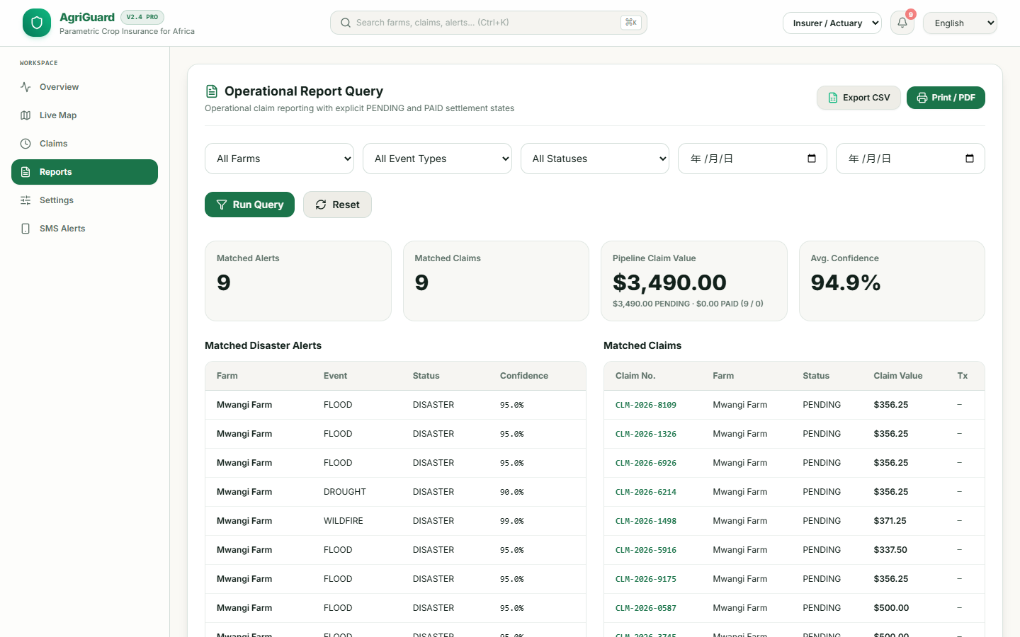
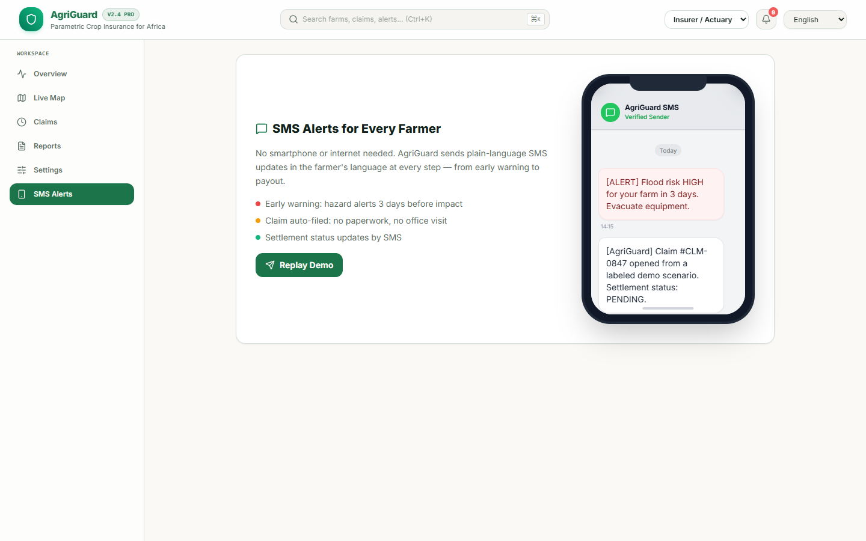
Operator reports and farmer alerts
The same claim record drives reporting, export, AI fallback, and SMS status.
Reporting: verified filters, CSV export, print-to-PDF, and confidence tracking.
SMS: Twilio when configured, mock fallback otherwise. AI reports use the configured OpenAI model or a deterministic fallback.
AgriGuard | G4-SAA Challenge II
09
Notes:
Sources: frontend/src/components/ReportQueryPanel.jsx, frontend/src/components/SmsMockup.jsx, core/tasks.py, and core/services/llm_service.py.

Slide 10
Market and impact targets
All figures on this slide describe targets or external benchmarks, not realized results.
Metric | Traditional benchmark | AgriGuard target
Claim cycle | 4 to 12 weeks | Minutes after verified data
Routine verification | $50 to $200 per claim | Materially lower through spatial automation
Evidence | Paper and subjective assessment | GNSS metadata plus deterministic hash
Farmer access | Large commercial farms | SMS-first, with USSD on the roadmap
Sustainability | Manual and cost-heavy | Recurring B2B2C platform model
TAM
485M African livelihoods exposed to climate risk. $9.3B annual loss context.
SAM
120M farms across Sub-Saharan Africa and Southeast Asia.
SOM target
120,000 insured farmers by Year 3 and about $3M ARR target.
AgriGuard | G4-SAA Challenge II
10
Notes:
Sources: docs/IMPACT_AND_MARKET.md and README.md. Targets and external benchmarks are shown as such.

Slide 11
Transferability and roadmap
The architecture separates data, rules, records, and settlement so partners can replace one layer at a time.
Q4 2026
Q1-Q2 2027
Q3-Q4 2027
Regional insurer pilot
Channel expansion
Partner platform
Validate thresholds, settlement operations, and farmer consent with an insurer partner.
Add USSD and deeper offline synchronization for feature phones and low-bandwidth areas.
Expose APIs for NGOs and governments and add new peril and asset templates.
Transferable design choices
New hazard polygons, new crop rules, new settlement rails, and new countries reuse the same spatial and evidence model.
AgriGuard | G4-SAA Challenge II
11
Notes:
Source: README roadmap and docs/IMPACT_AND_MARKET.md. Dates are planning targets and require partner validation.

Slide 12
AGRIGUARD
Live judge demo
From hazard signal to auditable claim
agri-guard-api-live.vercel.app
Repository
github.com/juangh123/agri_guard
GNSS boundaries
PostGIS spatial matching
Crop-specific parametric rules
Explicit settlement status
Public demo settlement: PENDING
No fabricated transaction hash
AgriGuard | G4-SAA | Challenge II
Notes:
Sources: live deployment and repository README. The public demo remains in a truthful PENDING state without Web3 configuration.

