Slide 1




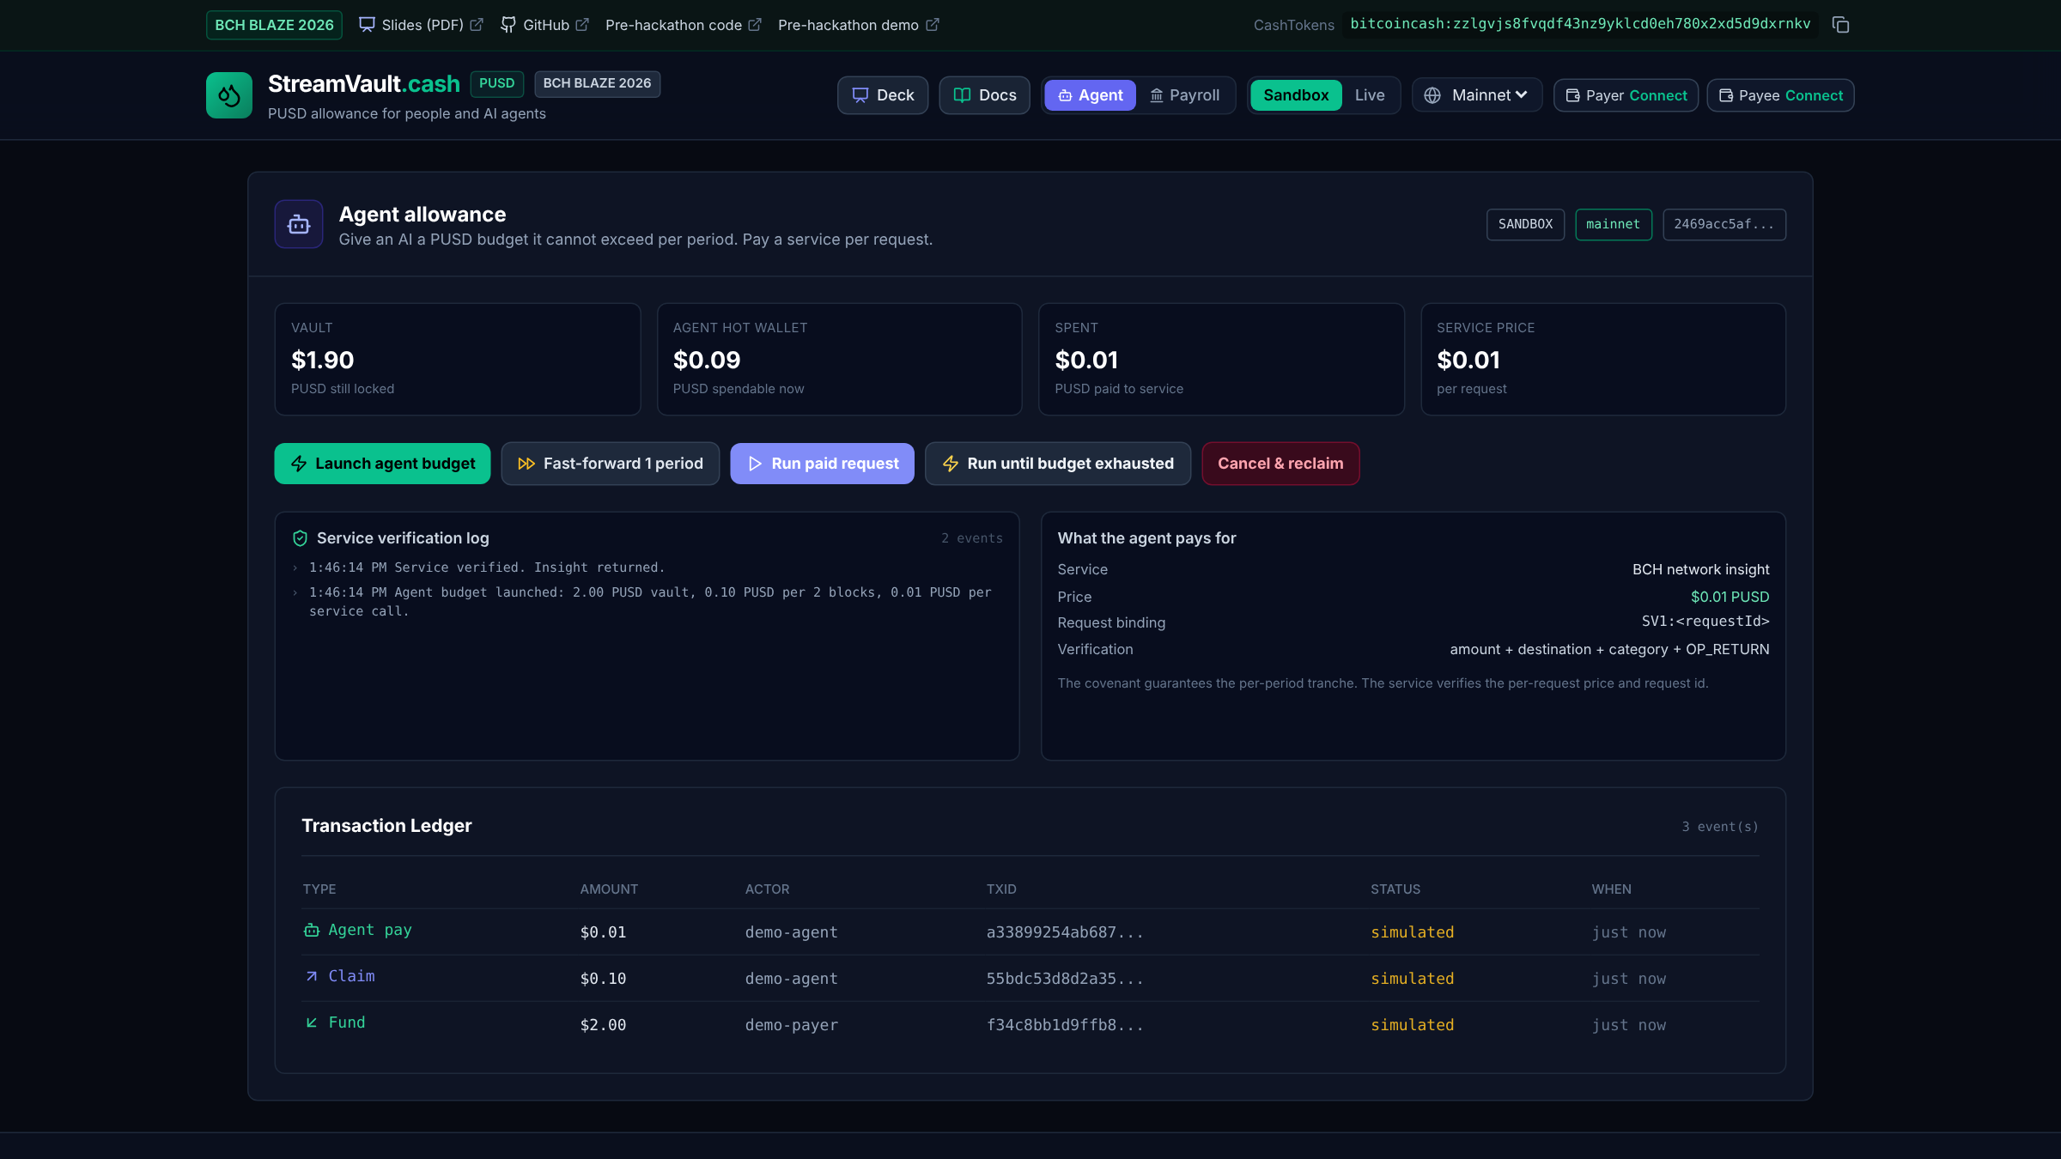

StreamVault.cash
Team Autonomous Cash: Jason
Give an AI an allowance,
not your bank account.
GitHub
Live demo
PUSD on BCH
Notes:
Live demo: https://streamvault-cash.vercel.app
Repository: https://github.com/juangh123/streamvault.cash
Baseline: https://github.com/juangh123/streamvault.cash/tree/v0-prehackathon-baseline

Slide 2
Prompts set intent.
The transaction enforces the limit.
Per-period PUSD budgets
for people and AI agents.
streamvault-cash.vercel.app
Notes:
StreamVault combines CashScript covenants, relative timelocks and CashTokens. Demo: https://streamvault-cash.vercel.app

Slide 3
The trust gap
PROMPT CAP
CUSTODY
COVENANT
Can be ignored
Can freeze funds
VM-enforced
A natural-language instruction is not a transaction rule.
A third party controls the key and the release path.
Category, amount, age and outputs are checked on spend.
No enforcement
Counterparty risk
Rules execute
The spending limit must live in the transaction, not the prompt.
www.bchblaze.cash
Notes:
The cap is enforced by claim() in the CashScript covenant, not by application code. See docs/STREAM_MECHANICS.md.

Slide 4

One covenant,
three users
01 SPONSOR
Locks PUSD. Keeps cancel control.
02 WORKER
Claims one tranche per period.
03 AGENT
Pays a service per request.
Shared rules: claim(), cancel(), amountPerPeriod, periodBlocks.
3 spend paths
claim · topUp · cancel
21 VM tests
run against the real BCH VM
Notes:
The same covenant supports payroll, subscriptions and agent allowances. See README.md and docs/PRD.md.

Slide 5
The VM checks four things before PUSD moves
VM REQUIREMENTS
01 category = PUSD
02 0 < amount <= 0.10
03 age >= 2 blocks
04 outputs = 2
VAULT UTXO
2.00 PUSD
One input only
PAYEE TRANCHE
amount PUSD
to the payee
VAULT CHANGE
remaining PUSD
same covenant bytecode
PAYER CANCEL
Sweeps 100% of the remaining PUSD.
Claims cannot empty the vault.
Notes:
The v1.2 covenant passes 21 real BCH VM tests, including over-limit, early claim, wrong destination, third output, category mismatch and BCH-buffer drain tests.

Slide 6
Why BCH,
who pays
WHY BCH
01 Sub-cent fees make $0.01 calls viable
02 CashTokens conserve PUSD on chain
03 Relative timelocks enforce the period
04 WizardConnect keeps keys in the wallet
WHO PAYS
Agent builders
Budget console for agent fleets (subscription)
API & MCP tool providers
SDK that verifies each $0.01 PUSD call
Hosted gateway
Small fee per verified call; self-hosting is free
No protocol fee in the covenant.
First market: paid MCP tools and data APIs.
Notes:
Why BCH: sub-cent fees, CashTokens conservation, relative timelocks and WizardConnect.
Who pays: agent builders pay for the hosted budget console; API and MCP tool providers integrate the SDK and verifier to sell $0.01 PUSD calls; the hosted gateway charges a small fee per verified call. The covenant has no protocol fee, so self-hosting stays free.
PUSD category: 2469acc5afa4b10cb5b5c04afb89c3a3ffd61c5da9c01e26d00951cae2a02544.

Slide 7

StreamVault.cash
Give an AI an allowance,
not your bank account.
Live demo / Deck PDF / GitHub
CASHTOKENS (MAINNET)
bitcoincash:zzlgvjs8fvqdf43nz9yklcd0eh780x2xd5d9dxrnkv
Notes:
Live demo: https://streamvault-cash.vercel.app
Deck PDF: https://streamvault-cash.vercel.app/StreamVault-BCH-Blaze-2026.pdf
Repository: https://github.com/juangh123/streamvault.cash
CashTokens receiving address: bitcoincash:zzlgvjs8fvqdf43nz9yklcd0eh780x2xd5d9dxrnkv

